Slide 1

Extension Microfilm Digitization Project: Putting History Into Our Hands
Inga Haugen
Meagan Russell
Julia Westblade

Slide 2

Inga
01.
Virginia Agricultural Publications Inventory

Slide 3

Virginia Ag Pubs Inventory (VAPI);
materials from VSU, VT, and VCE
VSU - Virginia State University
VT - Virginia Tech
VCE – Virginia Cooperative Extension
Ag Pubs – any materials, artifacts, or items created in the course of our work at these institutions meant to be seen, used, and available to the public

Slide 4

02.
Digital Imaging Lab
Virginia Tech's Newman Library

Slide 5

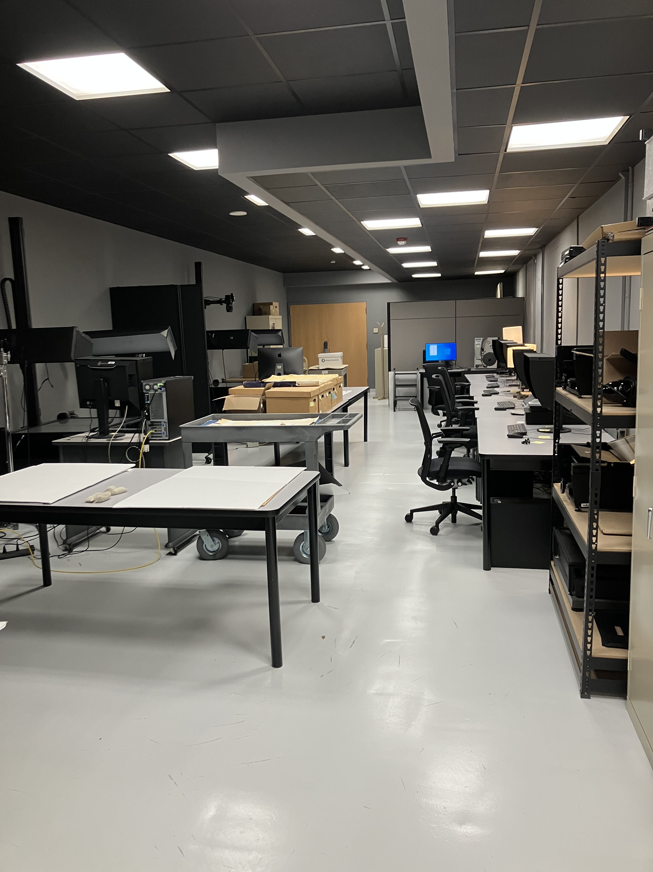
The Digital Imaging Lab provides high quality digitization services in a wide variety of formats from across the library collections and other cultural heritage institutions. Highly trained staff combine state-of-the-art digitization equipment with best practices to provide support for collection-level digitization projects, systematic digitization, as well as on-demand requests by VT researchers, faculty, staff, and other library patrons.

Slide 6

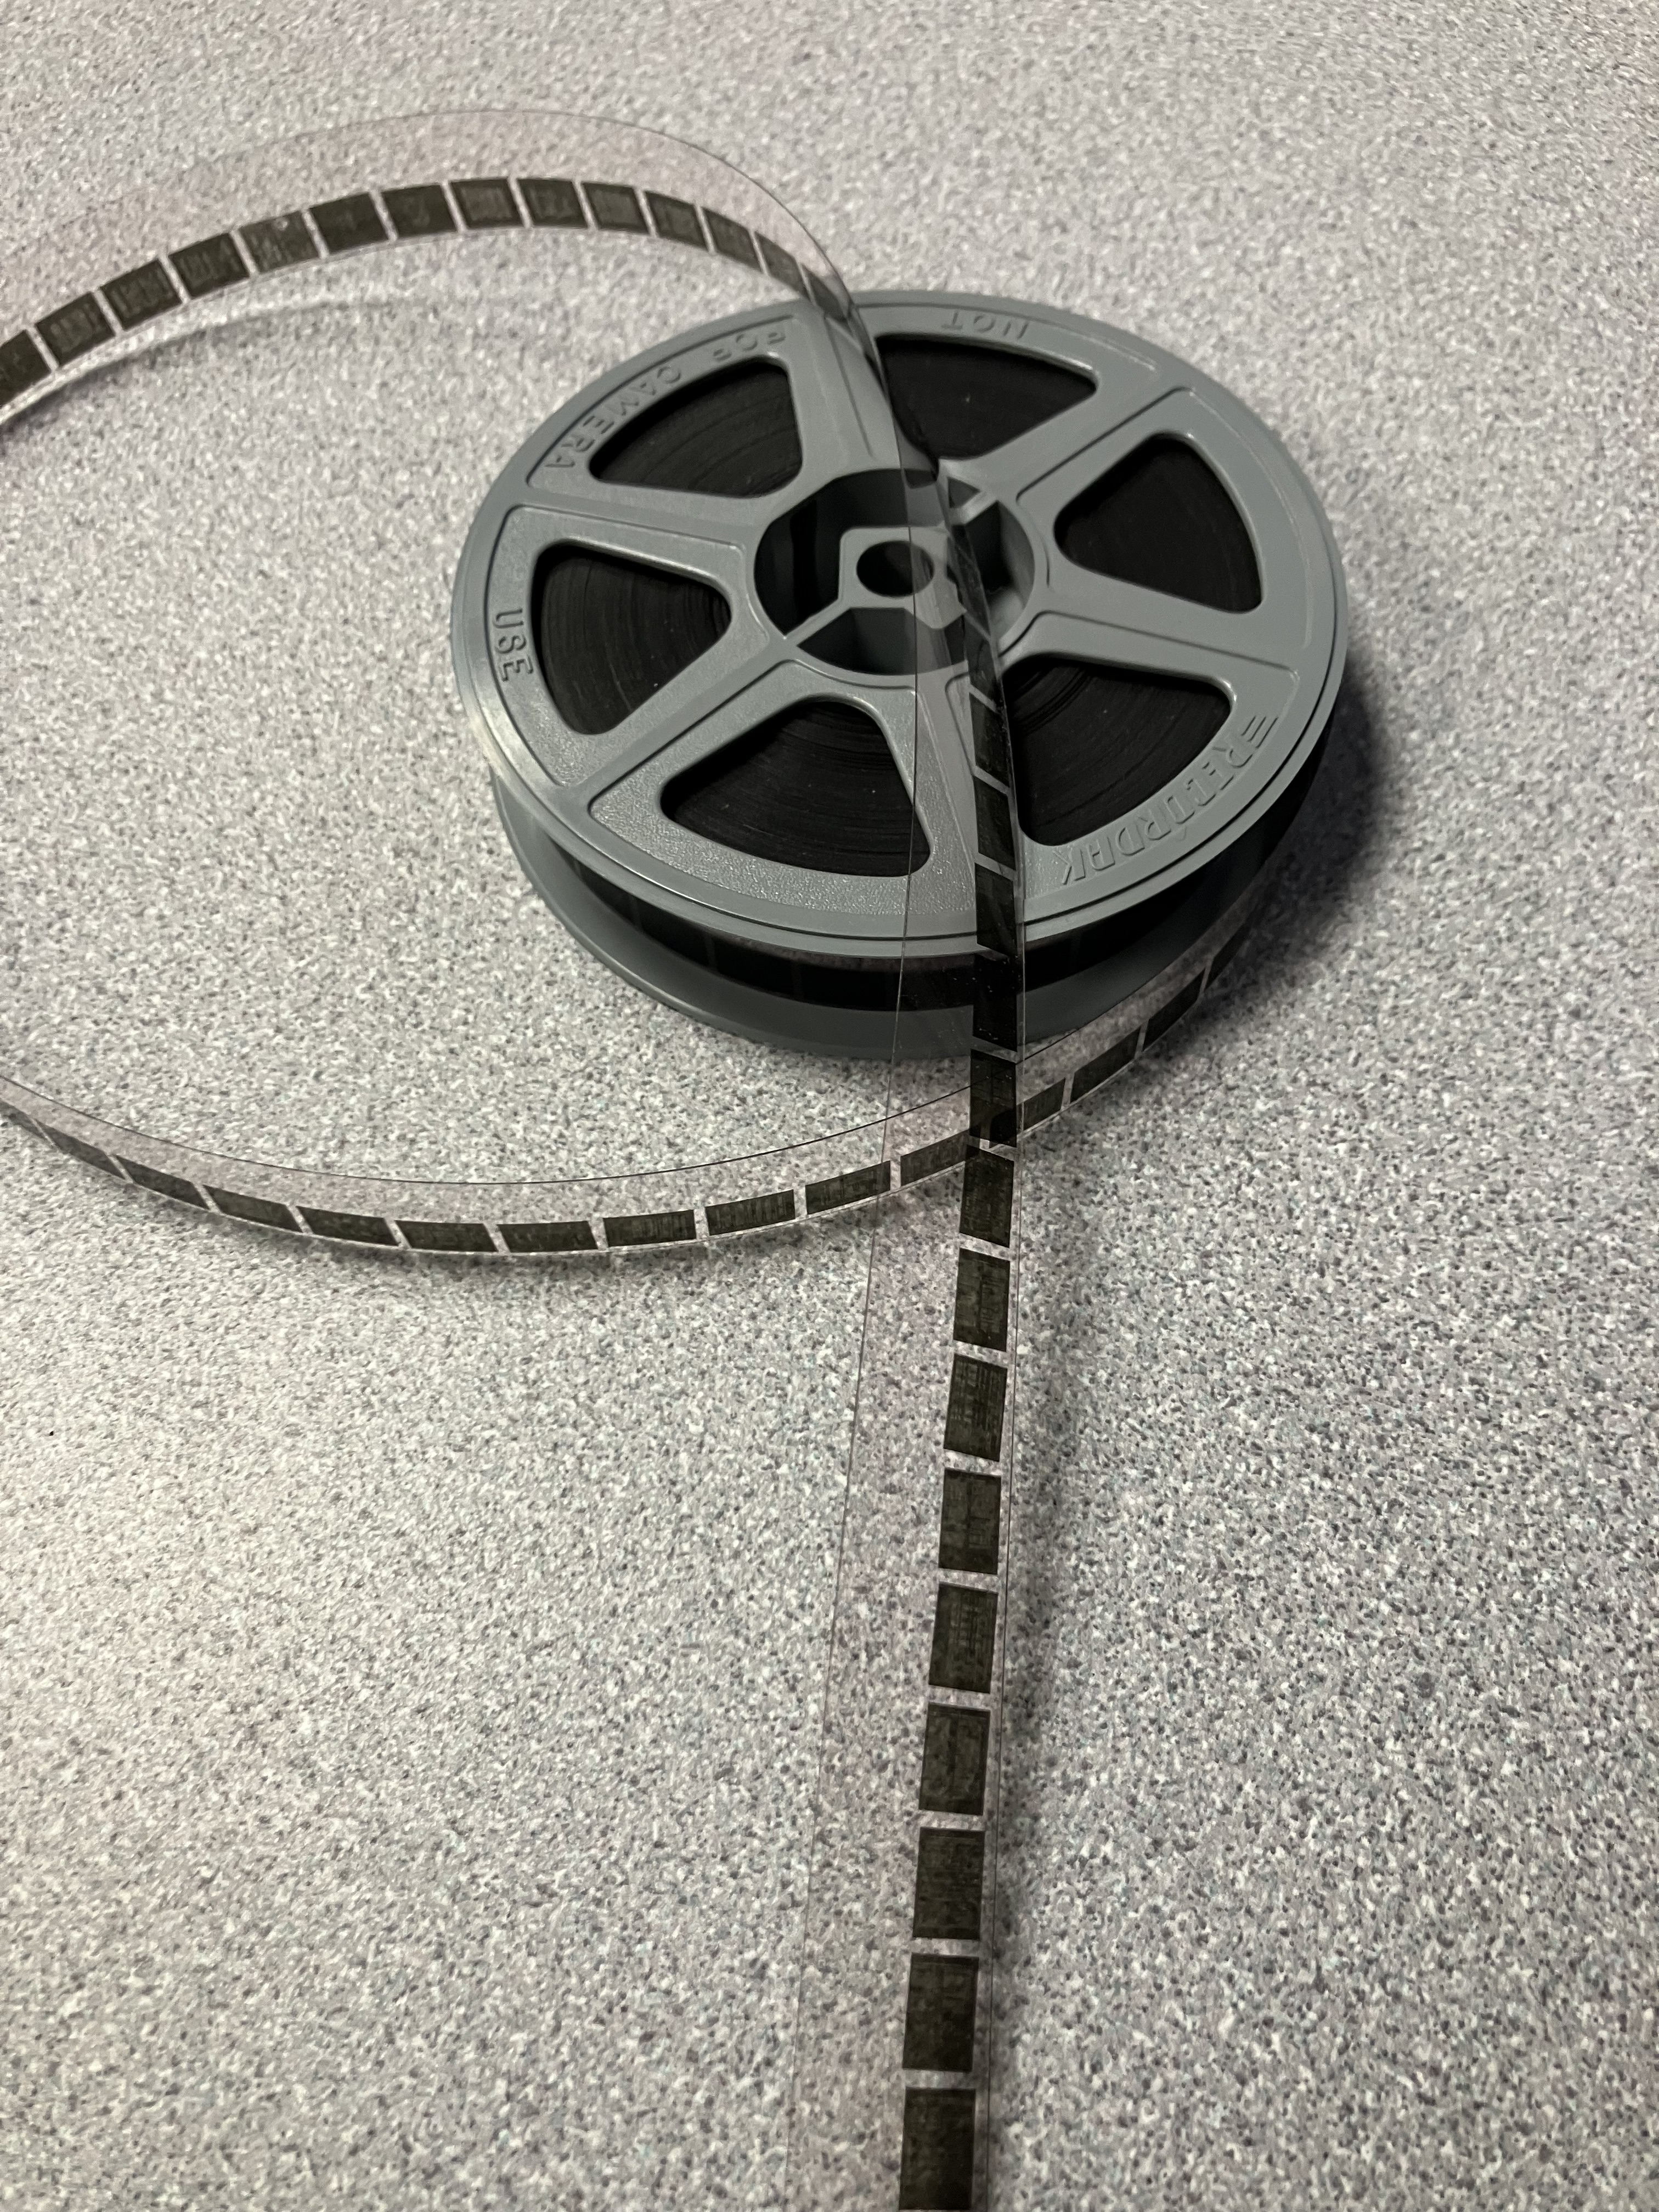
Reel Digitization
Create digitization guide
Scan the microfilm
Process/ identify pages
Straighten and crop pages
Flip and/or color correct pages
Identify and sort documents
Rename files
Create JPG derivatives
Create searchable PDFs
Pass off to metadata team

Slide 7
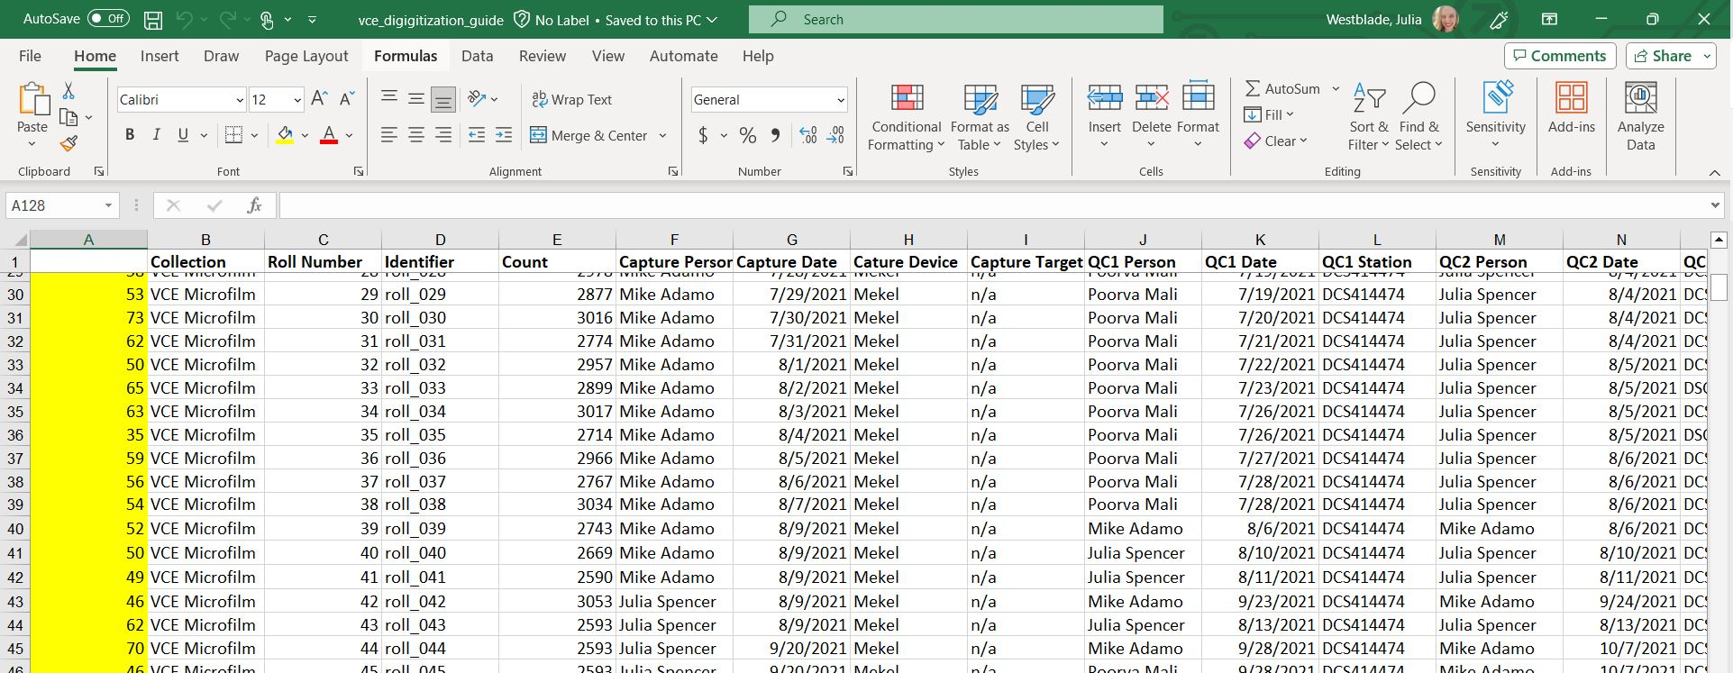
Create Digitization Guide
The Digitial Imaging Lab creates a digitizaton guide for every project we do. We record basic metadata such as who did each step of the work and when. We also record any notes that we would like to pass along to the next steps of the project

Slide 8
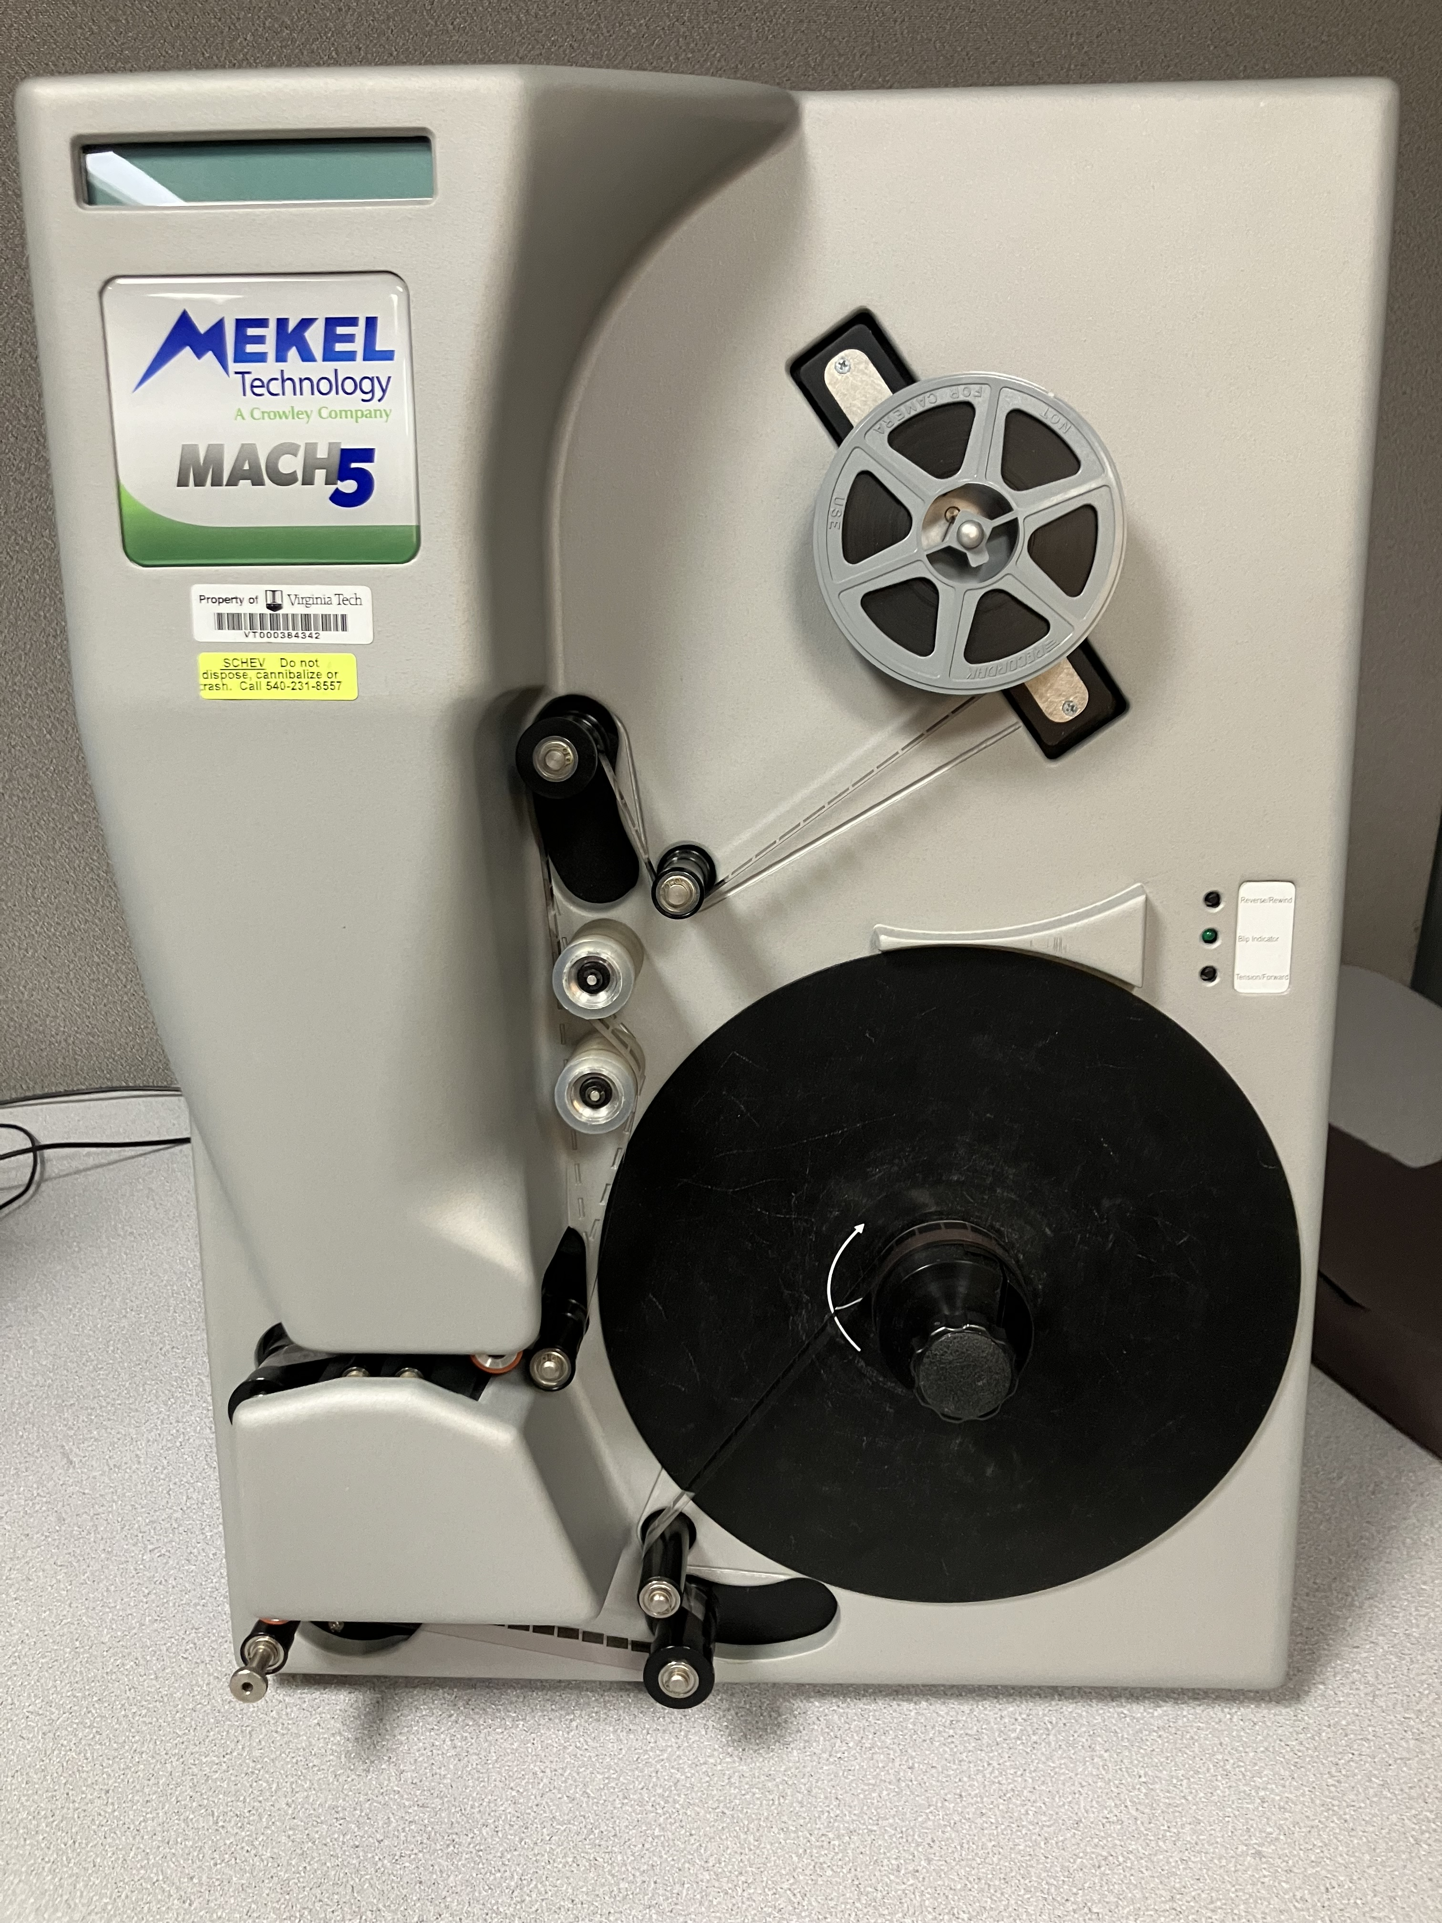
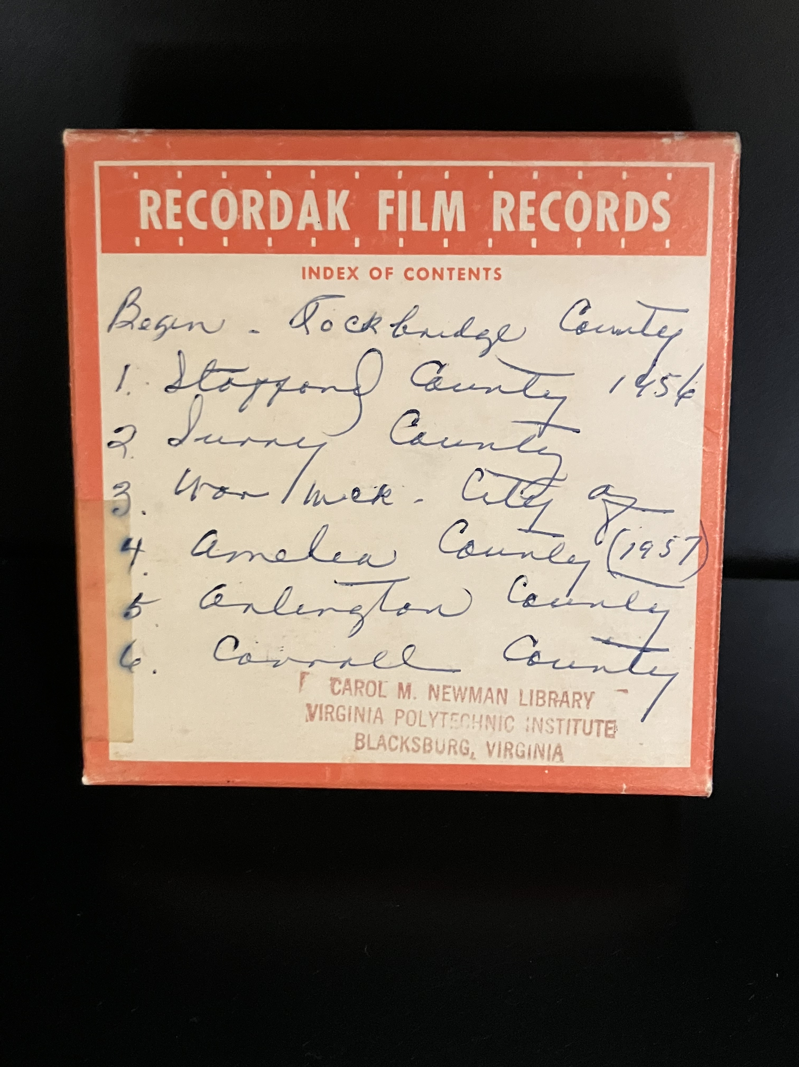
Scan the Microfilm
The lab digitized 141 reels of microfilmed from the Mekel scanner using Quantum Scanning software, then we pushed the images to the server and used the
Quantum Processing software
to identify individual pages.

Slide 9
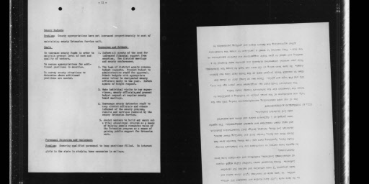
Straighten and crop pages
Early reels were scanned one page at a time but part way through they changed to two. The pages were not always straight, and frequently every other page was upside down. We had to check every page's orientation in the QC process.

Slide 10
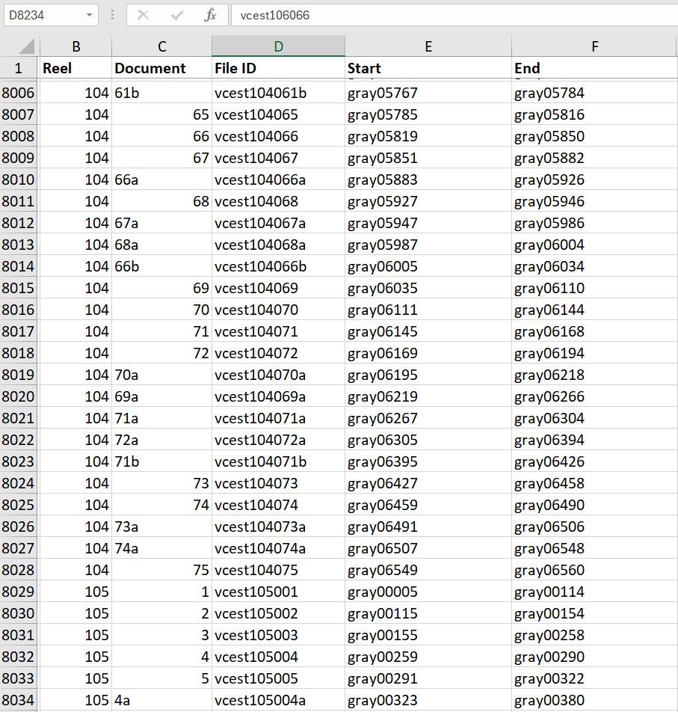
Identify and sort documents
Meagan went through each reel and identified groups of images for each document. Some were broken into two parts. Students grouped the identified images into individual folders – one for each document.

Slide 11
Identify and sort documents
Things got complicated somewhere around 2/3 of the way through the process when the pages were not grouped at all and weren't scanned in any sort of order. We could either ...
Value speed and break images into groups of 50 in the order they were scanned and add a note to researchers so that they could figure it out on their own.
Spend the time to individually sort pages and provide as many complete documents to researchers as possible.
Where possible we chose option #2.

Slide 12

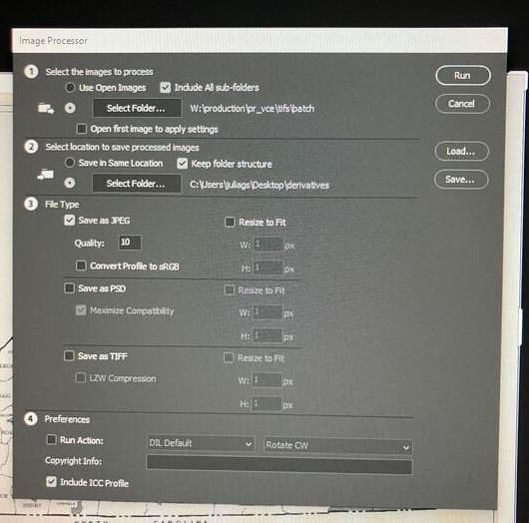
Rename files and create derivatives
Once the images were sorted into folders, we used a renaming tool and Python scripts to batch rename files according to our file naming convention.
We used Photoshop's Image Processer to then convert those folders of tifs into folders of jpgs.
Insert data/chart here.

Slide 13
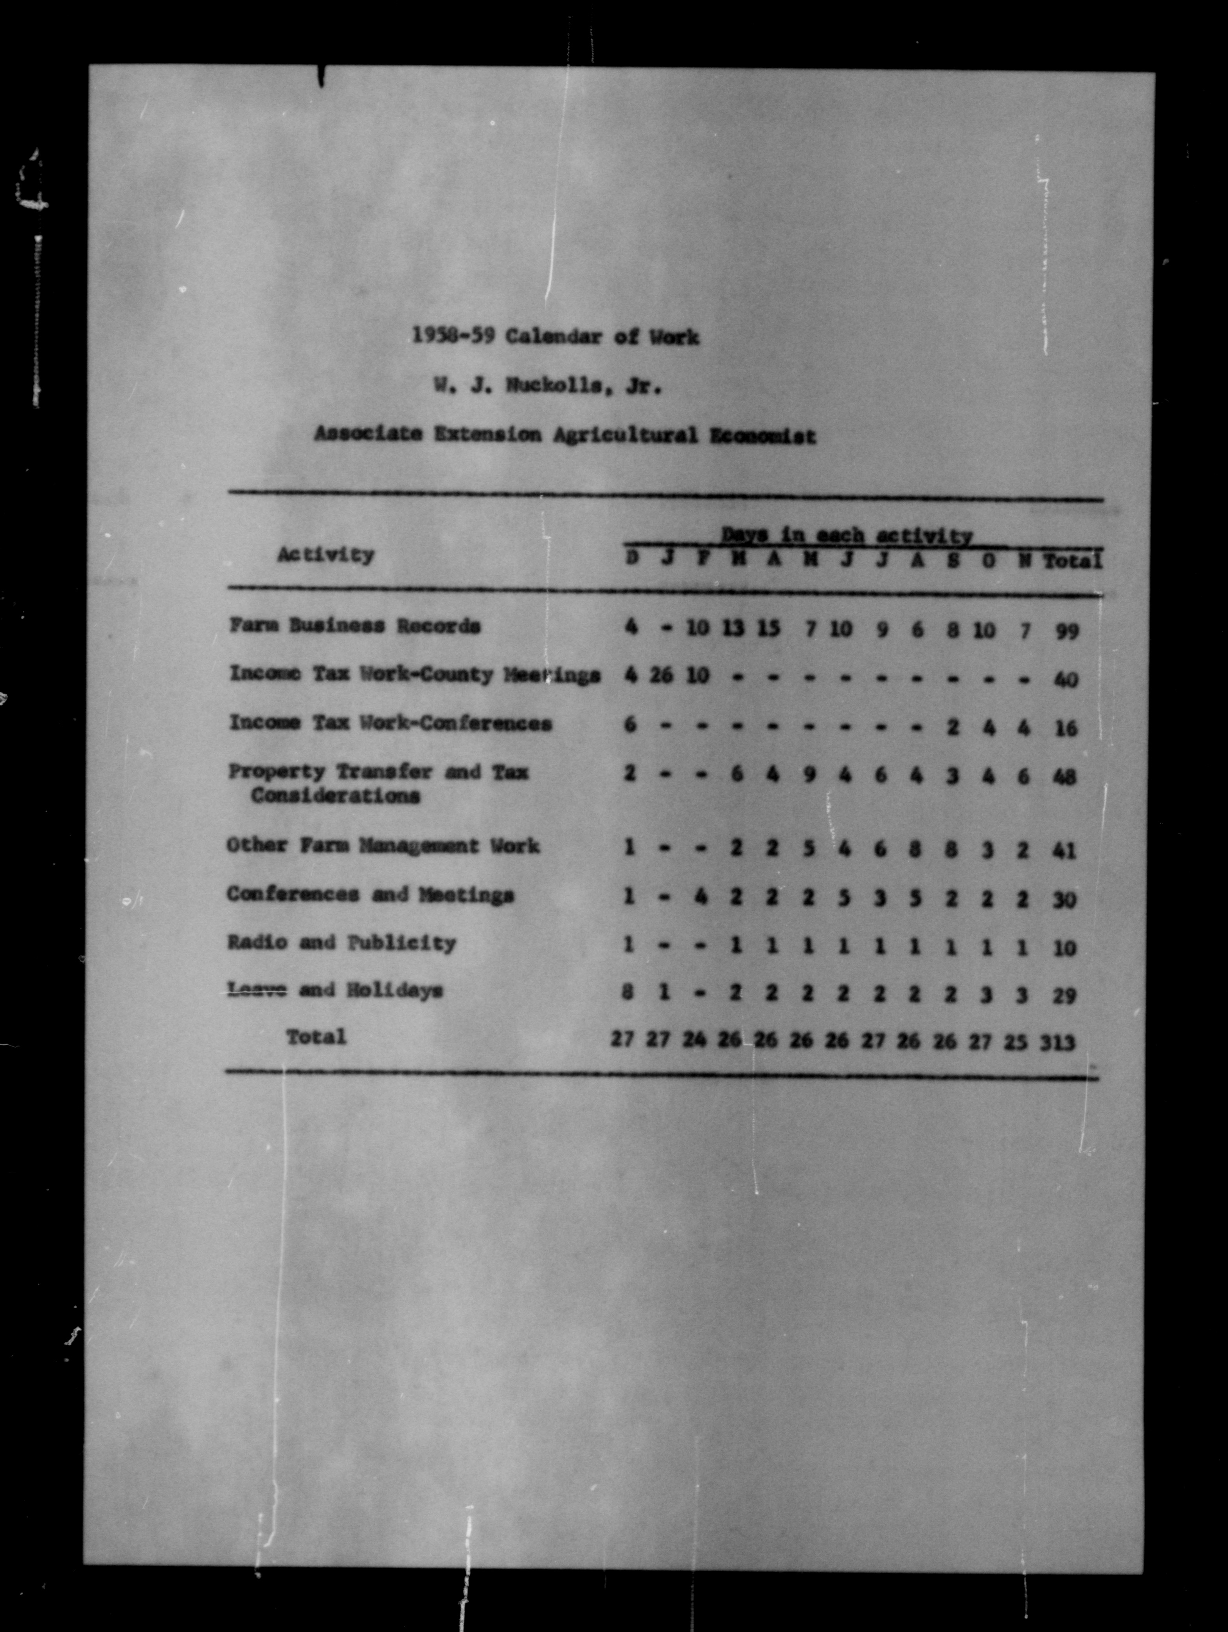
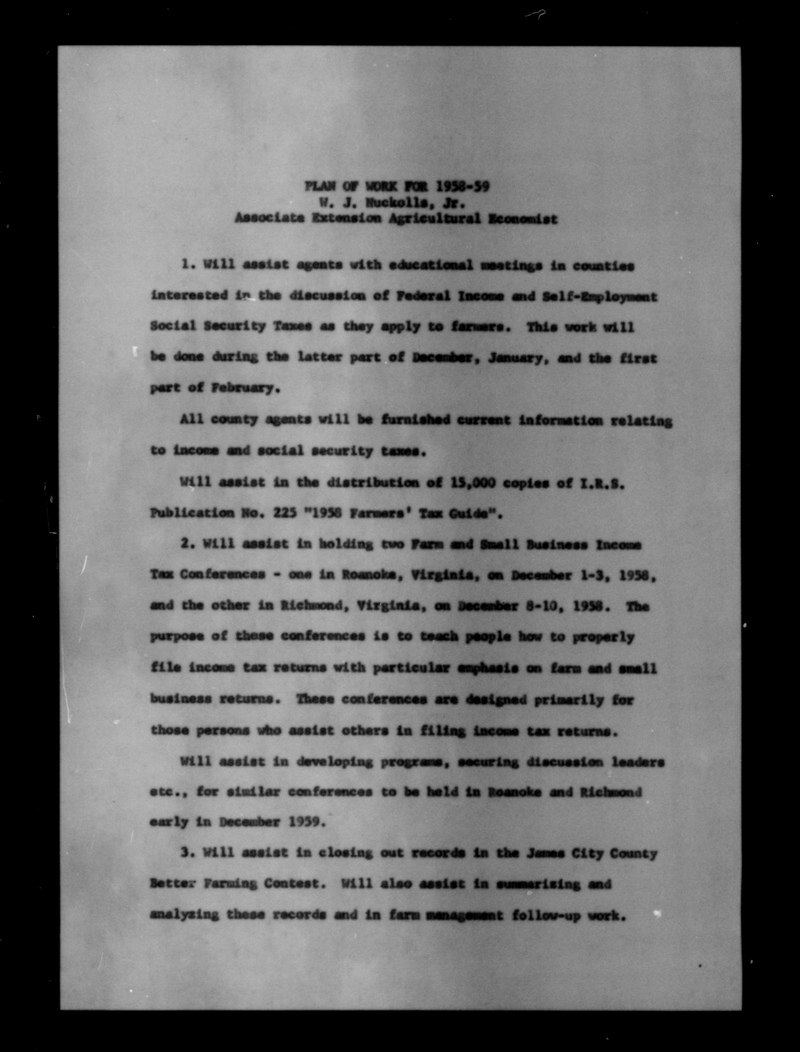
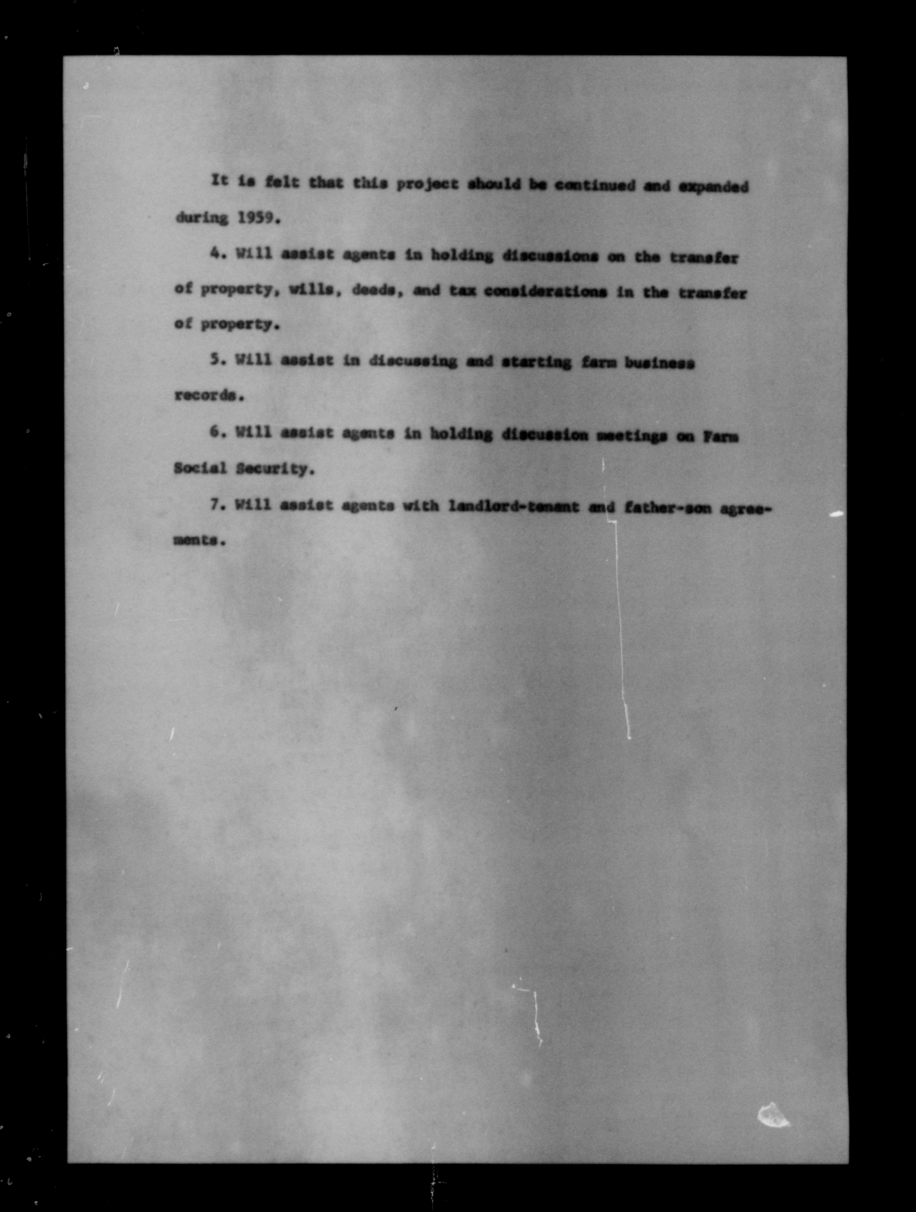
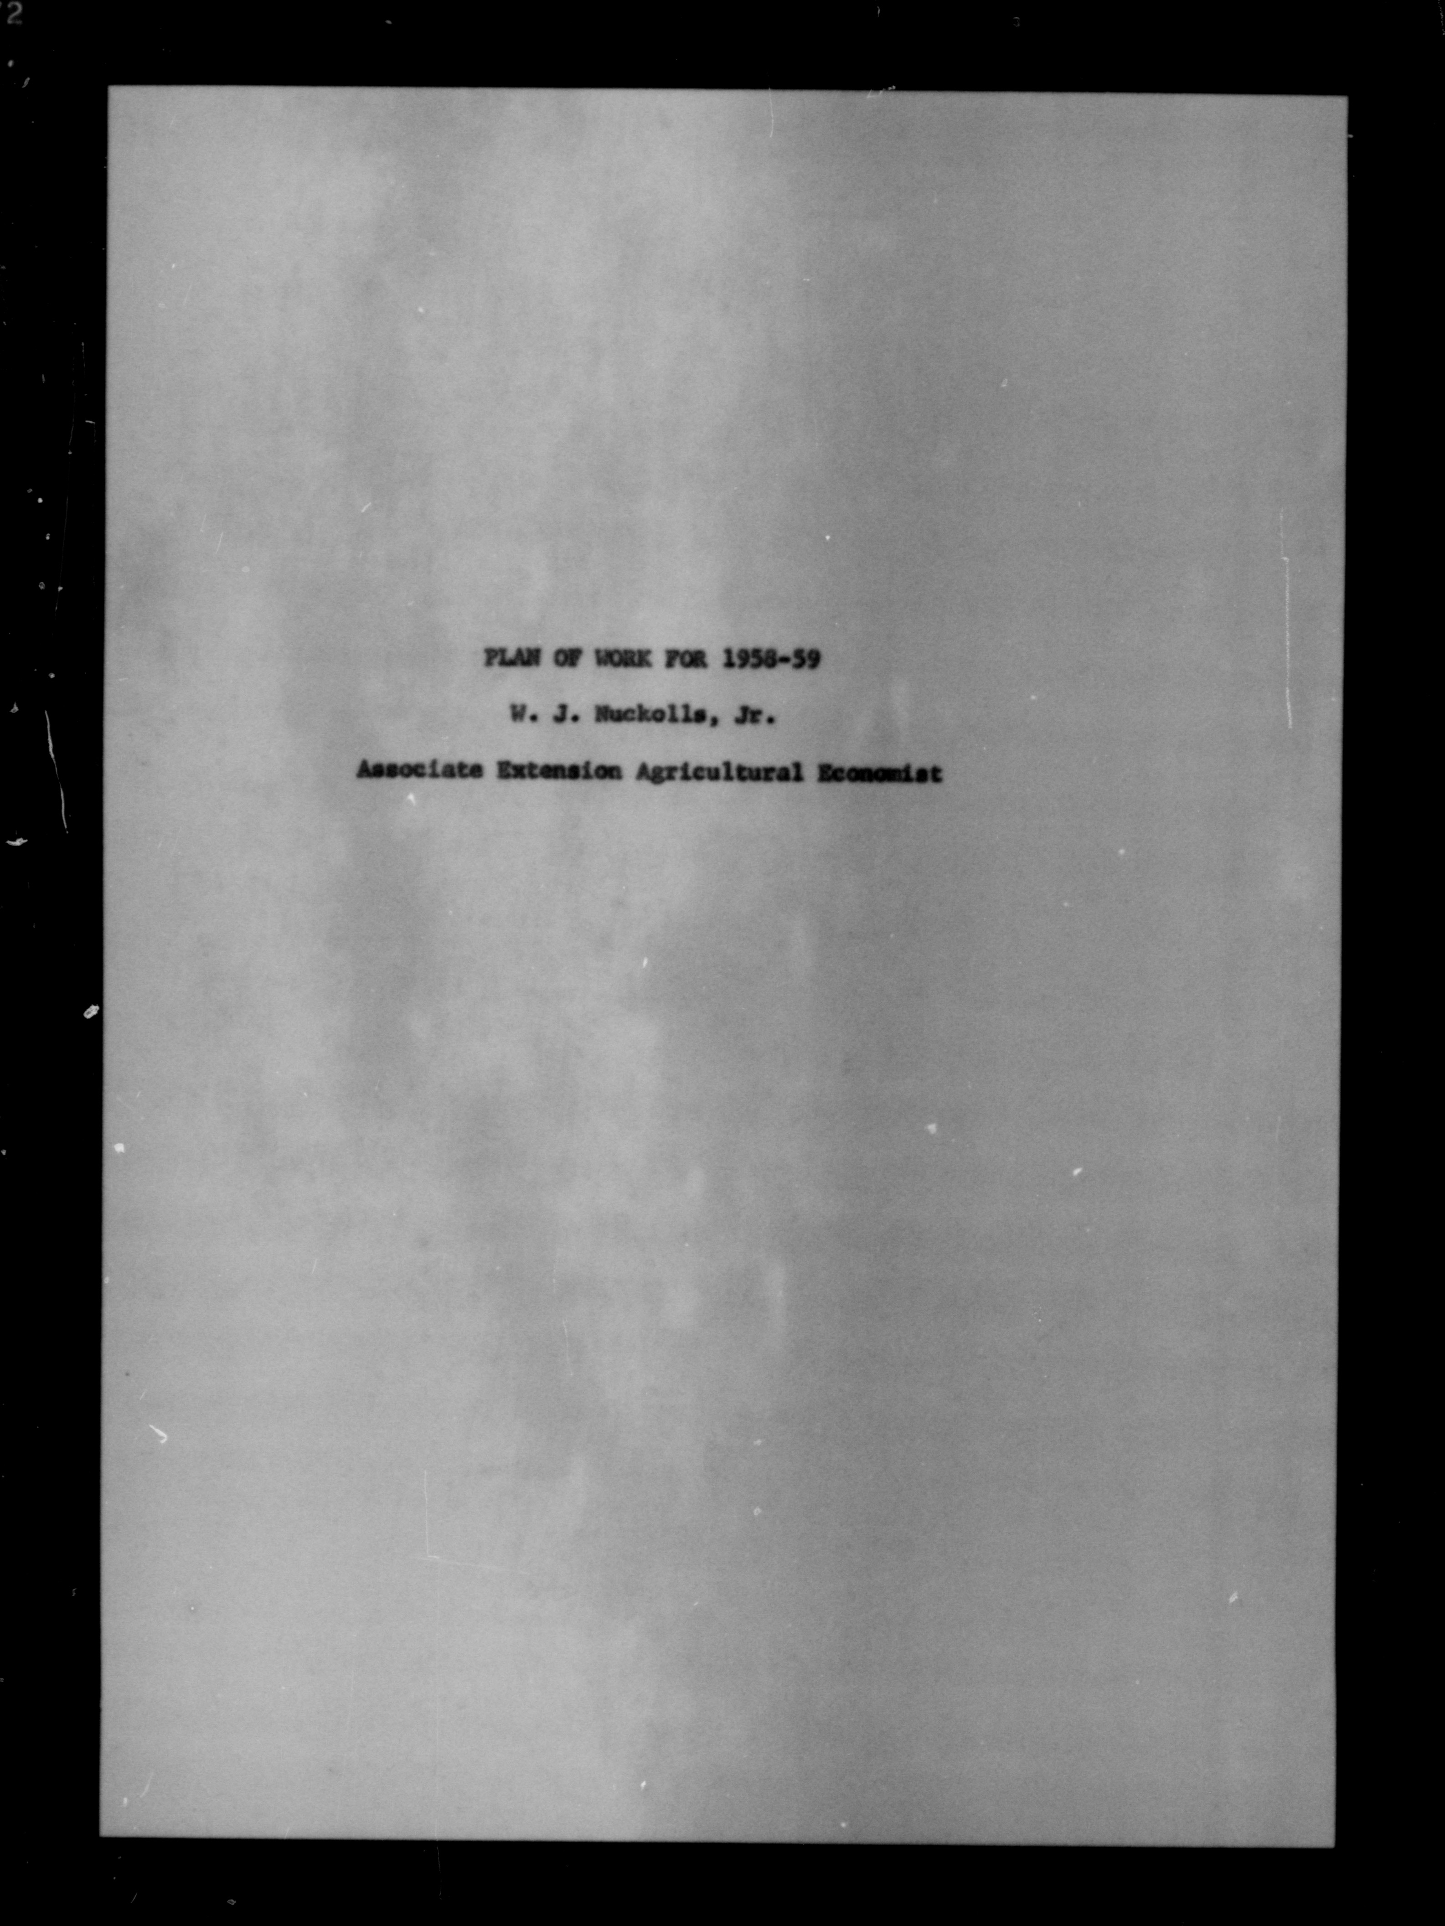
Create searchable PDFs
Student workers in the lab used Adobe Acrobat to combine the jpgs into PDFs and apply OCR.
These are stored on the server in their own folder.
Current count is10,989 PDFs.
vcest122091

Slide 14
Next Steps
03.
...we scanned them. Now what?

Slide 15
Once it leaves the lab
Inga's team is working on metadata for each document.
They are collecting basic information including
Document title
Author/ person who compiled the report
The county covered
Date

Slide 16
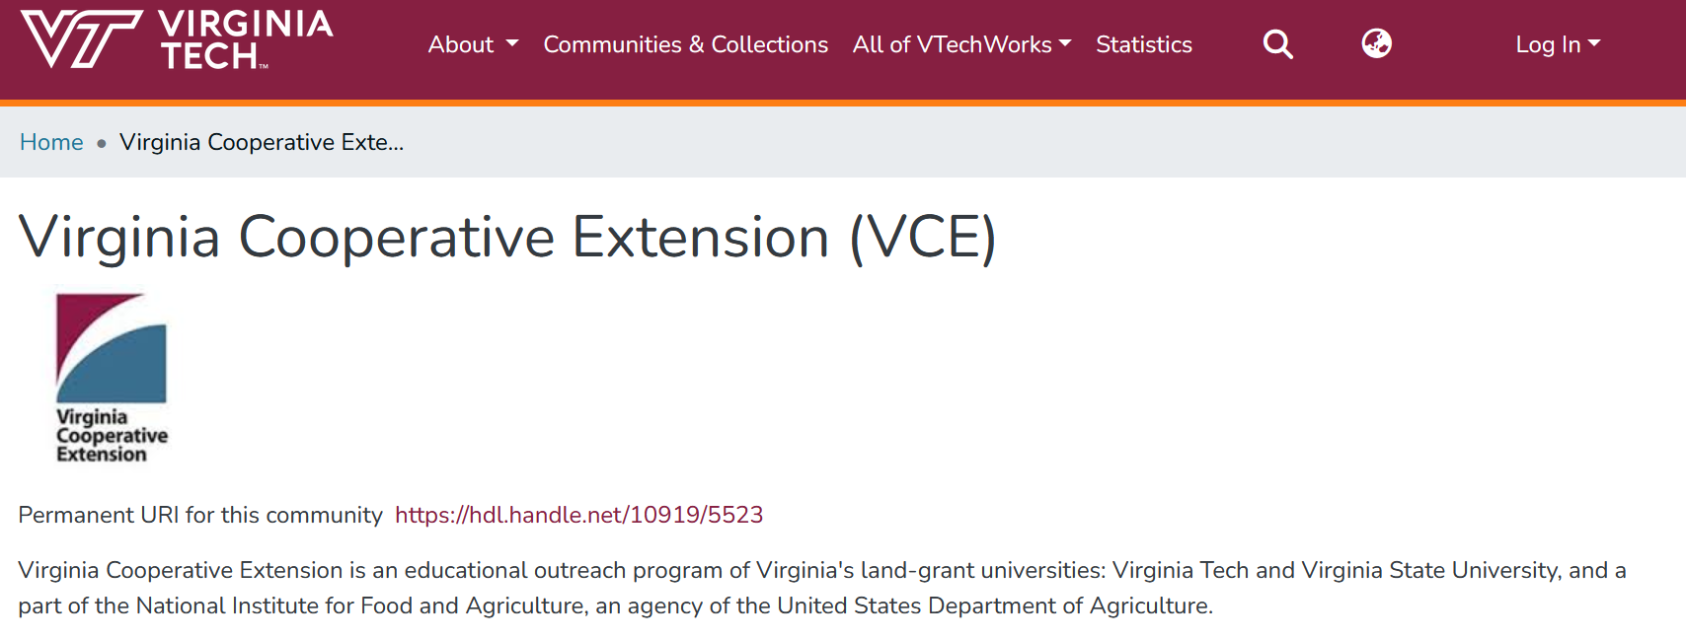
VTechWorks
Notes:
https://vtechworks.lib.vt.edu/home
Item level metadata available for each item in the collection. It will have it's own collection in the VCE community in VTechWorks.

Slide 17
Challenges
04.
(Once upon a time we thought we'd only have 2000 PDFs)

Slide 18
Hardware, software, time constraints
The scanner required some repairs and visits from technicians and workarounds.
On some reels, every other page was blank - delete them for more coherent documents and smaller file sizes? Or leave them to save time?
Some of the documents are in order but backwards.
Students working simultaneously can cause confusion so we would have to be clear about which aspect or reel each student was doing. Meticulous documentation is helpful.
The project is 5-6 times larger than we'd anticipated.
Leadership of the lab changed part way through the project.

Slide 19
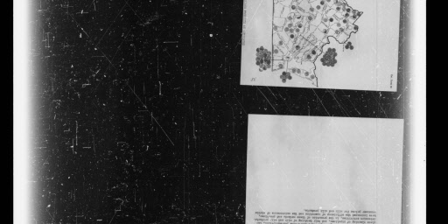
The quality of the film and original scans
The film was often scratched and lighting was inconsistent

Slide 20
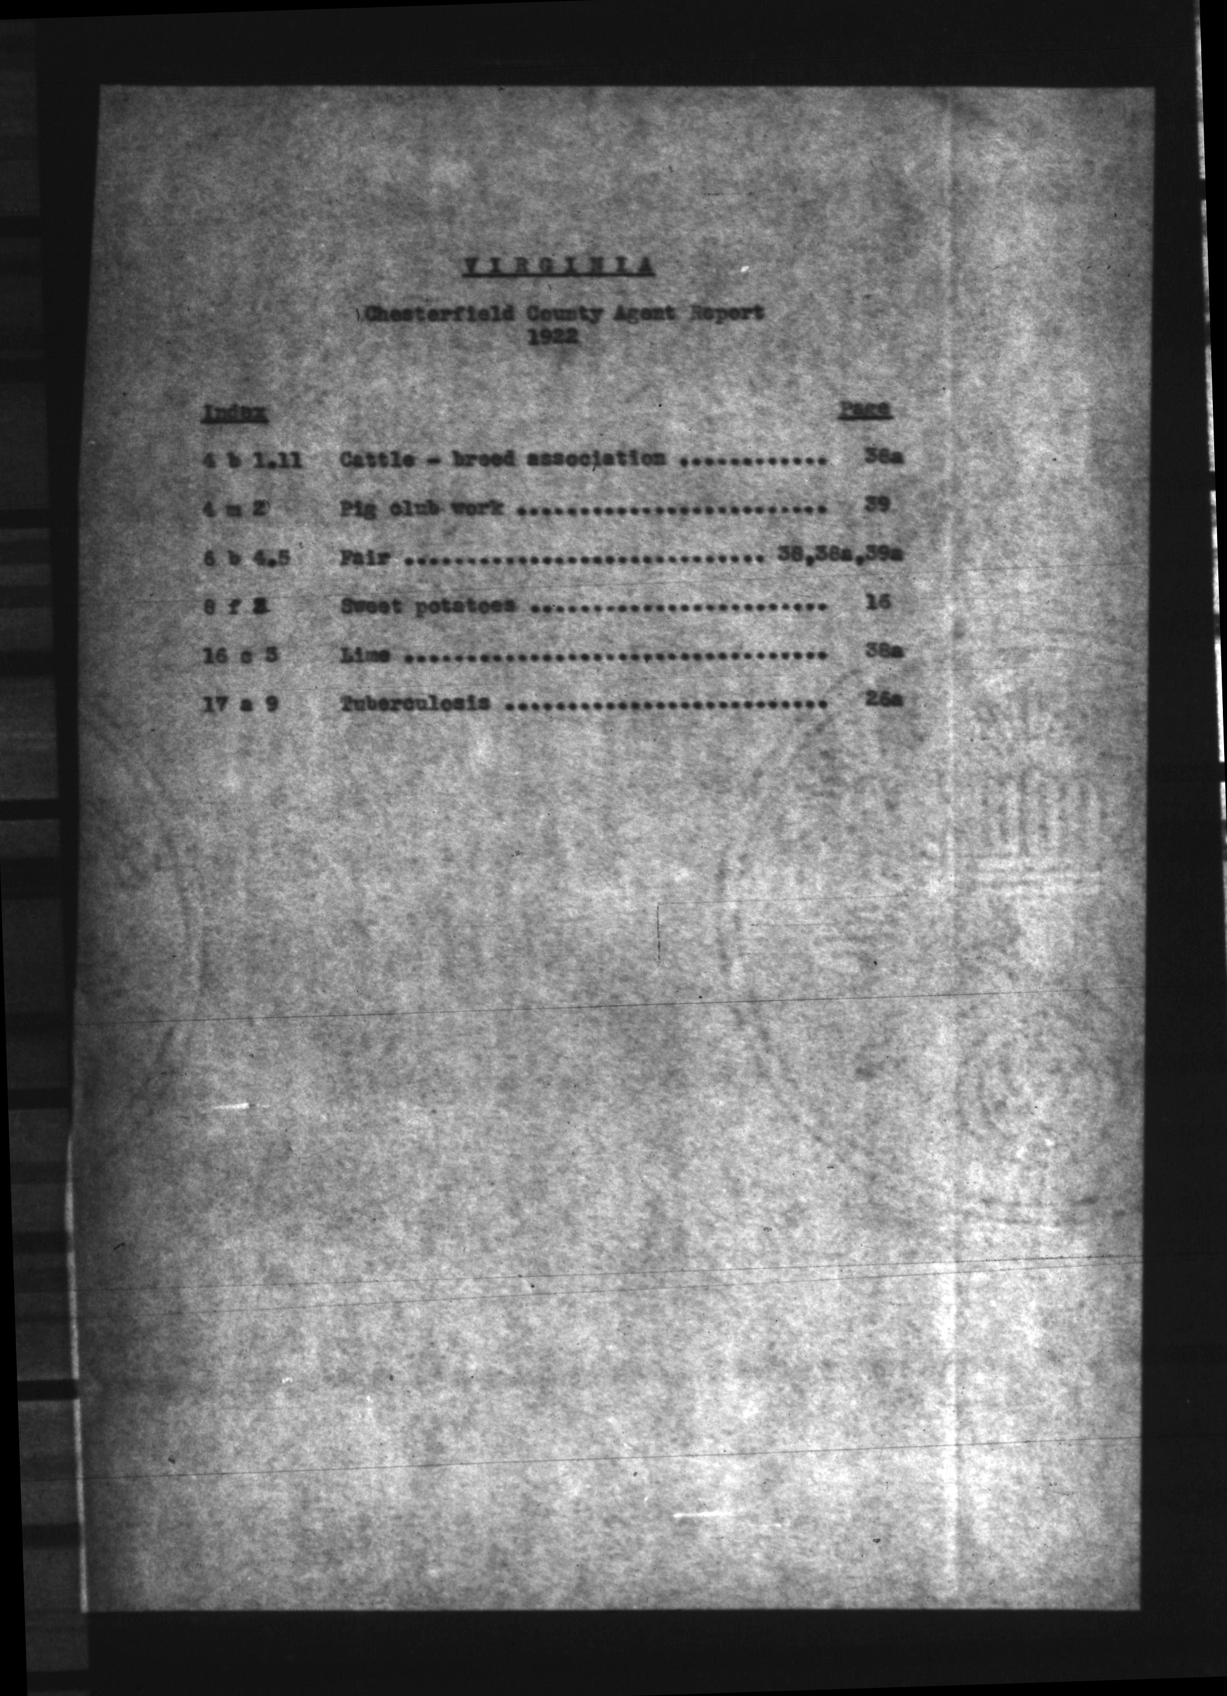
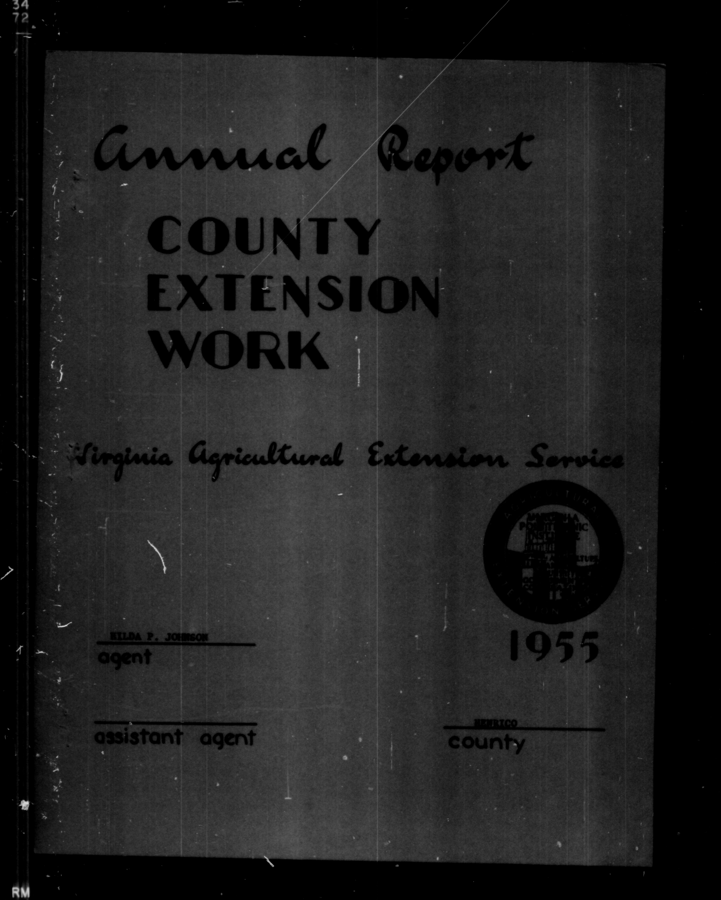
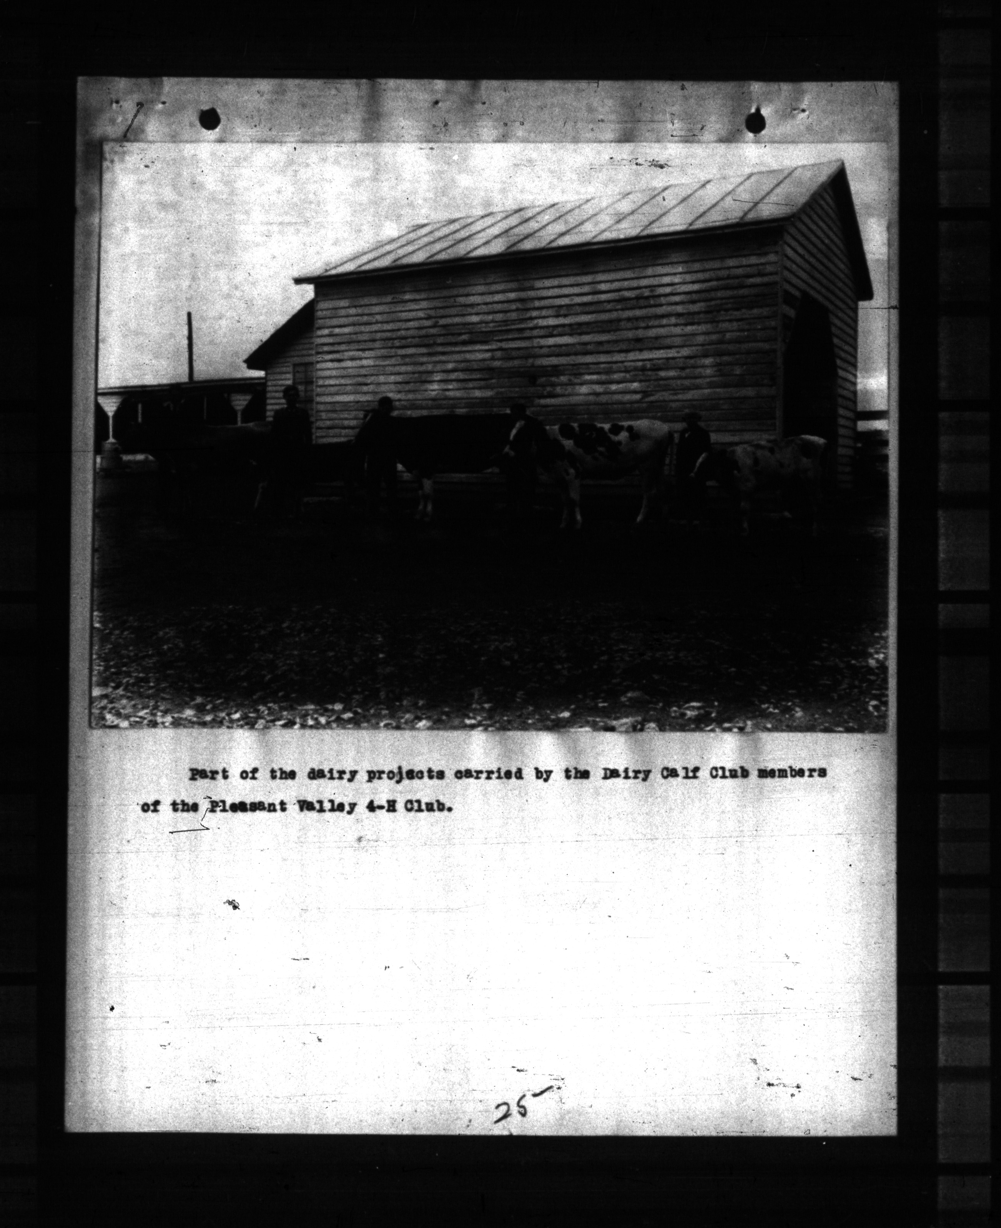
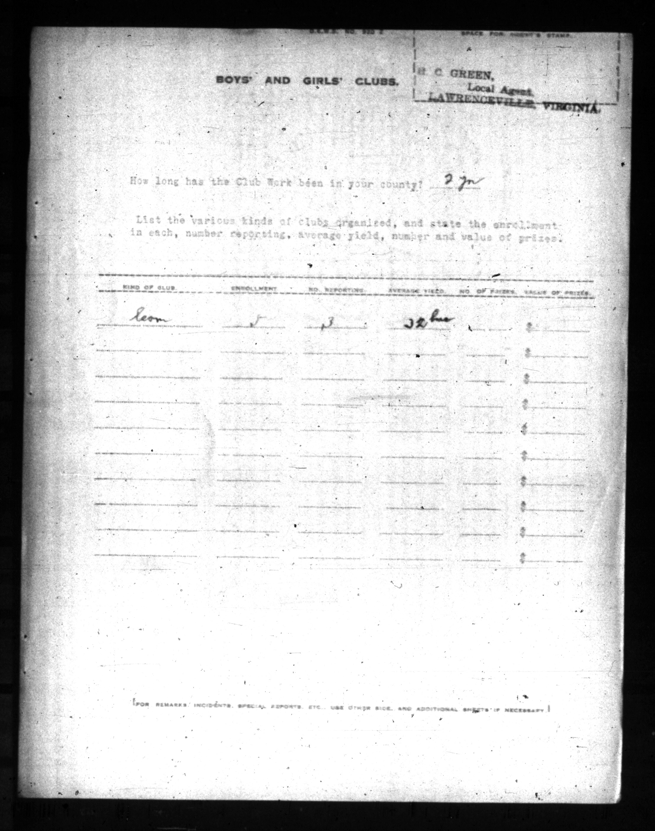
The quality of the film and original scans
vcest009014001
vcest111137001
vcest034046029
vcest001037040

Slide 21
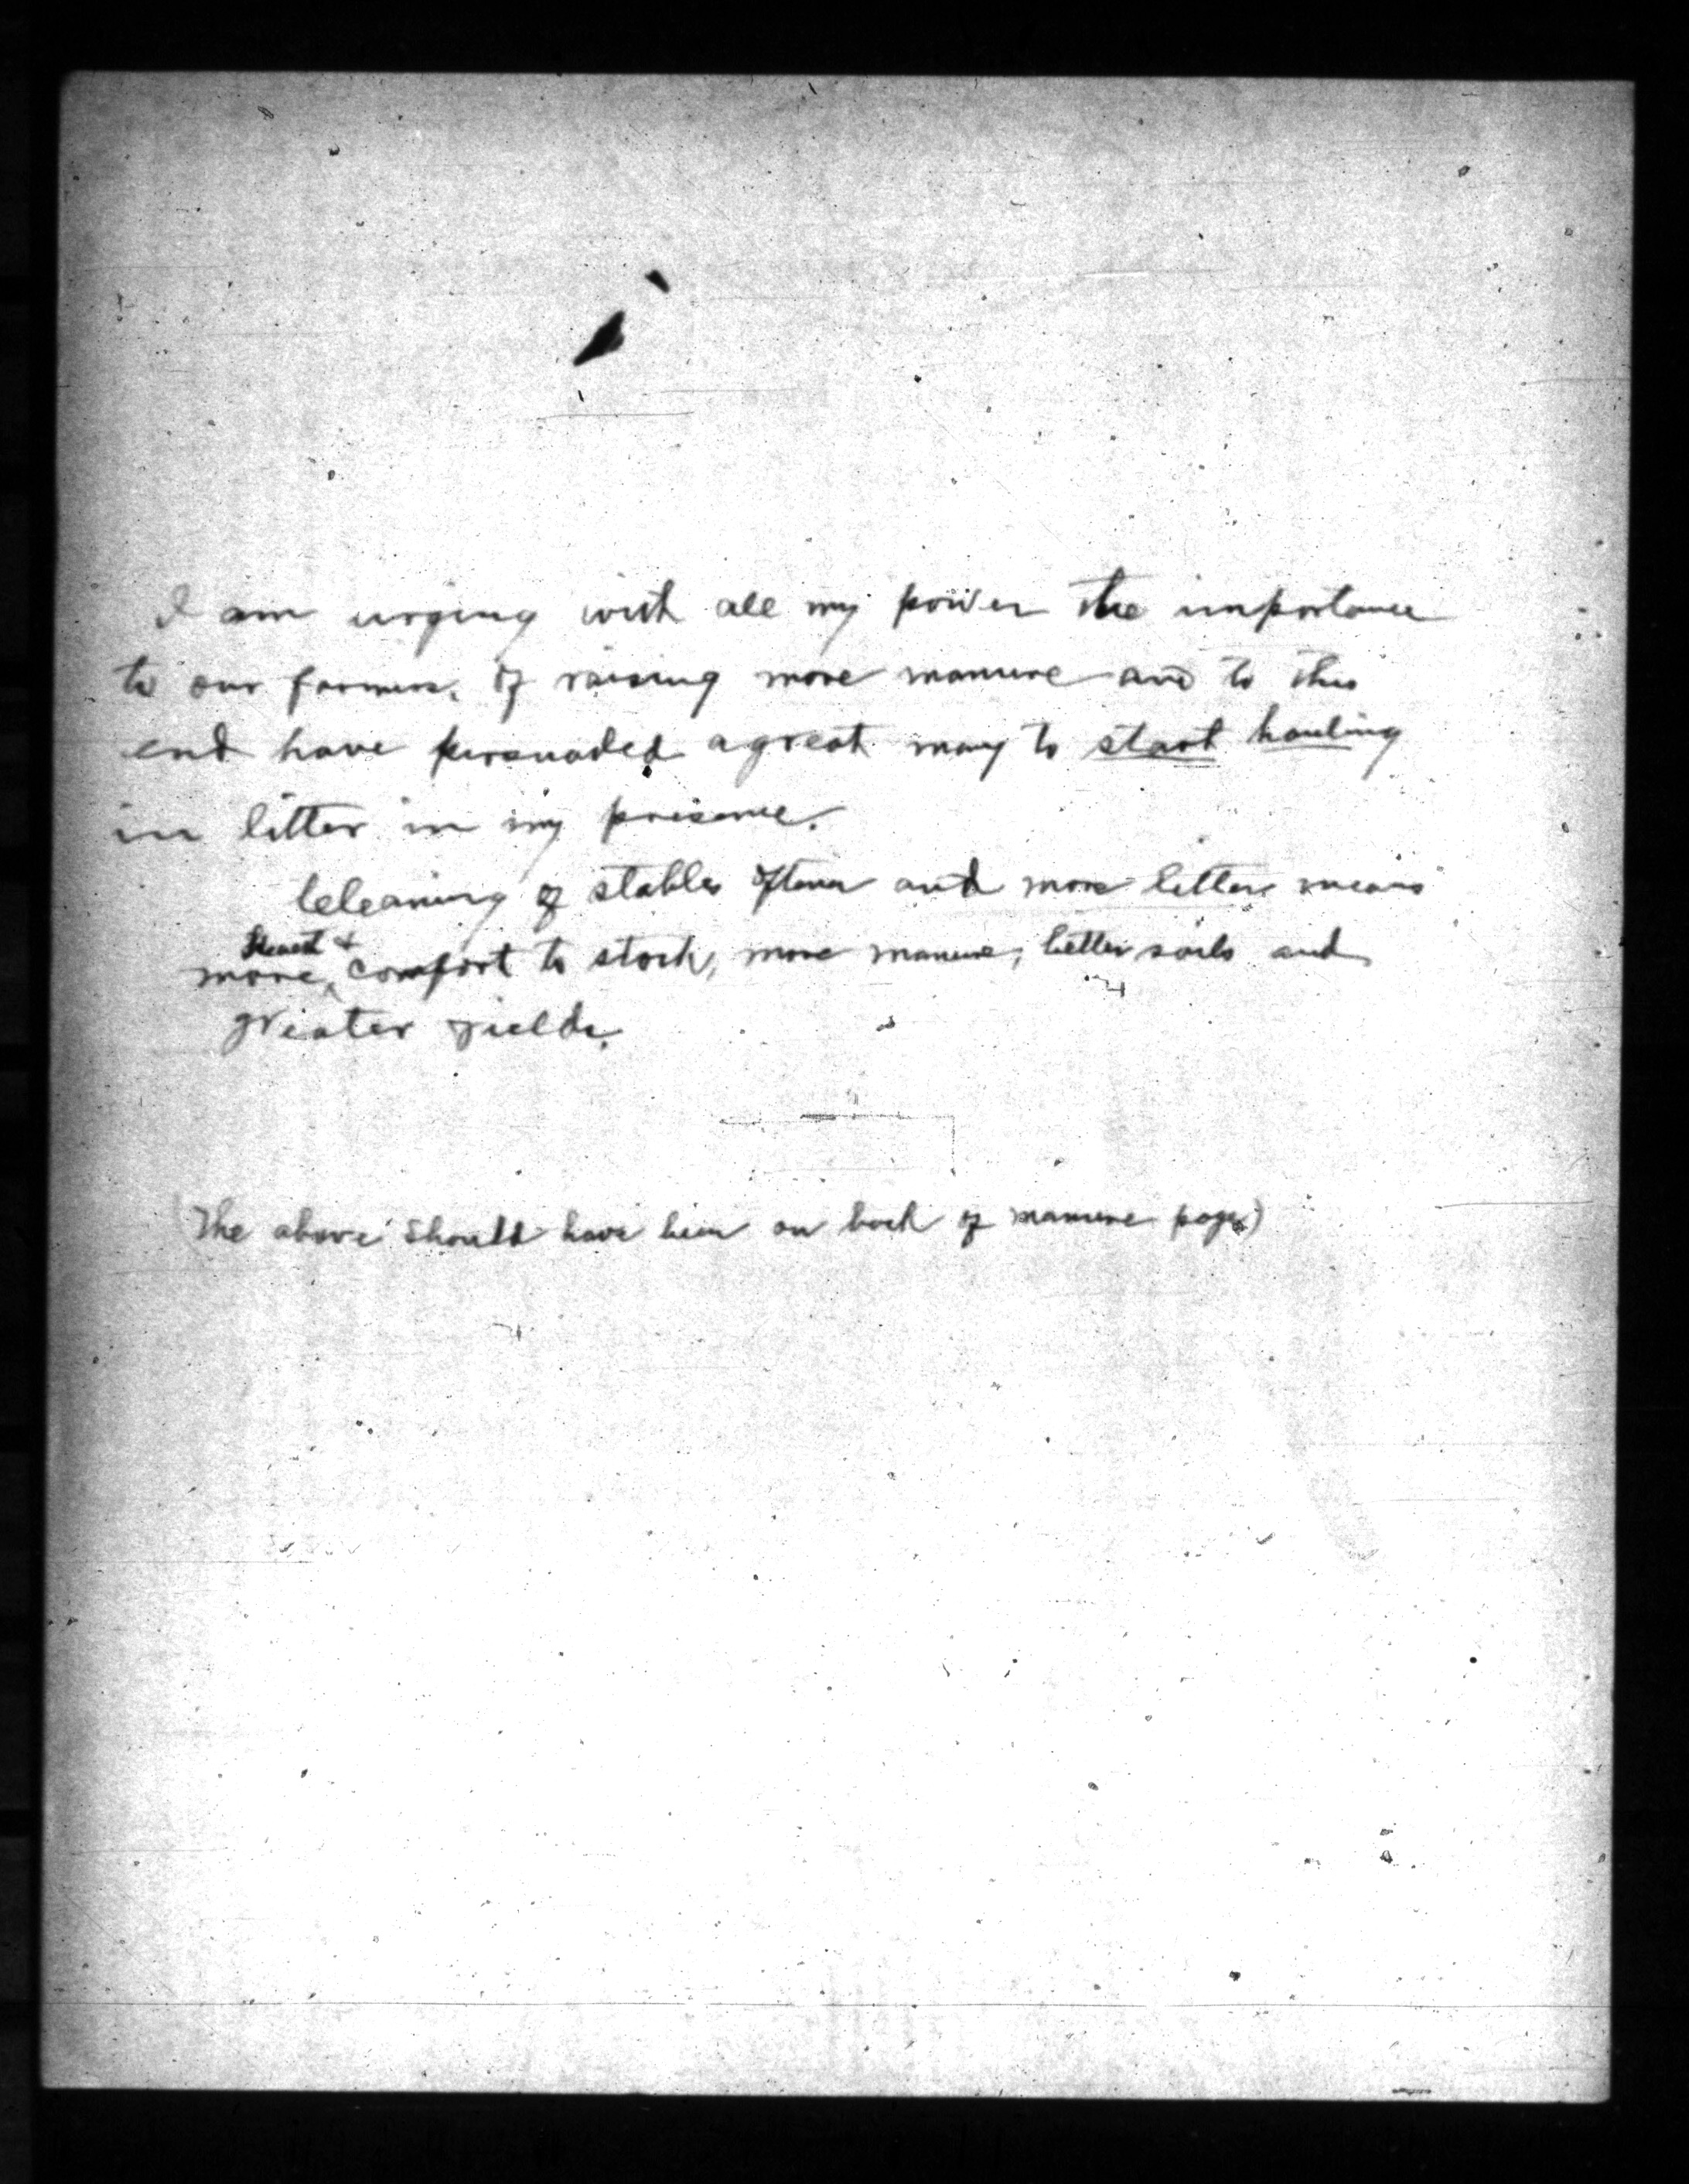
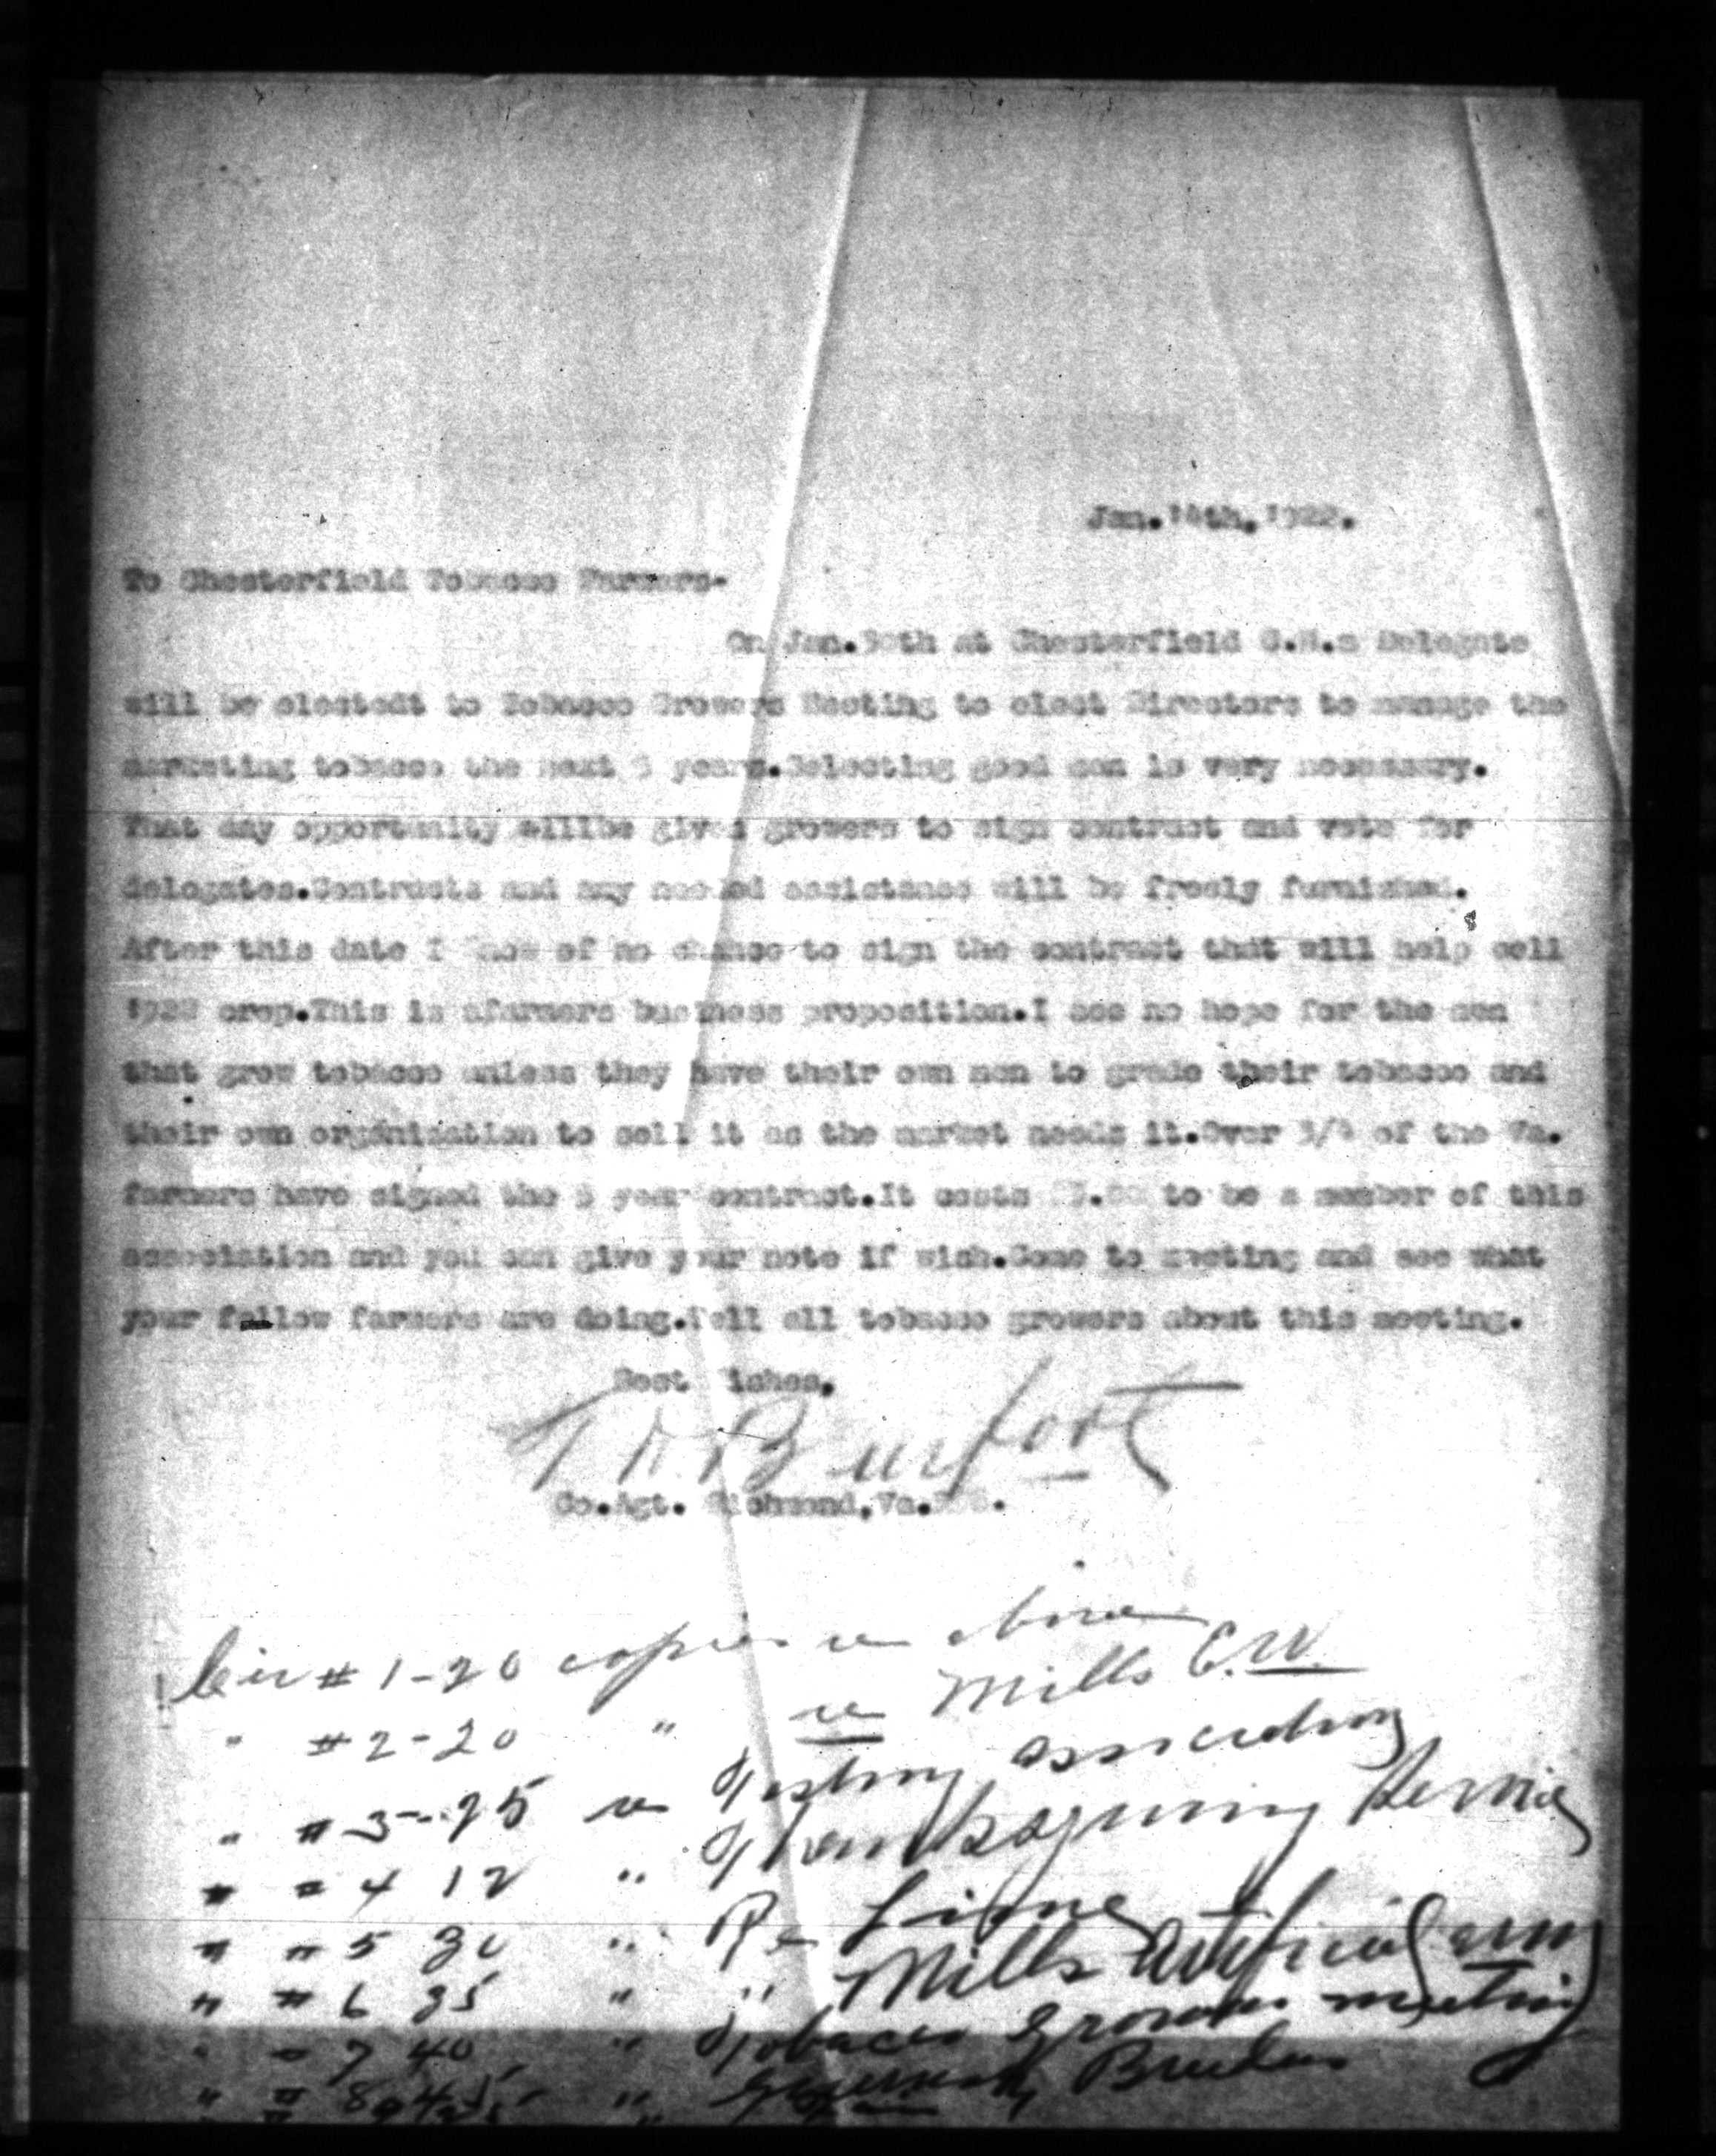
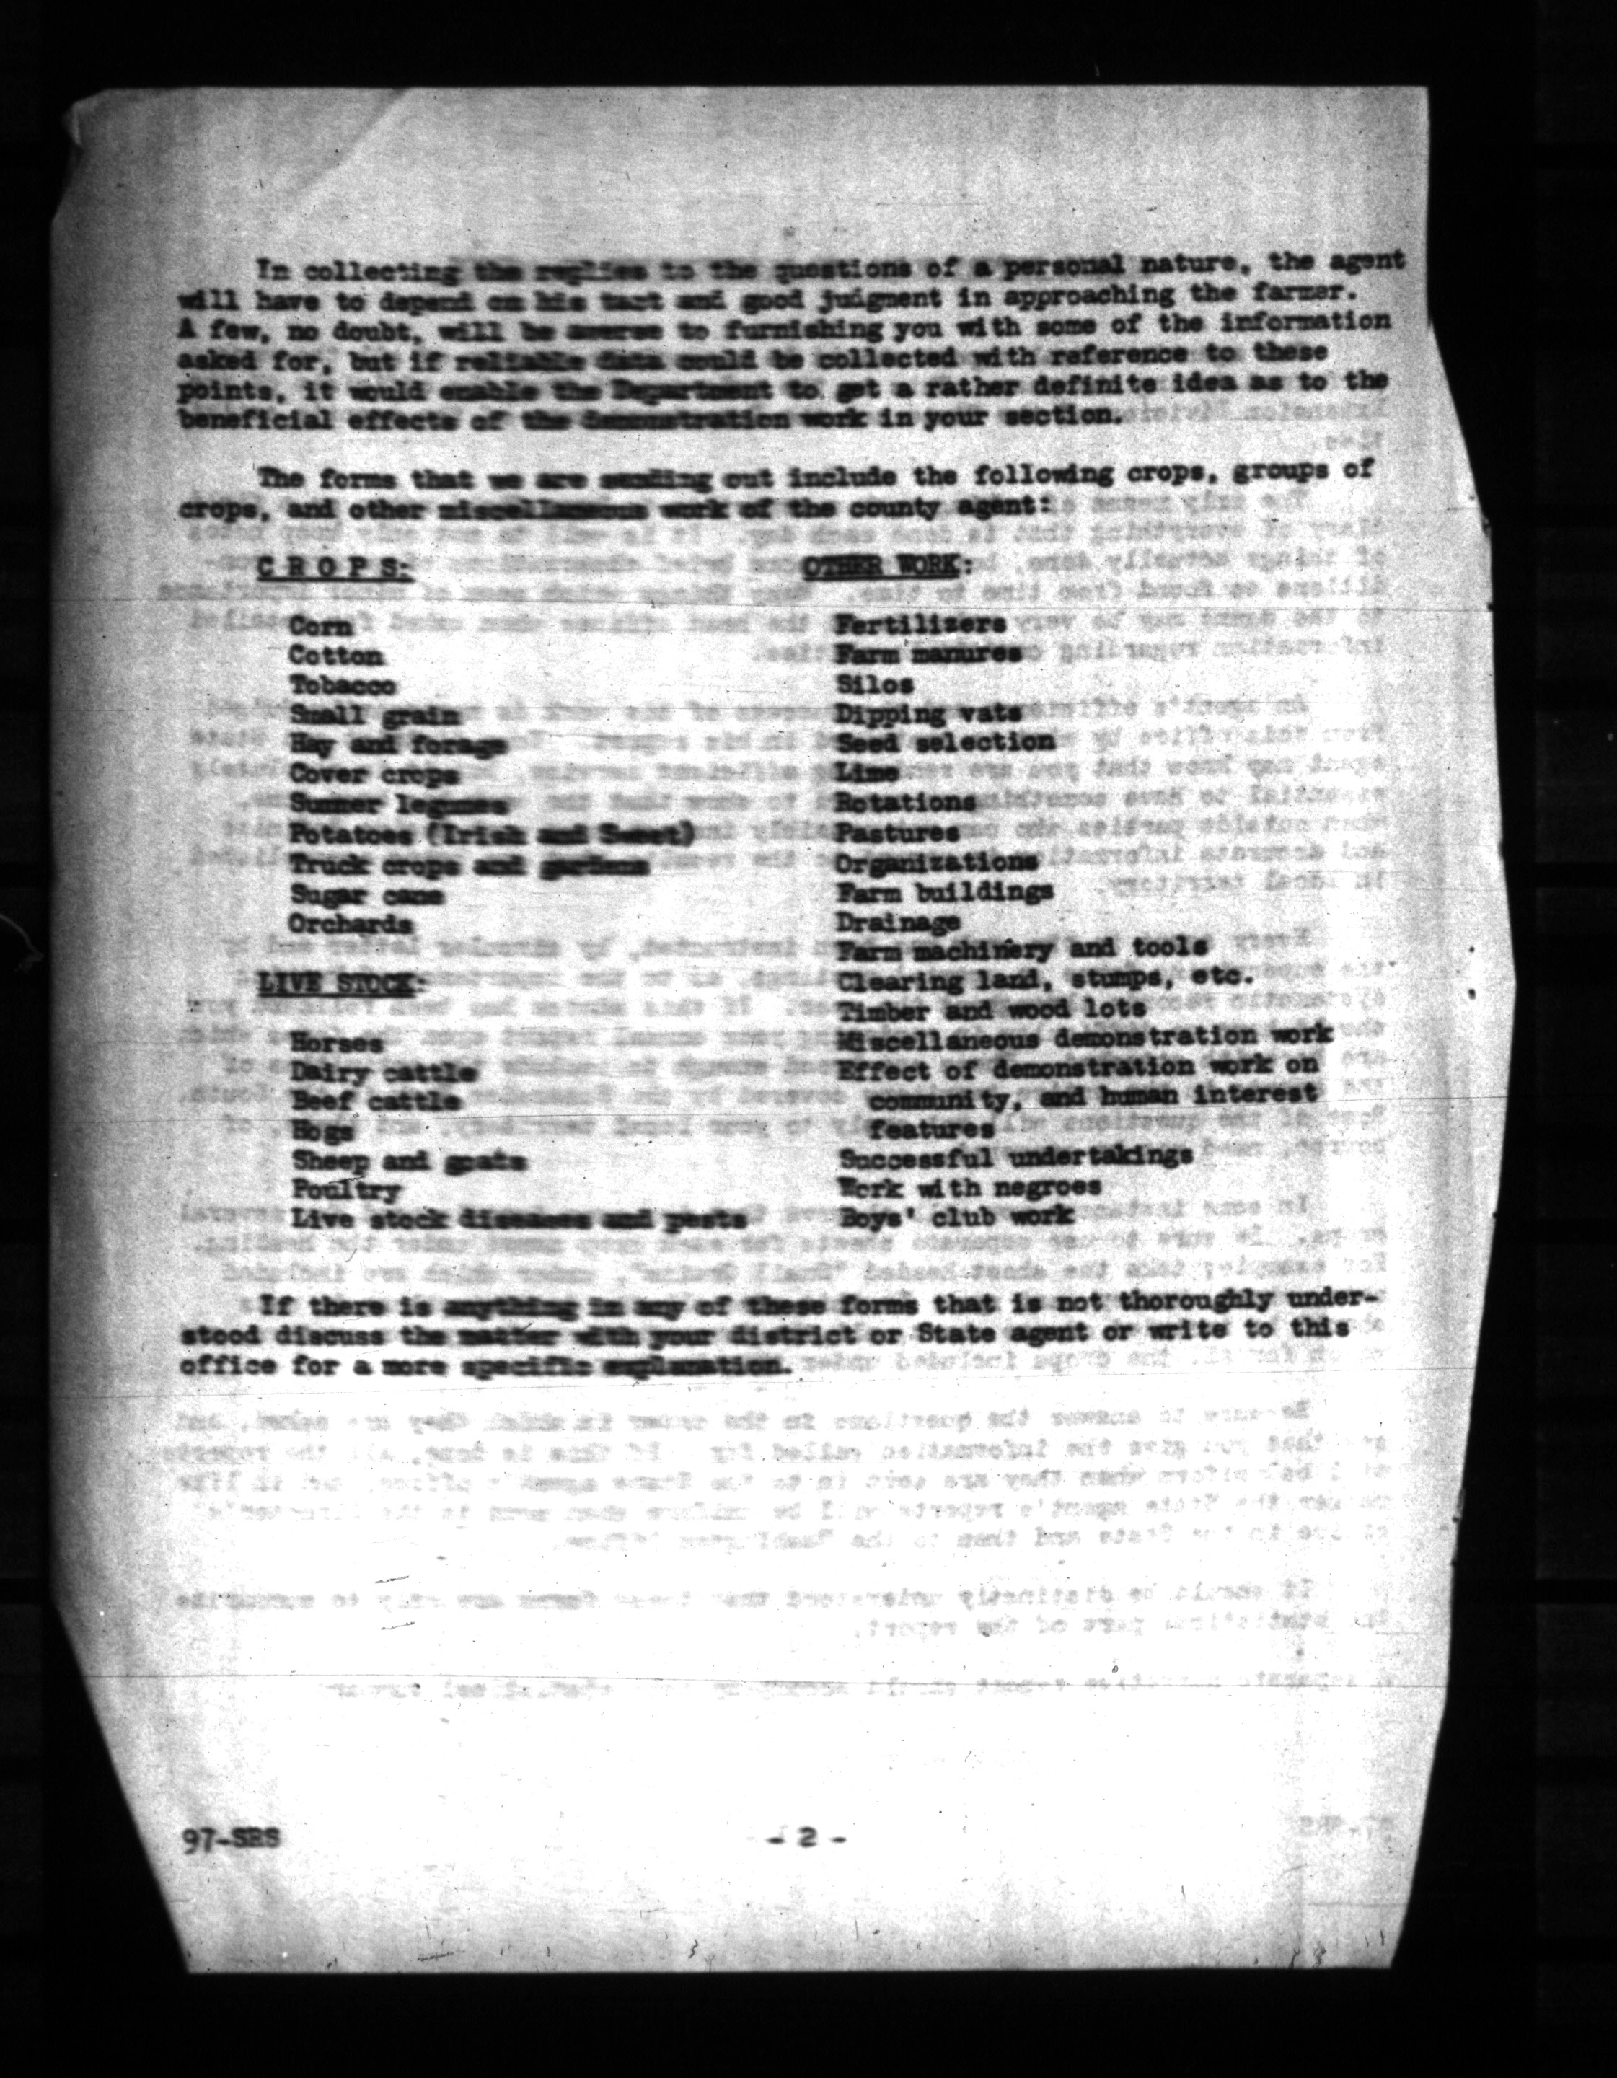
OCR doesn’t always pick everything up
vcest009014004
We just used the basic OCR feature in Adobe and for some pages, it was unable to detect some or any text.
vcest001037029
vcest009014015
Notes:
https://vtechworks.lib.vt.edu/home
Item level metadata available for each item in the collection. It will have it's own collection in the VCE community in VTechWorks.

Slide 22
Ransomware Attack
Totally normal challenge.
Early in the project, the library was part of the Kaseya ransomware attack and everything we had finished to that point was corrupted.
We were able to get all the images back but we lost some of our technical metadata.

Slide 23
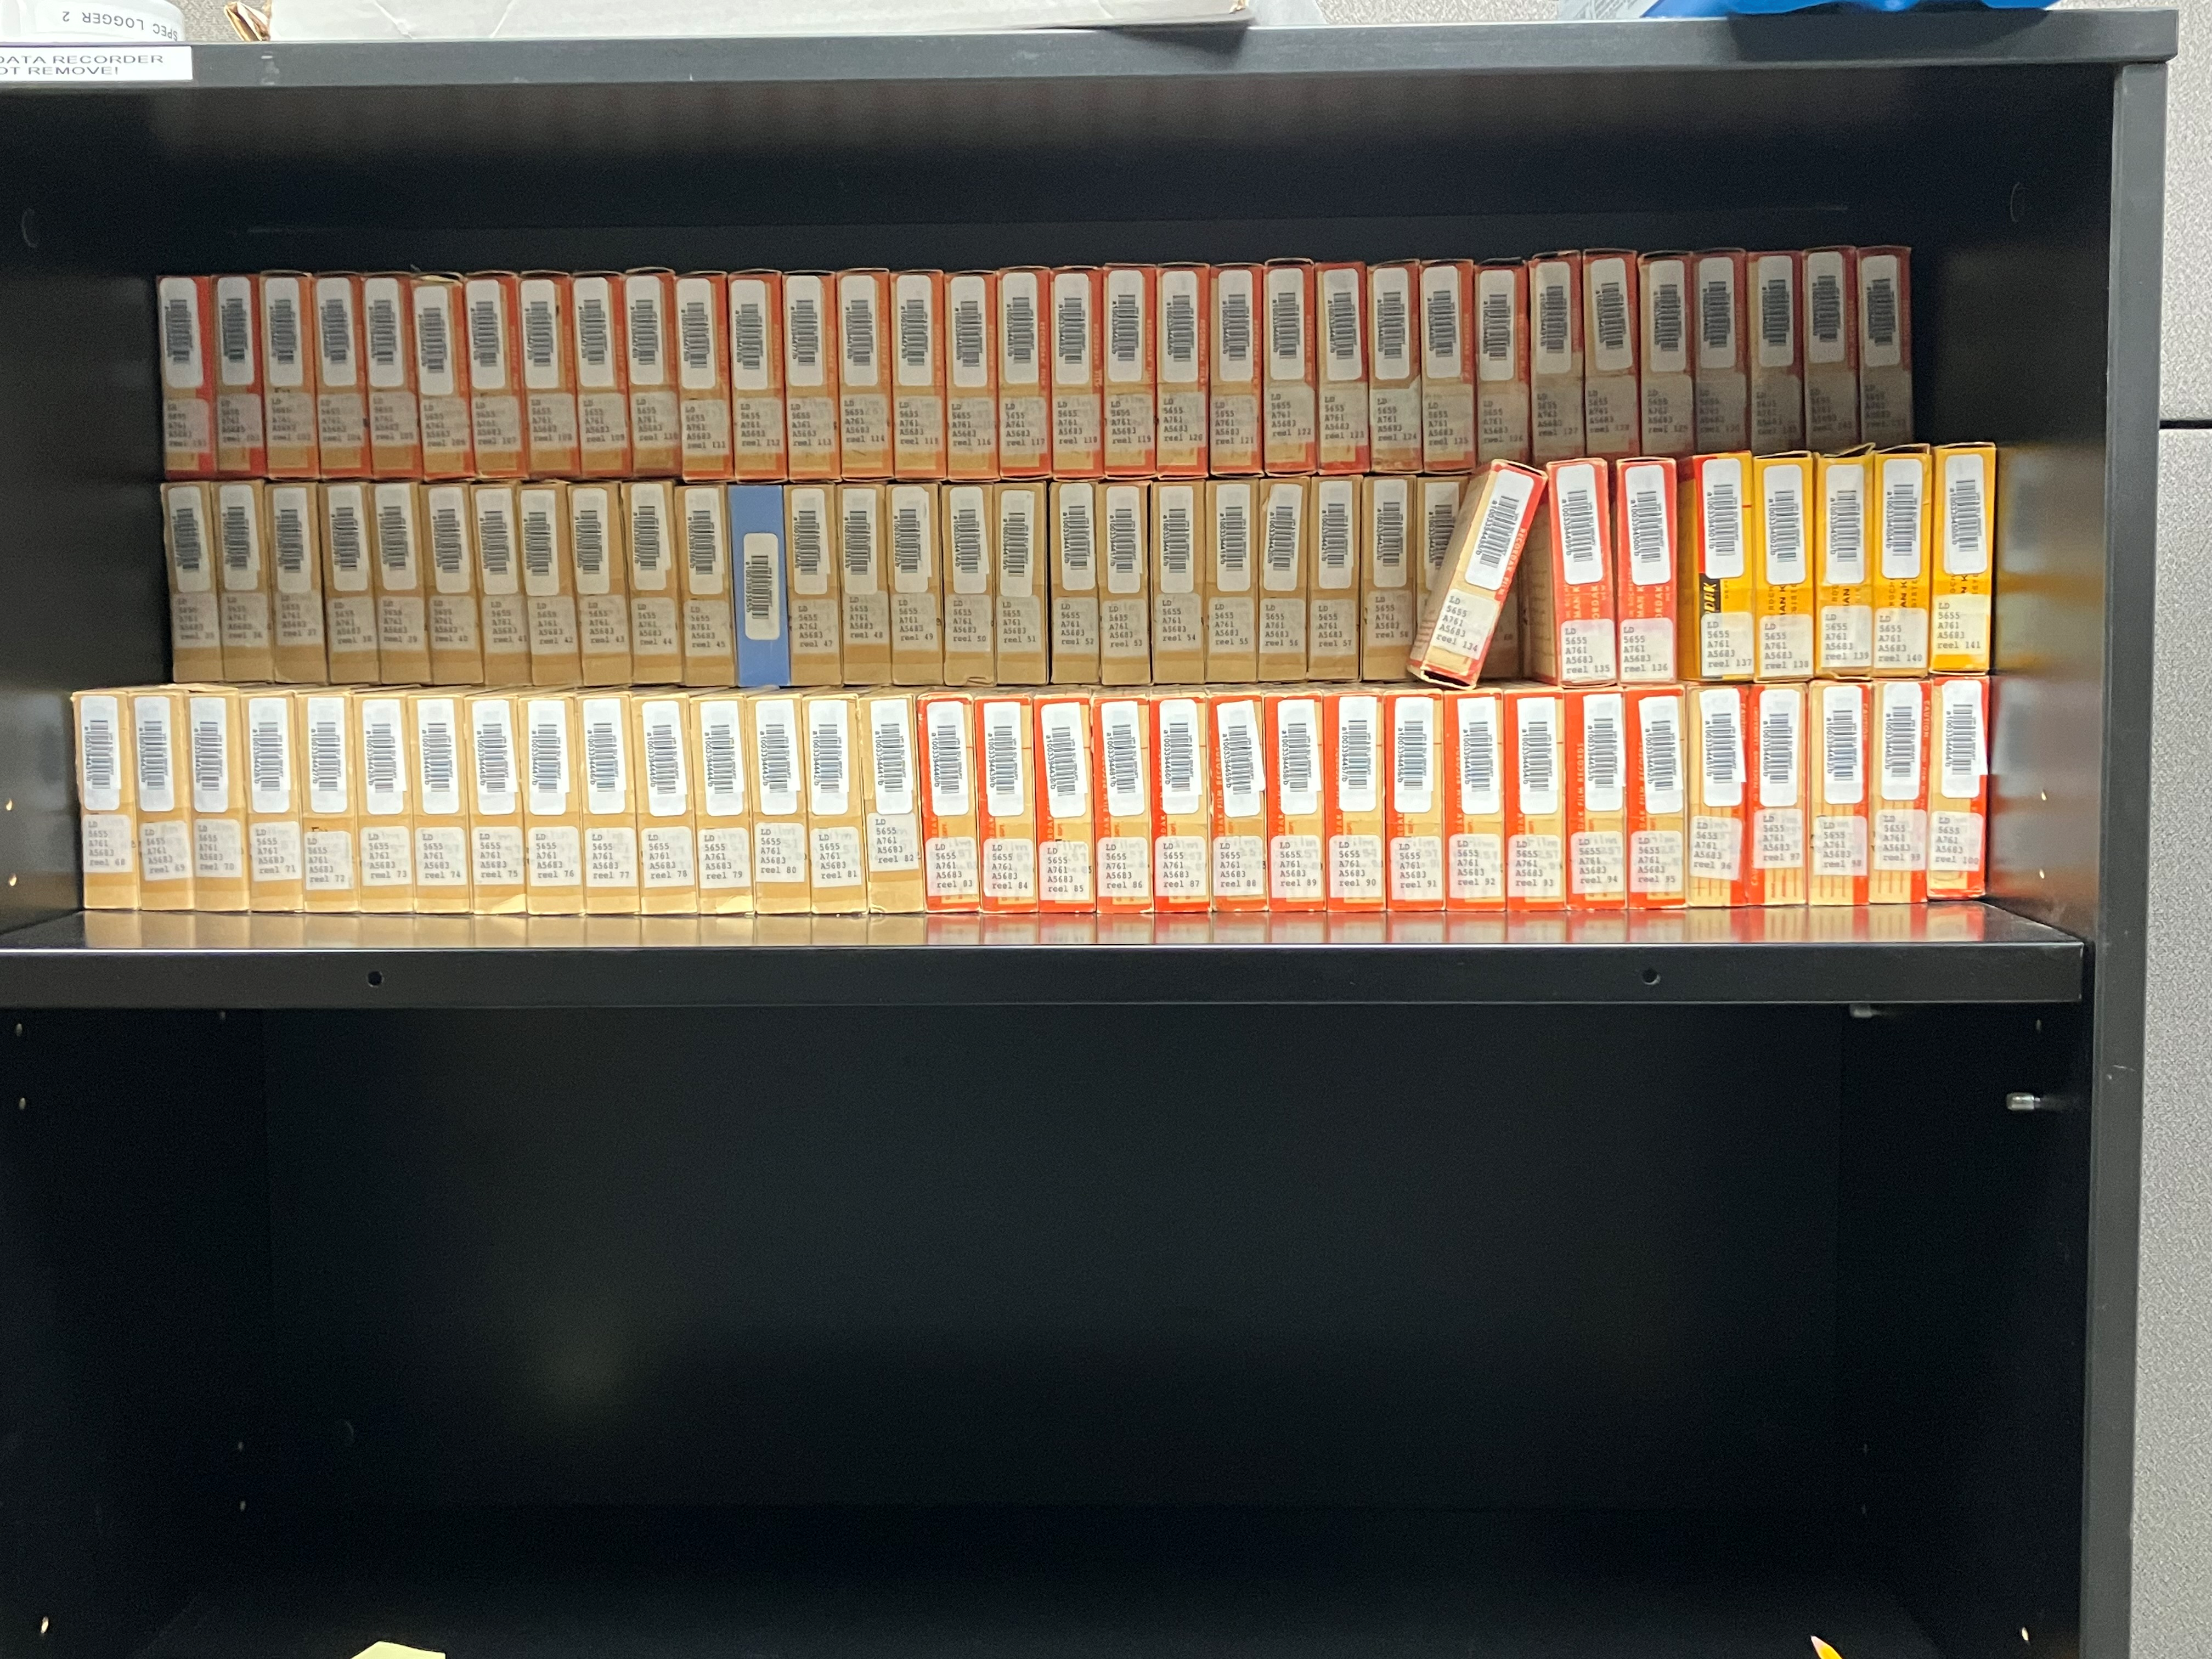
Julia – juliags@vt.edu
Inga – ihaugen@vt.eu
Meagan – rmeagan9@vt.edu
Questions?

