Slide 1
17 Moments in Soviet History
Karan Bhatia, Zak Edwards, Matthew Layser, Austin Moore
CS 4624 - Dr. Edward Fox
Virginia Polytechnic Institute and State University
Blacksburg, VA 24060
Clients:
James von Geldern (vongeldern@malacester.edu)
Amy Nelson (anelson@vt.edu)

Slide 2
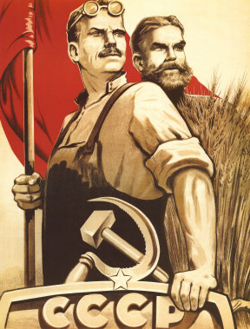
What is the Website?
Soviet Era website as a teaching tool
Archive of documents
  Videos
  Images
  Primary source documents
Notes:
Hired group of indians
remade the site we use now until problems occured
no supprot and lost them with security flaws
they worked for about a year
hacked on january 15th
emails, personal information, usernames and passwords (password big problem between many websites)
created on H-net network at MSU. Used by any teachers, students, or enthusiasts.
Matrix, the Center for Digital Humanities and Social Sciences at Michigan State University,
once security problems, they were forced offline of the host to prevent further infiltration of H-Net.
H-Net is an international interdisciplinary organization of scholars and teachers dedicated to developing the enormous educational potential of the Internet and the World Wide Web.
Humanities and Social sciences online

Slide 3
Our work
Fixed Security Flaws
  SQL queries sanitized
Fixing General Issues
  Clean up code
Fixing Database Issues
  Connectivity problems
Added Subtitles to Videos

Slide 4
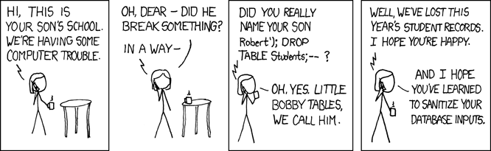
Testing
Extensive Attack Testing
Asked a Server Administrator to Test
Notes:
Asked Dennis Boone to test the website for other things (we did our own testing as well)

Slide 5
Lessons Learned
Support is important
  Have a plan for maintaining code
Use open-source/common frameworks
Modular code results in easier debugging
Hire qualified and trustworthy personnel for web development

Slide 6
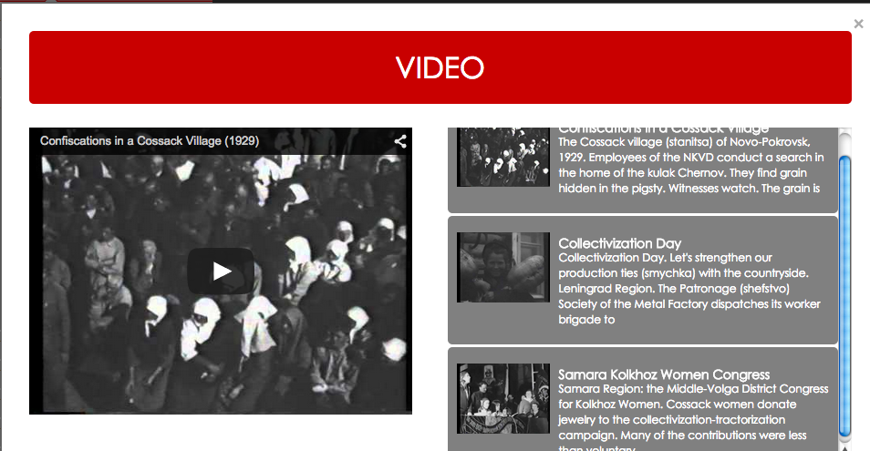
Screenshot

Slide 7
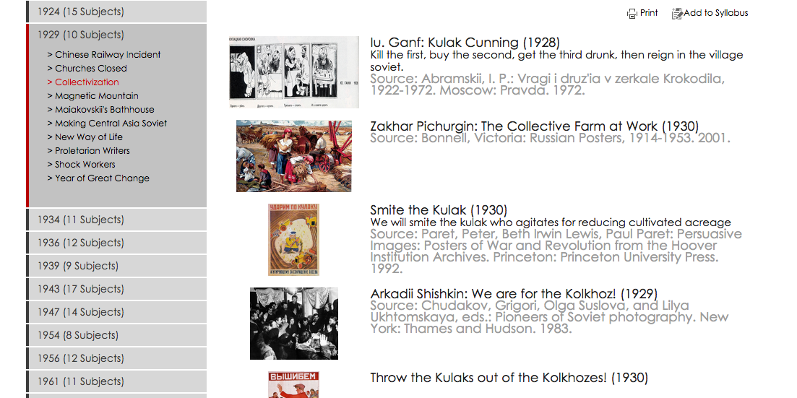
Screenshot

Slide 8
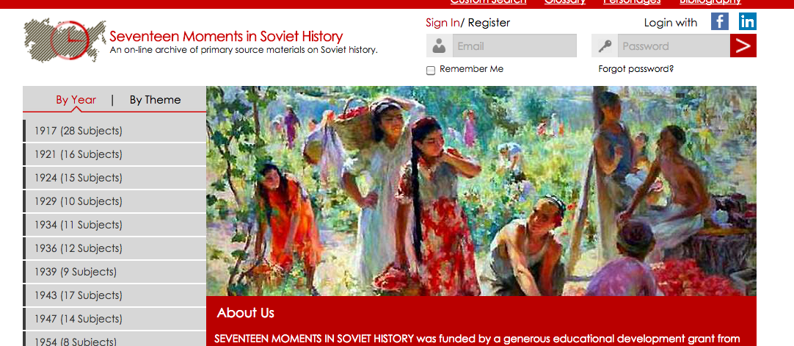
Screenshot

Slide 9
Acknowledgments
Dr. Edward Fox
Dr. Amy Nelson
Dr. James von Geldern
Dr. Lewis Siegelbaum
Dr. Kristen Edwards
Mr. Dennis Boone

