Slide 1

Analytical Unsteady aerodynamics model of a Horizontal axis wind turbines due to linear change in wind speed
By:
Mohamed Hammam
PhD Candidate, University of Calgary, Canada
Supervisor: Dr David Wood
University of Calgary, Canada
Co-Supervisor: Dr Curran Crawford
University of Victoria, Canada

Slide 2
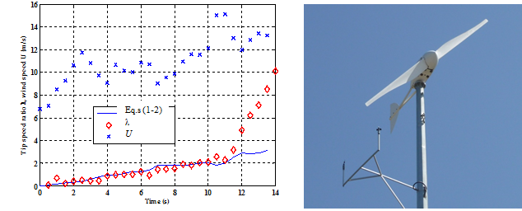
Small wind turbines work under unsteady conditions
Fig.1 University of Newcastle Australia 5 kW wind turbine, D= 5m

Slide 3
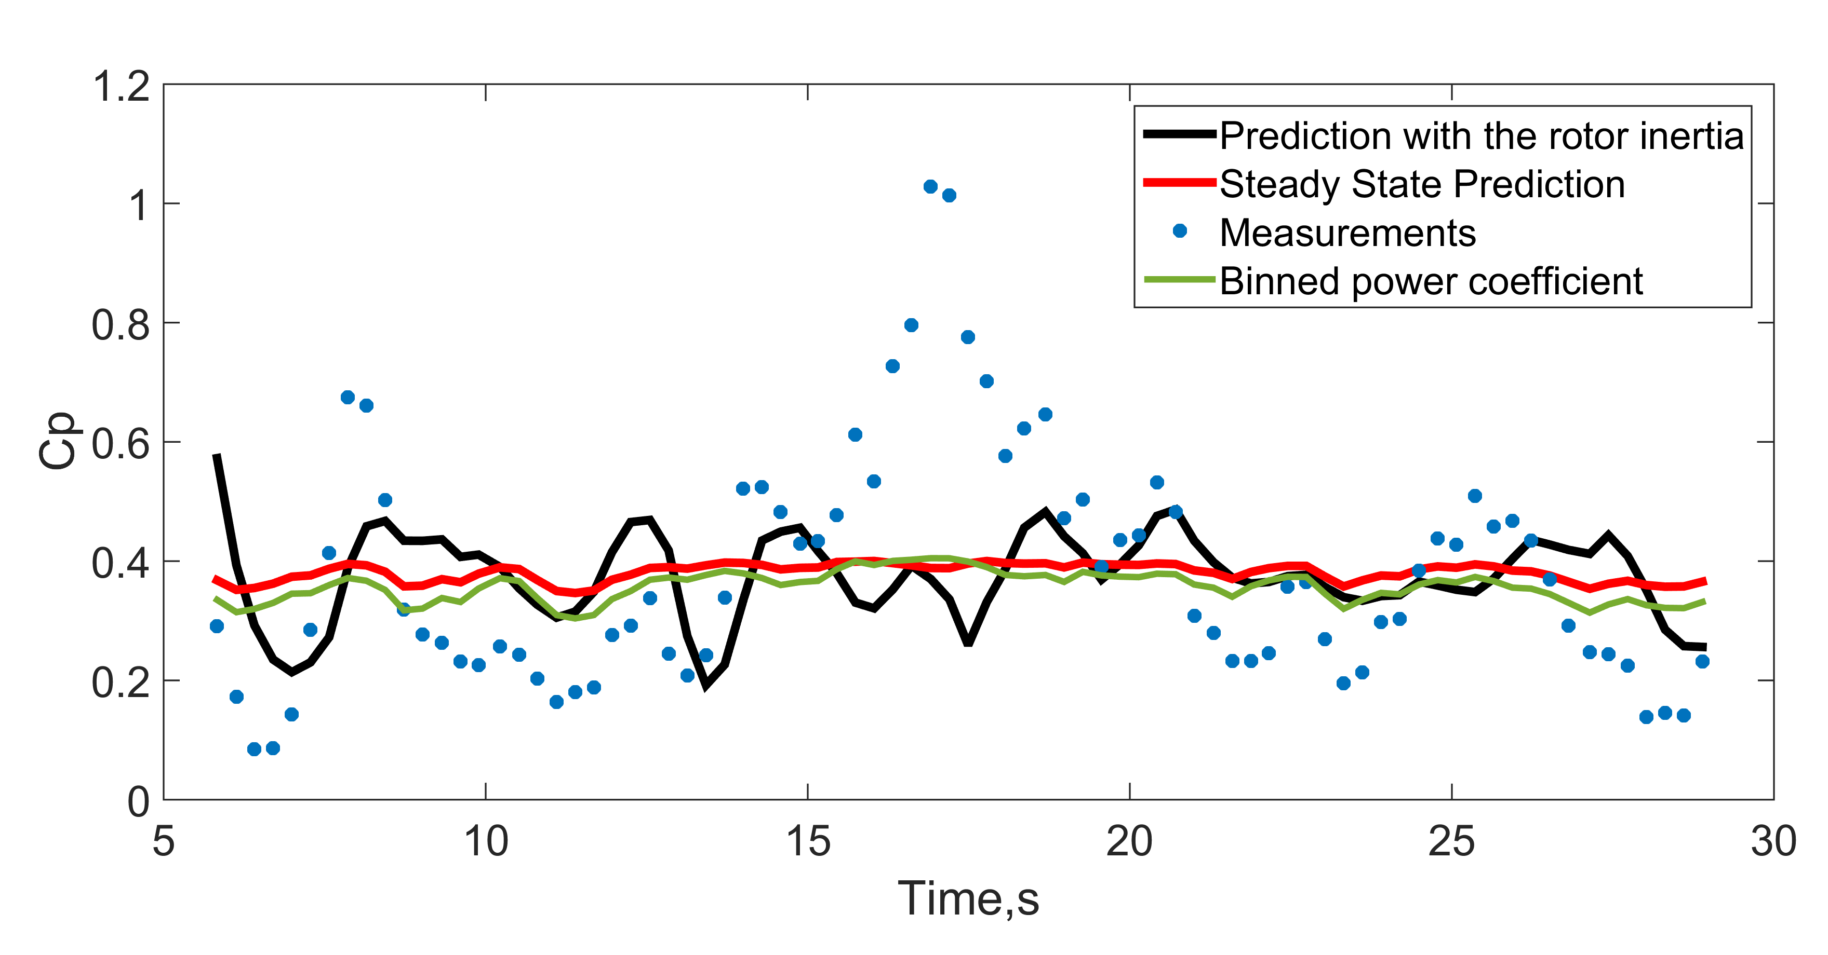
The instantaneous power coefficient of small wind turbines can exceed the steady BETZ limit.
Fig.2 Measured electrical Power coefficient and the averaged “binned” rotor power coefficient of the wind turbine.

Slide 4
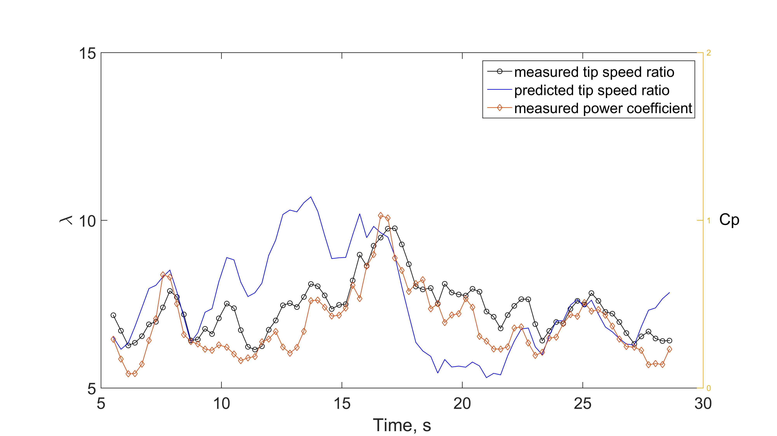

The power coefficient correlates with the tip speed ratio
$J\frac{dΩ}{dt}$=$Q_{a}$-$Q_{g}$
Fig.3 Measured and predicted tip speed ratio and measured power coefficient .

Slide 5
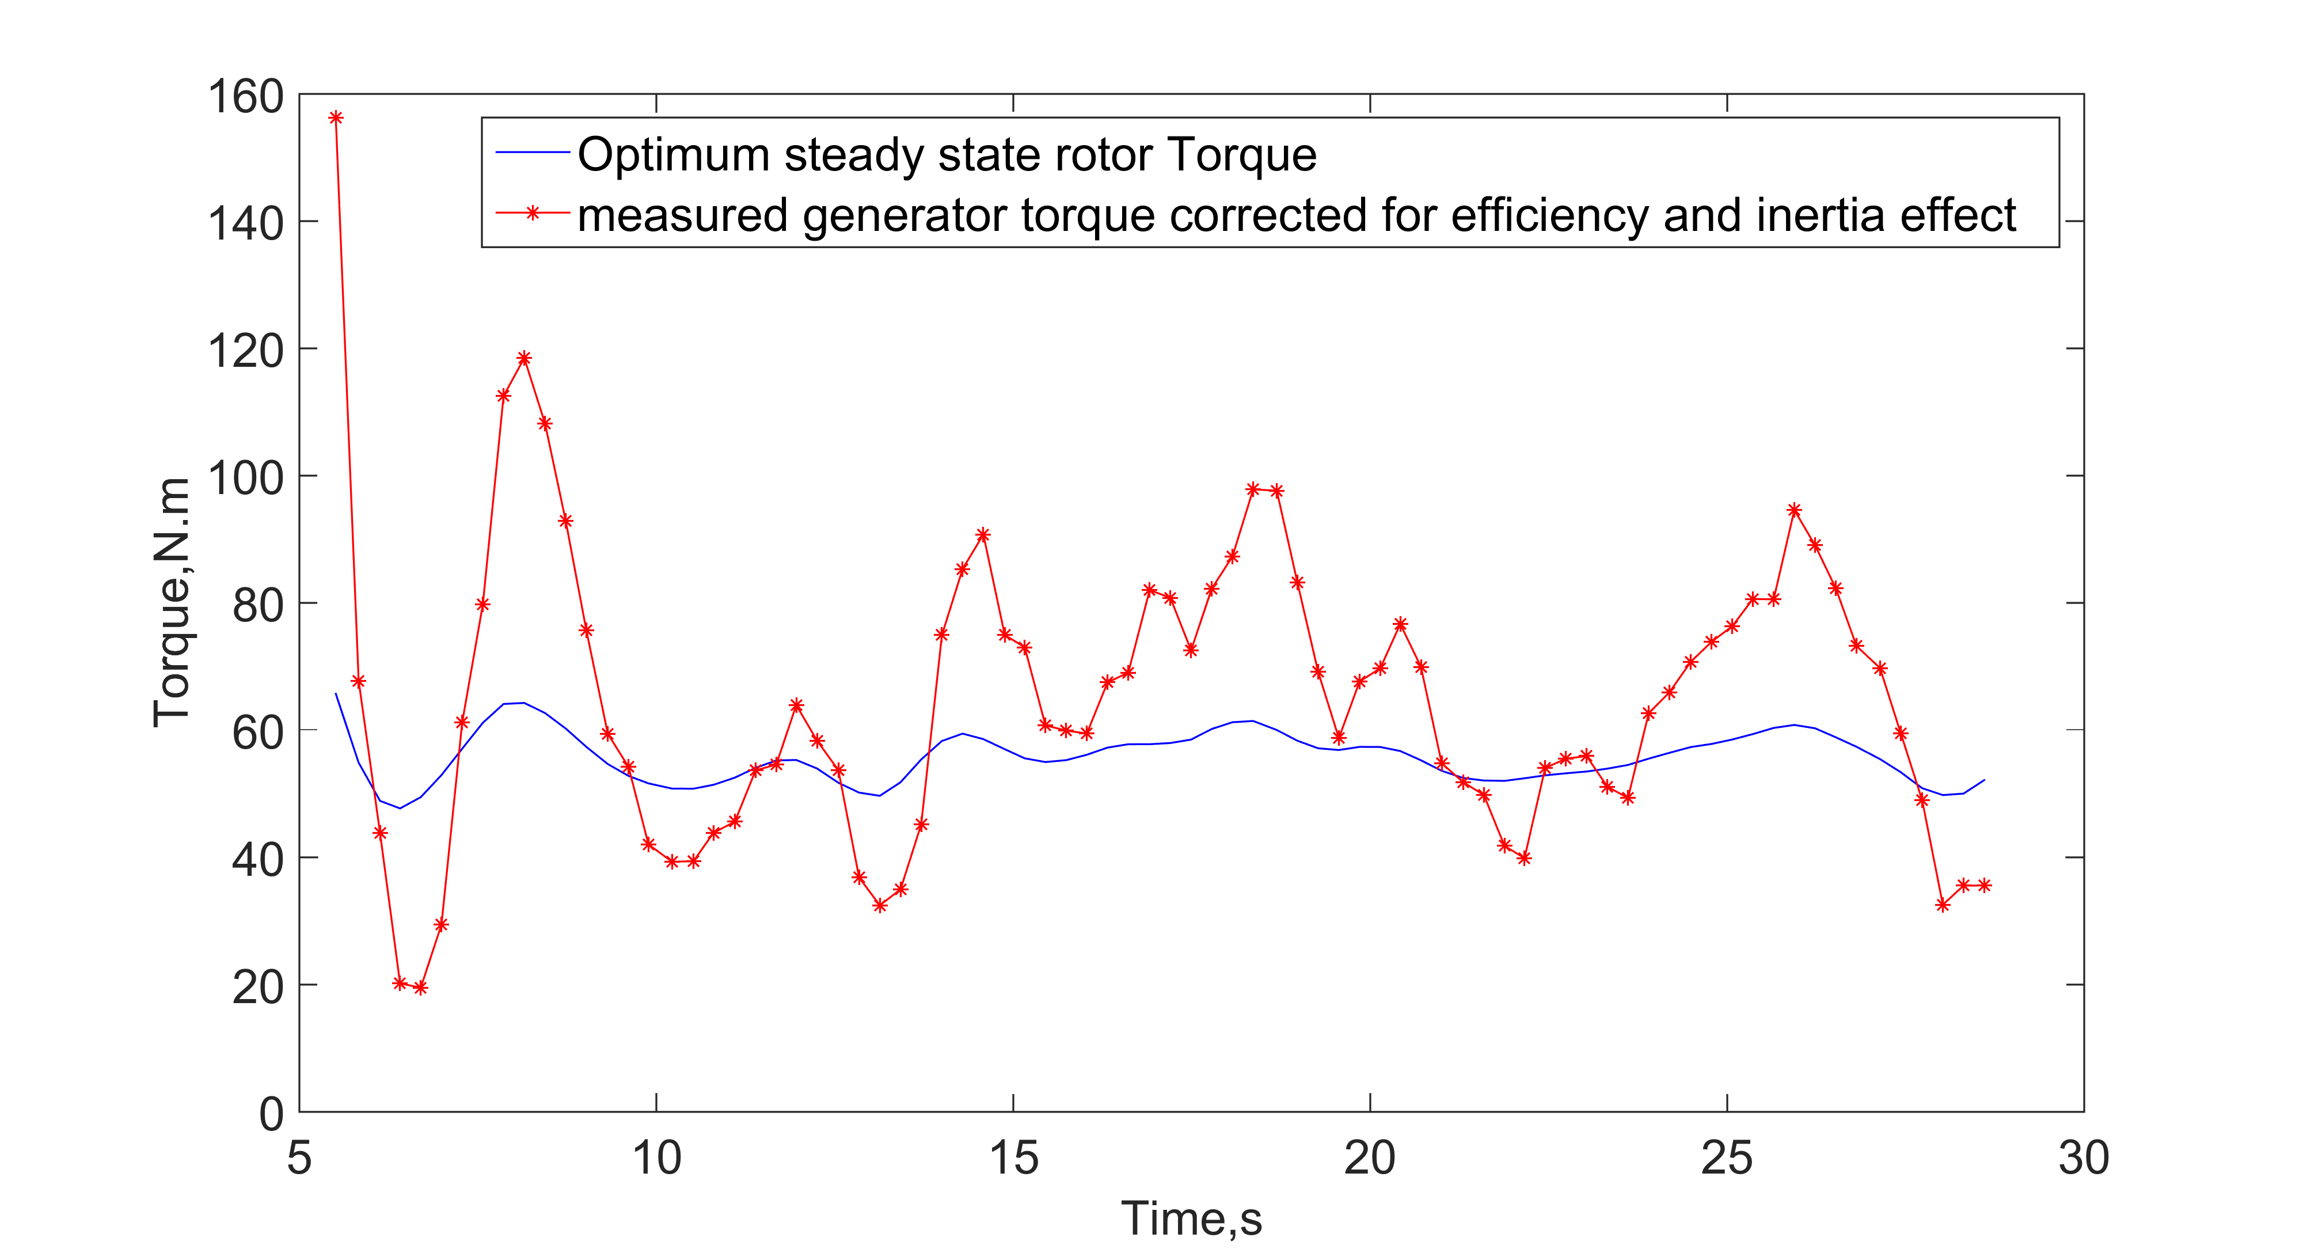


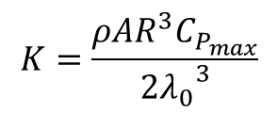
Optimum steady state control deviates from the actual torque
$$Q_{g}=KΩ^{2}$$
$$K=\frac{ρAR^{3}C_{P_{max}}}{2{λ_{0}}^{3}}$$
$C_{P_{max}}$= 0.4 & $λ_{0}$=8
Fig.4 Measured rotor torque and the steady optimum torque.

Slide 6
Steady Control doesn’t track the unsteady turbine torque
Power coefficient of small wind turbines can exceed the steady Betz limit.
The unsteady power coefficient correlates with the tip speed ratio .
The controller change the generator torque and consequently rotor rpm based on steady optimal conditions.
There is a large difference between actual turbine torque and the steady MPPT torque.
This shows the need for a simple and fast unsteady wind turbine model to be used with real time control.

Slide 7
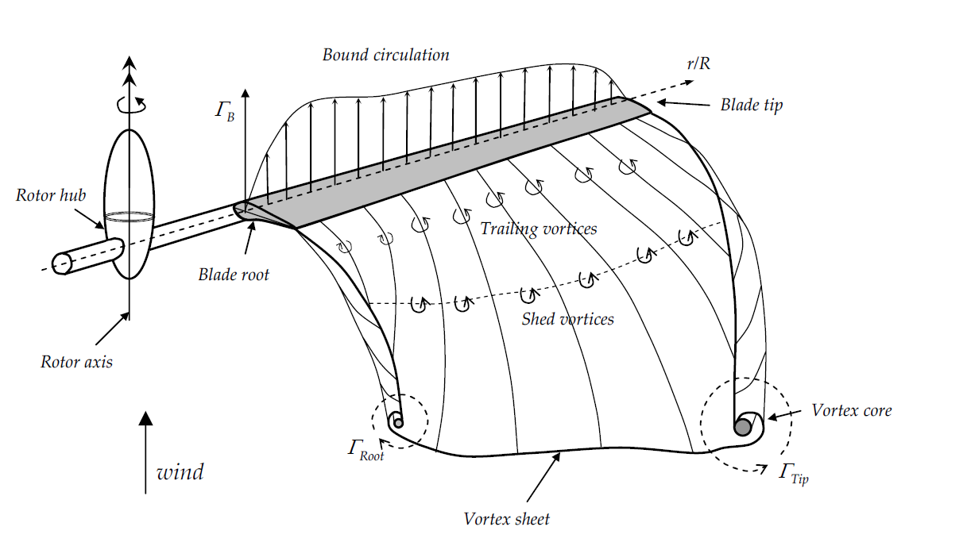
Two vortex systems are the main source of unsteady loading on wind turbines
Change in operating conditions change the strength of bound vorticity resulting in:
two vortex systems exist in the wake of wind turbines
Trailing
Shed
Fig.5a schematic of unsteady wind turbine vortices
Fig.5b Roll up of the vortex wakes
The effect of unsteady trailing vortex system is called dynamic inflow.
The effect of unsteady shed vortex system is called dynamic stall.

Slide 8
How the unsteady aerodynamics fit in BEM?
Unsteady Blade Element Method “UBEM”
$dCt=σ\left({\left(1−a\right)}^{2}{+\left(λ_{r}\right)}^{2}{\left(1+a′\right)}^{2}\right)\left(c_{l}cos∅+c_{d}sin∅\right)$ =4$a$($1$-$a$) - $τ\left[\frac{{\dot{U}}_{0}}{U_{0}}\text{−}\dot{a}\right]$
The dynamic inflow results from dynamic change in the induced velocity at the rotor.
The dynamic stall results from the lag of the lift and drag coefficients to the angle of attack change.

Slide 9
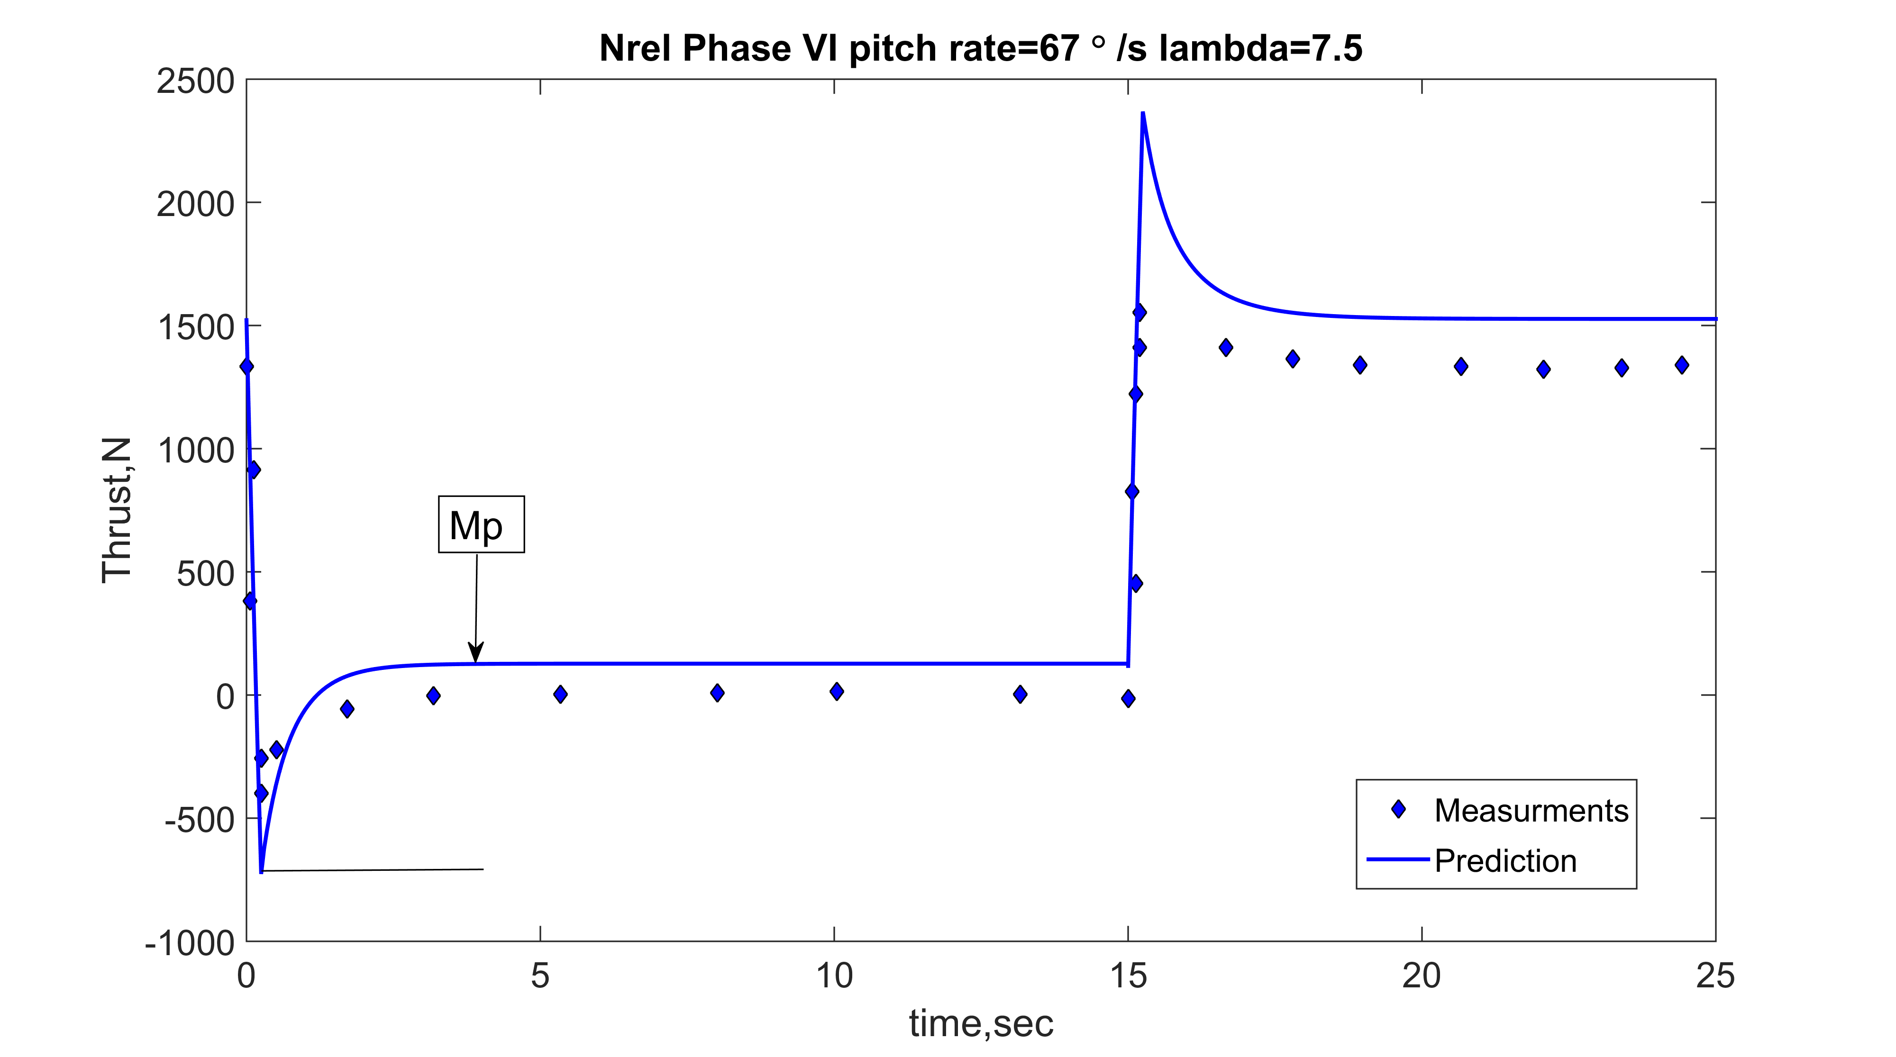
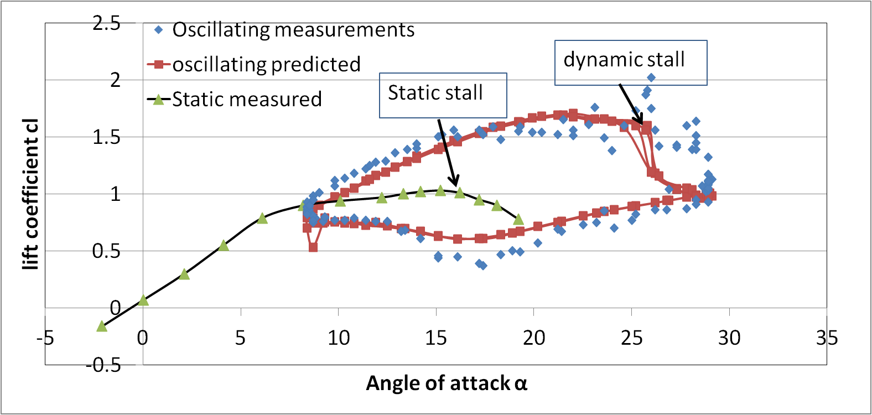

UBEM is used to predict the forces on NREL turbine due to a change in Pitch angle
Fig.6 Measured and predicted thrust force for a linear change in pitch angle due to dynamic inflow
Fig.7 Measured and predicted Lift coefficient of a pitching S809 airfoil Using Leishman-Beddoes dynamic stall model

Slide 10
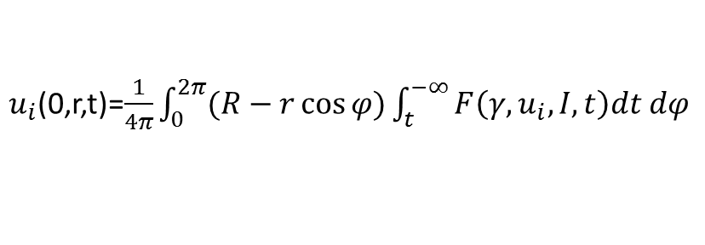

Existing dynamic inflow models have some shortcomings
ECN differential model:
$\frac{du_{i}}{dt}$= $4Rf(\frac{r}{R})\left[C_{t}U^{2}\text{−}\text{4}u_{i}\text{(}U\text{−}u_{i}\text{) }\right]$
ECN Integral model:
$u_{i}$(0,r,t)=$\frac{1}{4π}\int_{0}^{2π}{(R−r\cos{φ)\int_{t}^{−∞}{F\left(γ,u_{i},I,t\right)dt dφ}}}$
DTU semi-empirical model:

Slide 11

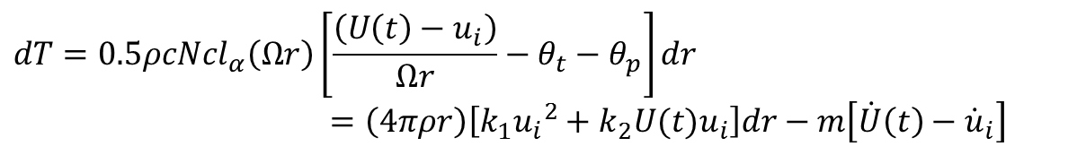
The UBEM has the form of Ricatti nonlinear differential equation due to dynamic inflow at high tip speed ratio
$$dT=0.5ρcN{cl}_{α}\left(Ωr\right)\left[\frac{\left(U\left(t\right)−u_{i}\right)}{Ωr}−θ_{t}−θ_{p}\right]dr$$
$=\left(4πρr\right)\left[k_{1}{u_{i}}^{2}+k_{2}{U(t)u}_{i}\right]dr−m\left[\dot{U}\left(t\right)−{\dot{u}}_{i}\right]$
$${\dot{u}}_{i}=α{u_{i}}^{2}+β\left(t\right)u_{i}+γ\left(t\right)$$
Assumptions:
1- High tip speed ratio operation
2- The angle of attack is small , drag is neglected and lift is linear in angle of attack

Slide 12
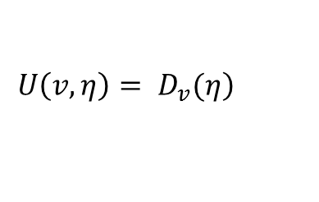
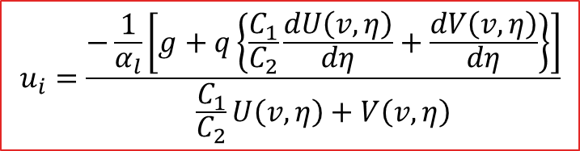

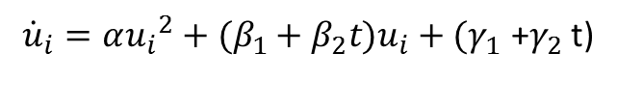
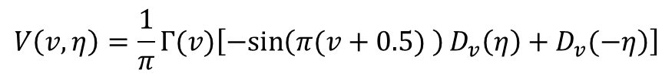
Riccati equation has analytical solution for a linear change in wind speed in the form of parabolic cylinder function
$$U\left(t\right)=a_{u}t+b_{u}$$
${\dot{u}}_{i}=α{u_{i}}^{2}+(β_{1}+β_{2}t)u_{i}+(γ_{1} \text{+}γ_{2}$t)
$$u_{i}=\frac{−\frac{1}{α_{l}}\left[g+q\left\{\frac{C_{1}}{C_{2}}\frac{dU\left(v,η\right)}{dη}+\frac{dV\left(v,η\right)}{dη}\right\}\right]}{\frac{C_{1}}{C_{2}}U\left(v,η\right)+V\left(v,η\right)}$$
$$V\left(v,η\right)=\frac{1}{π}Γ(v)\left[−\left.\sin\left(π(v+0.5) \right)D_{v}\left(η\right)+D_{v}(−η\right)\right]$$
$$\left.U\left(v,η\right)= D_{v}(η\right)$$

Slide 13
DUT Wind turbine Model is the only found controlled experiment for linear change in wind speed

Slide 14
Linear change in wind speed causes a very small over shoot
Tip speed ratio = 8 rpm =720 Re=1.5e5
Fig.7 Measured and predicted thrust force for a linear change in wind speed
Notes:
Angle of attack for the tip elements are less than 5°

Slide 15
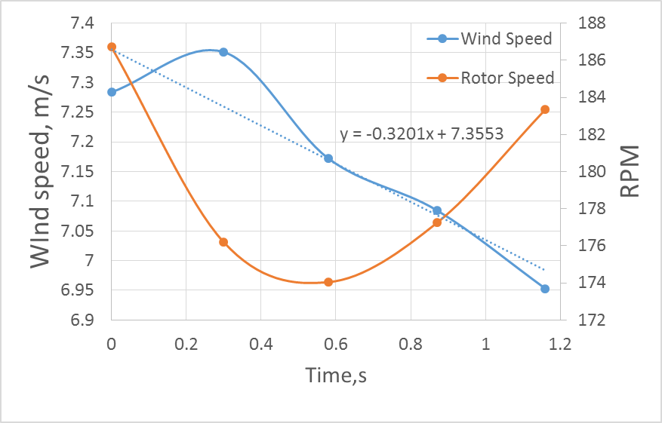
The wind series can be modeled as a sequence of linear wind velocity variation
Fig.8 Simulating the wind field as a small step of linear change.

Slide 16
The change in torque is more correlated with change in rpm
Newcastle 5 kW wind turbine
Fig.8 The measured and predicted torque for the conditions shown on the left.

Slide 17
Conclusion and Future work
A closed form solution of the UBEM has been obtained for a linear change in wind velocity at high tip speed ratio.
The model will be modified to include varying rpm.
The solution need to be extended for small tip speed ratio and high angle of attack to simulate the starting conditions of wind turbines.

Slide 18
Thank you

