Slide 1



Exploration of Conceptual Frameworks for University Engagement
Karen A. Vines
Department of Agricultural, Leadership, & Community Education
ESC - September 14, 2021

Slide 2

Consider implications of the Pruitt et al conceptual framework for University engagement within the context of an engaged model of program delivery for Cooperative Extension.
Where do they connect?
What is missing?
How does this fit your university setting?
Presentation Agenda
ESC Workshop Goal: Produce discussion that results in outcomes with actionable recommendations for practice.

Slide 3
Reviewing the frameworks-models

Slide 4


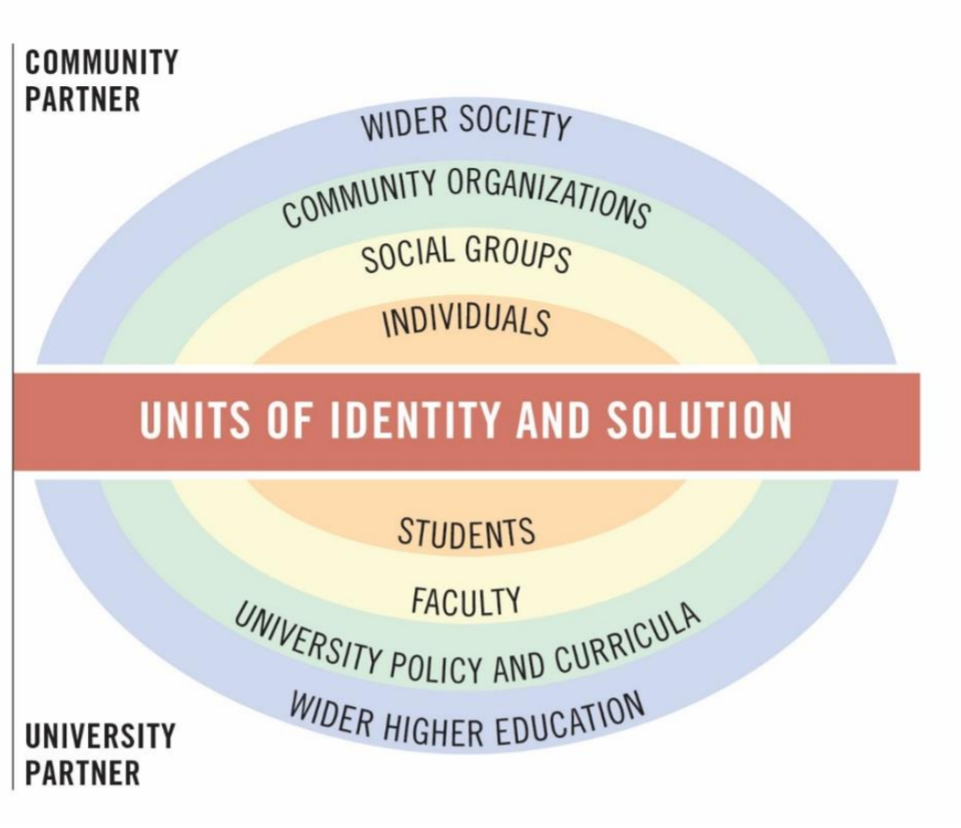

The 4 Rs
Reciprocity
Research
Give-Get Grid
Scholarship of Engagement
Gives | Gets
Relevance
Resilience
Double Rainbow Model
Relationships & Time
The 4 Rs –(Pruitt et al., 2019)
Notes:
Four Rs—relevance, reciprocity, research, and resilience

Slide 5
Relevance: Double Rainbow Model
Pruitt et al., 2019
Who are relevant stakeholders?
Notes:
Double Rainbow Model categorizes stakeholders and defines level of involvement through hierarchy. Emphasis on relevance, reciprocity, Use to identify relevant stakeholders.

Slide 6
Reciprocity: Give-Get Grid
PARTNER | GIVES | GETS
University | University Contributions | University Benefits
Community | Community Contributions | Community Benefits
Considered collectively in planning and outcome evaluation
Richards & Behringer, 1996
Notes:
Double Rainbow Model categorizes stakeholders and defines level of involvement through hierarchy. Emphasis on relevance, reciprocity,

Slide 7
Reciprocity
Research
Give-Get Grid
Scholarship of Engagement
Gives | Gets
Relevance
Resilience
Double Rainbow Model
Relationships & Time
The 4 Rs –(Pruitt et al., 2019)
Notes:
Four Rs—relevance, reciprocity, research, and resilience

Slide 8
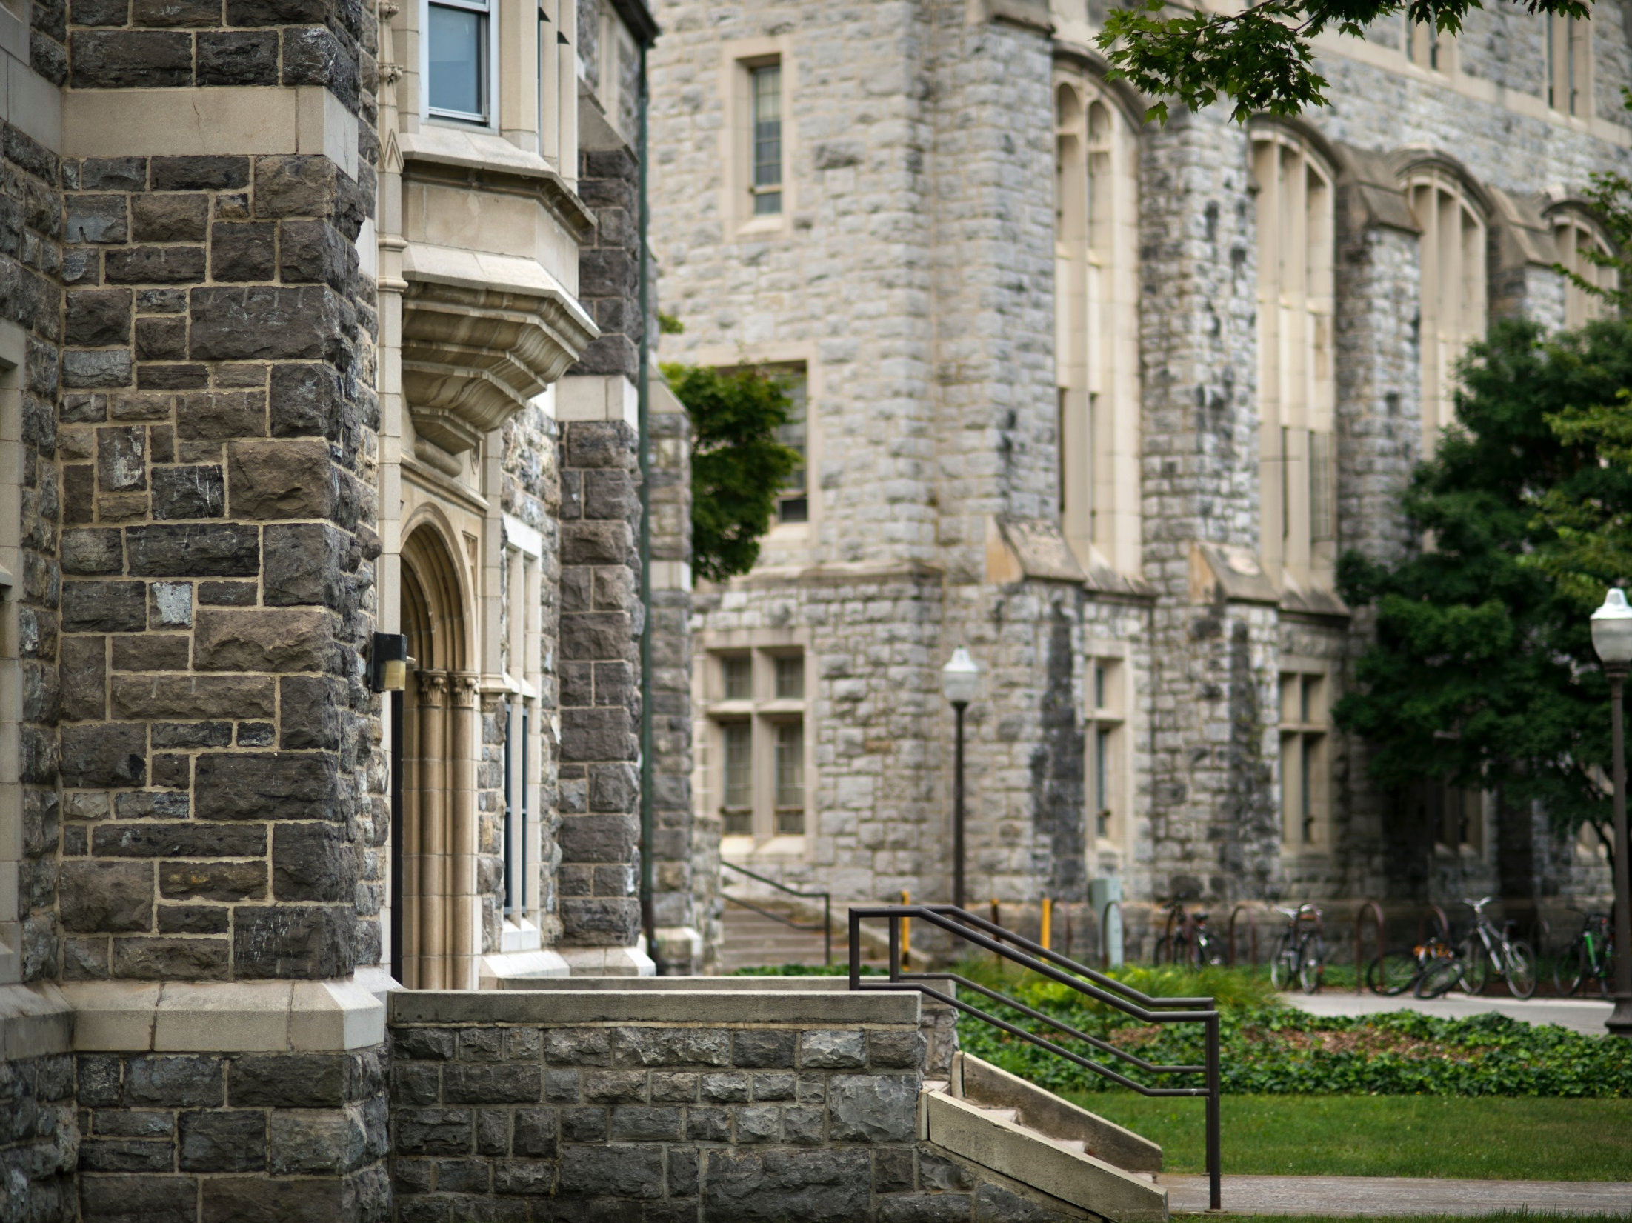
Conceptual Framework: An Engaged Model for Program Delivery by Cooperative Extension (Vines, 2018)
Educational Approaches
Theory of Change
Faculty Role in Society
Notes:
What is Cooperative Extension? Why is it important when talking about higher education engagement? Concept of engaged v. expert

Slide 9
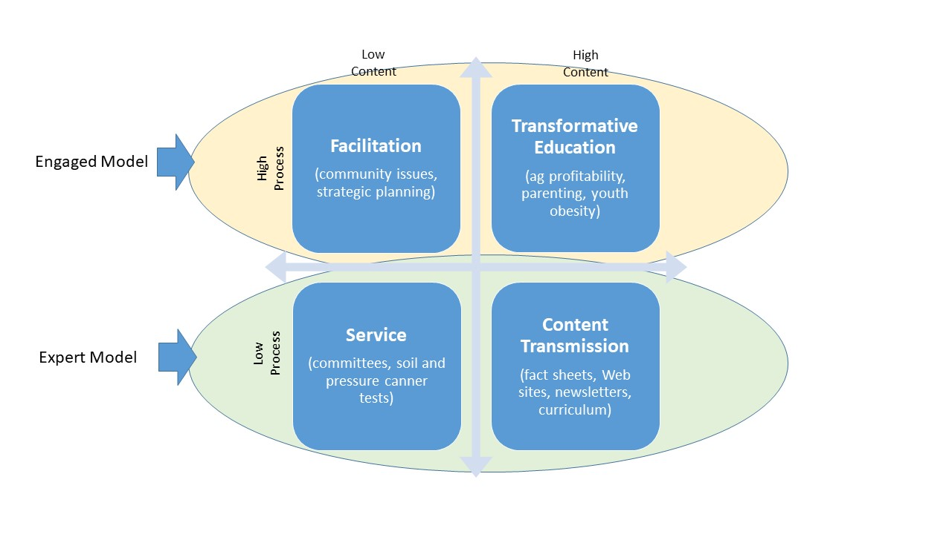
Educational Approaches (Process v. Content)
(Ewert’s approaches – adapted from Franz & Townson, 2008)
Notes:
Double Rainbow Model categorizes stakeholders and defines level of involvement through hierarchy. Emphasis on relevance, reciprocity, Use to identify relevant stakeholders.

Slide 10
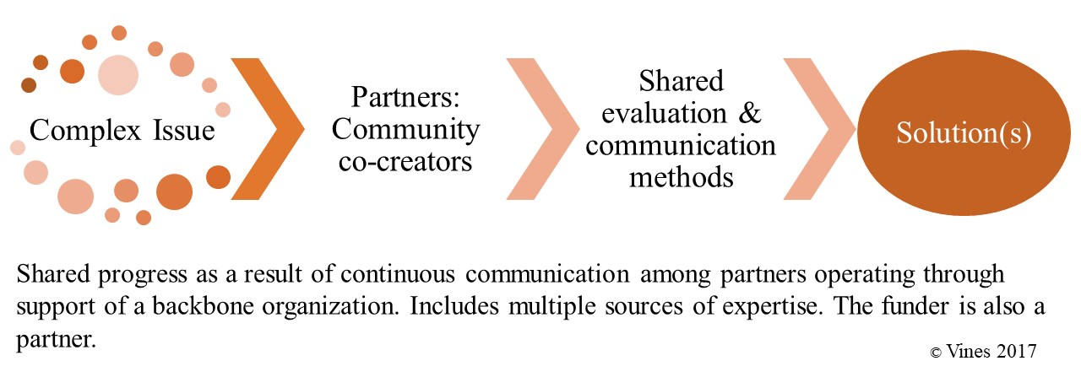
Theory of Change – Collective Impact
Conceptualization based on Kania & Kramer, 2011
Notes:
Double Rainbow Model categorizes stakeholders and defines level of involvement through hierarchy. Emphasis on relevance, reciprocity, Use to identify relevant stakeholders.

Slide 11
Values shared expertise
2-way communication between the institution and local citizens – identifying needs, developing, implementing, and evaluating programming to address those needs
Mutual benefits for community and university
Faculty Role in Society – Action Researcher, Public Scholar, & Educational Organizer
(Peters et al., 2010)
Notes:
What is Cooperative Extension? Why is it important when talking about higher education engagement? Concept of engaged v. expert

Slide 12
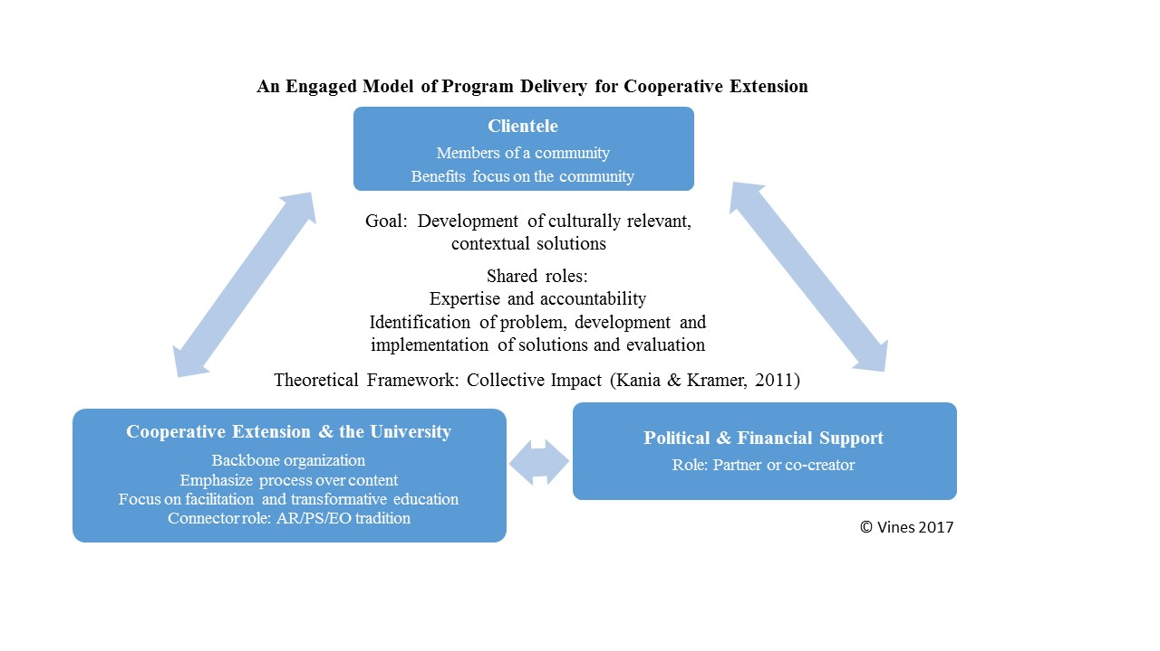
An Engaged Model of Program Delivery for Cooperative Extension
Notes:
Double Rainbow Model categorizes stakeholders and defines level of involvement through hierarchy. Emphasis on relevance, reciprocity, Use to identify relevant stakeholders.

Slide 13
Involve clientele in multiple aspects of programming that meets local needs
Emphasize shared expertise from partners including university, stakeholder organizations and individuals
Emphasis on continual interaction
Community defined by interest
Work may begin with expert model to raise community awareness, and transition to greater engagement
Emergent Hybrid Model – (Vines, 2018)
Notes:
What is Cooperative Extension? Why is it important when talking about higher education engagement? Concept of engaged v. expert

Slide 14

Comparing the Models

Slide 15
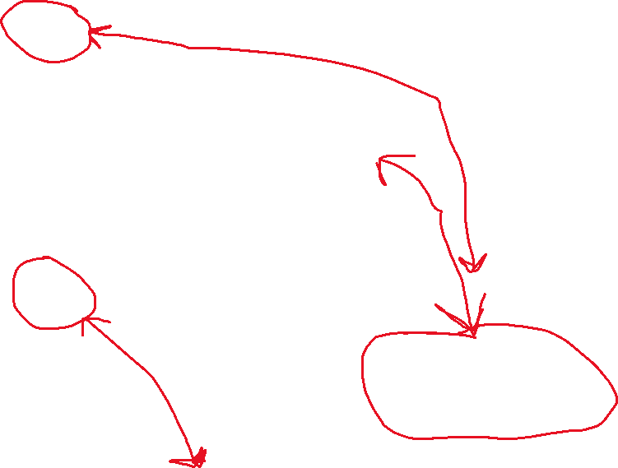
Where do the models connect – in terms of relevance?
Differences:
DRM: Categories & Hierarchy related to level of involvement
ENG: Theory of Change, Faculty Role, Educational Approaches, Emphasis on political & financial support

Slide 16
Where do the models connect – in terms of reciprocity?
Missing:
ENG: Reference to students – living classroom
Devalue University benefits
“Mutual benefits to all parties”
PARTNER | GIVES | GETS
University | Backbone, faculty role | Action research Political/Financial Capitol
Community | Facilitation, transformative education | Contextual solutions Political/Financial Capitol

Slide 17
Where do the models connect – in terms of resilience?
Relationships & Time: CE – Est. 1914
Trust based on long term, established local presence of university in community

Slide 18

Where do the models connect – in terms of research?
ENG: Greatest concern overemphasizing role of CE in CI as backbone organization & emphasizing process over content

Slide 19
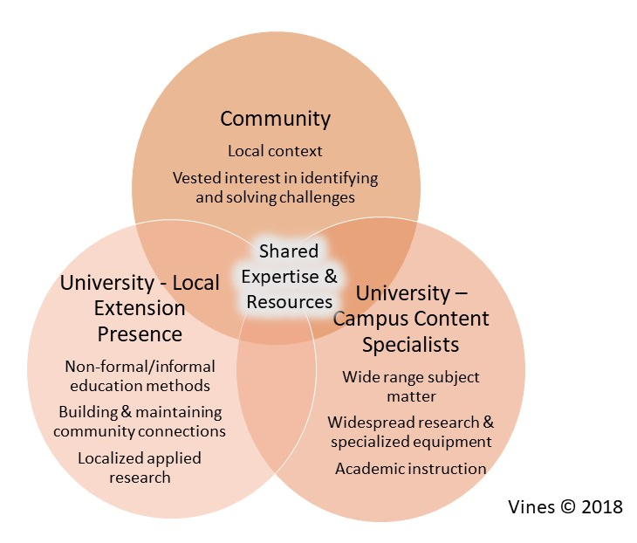
Shared Expertise
Recognize value in expertise as well as backbone
How do we carry these out in an attitude of mutual respect?
What is the hybrid model?

Slide 20
How does this fit in your university setting?

Slide 21
References:
Pruitt, S., McLean, J. E., & Susnara, D. M. (2019). Building a Conceptual Framework for Community-Engaged Scholarship. Paper presented at the 20th Annual Engagement Scholarship Consortium, Denver, CO. https://www.researchgate.net/publication/336241766_Building_a_Conceptual_Framework_for_Community-Engaged_Scholarship
Vines, K. A. (2018). Exploration of Engaged Practice in Cooperative Extension and Implications for Higher Education. Journal of Extension, 56(4). https://tigerprints.clemson.edu/joe/vol56/iss4/24/

Slide 22
Thank you!
kvines@vt.edu

