Slide 1
Clustering
CS5604 - Information Storage and Retrieval
Spring 2015
Virginia Tech
5/5/2015
Sujit Reddy Thumma
Rubasri Kalidas
Hanaa Torkey

Slide 2
Agenda
Project Description
System Design
Cluster Evaluation

Slide 3
Project Motivations
Problem 1: Query word could be ambiguous:
    Eg: Solr query “Star” retrieves documents about astronomy, plants, animals etc.
  Solution:
    Clustering document responses to queries along lines of different topics.
Problem 2: Constructing of topic hierarchies and taxonomies
  Solution:
    Preliminary clustering of large samples of web documents.
Problem 3: Speeding up similarity search
  Solution:
    Restrict the search for documents similar to a query to most representative cluster(s).

Slide 4
Project Overview
Data Preparation:
  Converting Avro data files to sequence files with key as document ID and value as cleaned text.
Data Clustering:
  Flat clustering of tweets and webpages collections
  Hierarchical clustering of tweets and webpage collections
Cluster Labeling:
  Labeling the output of the clusters using the top terms in the clustering result.
Analysis of Output:
  Statistics and evaluation for the clustering result

Slide 5
Workflow
AVRO=> sequence file
Input tweets
Input Webpages
Divide input based on results
K-means clustering
Label extraction
Load data into HDFS
Hierarchical clustering
Merge results from previous stage

Slide 6
Clustering Process
Cluster the document using K-Means algorithm based on:​
  Similarity measure: cosine similarity.
Clustering: ​
  Randomly choose k instances as seeds, one per cluster.​
  Form initial clusters based on these seeds.​
  Iterate, repeatedly reallocating instances to different clusters to improve the overall clustering.​
  Stop when clustering converges, no change in clusters.​

Slide 7
System Design
JAVA/Python
Evaluation
TWEETS / WEBAPGES
DATA EXTRACTION
JAVA/Python
KMEANS CLUSTERING
LABEL EXTRACTION
MAHOUT
HIERARCHICAL
CLUSTERING
MERGE RESULTS
LOAD DATA IN
HBASE
MAHOUT
JAVA/Python

Slide 8
Mahout K-Means Clustering
$MAHOUT clusterdump \
-i `hadoop fs -ls -d ${OUTPUT_DIR}/output-kmeans/clusters-*-final | awk '{print $8}'` \
-o ${OUTPUT_DIR}/output-kmeans/clusterdump \
-d ${OUTPUT_DIR}/output-seqdir-sparse-kmeans/dictionary.file-0 \
-dt sequencefile \
Typical output example:
Cluster 1: Top Terms: ebola => 0.07152884460426318 rt =>0.058896787550590086 outbreak =>0.021403831817739378 viru =>0.014907624119456567 africa =>0.013911333665597606 patient =>0.012710181097074835 liberia =>0.012436799376831979 health => 0.01211349267884965 spread =>0.011954053181191696 fight =>0.011414421218770166 | Cluster 2: Top Terms: drug => 0.16092978007424608 experim => 0.10931820179530365 make => 0.068495523952033 ebola => 0.05933505902257844 vaccin => 0.0446040908953977 rt =>0.038446578081122056 zmapp => 0.03291364296270642 trial => 0.03204720309608251 develo =>0.030003011526946913 monkei => 0.02626380297639355 | Cluster 3: Top Terms: death => 0.1090171554604992 kill => 0.08483980316278365 toll => 0.07380344646424317 ebola => 0.0630359353151828 dai => 0.06035789606747709 rt =>0.052361887019333926 peopl => 0.0515136862735416 break =>0.028802429266523474 africa =>0.024238362492392238 rise =>0.021512270038958534

Slide 9
Cluster Labeling
Labeling result for Boston bomb data set
1 2 3 4 5 6 7 8 9 10 | boston bomber bomb marathon suspect love stop rt know talk ass bomb feel rt made make sex food breakfast nap bomb rt da sound dick time drop af photo fuck gui hit follow bomb rt da diggiti love car meet get run bomb rt goofi jealou put trust listen wife dai bomb rt end happi ass birthdai on todai hope sai suspect set boston bomb airport rt break polic marathon lol come bomb rt ass shit know sound love make yogurt frozen sound greek bomb grape strawberri rn land rt amp bomb rt listen ass beauti cook commun goal pussi

Slide 10
Evaluation
Silhoutte Scores
Confusion Matrix
Human Judgement

Slide 11
Silhoutte
Goal: To measure intra-cluster similarity and inter-cluster dissimilarity
Silhoutte score is calculated based on following equation:
For each document:
  a = mean intra-cluster distance
  b = mean nearest-cluster distance
  Silhoutte Coefficient = (b - a) / max(a, b)
Silhoutte Score = mean of all coefficients of all documents in a collection
Score = +1 (Very Good), -1 (Very Bad), Anything > Zero (Good)

Slide 12
Silhoutte Scores for Webpages
Data Set | Silhoutte Score
classification_small_00000_v2 (plane_crash_S) | 0.0239099
classification_small_00001_v2 (plane_crash_S) | 0.296624
clustering_large_00000_v1 (diabetes_B) | 0.124263
clustering_large_00001_v1 (diabetes_B) | 0.0284772
clustering_small_00000_v2 (ebola_S) | 0.0407911
clustering_small_00001_v2 (ebola_S) | 0.0163434
hadoop_small_00000 (egypt_B) | 0.206282
hadoop_small_00001 (egypt_B) | 0.264068
ner_small_00000_v2 (storm_B) | 0.0237915
ner_small_00000_v2 (storm_B) | 0.219972
noise_large_00000_v1 (shooting_B) | 0.027601

Slide 13
Silhoutte Scores for Webpages (2)
Data Set | Silhoutte Scores
noise_large_00000_v1 (shooting_B) | 0.0505734
noise_large_00001_v1 (shooting_B) | 0.0329083
noise_small_00000_v2 (charlie_hebdo_S) | 0.0156003
social_00000_v2 (police) | 0.0139787
solr_large_00000_v1 (tunisia_B) | 0.467372
solr_large_00001_v1 (tunisia_B) | 0.0242648
solr_small_00000_v2 (election_S) | 0.0165125
solr_small_00001_v2 (election_S) | 0.0639537

Slide 14
Silhoutte Scores for Tweets (Small Collections)
Data Set | Silhoutte Score
charlie_hebdo_S | 0.0106168
ebola_S | 0.00891114
Jan.25_S | 0.112778
plane_crash_S | 0.0219601
winter_storm_S | 0.00836856
suicide_bomb_attack_S | 0.0492852
election_S | 0.00522204

Slide 15
Silhoutte Scores for Tweets (Big Collections)
 | Silhoutte Score
bomb_B | 0.0114236
diabetes_B | 0.014169
egypt_B | 0.0778305
Malaysia_Airlines_B | 0.0993336
shooting_B | 0.00939293
storm_B | 0.011786
tunisia_B | 0.0310645

Slide 16
Confusion Matrix
Data sets we have already are categorized into various clusters
  Small Collections
    Tweets related to ebola, elections, plane crash, etc.
  Big Collections
    Tweets related to diabetes, shooting, storm, etc.
We have identified and assumed such collections as a training set for clustering validation
  Used K-Means with various tunables
    Changing distance measure
    Iterations until convergence
    Feature Selection pruning out high frequency words
    Changed the analyzer to MailArchivesClusteringAnalyzer
    Random initialization of centroids

Slide 17
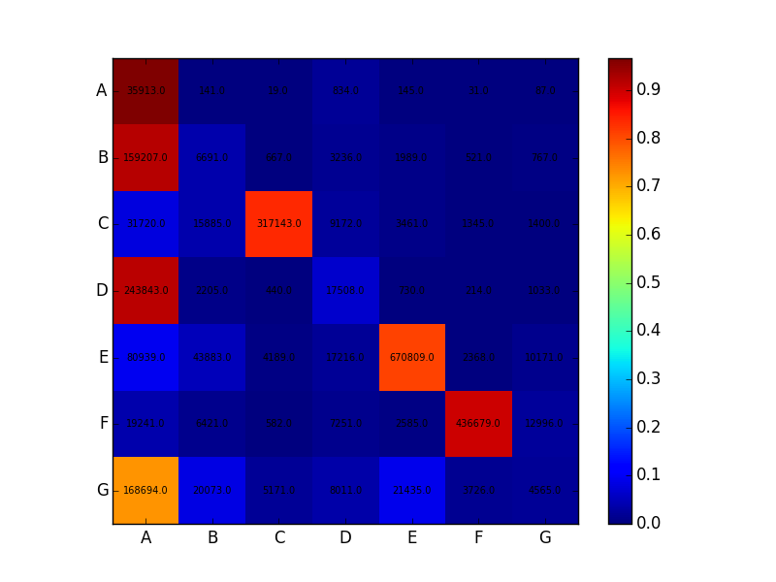
Confusion Matrix for Small Tweet Collection Concatenation (7)
A --> suicide_bomb_attack_S
B --> charlie_hebdo_S
C --> ebola_S
D --> plane_crash_S
E --> election_S
F --> winter_storm_S
G --> Jan.25_S

Slide 18
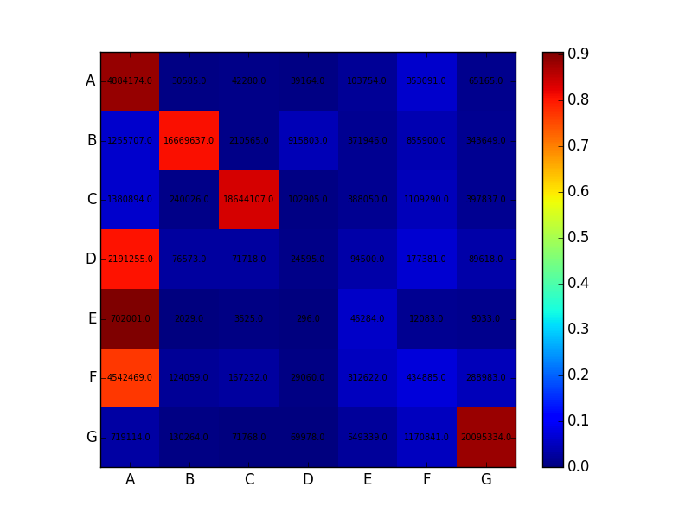
Confusion Matrix for Big Tweet Collection Concatenation (7)
A --> diabetes_B
B --> bomb_B
C --> storm_B
D --> tunisia_B
E --> Malaysia_Airlines_B
F --> egypt_B
G --> shooting_B

Slide 19
Silhoutte Scores for concatenated Data Sets
Data Set | Silhoutte Score
Small Tweet Collection | 0.0190188
Big Tweet Collection | 0.0166863

Slide 20
Clustering Statistics
Data Set | Dictionary Size | Sparsity Index | Clustering Time (K- means) (Minutes)
charlie_hebdo_S | 13452 | 99.8591179858 | 5.39
ebola_S | 25648 | 99.8957347915 | 6.37
Jan.25_S | 17639 | 99.9185522711 | 5.45
plane_crash_S | 16725 | 99.8628283162 | 5.82
winter_storm_S | 23717 | 99.8690672714 | 6.28
suicide_bomb_attack_S | 3748 | 99.7262108164 | 5.45
election_S | 59643 | 99.9231350261 | 6.93
Concat_S | 100548 | 99.9250943396 | NA

Slide 21
Clustering Statistics
Data Set | Dictionary Size | Sparsity Index | Clustering Time (K- means)
bomb_B | 508347 | 99.8591179858 | 14.68
diabetes_B | 224233 | 99.8957347915 | 15.32
egypt_B | 159347 | 99.9185522711 | 8.87
Malaysia_Airlines_B | 18498 | 99.8628283162 | 15.6
shooting_B | 600305 | 99.8690672714 | 16.6
storm_B | 516101 | 99.7262108164 | 16.22
tunisia_B | 175966 | 99.9231350261 | 7.34
Concat_B | 1559466 | 99.9460551033 | NA

Slide 22
Clustering Statistics
Data Set | Dictionary Size | Sparsity Index | Clustering Time (Minutes)
classification_small_00000_v2 | 3839 | 97.3941205733 | 5.1
classification_small_00001_v2 | 536 | 97.6227262127 | 5.1
clustering_large_00000_v1 | 11374 | 99.1809722871 | 5.3
clustering_large_00001_v1 | 15593 | 99.2333229766 | 5.2
clustering_small_00000_v2 | 385 | 97.9647495362 | 4.9
clustering_small_00001_v2 | 384 | 96.7801716442 | 5.1
hadoop_small_00000 | 4387 | 99.1756580464 | 5.4
hadoop_small_00001 | 4387 | 99.1756165435 | 5.1

Slide 23
Human Judgement
Ebola_S data set
# of Clusters: 5
Cluster 1: (related to deaths)
  Ebola kills fourth victim in Nigeria The death toll from the Ebola outbreak in Nigeria has risen to four whi
  RT Dont be victim 827 Ebola death toll rises to 826
  RT Ebola outbreak now believed to have infected 2127 people killed 1145 health officials say
  RT Two people in have died after drinking salt water which was rumoured to be protective against

Slide 24
Cluster 2: (related to doctors )
  US doctor stricken with the deadly Ebola virus while in Liberia and brought to the US for treatment in a speci
  RT doctor blogs from frontlines via
  Moscow doctors suspect that a Nigerian man might have Ebola
  RT Quelling Ebola outbreak will take six months doctors group says
  Pray for Government dismissed 16000 doctors on strike despite Ebola pandemic

Slide 25
Cluster 3:(related to politics)
  RT For real Obama orders Ebola screening of Mahama other African Leaders meeting him at USAfrica Summit
  Patrick Sawyer was sent by powerful people to spread Ebola to Nigeria Fani Kayode Fani Kayode has reacted
  RT The Economist explains why Ebola wont become a pandemic View video via
  Obama Calls Ellen Commits to fight amp WAfrica

Slide 26
Cluster 4: (related to ebola virus itself)
  How is this Ebola virus transmitted
  RT Ebola symptoms can take 2 21 days to show It usually start in the form of malaria or cold followed by Fever Diarrhoea V
  Ebola puts focus on drugs made in tobacco plants Using plants this way sometimes called pharming can pr
  Ebola virus forces Sierra Leone and Liberia to withdraw from Nanjing Youth Olympics

Slide 27
Cluster 5: (related to drugs)
  Ebola FG Okays Experimental Drug Developed By Nigerian To Treat
  RT Drugs manufactured in tobacco plants being tested against Ebola other diseases
  Tobacco plants prove useful in Ebola drug production See All
  EBOLA Western drugs firms have not tried to find vaccine because virus only affects Africans

Slide 28
Q&A
Thanks!!

Slide 29
Acknowledgment
We would like to thank our sponsors, US National Science Foundation, for funding this project through grant IIS - 1319578.
We would like to thank our class mates for extensive evaluation of this report through peer reviews and invigorating discussions in the class that helped us a lot in the completion of the project.
We would like to specifically thank our instructor Prof. Edward A. Fox and teaching assistants Mohammed Magdy, Sunshin Lee for their constant guidance and encouragement throughout the course of the project.

