Slide 1

CS6604 Project Final Presentation Ensemble Classification
Project Team:
Kannan, Vijayasarathy
Soundarapandian, Manikandan
Alabdulhadi, Mohammed
Hamid, Tania
Advisor:
Dr. Edward A. Fox
Project Client:
Yinlin Chen
Virginia Tech, Blacksburg
05/01/2014

Slide 2
Outline
Introduction
Project big picture
Workflow
Tuning training data
Multi-class vs. Single-class classification
ACM taxonomy
Methods and approaches
Evaluation
Challenges
Lessons learned
Future work
Questions

Slide 3


Introduction
Project objective:
Developing classifiers to aid in
Transfer learning
Classify educational resources for the Ensemble portal.
Machine learning (Text classification)
Transfer learning
Source data: 2012 ACM CCS
Target data: CS YouTube videos
Notes:
How presentation will benefit audience: Adult learners are more interested in a subject if they know how or why it is important to them.
Presenter’s level of expertise in the subject: Briefly state your credentials in this area, or explain why participants should listen to you.

Slide 4




Machine learning vs. Transfer Learning
Learning process of traditional machine learning
Learning process of transfer learning
Different tasks
Source tasks
Target tasks
Knowledge
Learning system
Learning system
Learning system
Learning system
Adapted from: http://ieeexplore.ieee.org/xpls/abs_all.jsp?arnumber=5288526&tag=1
Notes:
The difference between the learning processes of traditional and transfer learning techniques. As we can see, traditional machine learning techniques try to learn each task from scratch, while transfer learning techniques try to transfer the knowledge from some previous tasks to a target task when the latter has fewer high-quality training data.

Slide 5
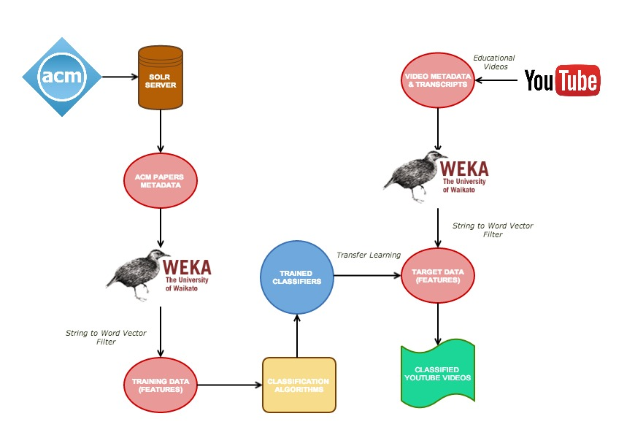
Big picture

Slide 6
Workflow
Training multi-class classifiers
Evaluation - training
Data collection
Feature extraction
Tuning training data
Single- class classifiers
Target data collection
Transfer learning
Bootstrap-ping
Evaluation - target
Midterm progress
Post-midterm progress

Slide 7
Tuning training data
Training data
Including ACM category name as a feature
Include all ACM classes
Stop list customization
Balancing positives and negatives
Using title and abstract as features
Filtering techniques
Formatting
Include ACM “Security & Privacy” class
Post-midterm progress
Midterm progress

Slide 8
Multi-class vs. Single-class classification
Multi-class classification:
Each training point belongs to one of N different classes
Predict the class(es) to which a training point belongs to
1 classifier
Single-class classification:
Determine whether a training point belongs to a given class or not
N classifiers (one for each class)
Better accuracy and performance
Single-class
Multi-class
Notes:
In single class classification, each training point either belongs to or does not belong to the class for which the classifier is being built. The classifier, hence, determines whether a test data point belongs to a given class or not. To classify documents into N classes, single class classification requires N different binary classifiers. For the ith classifier, positive examples are all points that belong to class i and negative examples are all points that do not belong to class I
In multi class classification, each training point belongs to one of the N different classes. The classifier predicts the class(es) to which a test point belongs to . To classify documents into N classes, multi class classification requires only 1 classifier.

Slide 9
ACM taxonomy tree
ACM CCS
General
And
Reference
Computer
Systems
Organization
Software and its
Engineering
Mathematics of Computing
Security and Privacy
Applied Computing
Social and Professional Topics
Hardware
Networks
Theory of Computation
Information Systems
Human-centered Computing
Computing Methodologies
Level-2 (L2): 13 topics
Level-3 (L3): 84 topics

Slide 10
Pruning ACM taxonomy tree
ACM CCS
General
And
Reference
Computer
Systems
Organization
Hardware
Mathematics of Computing
Security and Privacy
Applied Computing
Social and Professional Topics
Software and its
Engineering
Networks
Theory of Computation
Information Systems
Human-centered Computing
Computing Methodologies

Slide 11
Pruned ACM taxonomy tree
ACM CCS
Software and its
Engineering
Mathematics of Computing
Security and Privacy
Computing Methodologies
Computer
Systems
Organization
Networks
Theory of Computation
Information Systems
Human-centered Computing

Slide 12
Target data collection approaches
Target data
Computing domains
YouTube API
Manual extraction
ACM taxonomy
Computing domains
ACM taxonomy
Channels
Playlists
Education
ACM taxonomy
Bootstrapping
Final test set
Search by
Search by
Label by
Label by
Search for
3
1
2
4
5

Slide 13
Transfer learning approaches
2
3
4
5
Trained and classified on L3
Trained and classified on L3
Trained and classified on L2
Final test set

Slide 14
Bootstrapping
Bootstrapping
Random selection
Manual selection

Slide 15
Evaluation - training
Naïve Bayes Multinomial preferred
Fast
Reduce over-fitting

Slide 16
Evaluation - training (contd.)

Slide 18
Evaluation - target
Included only videos classified into <= 3 classes
Number of classes | % Correct decisions
1 | 31
2 | 35
3 | 35

Slide 20
Challenges
Target data collection
Availability and quality of target metadata.
Reliability of search.
Mismatch in ACM and YouTube vocabulary.
Limited features set for target data (YouTube).
Interdisciplinary nature of data poses difficulty in classification.
Notes:
Put tick mark against challenges resolved
Weka performance: concern for large data sets, aiming to deploy it on distributed platform
Classifier Accuracy : in progress. Improved it from 45 to 67 using various combination of filters

Slide 21
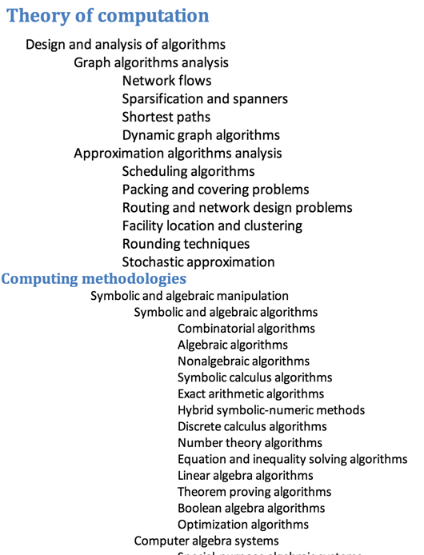
Challenges (contd.)
ACM CCS is generic and ambiguous

Slide 22
Lessons learned
“Do not trust anything!”
Techniques and processes used in transfer learning and text classification.
YouTube search by playlists – more relevant videos
Identifying more relevant set of features
Voice-to-text conversion
Classification in same domains is easier.

Slide 23

Future work
Avoid classification into multiple classes – probability of correctness
Extend the target set to different domains such as slideshare
Enhancing features selection
NLP to refine the features
Voice-to-text transformation
Image processing
CBIR
Text extraction - subtitles, text embedded

Slide 24


Questions ?
Questions ?

