Slide 1


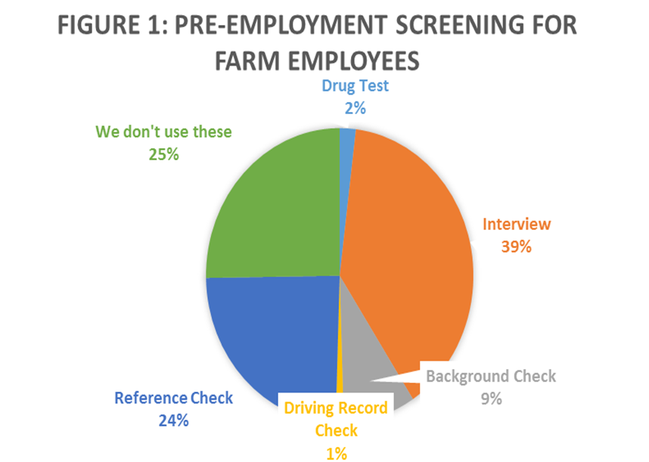
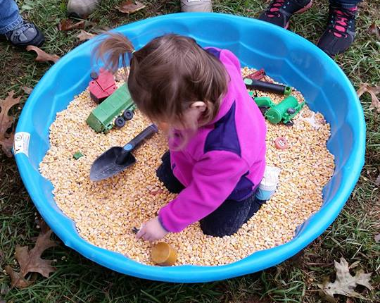
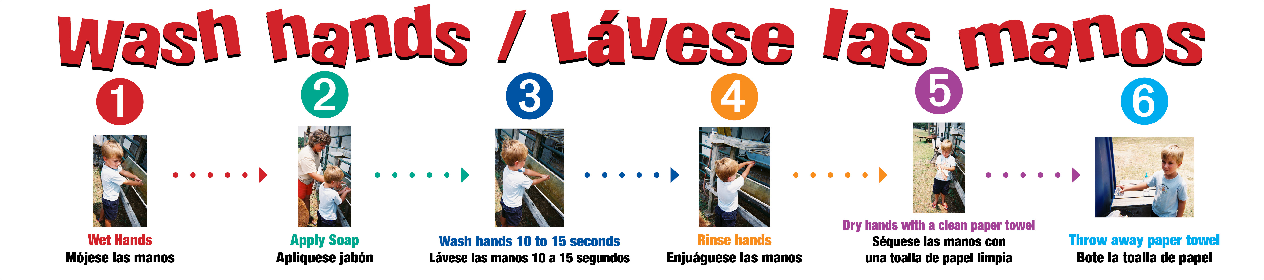
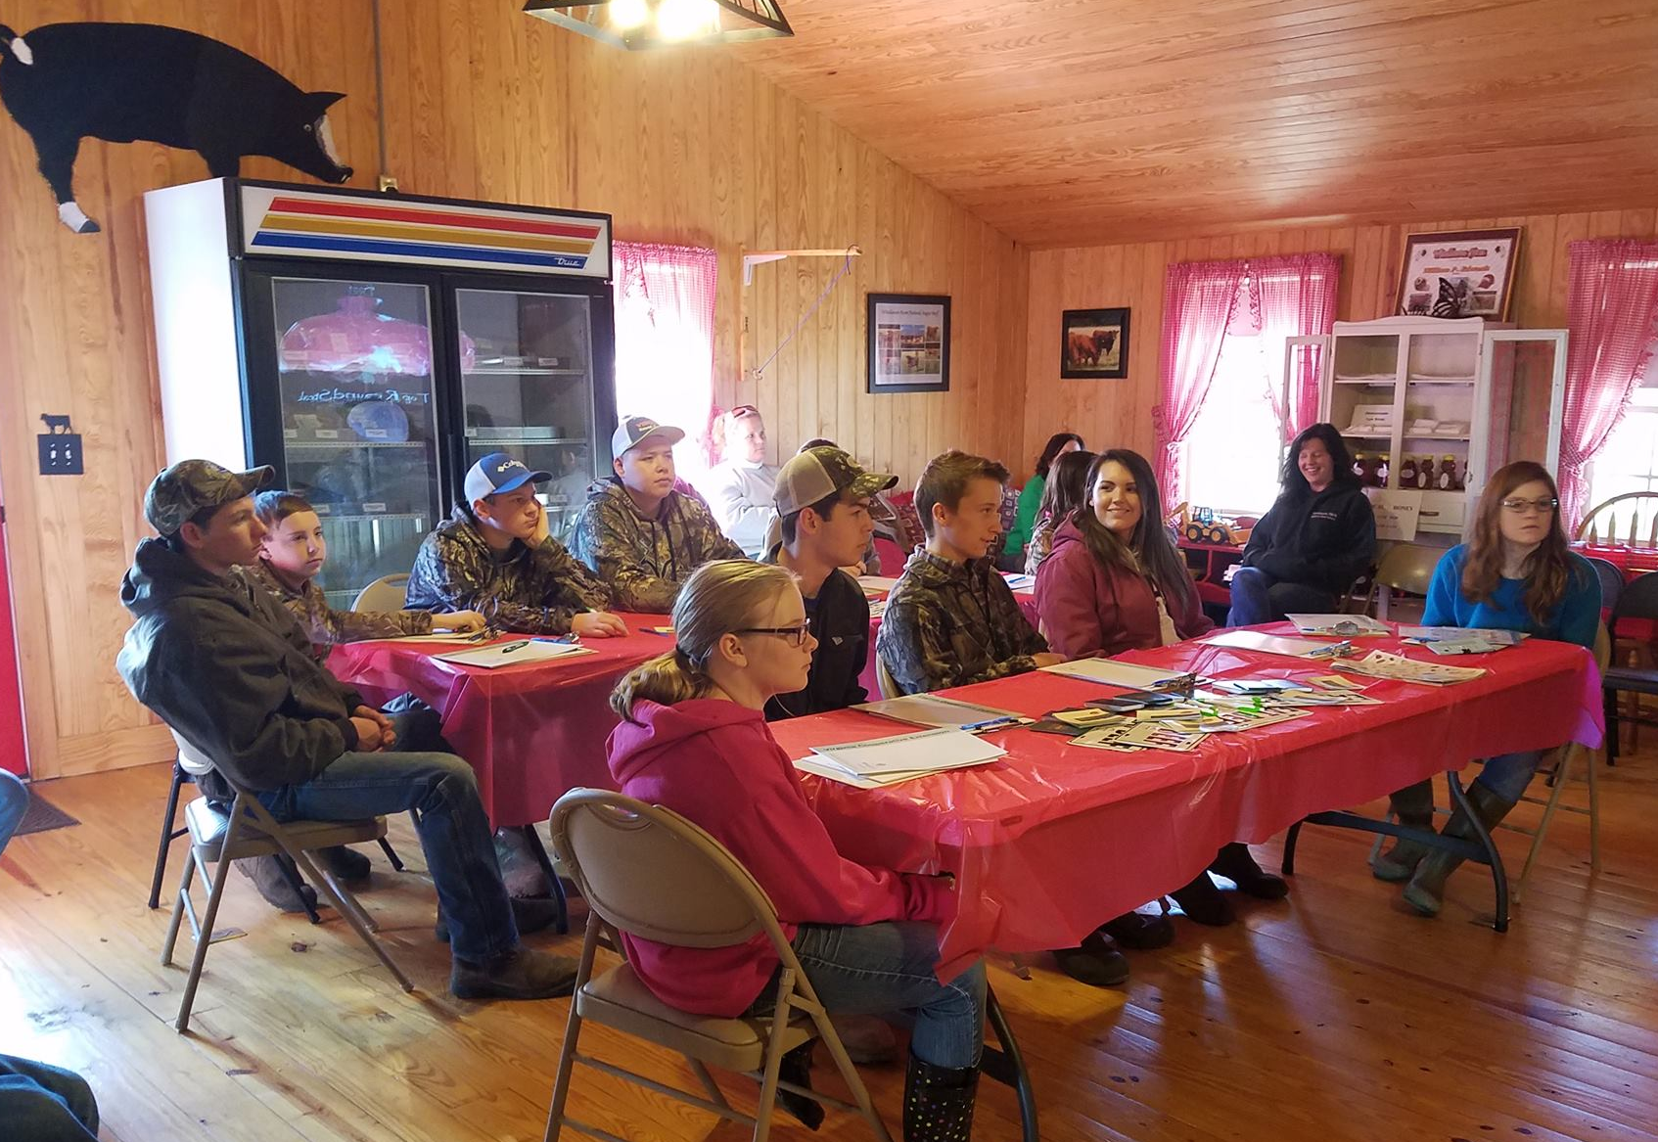
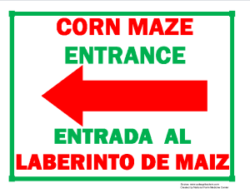
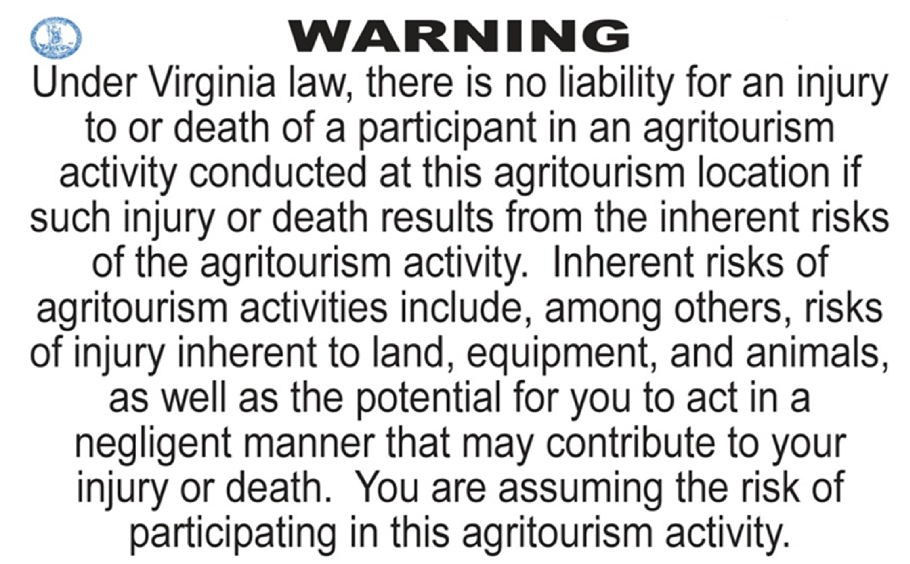
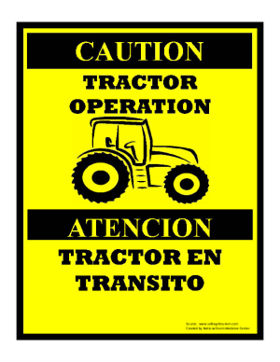




Agritourism Safety in Virginia
Afton (Livvy) Preisser
Faculty Advisor: Dr. Tiffany A. Drape
Committee Members: Dr. Martha Walker, Dr. Theresa Nartea, and
Dr. Kimberly Morgan
College of Agriculture and Life Sciences, Virginia Tech, Blacksburg, VA
Overview
Results
Recommendations
The purpose of the study was to gain a better understanding of current safety protocols on agritourism operations in Virginia. The question guiding this research was: What types of safety protocols are in place for visitors, how are they managed on Virginia agritourism operations, and how could they be improved for future operations?
Farm visitor safety was evaluated to showcase the current protocols utilized to keep visitors safe. Participants were also questioned regarding insurance. Additionally, insurance agencies covering agritourism operations were recorded, as well as the frequency of farm walkthroughs. Signage was the last area of study. Several reported having the Virginia agritourism liability
sign posted on their operations in various locations and languages.
Note: This liability sign must
be in 1 inch black lettering.
Supplementary operational walkthroughs
      (some being mandatory)
More extensive employee screening
Increase employee training and expectations
Expand signage (both visuals and languages)
Encourage emergency personnel contact
Background Information
Types of Agritourism:
Farm tour
Field trips
Educational workshop
Festivals
Weddings
Beer, wine, cider tastings
On farm lodging
Hayrides
U-pick operations
Pumpkin patch
Farm markets
Christmas tree farm
Cut your own operations
Corn maze
Agritourism examples: Top Picture- Sensory bin at a farm field trip.
Bottom picture- Meat educational workshop at a local farm market.
Conclusion
Agritourism safety should be considered from the entrance to the exit of every operation. Things to consider before opening your operation:
Parking
Bathrooms
Hand washing stations
Signage
Employee training
Emergency plans
Updating insurance
Walkthrough completion
Sign examples from
safeagritourism.org.
Methodology
Utilizing the Dillman method, a Qualtrics survey was sent to Virginia agritourism operators. The survey was broken into four question areas; Farm Employees, Farm Visitors, Insurance, and Signage.
References
Blacka, A., Couture, P., Coale, C., Dooley, J., Hankins, A., Lastovica, A.,Uysal, M. (May 1, 2009). Agri-Tourism. Publications and Educational Resources. Retrieved January 17, 2017, from http://www.pubs.ext.vt.edu/310/310-003/310-003.html.
Dillman, D., Smyth, J., and Christian, L. (2009), Internet, Mail, and Mixed- Mode Surveys. Retrieved July 3, 2017, from https://www.amazon.com/Internet-Mail-Mixed-Mode-Surveys-Tailored/dp/0471698687.
Dixon, K. (2016). Autumn Agritourism. Virginia Farm Bureau News, 75(4), 16-19. Retrieved on January 17, 2017 from Virginia Farm Bureau News
Humann, MJ, Ellis, TM and Lee, BC (2011). Agritourism Health and Safety Guidelines for Children. Second Edition. Marshfield, WI: Marshfield Clinic. Retrieved January 17, 2017, from http://sustainable-farming.rutgers.edu/wp-content/uploads/2014/09/MCRF-Centers-NFMC-NCCRAHS-AgritourismHealthandSafetyGuidelinesforChildren2011.1.pdf.
Magnini, V., Calvert, E., & Walker, M. (2017). The Economic and Fiscal Impacts of Agritourism in Virginia. Retrieved on March 4, 2017, from https://www.vatc.org/wpcontent/uploads/2017/06/TheEconomicAndFiscalImpactsOfAgritourismInVirginia.pdf.
Marshfield Clinic Research Institute. Agritourism. (n.d) Retrieved January 18, 2017, from http://www.marshfieldresearch.org/nccrahs/agritourism.
Walker, M. (2009). Agritourism: Ideas and Resources. Retrieved January 16, 2017, from https://pubs.ext.vt.edu/310/310-004/310-004.html.

