Slide 1
U.S. State Tourism
Danya Shere, Rebecca Mueller, Ahmad Ayub, Lexi Fabian, Akshat Shah
CS 4624: Multimedia, Hypertext, and Information Access
Dr. Edward Fox
Virginia Tech
Blacksburg, VA 24061
05/11/2020
Notes:
Danya

Slide 2
Outline
Overview
Data Extraction
  Headers and timestamps
  HTML body text
NLTK
Visualizations
  Overall frequency
  Seasonal frequencies
Challenges
Future Work
Acknowledgements
References
Notes:
Danya

Slide 3
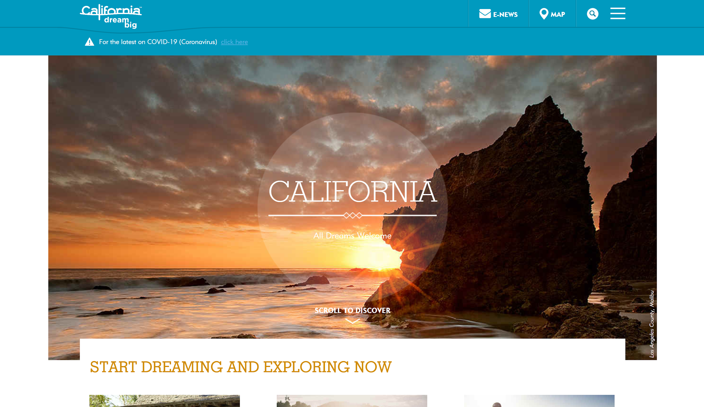
Overview
Monthly archives dating back to 2008 of U.S. state tourism websites exist on web.archive.org
Extracting information from Parquet files of visitcalifornia.com
Want to create meaningful visualizations about the changes that have been made to these websites over time
Notes:
Danya

Slide 4
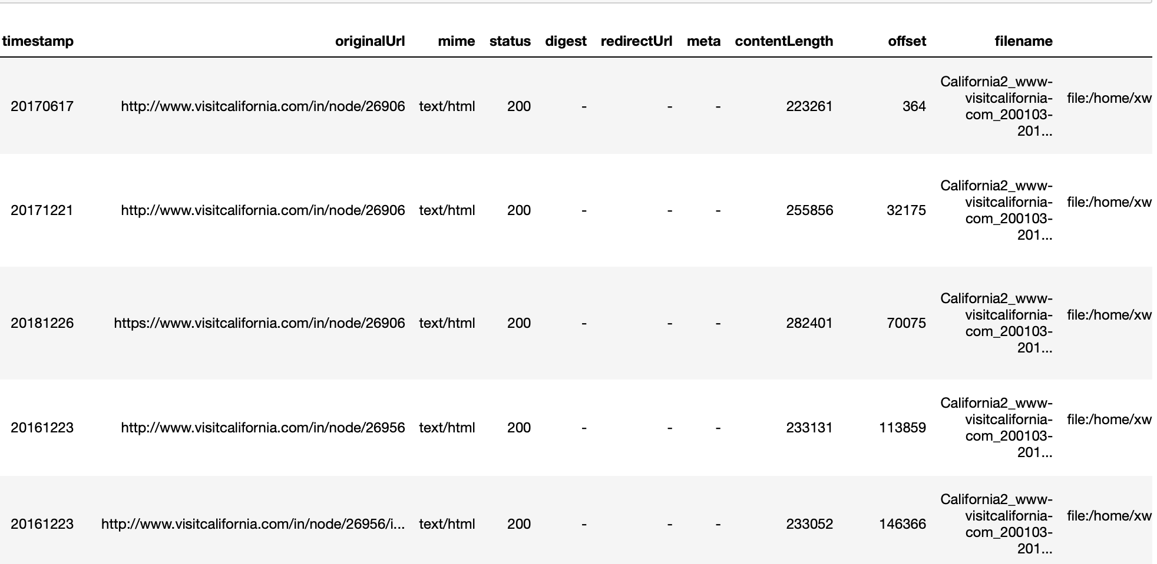
Data Extraction - Headers and Timestamps
Given Parquet files from previous project
Timestamp, URL, HTML, etc.
Filtered out information into CSV file
Notes:
Ahmad

Slide 5
Data Extraction - HTML Body Text
Function that removes the script and header tags from the HTML files leaving only the body
Text split into lines and trimmed
Important for getting content in snapshots
Notes:
Akshat
Explain why we wanted just the body
Explain importance of removing body from header and footer - restructuring

Slide 6

NLTK
Python Natural Language Processing Toolkit
Removing characters that are not in the English alphabet
Removing punctuation except for apostrophes
Removing a list of stop-words
  “The”, “a”, “an”, “is”, etc.
Leaves us with only significant words
Notes:
Lexi
Explain importance of running it through nltk and what nltk is
Define what a stop word is - unimportant common english words that would not help with research

Slide 7
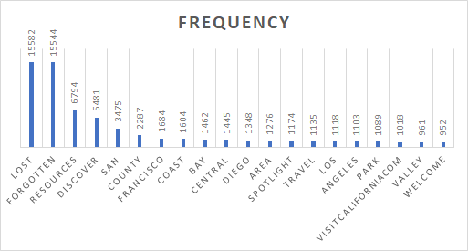
Visualizations - Overall Frequency
Found the frequency of words in the headers of every snapshot
Excel FreqWords VBA function and SORT function
Excel graph tools to create bar graph
Notes:
Becca
Explain what a VBA function is - imported excel function
Creating array of words and frequencies

Slide 8
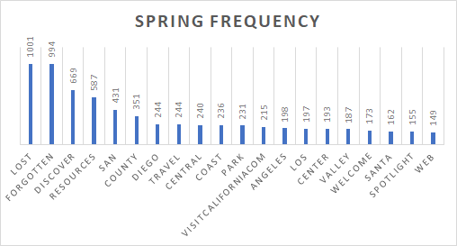
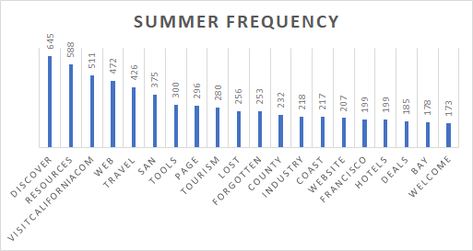
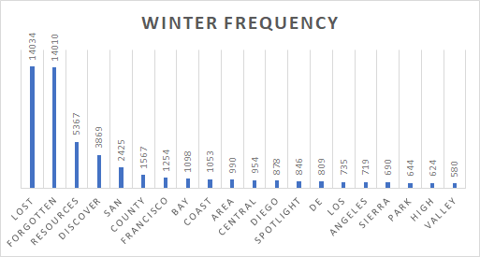
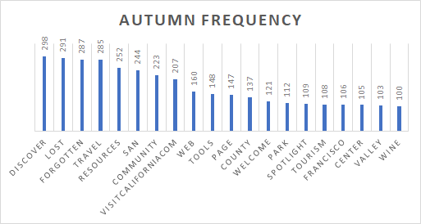
Visualizations - Seasonal Frequencies
Java program written to filter the four seasons into separate CSV files
Ran same frequency function on separate seasons
Notes:
Becca
Summer has travel and san (so talking about those southern california cities that start with San) and coast
Spring and Autumn have words like park and valley

Slide 9
Challenges
Virginia Parquet files
  Websites snapshots were from a blog, not the tourism site
Ten years of data vs. twenty
Long runtimes
  1-2 hours per Parquet file to filter out information
  Data too large for Excel functions
Notes:
Ahmad
Ten years of data vs twenty - we ended up having less data than we thought
Switching to California helped, tourism industry is bigger in CA

Slide 10
Future Work
Want future project teams to expand our methods
Use our research as a tool
Other California metadata
Expand to other states
Notes:
Danya

Slide 11
Acknowledgements
Florian Zach, Ph.D. - Assistant Professor in the Howard Feiertag Department Hospitality and Tourism Management
Xinyue (Cyrus) Wang, Ph.D. Student in the Department of Computer Science
NSF IIS-1619028, Global Event and Trend Archive Research (GETAR)
NSF CMMI-1638207, Coordinated, Behaviorally-Aware Recovery for Transportation and Power Disruptions (CBAR-tpd)

Slide 12
References
Doan, Viet, et al. “Tourism Destination Websites.” VTechWorks, Virginia Tech, 8 May 2019, http://hdl.handle.net/10919/92622.

Slide 13
Questions?

