Slide 1
INT Final Presentation
CS 5604 Information Retrieval
Integration and Implementation Team
Alex Hicks, Mohit Thazhath, Suraj Gupta, Cherie Poland, Xingyu Long, Hsinhan Hsieh, Yash Mahajan
Virginia Tech, Dept. of Computer Science, Blacksburg, VA 24061
12/7/20

Slide 2
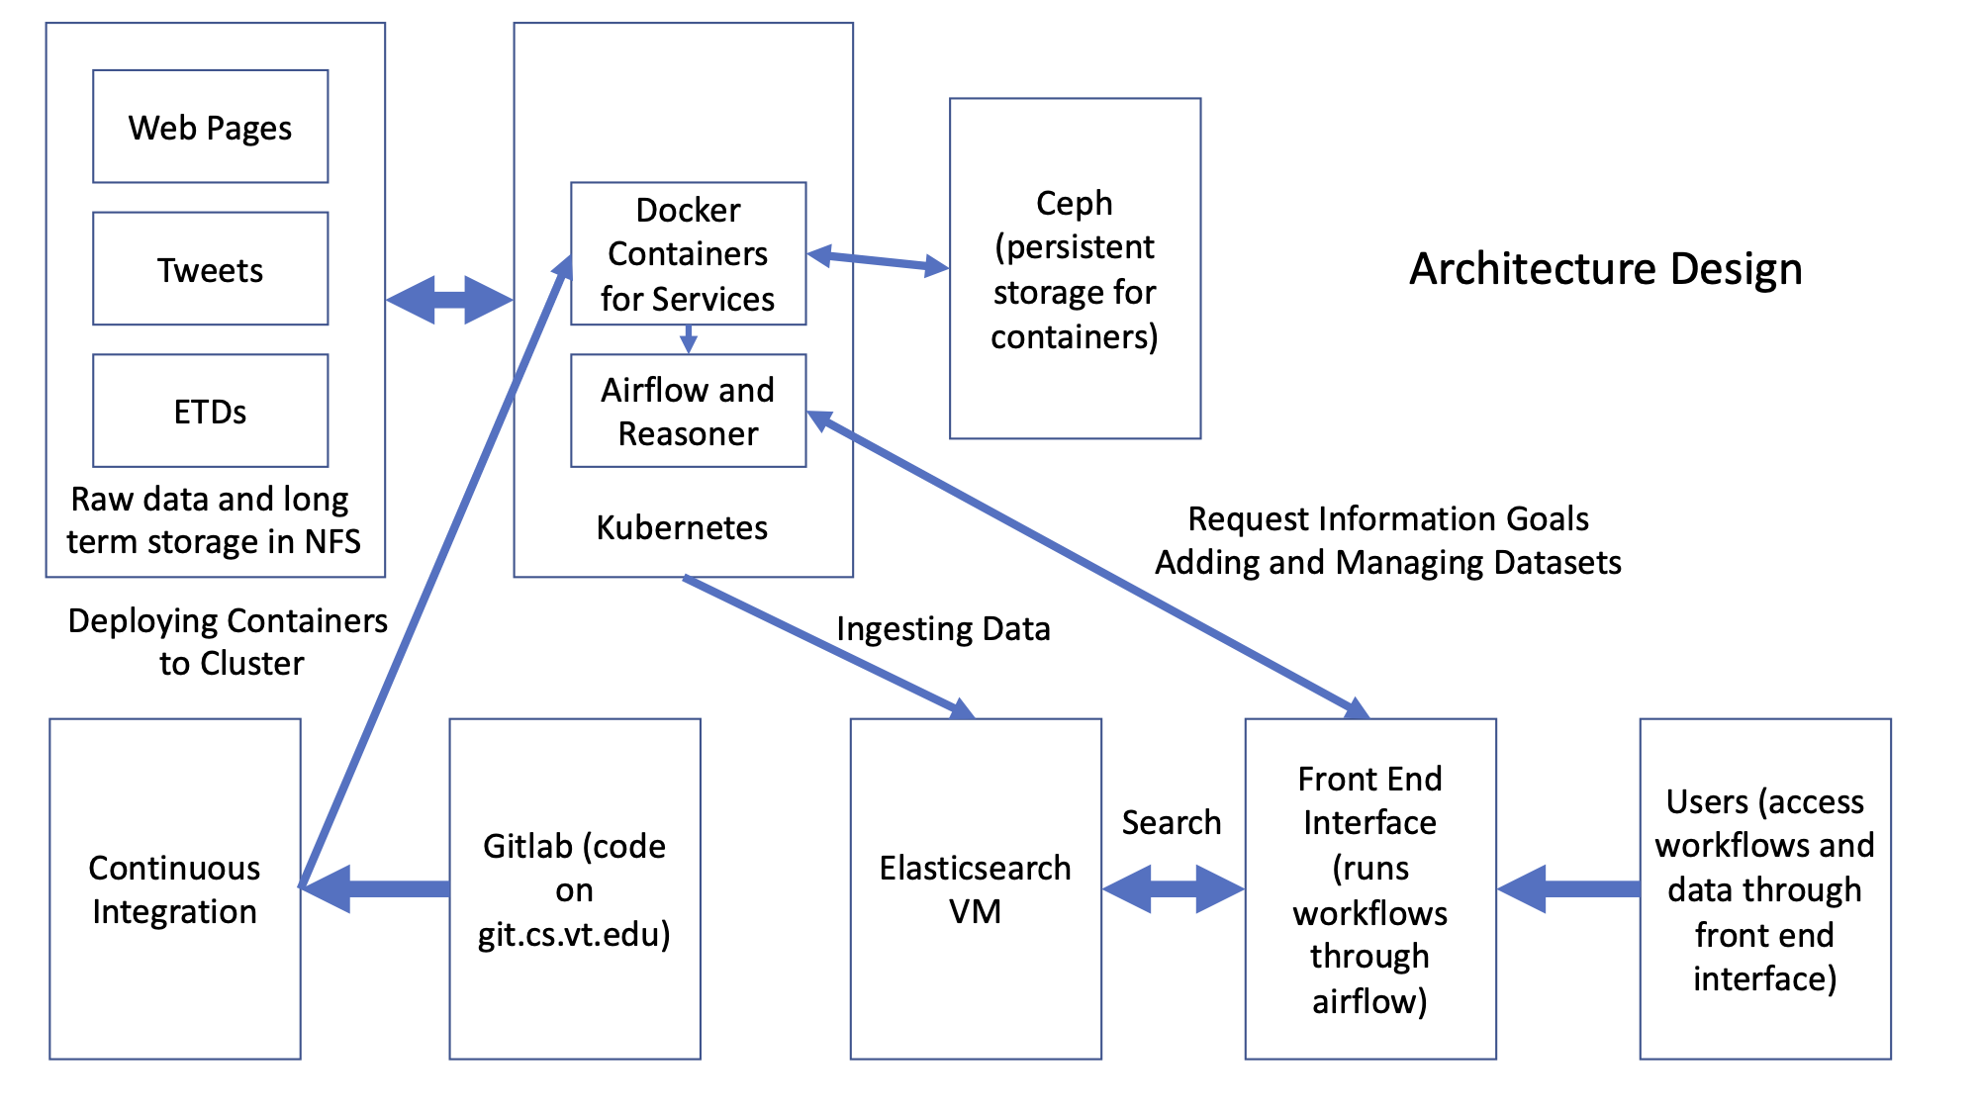
Architecture Design
Notes:
Alex

Slide 3
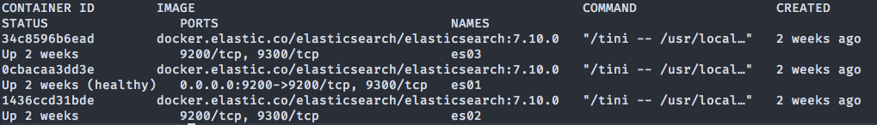
Managed Virtual Machines
Elasticsearch
elasticsearch.cs.vt.edu
Elasticsearch in Docker
Kibana
KGI
kgi.cs.vt.edu
Gitlab Runner
Notes:
Alex

Slide 4

Elasticsearch
Index data from content teams
Store ingested documents and metadata
Provide access to Front End for display and interaction
Notes:
Alex

Slide 5
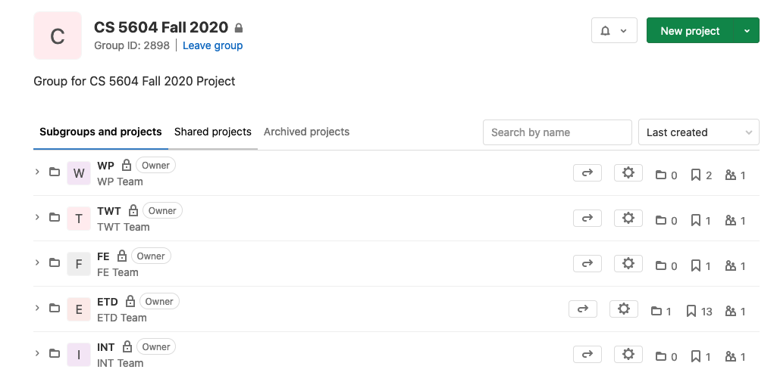
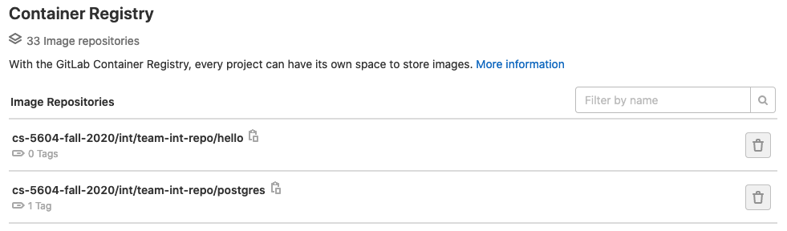
Gitlab
VT CS hosted Gitlab instance
git.cs.vt.edu
Provides almost complete DevOps system
Version Control
Runner
Container Registry
Notes:
Alex

Slide 6
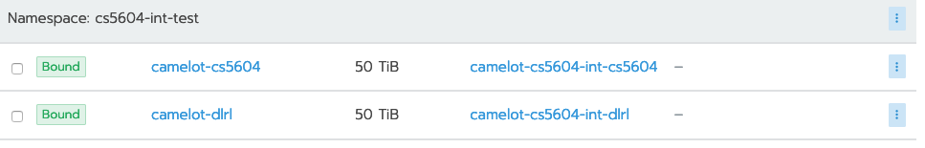
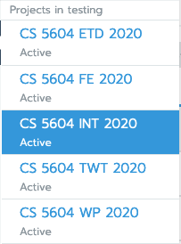
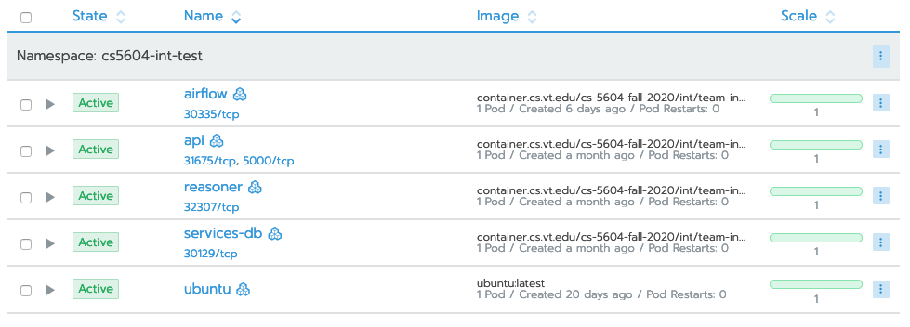
Kubernetes
Created projects for each team
Volume mounts
Airflow integration
Load Balancing for Front End interface
Notes:
Alex

Slide 7
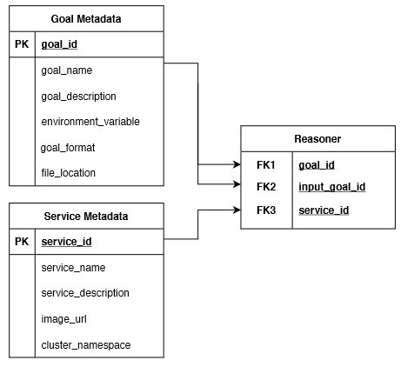
Postgres
Postgres instance running on Kubernetes
Service and Goals tables
Reasoner
Airflow
Database was also used by other teams
Front End - users and permissions

Slide 8
Using the API
Notes:
Alex

Slide 9
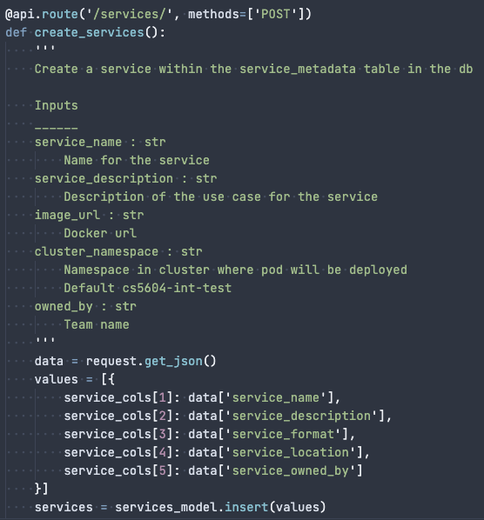
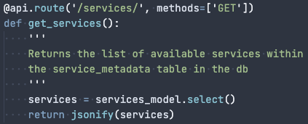
Service API
CRUD API to pass to Front End for registering services
Notes:
Alex

Slide 10
Reasoner
Mines workflows from the reasoner table
API built to make it accessible from the frontend
API call returns relevant information to the Front End

Slide 11
Mining and Running a Workflow

Slide 12
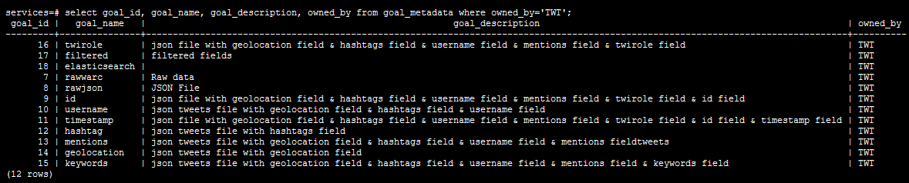
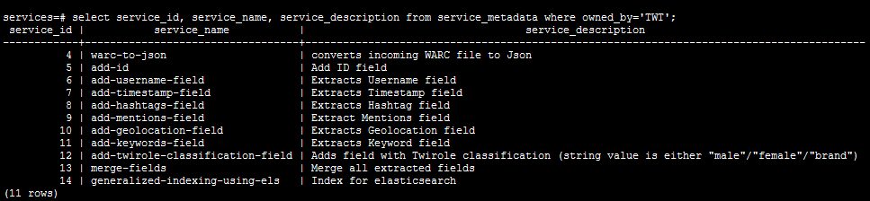
Mining a workflow

Slide 13
Apache Airflow
Used to run workflows on Kubernetes
API created for the frontend to trigger workflows
Workflow status and service logs made available to the frontend through the API

Slide 14
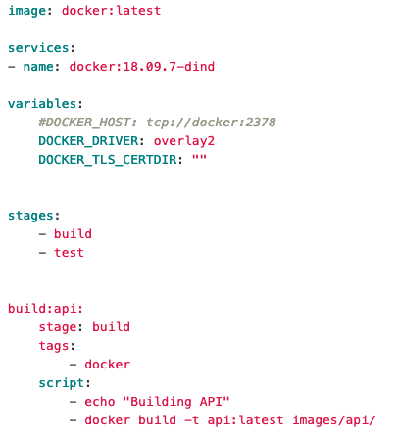
CI/CD
Gitlab Runner
KGI VM
Virginia Tech Computer Science Container Registry
container.cs.vt.edu
Virginia Tech Computer Science Gitlab
git.cs.vt.edu
Notes:
Alex

Slide 15
Unit Testing
Created unit testing framework
Worked with content teams through testing manager
Goal: All services have unit tests and integration tests
Not quite met
Notes:
Alex

Slide 16
Challenges
Docker rate limits
Elasticsearch security
Ceph and NFS storage mounting
Gitlab CI/CD interactions
Communication
Airflow currently only handles I/O through files

Slide 17
Future Work
Service API
Fix update operation
Connect to Front End
Add tests
Specifically for Service API and others

Slide 18
Questions?

