Slide 1
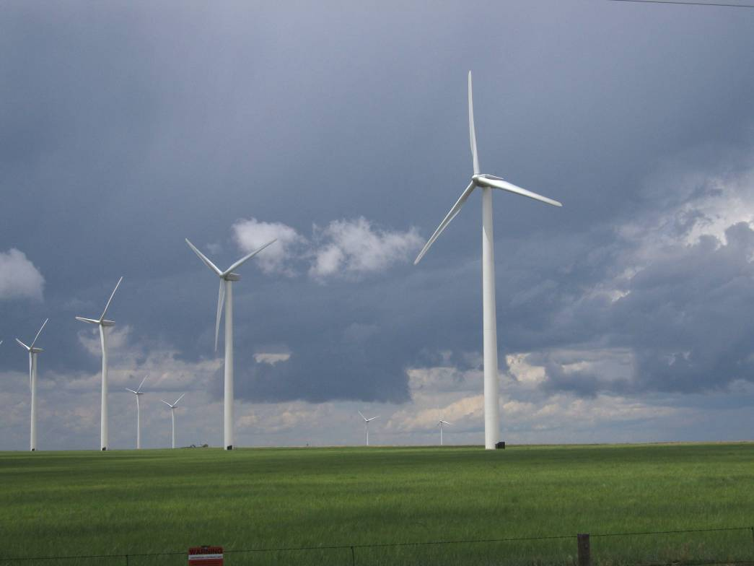
Modeling the variability of renewable generation and electrical demand in RTOs and cities using reanalyzed winds, insolation and temperature
Daniel Kirk-Davidoff^{1,2},
Stephen Jascourt¹,
Chris Cassidy¹
¹MDA Information Systems LLC
²AOSC, University of Maryland
Photo by Bob Henson (UCAR)

Slide 2
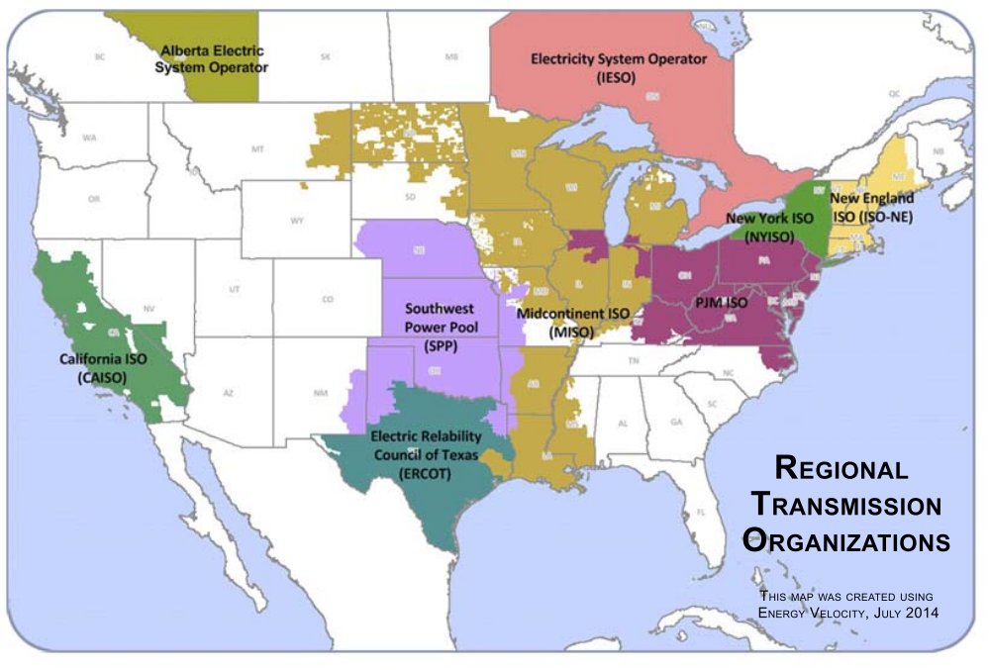
US and Canadian
RTO/ISO regions
BPA

Slide 3
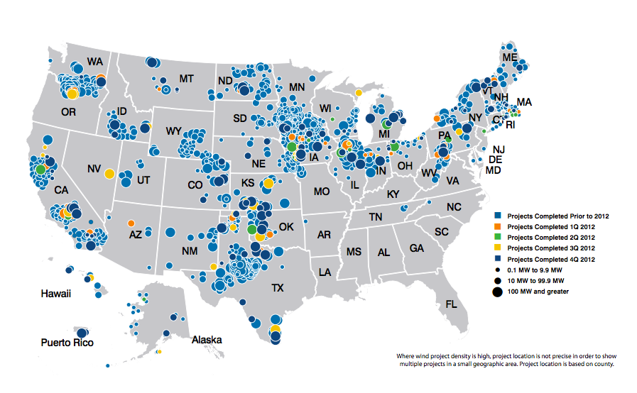
Wind Farms in the US
Image courtesy of AWEA

Slide 4
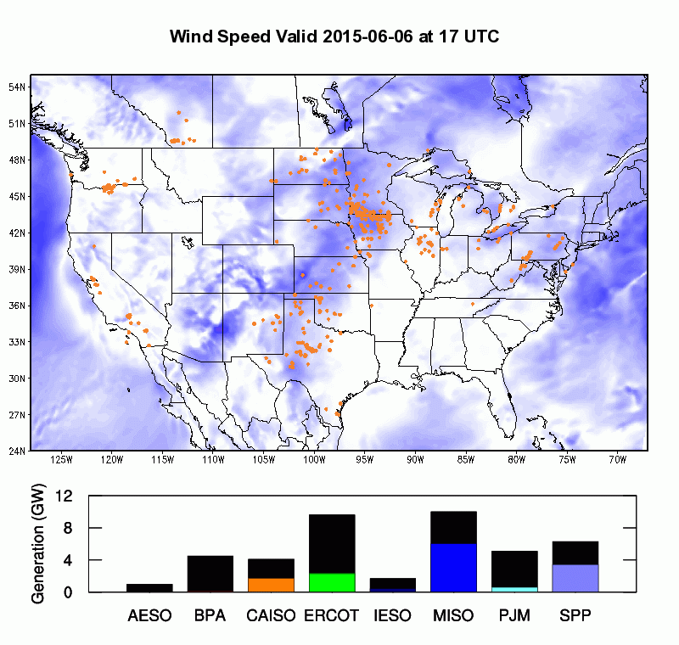
National Scale Wind Generation in near-real time

Slide 5
Generating an historical renewable generation index
The need: Energy traders and other electrical market participants need a consistent measure of wind generation in real electrical markets that represents the variability in electrical generation associated with weather fluctuations, and not changes in wind generation infrastructure. Such an index allows accurate assessment of the probability distribution of generation over the coming year, month, or week.
The solution: a procedure to generate a virtual history of wind generation for each electrical interconnection for past 30 years using an up-to-date, frozen wind generation infrastructure.
Each year, we can regenerate the 35+ year climatology of wind generation that would have resulted from the real wind variations over that period acting on the wind generation infrastructure of the present day.

Slide 6
Schematic of Wind Index Production
Generating an historical renewable generation index
Wind Farm Locations and Properties
Coupled climate prediction model
Wind Turbine Power Curves
Tuned Model
Dynamical Wind Generation Prediction
Reanalyzed Wind Speeds (1979-2011)
Simulated Wind Generation History
Climate Indices
(ENSO, NAO, MJO)
Observed Wind Generation Data (2011)
Statistical Wind Generation Prediction

Slide 7
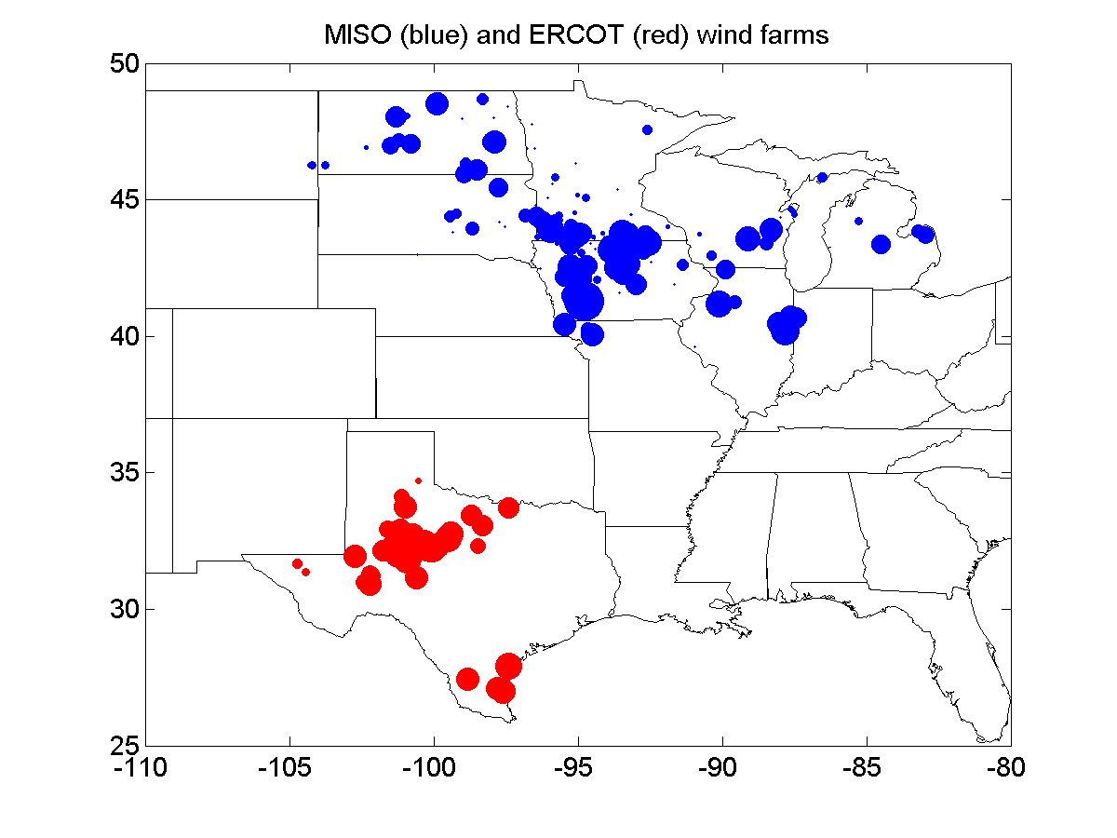
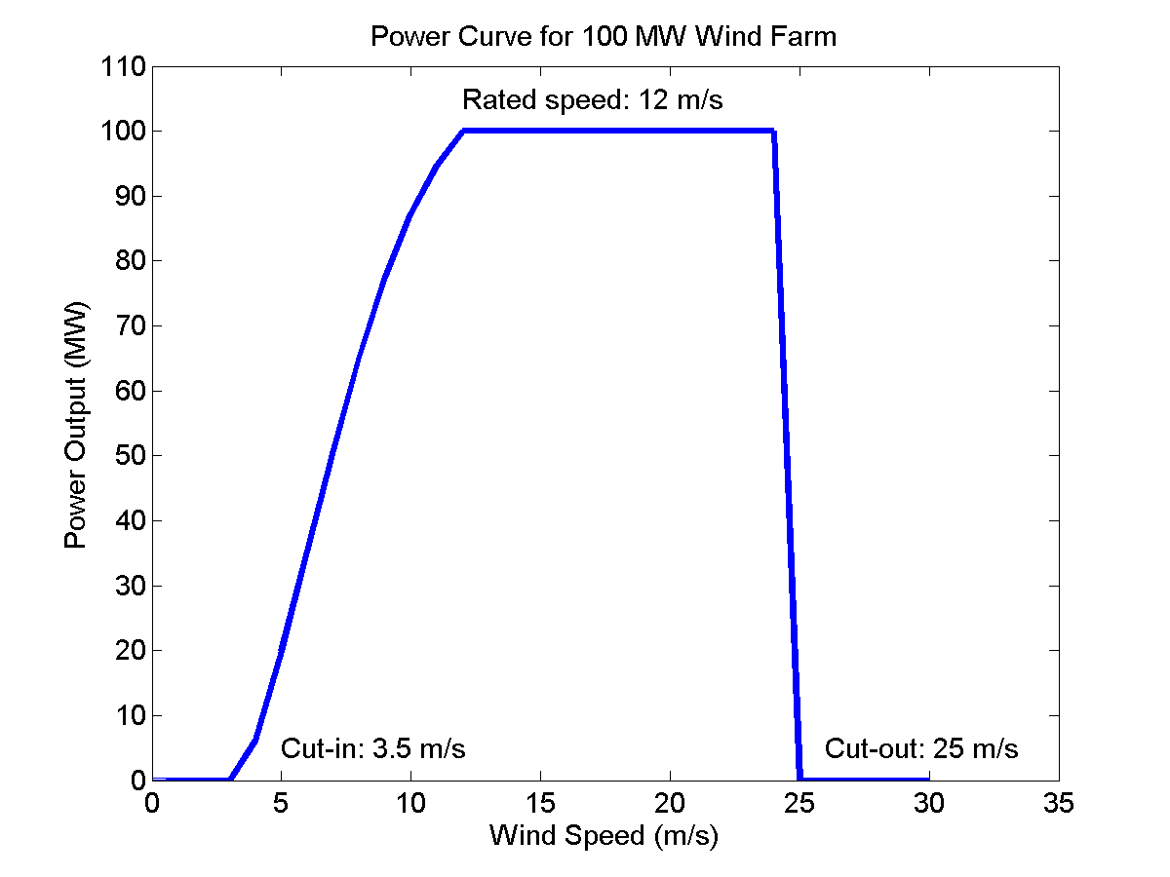
Wind Farm Locations & Properties
In this study, we will generate simulated historical wind and solar power generation for the AESO and IESO ISOs in Canada, and for the BPA, CAISO, ERCOT, MISO, PJM and SPP transmission organizations in the US.
We use a parametric power curve that allows for arbitrary values of the cut-in, rated and cut-out wind speeds.
Farm locations and generation capacity are indicated by dots, scaled by size (largest is 444 MW). Total capacities are 13 GW in ERCOT, 15 GW in MISO

Slide 8
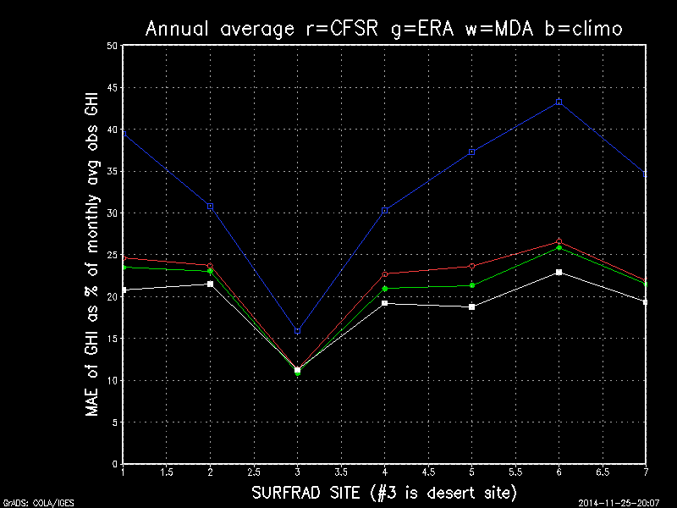
Solar Generation
Notes:
Because solar generation is still relatively small in the US, we use a simpler approach here to simulate its variability. We interpolate CFSR surface insolation values to the six largest population centers in each RTO, and then scale the total generation (weighted by population) so that the maximum power generated is equal to the maximum wind generation in each RTO. We’ve looked at the ability of the CFSR to reproduce variability at the Surfrad sites, and it’s adequate, as shown in the figure below.

Slide 9
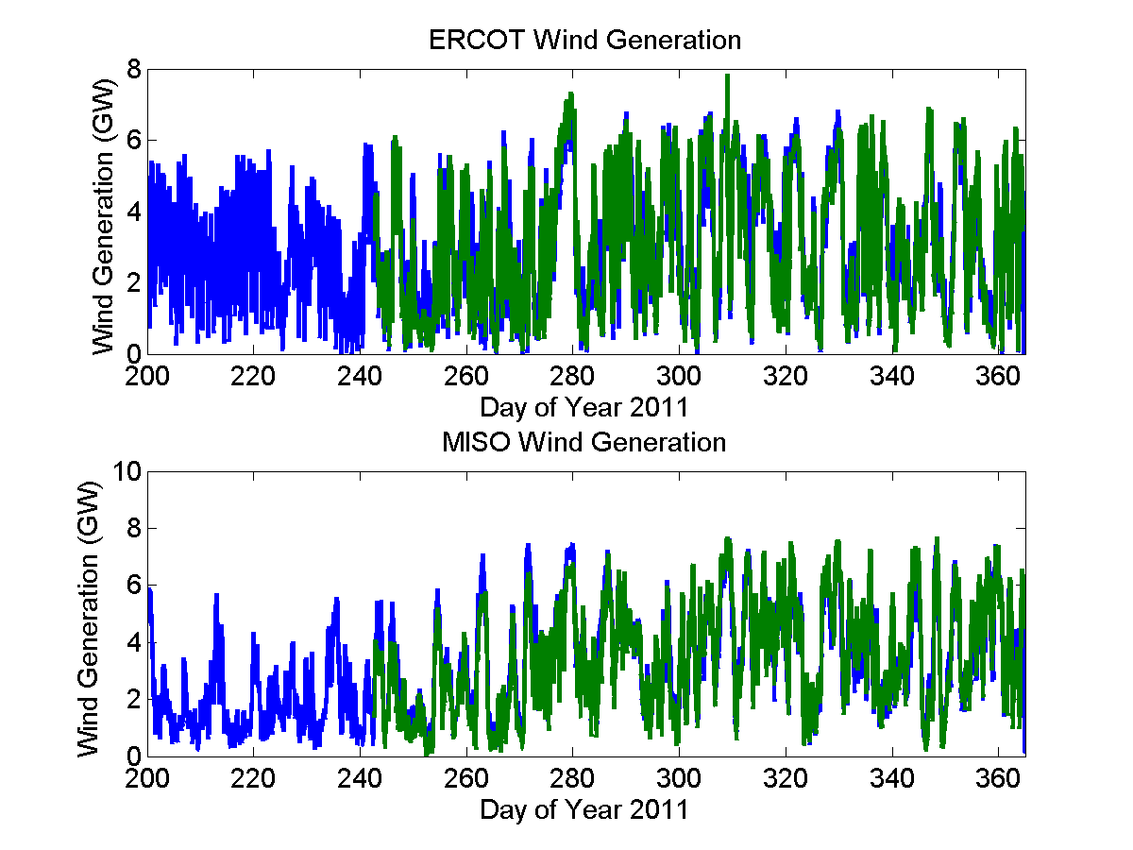
Simulated Wind Generation History
These plots show hourly wind generation for the ERCOT and MISO interconnections. Blue shows the simulated wind generation, green shows the actual generation. The agreement is quite good: correlation coeffcients are 0.91 and 0.94 for ERCOT and MISO respectively.

Slide 10
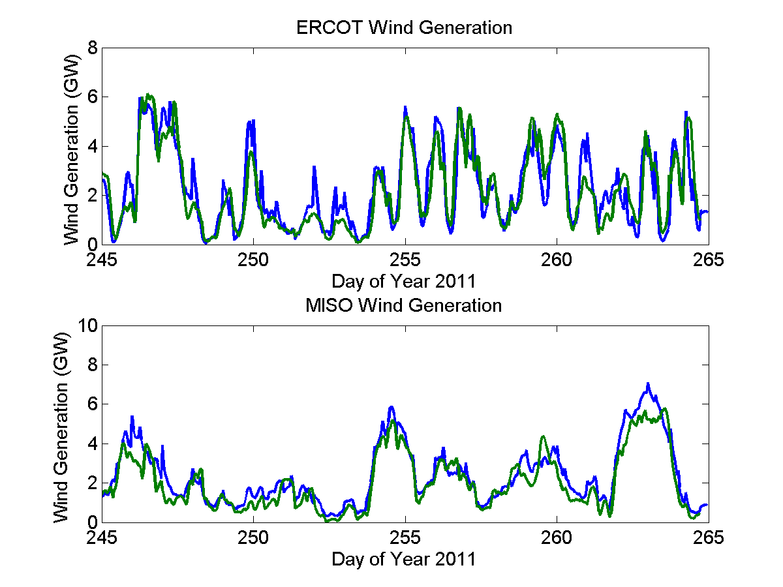
Simulated Wind Generation History
These plots show hourly wind generation for the ERCOT and MISO interconnections. Blue shows the simulated wind generation, green shows the actual generation. The agreement is quite good: correlation coefficients are 0.91 and 0.94 for ERCOT and MISO respectively.

Slide 11
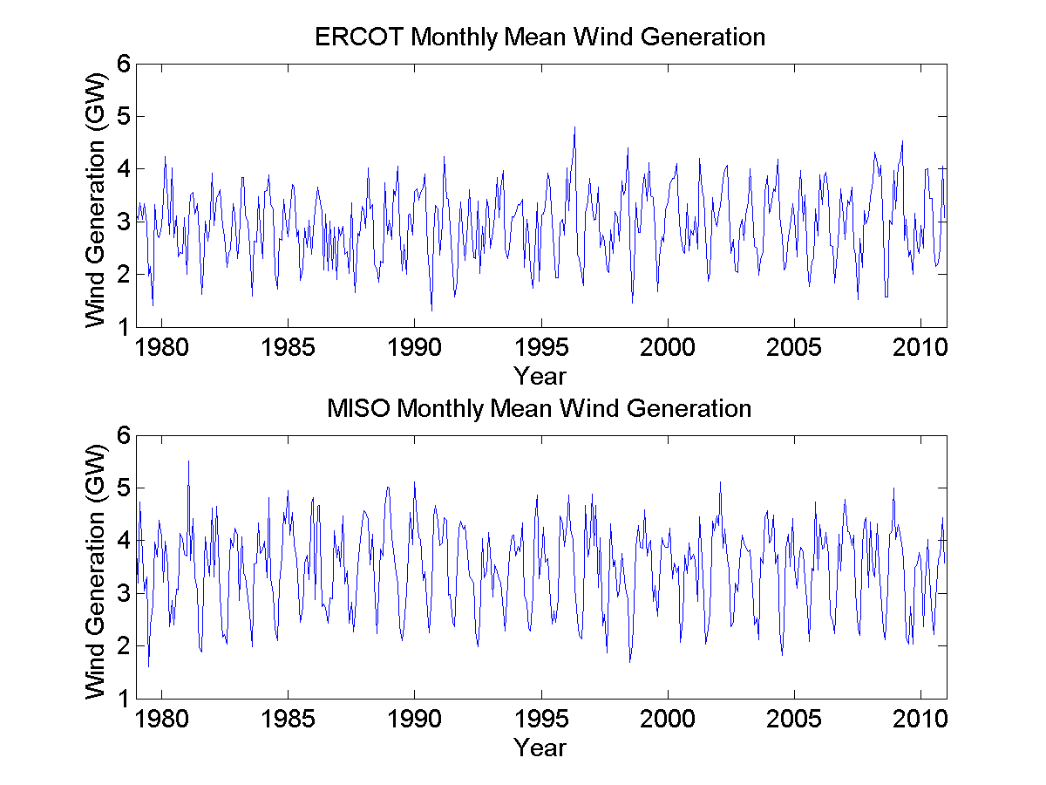
Simulated Wind Generation History
Here are the full 30 year histories, smoothed to monthly means for clarity.

Slide 12
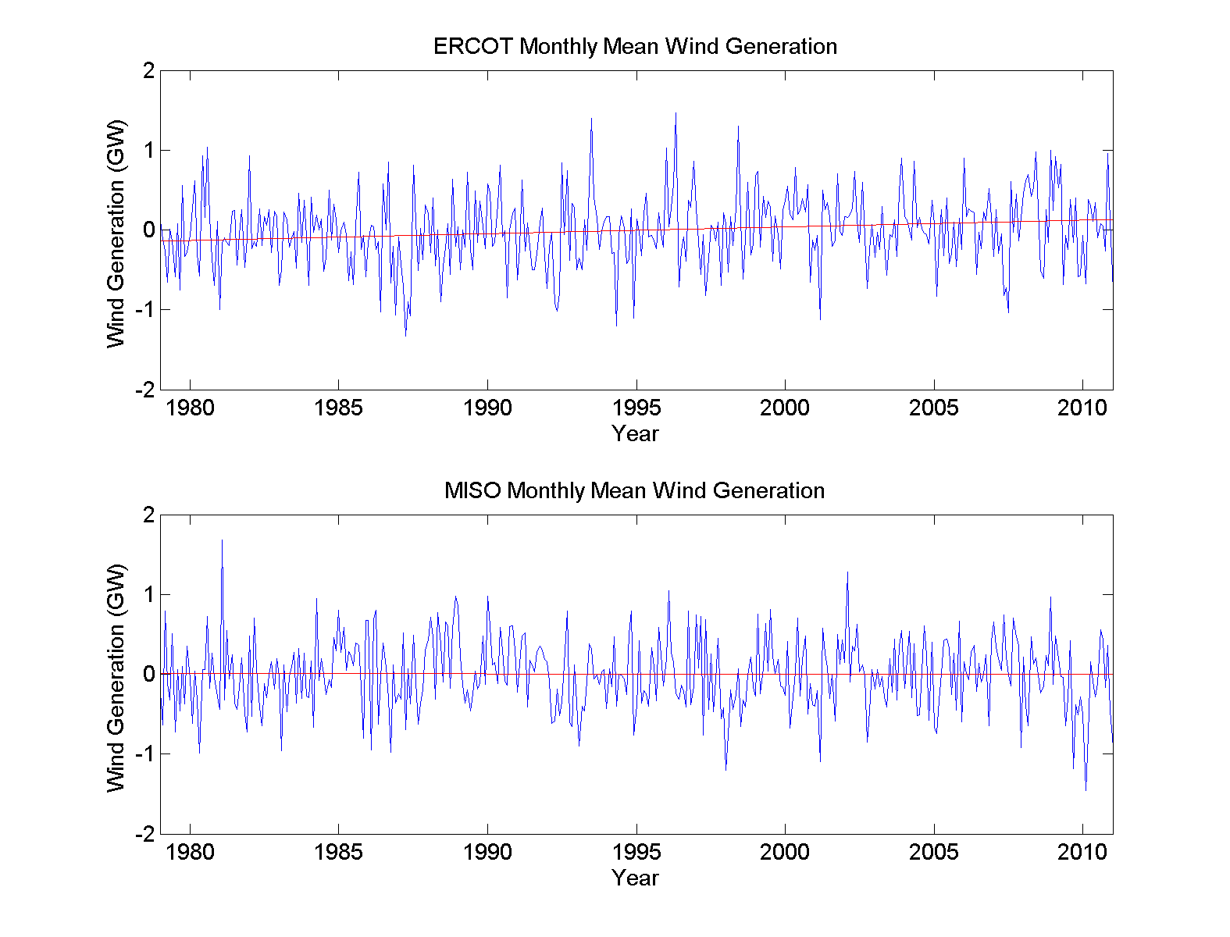
Simulated Wind Generation History
In these plots the annual cycle has been removed, to show the anomalous monthly mean generation in each interconnection.
A small, but significant trend of 85 MW/decade is evident in the ERCOT history, while the MISO history shows no significant trend.
Notes:
Climate model simulations of wind under anthropogenic climate change show some trend towards increasing wind power in central United States, due to an increase in storminess (rather than to any increase in the mean westerly flow).

Slide 13
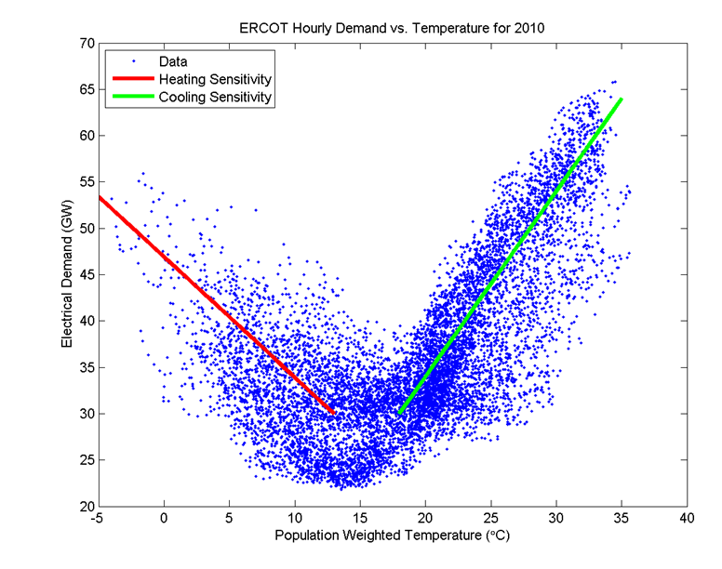
Reanalyzed Demand
Electrical Demand Simulation
We can also simulate the weather-dependent part of electrical demand using reanalysis temperature data (weighted by population) and actual demand data. Of course we could just use actual demand data as well, but we want to isolate the contribution of weather variability here.

Slide 14
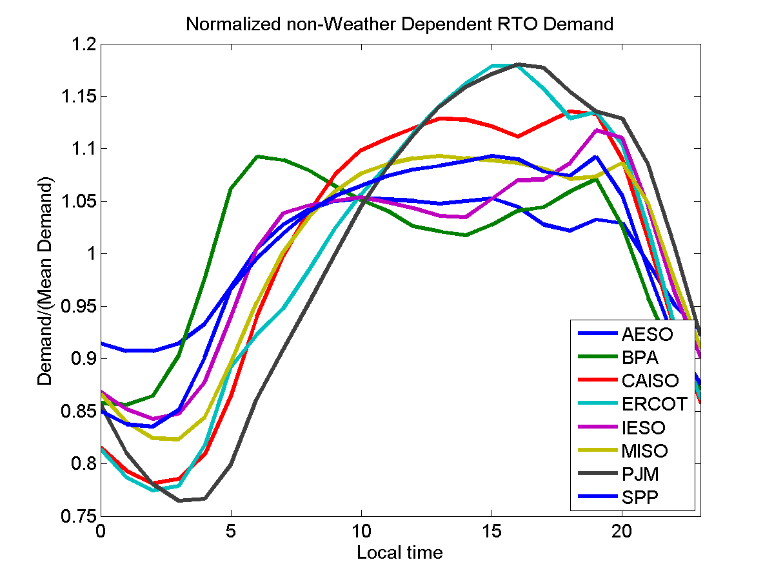
Reanalyzed Demand
Electrical Demand Simulation
We can also simulate the weather-dependent part of electrical demand using reanalysis temperature data (weighted by population) and actual demand data. Of course we could just use actual demand data as well, but we want to isolate the contribution of weather variability here.

Slide 15
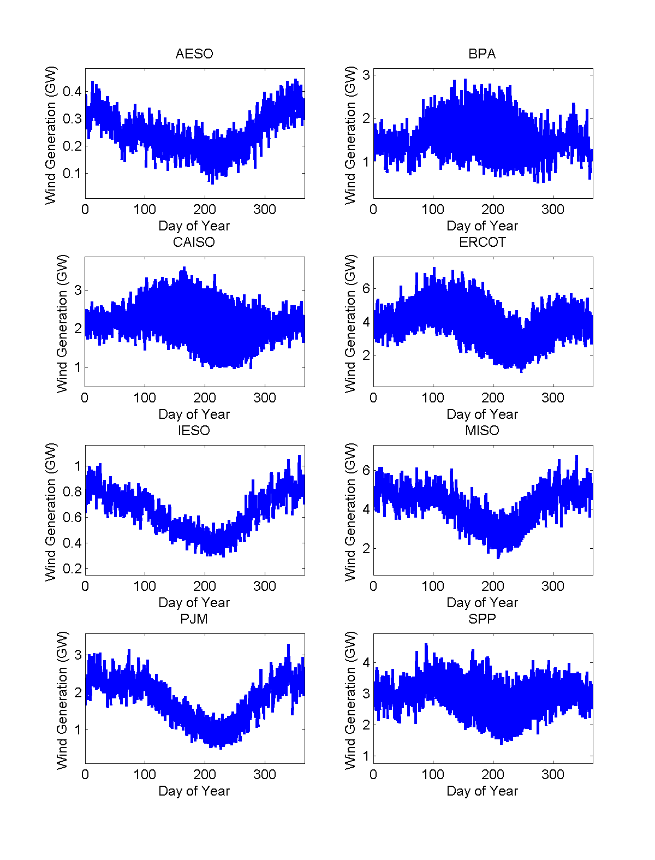
Climatology of Historical Wind Generation
Simulated Wind Generation History
Here we show the average of 32 years of simulated wind generation history, by hour of year.
This shows well the change in the amplitude of the diurnal cycle, as well as the change in daily mean generation through the seasonal cycle.

Slide 16
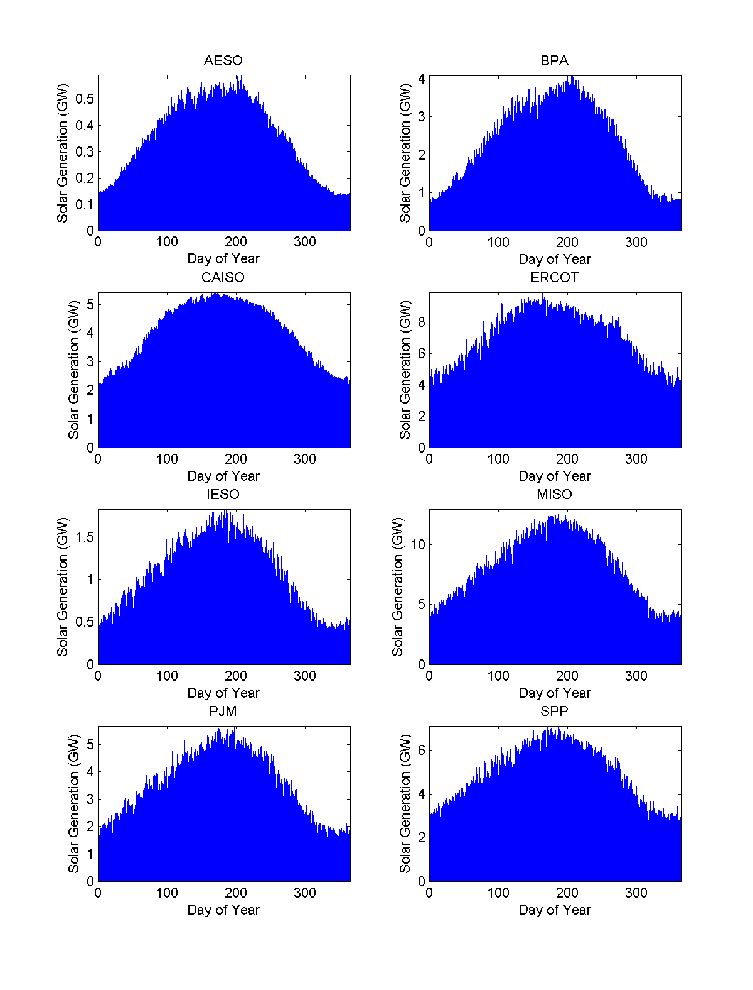
Climatology of Historical Wind Generation
Simulated Solar Generation History
Here we show the average of 32 years of simulated solar generation history, by hour of year.

Slide 17
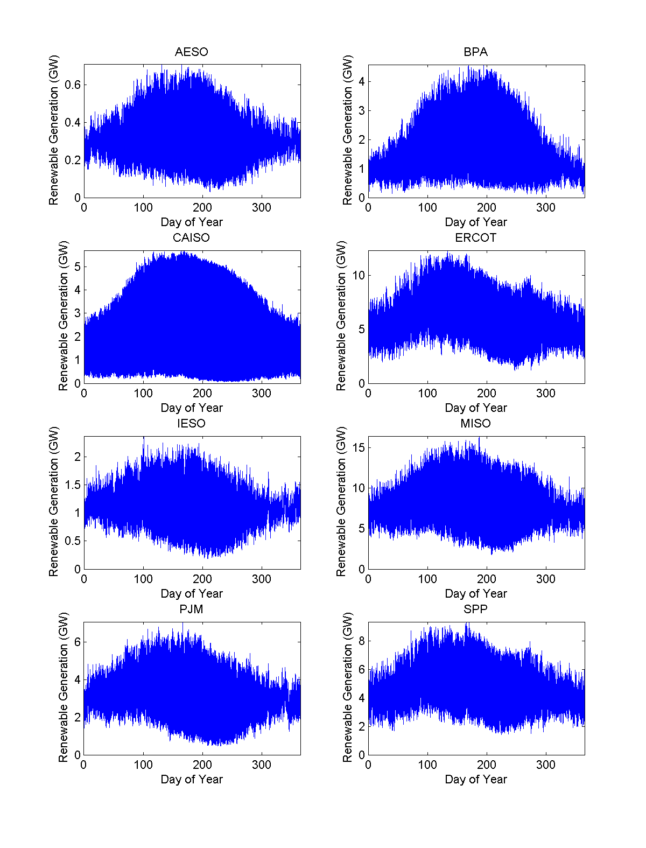
Climatology of Historical Wind Generation
Simulated Renewable Generation History
Here we show the average of 32 years of simulated total renewable (solar + wind) generation history, by hour of year.

Slide 18
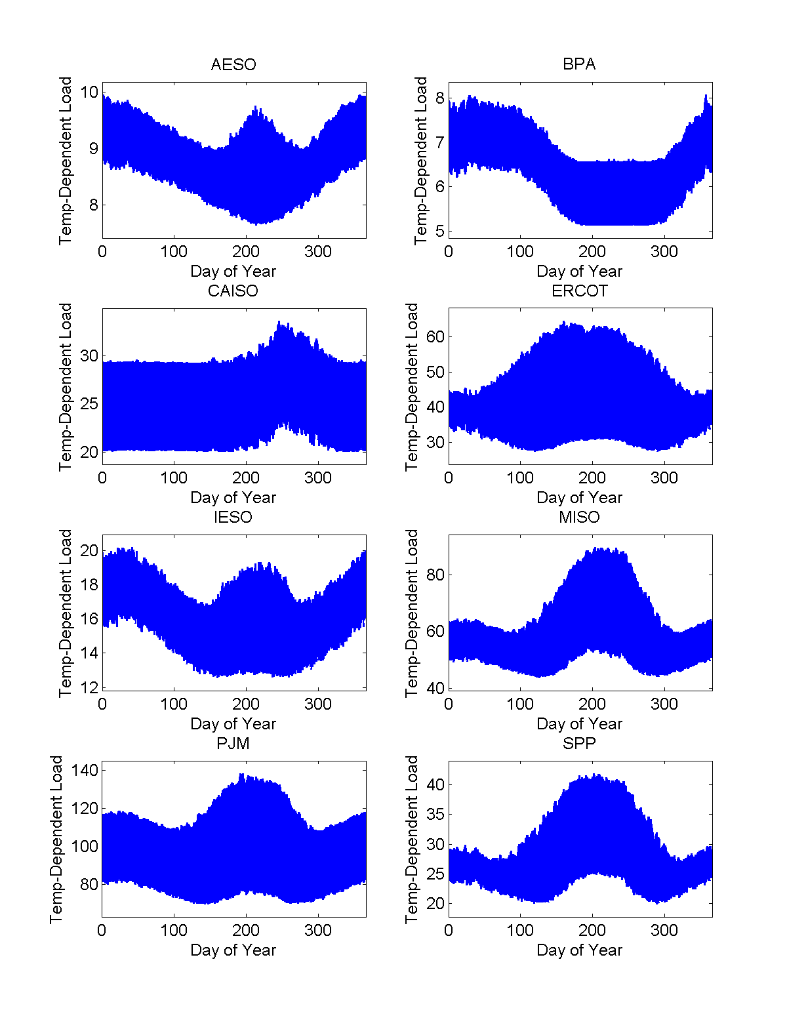
Climatology of Historical Electrical Demand
Simulated Electrical Demand History
Here we show the average of 32 years of simulated temperature-dependent electrical demand, by hour of year.
This shows well the change in the amplitude of the diurnal cycle, as well as the change in daily mean generation through the seasonal cycle.

Slide 19
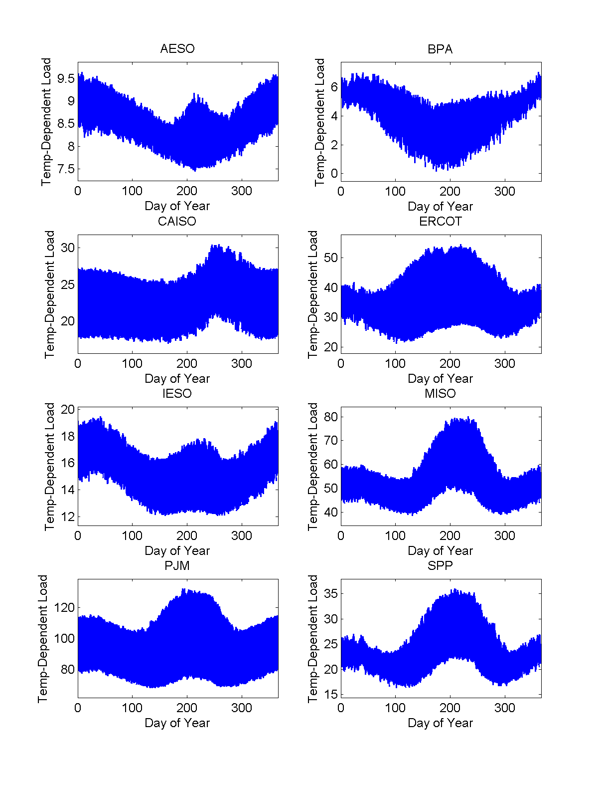
Climatology of Historical Electrical Demand
Simulated Electrical Demand History
These figures show demand with renewable generation subtracted.

Slide 20
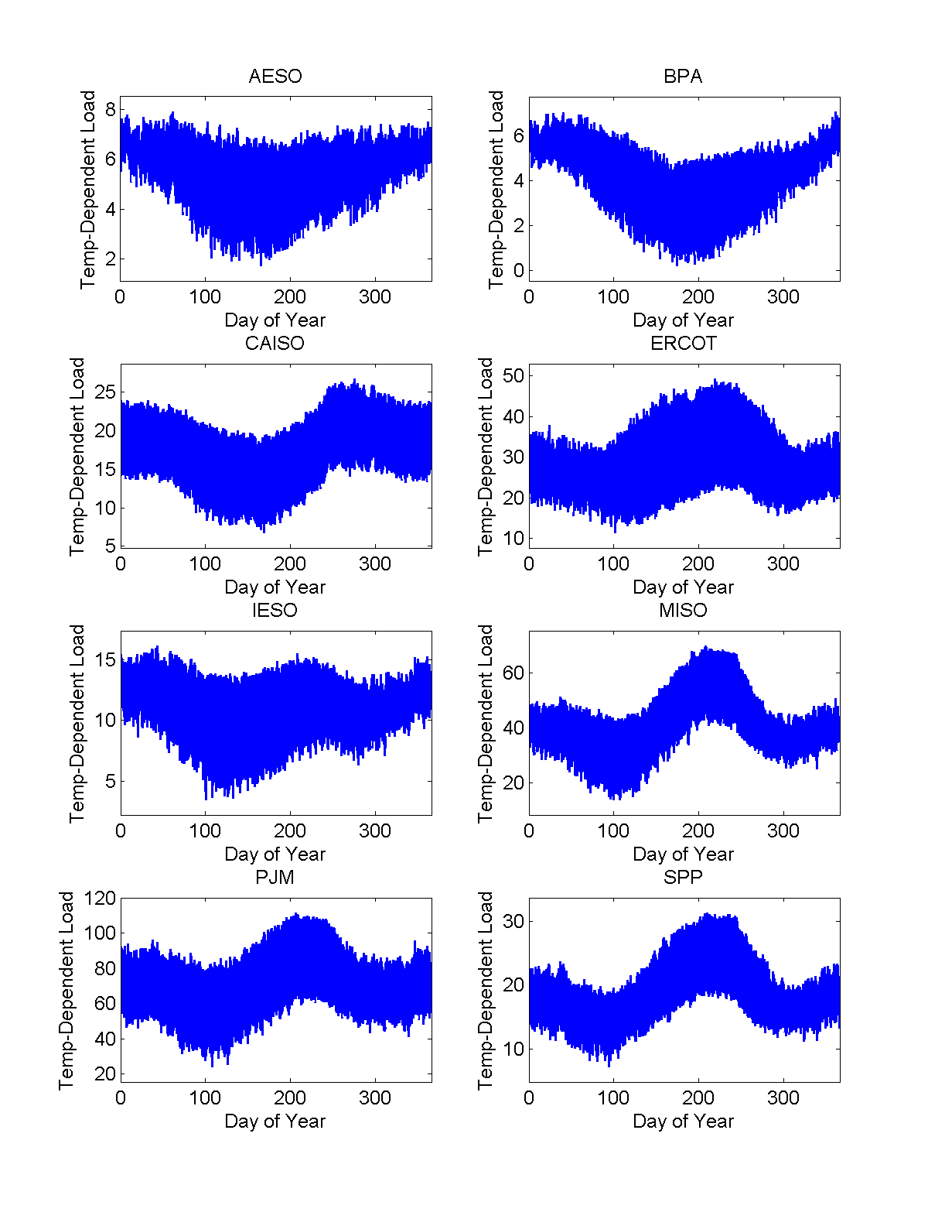
Climatology of Historical Electrical Demand
Simulated Electrical Demand History
These show demand minus renewable generation for 35% renewable penetration in each RTO/ISO.

Slide 21
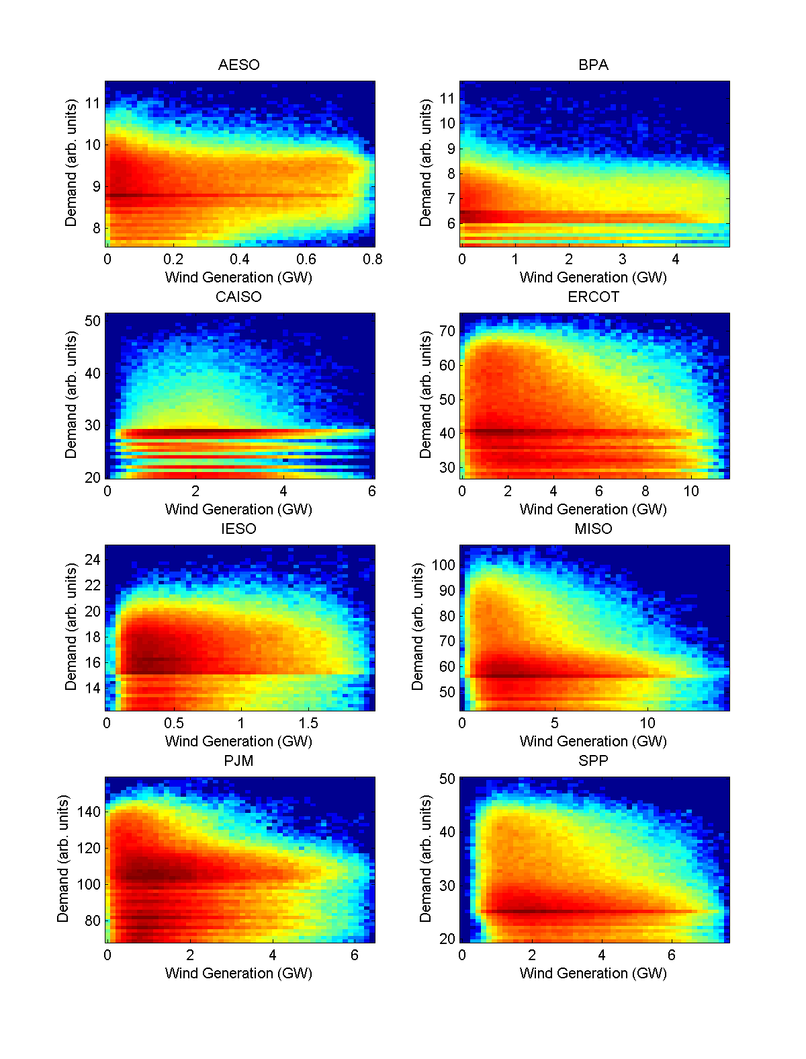
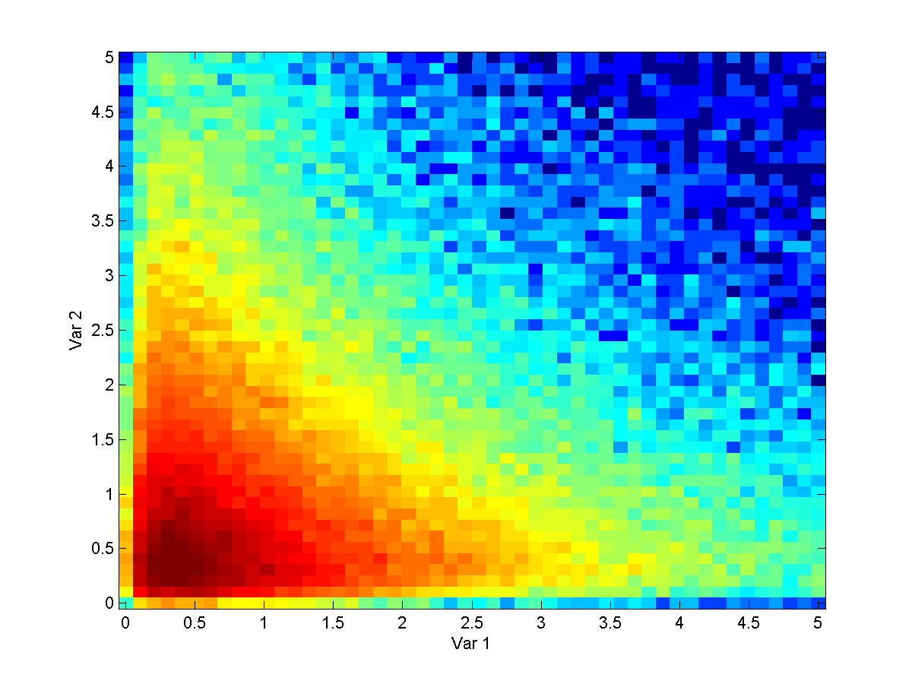
Correlation of Wind and Demand
Here we show two-dimensional histograms of wind generation (horizontal axis) and temperature-dependent electrical demand (vertical axis). For reference, the same map for two log-normally distributed random variables is shown below. Some of the relationships (MISO) are “worse” than random, in the sense of preferentially low generation during times of high demand and vice versa, while others are “better” (AESO, PJM).

Slide 22
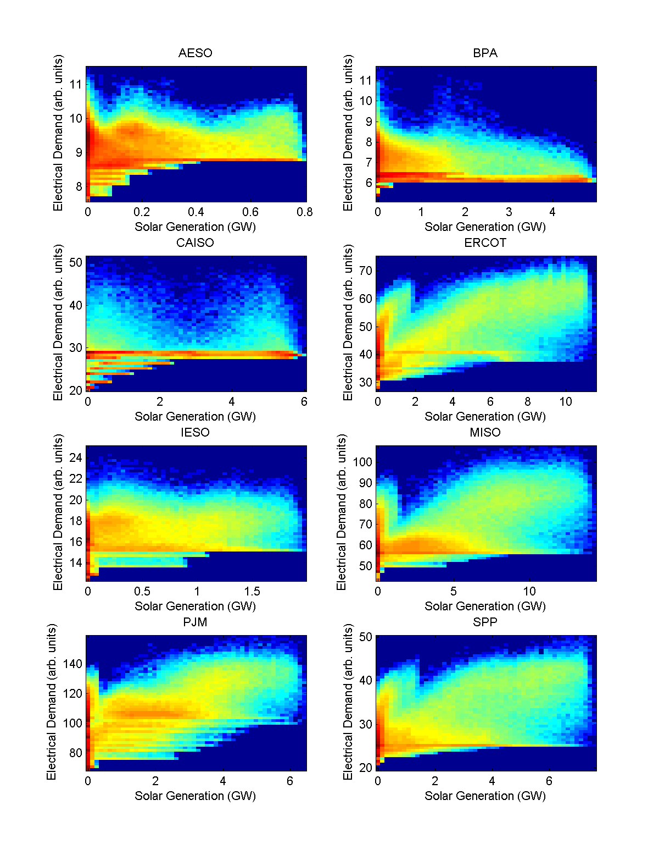
Correlation of Solar and Demand
Here we show two-dimensional histograms of solar generation (horizontal axis) and electrical demand (vertical axis). Correlations range from 0.03 in BPA to 0.72 in ERCOT.

Slide 23
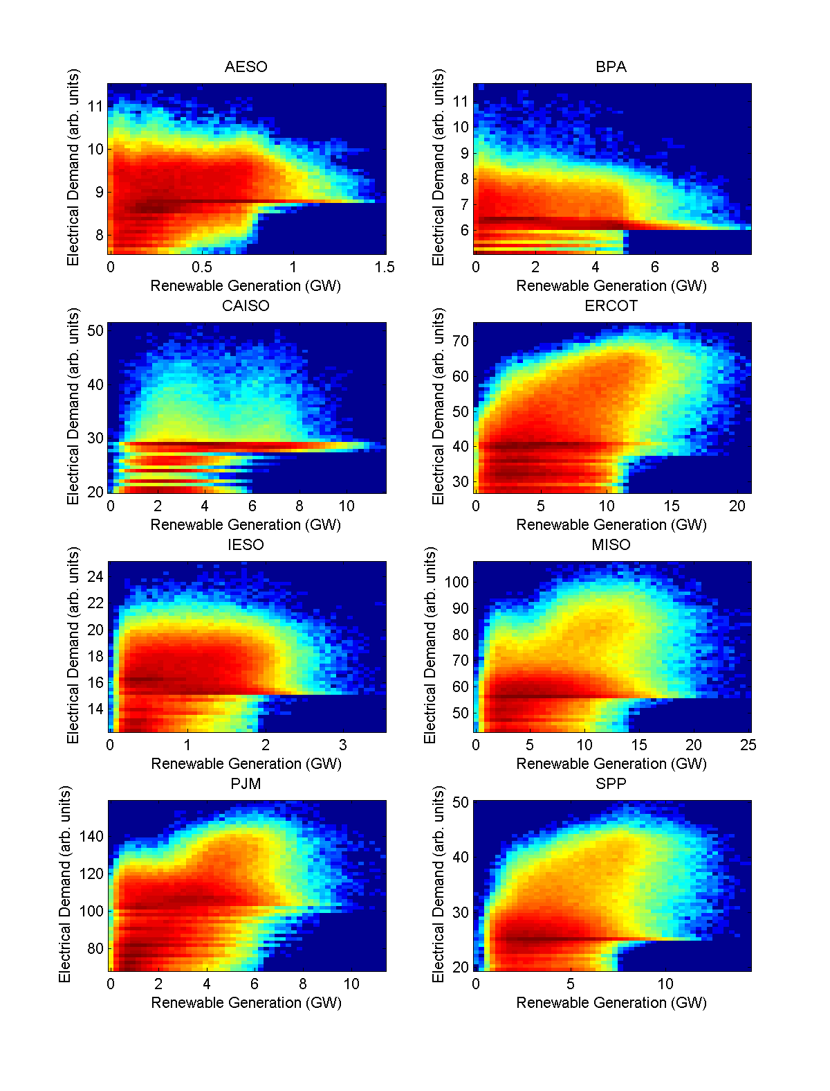
Correlation of Renewables and Demand
Here we show two-dimensional histograms of total renewable generation (wind + solar, horizontal axis) and electrical demand (vertical axis). Correlations range from 0.00 in BPA to 0.48 in ERCOT.

Slide 24
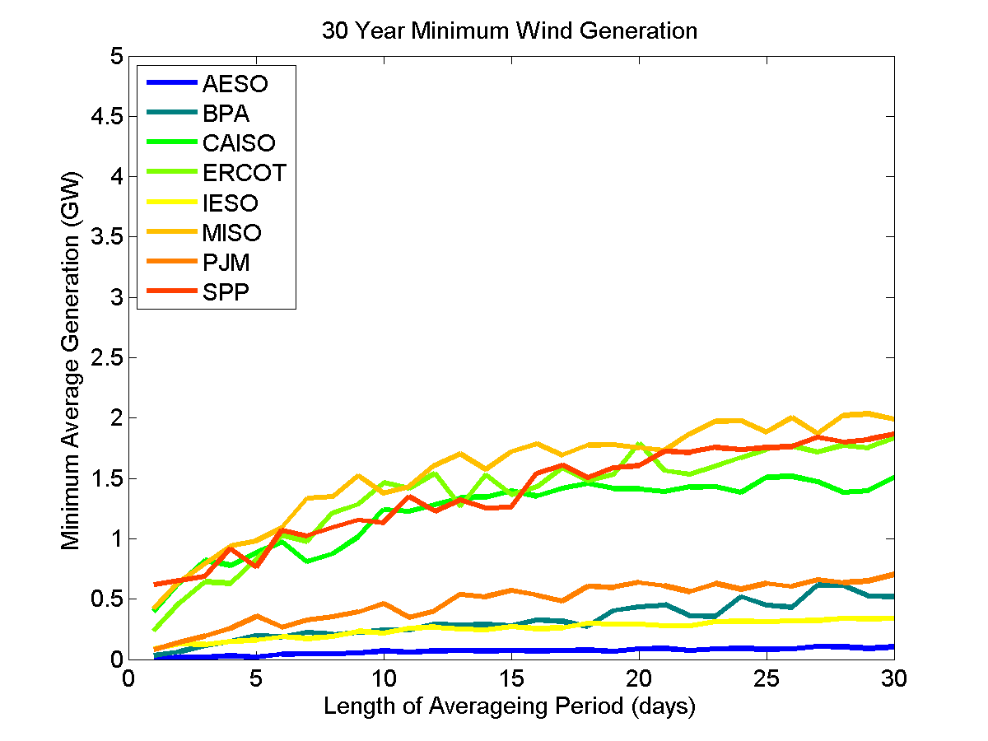
Generation Droughts

Slide 25
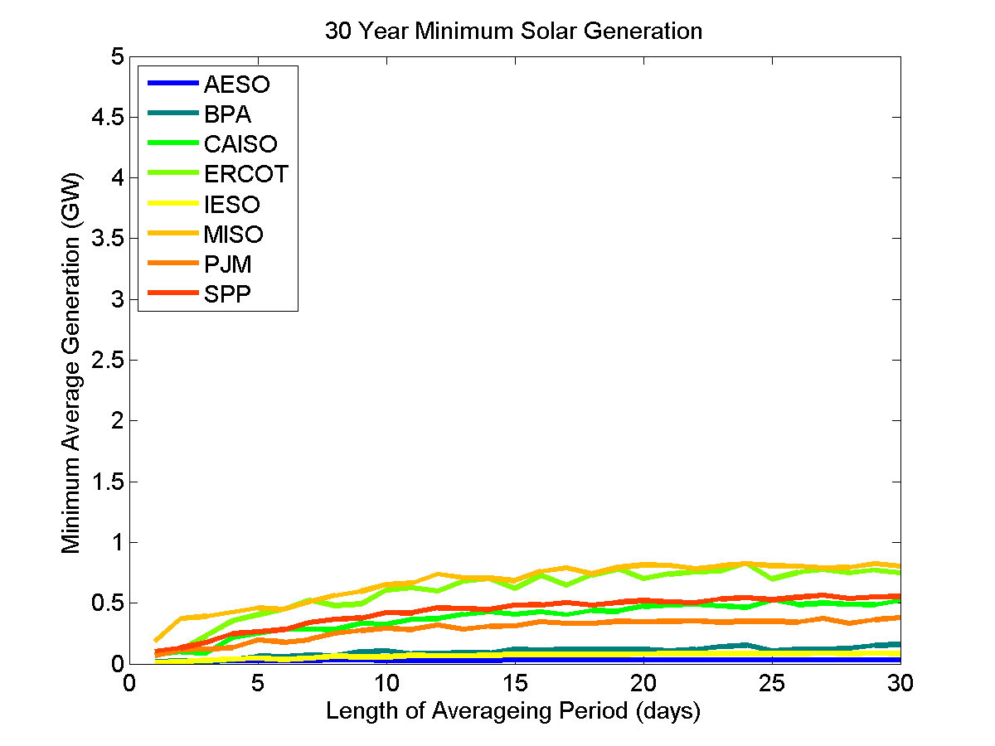
Generation Droughts

Slide 26
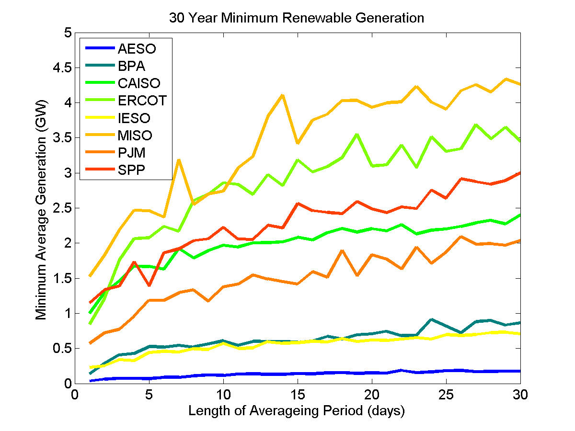
Generation Droughts

Slide 27
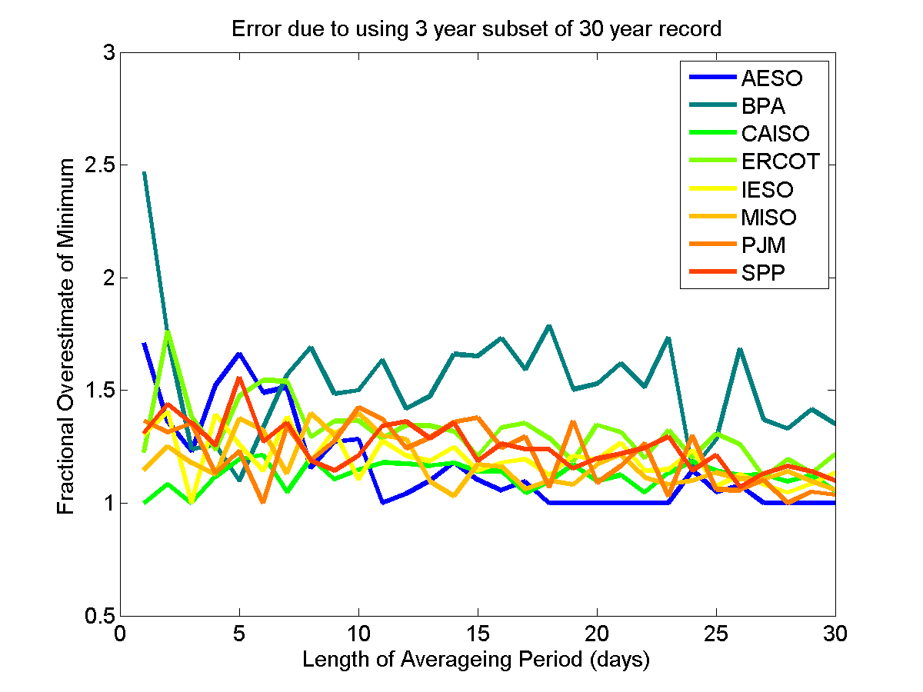
Generation Droughts

Slide 28
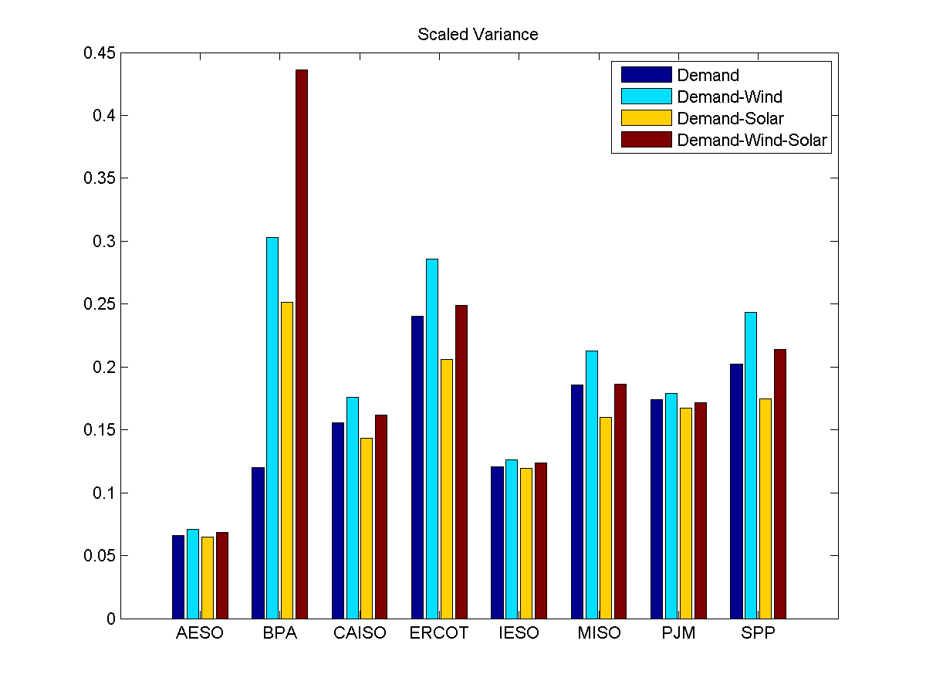
Over-all variance for present wind, scaled solar

Slide 29
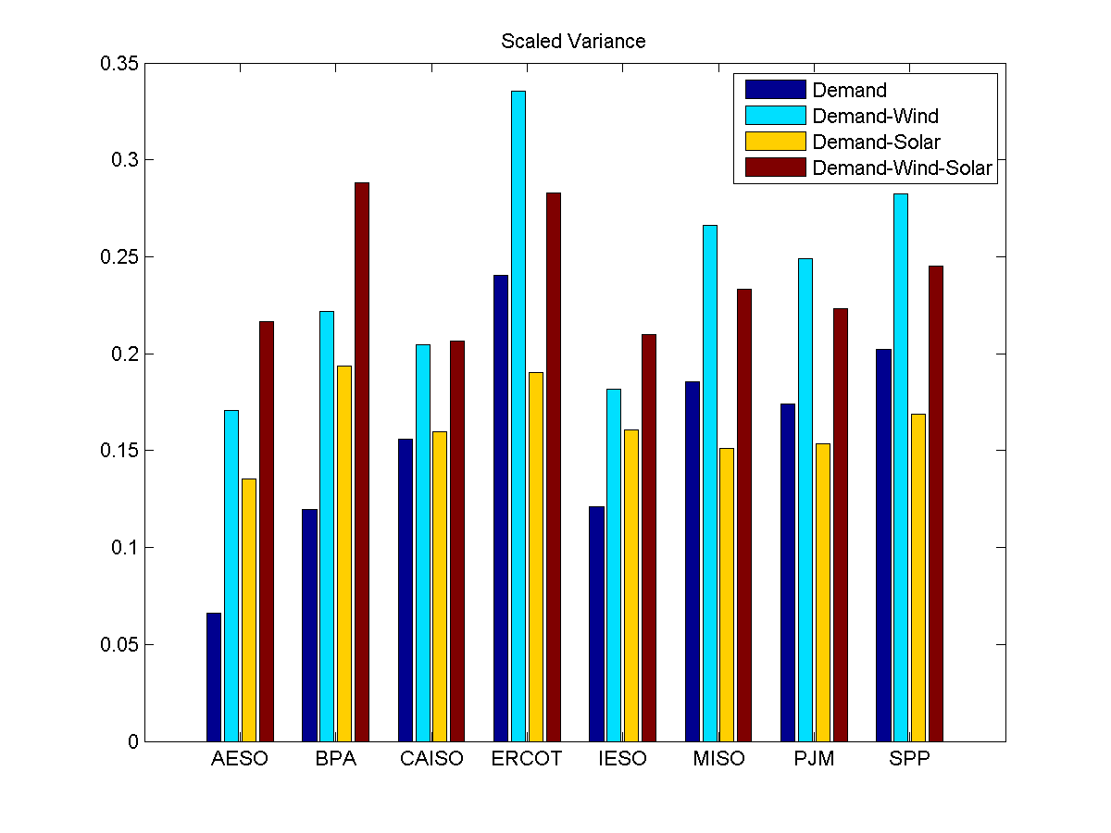
Over-all variance for 25% renewable generation

Slide 30
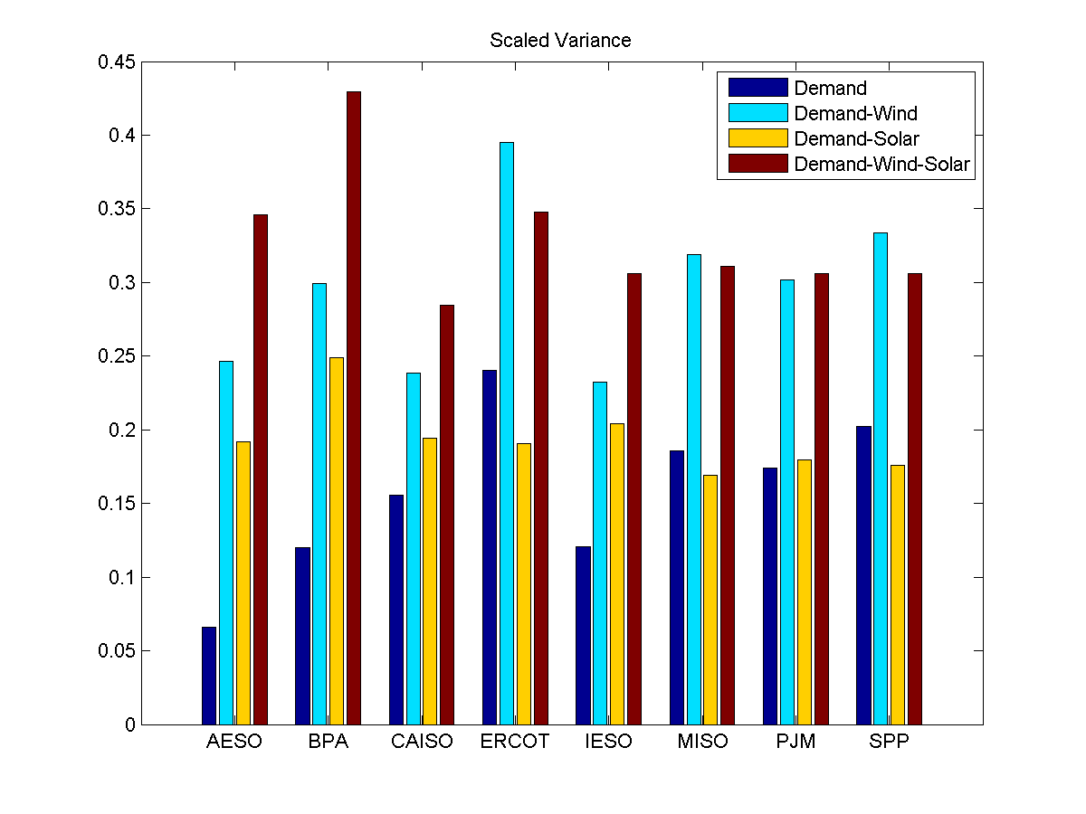
Over-all variance for 35% renewable generation

Slide 31
Conclusions
Renewable generation (solar, wind and combined) variability has very different characteristics in different regions.
Reanalysis does a good job reproducing wind generation and demand variability. High resolution is probably not necessary, given our ample observed generation record.
Determination of reanalysis’s ability to reproduce subtler aspects of solar variability will have to wait for more installed capacity for validation.
A thirty year record of simulated generation allows improved estimates of rare events vis-à-vis a shorter record, but the advantage isn’t overwhelming

