Slide 1

Medial Femoral Condyle (MFC)
Bone Flap
Anthony Capito, MD FACS
Oncologic Reconstructive Course
12/7/2025

Slide 2
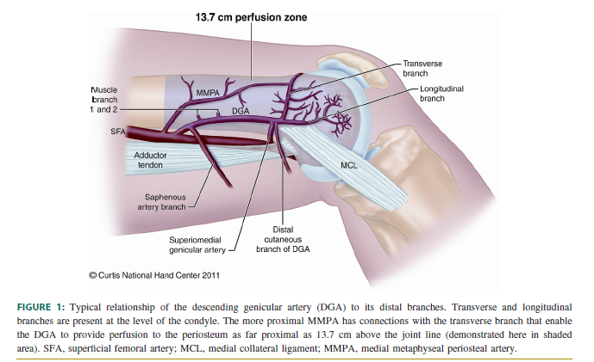
Anatomy
Iorio ML, Masden DL, Higgins JP. The Limits of Medial Femoral Condyle Corticoperiosteal Flaps. J Hand Surg 2011;36A: 1592-96.

Slide 3
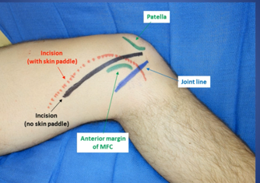
Wong VW, Higgins JP. Medial Femoral Condyle Flap.
PRS Global Open 2016;4:e834.

Slide 4
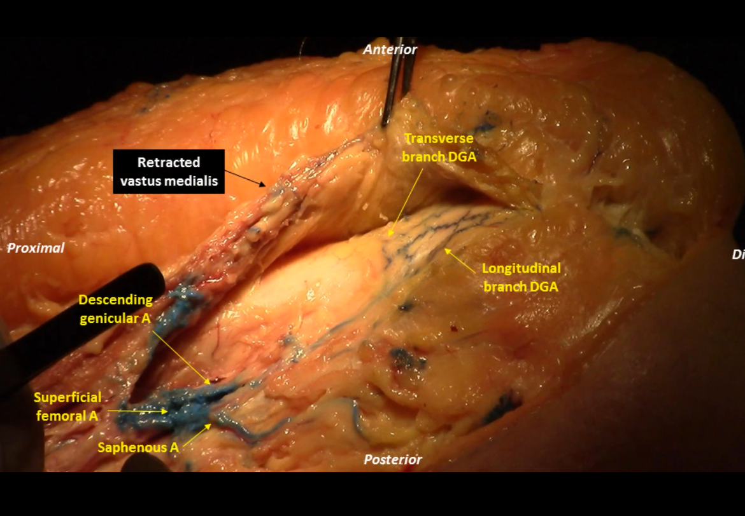
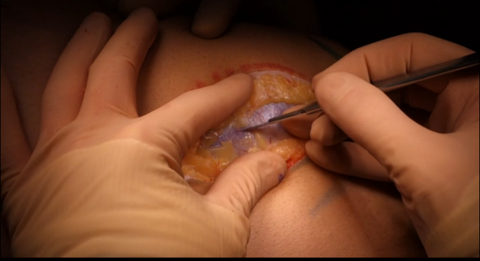
Wong VW, Higgins JP. Medial Femoral Condyle Flap.
PRS Global Open 2016;4:e834.

Slide 5
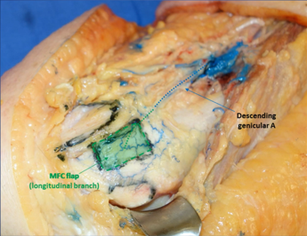
Wong VW, Higgins JP. Medial Femoral Condyle Flap.
PRS Global Open 2016;4:e834.

Slide 6
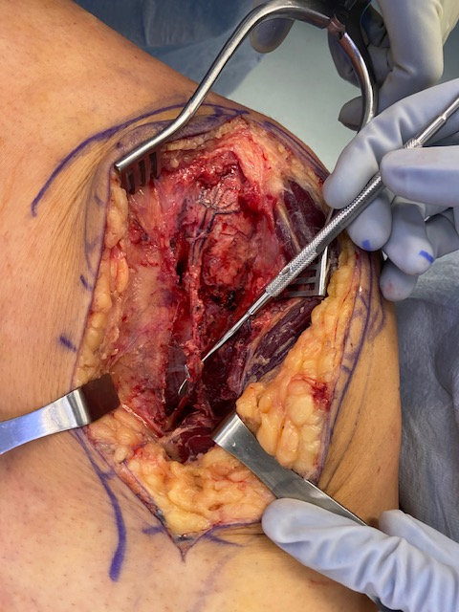
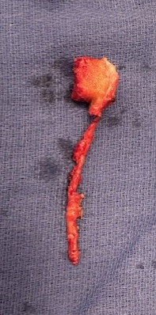

Slide 7
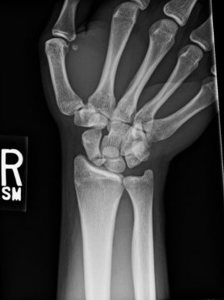
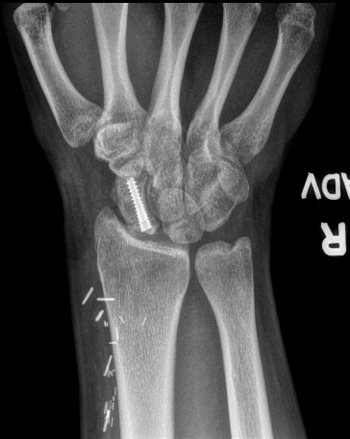

Slide 8
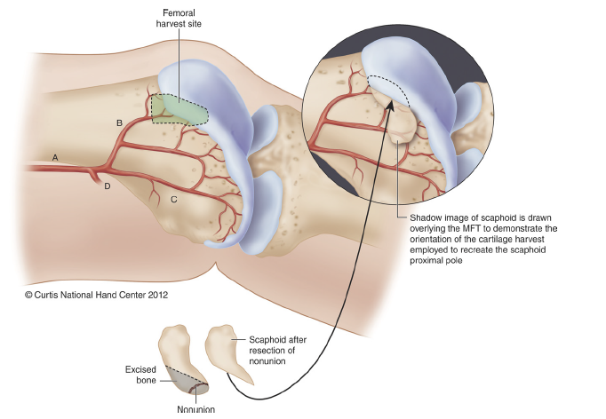
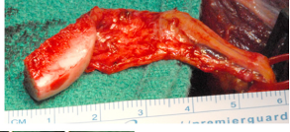
Burger HK, Windhofer C, Gagg, AJ, Higgins JP. Vascularized Medial
Femoral Troclea Osteocartilaginous Flap Reconstruction of Proximal Pole
Scaphoid Nonunions JHS 2013; 38A: 690-700.

Slide 9
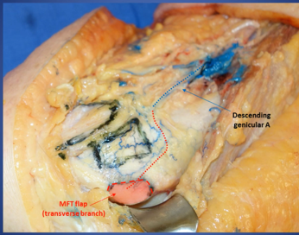
Wong VW, Higgins JP. Medial Femoral Condyle Flap.
PRS Global Open 2016;4:e834.

Slide 10
Iorio ML, Masden DL, Higgins JP. The Limits of Medial Femoral Condyle Corticoperiosteal Flaps. J Hand Surg 2011;36A: 1592-96.

