Slide 1


Strategic Management
Diversification/Vertical Integration
Walt Disney Entertainment King
Unless otherwise noted, this slide deck is (c) Virginia Polytechnic Institute and State University. It is released under a Creative Commons Attribution NonCommercial ShareAlike 3.0 license (CC BY NC-SA 3.0)
Instructor Name | Name of Institution
http://hdl.handle.net/10919/102735
Photo by Jon Sailer on Unsplash

Slide 2
Today’s Objectives – Date Here
Understand how managers seek to create value through diversification initiatives.
Be able to assess the potential for value creation at the corporate level within a firm.
Understand the alternative means of engaging in diversification (e.g., mergers and acquisitions, joint ventures/strategic alliances, and internal development).
http://hdl.handle.net/10919/102735

Slide 3
Review: Corporate-Level Strategy
Business Diversification (products & services)
Single
Dominant
Related
Unrelated – Diversified
2. Vertical Integration: Backward or forward
(industry value chain)
3. Horizontal Integration: Similar businesses
4. Geographic Diversification
http://hdl.handle.net/10919/102735

Slide 4
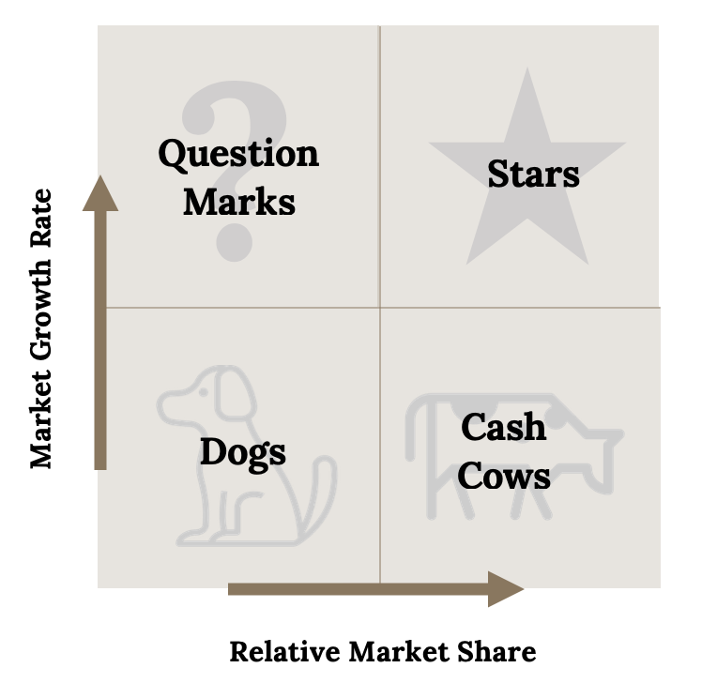
Review: Corporate-Level Tool
The BCG “Portfolio” Matrix
Kindred Grey (2020). “The BCG Matrix.” CC BY-SA 4.0. Retrieved from: https://commons.wikimedia.org/wiki/File:The_BCG_Matrix.png.
http://hdl.handle.net/10919/102735

Slide 5
The Walt Disney Company: The Entertainment King
Questions
What was Disney’s corporate level strategy in 1984 (be clear and concise)? How were the various business segments related at that time? Unrelated? How did Disney create corporate level synergies?
What is Disney’s corporate level strategy in 2000 (be clear and concise)? How are the various business segments related? Unrelated? How did Disney create corporate level value/synergies?
http://hdl.handle.net/10919/102735

Slide 6

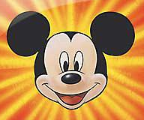



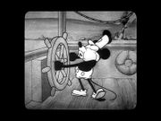










Why did Disney Grow from Mickey to Monday Night Football?
1984: $1.5 billion
2005: $30 billion
http://hdl.handle.net/10919/102735

Slide 7
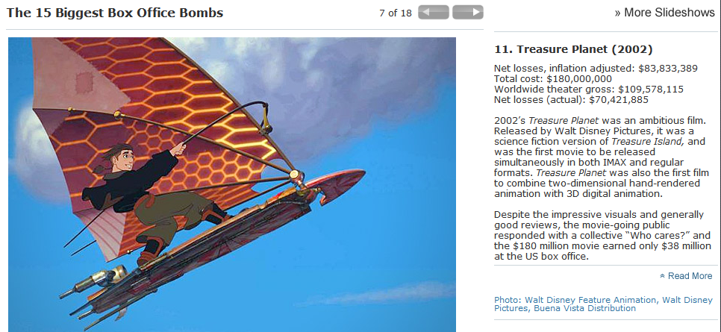
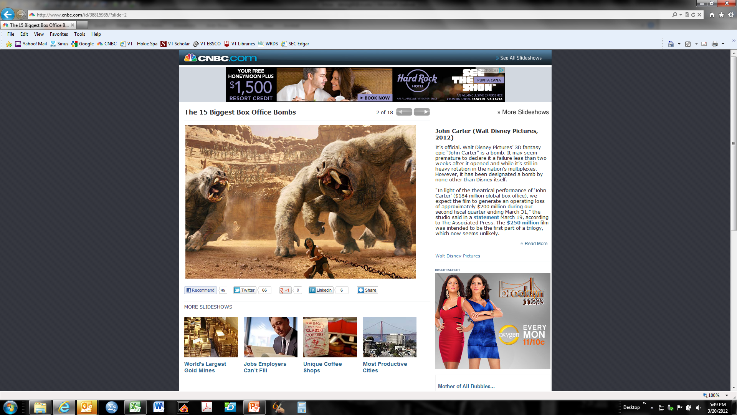
It Wasn’t all Honky Dory!
© Walt Disney Pictures. Fair Use.
http://hdl.handle.net/10919/102735

Slide 8
It Wasn’t all Honky Dory! (Cont.)
© Walt Disney Pictures. Fair Use.
http://hdl.handle.net/10919/102735

Slide 9
Levels & Types of Diversification Using Revenues
Low Levels of Diversification
Single business
> 95% of revenues from a single business unit
A
Dominant business
Between 70% and 95% of rev. from a single business unit
A
B
Related Diversification
Moderate to High Levels of Diversification
A
Related Diversification
< 70% of revenues from dominant business
B
C
Unrelated Diversification
Very High Levels of Diversification
A
Unrelated-Diversified
B
C
Business units not closely related
Adapted from R. P. Rumelt, 1974, Strategy, Structure and Economic Performance, Boston: Harvard Business School.
http://hdl.handle.net/10919/102735
Notes:
Which level of diversification did Disney have in 1984? See next slide.

Slide 10
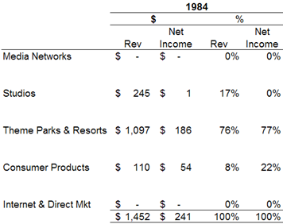
Disney’s Level of Diversification
http://hdl.handle.net/10919/102735
Notes:
According to Disney’s revenue distribution, they were a Dominant Business.

Slide 11
Levels & Types of Diversification Using Revenues
Low Levels of Diversification
Single business
> 95% of revenues from a single business unit
A
Dominant business
Between 70% and 95% of rev. from a single business unit
A
B
Related Diversification
Moderate to High Levels of Diversification
A
Related Diversification
< 70% of revenues from dominant business
B
C
Unrelated Diversification
Very High Levels of Diversification
A
Unrelated-Diversified
B
C
Business units not closely related
SOURCE: Adapted from R. P. Rumelt, 1974, Strategy, Structure and Economic Performance, Boston: Harvard Business School.
http://hdl.handle.net/10919/102735
Notes:
Which level of diversification did Disney have in 2000? See next slide.

Slide 12
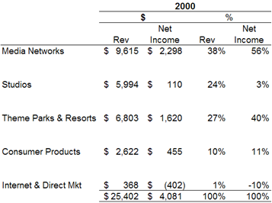
Disney’s Level of Diversification: 2000
http://hdl.handle.net/10919/102735
Notes:
2000 – Related Diversification

Slide 13
Levels & Types of Diversification Using Revenues
Low Levels of Diversification
Single business
> 95% of revenues from a single business unit
A
Dominant business
Between 70% and 95% of rev. from a single business unit
A
B
Related Diversification
Moderate to High Levels of Diversification
A
Related Diversification
< 70% of revenues from dominant business
B
C
Unrelated Diversification
Very High Levels of Diversification
A
Unrelated-Diversified
B
C
Business units not closely related
SOURCE: Adapted from R. P. Rumelt, 1974, Strategy, Structure and Economic Performance, Boston: Harvard Business School.
http://hdl.handle.net/10919/102735
Notes:
2000 – Related Diversification

Slide 14
A Short Summary
Corporate strategy (based on level of diversification):
1984; dominant business.
76% of revenue from theme parks and resorts
17% from studios
8% from consumer products
2000; related diversification - linked.
36% from media network,
24% from studios,
27% theme parks and resorts,
10% from consumer products
1% from internet & direct market.
http://hdl.handle.net/10919/102735

Slide 15
A Short Summary (Cont.)
From a dominant business (theme parks and resorts) in 1984 to related diversification (media network, studios, theme parks and resorts, and consumer products) in 2000.
Synergy???
Sharing the characters created in the animation studio and then utilized across the company.
Disney Dimensions
Monthly Synergy meetings
http://hdl.handle.net/10919/102735

Slide 16
Was Eisner a Success at Disney?
http://hdl.handle.net/10919/102735

Slide 17
Actions Launched by Eisen – Longer Term
National advertising of Disney brand name ($35 million for the first time).
Reinvest in university to maintain corporate culture.
Hire outsiders and bring in fresh air and ideas.
Open first international park and expand original parks.
Ramp up production of movies from 4 to 18 per year.
http://hdl.handle.net/10919/102735

Slide 18
What Mechanisms/Levers did Eisner use to Grow Disney? Why These?
Internal development – expanded scope of offerings
Partnerships – hotel development
Licensing – all the toys, merchandise, etc.
Acquisitions
Joint ventures?
International theme parks
Strategic Alliances?
http://hdl.handle.net/10919/102735

Slide 19
What Synergies Were Produced?
Costs – merging Touchstone Television into division of ABC to reduce expenses
Geographic– International (Japan, France, Hong Kong, Shanghai)
Horizontal – new types of entertainment such as ESPN Zones, cruises (used to bring people to Disney, not to make money independently), and DisneyQuests
Vertical – Internet and TV (outlet for their own programming)
http://hdl.handle.net/10919/102735

Slide 20
Recap & Look Ahead
Today
Next Class: See Schedule
Diversification exercise
Read: In-class exercise materials posted to Scholar on Six Flags, Carnival Cruise Lines, and QVC (of Liberty Media).
Prepare a position (see handout for aspects to address) in accordance with the prep questions
Prepare class preparation questions
Post slides in advance to Canvas
Teams will be presenting
Understand how managers seek to create value through diversification initiatives.
Be able to assess the potential for value creation at the corporate level within a firm.
Understand the alternative means of engaging in diversification (e.g., mergers and acquisitions, joint ventures/strategic alliances, and internal development).
http://hdl.handle.net/10919/102735

