Slide 1
Identifying Drug Related Events from Social Media
Jeongho Noh
Jisu You
Yoonju Lee
Woo Jin Kye
Sungho Kim
CS4624 Multimedia, Hypertext, and Information Access
Professor: Edward A. Fox
Client: Weiguo Fan, Long Xia
May 2, 2017
Virginia Tech, Blacksburg, VA 24061
Notes:
Hi We are Identifying Drug Related Events from Social Media team My name is

Slide 2
Innovative information system and processing steps
(Crawl social network reviews on drugs that are used to treat diabetes - by client)
Label the crawled data manually
Generate side effect dictionary to recognize side effect entities.
Visualize the resulting information for doctors and patients
Create confusion matrix to see result
Notes:
I will introduce the processing steps for our innovative information system. First we got crawled social network review data that are used to treat diabetes from our client. We labeled each data to start, and then we generated side effect dictionary to recognize side effect entities. After that we create pie chart and confusion matrix to see visualized result

Slide 3
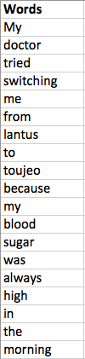

Data Labeling
Manual labeling is necessary to build a problem specific dictionary.
Labeled about 235,000 words for named entity recognition.
Notes:
Table on the right shows sequence of words from reviews retrieved using crawler

Slide 4
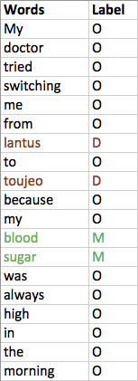
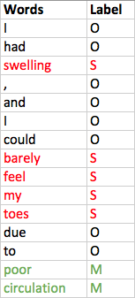
Data Labeling - Named Entity Recognition
Four different labels for different entities:
  D – drug entity
  S – side effect entity
  M – miscellaneous medical terms that are not a drug entity or a side effect entity
  O – others
Notes:
This labeling process is very important since as you can see from table on the left, word blood and sugar is labeled medical term instead of others since they are in sequence and blood sugar relates to medical term for this problem specific dictionary for diabetic drug reviews. Also from tables on the right words barely, feel, my, toes are labeled side effect entity due to the mention of swelling in the same review.

Slide 5
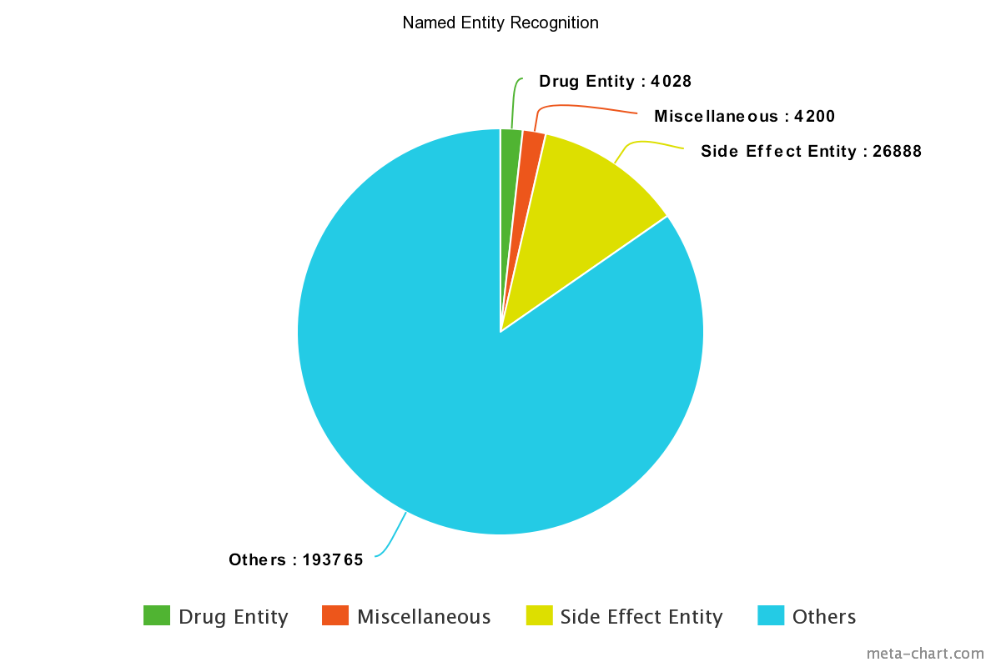
Data Labeling - Named Entity Recognition Cont.
There are a total of 2242 unique side effect entities and 412 unique drug entities out of 228881 named entities.
Notes:
And this pie chart shows the number of entities after labeling process. There are a total of 2242 unique side effect entities and 412 unique drug entities. This problem specific dictionary was used to create smokelist which woojin is going to talk about next.

Slide 6
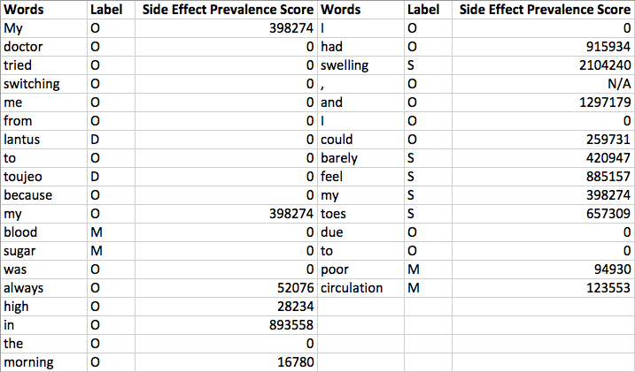
2. Generating Side Effect Dictionary - Smoke List
Notes:
From the manually labeled list of words, we created a side effect dictionary. The first step was to create a smoke list that contains prevalence scores of each word. The scores indicate how much likely each word is associated with side effect.

Slide 7
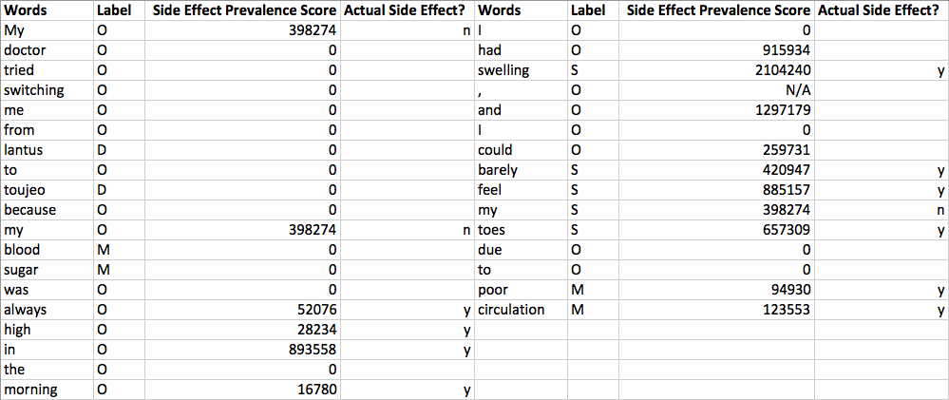
2. Generating Side Effect Dictionary - Filtering
Notes:
Out of the side effect entities, we filtered out some neutral words like ‘my’.

Slide 8
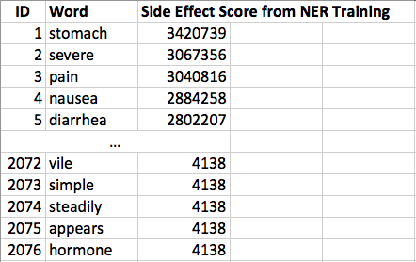
2. Generating Side Effect Dictionary - Result
Notes:
The resulting dictionary contains total 2076 unique words.

Slide 9
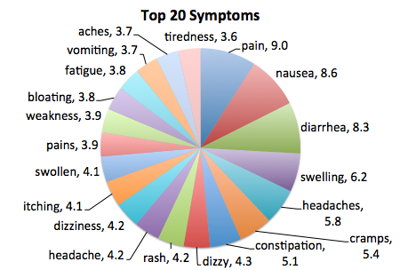
3. Visualization
*values are in percentage
Notes:
Using the dictionary, we created this pie chart that shows the top 20 symptoms of the drugs that treat diabetes

Slide 10
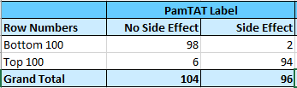
4. Validation
Confusion Matrix
  summary of the result.
Select two hundred reviews from the list of 5585 reviews labeled by PamTAT
  100 from the top and 100 from the bottom of the list.
Hypothesis: All the reviews from the top of the list will contain a mention of side effects, and the reviews from the bottom of the list will not.

Slide 11
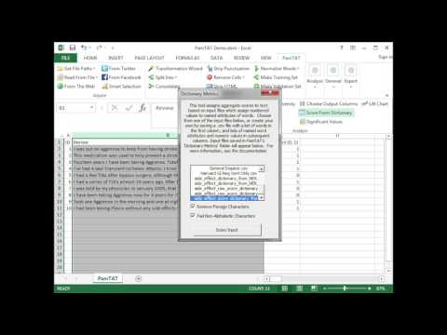
Demo
https://www.youtube.com/watch?v=QYgBhBQtGsQ

