Slide 1
Event Trend Detector
Ryan Ward, Skylar Edwards, Jun Lee, Stuart Beard, Spencer Su
CS 4624 Multimedia, Hypertext, and Information Access
Instructor: Edward A. Fox
May 4, 2018
Virginia Tech, Blacksburg VA 24061
Notes:
Spencer

Slide 2
Table of Contents
Project Overview
Current Status
Trend Detection
Clustering
Challenges
What’s Left
Acknowledgements
Notes:
Spencer

Slide 3
Project Introduction
Collects news articles from Reddit and Google and identifies trends in frequency of mentioned entities.
Builds on a previous CS4624 project which identifies similarities (clusters) in top Reddit news stories.
Tasked with improving clustering algorithm and UI and implementing trend detection.
The project is viewable outside Torgersen 2030.
Notes:
Spencer

Slide 4
Work Completed
Clustering algorithm
Trend detection
Google News article collection
Updated UI
Notes:
Spencer

Slide 5
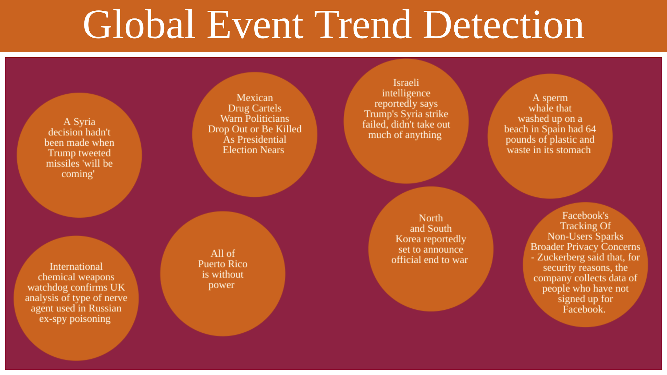
Cluster Display

Slide 6
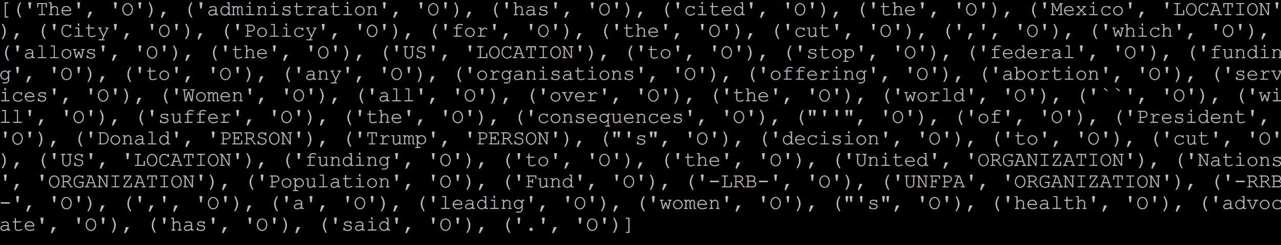
Tagged Entities before cleaning
Notes:
For the trend detection, we used a library called sner to extract all named entities. Here is what the entities looked like before we cleaned the data.

Slide 7
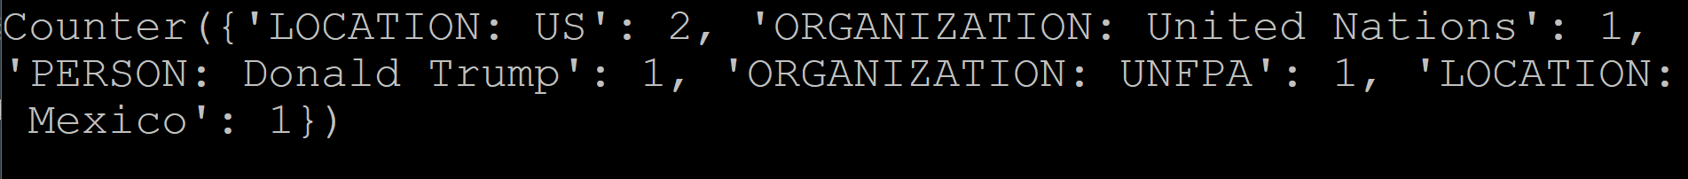
Cleaned Tagged Entities

Slide 8
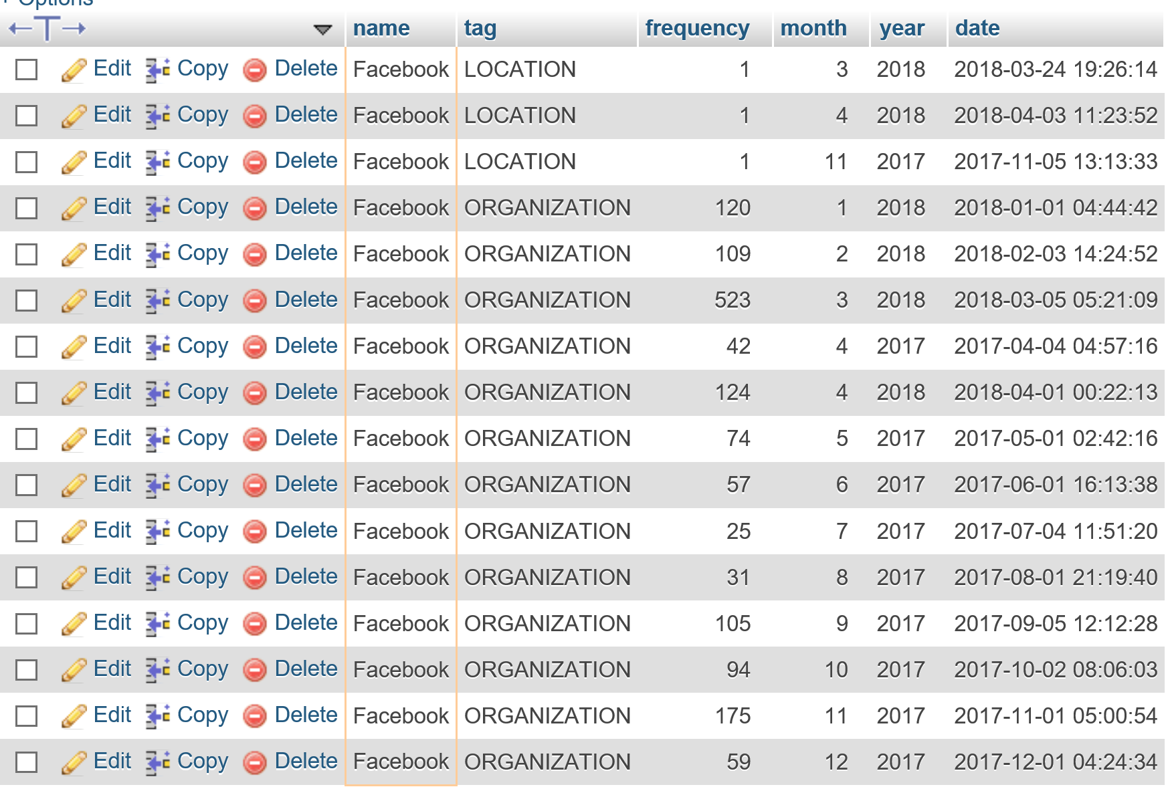
Tagged Entity Database Table Example

Slide 9
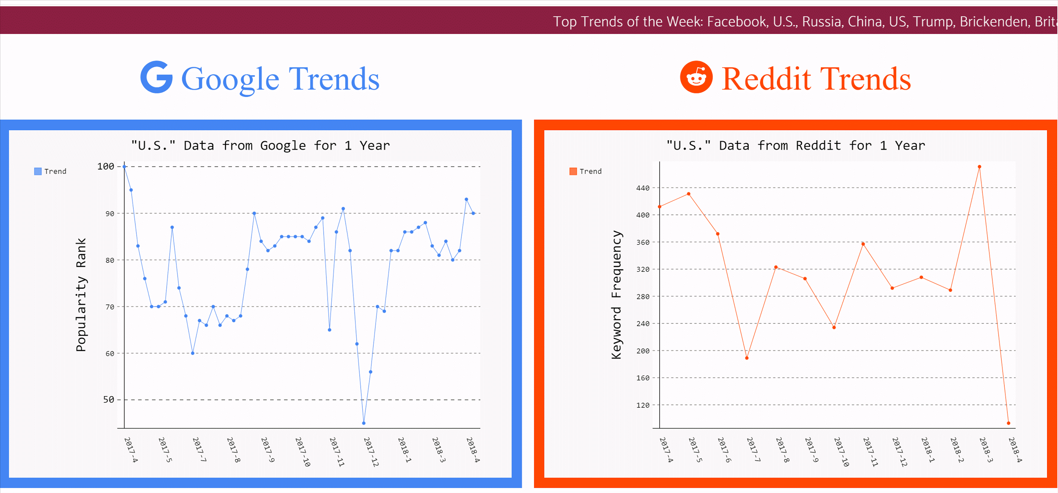
Output graph

Slide 10
Clustering Implementation
Document Similarity Matrix
  Determines subgraph connectivity
  Subgraphs are recalculated for dynamic similarity threshold
Threshold filtering
  Sizes of the subgraphs change based on different similarity threshold settings
  Decrease threshold in each iteration to decrease the number of clusters
  Subsequently, number of centroids also decreases
  Goal is to create ‘the most acceptable’ number of clusters with highest similarities
Notes:
Jun

Slide 11
Changes to algorithm
TensorFlow -> Scikit-learn
  Tools performs K-means clustering
  Hardship in manipulating data for cluster representation
Creating subgraphs with iterations
Testing various threshold percentages (High -> Low)
Using clique as representative
New articles will be…
  Added in clusters -OR-
  Used to create new clusters
Notes:
Spencer

Slide 12
Challenges Faced
Apache configuration/version issues
Matching the x-axis for trend graphs
Using pre-built libraries - sometimes not so compatible
Deciding number of clusters for display system
Notes:
Stuart

Slide 13
Acknowledgements
Client: Liuqing Li
Supported by NSF (IIS-1619028 and 1619371)
References:
Google Trends: https://trends.google.com/trends/story/US_cu_J7SG6GEBAADA3M_en
https://trends.google.com/trends/explore?q=trend
Cluster Methods:
http://www.sthda.com/english/articles/25-cluster-analysis-in-r-practical-guide/111-types-of-clustering-methods-overview-and-quick-start-r-code/

Slide 14
Questions?

