Slide 1
VeSPA Video
Client : VeSPA & Thomas Schlegel
Virginia Tech University
CS 4624 Multimedia/Hypertext
May 8, 2013
Siggi Simonarson & Sean Case

Slide 2

The Hokie Grail
League of Legends tournament
24 Teams
Over 75 games
$1000 cash prize + raffles & other prizes

Slide 3






Goals
Create promotional material for Virginia eSports Association to:
  Obtain sponsors for future events
  Excite players to compete in future events
Notes:
The goals of this project were to create promotional material for client aimed at two audiences
The first audience is sponsors of future events.
VeSPA contacts companies that may be interested in sponsoring a tournament that they put on in order to provide larger prizes and more resources to those participating in the event.
The second is the gamers.
The goal there is to create material that will excite the gamers into participating in future events.

Slide 4
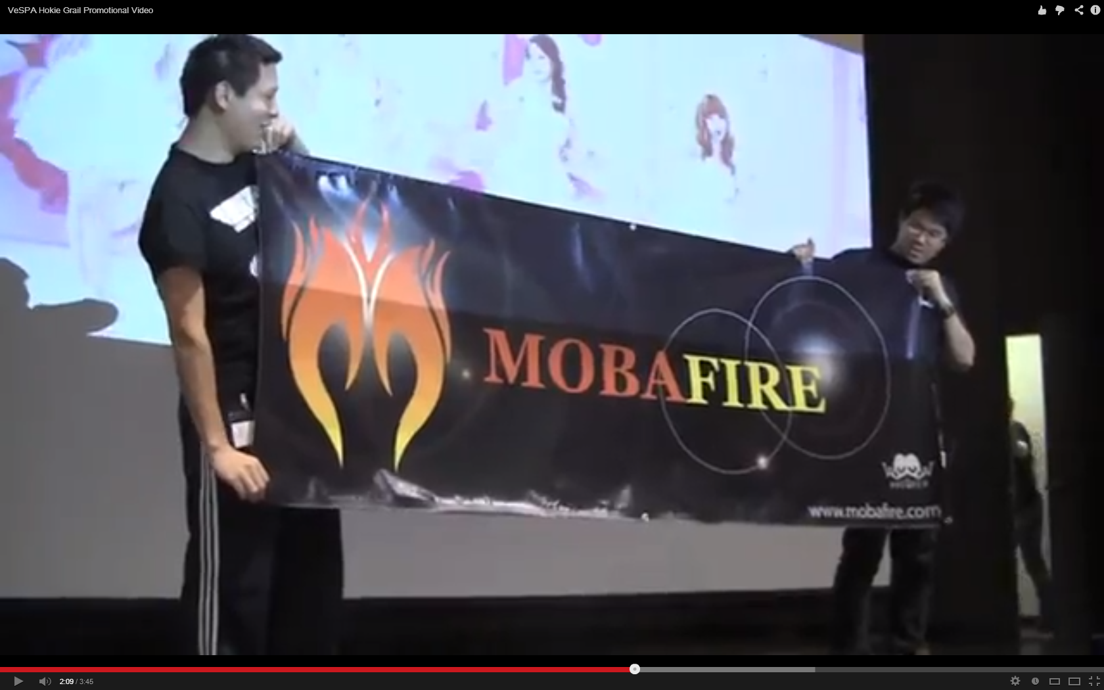
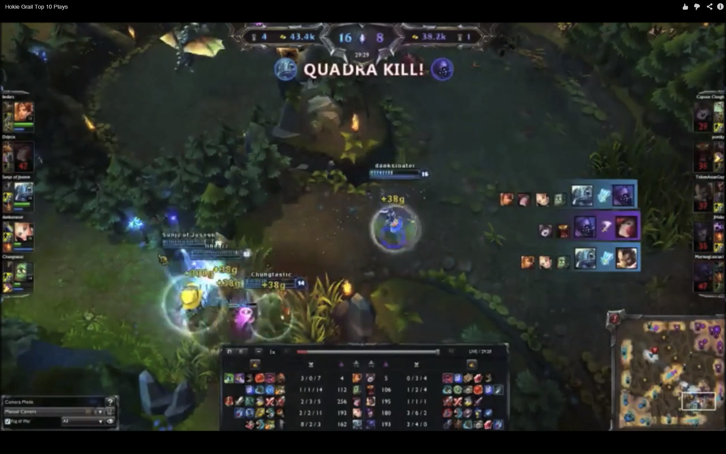
Deliverables
Promotional Video
  Footage taken at event
  ~ 4 minutes
  Used by VeSPA to get sponsors
Highlight Reel
  In game footage
  ~ 5 minutes
  Entertainment for League of Legends Players

Slide 5
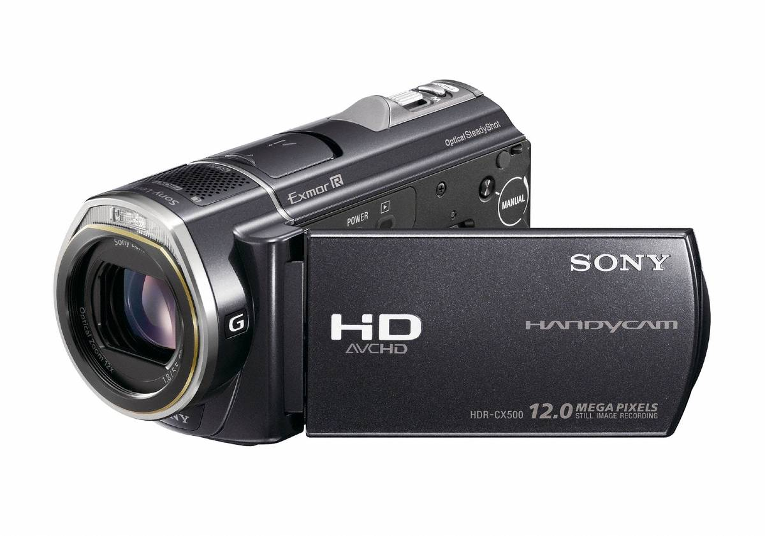
Filming
Event took place in the beginning of the semester
Shot the live event with two cameras from Innovation Space
Lighting & spread out nature of event were issues
Notes:
Luckily our event took place right at the beginning of the semester.
This allowed us to obtain the footage early and spend more time compiling and on editing.
There were some drawbacks however, in that we hadn't had some of the lessons on filming and lighting.
We used two cameras from innovation space and tried to get footage of before during and after the event of participants playing and of the audience reacting.
Lighting was an issues especially in the auditorium since it wasn't under our control. It was so dark that nearly all the footage taken of the audience was useless.
The event was also spread out from the Graduate Life Center Auditorium to various classrooms all the way to Torg. This made shooting footage of the entire event challenging.

Slide 6
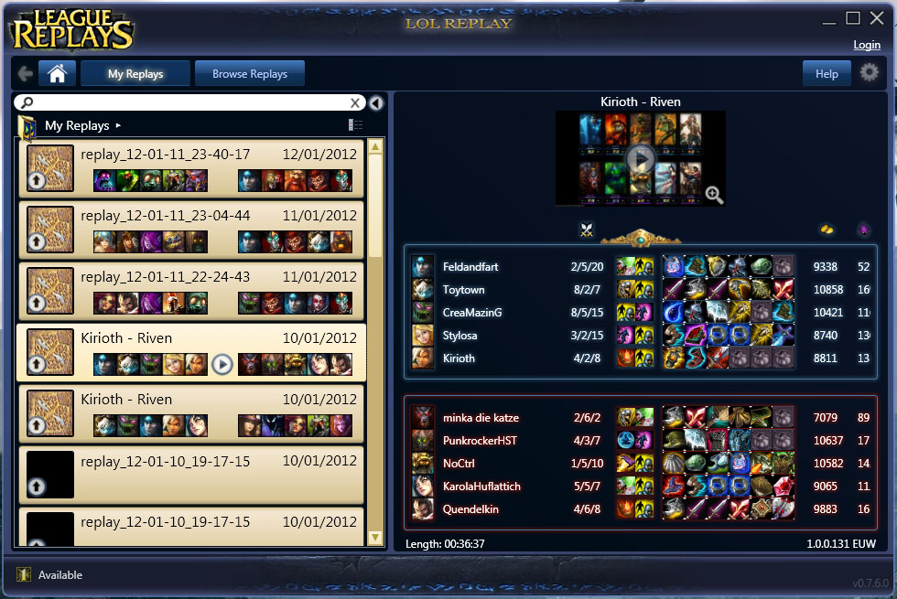
In Game Footage
Some of the teams submitted LoL Replay files
Issues arose with compatibility between patches
Ended up using footage from the stream

Slide 7

Conversion
Cameras recorded in .mts format
Streamed games were in .fla format
Needed them in .mov format for editing software
Used software called Toast
Notes:
The cameras recorded in a proprietary HD file format created by Sony and Panasonic called MTS.
The footage from game streams was in the Flash fla format.
For our video editing software we used, iMovie, needed .mov files, so we used a program called Toast to handle the conversion.
Took many hours to converts.

Slide 8
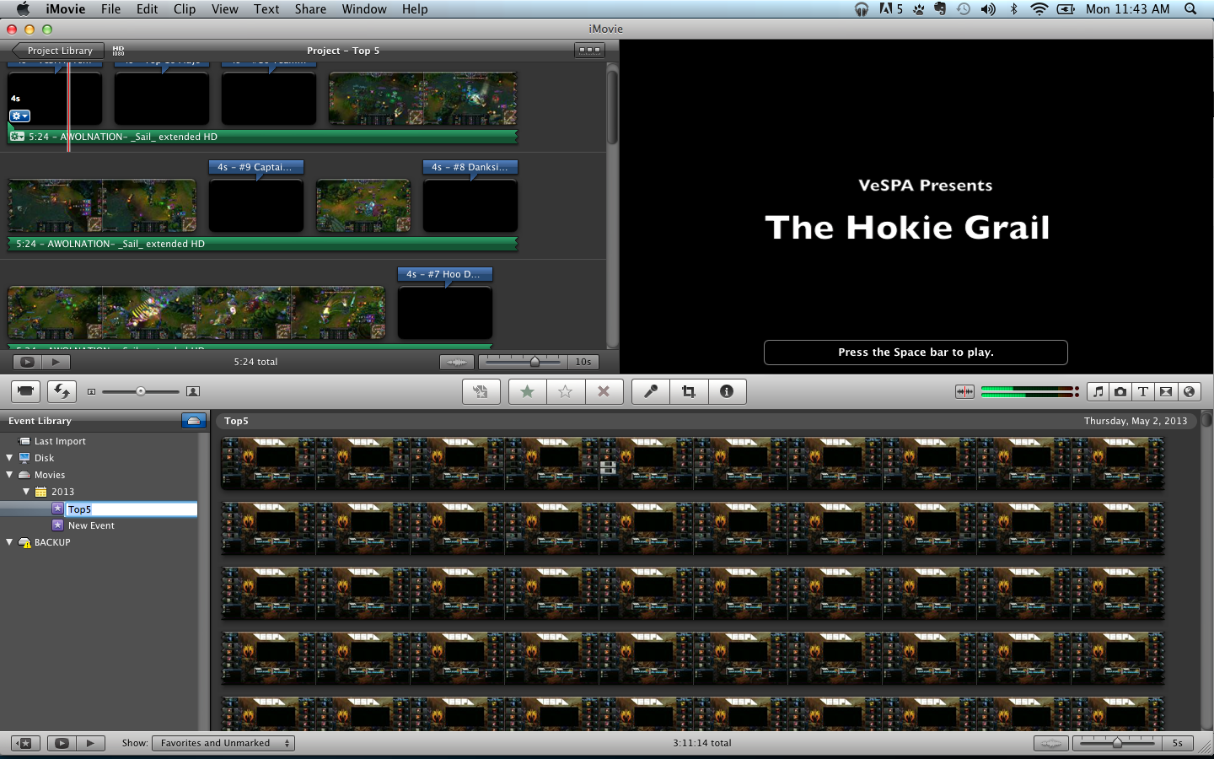
Editing
Tried out a lot of different editing software at Innovation Space
Decided to work with iMovie for ease and ability to work on our personal computers

Slide 9
Publishing
Videos themselves only 500 - 700 MB
Published to YouTube
Music usable on YouTube
  Copyright holders are YouTube Content Partners
  Can't collect ad revenue from video - not an issue
VTechWorks versions of videos
  Creative Commons Licensed Music
VTechWorks hosting for:
  CC licensed videos
  iMovie Project files for future videos
Raw video totals 120 GB
Notes:
We ran into several issues when publishing the videos.
The videos themselves were only 500 - 700 MB, so uploading them to YouTube was fine.
We chose music from copyright holders who were YouTube Content Partners.
This means we're allowed to play the videos on YouTube, but we can't collect advertising revenue from them - which our client is okay with.
For VTechWorks we created separate versions of the videos that used music that was liscensed under the Creative Commons liscense.
On VTechWorks we are also hosting the iMovie projects used to create the all four videos.
This will allows the client to use the current videos as a template for future top 10 or promotional videos.

Slide 10
Updated Timeline
✔ Jan 27 - Feb 2: Collection of in game footage
✔ February 1 & 2: Filming of live event
✔ February 12: Meet with client to nail down specifics & collect necessary files
✔ March 26: Promotional video draft done
✔ March 27: Midterm presentation
✔ March 27 - April 3: Work with client for promotional video edits
✔ April 7: Promotional video final edit
✔ May 1: Highlight reel video draft
✔ May 1 - 8: Work with client for highlight reel video edits
IP May 8: Final presentation

Slide 11
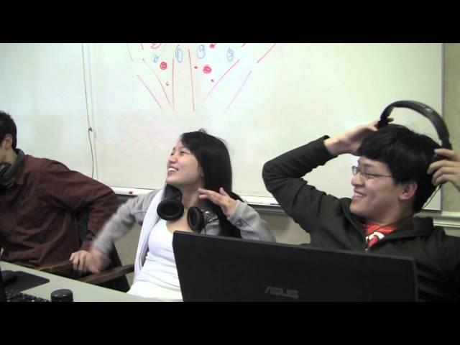
Promotional Video

Slide 12
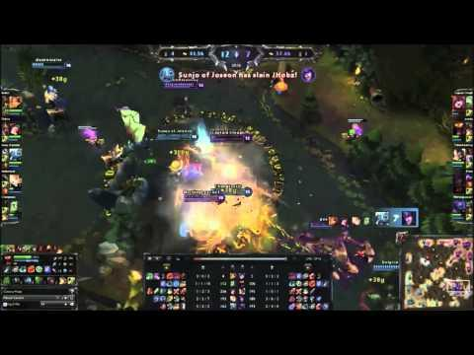
Highlight Reel Video

