Slide 1

Evidence Synthesis Triage in an Academic Library
David Nolfi, Carolyn Baker, Madelyn Glymour
Gumberg Library at Duquesne University
Library Evidence Synthesis Services Symposium
June 18, 2026

Slide 2
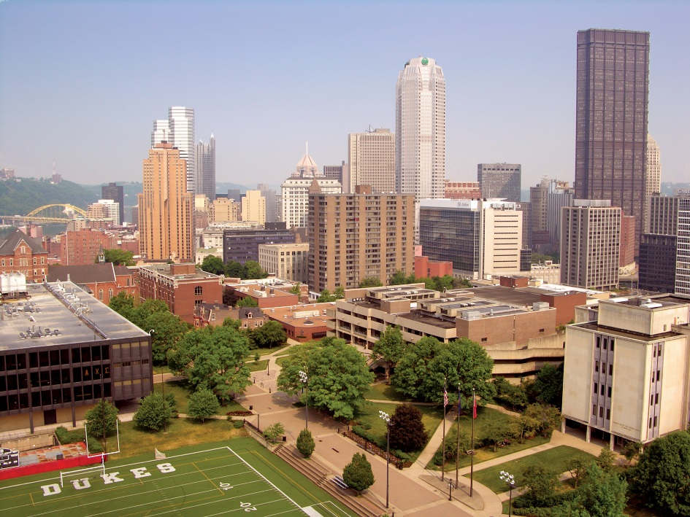
Duquesne University
Private, Catholic
Downtown Pittsburgh
Carnegie Classification-R2
8,087 students (FTE)
Two Libraries:
Law - 529 students
Gumberg Library - 7,558 students

Slide 3
Schools Served by Gumberg Library
School | FTE | %
Business | 1,363 | 18%
Education | 532 | 7%
Health Professions | 1,099 | 15%
Liberal Arts | 1,43 | 15%
Medicine* | 283 | 4%
Music | 205 | 3%
Nursing | 1,134 | 15%
Pharmacy | 812 | 11%
Science & Engineering | 980 | 13%
Non-School | 7 | 0%
Total | 7,558 | 100%
Notes:
Of the total student population served by Gumberg, roughly 75% are undergrads and 25% grad students. However, for the health sciences students, the numbers undergrads comprise approximately 52% of the population and graduate students comprise approximately 48%.
*I placed an asterisk on Medicine because these numbers are only reflecting years 1 and 2 and the medical school curriculum (please masters in biomedical science students). Medicine is enrolling it’s enrolling it’s third class, which will be an additional XXX students in FA26 and another class of YYY students in FA227. Full enrollment is projected by 20232, with a 680 medical students and 50 MBS students by 2033. This number is important because this group of 450 additional students will all be graduate students and will likely have a higher than average interest in doing systematic views and other evidence syntheses.
As the medical school builds toward full enrollment, the percentage of health sciences students Gumberg serves will surpass 50% of the total. However, I note that Fall 2026 admissions, show substantial increases in Nursing and Pharmacy undergrad admissions and the university is projecting these increases will continue.

Slide 4
Evidence Synthesis at Duquesne
Programs / Schools
Purposes
Very high activity:
  Health sciences
  Education
  Liberal Arts/Social sciences
Moderate activity:
  Business
  Economics
  Health care ethics
Some activity:
  All schools
Publications & presentations
Grants
Teaching & learning:
  Undergraduates
  Master’s
  Professional Doctorate
  PhD

Slide 5
Student Evidence Synthesis Work Examples
Health Sciences
CATs:
Athletic Training Master's
Capstones:
Occupational Therapy Doctorate
Systematic:
Health Sciences PhD
Medicine
Systematic:
M2s
M3s & M4s
Residents
Nursing
Scoping & Integrative:
PhD Dissertations
BSN Honors
Pharmacy
Systematic & Scoping:
Post PharmD Masters
Residents
Education
Scoping:
Counselor Training
Educational Psychology
PhD Dissertation

Slide 6
Current Service Model

Slide 7
Traditional Service Model
Evidence Synthesis Specialist (ES) Librarians:
Complete formal ES training
Mentored through two full projects before working independently
Cross-team mentorship & collaboration
Continuing education (SRSS-1, SRSS-2, etc.)
Levels of Service:
Teaching
Consultant
Team Member
Workshops
Course-integrated
Acknowledgment
Expert help with searches
Authorship
Develop searches
Provide methodological guidance
Participate in writing manuscript with focus on methods section

Slide 8
Teaching Research & Engagement (TRE)
Health Sciences Team
Other TRE Librarians
Full Time – 3
  Health Sciences
  Medicine
  Nursing
  Pharmacy
MLIS Intern – 1
Full Time – 4
  Humanities
  Education
  Music
  Psychology
  Science & Engineering
Others:
  Part Time – 2
  Assistant Dean - 1
  Other Departments – 2

Slide 9
Current Model in Practice
Health Sciences Team:
Provide bulk of ES services (all schools)
Mentor other librarians
Other TRE librarians:
Full time librarians completed or enrolled in formal training
Variable levels of confidence to work independently*
Selected librarians are not trained and do not provide ES support
2 PT librarians:
Cover the bulk of on-call research assistance time
Develop related LibGuides
Provide help with selected tasks

Slide 10
Problems with the Traditional Model
Frustrating for researchers and generalist librarians alike!
Hand offs after can be unexpected or difficult
Delays in providing library support for review teams
Increased workload for ES librarians

Slide 11
New Approach

Slide 12
Setting the Stage
On-call librarians can help review teams get started
Many ES services do not require highly specialized skills
Most librarians can provide needed help in early review stages

Slide 13
Triage Approach
Benefits
Support researchers as soon as possible
Challenges
Additional training and support required
Differentiate ES vs. traditional reviews
Positive experiences for librarians working on-call
More time for ES-trained librarians to focus on advanced support
Handoffs can be tough for librarians & research teams
Understanding when to handoff

Slide 14
Support Roles for Generalist Librarians*
Pre-Consultation:
Help teams discern if they truly want to do a formal ES methodology
Introduce ES methodologies and question frameworks
Connect review teams with relevant resources and tools
Tasks:
Initial exploratory searching
Citation management
Review management software
set up
Getting full text
Warm Handoffs:
Levels of service
When to handoff a question
Help review team understand how/when/why to request advanced support
*Based on the levels of support model (Roth, 2022) and the Systematic Review Working Group (Wafford, 2023).

Slide 15
Roles for ES Specialist Librarians
Initial Consultation:
  Authorship vs. acknowledgment
  Review question & type
  Operational definitions
  Eligibility criteria
  Database selection
  Develop initial search
  Feedback on research team’s searches (acknowledgment)
Authorship Level Tasks:
  Finalize and register protocol
  Develop comprehensive searches
  Update review management software project to reflect final protocol
  Provide continued methodological guidance
  Draft methods section of the manuscript
  Participate in writing full manuscript

Slide 16
Implementing the New Model
HS team organized a series of 12 brief training sessions:
Sessions included in alternating TRE meetings
Primarily address functions that any TRE librarians can do to support review teams
Other sessions go beyond the basics to help other librarians understand the whole process
Recordings, slides, handouts saved on departmental shared drive
Other TRE librarians are invited to:
Shadow review consultations
Participate in parts of ES projects with guidance

Slide 17
Training Sessions Part I
Getting to Know You: Learning About the Types of Evidence Syntheses
What the Heck Is an Evidence Synthesis? Overview of the Process
You want me to do what?!? Pre-Consultation with ES Research Teams
Take a Deep Breath: Initial Consultation with an ES Research Team
Fail to Plan or Plan to Fail: Developing and Registering a Protocol
How Not to Waste Everybody’s Time: Searching, Finding, and Updating Existing Reviews

Slide 18
Training Sessions Part II
That is the Question: Matching Question Frameworks to Specific Review Types
Exercise in Obsession: Developing a Comprehensive Literature Search
The One Your Mother Warned You About: Grey Literature
Critical Appraisal & Report of Bias
Data Extraction
Writing the Methods Section

Slide 19

Initial Results
Departmental training:
Part I: December 2025-April 2026
Part II: June-October 2026
PT librarians:
Shadowed consultations with review team members
Developed comprehensive literature searches with guidance
Revised review management software guide and co-taught workshops
Other TRE librarians:
Completed two ES projects as part of dissertations (mentored)
Working on an ES project intended for publication (mentored)
Conducting scoping review related to information literacy (with help)

Slide 20

Next Steps
Training
Complete training sessions
Continue to offer mentorship and shadowing opportunities
Consider additional tasks for generalist librarians
LibGuides
Revise existing ES-related LibGuides
Create additional higher-level ES LibGuides
Prepare for Increased Demand
Offer additional researcher-facing workshops
First class of third year medical students
Snowball effect

Slide 21
Lessons Learned…
So Far
Saving Teams meeting videos can be tricky…
Sessions took longer than expected due to audience engagement
Experienced colleagues benefitted & requested additional mentoring
Pace yourself with staff training to avoid overload!
Teaching librarian colleagues offers unique challenges & opportunities
A triage approach makes it easier for clients to request services

Slide 22
Resources to Help You Get Started
Inspiration for Gumberg’s Work:
Roth, S. (2022, July 27). Easy steps to building a systematic review service. Medical Library Association Continuing Education [webinar]. Chicago, IL. https://www.mlanet.org/professional-development/medlib-ed/
Wafford, Q. E. (2023, August 7). It takes a working group to help create strong reviews: Enhancing systematic review support and services. Medical Library Association Continuing Education [webinar]. Chicago, IL. https://www.mlanet.org/professional-development/medlib-ed/
Additional Resources:
Dreker, M. R. (2022). Establishing and managing review services. In M. J. Foster, & S. T. Jewell (Eds.), Piecing together systematic reviews and other evidence syntheses (pp. 267-276). Bloomsbury.
McKeown, S., & Ross-White, A. (2019). Building capacity for librarian support and addressing collaboration challenges by formalizing library systematic review services. Journal of the Medical Library Association, 107(3), 411–419. https://doi.org/10.5195/jmla.2019.443
Roth S. C. (2018). Transforming the systematic review service: A team-based model to support the educational needs of researchers. Journal of the Medical Library Association, 106(4), 514–520. https://doi.org/10.5195/jmla.2018.430
Siddiq, T. A. (2026). Boundaries at scale: A service blueprint for evidence synthesis support in STEM libraries. Science & Technology Libraries, 1–16. https://doi.org/10.1080/0194262X.2026.2661326
Tchangalova, N., Coalter, J., Trost, A., & Pierdinock, A. (2021). Research support services in STEM libraries: A scoping review. Issues in Science and Technology Librarianship, 97. https://doi.org/10.29173/istl2574
Wafford, Q. E., & O'Dwyer, L. C. (2021). Adopting a toolkit to manage time, resources, and expectations in the systematic review process: A case report. Journal of the Medical Library Association, 109(4), 637-642. https://doi.org/10.5195/jmla.2021.1221

Slide 23

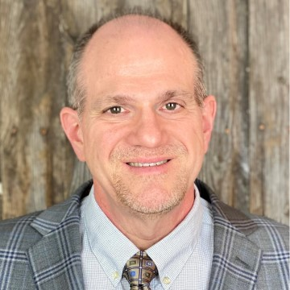


Presenter Contact Information
David Nolfi, MLS, AHIP-D
Head, Research Engagement, Health Sciences/STEM Initiatives & Assessment
nolfi@duq.edu
Carolyn Baker, MLIS, MOT
Health Sciences Librarian
bakerc19@duq.edu
Madelyn Glymour, MLIS
Medical Librarian
glymourm@duq.edu

