Slide 1
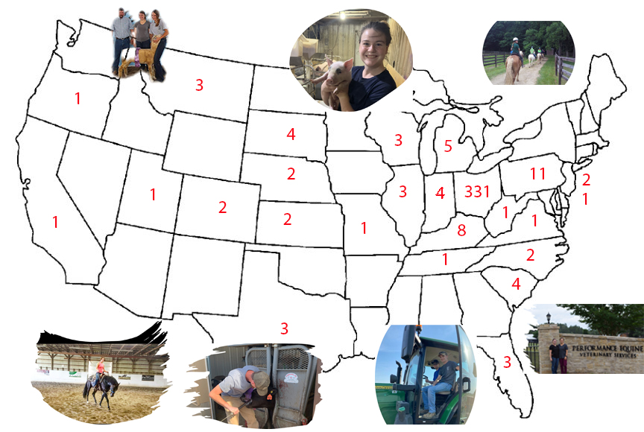

Influence of Pandemic and Academic Major on Undergraduate Agricultural Internship Selection
K. Bennett-Wimbush¹, M. Amstutz¹, J. Suagee-Bedore²
¹ Ohio State University, Wooster, OH ² Virginia Polytechnical Institute, Blacksburg, VA
Introduction and Objectives
Results
Internships provide valuable learning and career opportunities to undergraduate students. Selection of an industry internship is influenced by many factors including compensation, perceived value, external hiring opportunities, and location. Individual students may weight each factor differently, particularly regarding location! Internship hiring is a two-way street. Many businesses begin their internship and summer hiring early in the year and may prefer to hire employees from college programs from which they are familiar, and those early applicants. Our objectives were to evaluate the influence academic major, internship location (travel distance from home address to internship site) and COVID-19 pandemic had on internship selection by undergraduate agriculture students enrolled in Associate of Science degree program.
Average (LS means) distance from students’ home to their internship site was not different before (34.1 miles), during (39.4 miles), or after (34.5 miles) the COVID-19 pandemic.
There was no differences in DIST based on degree type (Associate of Applied Science vs. Associate of Science).
Academic major had a significant effect (P < 0.001) on DIST and frequency (all = 17.25%) of out-of-state internships (P < 0.001). Figure 1
Students majoring in Horse Management and Turfgrass Management completed internships further from home (P < 0.01) compared to Business Management, Crop Management, Landscape Design, and Power Equipment.
Frequency of OSI for all years ranged from 7.5% to 34.1% for Business majors compared to Horse majors respectively with significant differences (P < 0.001) between Horse majors compared to both Business and Greenhouse majors.
Figure 2 illustrates the frequency and locations of OSI for all majors from 2016-2023.
Beef majors completed more OSI post pandemic compared to pre-pandemic (P < 0.01).
Frequency of type of internship based on the variety of majors is in table 1.
Materials and Methods
Internship agreement forms (n = 400) from 2016 through 2023 were used to create an Excel spreadsheet that included: year, semester, type of degree (Associate of Applied Science vs. Associate of Science), academic major, home address, internship address internship state (in-state vs. out-of-state/ OSI), and type of internship (Business, Production, Husbandry, Recreation, Gold etc.).
Year of internship was categorized as: Pre-pandemic (2016-2019), Pandemic (2020-2021), and Post-pandemic (2022-2023).
The internship requirement for degree completion was waived by the university during the pandemic and an alternate course was allowed, but students were allowed to enroll in, and complete internships.
Addresses were generalized and recorded as ‘home town’ and ‘town of internship location’, rather than using the exact address in order to keep data unidentifiable.
Google maps was used to calculate both the driving distance in miles (DIST) and minutes, and the shortest route was used in the spreadsheet.
Internships located in the home town were assigned a distance of 5 miles unless it was a large city (ex. Cleveland, Columbus) in which a distance of 10 miles was assigned.
Differences in DIST between main effects (major, period) and interactions were evaluated with Tukey-Kramer test (ANOVA, SAS). Differences in frequency of out-of-state (OSI) comparing PreP vs. PostP was evaluated by generalized linear model (GenMod).
Figure 1
Average miles between interns’ home address and internship address by major. Differences are indicated by different subscripts.
Figure 2
Locations of OSI completed by all majors from 2016-2023.
Table 2
Frequency (%) of type of internship by major. Note: not all majors are included due to limited data in some majors. Type varied by specific major and was based on the job description and responsibilities listed on the internship agreement.
Major | Most prevalent type of internship and % within major | 2nd most prevalent type of internship and % of total within major | 3rd most prevalent type of internship and % within major
Horse Management | Husbandry 42.6% | Recreation 34.5% | Training 14.5%
Animal Science (all specializations) | Husbandry 50% | Other 20% | Health 17.5%
Turfgrass Management | Golf related 85% | Sport turf 10% | Installation 5.4%
Business Management | Office 30.8% | Agriculture related 30.8% | Sales 28.2%
Crop Management | Production 43.8% | Service 31.3% | Sales 18..8%
Agronomy | Production 41.7% | Service 33.3% | Sales 18.8%
Construction Management | Management 72.7% | Production 27.3% | Service 1%
Dairy Management | Husbandry 92.3% | Business 7.7%
Greenhouse Management | Production 94.7% | Management 5.3%
Power Equipment | Service/ Technician 100%
Summary
The COVID-19 pandemic had no effect on the distance undergraduate students traveled to internships, however, academic major significantly influenced both the distance and frequency of out- of-state internships. Internship availability in some industries can be geographically dependent which may influence students’ site selection.

