Slide 1

VLA
Writing Academy
Resources Folder
http://tinyurl.com/WritingAcademy-VLA-2016

Slide 2
Your Facilitators
Virginia Pannabecker, Health Sciences Research Support Coordinator, Virginia Tech University Libraries
Brian Burns, Interim Media & Access Services Librarian, Hampden-Sydney College
Susan LaParo, Head of Youth Services, York County Public Library
Robin Sofge, Youth Services Manager, Duncan Branch Library
Additional Virginia Libraries Editorial Board members:
Renee DiPilato, Deputy Director, Alexandria Library; Renee contributed to planning this preconference
Luke Vilelle, University Librarian, Hollins University

Slide 3
Introductions
Your name
Institution / Organization
Experience with Writing
Current Writing Interests

Slide 4
Session Plan
Planning a Writing Project
Activity - Resources for Writing an Academic Journal Article
Choosing a Publication Venue
Virginia Libraries journal
Activity - Reviewing journal scope, content types, and guidelines
Your Writing Project
Working time
Feedback
Wrap Up & Questions

Slide 5
Planning a Writing Project
Topic ideas
Type of writing project
Preparation needed, research protocol?
Co-Authors
Publication venues
Who is your target audience?
What else is important?
Access / Copyright / Licensing
Target publication guidelines
Previous publications
Examples
References

Slide 6
Planning a *Literature Review*
Co-Authorship
Project Plan
Key Components
Purpose / Research Question
Context
Approach / Methodology
Results / Synthesis
Implications
Next Stpes
Notes:
Co-Authorship
Project Plan
Key Components
Purpose / Research Question
Context
Approach / Methodology
Source identification & Selection
Synthesis methods
Results / Synthesis
Qualitative / Quantitative
Important categories for your purpose
Implications
Next Stpes

Slide 7
Planning a *Research* Article
Co-Authorship
Study Design
IRB or other protocol for human subjects
Project (and data management) Plan
Key components
Introduction / Background (literature and context)
Participants
Methodology
Discussion
Limitations
Further Research
Conclusion

Slide 8
Planning a *Practice* Article
Co-Authorship
Project Plan
Key Components
Background / Context
Planning notes
Implementation
Assessment Results
Lessons Learned
Next Steps
Implications for Practice
Notes:
Brian - Best Practice / Case Study type

Slide 9
Planning a *Feature* or *Column* Article
Co-Authorship
Project Plan
Key Components
A unique / stand-out topic
Identify connections between the topic and libraries / information broadly and in Virginia
Define subsections
Consider highlighting key players
Include tips and details of note
Point to resources, or contacts for those who would like to know more

Slide 10
Planning a *Book Review*
Project Plan
Key Components
Decide what you want to review
Research potential publications
Query publication
Read the writer guidelines
Study the publication
Write a draft
Revise
Submit

Slide 11
Writing
Abstract
Journal guidelines
Include for all abstracts: Major points, clear conclusion, author-supplied keywords
Research Studies: Write a Structured abstract
Outline and Research
Draft
Final Version
Find a colleague to provide feedback! → Revise
Check Formatting, Style, & Submission requirements
Figures / Images / Supplementary files / Appendices → these can be helpful for readers!

Slide 12
Resources for Writing an Academic Journal Article
Each Group:
Read the article provided & Discuss:
What are key points?
What recommendations would you add?
What questions do you have?

Slide 13

Choosing a Topic

Slide 14
Journal Guidelines
Consider your publication choice carefully
About
Aims / Scope
Target area
Target Audience
Author Instructions / Guidelines
Access / Copyright / Licensing
Let’s take a look at Virginia Libraries journal

Slide 15
Virginia Libraries Journal Focus/Scope
Peer reviewed open access publication by VLA
https://ejournals.lib.vt.edu/valib

Slide 16
Types of Articles
Research Articles
Best Practices
Case Studies
Essays/Commentary
Themed Columns

Slide 17
Research Articles
Reports on in-depth original scholarly research and analysis or research studies
Examples include theoretical approaches to topics or issues or describe an issue in-depth
Submissions 4,500-7,000 words
All types of libraries

Slide 18
Best Practices Articles
Should include solutions to issues that are affecting libraries today
Examples: Moving to a one-desk reference/circulation service, and creating a digital archive
Submissions 4,500-7,000 words

Slide 19
Case Studies
More detail than Best Practice Articles
Includes a description of the issue through fictional scenario or example from the field
Includes references to current trends, theories and published works
May raise more questions than it answers
Submissions of 2,000-5,000 words

Slide 20
Essays/Commentary
More subjectivity and expression of a position on a topic or issue of interest to libraries or library employees
References, data and illustrations encouraged
Submissions may be lengthy (3,000-5,000 words), or somewhat brief (under 2,000 words)

Slide 21
Themed Columns
Synthesize brief reports on a topic from libraries across the state
For detailed information on this submission type for the current year, please contact the Virginia Libraries Editorial Board: virginialibrariesjournal@googlegroups.com

Slide 22
Style
Chicago Manual of Style - Notes; and Webster's Third New International Dictionary, Unabridged

Slide 23
Editorial Guidelines
Peer review types articles sent to two reviewers for blind review
Articles submitted as one of the non-peer review article types will be reviewed by the Virginia Libraries Editorial Board
Authors of peer review and non-peer review will be notified within 6 weeks of a decision to: accept and publish as submitted (with possible editing for style or clarity), or not accepted with possible recommendations for revisions to re-submit

Slide 24
Open Access
The journal does not require authors to pay article processing charges
The journal does not charge readers for access

Slide 25
Author Rights / Open Licensing
Creative Commons Licenses: https://creativecommons.org/licenses/
CC BY - Attribution
CC BY SA - Attribution-ShareAlike
CC BY-ND - Attribution-NoDerivs
CC BY-NC - Attribution NonCommercial
CC BY-NC-SA - Attribution-NonCommercial-ShareAlike
CC BY-NC-ND - Attribution-NonCommercial-NoDerivs
CC0 - Public Domain mark - waive *all* rights

Slide 26
Each Group:
Investigate a journal
Scope / ‘Aims and Purpose’
Article or Content Sections
Author Instructions or Guidelines
Submission requirements
Content Section requirements
Author Rights / Copyright / Licensing policies
What questions do you have?
How long would it take you to prepare a submission?

Slide 27

Your Writing Project Plan

Slide 28
Identifying a Topic
Note:
Topics of interest
Projects or initiatives you're working on
Browse current articles in journals / magazines of interest → What is your take on the topic?
Consider writing with one or more co-authors - if the topic you want to write about is a team effort; writing with a co-author can help motivate both of you to plan and see the project through
Investigate journals / publications you’re considering as a venue - do their content types or guidelines give you any ideas?
Write a paragraph or two summarizing:
Topic / Project
Major points you plan to address or discuss
What you already know
What you want to research

Slide 29
Developing an idea
Start with your topic ideas
Consider
Your project goals: why are you writing?
Project types: what kind of writing is this? (research article, practice article, other)
Investigate the market and related publications

Slide 30
Expanding from an Outline
Depending on the article type
Develop a hook with the opening paragraph
Read through to ensure major subsections are covered
What are your main points
Depending on the article type, what are your sources

Slide 31
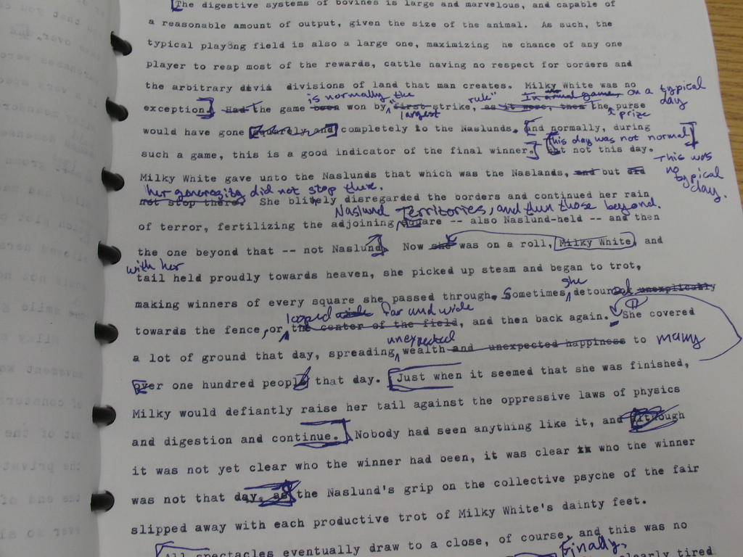
Revising a Draft

Slide 32
Feedback Exchange - Note for Your Partner:
General comments
What you find most interesting
One question
One recommendation

Slide 33
What are next steps for
your writing project?

Slide 34
Questions?
(Interest in an online writing group?)

Slide 35
Please complete our short evaluation.
Thank you!

