Slide 1
Shark Detection Classification
CS 4624: Multimedia, Hypertext and Information Access
3 May 2023
Dr. Edward Fox, Virginia Tech
Blacksburg, VA. 24061
Jack Golden
Alfred Premkumar
Nicholas Cho
Charan Srinivasan
Notes:
Jack
Training data assumed to be correct
Only use validated images
Take sharkpulse, training, and validated to get all images necessary for training.

Slide 2
Outline
Roles
Problem & Objectives
Design and Implementation: Database
Design and Implementation: Machine Learning
Testing and Results: Database
Testing and Results: Machine Learning
Challenges / Lessons Learned
Future Work
Acknowledgements
References
Notes:
Jack

Slide 3
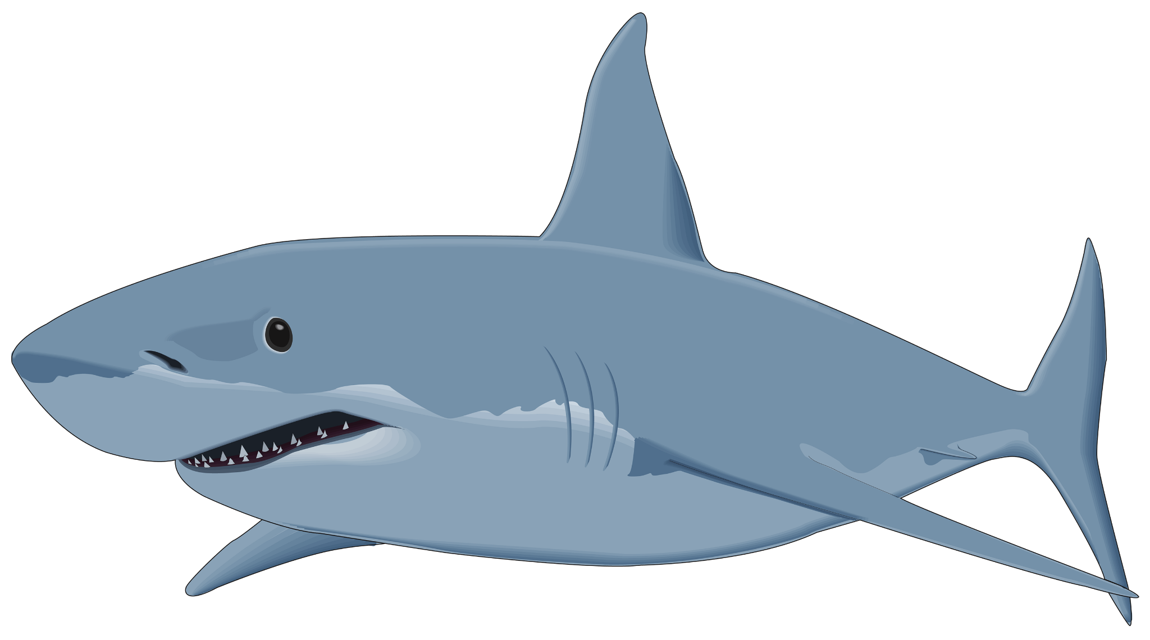
Roles
Database Team
  Jack Golden, Nicholas Cho
Machine Learning Team
  Alfred Premkumar, Charan Srinivasan
Notes:
Jack

Slide 4

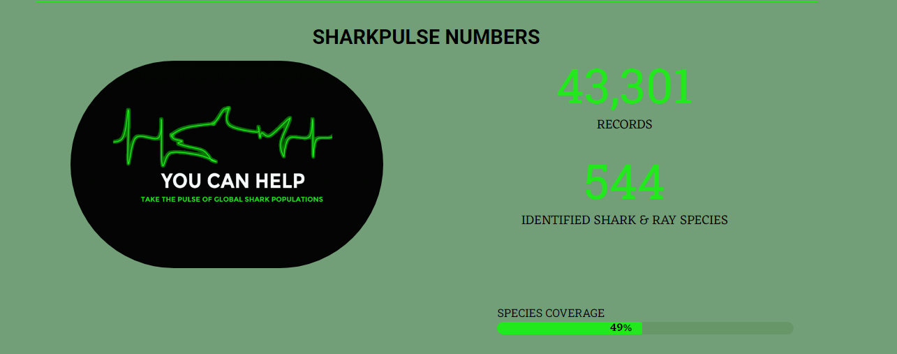
Problem and Objectives
Client: Dr. Francesco Ferretti
  SharkPulse: Uses computer vision and machine learning to locate and classify shark species from visual media.
Objectives:
  Database Objective
    Merge collection databases and create pipeline to training data table (PSQL)
  Model Objective
    Increase overall classification accuracy by 5-10%.
    Increase number of species identified (currently 47)
Notes:
Nicholas

Slide 5

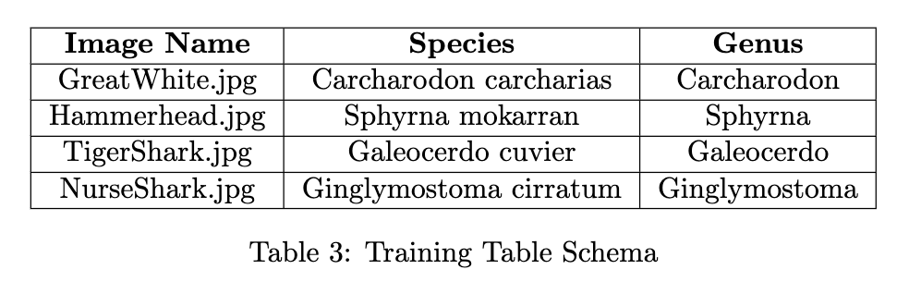
Design and Implementation: Database
Data team merged new validation monitor images into existing training data table.
Previous Training Table: 66794 images
New Training Table: 73119 images
Table automatically updates when web scrapers add new entries.
⊂
SharkPulse Database
Notes:
Jack

Slide 6
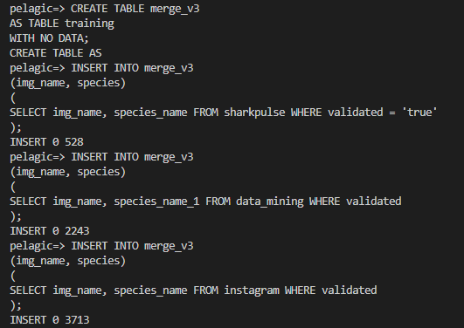

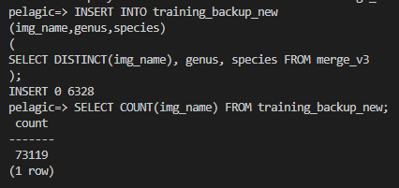
Design and Implementation: Database
Collected and merged 6484 unique records into our training table.
PSQL query: Updating genus attributes
PSQL query: Table Creation
Notes:
Nicholas

Slide 7
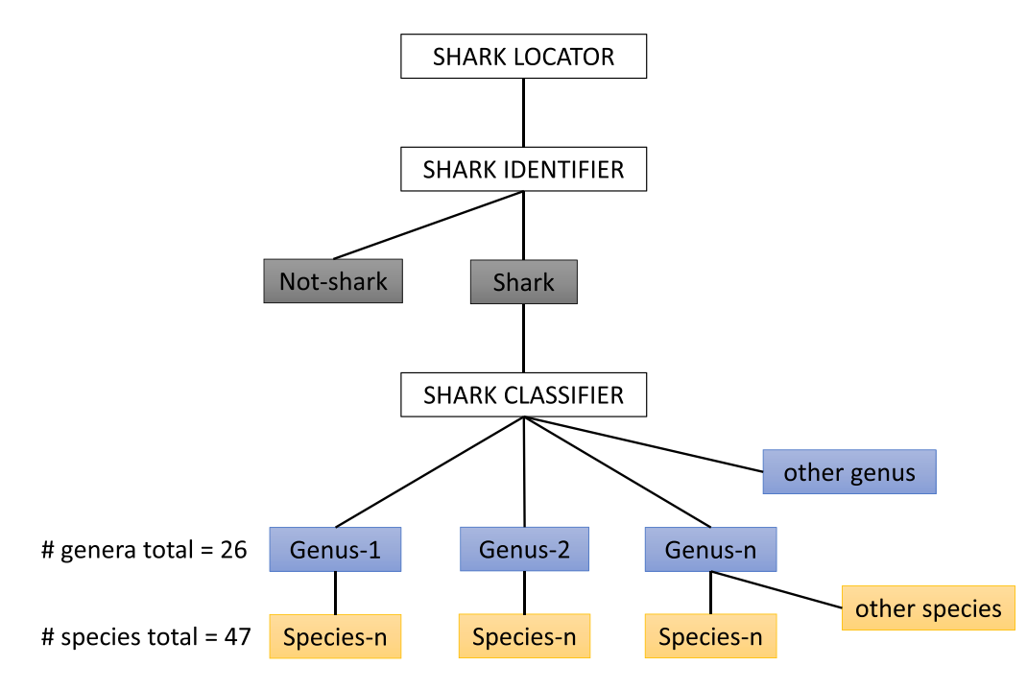
Design and Implementation: Machine Learning
Layered Model:
  Detection: Locate Shark
  Classification: Shark or Not?
  Classification: Shark genus?
  Classification: Shark species?
Goal: Update the classification models to Vision Transformer Models.
Notes:
Alfred

Slide 8
Design and Implementation: Machine Learning
Tools: Keras, Tensorflow, VIT-Keras
3 training files: train_SI_vit.py, train_gen_vit.py, train_spec_vit.py
Data threshold:
  900 images for genus, 400 for species, otherwise gets put into “other”
  80/20 Training/Testing Split, of the training: 80/20 Training/Validation Split
Data breakdown:
Model | Training Data (images)
Shark Identifier | 117060
Genus Classifier | 41724
Species Classifiers | 32109
Notes:
Alfred

Slide 9
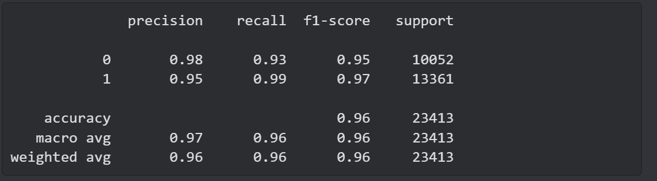
Testing and Results: Machine Learning
Data is split 80/20 for training data and testing data.
During training, cross validation is performed at each epoch with a 80/20 split of training data
After the model is formed, it is used to predict labels from the testing data, which are then compared to the actual labels
Notes:
Charan

Slide 10
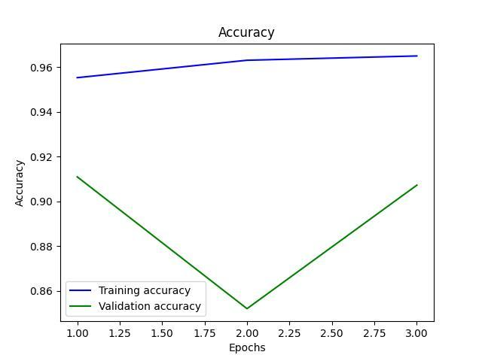
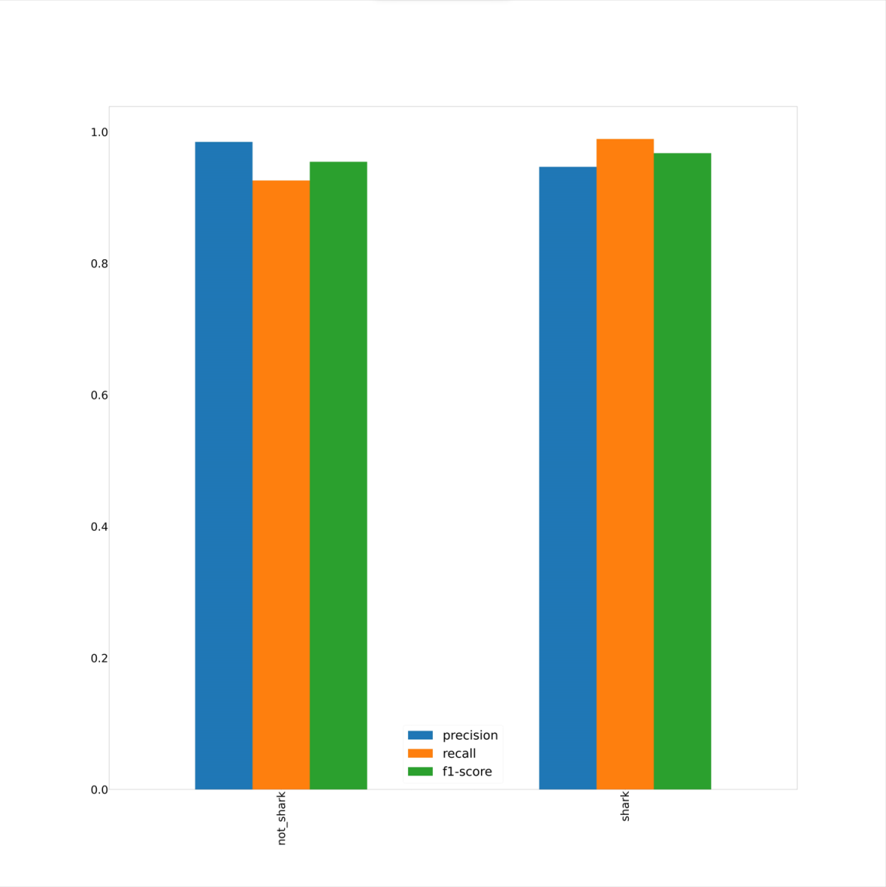
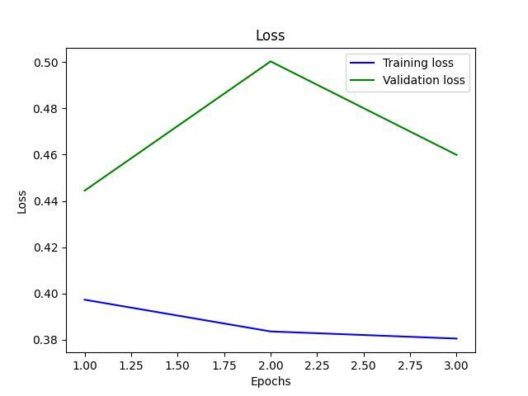
Testing and Results: Machine Learning
Overall Shark Identification Accuracy: 96%
Notes:
Charan

Slide 11
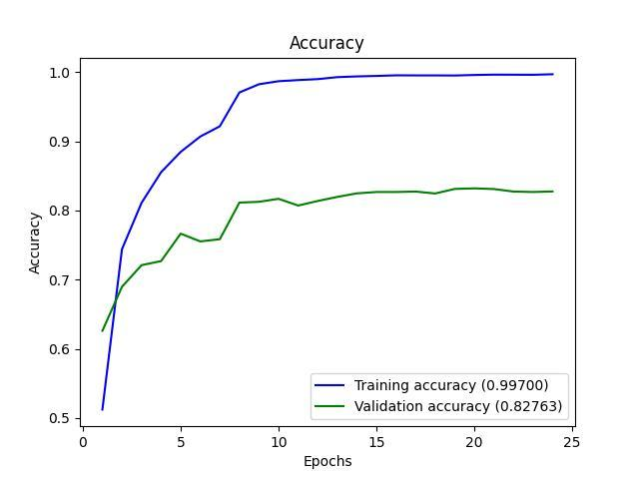
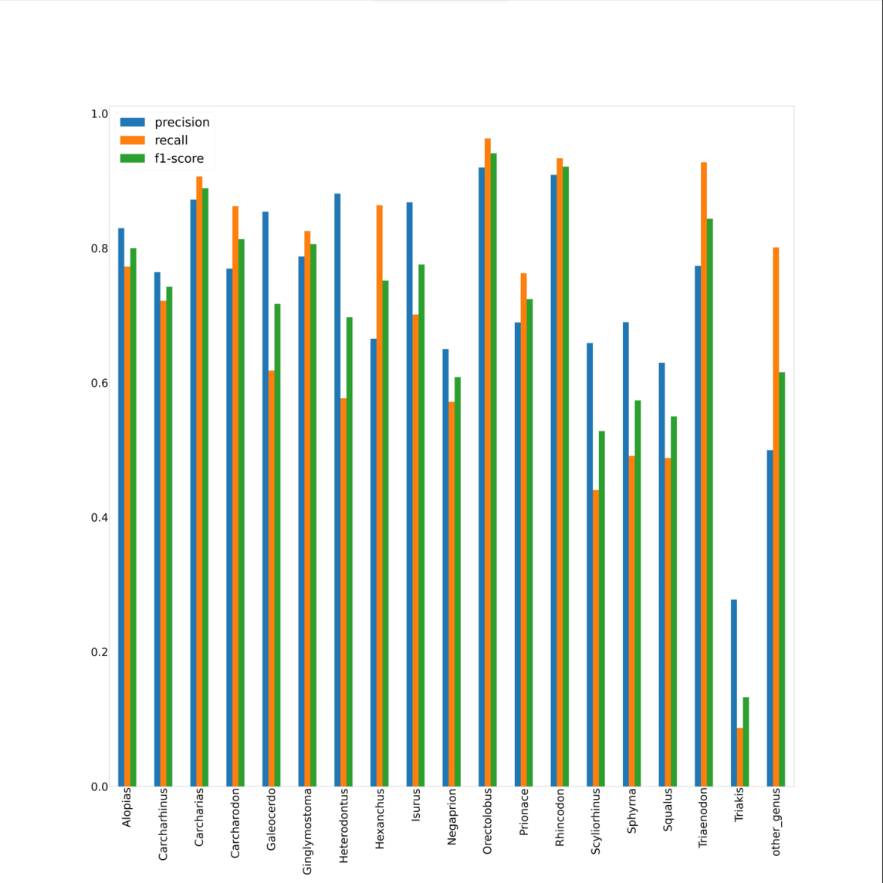
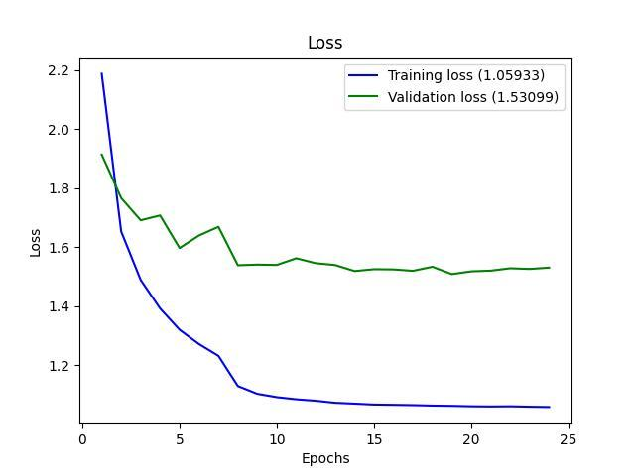
Testing and Results: Machine Learning
Overall Shark Genus Classification Accuracy: 72%
Notes:
Charan

Slide 12
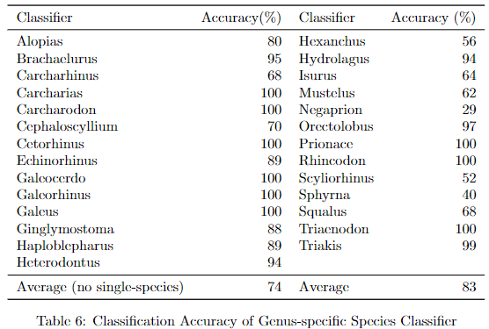
Testing and Results: Machine Learning
Average Shark Genus-specific Species Classification Accuracy: 74%
27 Genera able to be classified
  (Up from 26)
51 Species able to be classified
  (Up from 48)
Notes:
Charan

Slide 13
Testing and Results: Machine Learning
Model | Testing Accuracy
Old Shark Identifier | 90%
New Shark Identifier | 96%
Old Shark Genus Classification* | 70%
New Shark Genus Classification | 72%
Old Shark Species Classification* | 70%
New Shark Species Classification (average) | 74%
*The old genus and species classifiers were used in tandem, and should not be directly compared to.
Notes:
Charan

Slide 14
Challenges / Lessons Learned
Training sometimes crashed due to server capacity. Resolved by tuning hyperparameters as well as monitoring the training while it is happening.
Difficulty navigating PSQL database + confusion over the flow of data. Resolved by asking clarifying questions to Jenrette / Ferretti.
Weekly meetings and frequent communication with our client was key to the success of our team.

Slide 15
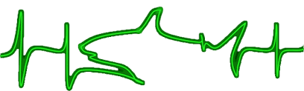
Future Work
Techniques to fetch a larger volume of shark data
Further hyperparameter tuning for model training
Decreasing training time for each model
Moving models into a production environment

Slide 16
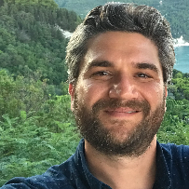


Acknowledgements
Jeremy Jenrette
Francesco Ferretti
Edward Fox

Slide 17
References
http://sp2.cs.vt.edu/ (sharkpulse website)
J. Jenrette, Z. Y.-C. Liu, P. Chimote, T. Hastie, E. Fox, F. Ferretti, Shark detection and classification with machine learning,
Ecological Informatics, Volume 69, 2022, 101673, ISSN 1574-9541,
https://www.analyticsvidhya.com/blog/2021/03/an-image-is-worth-16x16-words-transformers-for-image-recognition-at-scale-vision-transformers/

