Slide 1
Knowledge Graph For Researchers
Kyle Vincent and Emma Meno
CS 4624: Multimedia, Hypertext, and Information Access
Dr. Edward Fox
Virginia Tech, Blacksburg, VA 24061
May 6, 2020
Notes:
Hi My name is Emma, and I’m joined by Kyle, and today we will be giving our final presentation for our capstone project, Knowledge Graph 4 Researchers. Thank you all for joining us and let’s get started.

Slide 2
OUTLINE
Project Deliverables
Accomplishments
Testing and Evaluation
Lessons Learned
Future Work
Acknowledgements
References
[3]
[5]
[20]
[22]
[26]
[28]
[29]
Notes:
Here’s an outline for our presentation: we’ll be spending some time to review the deliverables and the cover what we’ve accomplished this semester. We’ll also discuss testing/evaluation, lessons learned, future areas of work, and then finish with acknowledgements and references.

Slide 3
Deliverables
Notes:
First, we’ll review the deliverables for our capstone project.

Slide 4


Project Reports
Dataset - Algo - Dataset Tuples
Project Team
Reads
To Generate
DATABASE
Stored In
Knowledge Graph
Workflow Diagram
And Make Up
QUERY SERVICE
(Input Data Set, Output Data Set)
To Return
Subject Matter Experts
Notes:
This is a brief overview of our project this semester. We, the project team, read through a series of project reports to extract dataset-algorithm-dataset tuples and build an ontology. This ontology was stored in a database to model a knowledge graph, which subject matter experts in non-CS fields can query to generate workflow diagrams.

Slide 5
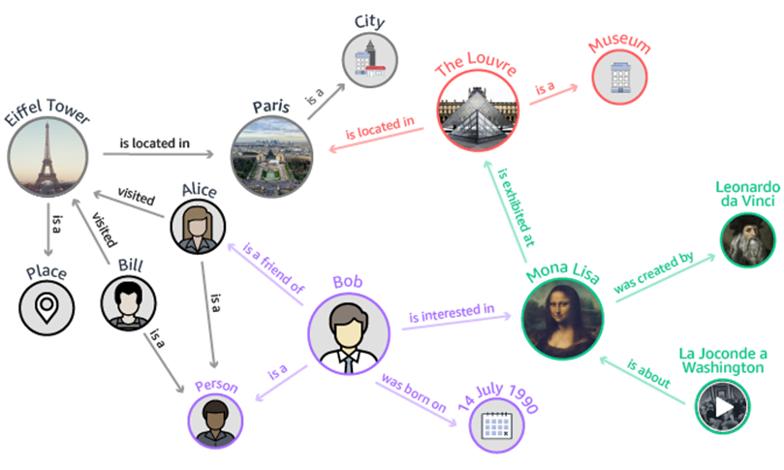
Project Deliverables
Build ontology for Twitter-based project info an SME might want to query, answer or calculate
Build knowledge graph based on created ontology
Build set of APIs to trigger set of network algorithms based on info queried to graph
Notes:
As far the specific project deliverables, our team was tasked with building an ontology for Twitter-based project algorithms and datasets that a subject matter expert might want to find or query. Our team would then build a knowledge graph based on the created ontology, and a corresponding set of APIs for triggering network algorithms given the queried information.
https://d2908q01vomqb2.cloudfront.net/77de68daecd823babbb58edb1c8e14d7106e83bb/2019/01/10/Neptune-Metaphactory-1.png

Slide 6
Accomplishments
Notes:
Now we’ll move into our accomplishments on the project.

Slide 7
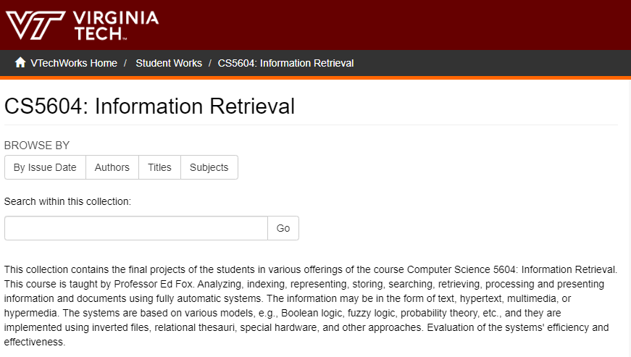

Literature Review: Twitter Data Source
2016
2017
Notes:
We first conducted a literature review, reading reports from the CS5604 Information Retrieval courses in 2016 and 2017 to extract information related to Twitter data and algorithms.
Image URLs:
https://www.google.com/url?sa=i&url=https%3A%2F%2Fwww.visualpharm.com%2Ffree-icons%2Fin%2520progress-595b40b75ba036ed117d84b0&psig=AOvVaw12e0spB2xJXv_XMlnmyse0&ust=1585832434042000&source=images&cd=vfe&ved=0CAIQjRxqFwoTCPimyKqkx-gCFQAAAAAdAAAAABAD
https://cdn3.vectorstock.com/i/1000x1000/09/82/check-icon-vector-10850982.jpg

Slide 8
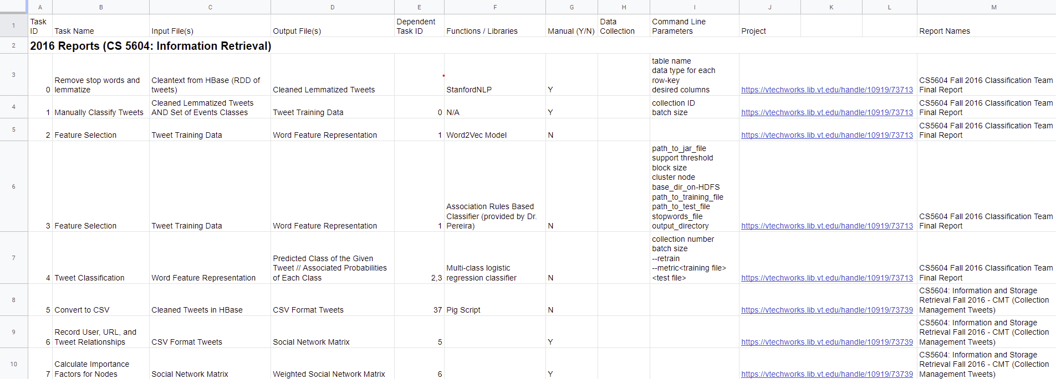
Built Ontology
Notes:
We then constructed our raw ontology, which contained a set of dataset-algorithm-dataset tuples. Here is a snapshot of the first few rows of unedited information. We assigned a unique Task Identifier for each Task Name. Each task had a corresponding input file, output file, dependent task ID, relevant functions and libraries (like Python, Pig Scripts, etc), whether the task required manual input, command line parameters, and the information about the project report. We manually built this ontology in Google Sheets to support our collaborative efforts.

Slide 9
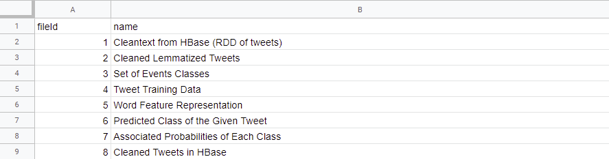
Nodes.csv
Dataset
Dataset
Algo
Notes:
Graph databases require their data to be in a specific format, so we converted our raw ontology in Google Sheets to two csv files. The first is a file with the node information, some of which is shown here. For our project, the nodes in the knowledge graph will be the datasets. Each node has an associated fileID and name. There were a total of 91 nodes in our spreadsheet.

Slide 10
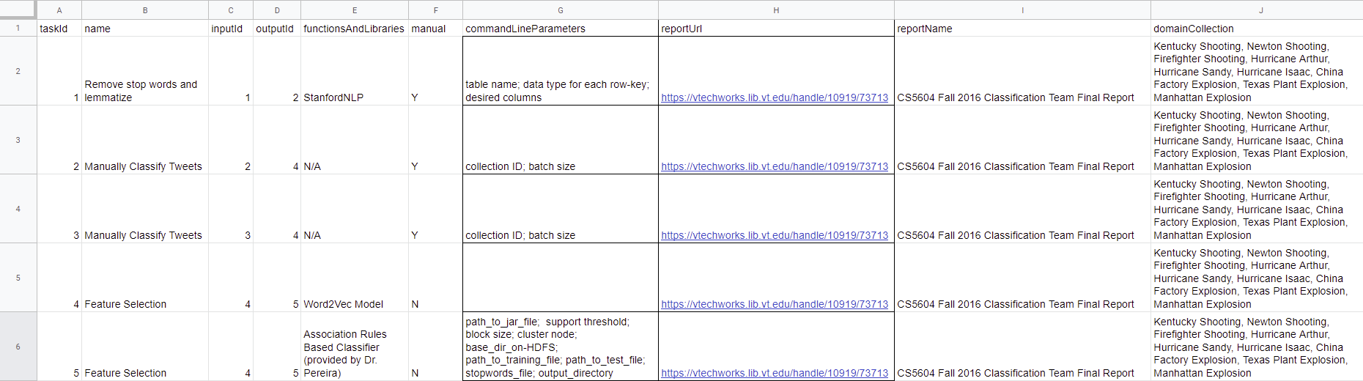
Edges.csv
Dataset
Dataset
Algo
Notes:
The second csv we built was the edges.csv file. The edges of our knowledge graph represent the algorithms connecting datasets. Each edge in the graph will have a taskID, name, inputID and outputID for the nodes, functions and libraries, whether the task is manual, command line parameters, report information, and domain collection information, representing the datasets that this algorithm was tested on in the CS5604 reports. There were a total of 89 edges in this csv file.

Slide 11
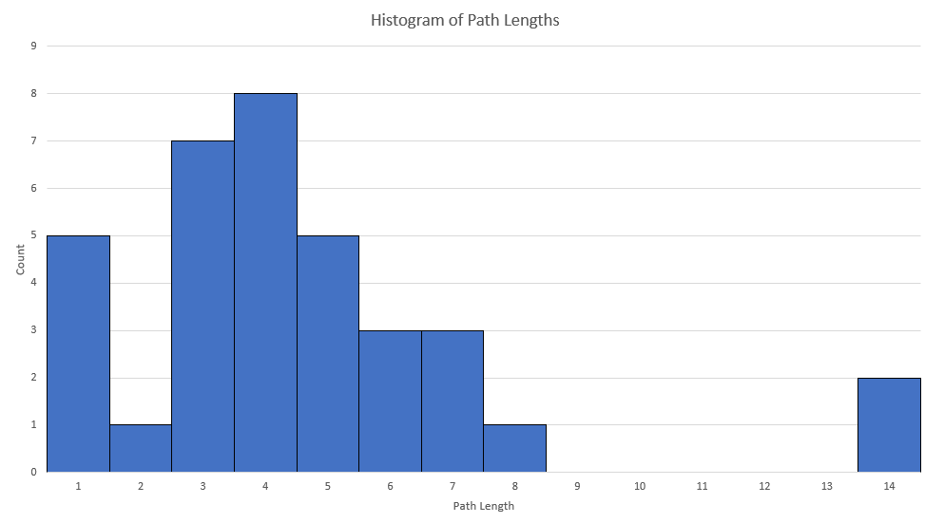
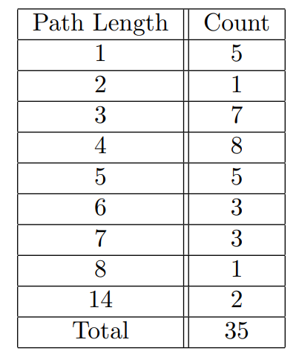
Path Metrics
Notes:
After we built our initial nodes.csv and edges.csv files, we found a lot of single paths. After reviewing the ontology with our client, we fixed and edited the workflows to be more comprehensive, removing any duplicate nodes and adding preprocessing algorithms for consistency. Shown here is the path metrics for our graphs. There were a total of 35 paths in our graph, most of which had lengths between 3 and 5.

Slide 12
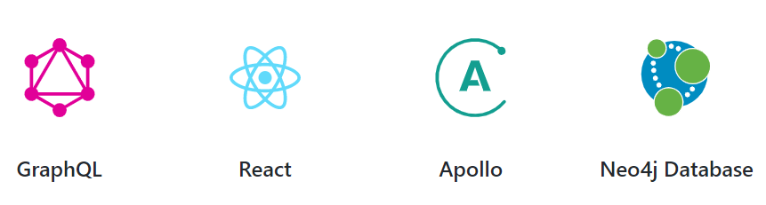
Interim Project Toolkit - The GRANDstack
Notes:
In our last presentation, we had decided to try to use The GRANDstack for our application. With Neo4j already established as the graph database, we were hoping to be able to build and configure these other three tools as a relatively new stack, with React used as the front end and GraphQL used for the query language.

Slide 13
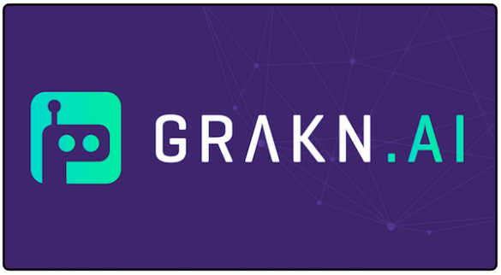
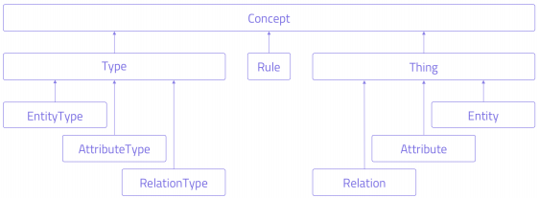
Implemented Project Toolkit - Grakn
Database storage/interface
Graql queries for reads, writes, & analysis
Three Client APIs:
  Node.js
  Python
  Java
Notes:
However, the new implemention method we ended up going with is a graph database called grakn.ai, which has its own database, query language, and an interface and the next few slides we’ll talk about the reason for the late adjustment.

Slide 14
The And/Or Problem
Input
Input
With traditional node-edge-node relationships, we weren’t sure how to differentiate between two scenarios present in our data:
  A certain output requires Input 1 AND Input 2 to be produced
  You can use either Input 1 OR Input
This means the difference between returning 2 paths and 1 path
Output
Notes:
After modeling our graph, we ran into a bit of a logical problem. Our graph is made of a combination of workflows, and sometimes those workflows share datasets and algorithms. The question becomes, how do we tell the difference between needing two different inputs to generate an output, for instance having to train a model via several steps and having to prepare a dataset, then putting those things together, versus having two different ways of reaching that output, for instance, two different softwares that can help you visualize data.

Slide 15
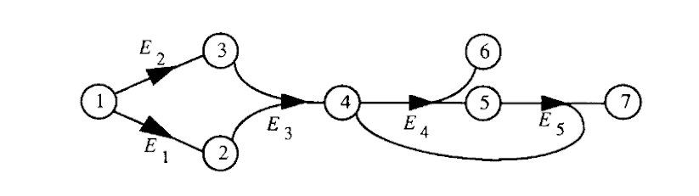
Solution: The Hypergraph
Recommended by our Client
A hyperedge can connect any number of entities
Now we can distinguish between hyperedges and normal edges
Notes:
A solution our client recommended was the hypergaph. Hypergrpahs are made up of hyperedges, and essentially these hyperedges can connect any number of nodes, in either direction. This would allow us to use hyperedges to represent the AND condition, and regular one to one edges for the OR condition.

Slide 16
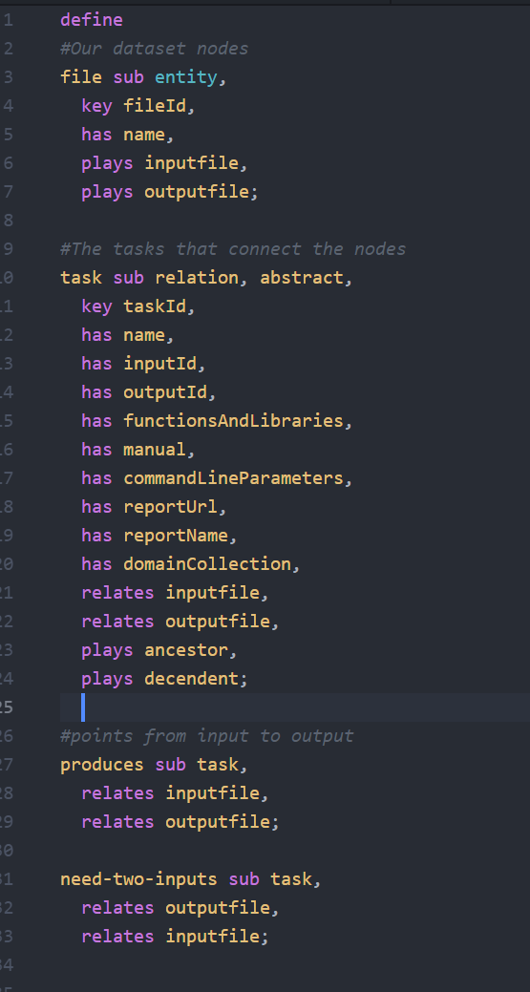
Grakn Database Schema
Our client recommended a tool called Grakn.
  Designed for Knowledge Graphs specifically
  Open Source
  Allows Hyper-Relationships
Sample of our Schema:
Notes:
To build our hypergraph, our client recommended Grakn. They design their software to be catered to knowledge graphs. It is a Very flexible that is open source, allows hyper relationships, or edges, and comes with it’s own query language. Now this shift over to a new technology happened within the last week or so, so we didn’t have a whole lot of time to get comfortable with the tool, but to the right you can see part of the schema we came up with. It’s very similar to object oriented class structures, you have your entities as your nodes and relations as your edges. Additionally you can have inheritance between types, and pass down attributes.

Slide 17


Migration Scripts
With schema established, starting migrating the data
Grakn has three clients:
  Python
  Java
  Node.js
Wrote data migration scripts that could use these clients and migrate from CSV → Grakn DB
This proved way more challenging than it had been with Neo4j
Notes:
To get the data into the graph, we decided the easiest way would be to use the clients available to us. We used both the java and python clients to write data migration scripts that would take our csv data and put it into the database. This proved more challenging that prior tools, and Grakn’s overall lack of documentation was frustrating.

Slide 18
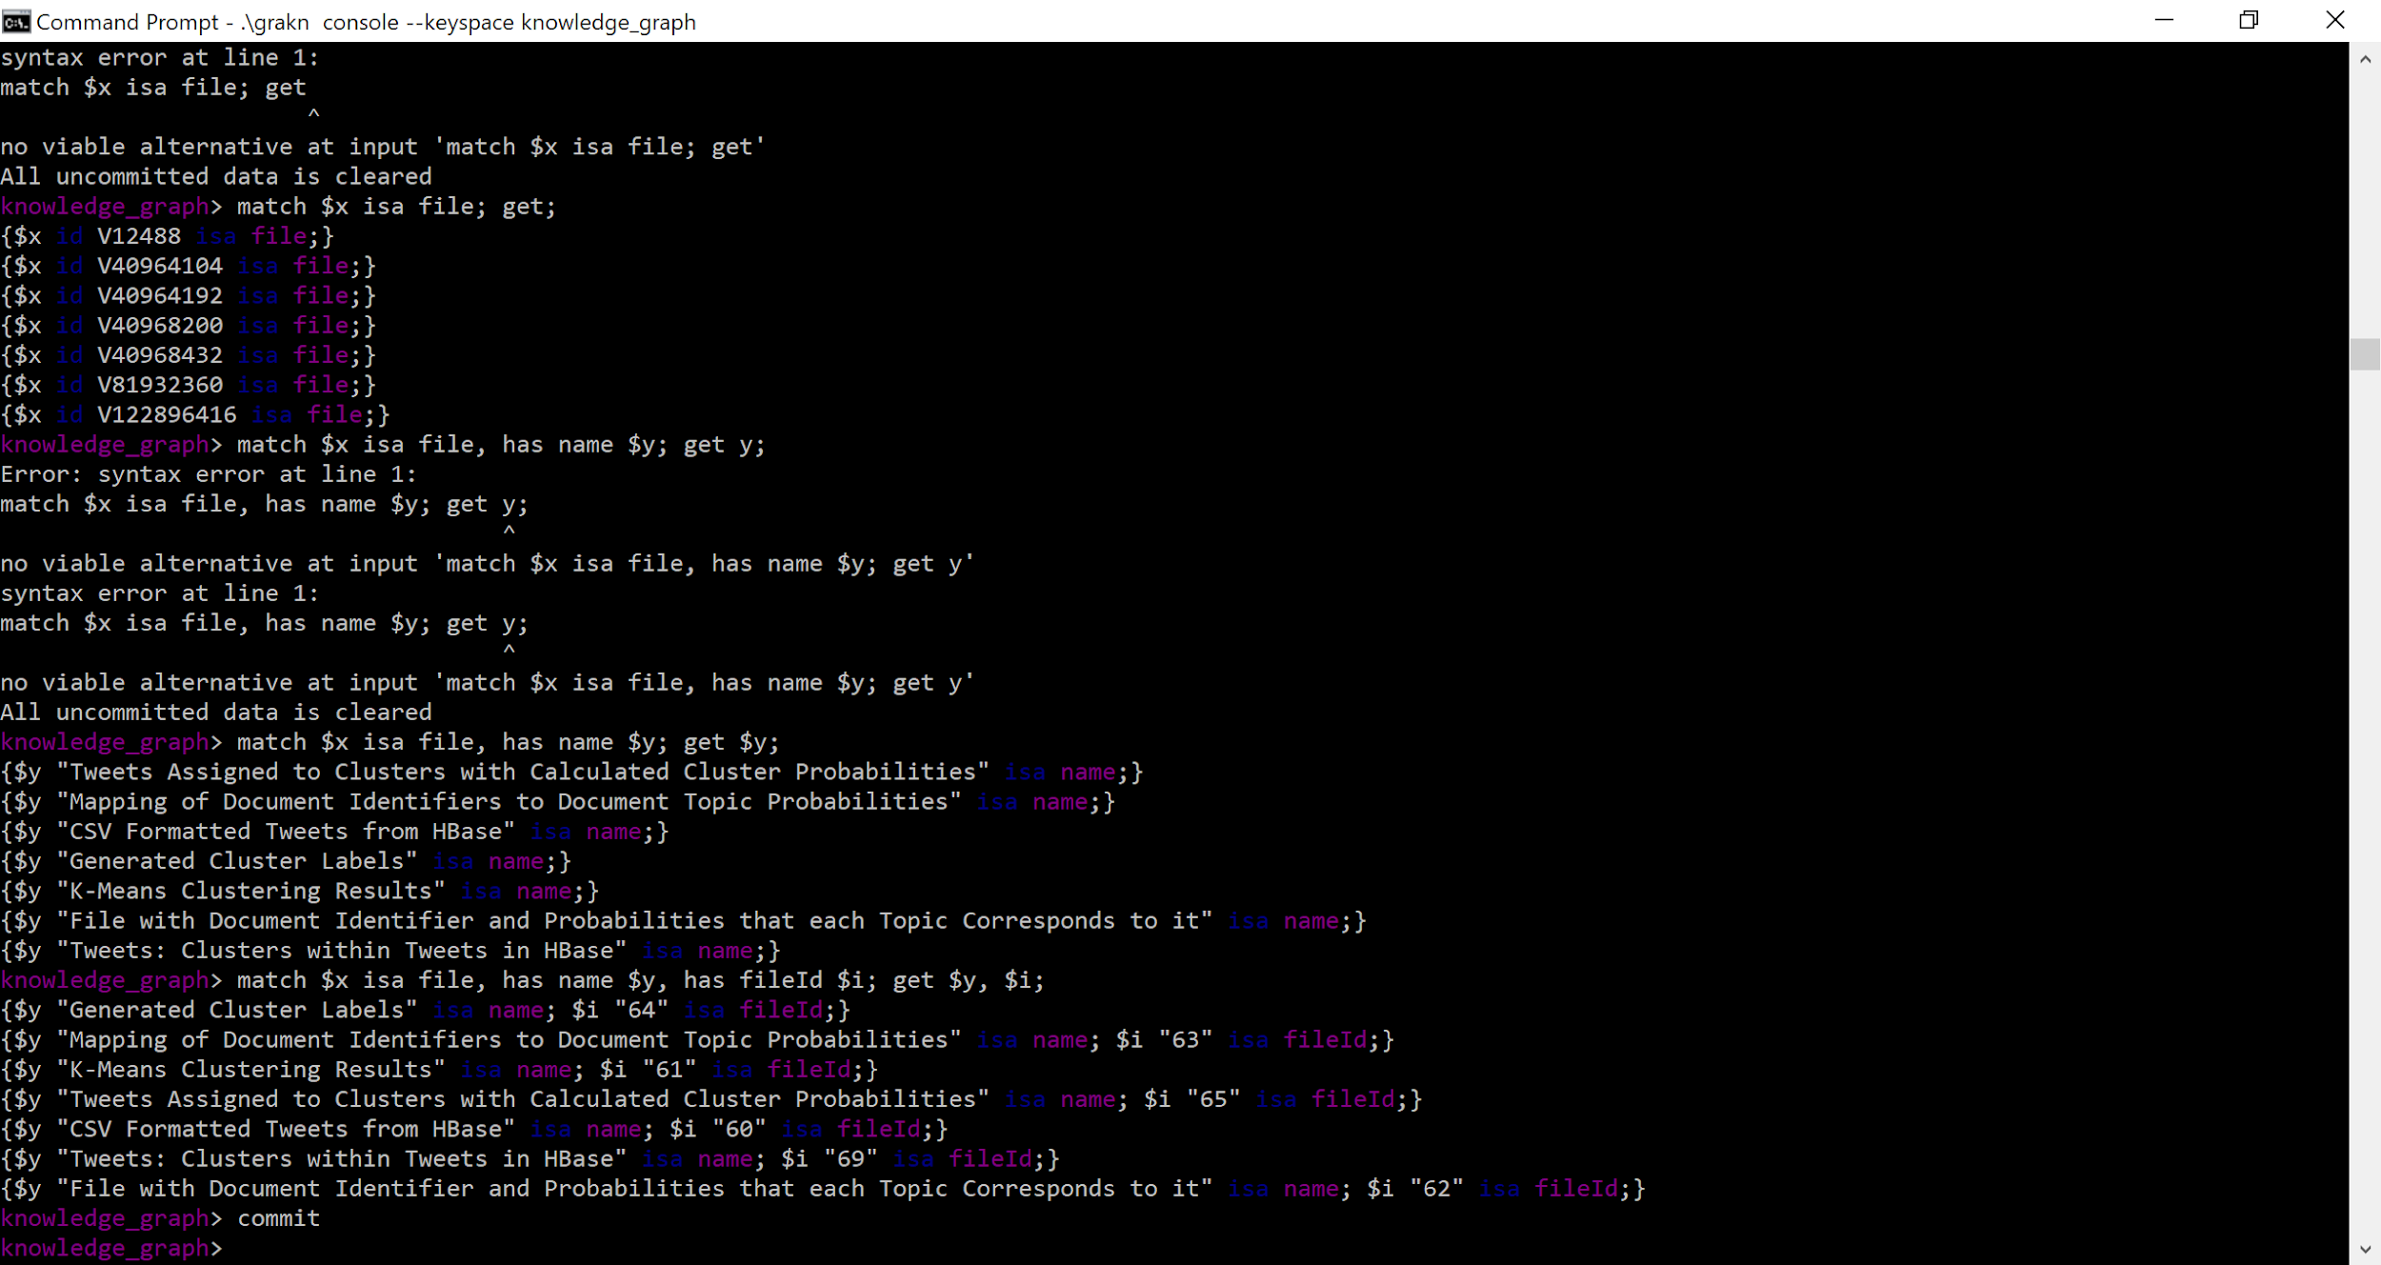
Possible User Interface: Console
Grakn Console, included in software download, uses the Graql language
Notes:
One way a user can interact with the data is via the console. By typing in a graql statement, that can retrieve information about data in the graph, from relationships to entities to derived rules. Rules in grakn are sort of like attributes and relations that only get applied when a query is made that asks for them. For instance, in our schema we have a rule that determines whether two nodes fall within the same workflow, or if a node is a leaf node.

Slide 19
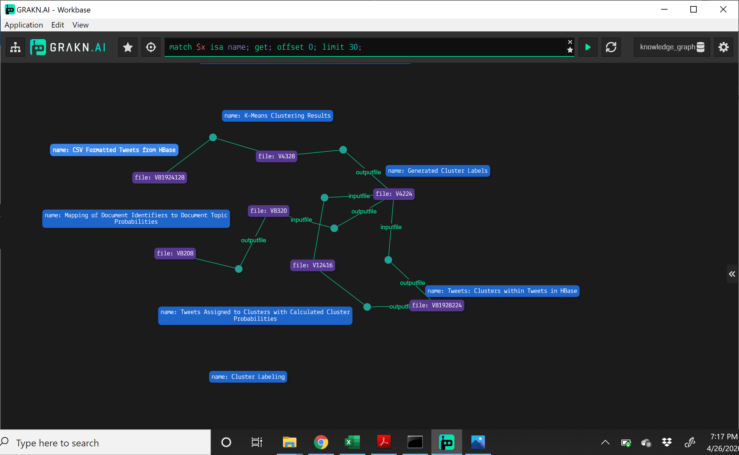
Grakn Workbase UI
Notes:
The second way a user can interact with the data is via Grakn’s data visualizer called Workbase. The user can enter the same graql queries in the top bar, and see the connections within the knowledge graph. Here is a screenshot of one of our workflows. It shows the files and whether they are inputs or outputs along the edge. This easy to configure UI is very easy to use, and with the right commands, a subject matter expert can gather insights and develop workflows to follow.

Slide 20
Testing and Evaluation

Slide 21

Testing and Evaluation
First test to be conducted by client shortly after project submission
Next test will be to have a subject matter expert use both the console and the Workbase UI
Notes:
We have yet to conduct any testing or evaluation. The first test will be conducted by our client, as he tries to recreate what we’ve done based on our schema and developer’s manual. The next test we need to conduct will be with a subject matter expert. We will want to see whether they find it intuitive to query for a workflow if given a dictionary of commands and their results.

Slide 22
Lessons Learned
Notes:
Now we’ll quickly review some lessons we learned during this project

Slide 23




Challenges Faced
Waiting on network science data
Gathering sufficient material from project reports
Selecting an appropriate project toolkit
Transition to virtual learning
Notes:
https://image.shutterstock.com/image-vector/no-stop-report-document-icon-260nw-1394299211.jpg
https://www.skytap.com/wp-content/uploads/2017/09/webinar-icon-drk-gry.png
https://www.pngitem.com/pimgs/m/76-764671_software-tools-icon-png-transparent-png.png
https://www.shareicon.net/data/512x512/2015/10/27/662681_magnifying-glass_512x512.png

Slide 24



Solutions
Focus on different data → Twitter
Including reports from multiple years → 2016 & 2017
Shift to Grakn
Use of Zoom and other online platforms
Notes:
https://cdn4.iconfinder.com/data/icons/social-media-icons-the-circle-set/48/twitter_circle-512.png

Slide 25



Overall Lessons
Asking more questions earlier in the design process
Communicating with the professor, client, and team
Documentation and project tools
Notes:
https://www.pngitem.com/pimgs/m/73-739528_transparent-asking-question-clipart-asking-questions-icon-hd.png
https://img.icons8.com/ios/500/communication.png
https://image.flaticon.com/icons/svg/35/35920.svg

Slide 26
Future Work

Slide 27
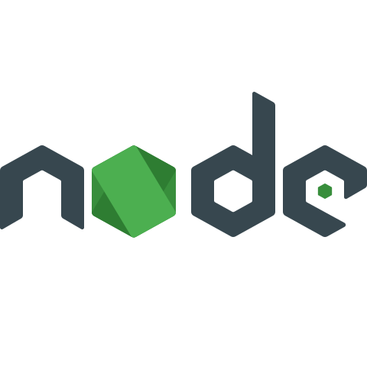
Future Work
Upload the rest of the data to the graph
Build upon schema to aid better path queries
Use Node.js Cient to establish a website as front end
Automate process of parsing through reports
Notes:
There is certainly a lot of work left on the table to fully realize a knowledge graph for researchers. First, the rest of the data needs to be imported into the graph using the migration scripts. We need to fully flesh out the schema we created so that users will be able to get an accurate workflow from just one query. Ultimately, we’d like to see less reliance on Grakn’s front end, and instead have a customized javascript front end somewhere, since grakn has a node.js client, but that goal is very far in the future. And depending on the resources that would eventually get devoted to this project, it would be great to have an automated parser that could generate workflows, since parsing through reports manually was such a time consuming process..

Slide 28
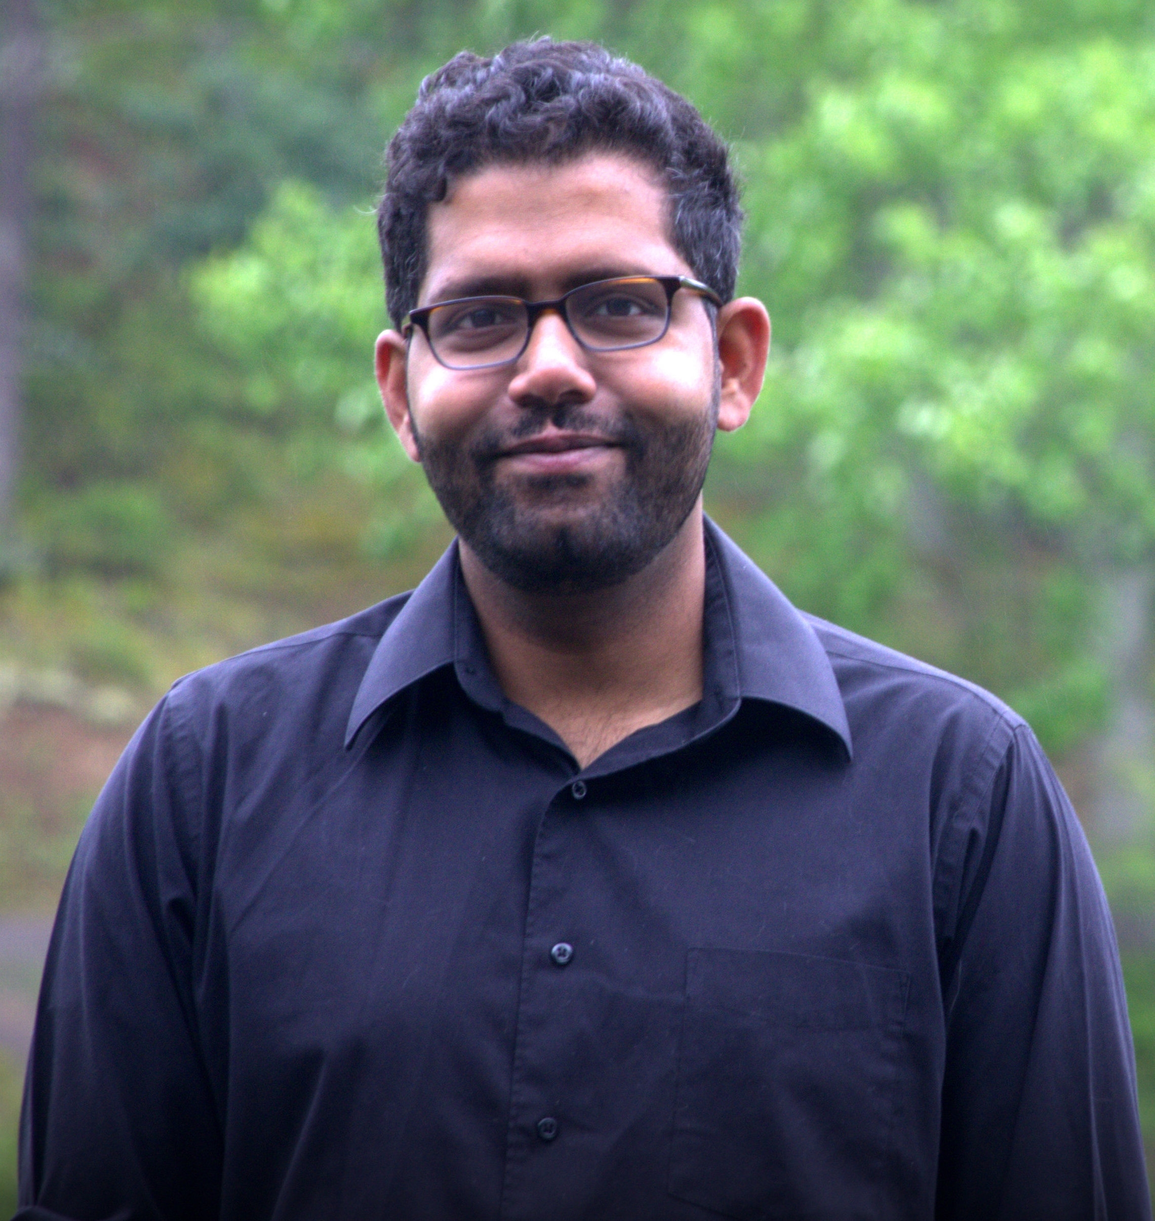
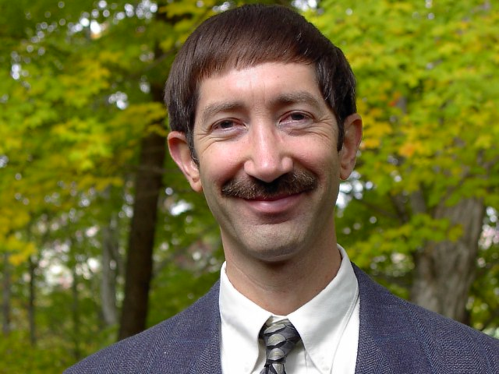

Acknowledgements
Client: Prashant Chandrasekar
Fifth-year PhD student with Dr. Fox
Professor: Dr. Edward Fox
Director of Digital Library Research Laboratory
Grants: National Science Foundation
NSF CMMI-1638207, CRISP Type 2/Collaborative Research: Coordinated Behaviorally-Aware Recovery for Transportation and Power Disruptions (CBAR-t pd)
NSF IIS-1619028: Global Event and Trend Archive Research (GETAR)
Notes:
We would like to acknowledge our client Prashant.
Our work will help him for his proof of concept for his PhD. He has been very helpful throughout the process and we thank him for that.
https://www.nsf.gov/awardsearch/images/common/head.gif
We would also like to acknowledge Dr. Fox, for all of his help throughout the project.
Image URLs:
http://peeceeprashant.weebly.com/
http://fox.cs.vt.edu/photos/Fox2002OctLowRes.jpg

Slide 29
References
”Grakn.AI – Text Mined Knowledge Graphs”, https://www.stockwerk.co.at/event/grakn-ai-textmined-knowledge-graphs/
”Grakn Schema Overview”, https://dev.grakn.ai/docs/schema/overview
Directed Hypergraph and Applications: https://www.sciencedirect.com/science/article/pii/0166218X9390045P
Grakn Documentation: https://grakn.ai/
Notes:
These are our references for the content we’ve covered during this presentation.

Slide 30
Questions?
Notes:
And now we have some time left for questions

