Slide 1
Cholera Database
Michael Roberto, Andrés García Solares, Gabby Alcantara, Hemakshi Sharma, Emily Croxall
CS 4624 Multimedia, Hypertext, & Information Access
Dr. Fox
Virginia Tech, Blacksburg, VA 24061
6 May 2020

Slide 2
Outline
Background
Deliverables
Timeline
Accomplishments
Workflow Diagrams
Testing & Assessment
Lessons Learned
Ideas for the Future
Summary
Acknowledgements

Slide 3

Background
Build a database to track Cholera outbreaks worldwide over the last 10 years
Usage of the database to analyze the data to identify trends and correlations in order to help predict when a cholera outbreak may occur
To be used in future analysis by client

Slide 4
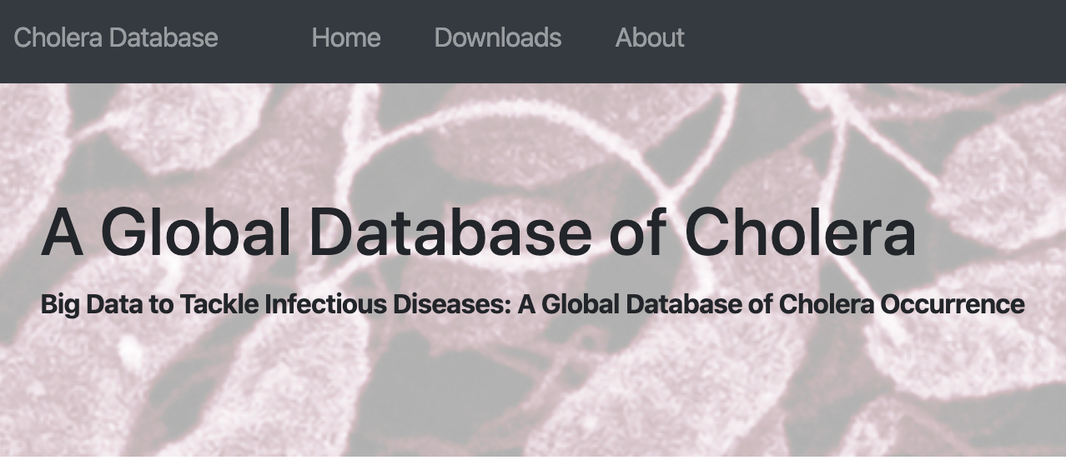
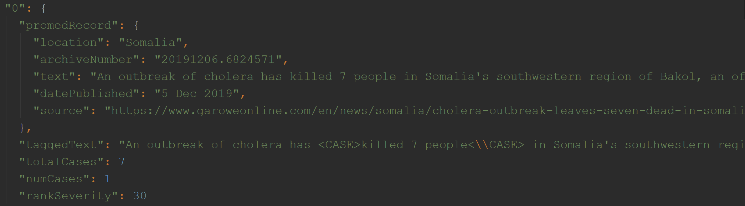
Deliverables
Database of Cholera cases
  Data includes number of cases, location, and dates
  Data is organized by location or year
Website to access data
Ability to download data
Pipeline of process to make project replicable

Slide 5

Timeline
1/28: Finalize project proposal
2/12: Data collection from one repository fully functional and a list of repositories to use
3/5: Prototype website with data from one online repository
4/1: Data collection from at least one more repository fully functional
4/14: Data collection from all repositories completed, website is being built and refined
4/23: Final project presentation -- work completed
4/30: User views finalized, data is downloadable
5/5: Reports and all other deliverables completed
5/6: Project due

Slide 6
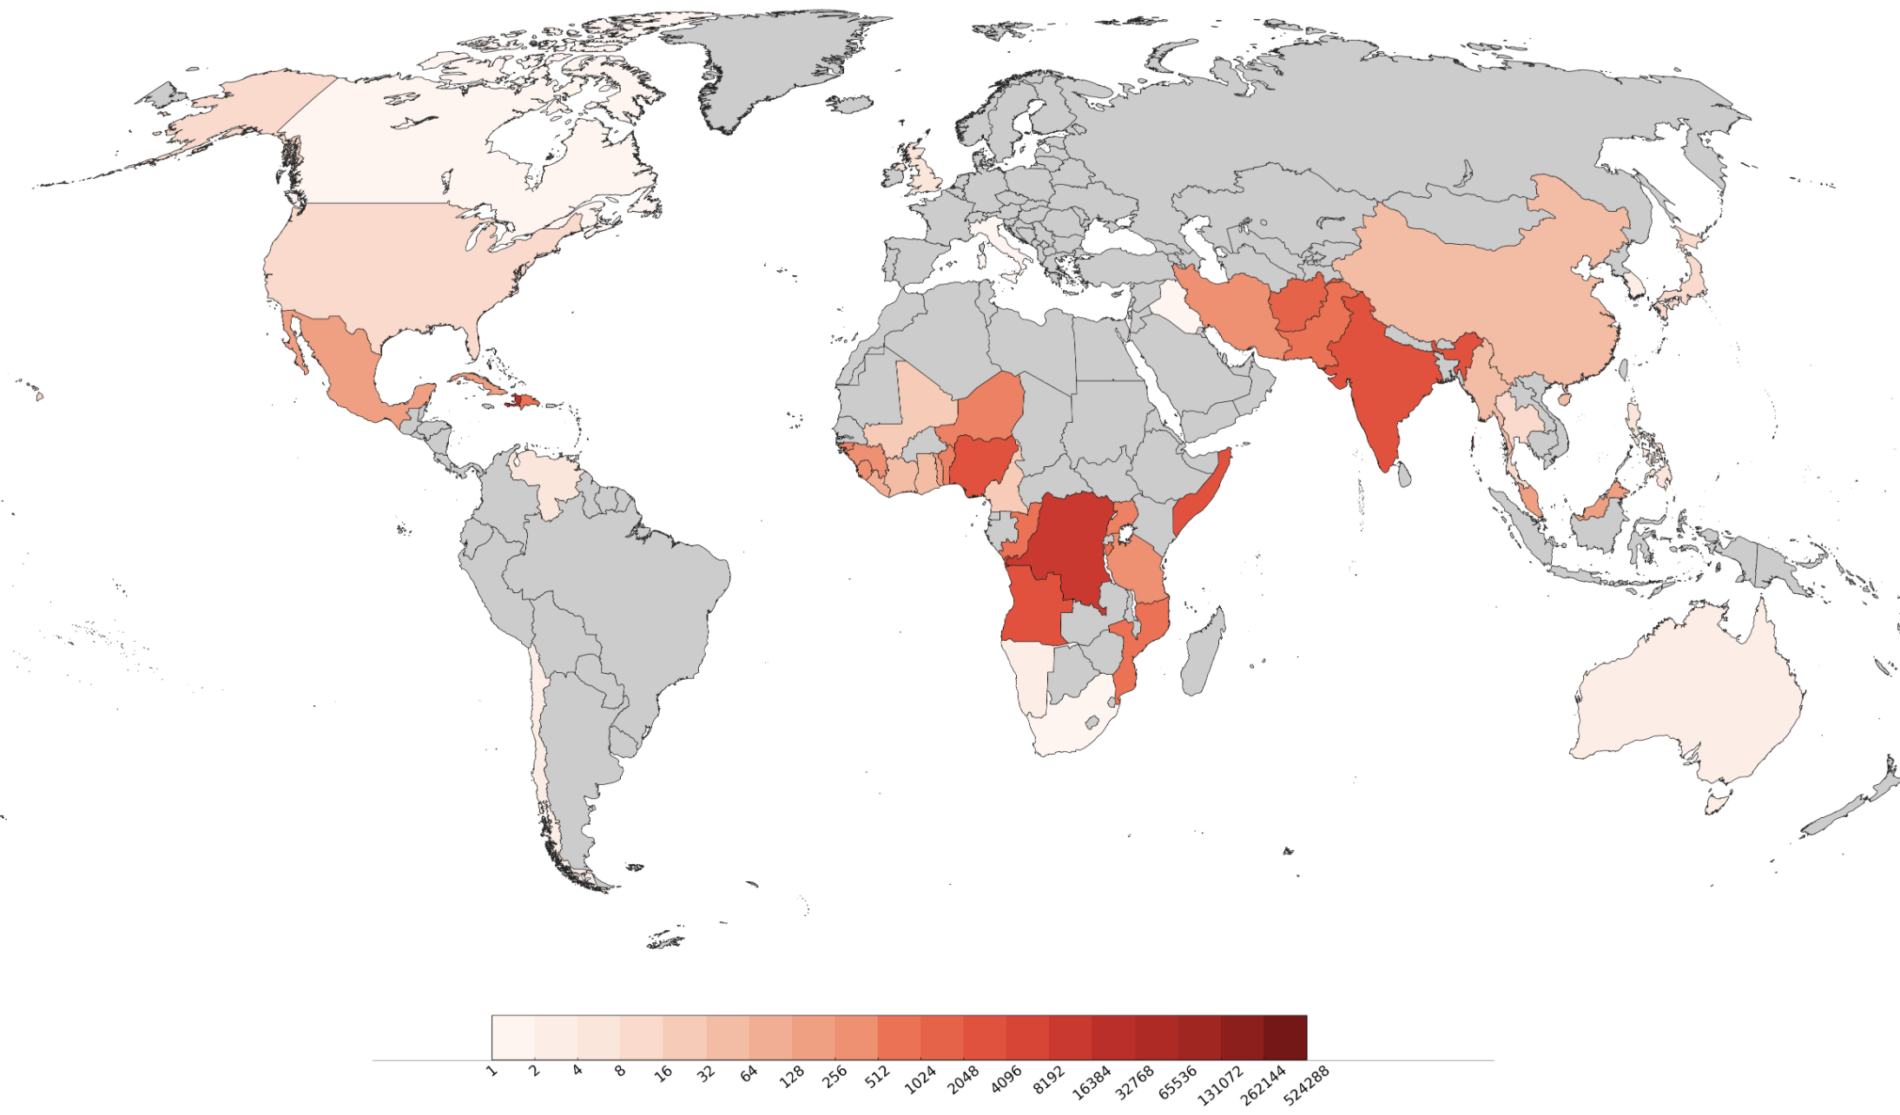
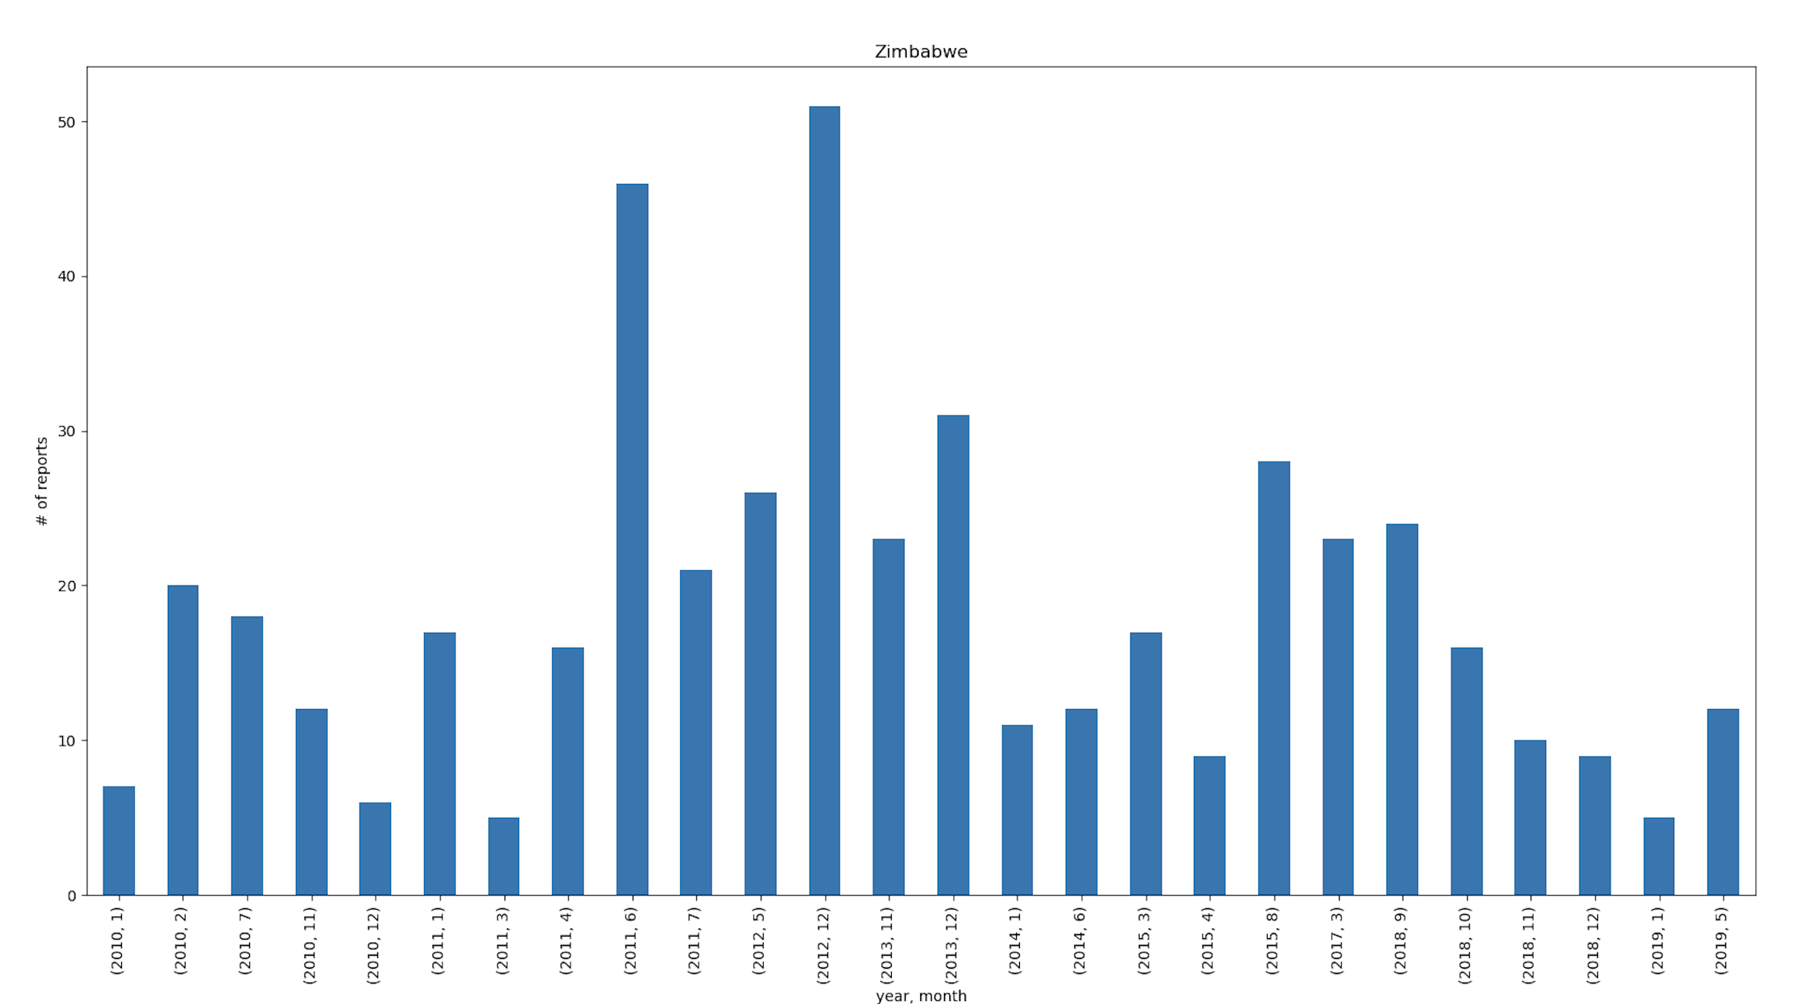
Accomplishments
Database as CSV files per year
  All data from WHO
  Modified data from ProMED
Website is live and active for 1 year
  Maps from WHO
  Graphs from ProMED
Final report has user guide and developer guide for future users
Notes:
We didn’t completely parse the promed data, more work needs to be done on NLP

Slide 7

WHO - Workflow Diagram
/who/
user arguments
who.py
make_map.py
/resources/*.cvs
/out/*.cvs
/images/*.png

Slide 8
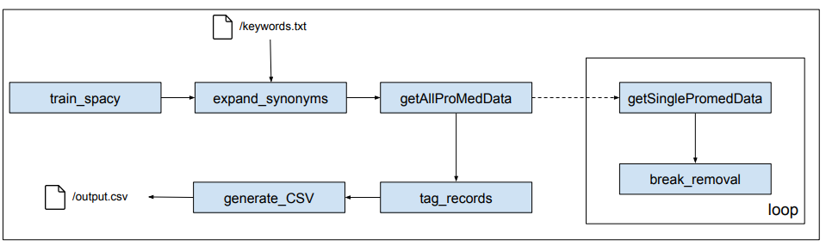
ProMED - Workflow Diagram
Notes:
Michael

Slide 9
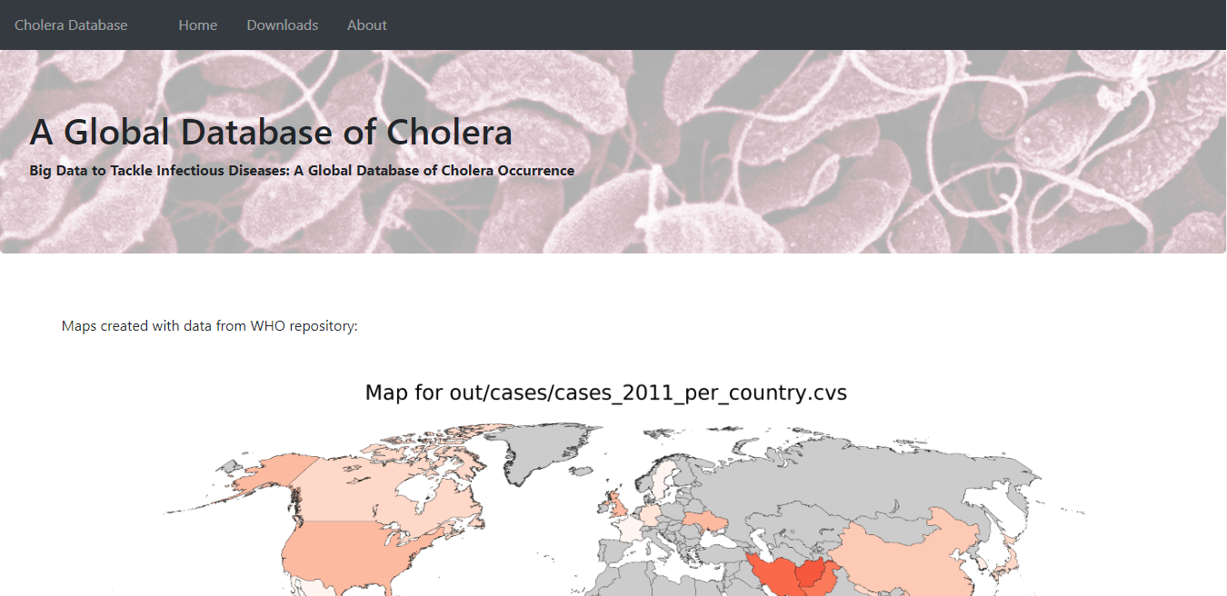
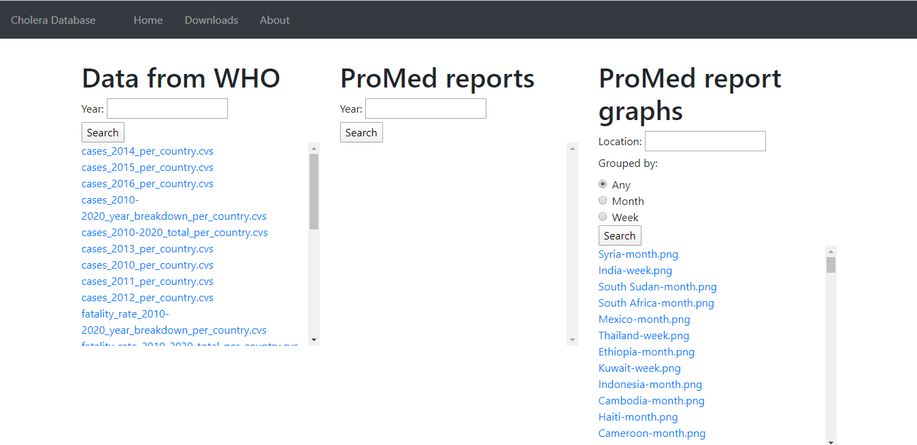
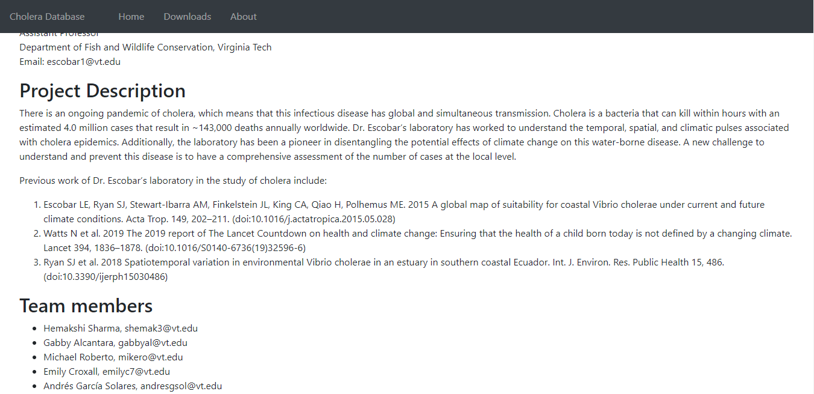
Testing and Assessment
Static data allowed for us to test our code directly on all data collected
Usability testing with test subject
Locate the map for WHO data of cases in 2014 per country
Download the fatality rate per country WHO data for 2011
Download the monthly graph for Kuwait from the ProMed data
Locate the team members’ contact information
Approval from client on website formatting

Slide 10


Lessons Learned
Natural Language Processing
  Parsing ambiguity
Incremental development
  Intermediate steps
  Better planning
  Communication over time zones
Notes:
Michael

Slide 11


Ideas for the Future
Gather data from HealthMap.org
Develop better methods for extracting ProMED data
Analysis for our client
Healthmap
Notes:
Emily

Slide 12



Summary
WHO data collected, sent to CSV, and data visualization maps created
ProMED data collected, cleaned up, sent to CSV, and visualized with bar graphs
All data is downloadable from our website
Detailed document of process created so project is replicable
Unable to completely extract data from ProMED; some manual analysis required
  Improvements in our NLP to do this
Notes:
Emily

Slide 13

Acknowledgements
Dr. Luis Escobar
Department of Fish and Wildlife Conservation, Virginia Tech
Laboratory
  Analyze temporal, spatial, climactic pulses of cholera
  Studies potential effects of climate change on water-borne disease
Dr. Edward Fox
Our instructor
Notes:
Emily

Slide 14
References
[1] ProMED International Society for Infectious Disease, 2020. Available: promedmail.org
[2] World Health Organization, 2020. Available: who.int

Slide 15
Questions?

