Slide 1

Chapter 1
Introduction to Sustainable Property Management
Unless otherwise noted, this slide deck is (c) Erin A. Hopkins.
It is released under a Creative Commons Attribution NonCommercial ShareAlike 3.0 license (CC BY NC-SA 3.0).

Slide 2
Chapter Sections
1.1 Introduction
1.2 What is Sustainable Property Management?
1.3 Why Sustainable Property Management Matters
1.4 Evolution of Sustainable Property Management
1.5 Barriers to Sustainable Property Management
1.6 Conclusion

Slide 3
Learning Objectives
Explain the building lifecycle
Define sustainable property management
Identify the three spheres of sustainability
Understand the role of real estate in sustainability
Explain why sustainable property management matters
Identify what's driving sustainable property management
Describe the main barriers of sustainable property management

Slide 4
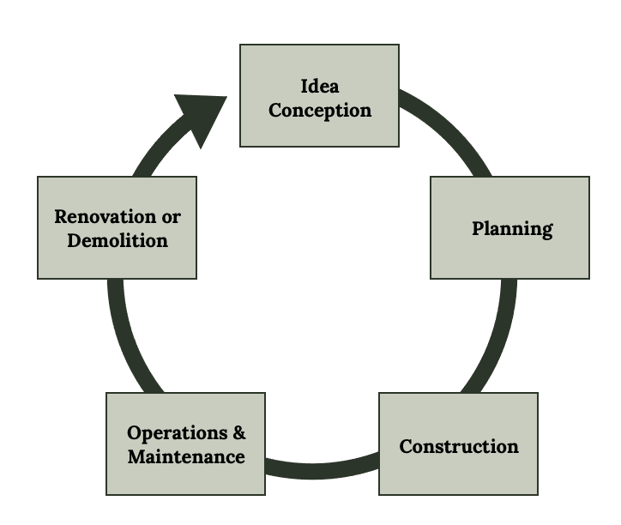
1.1 Introduction
Green Building Initiatives & The Building Lifecycle
Figure 1.1: Building lifecycle. Kindred Grey. 2023. CC BY 4.0.

Slide 5
1.2 What is Sustainable Property Management?
Sustainability
Sustainable Property Management

Slide 6
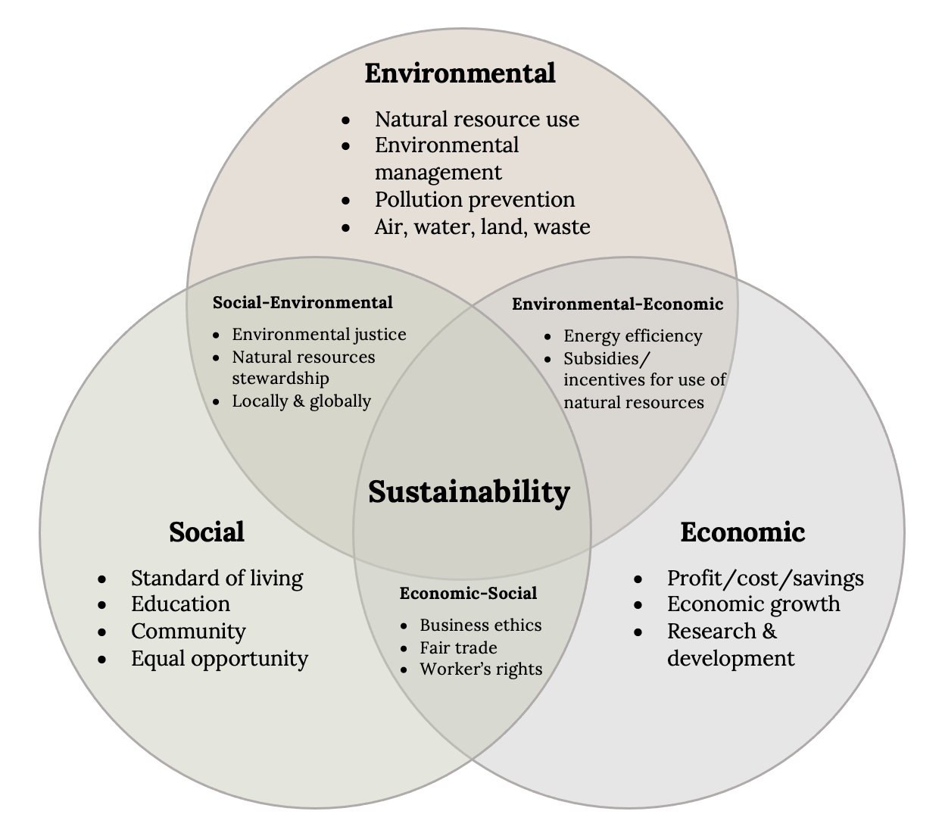
Sustainability
Three Spheres
Figure 1.2: The three spheres of sustainability. Kindred Grey. 2023. Adapted under fair use from DOI:10.4018/jcrmm.2013010101.

Slide 7
Sustainable Property Management
Implementing green building initiatives during the operations and maintenance phase of the building lifecycle, taking into account their environmental, social, and economic impacts with the goal of reconciling these three spheres in such a way that a balance is achieved between economic development and protection of environmental and social resources.
Notes:
The idea of how sustainability fits into sustainable property management

Slide 8







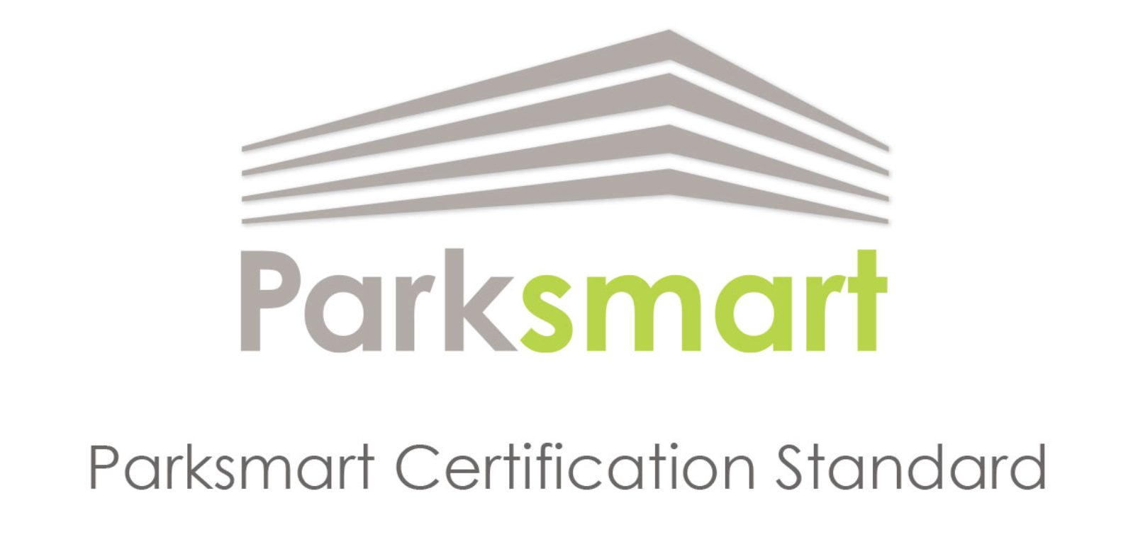
A selection of global green real estate management accreditations and certifications
Notes:
Certifications that try and embody sustainable property management

Slide 9
1.3 Why Sustainable Property Management Matters
building operation activities contribute to greenhouse gas emissions (GHGs)

Slide 10
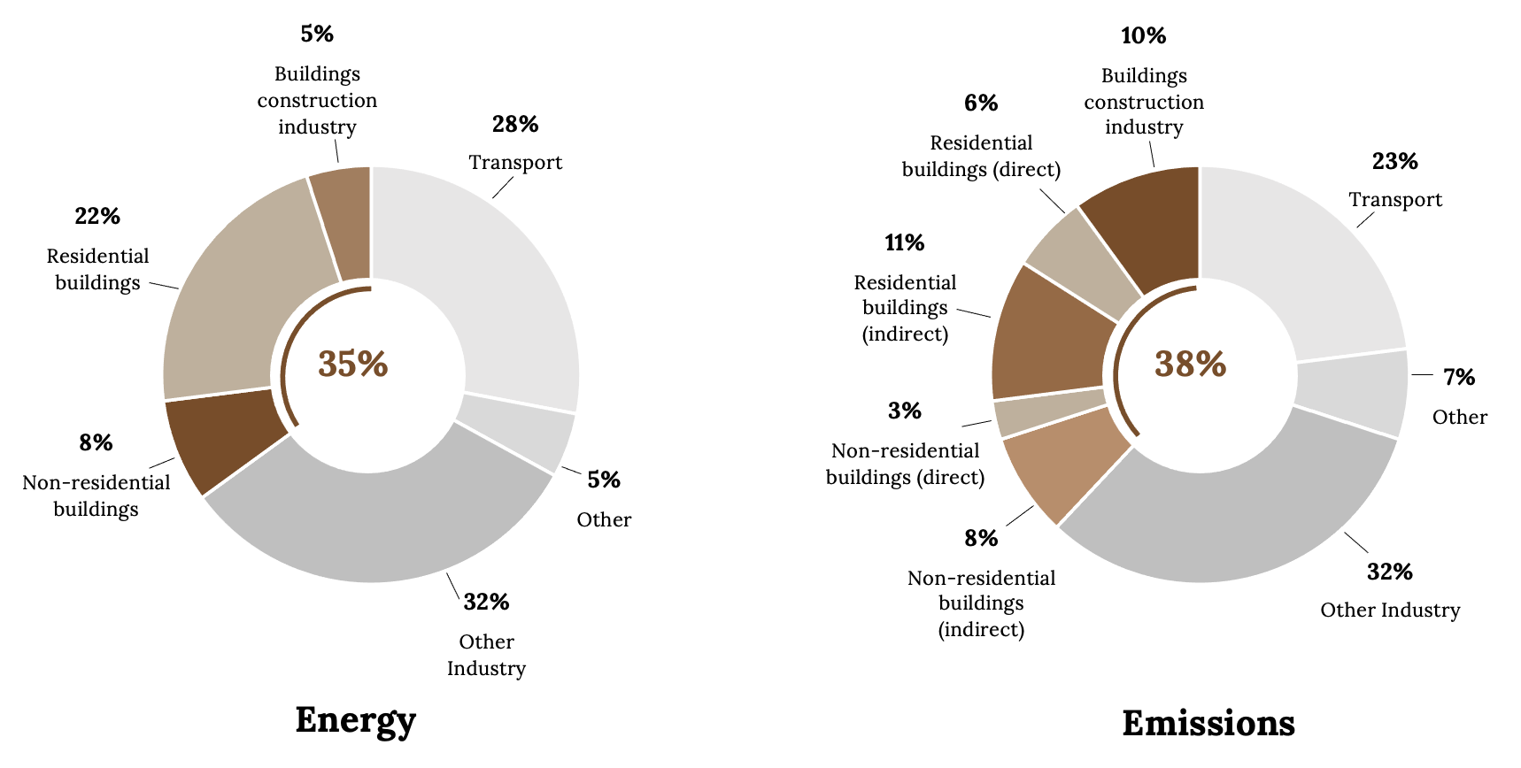
Continued: Why Sustainable Property Management Matters
Figure 1.3: Global share of buildings and construction final energy and emissions (2019). Kindred Grey. 2023. CC BY 4.0. Data from United Nations Environment Programme 2020 Report (https://globalabc.org/resources/publications/2020-global-status-report-buildings-and-construction).

Slide 11
1.4 Evolution of Sustainable Property Management
1987, the Report of the World Commission on Environment and Development: Our Common Future (also known as the Brundtland Report) was published by the United Nations and contained a call to action for sustainable development in the built environment.

Slide 12
Introduction of Green Building Certifications for Existing Buildings
Year Label Country
1990 BREEAM United Kingdom
1993 Energy Star for Buildings United States
1995 Energy Star for Homes United States
1998 LEED United States
2001 CASBEE Japan
2003 Green Star Australia
Year Label Country
2005 LEED for Existing
Buildings United States
2009 BREEAM In-Use United Kingdom
2009 DGNB System Germany
2009 BOMA 360 United States
2013 Green Star-Performance Australia
2015 IREM CSP United States

Slide 13
ESG Reporting
●“E” = Environmental
●“S” = Social
●“G” = Governance
●Global Real Estate Sustainability Benchmark (GRESB) assessment framework
○Founded in 2009
○Used as an ESG benchmark for real estate assets
○As of 2021, 117,000 real estate assets across 1,520 property companies, REITs, funds, and developers participated in the GRESB Real Estate Assessment, representing $5.7 trillion of assets under management (“The GRESB)

Slide 14
Introduction of ESG Reporting
Year Label Country
1990 BREEAM United Kingdom
1993 Energy Star for Buildings United States
1995 Energy Star for Homes United States
1998 LEED United States
2001 CASBEE Japan
2003 Green Star Australia
Year Label Country
2005 LEED for Existing
Buildings United States
2009 BREEAM In-Use United Kingdom
2009 DGNB System Germany
2009 BOMA 360 United States
2013 Green Star-Performance Australia
2015 IREM CSP United States

Slide 15
1.5 Barriers to Sustainable Property Management
The real estate industry has certainly made significant progress in adopting sustainable practices, but a number of barriers still stand in the way of further progress.

Slide 16
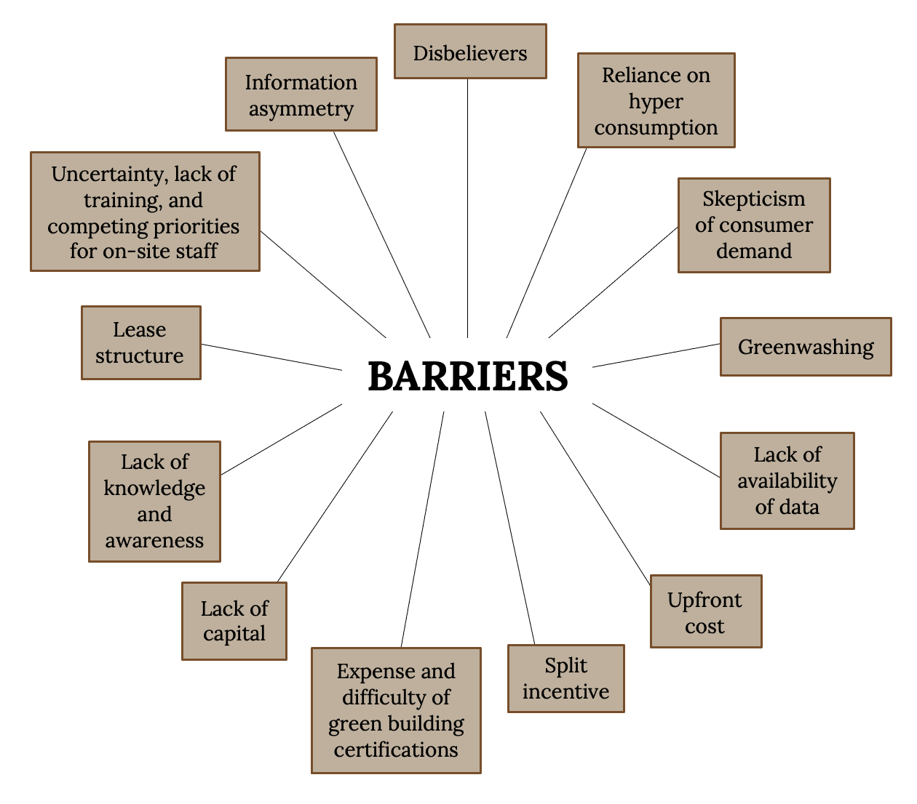
Continued: Barriers to Sustainable Property Management
Figure 1.7: Sustainable property management barriers. Kindred Grey. 2023. CC BY 4.0.
Notes:
The text box above the slide is for accessibility purposes. If you edit this PPT, please leave it there. It doesn’t show up in preview mode.

Slide 17
1.6 Conclusion
Becoming more commonplace
Can positively impact all three spheres of sustainability
A human science as well as a building science because humans create and manage buildings, not the building itself
Barriers must be addressed

