Slide 1

For the Joy of It All:
The Case for Collaboratively Building and Sharing Open Educational Resources (OER)
Anita R. Walz, Associate Professor and Assistant Director of Open Education and Scholarly Communication Librarian, University Libraries, Virginia Tech
Virginia Library Association 2021 Annual Conference ~ Richmond, VA October 29, 2021
http://hdl.handle.net/10919/106482
© Anita Walz and CC BY 4.0 unless otherwise noted.
Template and logo-lockup are © Virginia Tech.

Slide 2
Today’s Presentation
What is Open Education?
Acknowledging that this work is challenging
Many different types of collaborations as potential solutions
What makes collaboration work?
Discussion

Slide 3
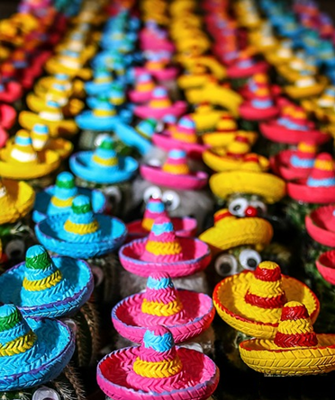
Lots of variety . . .
Strategize and direct OER program
Deeply involved in OER + ancillary creation (e.g. test banks, slides, etc.)
Collaboration at and off campus
Committee service + research agenda
some supervisory (1 FTE)
Pixabay license https://cdn.pixabay.com/photo/2015/02/11/13/08/cactus-632405__340.jpg

Slide 4

Getting to Know You

Slide 5
Academic library
Public library
Something else

Slide 6
Some experience with OER
More than “some” experience w/OER
Pretty new to this conversation

Slide 7
Somewhat familiar with “open education”
How is open education different from OER?
Open education is a new idea to me!

Slide 8
Thank you . . .

Slide 9

Open Education is . . .
Public Domain image. Unsplash :https://unsplash.com/photos/qNHbXkO3Xbc
Notes:
https://unsplash.com/photos/qNHbXkO3Xbc

Slide 10
Open education is a philosophy about the way people should produce, share, and build on knowledge. Proponents of open education believe everyone in the world should have access to high-quality educational experiences and resources, and they work to eliminate barriers to this goal. - opensource.com
Open education is an attitude, a practice, and a method of teaching that inspires inquiry, equal access to course materials, and sharing lessons and materials with the wider community. At the center of open education is the belief that education is strengthened when shared openly. - CCCOER
Open educational practices and open pedagogy are components of open education that move beyond resources to address pedagogical approaches and the relationships between teachers and learners - C. Cronin

Slide 11
Open Education is . . .
Public Domain image. Unsplash :https://unsplash.com/photos/qNHbXkO3Xbc
Notes:
https://unsplash.com/photos/qNHbXkO3Xbc

Slide 12

Philosophy
Statue photo used under Fair Use.

Slide 13
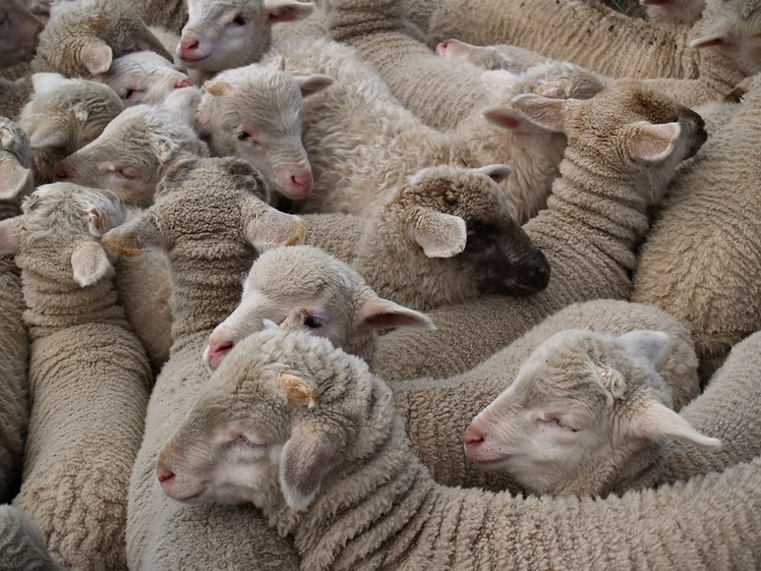
Working with Humans
(who have many different ideas and ways of doing things)
Public Domain (Unsplash) https://unsplash.com/photos/z86KJCr4zS8
Notes:
https://unsplash.com/photos/z86KJCr4zS8

Slide 14

Involves a “change” agenda.
We ask ourselves and others to work in different ways
Public domain (Unsplash) https://unsplash.com/photos/KT7KdjhVDoU
Notes:
https://unsplash.com/photos/KT7KdjhVDoU

Slide 15

Basic and Advanced things to discover and learn about a wide array of things that no one could possibly master all parts of -- pedagogy, copyright, implementation, communication strategies, assessment, project management, etc.
Public domain (Unsplash) https://unsplash.com/photos/Oalh2MojUuk
Notes:
https://unsplash.com/photos/Oalh2MojUuk

Slide 16
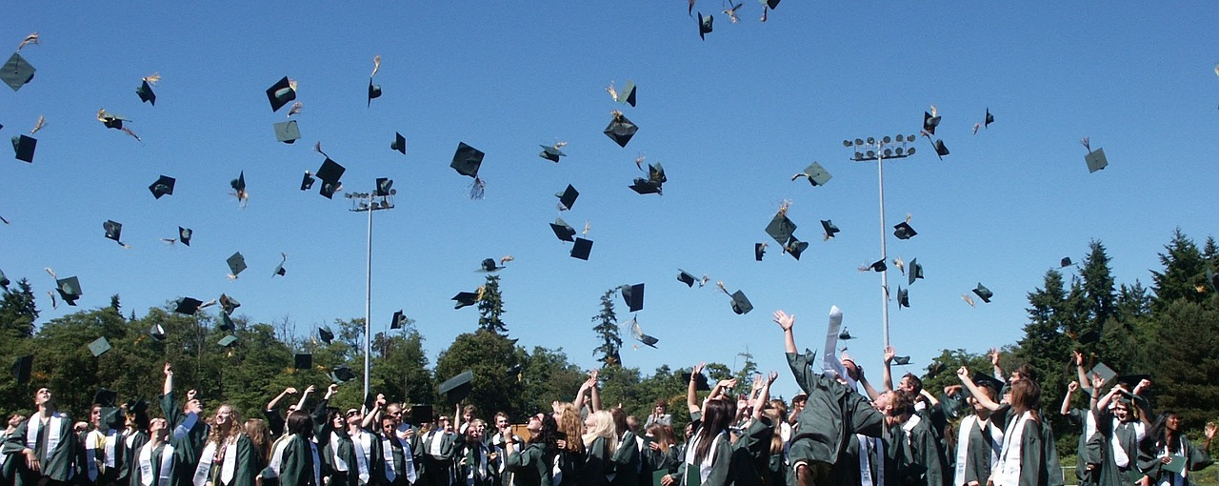
Rewarding for students and educators to meet various goals
Pixabay open license: https://pixabay.com/static/uploads/photo/2015/10/18/19/04/graduation-995042__180.jpg

Slide 17

Challenges
[Discussion] What challenges have you encountered
-- or expect that you would encounter in this type of work?

Slide 18

Inadequate institutional support / limited resources of various kinds
Public domain (Unsplash) https://unsplash.com/photos/oPxXsjTMDTA
Notes:
https://unsplash.com/photos/oPxXsjTMDTA

Slide 19
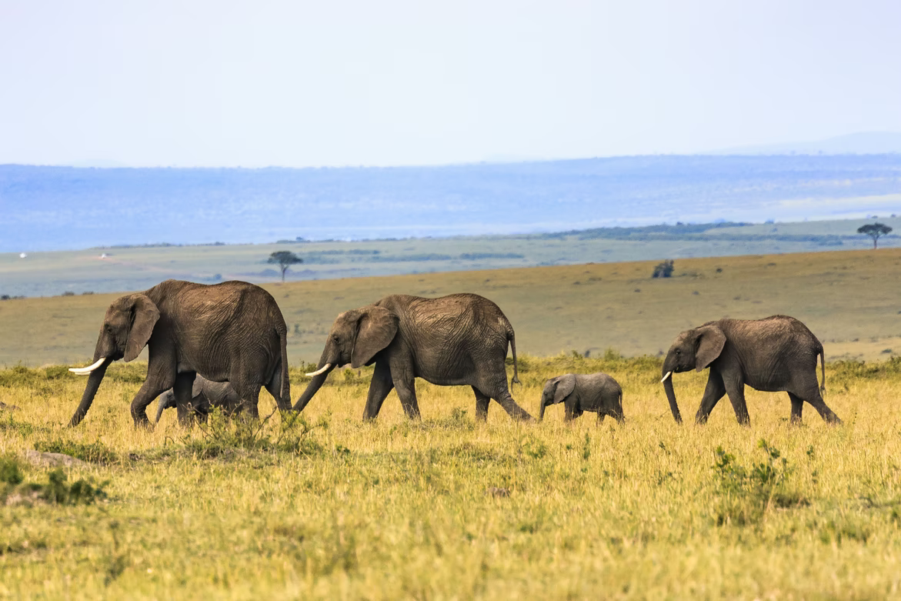
Maybe your institution is small . . . or you feel small
Public domain (Unsplash) https://unsplash.com/photos/uZqJVqwFxMQ
Notes:
https://unsplash.com/photos/uZqJVqwFxMQ

Slide 20
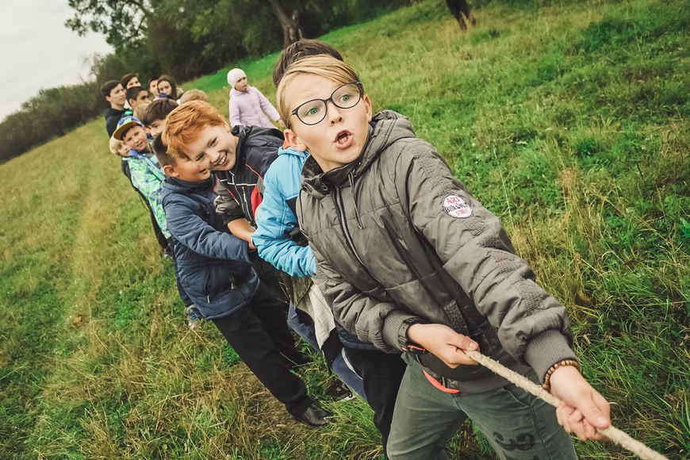
Internal or external tug-of-war between short and long-term strategies
(between paying for closed access eBooks or making a long-term investment in open)
Public domain (Unsplash) https://unsplash.com/photos/w55SpMmoPgE
Notes:
https://unsplash.com/photos/w55SpMmoPgE

Slide 21

Limited individual capacity
Wearing too many hats, now having enough time for this work, limited expertise
Doing the best we can, but it is not sustainable in the long run
Public domain (Unsplash) https://unsplash.com/photos/KvkvaFlZdSg

Slide 22
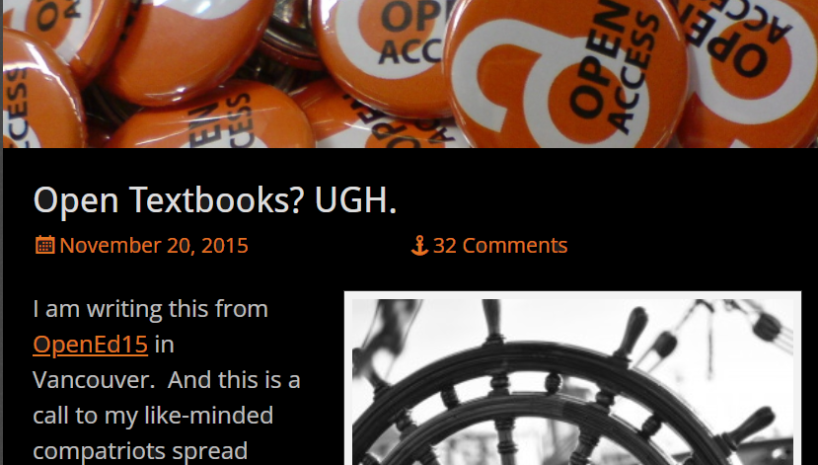

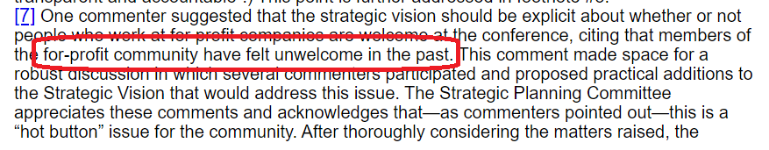
Experience of unjust criticisms, conflicting goals,
inflammatory comments . . .
or just hot button issues (that hurt)?
Notes:
https://docs.google.com/document/d/e/2PACX-1vSQ9-B-Lf5b3H5CkN6A8hUQ2hAoAre_PT-0B3zU3OUOIhtaOsniVpxZ30pvAVkVWIzR7zroqCsni7GS/pub

Slide 23

Does any of this resonate?
Public domain (Unsplash) https://unsplash.com/photos/dGxOgeXAXm8
https://unsplash.com/photos/w2JtIQQXoRU
Notes:
https://unsplash.com/photos/dGxOgeXAXm8
https://unsplash.com/photos/w2JtIQQXoRU

Slide 24
If so . . . . you are not alone.

Slide 25


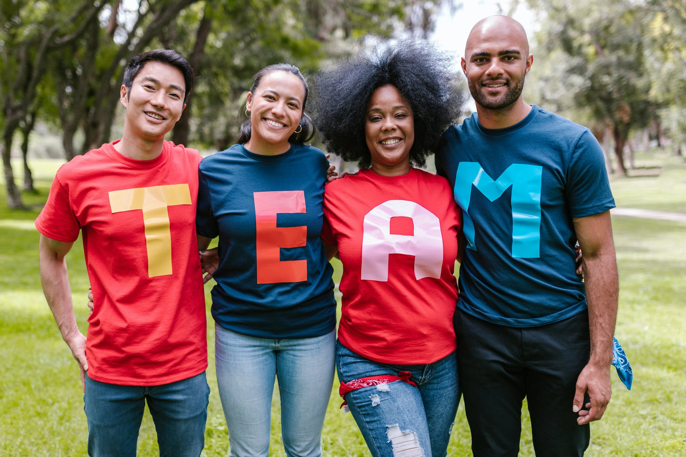
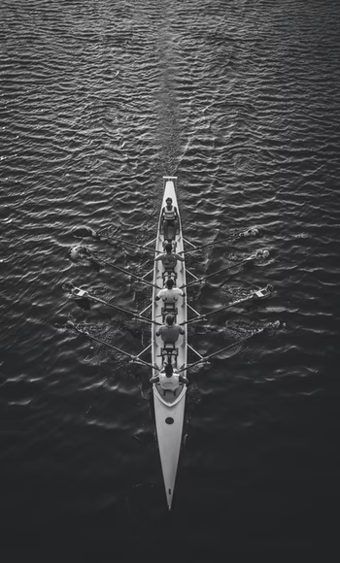

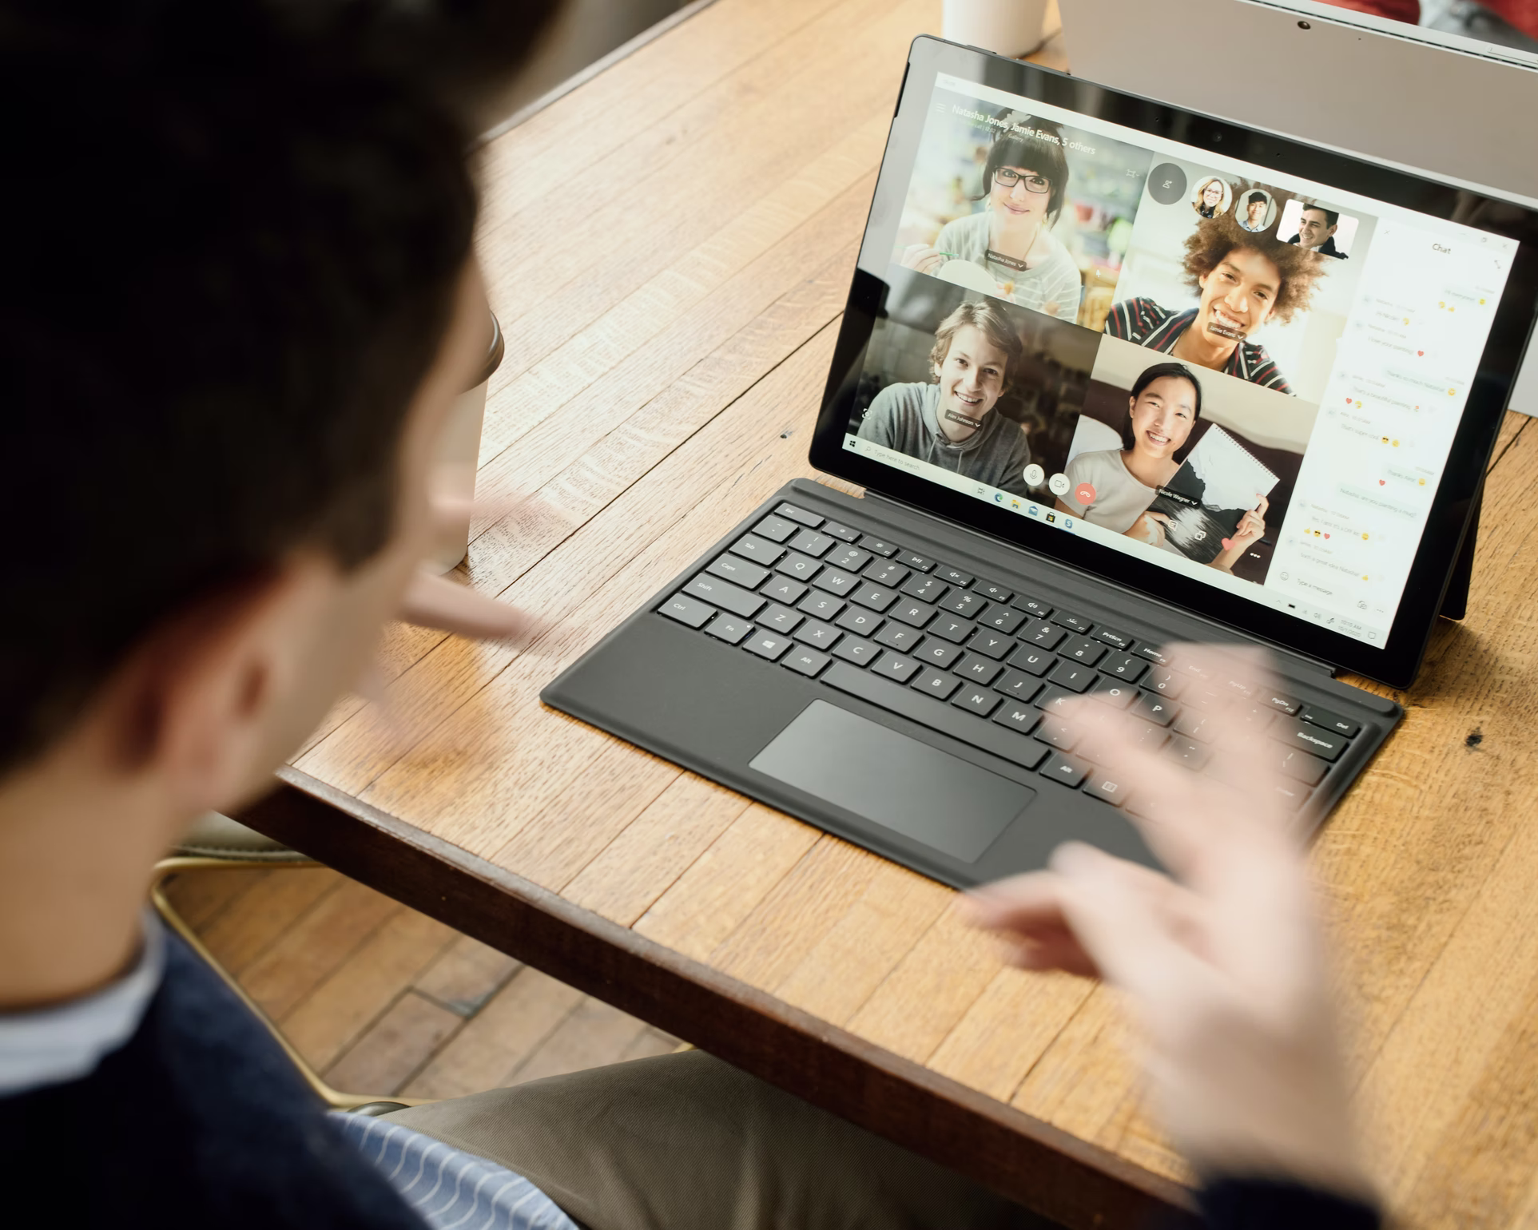

The Case for Collaboration
Public domain: https://unsplash.com/photos/g1Kr4Ozfoac
https://unsplash.com/photos/Zyx1bK9mqmA
https://unsplash.com/photos/HJgaV1qjHS0
https://unsplash.com/photos/nZL80Di-YAg
https://www.pexels.com/photo/group-of-people-wearing-shirts-spelled-team-7551442
Notes:
https://unsplash.com/photos/g1Kr4Ozfoac
https://unsplash.com/photos/Zyx1bK9mqmA
https://unsplash.com/photos/HJgaV1qjHS0
https://unsplash.com/photos/nZL80Di-YAg
https://www.pexels.com/photo/group-of-people-wearing-shirts-spelled-team-7551442
Trust
Respect and appreciation
Shared goal(s)
Commitment to each other and the project
Time
A plan
Things to share
Skill and effort

Slide 26
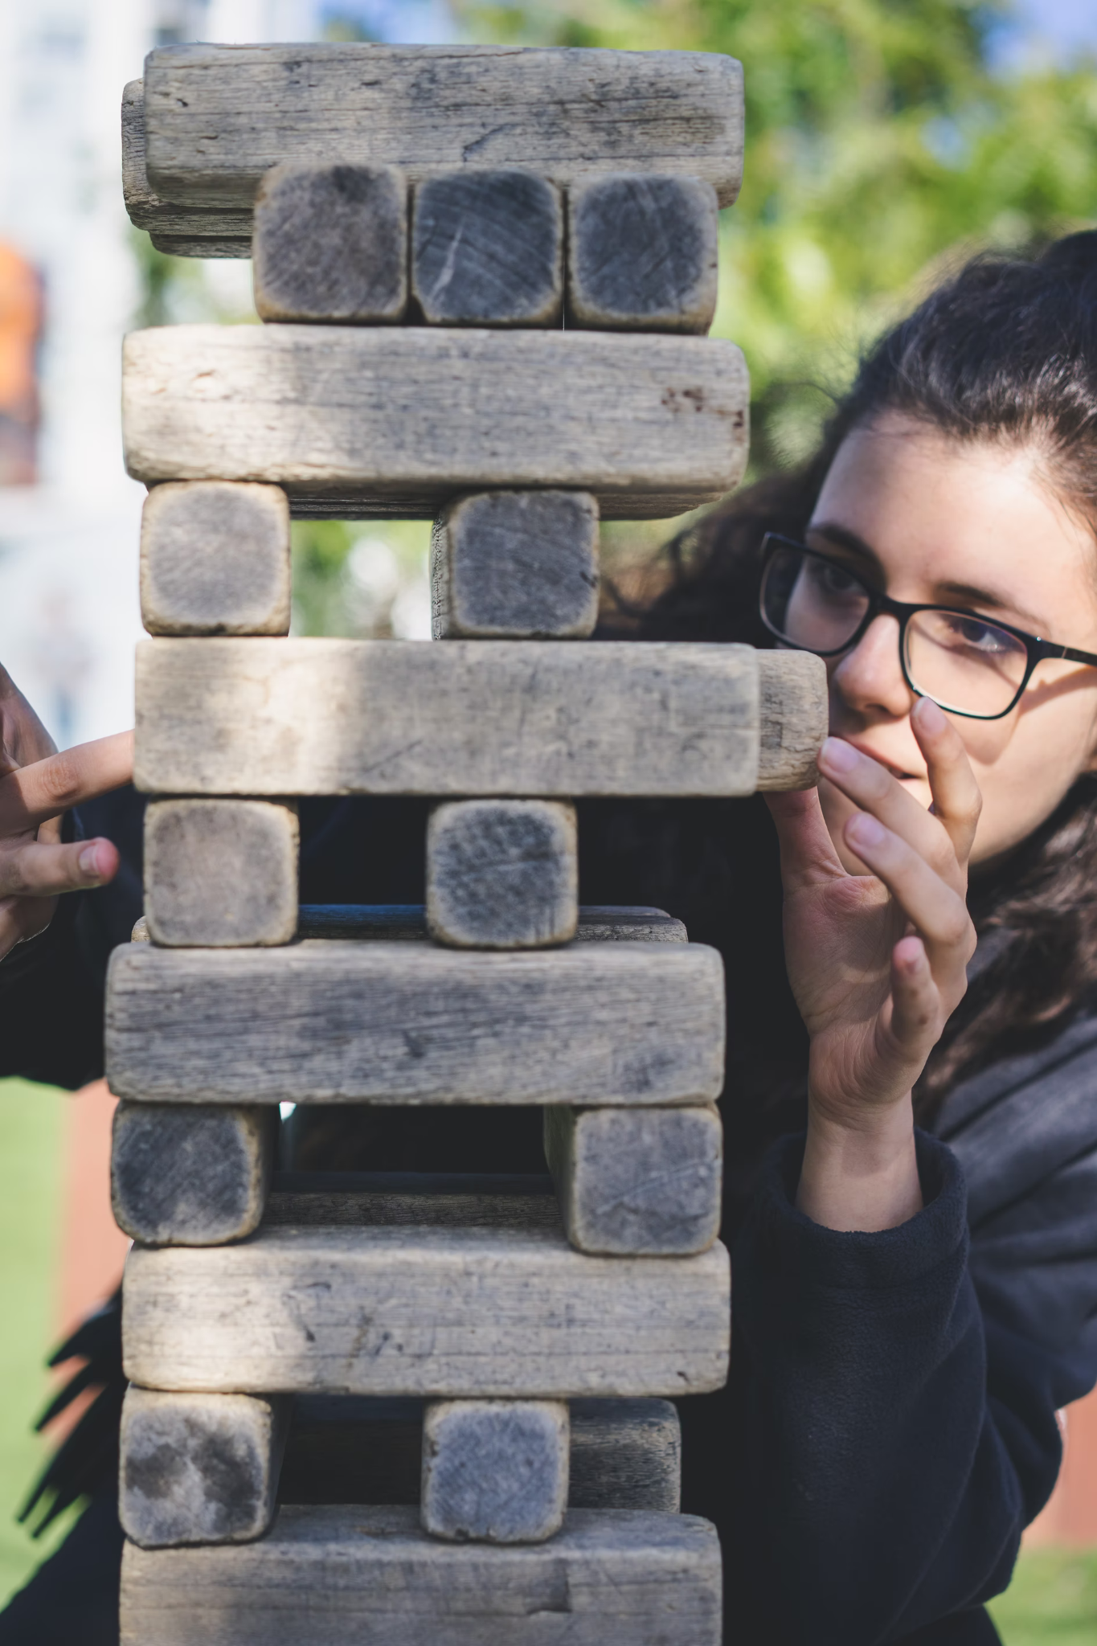

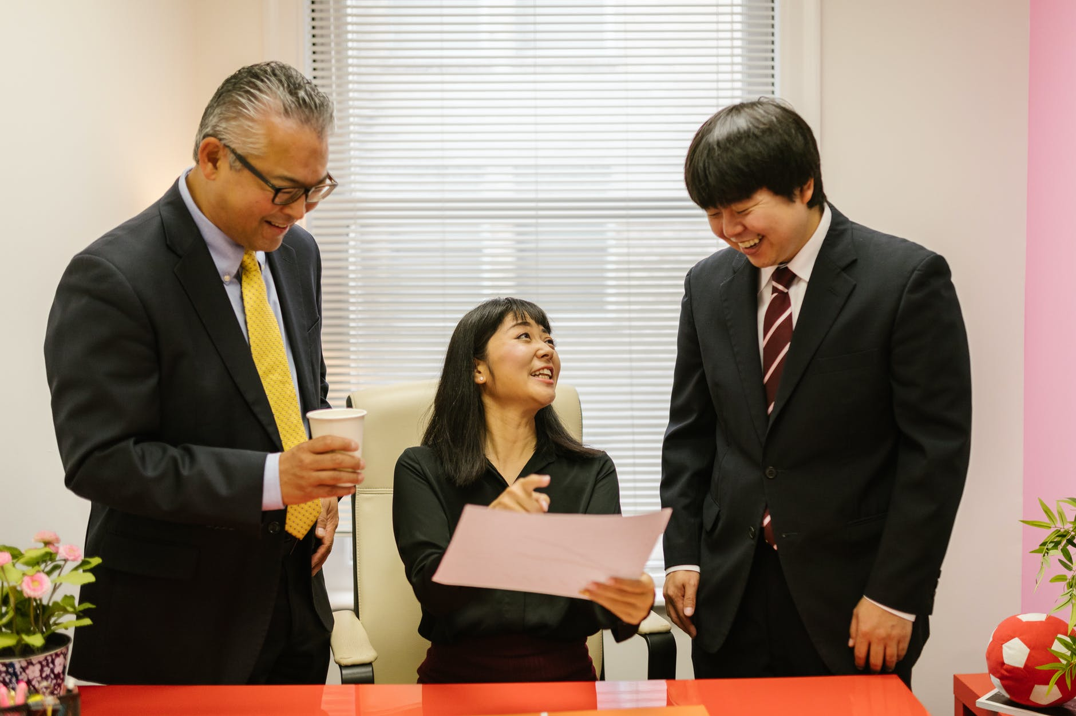
Public domain: https://unsplash.com/photos/bEY5NoCSQ8s
https://www.pexels.com/photo/people-discuss-about-graphs-and-rates-3184292/
Notes:
https://unsplash.com/photos/bEY5NoCSQ8s
https://www.pexels.com/photo/people-discuss-about-graphs-and-rates-3184292/
https://www.pexels.com/photo/group-of-people-wearing-shirts-spelled-team-7551442

Slide 27
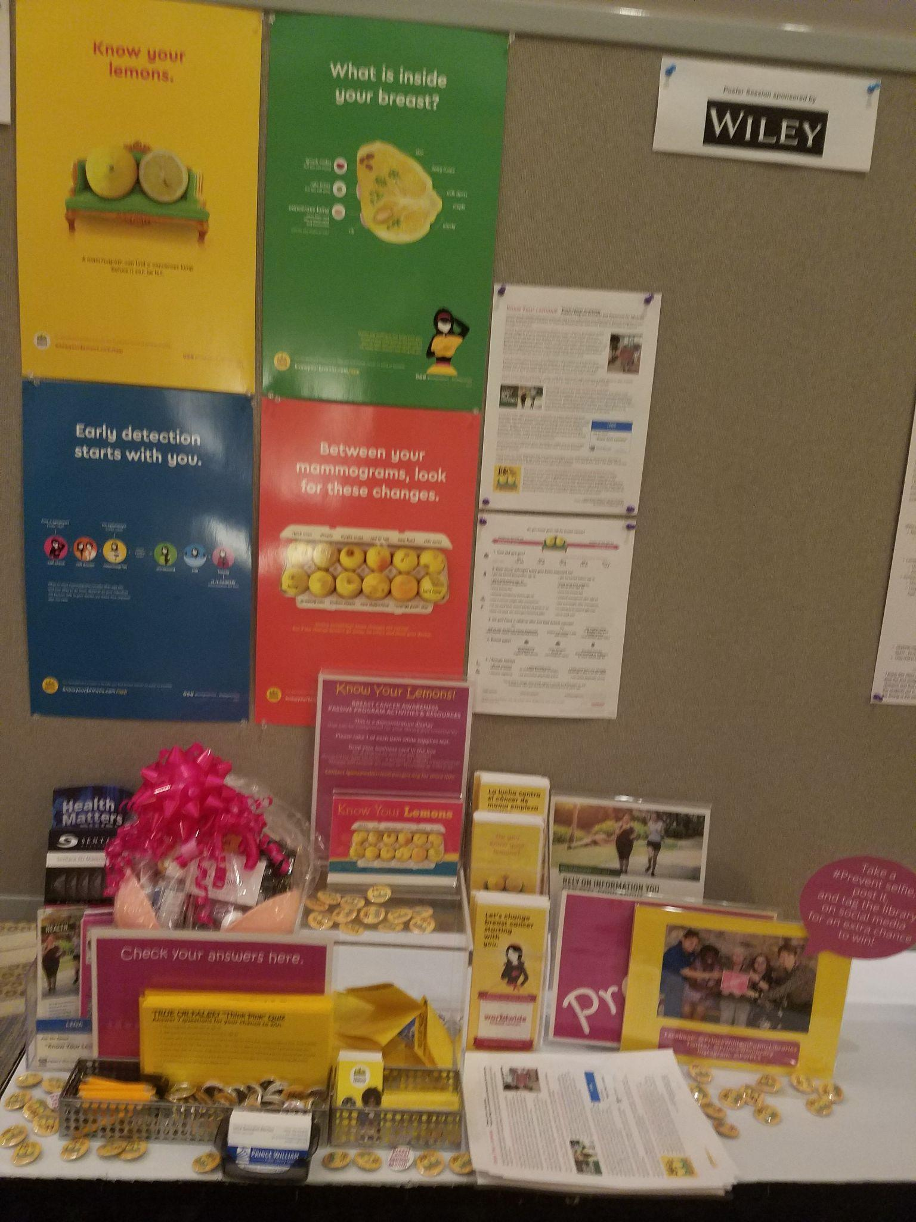
Passive Exhibit
Printed (or digital) copies of OER
various sources
Digital Sources
Open Textbook Library https://open.umn.edu/opentextbooks
OER Commons http://oercommons.org
VIVA’s “VIVA Open” Site https://vivaopen.oercommons.org
VCCS Transfer Course Mapping Hub https://vivaopen.oercommons.org/hubs/vccs_course_mapping
OER Starter Kit
https://iastate.pressbooks.pub/oerstarterkit
SPARC Open Education FactSheet
https://sparcopen.org/our-work/sparc-fact-sheets/
Brochures about Creative Commons (scroll down)
https://creativecommons.org/about/downloads/
Games: Guess the cost of X OER vs. the commercial equivalent
Creative Commons, Open Education Network, or other stickers
A way for people to “sign in” or “sign up”
your business card
Exhibit by Lena Gonzalez Berrios at 2021 VLA Conference

Slide 28
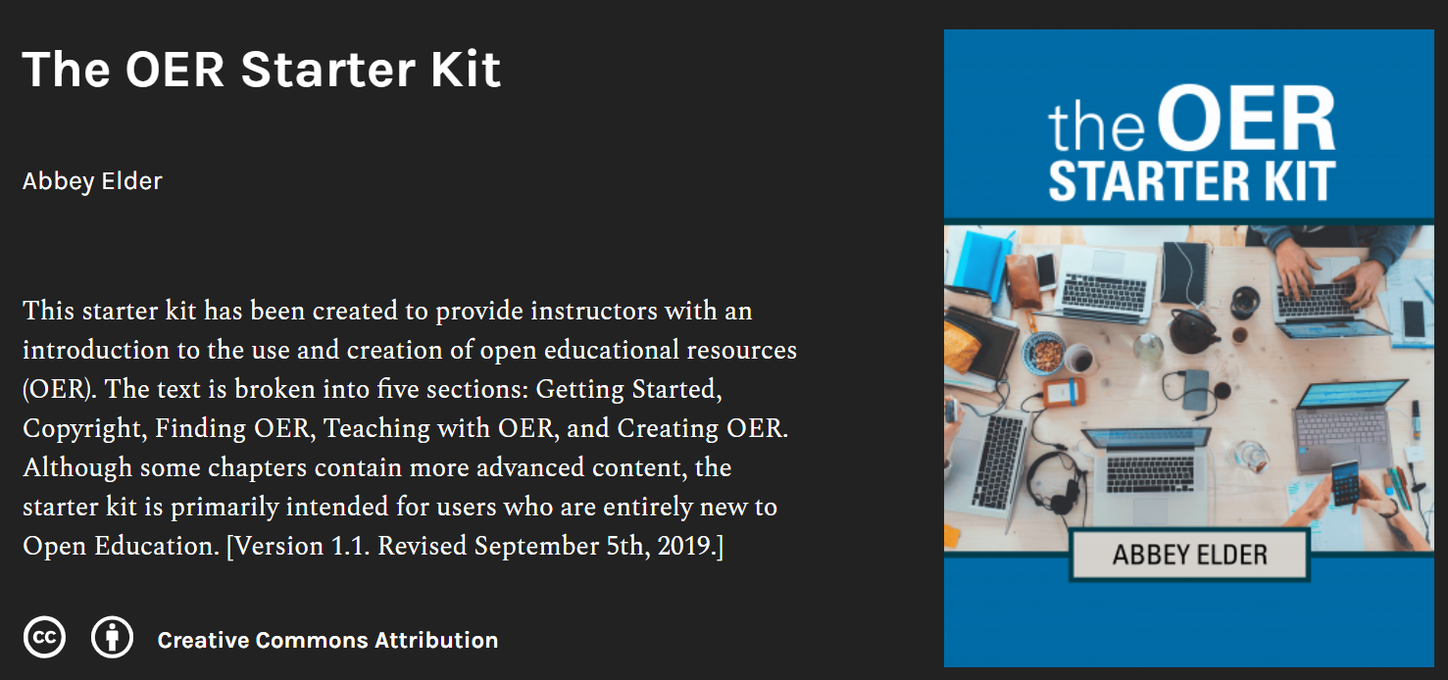
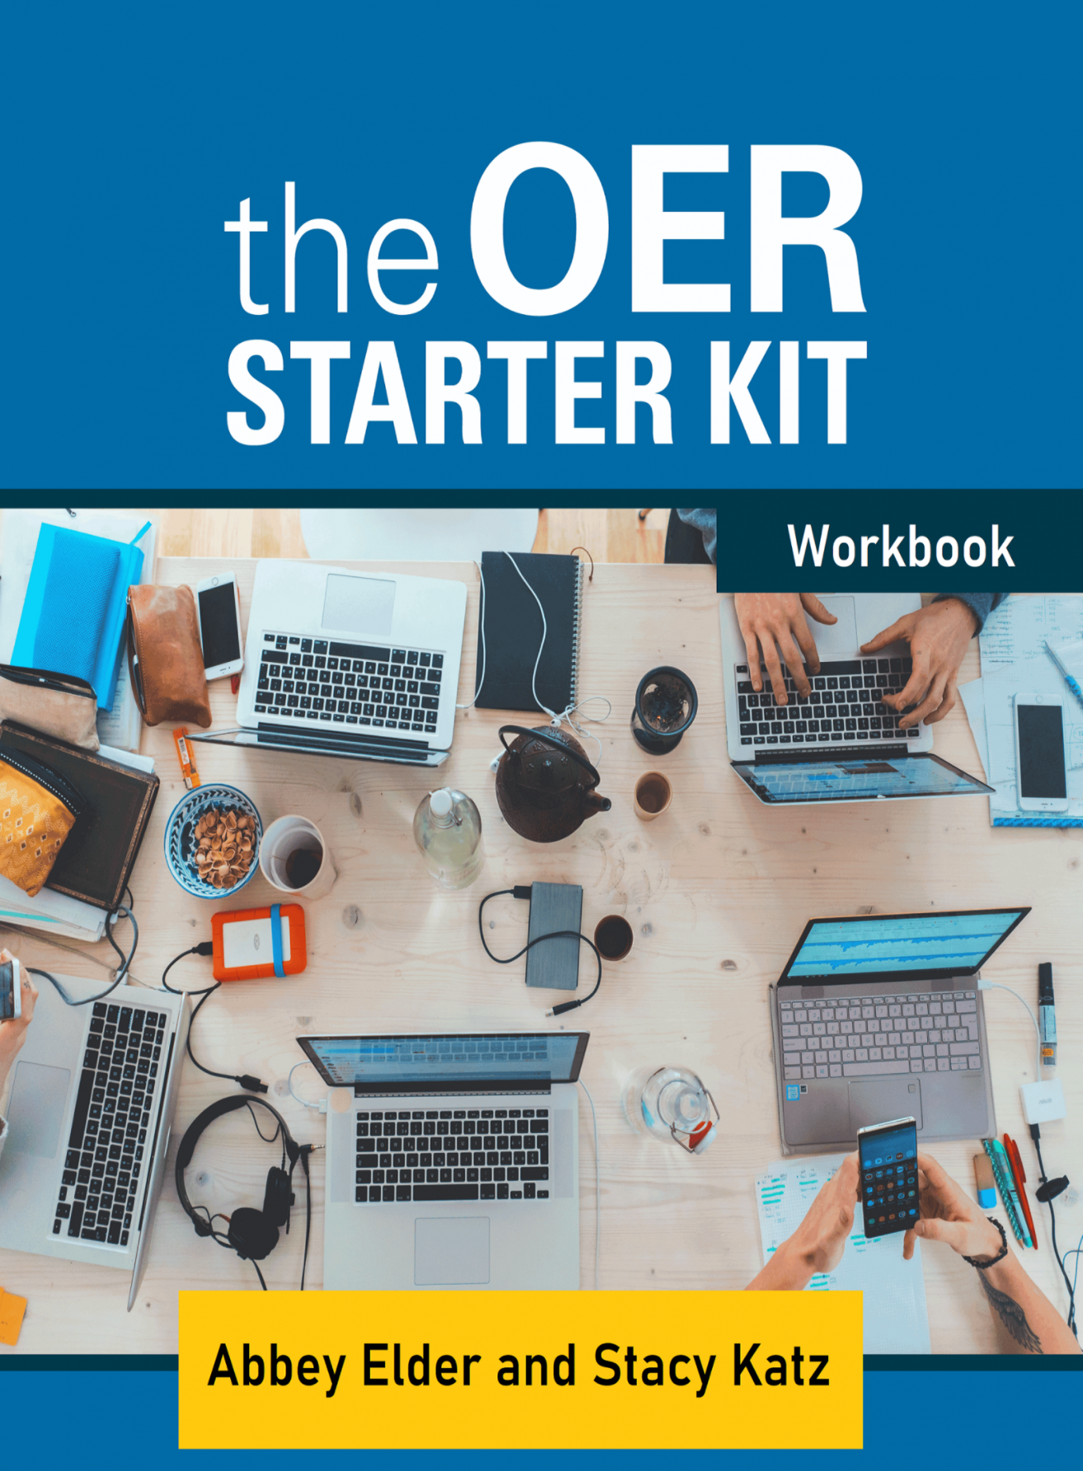
Build a learning or inquiry community
OER Starter Kit
https://iastate.pressbooks.pub/oerstarterkit
workbook:
https://cuny.manifoldapp.org/read/the-oer-starter-kit-workbook
Webinar recording: Abbey Elder “Getting Started with Open Educational Resources”
http://hdl.handle.net/10919/102634

Slide 29
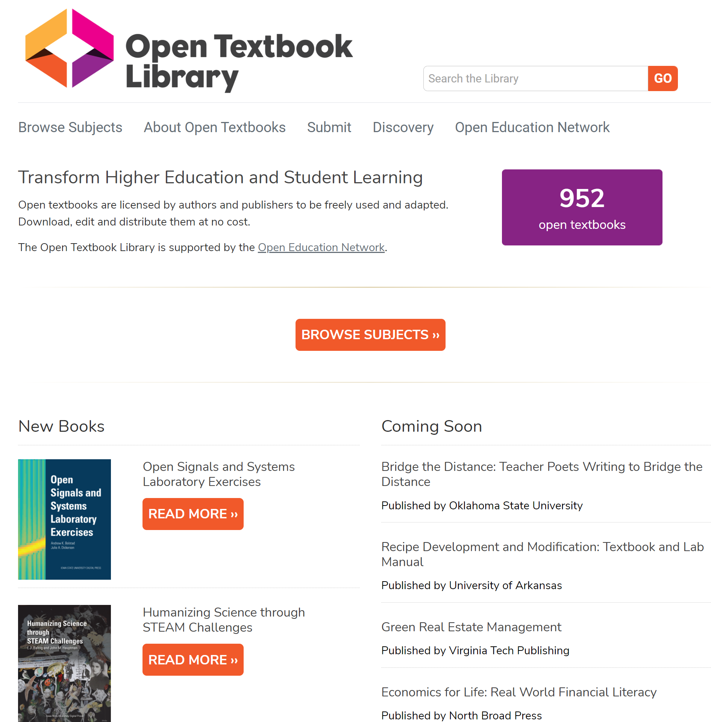
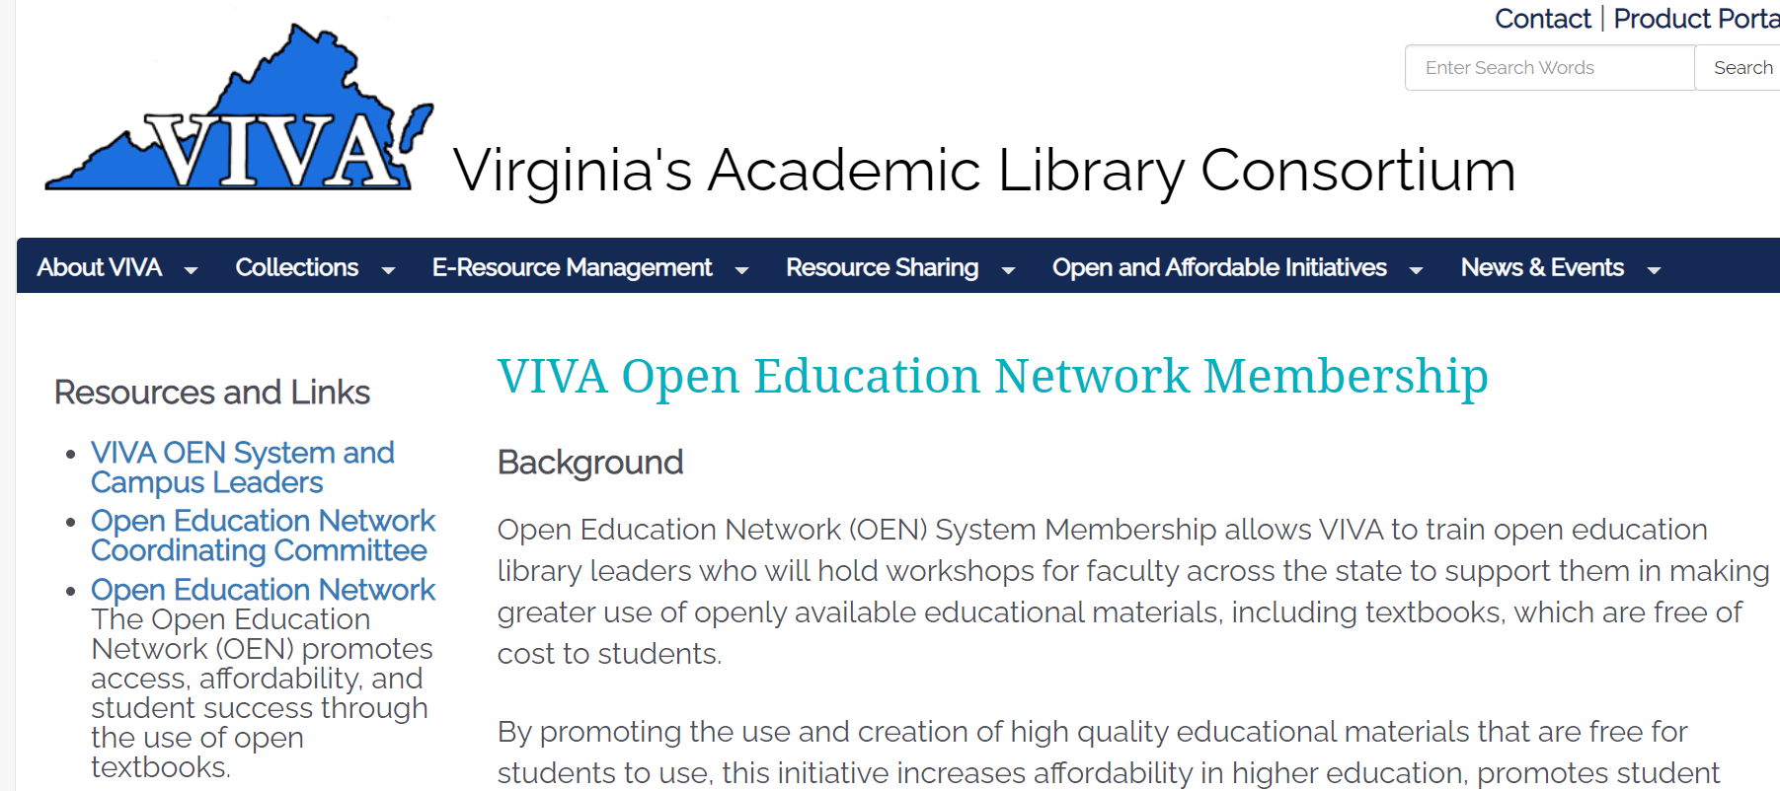
Collaborate on delivering an Open Education Network workshop (aka Open Textbook Workshop)
https://vivalib.org/va/open/otn
Delivering a virtual, asynchronous open textbook workshop; Liz Thompson (James Madison University) and Kyle Binaxas (Richard Bland College)
Workshop link
Outline link
Lightning Talk Notes
Lessons learned from a synchronous multi-institution online OTN workshop; Heather Blicher (Northern Virginia Community College) and Anita Walz (Virginia Tech)
Summary of Lessons Learned link
Workshop recording link
OEN document: 7 Tips for Hosting an OTN/OEN Virtual Workshop
http://hdl.handle.net/10919/98624
Open Textbook Library: https://open.umn.edu/opentextbooks

Slide 30

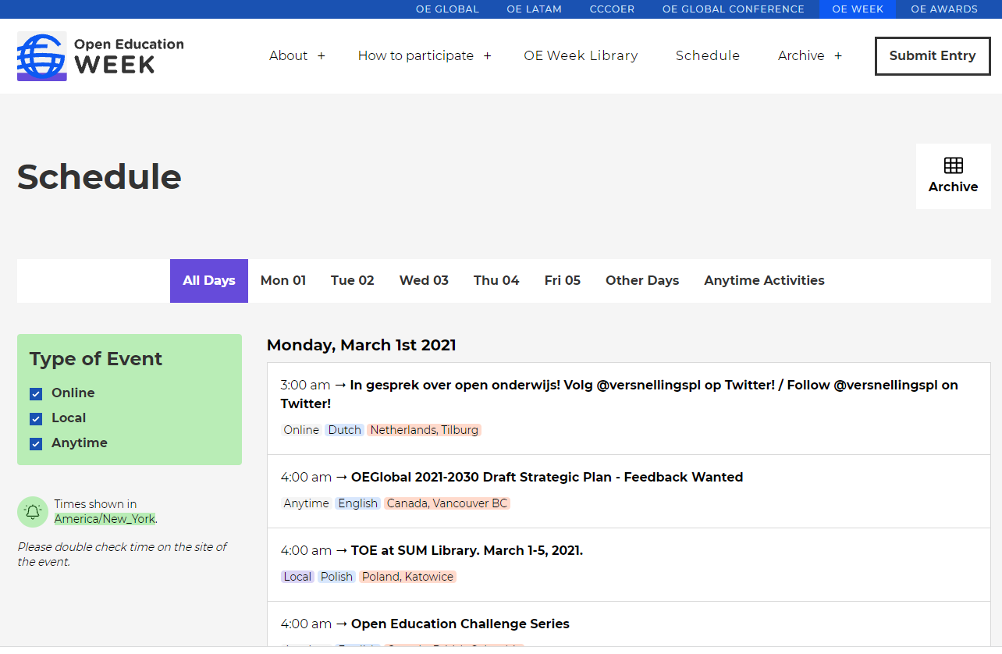
Curate a selection of Open Education Week events
Example: Colorado: https://masterplan.highered.colorado.gov/oer-week
Example: Idaho: https://sites.google.com/isu.edu/open-ed-week-2021-id/home
https://www.openeducationweek.org

Slide 31
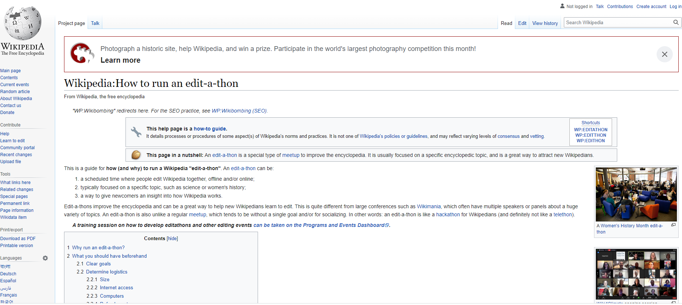
Edit-a-thon / Contribute-a-thon
https://en.wikipedia.org/wiki/Wikipedia:How_to_run_an_edit-a-thon
https://commons.wikimedia.org/wiki/Commons:Contributing_your_own_work

Slide 32







Student Book Projects
Project template: http://hdl.handle.net/10919/87742
Presentation: http://hdl.handle.net/10919/87741
Faculty + students
Welcome to the Beatles!
Production
Book proposal / info form
Consultation
Agreements
Production
https://publishing.vt.edu/site/books/series/virginia-tech-student-publications
NOTE: Cover design is © their creators.
Notes:
Organized, authored, and edited over the course of five months by a class of eighteen Virginia Tech undergraduate students, Welcome to the Beatles represents their collective contribution to the larger scholarship on the most important band in rock history.

Slide 33
Comparative Course Material Review Process
Find a mentor (I have a colleague I’d be happy to connect you with.)
Requires departmental buy in
Obtain copies of commercial and OER texts
Implement review process in line with department’s schedule
Write up and share the results!

Slide 34
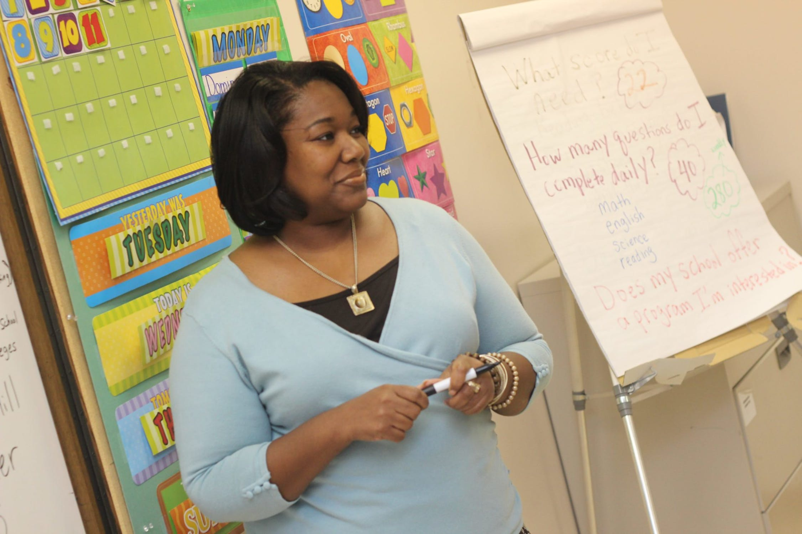
Facilitating Higher Ed / PreK-12 Partnerships
Slides and documents: http://hdl.handle.net/10919/105384
Recording: https://youtu.be/gYzCzWaNJb0
Presented by Anita Walz and Julee Farley
Messages to Higher Education
PreK12 teachers are EXPERTS at teaching
Creating generalizable lesson plans (to share) is not a small, effortless, nor easy task
PreK12 are generally paid when collaboratively creating resources to share beyond their classroom
Questions to ask:
What standards are your students struggling with?
How much time can you/do you plan to spend teaching this specific concept, topic, task or project?
Is there specific terminology that should be included (or not included) to which you want students to be exposed?
What would make it easy for you to actually use the material?
When do you plan to teach the material? How far in advance would you like to receive it?
Pexels license: https://www.pexels.com/photo/photo-of-woman-teaching-935943

Slide 35

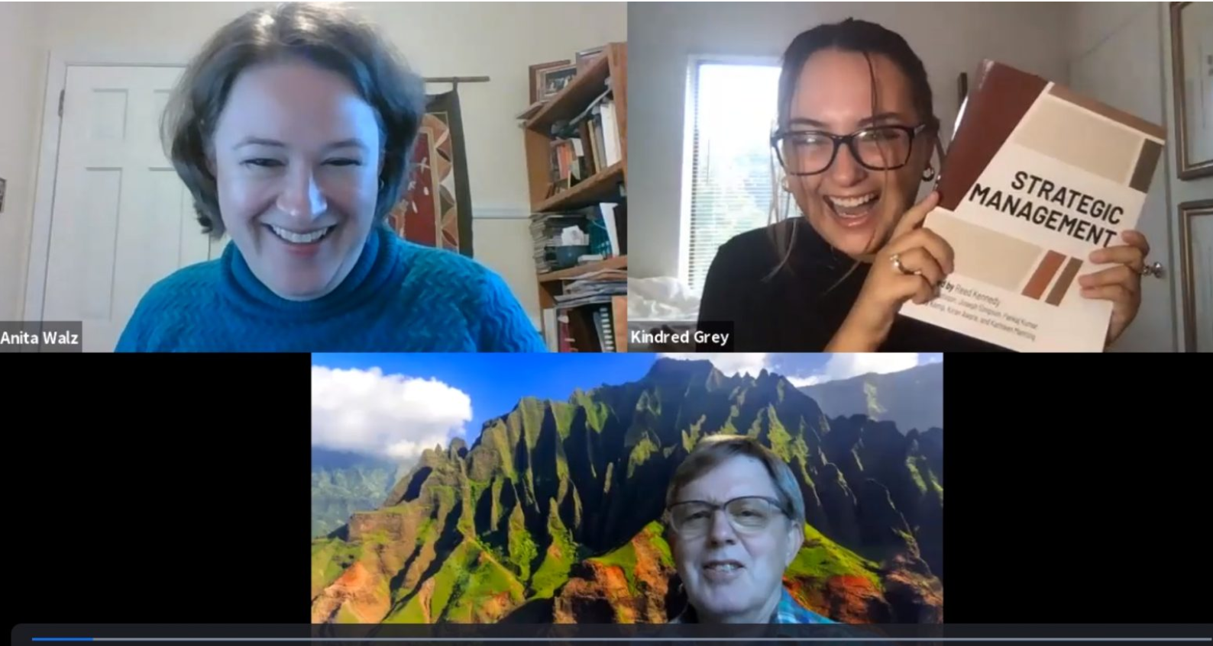
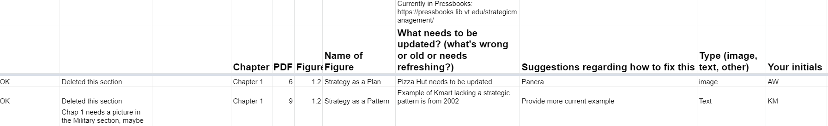
Join forces with faculty and students: Strategic Management
Subject matter Experts (includes
a student)
Editorial team (includes students)
Production team
(includes students)
https://blogs.lt.vt.edu/openvt/2020/09/15/announcing-open-textbook-strategic-management
https://pamplin.vt.edu/news/2020/10/pamplin-managementopen.html
Video chat and cover image courtesy of Virginia Tech.

Slide 36

Find collaborators to help:
Multi-Institutional Test Bank Development Project
40-minute recorded presentation: https://youtu.be/b8EStXVKN_g
Slides and resources available at:http://hdl.handle.net/10919/105385
Test bank request process: http://hdl.handle.net/10919/104179
Cover image, courtesy of Virginia Tech.
Public domain (Unsplash) https://images.unsplash.com/photo-1458943167885-38e8cfee2a23

Slide 37

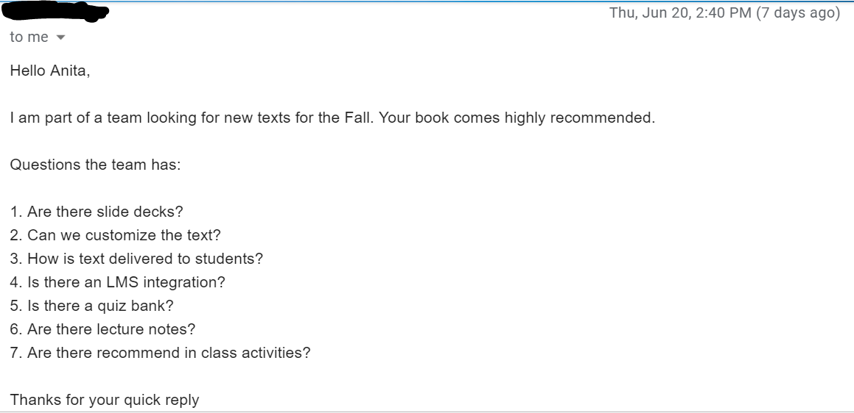
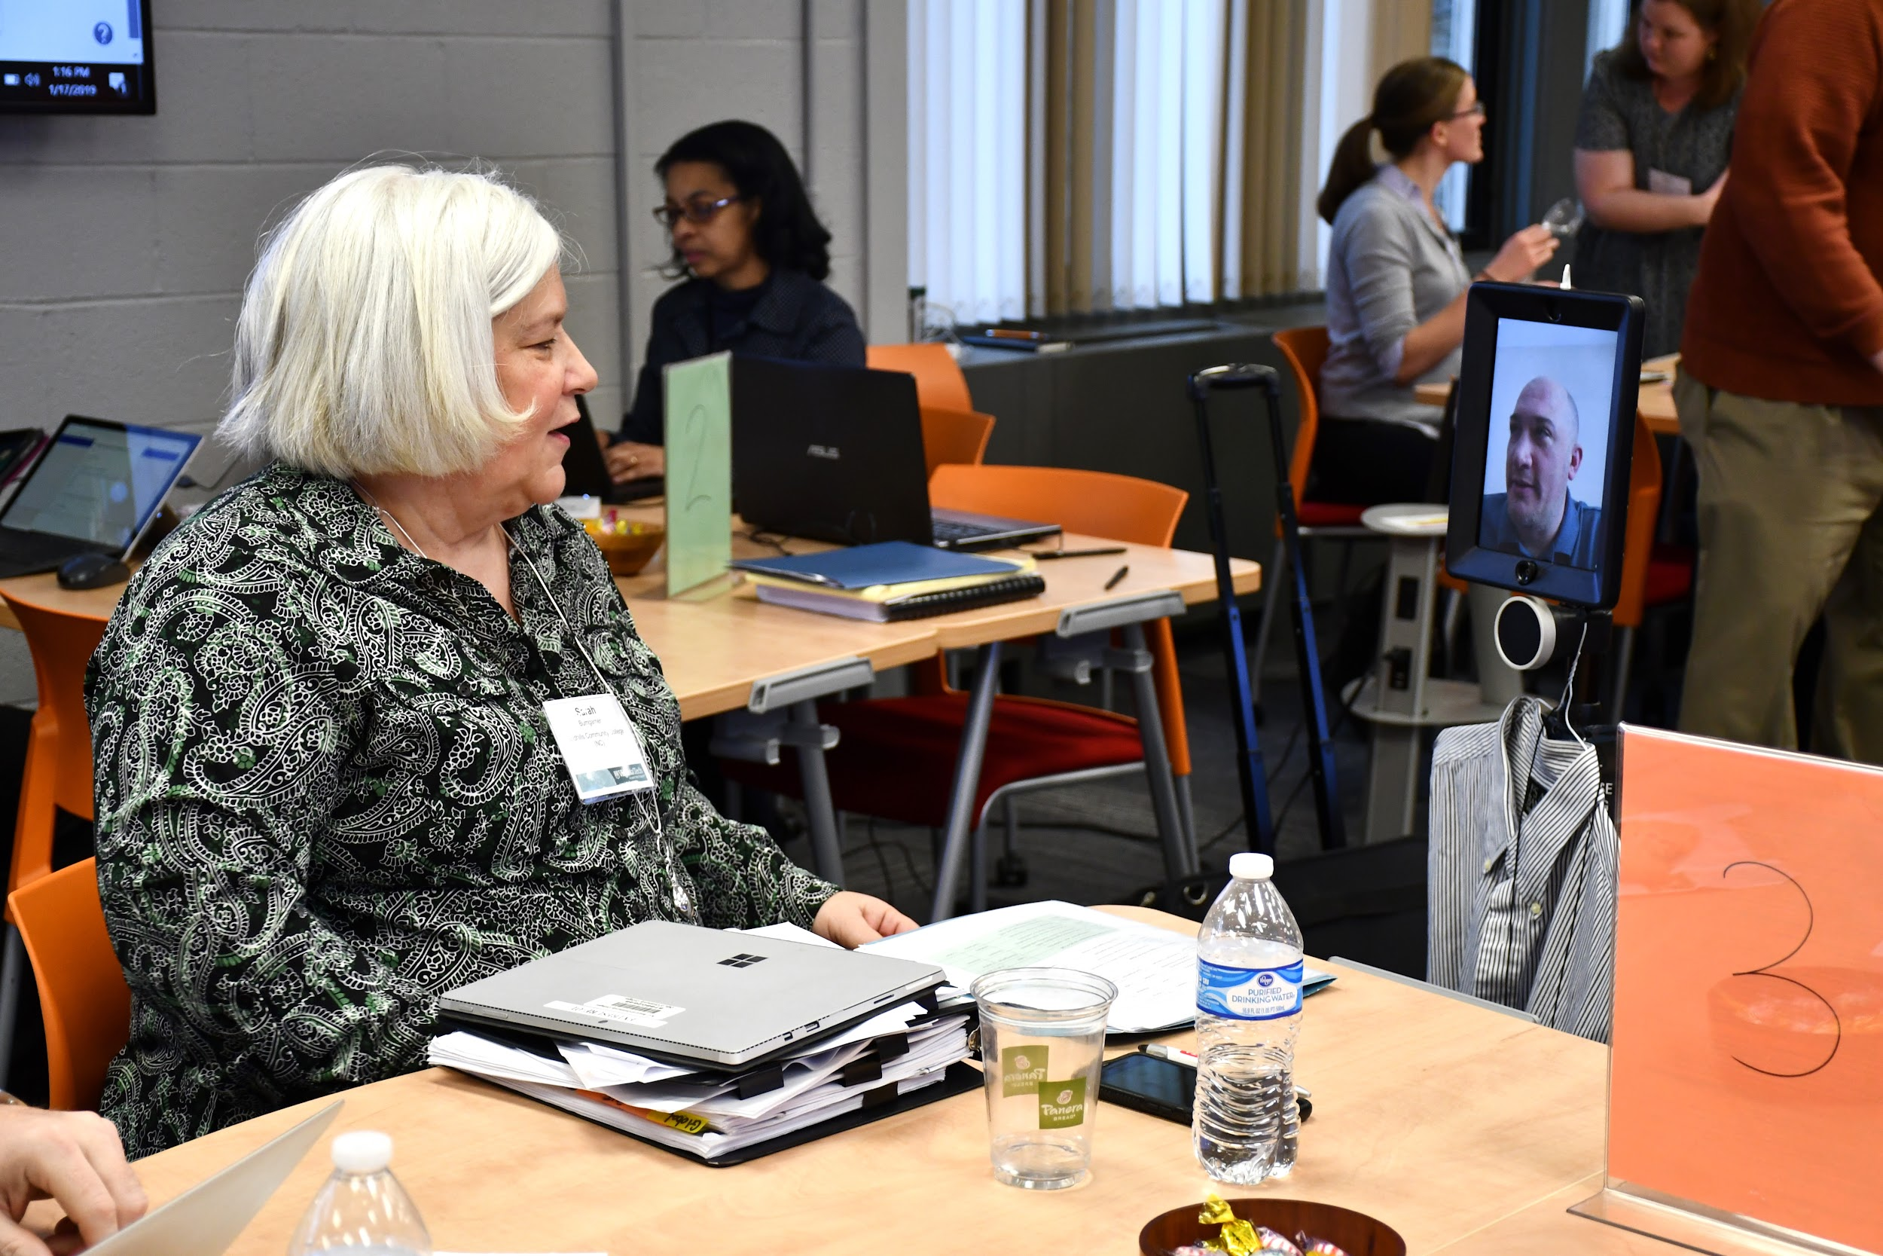
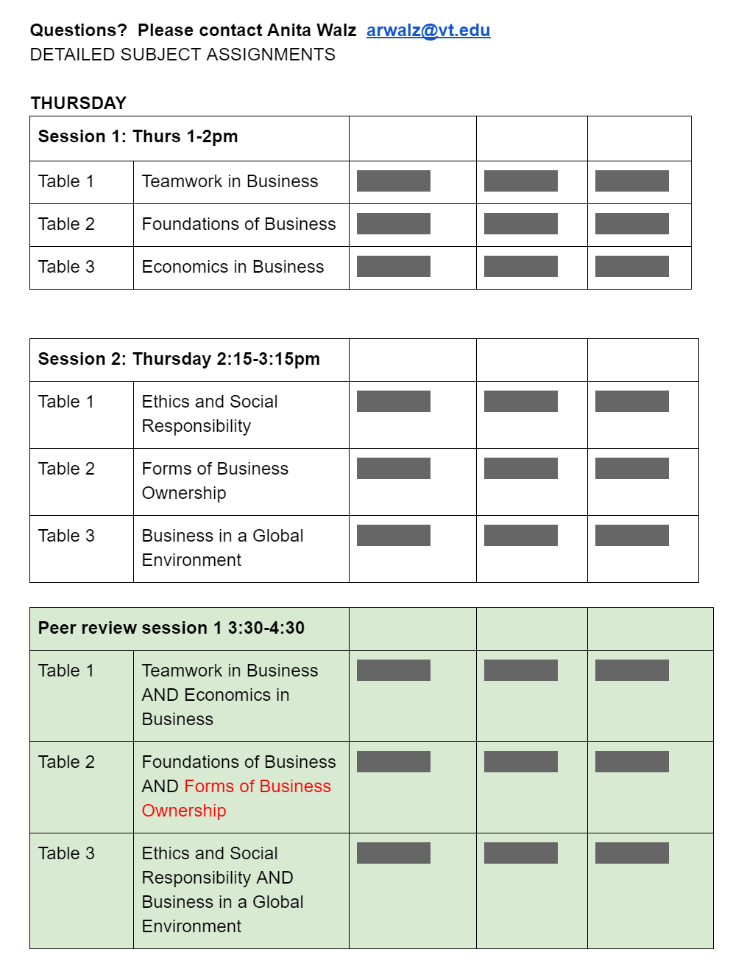
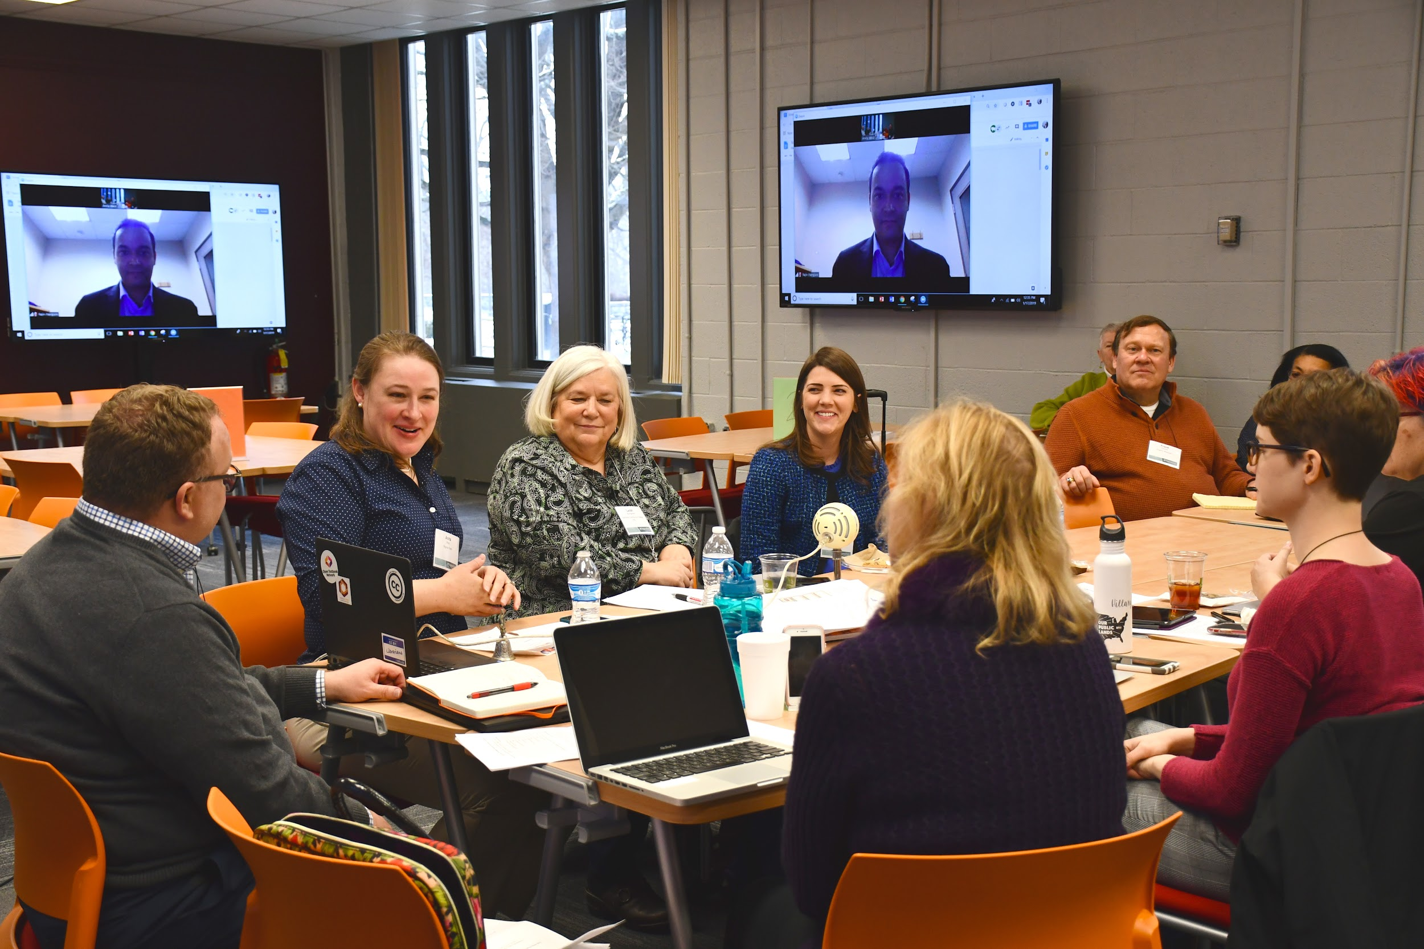
Find mentors:
Regional Testbank Sprint for Fundamentals of Business (pre-pandemic)
More info on the sprint: http://hdl.handle.net/10919/91377
Photos: Alice Rogers; For cover art see attribution within book: http://hdl.handle.net/10919/84848

Slide 38
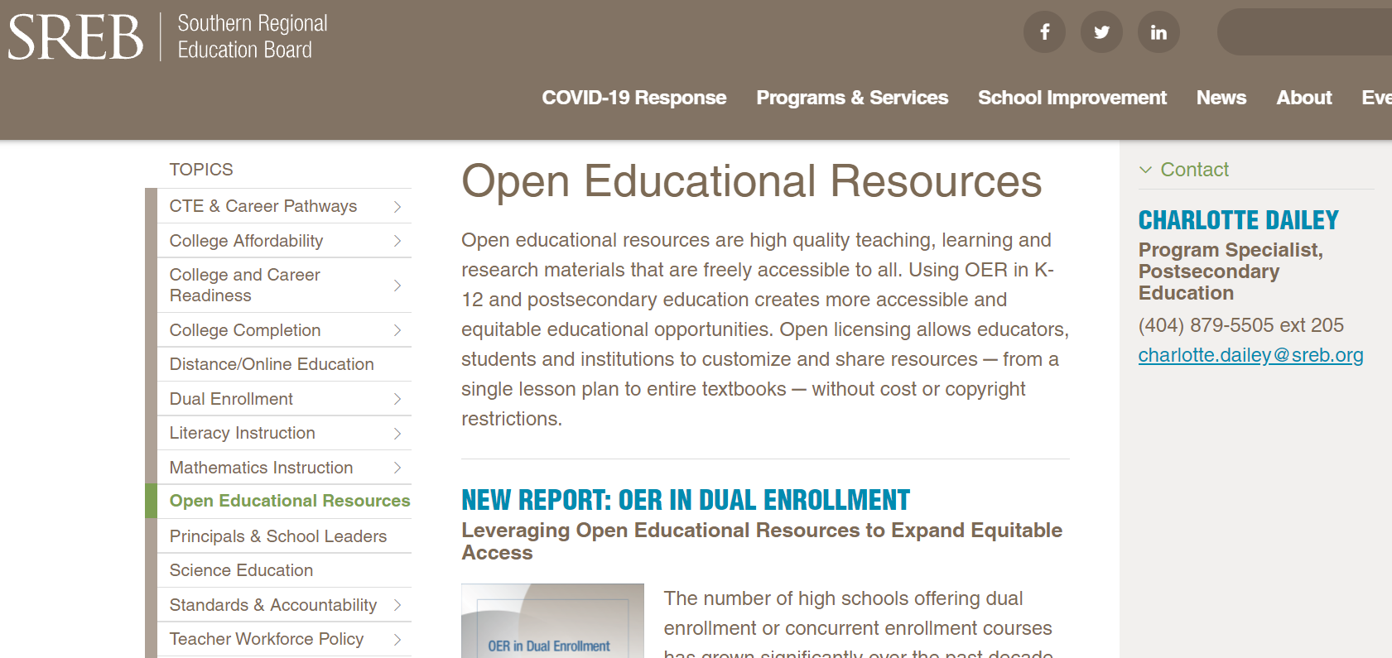
Got Dual-Enrollment?
SREB’s Open Educational Resources in Dual Enrollment webinar series.
https://www.sreb.org/topic-open-educational-resources

Slide 39
What makes collaboration work?
https://unsplash.com/photos/g1Kr4Ozfoac
https://unsplash.com/photos/Zyx1bK9mqmA
https://unsplash.com/photos/HJgaV1qjHS0
https://unsplash.com/photos/nZL80Di-YAg
https://unsplash.com/photos/bEY5NoCSQ8s
https://www.pexels.com/photo/people-discuss-about-graphs-and-rates-3184292/
https://www.pexels.com/photo/group-of-people-wearing-shirts-spelled-team-7551442
Notes:
https://unsplash.com/photos/g1Kr4Ozfoac
https://unsplash.com/photos/Zyx1bK9mqmA
https://unsplash.com/photos/HJgaV1qjHS0
https://unsplash.com/photos/nZL80Di-YAg
https://unsplash.com/photos/bEY5NoCSQ8s
https://www.pexels.com/photo/people-discuss-about-graphs-and-rates-3184292/
https://www.pexels.com/photo/group-of-people-wearing-shirts-spelled-team-7551442
Trust
Respect and appreciation
Shared goal(s)
Commitment to each other and the project
Time
A plan
Things to share
Skill and effort

Slide 40
Thanks and discussion
Anita Walz
arwalz@vt.edu
@arwalz

