Slide 1



Open edX Course Converter and Data Visualization
Capstone Team 1
Christian Ross, Grayson Childs, (Hannah) Yi-Han Chen, (Jessica) Hsin-Yu Chien, Robert Benish
Notes:
Hello my name is Robert Benish, and I am part of the CS5934 Capstone Team 1 which includes myself, Christian, Grayson, Hannah, and Jessica. For our project, Boeing has tasked us to create a solution in the everchanging field of Learning Management Systems. They are very interested in using the Open edX platform which is an open source free to use learning management system that is very customizable. Boeing has tasked us with creating features to make the platform stand out. We were able to accomplish this by adding features that are not present on other learning management systems that allow for Open edX to be a better platform than Canvas as well as making the transfer from other learning management systems to Open edX easier.

Slide 2
Outline
Work accomplished
Feature 1 (Canvas Course Converter)
Feature 2 (Data Visualization Web Page)
Demo of Product
Notes:
Here is a brief outline of what the presentation will be on. I will start with an overview of the work that we accomplished then move on to the 2 main features that we implemented into Open edX which I will go further in depth on later in the presentation. Finally, I will show an actual demo of the product and how it can be used.

Slide 3
Work Accomplished
Hosting: local & cloud
Course Converter
Data Visualization application
Converter and application integration
Notes:
For the work that we were able to accomplish on this product we were able host the Open edX platform locally and on the cloud as well as integrating 2 main features into the edX platform. In the first feature we were able to create a course converter that will allow the import and translation of an exported canvas course file and upload it to Open edX editable studio view. The second feature is a data visualization application that will be show live data from student participating in the courses hosted on Open edX.

Slide 4

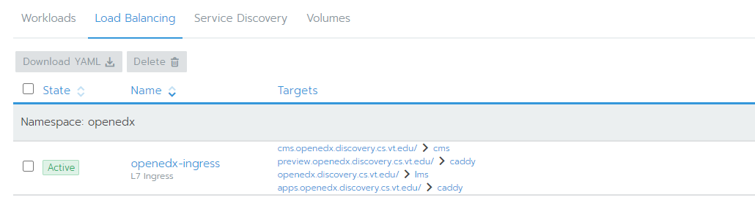
Hosting: Local & Cloud
Tutor
Hosting on local machine
  OSX
    mariaDB instead of mySQL
  Windows
Hosting on cloud
  Kubernetes deployment created for Open edX
  Utilizes cloud.cs.vt.edu for hosting
    AMD64 architecture
    Linux OS
Notes:
For hosting throughout the development process, we mainly used the cloud hosting as we were all able to access class information. We were able to use Virginia Tech’s cloud account to host the course which allowed us to interact with the course without running on our machines every time we wanted to access the course. The cloud deployment was a Kubernetes deployment created for Open edX. Tutor was used as it is a docker based Open edX distribution that allowed us to deploy the platform.

Slide 5



Course Converter
Converts exported Canvas files into Open edX import files
Canvas course export file is .imscc, which is shared among other popular online educational platforms (Blackboard, Hoodle, D2L, etc..)
Open edX imports a .tar.gz file and is structured differently
Notes:
The first main feature that we implemented was the course converter. With this an instructor can convert exported Canvas files into Open edX from the studio view. The file format of the exported canvas course is .imscc which is the same as other LMS platforms such as Blackboard and D2L. We were mainly focused on Canvas but this could work for others with this file type. The feature will import a tar.gz file that is translated and structured to match the format that Open edX is looking for and will automatically fill in the content for the instructor in the studio view.

Slide 6
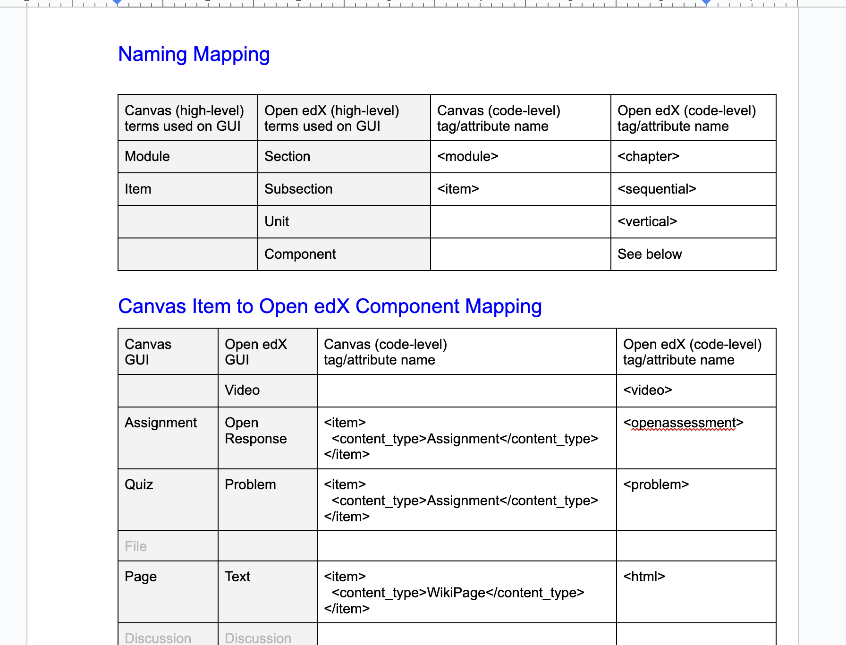
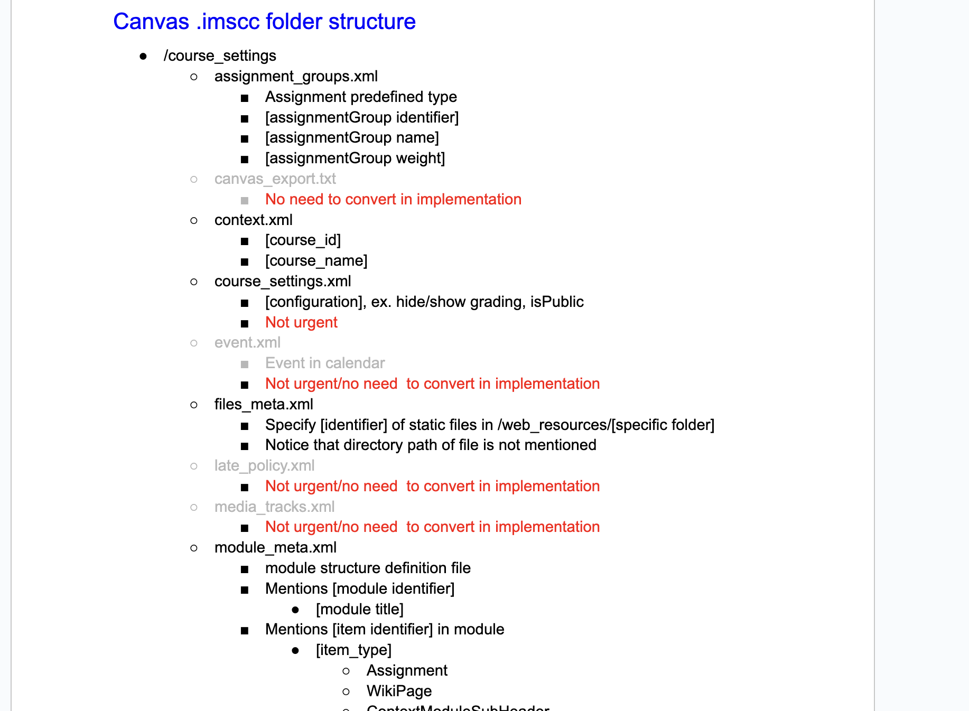
Converter Mapping
Mapping the content and structure of Canvas to Open edX was the biggest challenge of the converter
Canvas relies on Modules where assignments and assessments have similar behavior
Open edX has a tree-like structure with units and subunits
Notes:
One of the most challenging parts of the converter was working on the mapping of content from Canvas to Open edX as the files are in very different formats. The main difference is that Canvas courses revolve around modules where the assignment and assessments behave similarly. On the other hand, Open edX has more of a tree-like structure where there are units and subunits to hold this information.

Slide 7
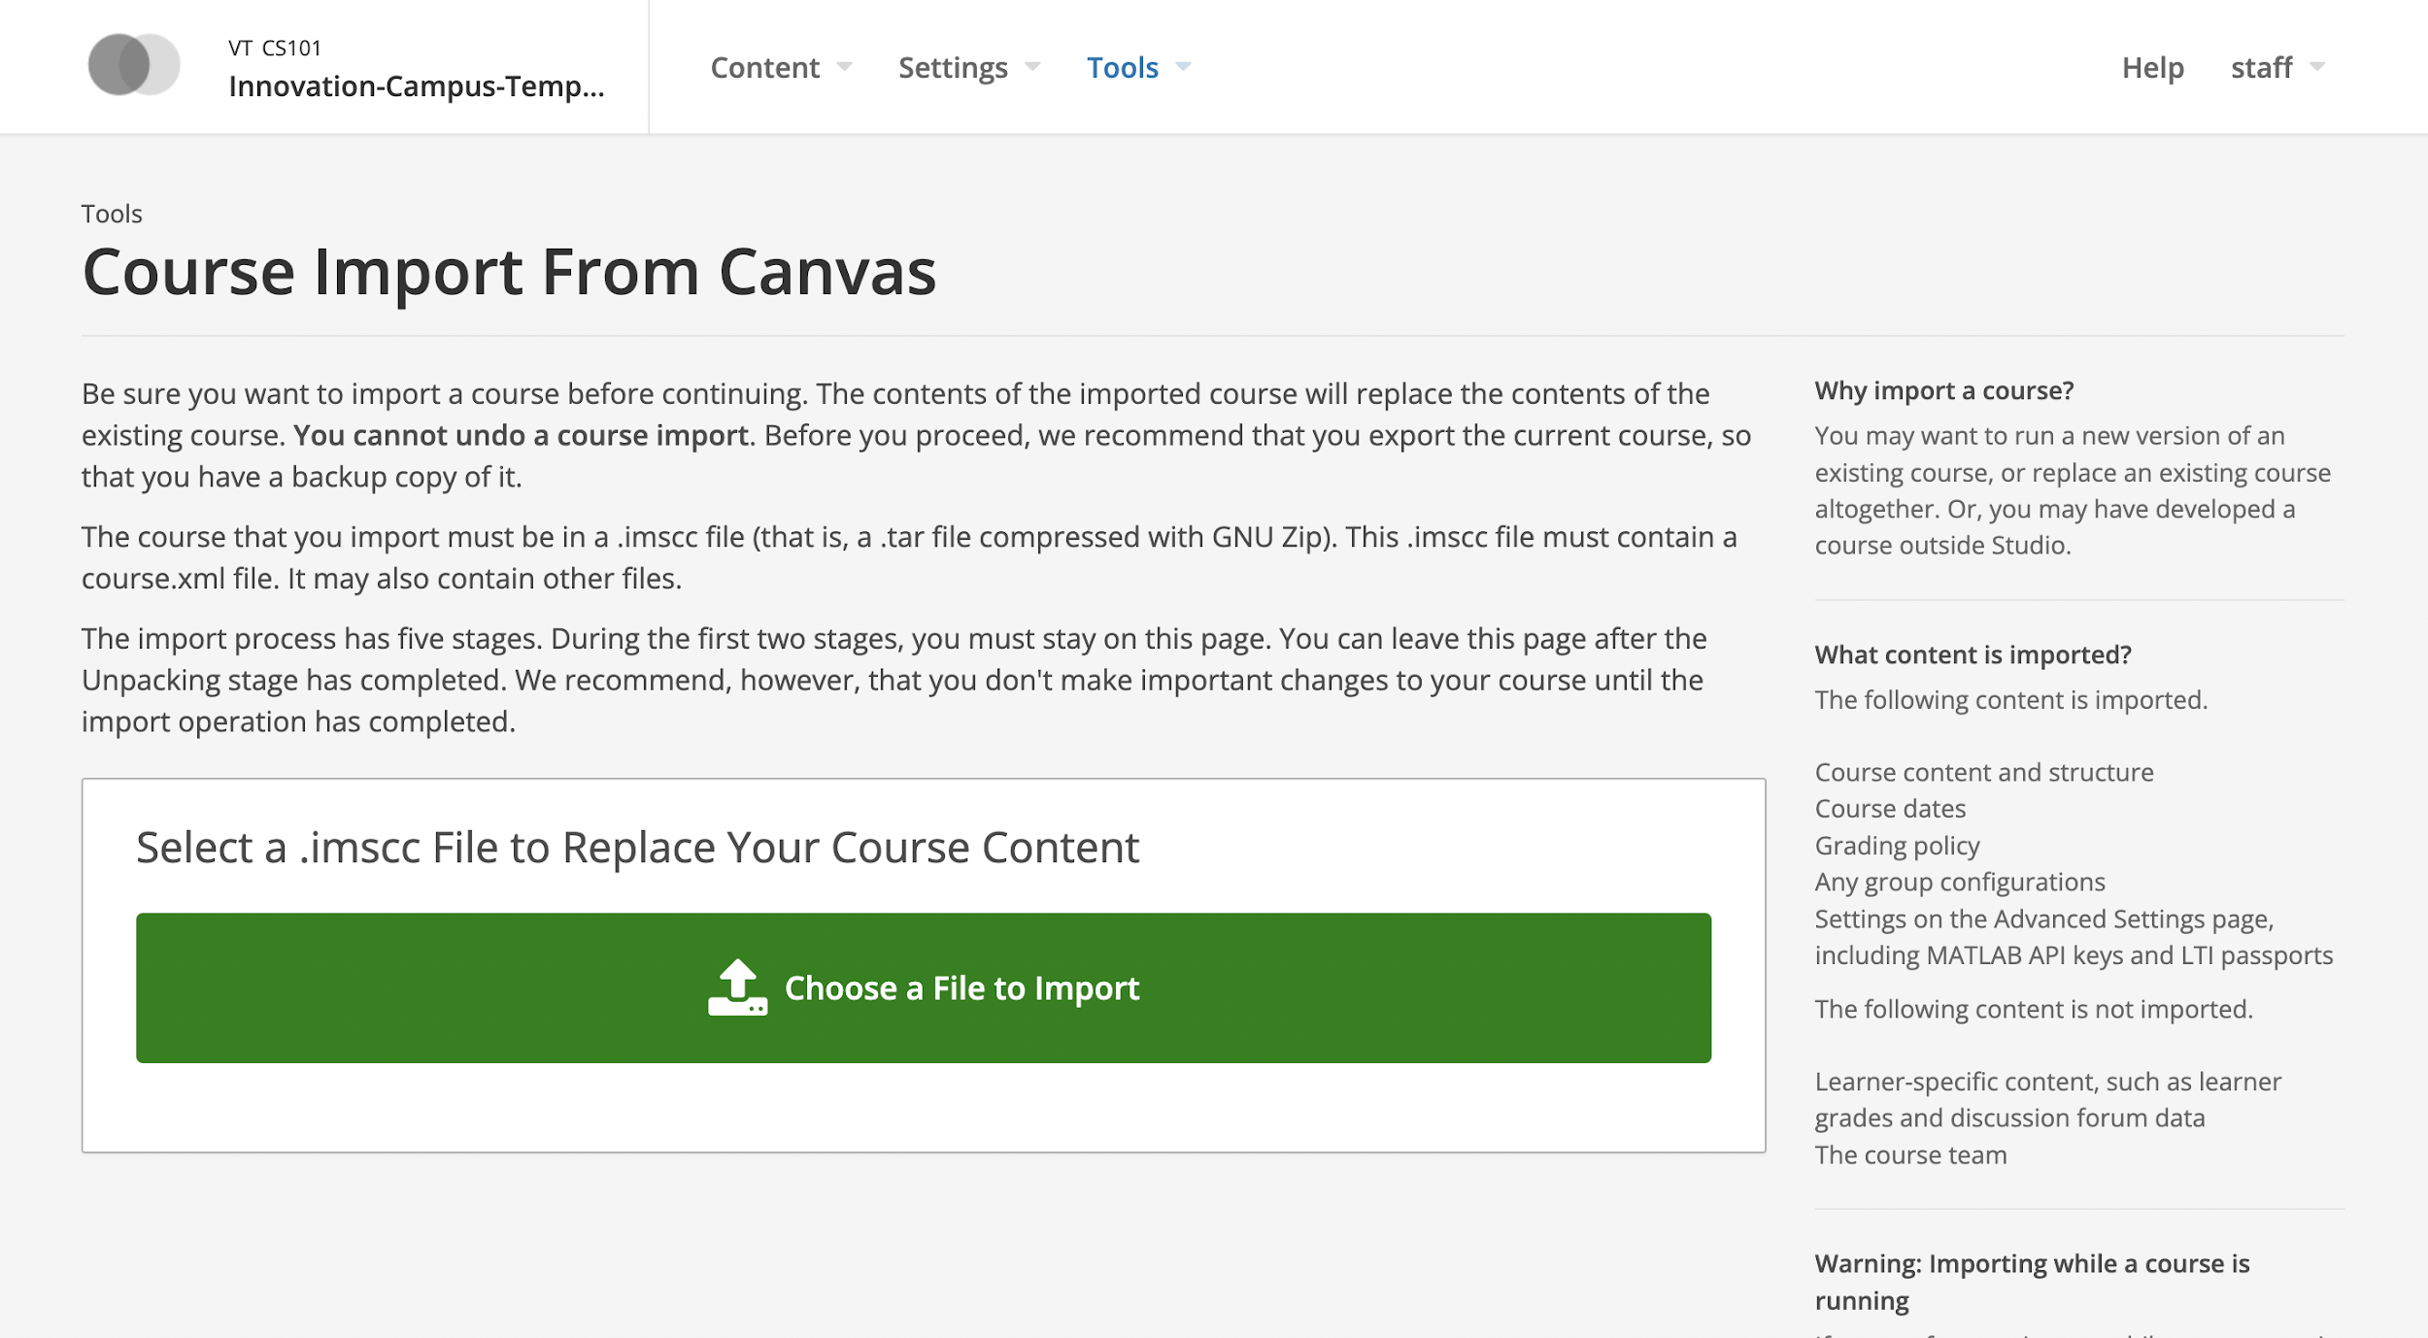
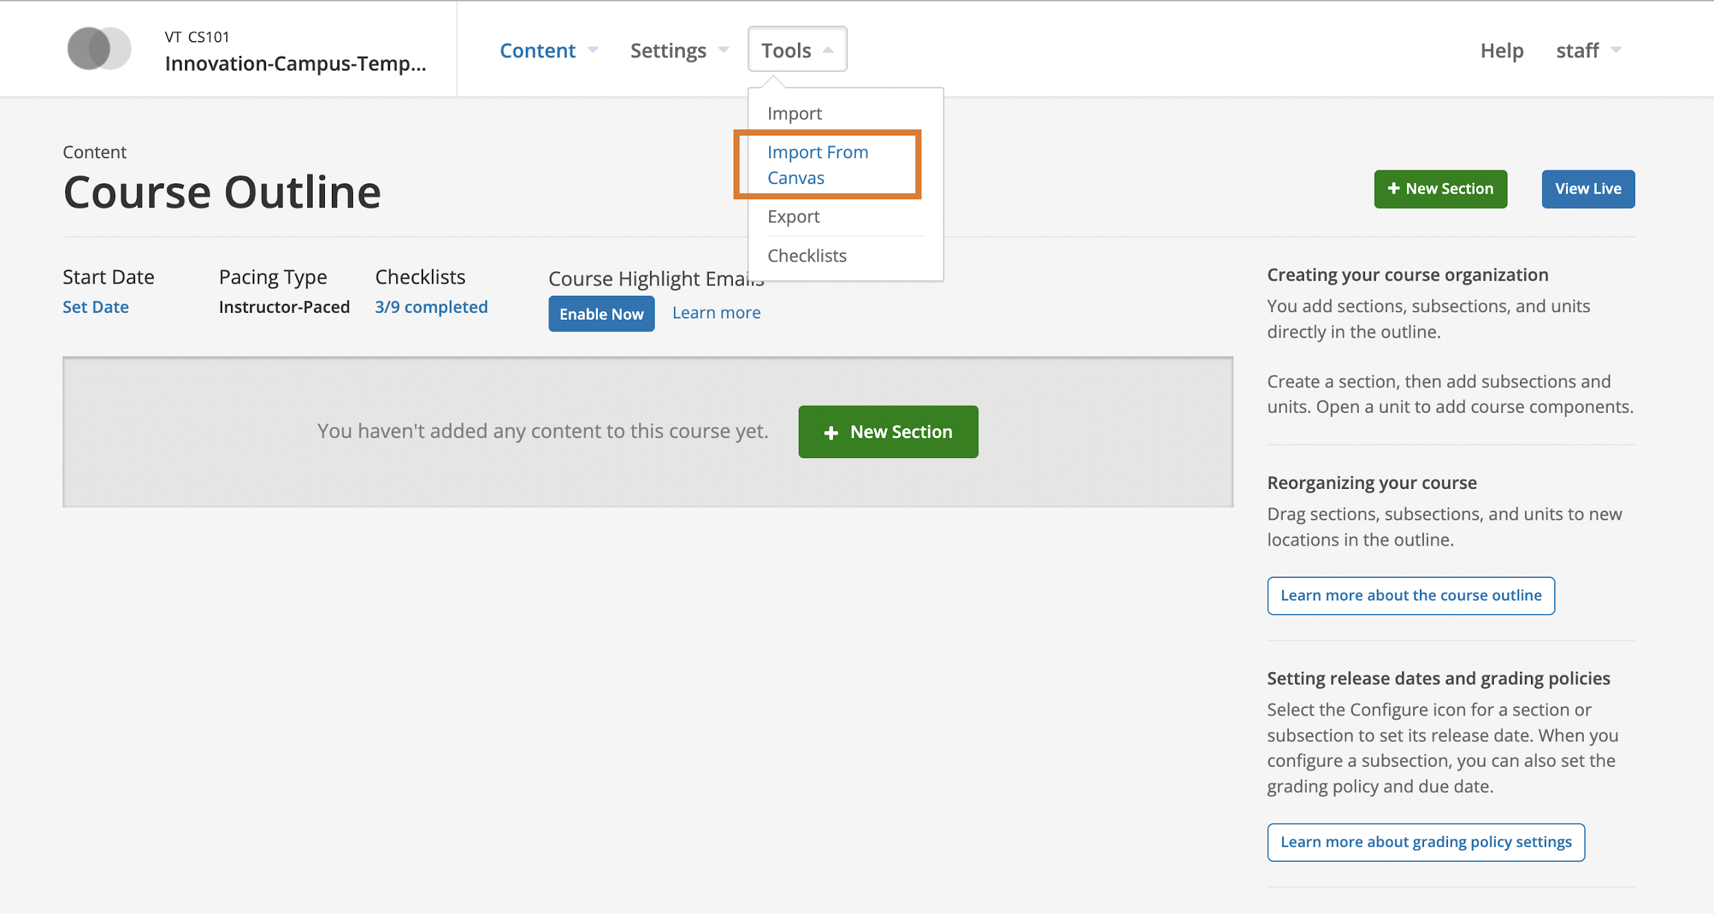
Importer integration
Integrated importer in Open edX studio to allow ease of access for instructors
Notes:
Here you can see the integration of a button that was not originally present on the tools tab inside of the Open edX studio view that will directly take the user to the import page where they can drop the canvas .imscc file for conversion and upload.

Slide 8
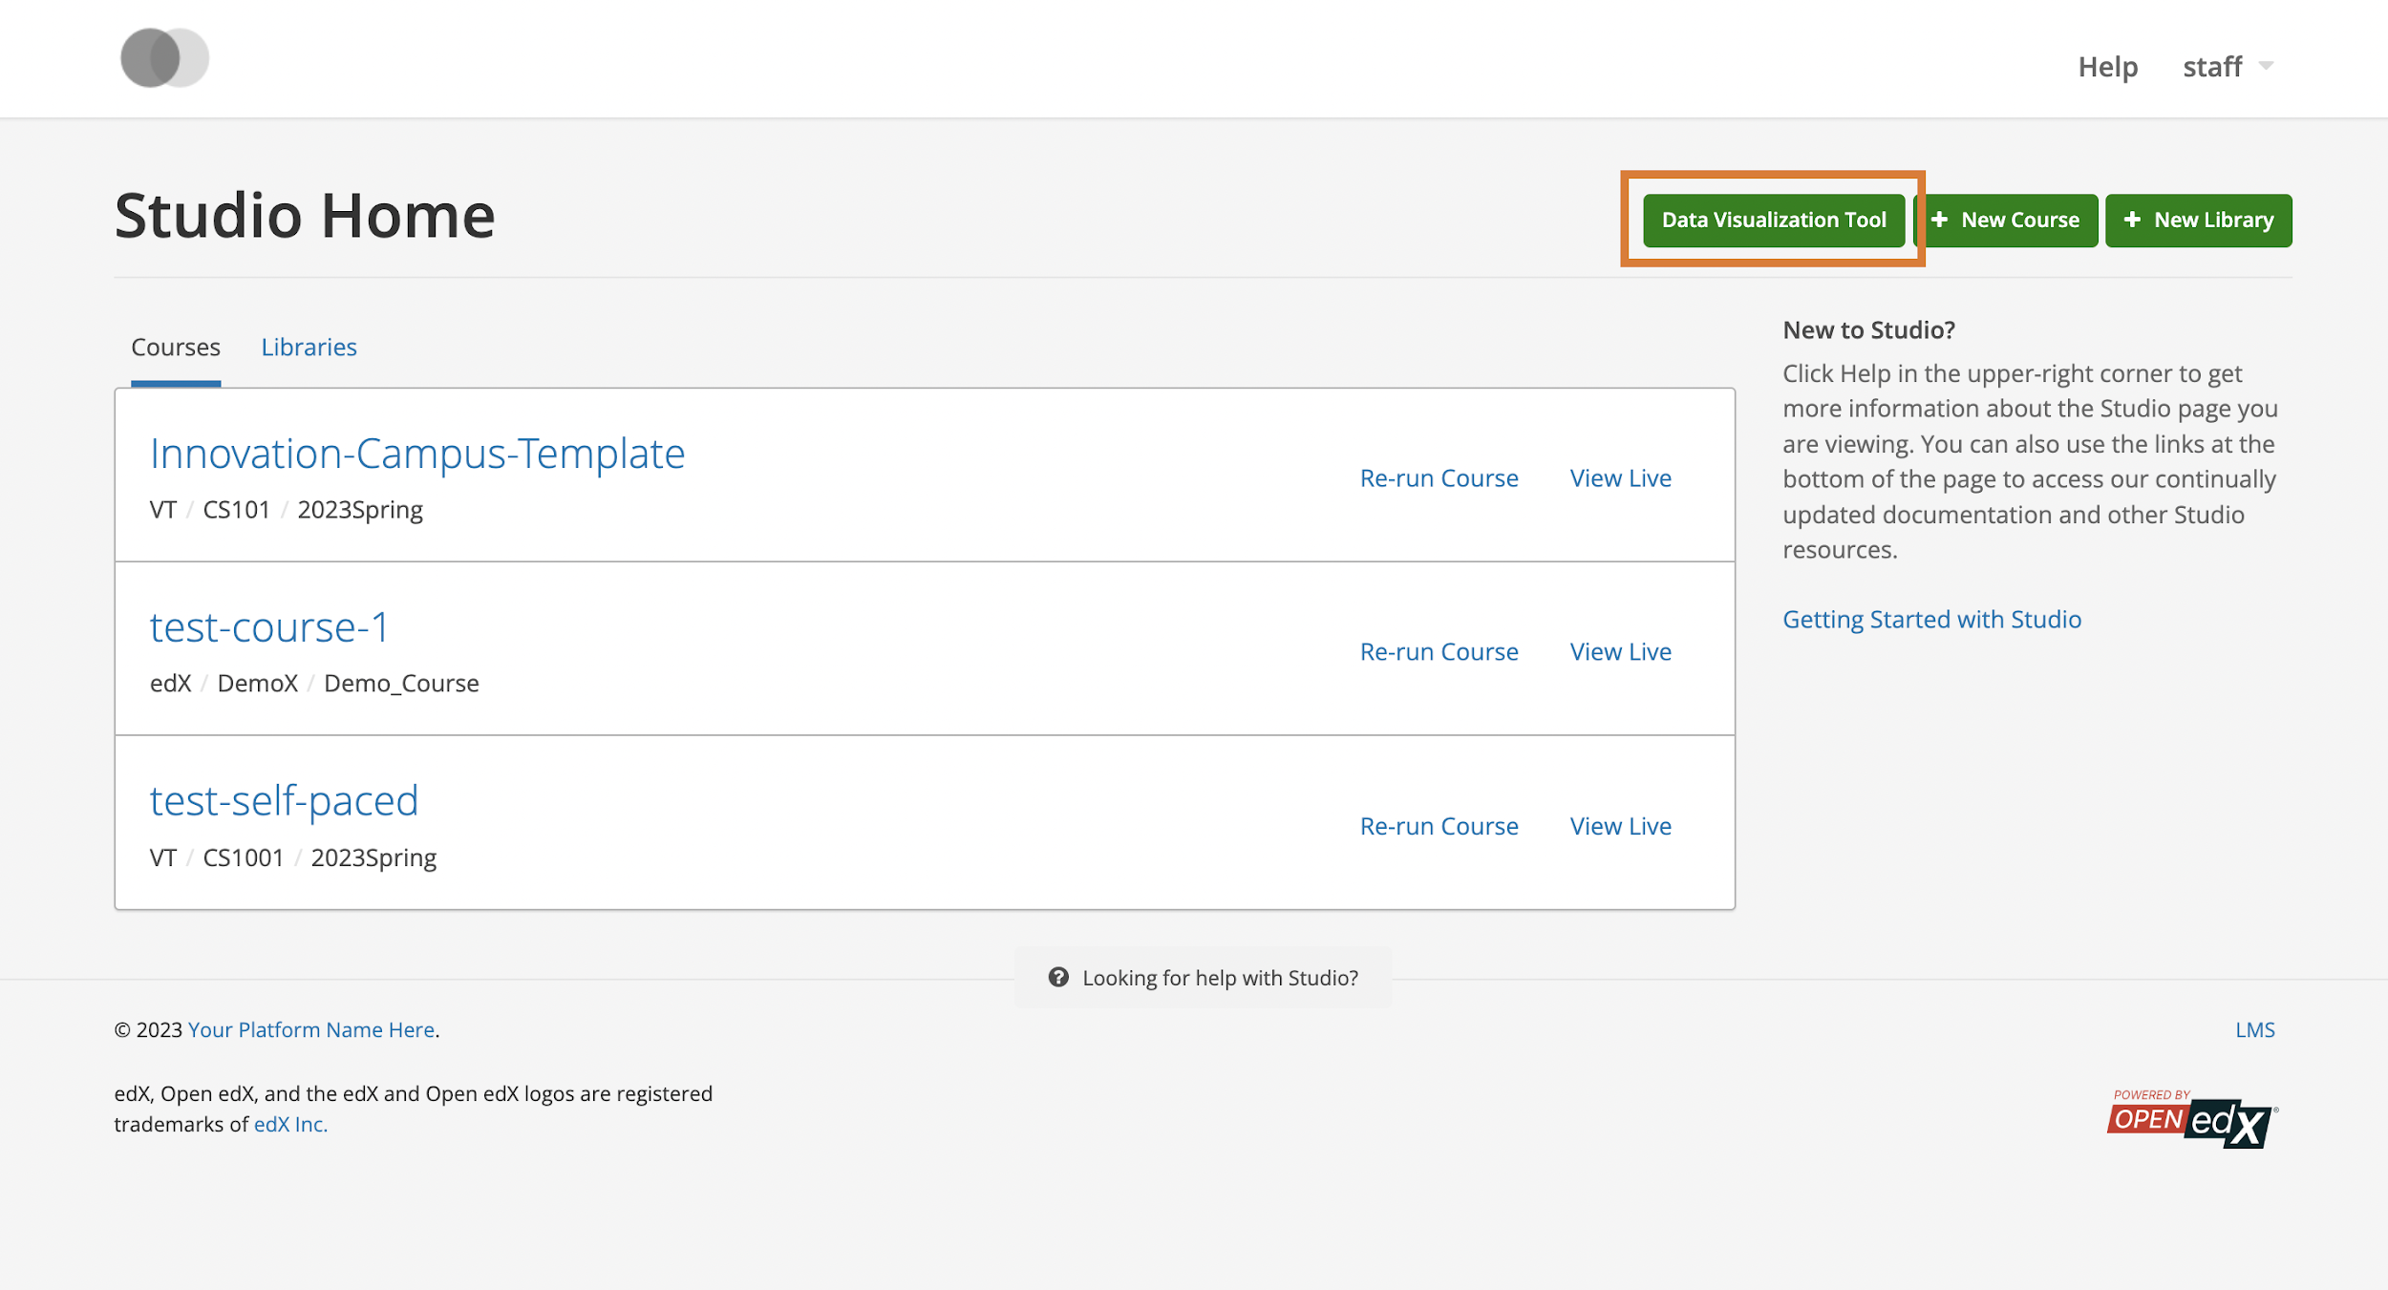
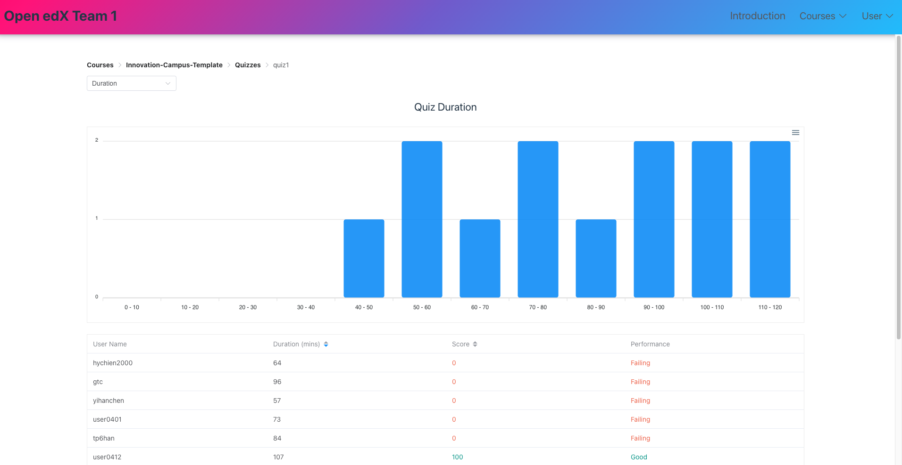
Data Visualization Application
Created a Data visualization application that can show the following graphs:
  Geographical information of logins
  Session time of each student for each student
  Scores/Duration for each quiz/assessment
  Submission date for assignments
Integrated button in Open edX for easy access
Notes:
The second feature that we were able to integrate is a data visualization application that can be accessed from the home page of the open edx studio. This is mainly geared towards instructors as they will be the ones keeping up with the students in their courses. The data that is viewable from the different pages is live data that is directly tracked from our cloud hosted course to show the possibility of live data visuals from student interactions. We have implemented several data graphics that track the geographical location from logins, session time associated with the students logged in time, Score and duration of quizzes and assessments, and graph of the dates and time of submissions. Each of these graphs have been created for each individual quiz and assignment so the scope of the visual is restricted to that assignment. For the quizzes and assessments grade are also presented as well as a mapping using the grade on the assignment that will represent if they are struggling, failing or performing good on the assignment to help show the instructor if there are issues from certain students based on other factors such as time spent on quizzes. All these metrics will help the instructor have a better idea of the performance of the student so they can effectively teach.

Slide 9
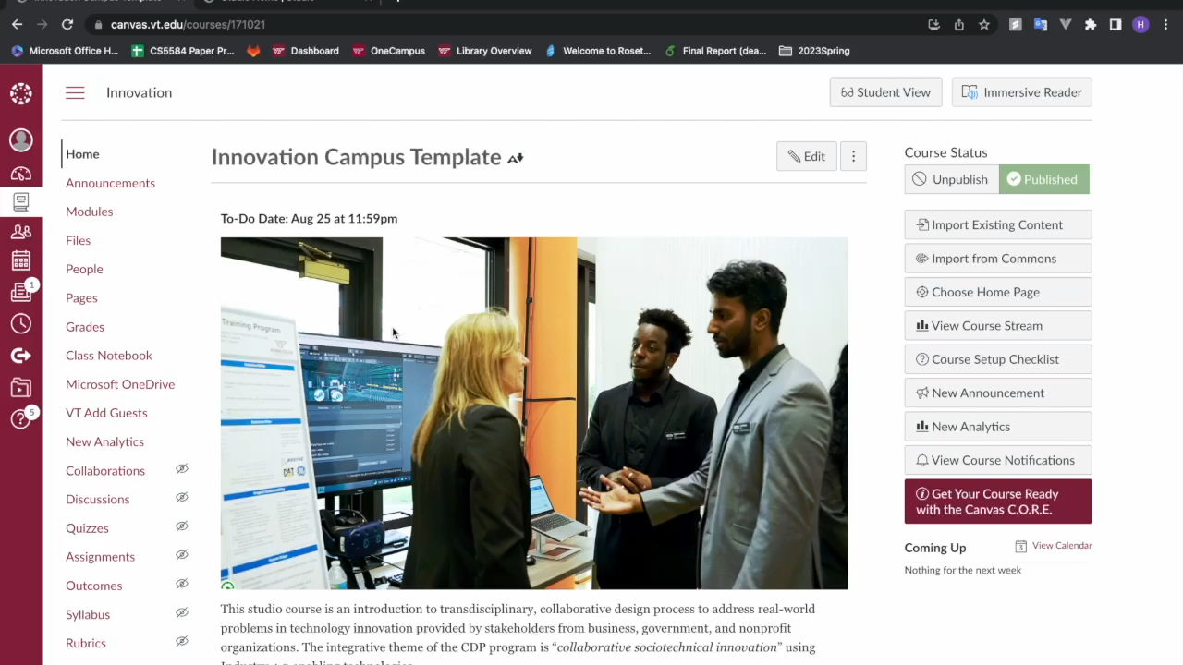
Product Demonstration

Slide 10
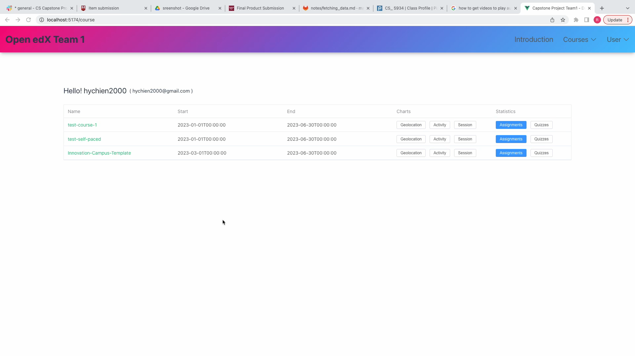
Product Demonstration continued

