Slide 1
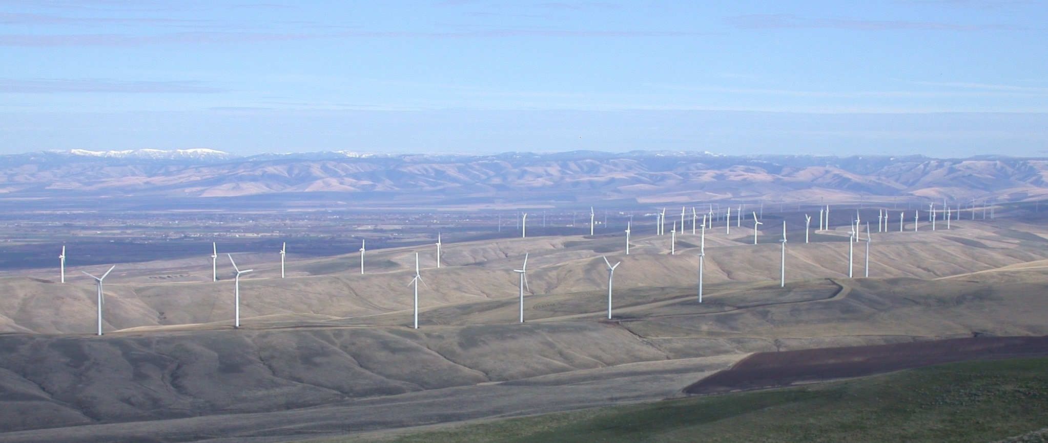
Current Status of DOE Wind Resource Characterization Efforts
NAWEA 2015 Symposium
Blacksburg, Virginia
June 11, 2015
Joel Cline
Team Lead
Resource Characterization
Wind and Water Power Technologies Office
Notes:
Headline/Name:
Rows of wind turbines along the tops of ridgelines
Caption/Description:
The 300-MW Stateline Wind Energy Center located on VanSycle Ridge between the states of Washington and Oregon
Photographer:
Pacific Northwest National Lab

Slide 2
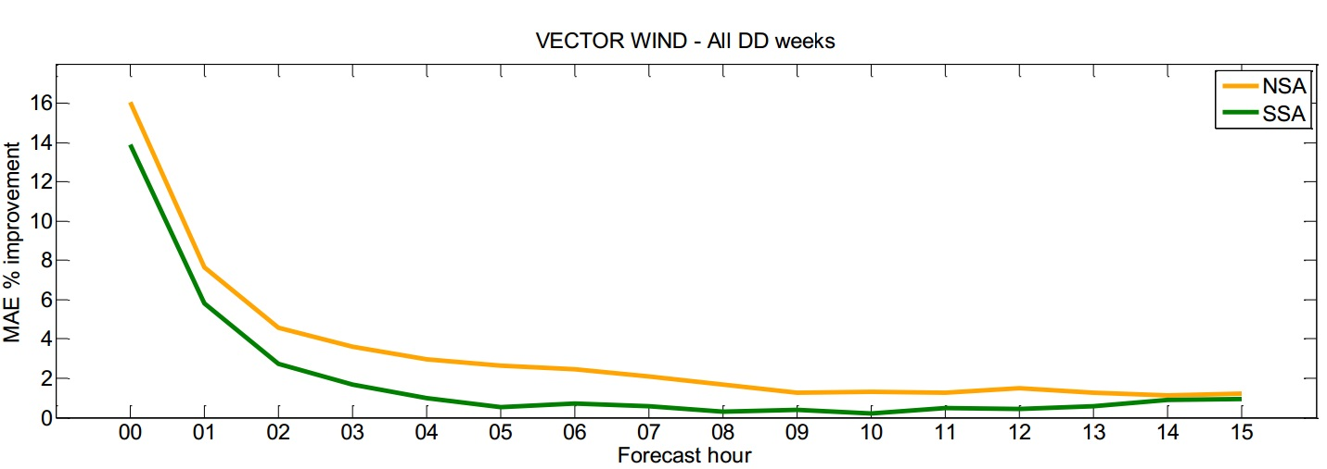
Why Should DOE Invest in Wind Forecasting?
If wind forecasts are improving incrementally over time – why should we still invest?
  Incremental improvements not providing accurate enough forecasts today
  Improvements in forecasts matter because it can allow wind energy to be sold more effectively and managed more efficiently
What is still missing?
Confidence utility has in the accuracy of forecasts to integrate into the market
  Short-term forecasts have improved ¹ while improvements in long-term forecasts have lagged
  Long-Term, high fidelity data variations over the lifetime of a wind plant still unknown
  Will extreme storms happen more frequently? More intensity?
  Wind forecasts at mesoscale need to be downscaled and coupled with microscale / wind plant scale
Mean Absolute Error (MAE) percent improvement for the vector wind, for the Northern Study Area (NSA - orange curve)
and Southern Study Area (SSA - green curve) during the Wind Forecasting Improvement Project (NOAA, 2014)
Notes:
Figure taken from NOAA’s WFIP final report:
Figure 6.18. MAE percent improvement for the vector wind, for the NSA (orange curve) and SSA (green curve) for all 56 DD episode days.
1) Barthelmie, R.J.; Murray, F.; Pryor, S.C., 2008. “The economic benefit of short-term forecasting for wind energy in the UK electricity market,” Energy Policy, Elsevier, vol. 36(5), pages 1687-1696, May.

Slide 3
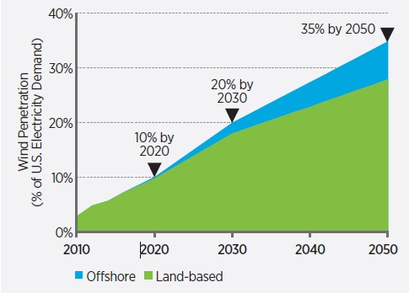
Why Should DOE Invest in Wind Forecasting?
Wind forecasts are important for:
  Hours-ahead (0-15 hr) forecasts for ramp events
  Day-ahead (up to 45 hr) forecasts for markets
  Lifetime of plant (20-25 yr) for resource assessments and financing costs
  Extreme weather events for mitigating potential losses
In the United States, new investments in wind plants averaged $13 billion/year between 2008 and 2013¹
  Expected to increase as wind energy increases from 4.5% of overall energy portfolio in 2013 to 20% by 2030^{1,2}
Wind Vision Study Scenario (DOE, 2015)
In the scenario of 14% wind energy penetration in the U.S., a 10% improvement in day-ahead wind generation forecasts yields an average of $140M savings in annual operating costs³
As wind power capacity installed on a power system increases, so does the value of accurate short-term forecasts of its output⁴
Notes:
NREL study does not take into account a lot of the items and nothing for reliability, safety, weather work windows etc.
1) Wind Vision: A New Era for Wind Power in the United States. Washington, DC: U.S. Department of Energy, 2015.
2) 20% Wind Energy by 2030: Increasing Wind Energy’s Contribution to U.S. Electricity Supply. Washington, DC: U.S. Department of Energy, 2008.
3) Lew, D.; Milligan, M.; Jordan, G.; Piwko, R., 2011. “Value of Wind Power Forecasting,” 13 pp.; NREL Report No. CP-5500- 50814.
4) Barthelmie, R.J.; Murray, F.; Pryor, S.C., 2008. “The economic benefit of short-term forecasting for wind energy in the UK electricity market,” Energy Policy, Elsevier, vol. 36(5), pages 1687-1696, May.

Slide 4
Wind Industry Needs in 2012 to Increase Confidence in Wind Forecast Accuracy
What Does the Wind Industry Need?
During a UVIG Workshop in 2012, industry participants identified a need to examine physical phenomena
A Top 10 List of key phenomena impacting the Renewable Energy (RE) industry was developed
The list helped guide DOE to fund meteorological research targeting phenomena that are relevant to the wind industry
Top 10 List of what impacts RE
the most in the atmosphere:
Low Level Jet
Stability
Boundaries (e.g., fronts, outflow, wakes)
Clouds
Representativeness of observations
Aerosols
Pressure gradients
Near surface moisture
Snow and soil
Downscaling of microscale features from mesoscale
Notes:
First thing to do to scope the industry needs to ask the industry – then ask again – work on strategy and then check with them to verify the strategy is on track.
Complex Flow Workshop, lab summit, Industry Day and more UVIG meetings too.
#5 are observations at 10 m relavent for wind turbines or in a city airport match the wind farm at the top of the hill
#6 Needed for lidars, radars, sodars – remote sensing devices
#7 Important for small scale and regional scale boundaries and a big player in WFIP 1
#8 Aids in instability and thus turbulence

Slide 5
Wind Industry Needs in 2015 to Increase Confidence in Wind Forecast Accuracy
During a subsequent UVIG Workshop in 2015, additional needs were identified by industry participants:
  Improved short-term (0-15 hour) forecasts - important for reliability & operations
  Improved day-ahead (45 hour) forecasts - important for markets
  Need better data management – includes archival and access to data
  Need tools for uncertainty quantification of wind forecasts
  The economic value of wind forecasts needs to be determined
  The quality of existing observation networks needs to be improved
Notes:
Economic value in WFIP 1 was very complex – caused the DOE to rethink how to properly do this – brought in industry and private companies and labs to work on what is the best way to move forward. Reliability, weather work windows, crew safety especially offshore arena, moving equipment, assessment, siting, plant layout --- also depends on the ISO mix of energy sources so as not to do this for one region – want to come up with what it means for the nation.
Standards work changes the industry and can utilize this to aid with the quality of the observations.

Slide 6
How Can We Meet Industry Needs Meteorologically Today?
Focus on improving underlying theory for models:
  Current theory (Monin-Obukhov Similarity Theory) based on clear day in flat terrain (e.g. Kansas in the 1950s)
  Two ways to improve underlying model theory:
    Horizontal homogeneity: Surface layer scheme needed as alternative to M-O similarity theory for regions of complex terrain
    Improve topography in the models: Implement Immersed Boundary Method (IBM)
Improve understanding of heat, moisture, and momentum fluxes which drive stability and turbulence
  Stability and turbulence impact many physical phenomena
Top 10 List of what impacts RE
the most in the atmosphere:
Low Level Jet
Stability
Boundaries (e.g., fronts, outflow, wakes)
Clouds
Representativeness of observations
Aerosols
Pressure gradients
Near surface moisture
Snow and soil
Downscaling of microscale features from mesoscale
Notes:
So how do we address this at Pentration levels of up to 20 percent to get to that level?
Why are this items an issue for wind farm forecasting and not weather forecasting ???? NEXT SLIDE

Slide 7
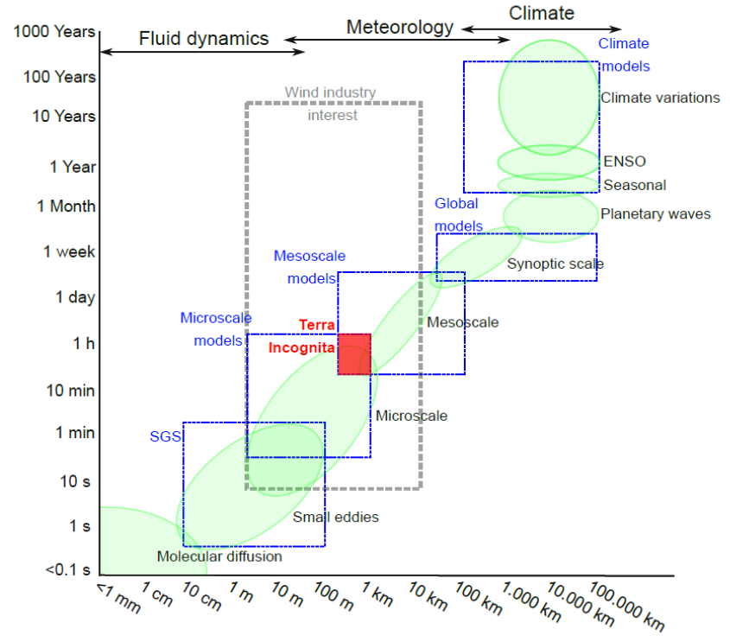
Challenges at the Mesoscale- Microscale Interface

Slide 8
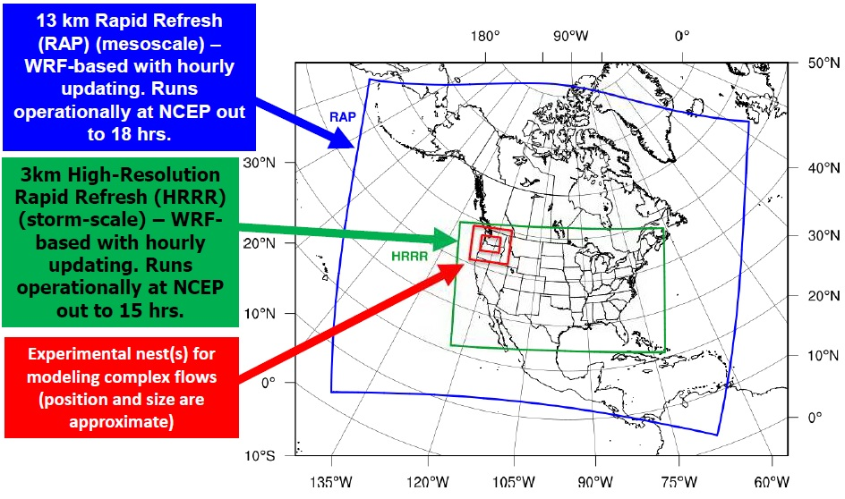
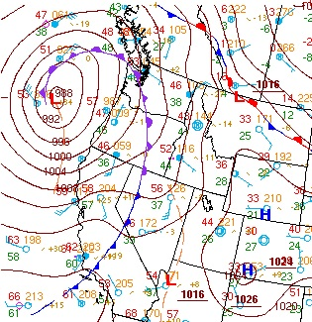
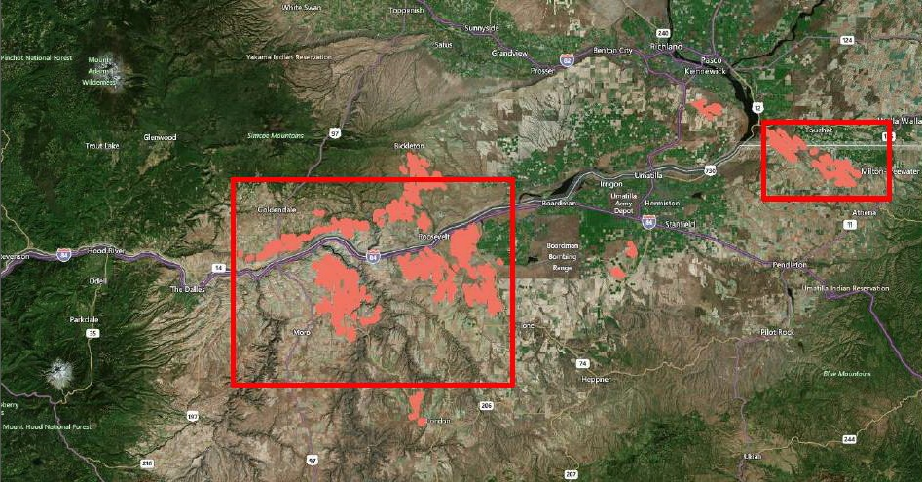
Challenges of Downscaling Forecasts to the Wind Plant Scale
Mt. Adams
Representing mesoscale (~10 km) forecasts down to the wind plant scale (less than 750 m)
Changes in the horizontal matter – heat, moisture, momentum fluxes and pressure - along with topography
Today’s mesoscale models based on M-O similarity theory – changes in horizontal are similar and parameterized
Mt. Adams
PNNL
Washington
Columbia River
Gorge
Mt. Hood
Oregon
Notes:
Scales are very important as we learned from the past slide.
The differences show up more in complex terrain
Changes in the horizontal matter – heat, moisture, momentum fluxes and pressure – to understand the physics and properly model them for forecasting and assessment.
Top Left: Surface analysis at 06 UTC on 2/9/15
Source: National Weather Service
Top Right: WFIP 2 model domains
Source: NOAA
Bottom Right: Wind turbine locations (red circles)
in the WFIP 2 field study area
Source: Vaisala

Slide 9
DOE Wind Resource Characterization Portfolio
Field Testing
Observations
Analysis
Modeling
Notes:
All of these fall within the A2e Initiative.
WFIP 1 – more observational impacts to the models in the short term 0-15 hours.
XPIA – remote sensor testing mainly lidars, but radars too
Testing – Validate and verify so as not to TUNE a model for a specific area of the country but to resolve it for the nation – make it transferrable
RFORE – offshore reference facility – can be used for resource assessment, wind climatology, verify models, validate observational instruments and methods.
Floating Lidars – 2 will move around after about a one year deployment to different sites – likely to be involved with WFIP 2
Wind Profiling Radars – 3 in WA / OR to match the 4 in State of California and 1 in Vancover from Olympics
Hurricanes – to eliminate risk and develop standards for structures. Work with the Hurricane Hunters – my old job
Standards Development – to ensure quality of the observations
IEA Task – 1. Physics 2. Uncertainty Quantification 3 . Forecast confidence
Data Archive and Portal – place to store data and utilize for further research today and in the future and not have to repay for observational information
UQ – get more from the forecast itself
Met-Ocean Coupling – for offshore -- how do waves change the wind through the swept area and how to waves do to the structure from crashing or extreme storms
Meso-Micro Coupling – resolving the scaling issues
IBM – complex terrain on scales that are relavent to the forecasting
WFIP 2 – physics and combine a lot of these items.

Slide 10
Modeling Projects / Increasing Confidence
Field Experiments need to address the Physics:
  Develop new or improved WRF model schemes or atmospheric modeling theories
  Not just incremental improvements in parameterizations but actual understanding the physics driving wind
  Tackling the physics drives greater accuracy and confidence – not incremental but fundamental changes across scales
Met-Ocean Model Coupling:
  How do waves change the wind through the swept area?
  What do crashing waves do to the structure during extreme storms?
Mesoscale-Microscale Coupling:
  Address known deficiencies common to industry research and design tools by assessing and validating mesoscale-microscale coupling (MMC) strategies
Immersed Boundary Method (IBM):
  Developing a method to resolve complex terrain on scales that are relevent to forecasting
  Not yet performed for mesoscale models
Mesoscale
Nested LES
Internal Mesoscale-Microscale Coupling
for which both mesoscale and microscale
simulations are performed within the same
solver. Source: LLNL
Notes:
Met-Ocean Coupling – for offshore -- how do waves change the wind through the swept area and how to waves do to the structure from crashing or extreme storms
Meso-Micro Coupling – resolving the scaling issues
IBM – complex terrain on scales that are relavent to the forecasting
WFIP 2 – physics and combine a lot of these items.

Slide 11
DOE Wind Resource Characterization Portfolio
Field Testing
Observations
Analysis
Modeling
Notes:
All of these fall within the A2e Initiative.
WFIP 1 – more observational impacts to the models in the short term 0-15 hours.
XPIA – remote sensor testing mainly lidars, but radars too
Testing – Validate and verify so as not to TUNE a model for a specific area of the country but to resolve it for the nation – make it transferrable
RFORE – offshore reference facility – can be used for resource assessment, wind climatology, verify models, validate observational instruments and methods.
Floating Lidars – 2 will move around after about a one year deployment to different sites – likely to be involved with WFIP 2
Wind Profiling Radars – 3 in WA / OR to match the 4 in State of California and 1 in Vancover from Olympics
Hurricanes – to eliminate risk and develop standards for structures. Work with the Hurricane Hunters – my old job
Standards Development – to ensure quality of the observations
IEA Task – 1. Physics 2. Uncertainty Quantification 3 . Forecast confidence
Data Archive and Portal – place to store data and utilize for further research today and in the future and not have to repay for observational information
UQ – get more from the forecast itself
Met-Ocean Coupling – for offshore -- how do waves change the wind through the swept area and how to waves do to the structure from crashing or extreme storms
Meso-Micro Coupling – resolving the scaling issues
IBM – complex terrain on scales that are relavent to the forecasting
WFIP 2 – physics and combine a lot of these items.

Slide 12
Field Testing Projects – WFIP 2
Wind Forecasting Improvement Project in Complex Terrain (WFIP 2):
Objectives:
Improve the physical understanding of atmospheric processes which directly impact wind industry forecasts
Incorporate the new understanding into the foundational weather forecasting models
Budget Periods:
Budget Period 1: Planning integration and acquiring land easements (up to 9 months)
Budget Period 2: Field campaign (up to 18 months)
Budget Period 3: Data analysis and model improvement (up to 12 months)
Desired Outcomes:
Develop new or improved WRF model schemes or atmospheric modeling theories that better represent physical processes and increase accuracy of predicted wind changes in the 0 to 15 hour forecasts, with positive implication for day-ahead forecasts, in foundational weather models
Develop decision support tools which could include probabilistic forecast information, uncertainty quantification and forecast reliability for system operations
Notes:
One of our ways to learn but not the only way. (say at the end of the slide.)

Slide 13
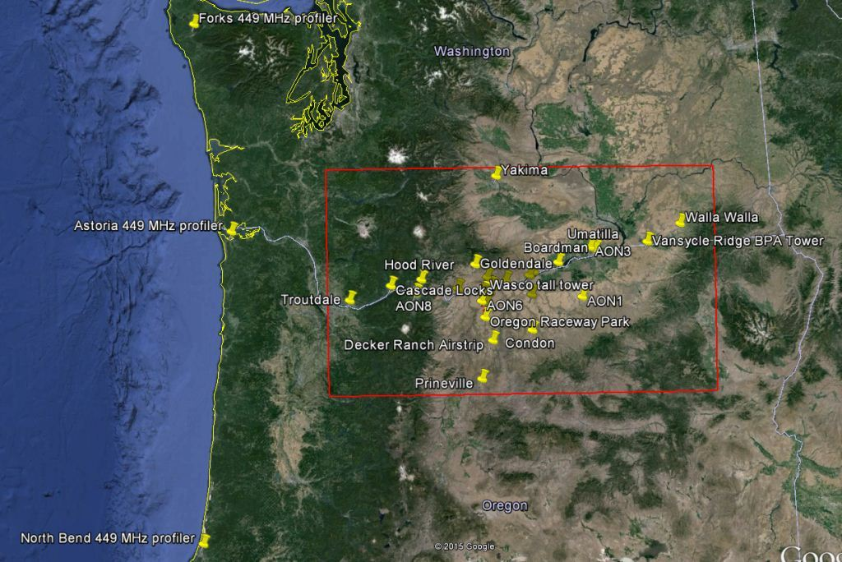
Field Testing Projects – WFIP 2
WFIP 2 Field Study Plan
Vaisala, Inc. selected as awardee
Awardee will work with larger, integrated WFIP 2 team:
  National Atmospheric and Oceanic Administration (NOAA)
  4 DOE Laboratories:
    Argonne National Laboratory
    Lawrence Livermore National Laboratory
    National Renewable Energy Laboratory
    Pacific Northwest National Laboratory
Washington
Oregon
Field study area (red box) with instrument locations (yellow pins)
Source: Vaisala
Field study will occur in the Columbia River Gorge region of Washington and Oregon:
  Instrumentation will be provided by DOE, NOAA, and Vaisala
  Measurements will be collected during all four seasons

Slide 14
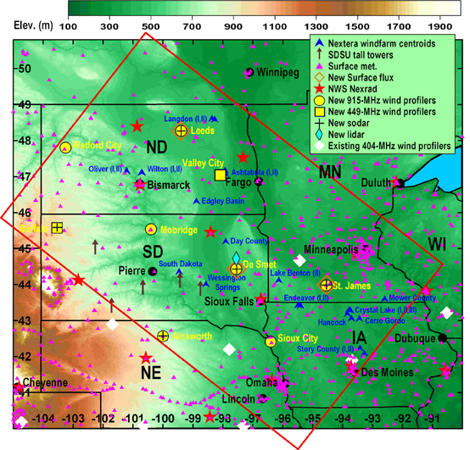
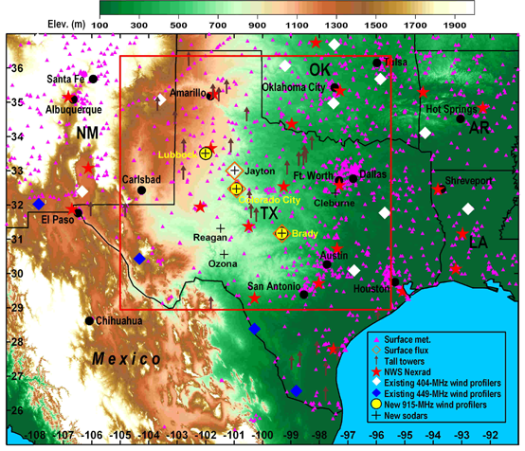
Field Testing Projects – WFIP 1
Wind Forecasting Improvement Project (WFIP 1)
Two private sector groups were selected by DOE to partner with NOAA:
  Windlogics: Northern Study Domain
  AWS Truepower: Southern Study Domain
Observations collected from the surface to slightly above the swept area
Examined impact of improved initial conditions in rapidly refreshed models with high resolution
Focused on 0 to 6 hr forecasts – examined ramp forecasts
  Results showed MAE power forecast skill improvements up to 8%
  Power forecast skill improvement remained until the last forecast hour (up to 15) in both domains
Notes:
The core elements of WFIP included: (Source: http://www.esrl.noaa.gov/psd/psd3/wfip/)
- Deployment of a regional network of upper-air remote sensing observing systems
- Developing the capability to obtain and transfer to NOAA in real-time industry-provided meteorological observations from networks of tall towers and turbine nacelle anemometers
- Assimilation of the remote sensing, tall tower, and nacelle data sets into NOAA's developmental, rapid-update High Resolution Rapid Refresh (HRRR) numerical weather prediction model
- Dissemination of the HRRR model output to the wind energy industry, including WFIP private sector partners
- Forecasting wind power production (by DOE and private sector partners) based on HRRR output
Evaluation of the economic benefit of the HRRR model, with and without assimilation of the new observations

Slide 15
DOE Wind Resource Characterization Portfolio
Field Testing
Observations
Analysis
Modeling
Notes:
All of these fall within the A2e Initiative.
WFIP 1 – more observational impacts to the models in the short term 0-15 hours.
XPIA – remote sensor testing mainly lidars, but radars too
Testing – Validate and verify so as not to TUNE a model for a specific area of the country but to resolve it for the nation – make it transferrable
RFORE – offshore reference facility – can be used for resource assessment, wind climatology, verify models, validate observational instruments and methods.
Floating Lidars – 2 will move around after about a one year deployment to different sites – likely to be involved with WFIP 2
Wind Profiling Radars – 3 in WA / OR to match the 4 in State of California and 1 in Vancover from Olympics
Hurricanes – to eliminate risk and develop standards for structures. Work with the Hurricane Hunters – my old job
Standards Development – to ensure quality of the observations
IEA Task – 1. Physics 2. Uncertainty Quantification 3 . Forecast confidence
Data Archive and Portal – place to store data and utilize for further research today and in the future and not have to repay for observational information
UQ – get more from the forecast itself
Met-Ocean Coupling – for offshore -- how do waves change the wind through the swept area and how to waves do to the structure from crashing or extreme storms
Meso-Micro Coupling – resolving the scaling issues
IBM – complex terrain on scales that are relavent to the forecasting
WFIP 2 – physics and combine a lot of these items.

Slide 16



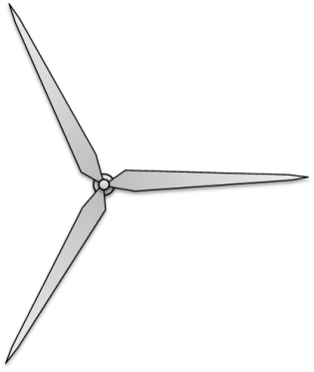

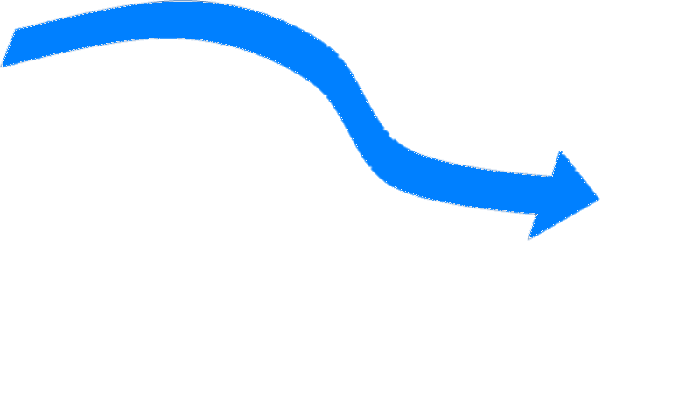

Observational Issues
Observations in and near wind farms currently target nowcast and forecast verification. Even forward facing lidars see out about 3 km. Will not aid in the forecast of ramps, day ahead or anything more than reaction to immediate impact.
Need more observations for heat, moisture, and momentum fluxes to better represent stability and turbulence. Therefore addressing the TOP 10 list.
Downscaling model resolution in half (6km to 3km) requires four times as many observations
  Due to high cost for an adequate observation network, need to use models
120m
50m
Lidar
Met Tower
Notes:
Use the models to fill the gaps in observational analysis.

Slide 17
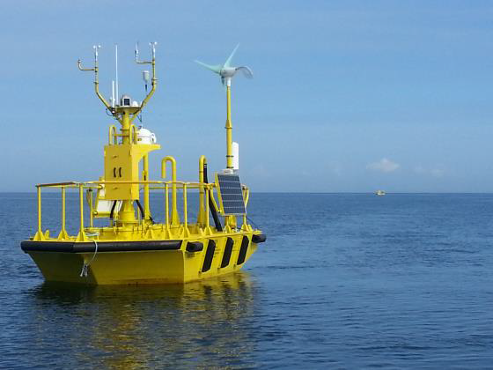
Observations Projects
The Experimental Measurement Campaign (XMC) for Planetary Boundary Layer (PBL) Instrument Assessment (XPIA):
  DOE funded study to validate methods to make high fidelity measurements of 3D wind fields of wind farm inflows and wake flows using remote sensing instrumentation
Testing:
  Validation and Verification (V&V): Ensure model results are not tuned for one specific area but transferrable for the nation as a whole
Reference Facility for Offshore Renewable Energy (RFORE):
  Can be used for resource assessment, wind climatology, model verification, observational instruments and methods validation
Floating Lidars:
  Located at 2 sites with ability to move to different sites after one year deployment
Wind Profiling Radars (WPRs):
  3 WPRs deployed in Washington and Oregon to complement 4 existing WPR sites in California and 1 near Vancouver, Canada
Hurricane Risk to U.S. Offshore Renewable Energy Facilities: NOAA/AOML
  Examine the wind profiles collected during hurricanes in the vicinity of identified or planned offshore wind farms
Floating lidar deployed in waters near Sequim
Washington. Source: PNNL
Notes:
- XPIA – remote sensor testing mainly lidars, but radars too
- Testing – Validate and verify so as not to TUNE a model for a specific area of the country but to resolve it for the nation – make it transferrable
- RFORE – offshore reference facility – can be used for resource assessment, wind climatology, verify models, validate observational instruments and methods.
- Floating Lidars – 2 will move around after about a one year deployment to different sites – likely to be involved with WFIP 2
- Wind Profiling Radars – 3 in WA / OR to match the 4 in State of California and 1 in Vancover from Olympics
- Hurricanes – to eliminate risk and develop standards for structures. Work with the Hurricane Hunters – my old job

Slide 18
DOE Wind Resource Characterization Portfolio
Field Testing
Observations
Analysis
Modeling
Notes:
All of these fall within the A2e Initiative.
WFIP 1 – more observational impacts to the models in the short term 0-15 hours.
XPIA – remote sensor testing mainly lidars, but radars too
Testing – Validate and verify so as not to TUNE a model for a specific area of the country but to resolve it for the nation – make it transferrable
RFORE – offshore reference facility – can be used for resource assessment, wind climatology, verify models, validate observational instruments and methods.
Floating Lidars – 2 will move around after about a one year deployment to different sites – likely to be involved with WFIP 2
Wind Profiling Radars – 3 in WA / OR to match the 4 in State of California and 1 in Vancover from Olympics
Hurricanes – to eliminate risk and develop standards for structures. Work with the Hurricane Hunters – my old job
Standards Development – to ensure quality of the observations
IEA Task – 1. Physics 2. Uncertainty Quantification 3 . Forecast confidence
Data Archive and Portal – place to store data and utilize for further research today and in the future and not have to repay for observational information
UQ – get more from the forecast itself
Met-Ocean Coupling – for offshore -- how do waves change the wind through the swept area and how to waves do to the structure from crashing or extreme storms
Meso-Micro Coupling – resolving the scaling issues
IBM – complex terrain on scales that are relavent to the forecasting
WFIP 2 – physics and combine a lot of these items.

Slide 19
Analysis Projects
Standards Development:
  To ensure quality of observations
  Offshore wind energy standards and guidelines to address extreme storms
International Energy Agency (IEA) Task on Forecasting:
  Global issue for wind industry – cuts across policy and tax credits – accuracy and confidence in the forecast
  Will examine physics, uncertainty quantification, and forecast confidence
  Co-led with Gregor Giebel from Danish Technical University (DTU)
Data Archive and Portal:
  Sharing of data
  Can utilize prior data for today’s research and save money
  Will collect, store, catalog, process, preserve, and disseminate all significant DOE A2e data with state-of-the-art technology while conforming to or helping define industry data standards
  Provide easy access to all field and validation data for analysis and avoid duplication
Uncertainty Quantification (UQ):
  Making forecasts more meaningful to the end user
  Developing confidence bounds for decision support tools
Notes:
Standards Development – to ensure quality of the observations
IEA Task – 1. Physics 2. Uncertainty Quantification 3 . Forecast confidence
Data Archive and Portal – place to store data and utilize for further research today and in the future and not have to repay for observational information
UQ – get more from the forecast itself

Slide 20
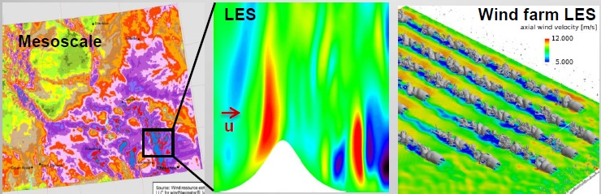
Industry Needs for the Future
Improved coupling from mesoscale to microscale
  Bridge the gap between Numerical Weather Prediction (NWP) models at the mesoscale to Large Eddy Simulations (LES) at the microscale
  Improve wind forecasts at the wind plant scale
Emerging offshore market and new technologies driving push for higher turbine hub heights
  Will require wind resource assessments at new heights and offshore
Better understanding of climate drivers and their effects on the wind resource can enhance wind plant power production/profitability
Coupling from
mesoscale to
microscale
Source: LLNL

Slide 21
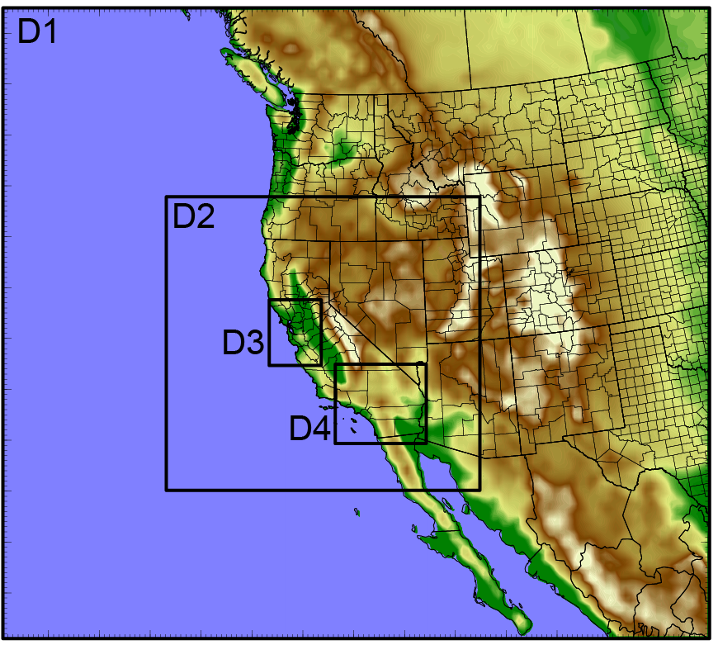
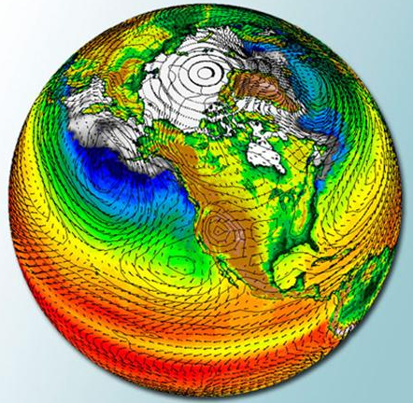
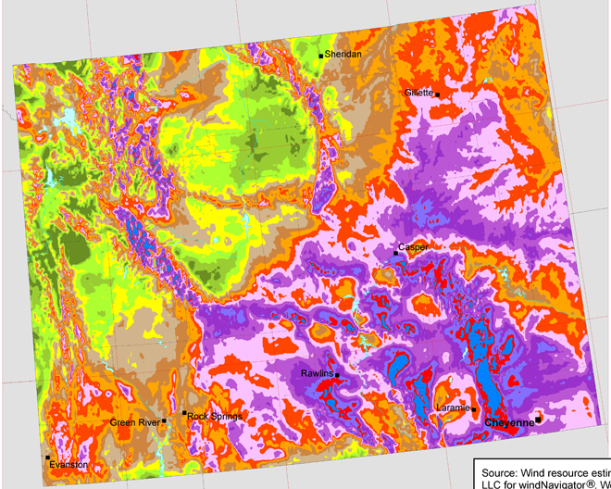
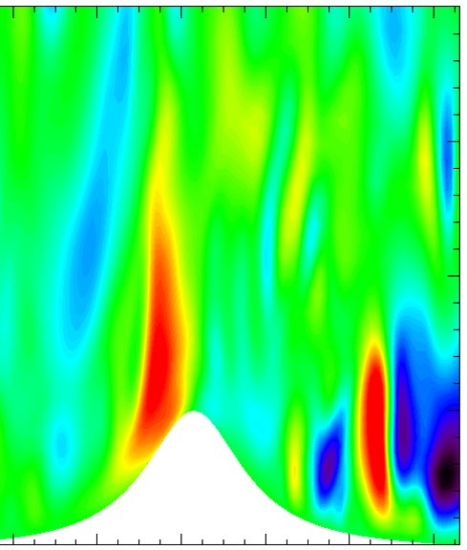
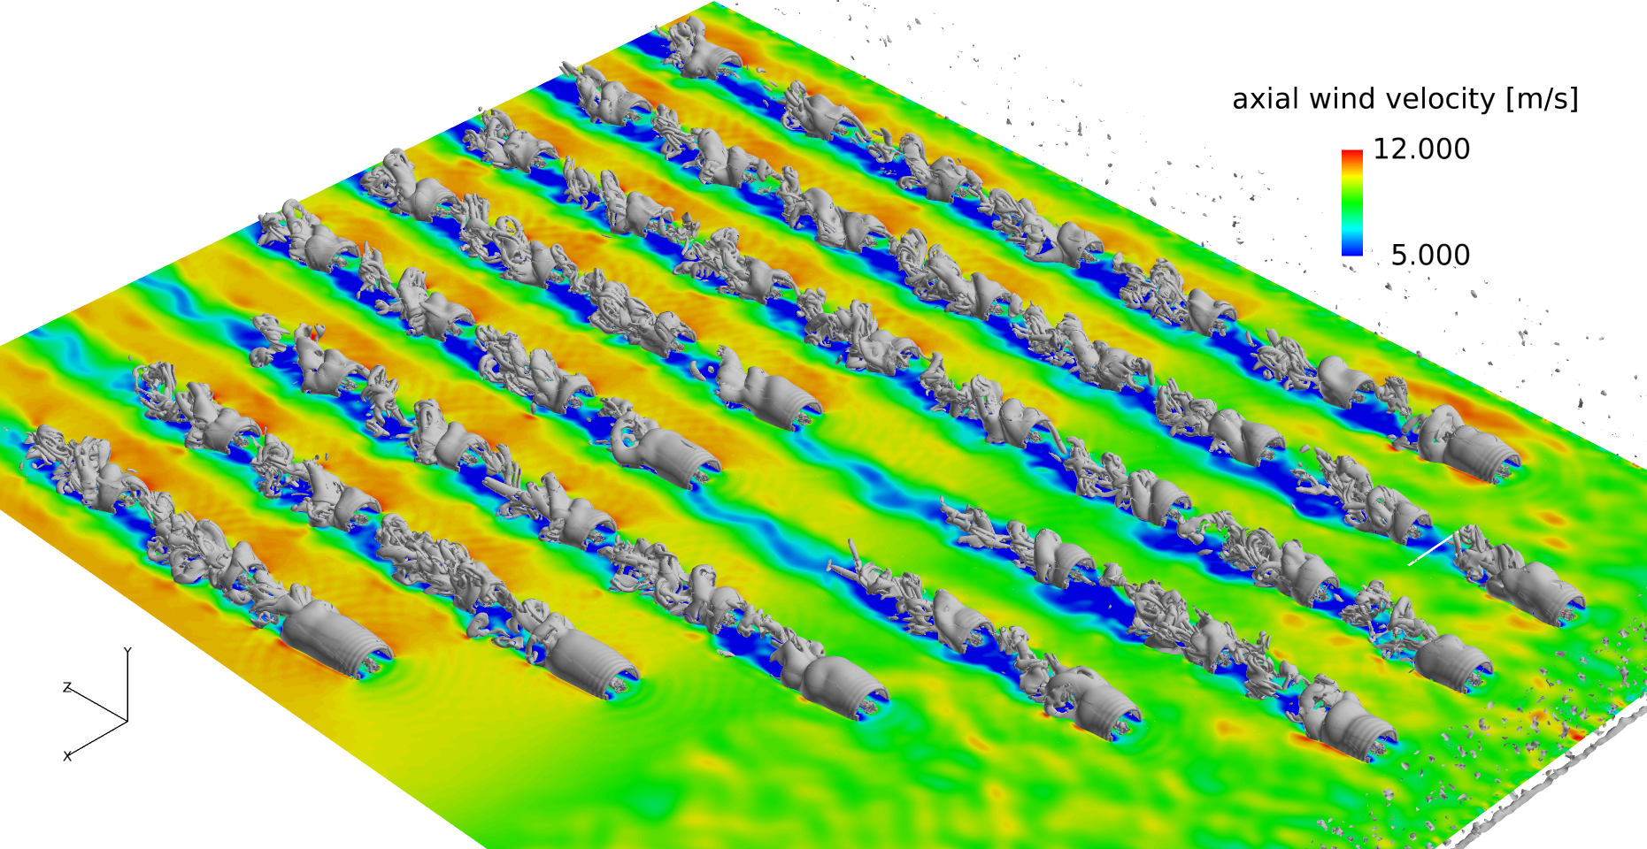
Challenges at the Mesoscale- Microscale Interface
Wyngaard, J. J. Atmospheric Sciences, 2004
?
Notes:
Courtesy of: Jeff Mirocha (presented at A2e External Merit Review on March 31, 2015)
The issue is that both our theoretical and computational frameworks have evolved to consider mesoscale and microscale turbulence separately. Scales of motion between the mesoscale and the microscale have been come to be known as either the terra incognita, following a seminal paper by Wyngaard from Penn State back in 2004, from which this image was obtained, or the “gray zone”, as others refer to it. Why would Wyngaard call this the terra incognita?
Shown here is a spectrum of microcale turbulent motions, characterized by a peak, at l, the integral scale of three-dimensional, or microscale atmospheric turbulence. The other two dotted lines show the filter-scales of our contemporary simulation framework, those lines that separate the flow field into components that are resolved, and those which are subgrid, for which the effects of unresolved scales on the resolved-scale features, must be parameterized.
On the right shows the filter-scale for LES, for which the spectral peak is resolved, and the subgrid model represents the effects of motions at intertial subrange and dissipation scales. Les can explicitly resolve relevant turbulence structures in atmospheric applications, and also are of course very popular in engineering applications.
The line on the left shows a representative mesoscale filter scale. As mesoscale models are essentially high-resolution versions of numerical weather prediction models, the assumption of mesoscale models is that the grid spacing is so coarse that none of the microscale turbulence spectrum, shown here, is resolved. Since none of those motions are resolved, a so-called planetary boundary layer scheme is tasked with representing the effects of the entire spectrum of microscale motions on the resolved scale weather features. What do we use for scales between? We don’t currently have anything. Hence the nomenclature.
Why is this called the terra incognita? We have subgrid models that are appropriate for both the LES and the mesoscale limits, i.e. where the peak of turbulence is resolved, or when none of the turbulence is resolved. However, we have neither a firm theoretical issue or computational basis for modeling the effects of the subgrid or subfilter motion field on resolved scales when the filter scale between these limits. We cannot use LES, since we aren’t resolving the spectral peak. Yet, our basis for using PBL schemes in mesoscale models, that none of the microscale motions re resolved, is also not appropriate.

