Slide 1


Digging Deeper into Text and Data Mining
By Inga Haugen, Edward F. Lener, Virginia Pannabecker, & Philip Young
Virginia Tech, University Libraries
Presentation available in VTechWorks institutional repository
http://hdl.handle.net/10919/79483
This presentation is licensed CC BY 4.0 for reuse:
https://creativecommons.org/licenses/by/4.0/
Notes:
Inga
We are focusing on research at the college and university level.
https://secure.hosting.vt.edu/www.downloads.branding.unirel.vt.edu/

Slide 2

Roadmap / Outline
This presentation’s approach and perspective
Text and Data Mining definition
Examples of TDM in Research
Opportunities for Library Support for TDM
  Identifying TDM Sources and Tools
  Expanding library licensing permissions
  Clarifying legal aspects
  Developing expertise
  Outreach and Training
Notes:
Inga
Text and Data Mining approaches are increasingly used for research in a variety of disciplines to create, explore, and analyze large datasets. This presentation explores opportunities for library support for TDM, including expanding licensing permissions, clarifying legal aspects, identifying TDM sources and tools, developing expertise, and outreach.
This is not comprehensive- just the start of a conversation.

Slide 3

Introductions - Presenters
Inga Haugen Agriculture, Life Sciences, and Scholarly Communication Librarian; Interim liaison to the College of Natural Resources and the Environment (CNRE)
Edward Lener Associate Director for Collection Management and College Librarian for the Sciences
Ginny Pannabecker Associate Director for Research Collaboration and Engagement; Liaison Librarian for life sciences and biomedical programs
Philip Young Institutional Repository Manager
Notes:
Inga

Slide 4
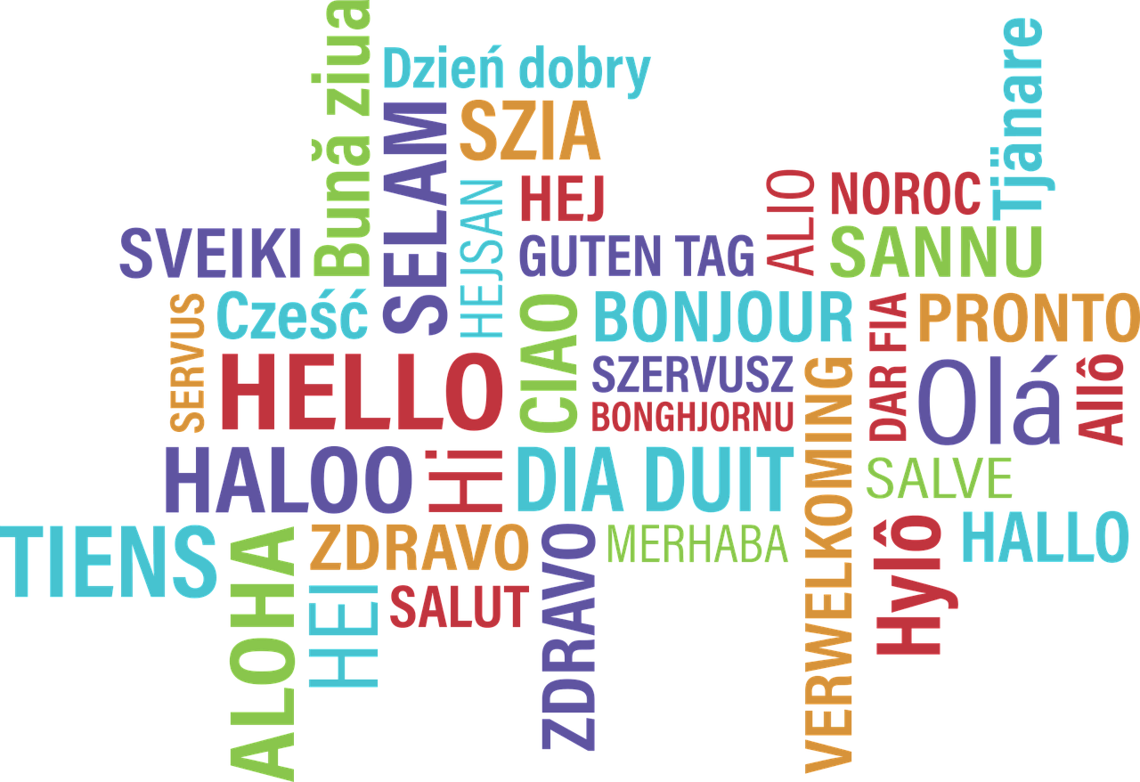
Notes:
Inga
2-5 min tops
Anticipating there not being a massive (more than 10-20 people) audience, might as well get to know people interested in this that we might connect with. *If there are more than 10 or so, then we could do this as a couple poll everywhere questions for some categories → type of library; familiarity/exp w/ or w/ 2-3 quick examples of supporting TDM, ….other?

Slide 5
What is Text and Data Mining (TDM)?
Text and data mining (TDM) uses methods of automated extraction, combination, and analysis of data to create new information by revealing trends, patterns, and relationships. The mining of text and of data usually require different considerations. Text mining, sometimes called text analytics, can be viewed as a subset of data mining.
Notes:
Inga
[2-4 min]
Start by asking audience for their definitions, then follow up (new slide / animation) with one or more definitions we like.

Slide 6
Examples of TDM in research / scholarship
From VT
TDM Forum - variety of topics and examples - business, cyber bullying, statistics
History - 1918 influenza pandemic project
Other examples
Health
Discovering associations between adverse events from electronic health record data
Digital Humanities
Librarian collaborations for research and training in text encoding
Opioid Crisis
A Text Mining Analysis of Public Reactions to Opioid Crisis
Notes:
Inga
[2-3 minutes]
-Consider TDM on current newspapers and news (Twitter, social media, news)
-Point out multi-disciplinary applications
Example: Patient data, such as electronic health records or adverse event reporting systems, constitute an essential resource for studying Adverse Drug Events (ADEs)
Can social media postings by consumers be a source of useful information about vehicle safety and performance defects for automobile manufacturers?
Yes, say Pamplin College of Business researchers who conducted what is believed to be the first large-scale case study confirming the value of social media for vehicle quality management.

Slide 7
TDM: Academic library support opportunities
Identifying TDM Sources and Tools
Expanding library licensing permissions
Clarifying legal aspects
Developing expertise
Outreach and Training
Notes:
Ed-Outline slide: What we will cover next

Slide 8

Examples of academic library support for TDM
Identifying & Sharing
TDM Sources and Tools
Tool and Methods Guides
  UC Berkeley Library guide
  MIT Libraries - APIs guide
  University of Melbourne - Text Mining Tools list
  Carnegie Mellon University Libraries guide
  VT Libraries
Conversations with researchers / Community of practice
Open educational training options
Conducting literature reviews for updates to to stay current in best practices and tools
Notes:
~2-3 min
Ed-
-Point 1 - text and data mining methods reference a variety of processes related to getting, using, analyzing, and outputing results from data, including: identifying sources; acquiring data; software, code, or other tools for analysis of text, images, or other formats; tools for creating visualizations from data, and more.
-Point 2 - options for identifying tools include: library guides, Talking with researchers at your institution - computer science, social sciences, statistics
(data science); seeking out resources from open educational options (Coursera data science courses), professional association resources, etc.; web searches, lit reviews,

Slide 9

Examples of academic library support for TDM
Expanding library licensing permissions
Each license represents an opportunity
Vendors are at widely different places on this issue
Liblicense model agreement and others like it can be a very helpful starting point
Need to decide how important this issue is to you and what you are prepared to accept
Notes:
Ed-
~2-3 min

Slide 10

Examples of academic library support for TDM
Clarifying legal aspects*
Subject to U.S. law
No specific exemption for TDM in U.S. copyright law**
License agreement overrides Fair Use provisions of copyright law
Researchers may need data from multiple sources with varying rights
ARL Issue Brief
Text and Data Mining and Fair Use in the United States
* Note - We are not attorneys!
**You may hear about a specific tdm exemption in the UK - more info here.
Notes:
Ed
~3-4 min
ARL issue brief cites 8 court cases and analyzes the 4 fair use factors from a TDM perspective

Slide 11
Examples of academic library support for TDM
Sample license language from one major library vendor
“TDM Output” means the result of any TDM activity by Researcher, such as the creation of an index, abstract, relative or absolute description or representation of the Content; any algorithm, metrics, method, standard or taxonomy describing or based on the Content, … whether in a the form of a direct extraction or a representation in any form which is based on any portion of the Content. Any quotes from the Content shall be limited to fifty (50) words or less.
Notes:
Ed
1-2 min

Slide 12

Examples of academic library support for TDM
Developing expertise
Join Communities
  Text and Data Mining Research Support List (JISC)*
Read / Start a Journal Club - How-To Texts, Research studies that used text and data mining methods
  Introduction to Text Analysis
Tutorials / Training / Webinars
  Coursera Data Science course via Johns Hopkins
  Hathi Trust Research Center | Training
  Programming Historian
  R and Data Mining Courses - Directory of free options
  Software Carpentry / Data Carpentry / Library Carpentry
*JISC (formerly Joint Information Systems Committee) is a UK non-profit supporting higher education
Notes:
Emphasize that JISC is a UK non-profit and that therefore conversation on this list is often within the realm of UK copyright / IP, which includes a specific exemption for Text and Data Mining for research and educational purposes.

Slide 13

Examples of academic library support for TDM
Outreach and Training
Host events / Workshops / Discussions
Open Data Day
  Invite a local Code for America brigade to co-host or facilitate a hack-a-thon or workshop
ContentMine
  Identify researchers or applications producers you’d like to work with and work with them to provide an event.
TDM Forum
  Invite researchers in your community/institution to share their experiences and expertise
Notes:
Ginny
2-3 min
Invite a Code for America chapter or other local / institutional group to co-host with you and help plan the event / provide a workshop, training, or facilitate a hack-a-thon
- Code for NRV - PDF scraping, using APIs

Slide 14

Employ TDM to
improve library services
‘Bibliomining’
Examples
Gaining strategic advantage through bibliomining: Data mining for management decisions in corporate, special, digital, and traditional libraries.
Use and understand: the inclusion of services against texts in library catalogs and “discovery systems
Towards linking libraries and Wikipedia: automatic subject indexing of library records with Wikipedia concepts
Data-mining the Library
Notes:
Ginny
1-2

Slide 15
Activity
Consulting on a TDM Project:
Questions to Ask
If you knew someone were coming to you for a 'TDM Consultation,' what questions might you ask?:
Ahead of time (if you have the opportunity)
At the start of the consultation
During the consultation (what are key info points you'd want to be sure to touch on during the conversation)
Notes:
Ginny
3 minutes to set up
How many of you are familiar with a reference interview process? (Asking questions of someone needing a consultation on a topic to elicit information about what they need in order to better advise them.)
3-5 min to talk to neighbor

Slide 16
Activity
Consulting on a TDM Project:
Questions to Ask - Examples
Does the content source provider support TDM projects, provide policies, or offer contacts for requests?
How will the file type or extraction method affect the TDM project goals?
How large is the expected data? How will it be transferred? Where will it be stored?
If the data is digitized text, what is the quality of the Optical Character Recognition (OCR)? Is it possible to get a sample of the OCR to check for quality?
→ What would you add?
Notes:
Ginny
2-3 min
Differences from a traditional reference interview
This is new, but it isn’t new. Someone will ask you how to get access to content “How do I get to X”
Ask the audience what they would add

Slide 17
Additional References
Report: Young, P., Brittle, C., Haugen, I., Lener, E., Pannabecker, V. (2017). Library support for text and data mining: A report for the University Libraries at Virginia Tech. Retrieved from http://hdl.handle.net/10919/78466
This Presentation: http://hdl.handle.net/10919/79483
Libraries, licensing, and TDM
Text & Data Mining Clauses in Academic Library Licenses: A Case Study
Organization to Follow
Future TDM
Selected recent items of interest since our report was shared
Text mining of 15 million full-text scientific articles
JSTOR Labs - Text Analyzer for Topics and Recommended Readings
Legal Analytics Lab at Georgia State University
Common Crawl web archiving organization | Related article
Notes:
Ginny
15 sec

Slide 18
Images
Sourced from Pixabay - CC0 - public domain license
https://pixabay.com/en/binary-binary-system-data-dataset-2728121/
https://pixabay.com/en/road-asphalt-space-sky-clouds-220058/
https://pixabay.com/en/balloon-discussion-comment-2223048/
https://pixabay.com/en/hello-bonjour-hi-greeting-foreign-1502369/
https://pixabay.com/en/chat-multiple-icon-symbol-message-2389223/
https://pixabay.com/en/contract-consultation-pen-signature-1332817/
https://pixabay.com/en/weight-scale-equal-arm-balance-scale-2402966/
https://pixabay.com/en/home-office-workstation-office-336377/
https://pixabay.com/en/people-girls-women-students-2557396/
https://pixabay.com/en/silhouette-head-bookshelf-know-1632912/
https://pixabay.com/en/banner-header-question-mark-1090830/
https://pixabay.com/en/icon-feedback-message-cloud-data-1968237/
Notes:
Ginny
15 sec

Slide 19


Questions?
Notes:
ALL

Slide 20

Evaluation Link
Please let us (and VLA) know your thoughts on
this presentation!
tinyurl.com/th2017vla

Slide 21

Thank You word cloud by Ashashyou [CC BY-SA 4.0], via Wikimedia Commons
Notes:
ALL

