Slide 1
Interactive Website for Values Diagnostic Reporting and Analysis (Sustainability Values Diagnostic)
Xavier Brizuela, Sunny Eltepu, Caroline Stewart, Harsh Mistry
CS 4624: Multimedia, Hypertext, and Information Access - Edward A. Fox
Virginia Tech, Blacksburg VA 24061
April 26, 2018
Notes:
Sunny
Hey everyone, I’m Sunny …harsh caroline xavier
And we’re the sustainability values diagnostic group

Slide 2
Outline
Recap
Current Status
Setbacks
Milestones/final touches
Resources & acknowledgements
Questions
Notes:
Sunny
Here’s a quick outline of what we’re gonna be talking about today
…..

Slide 3
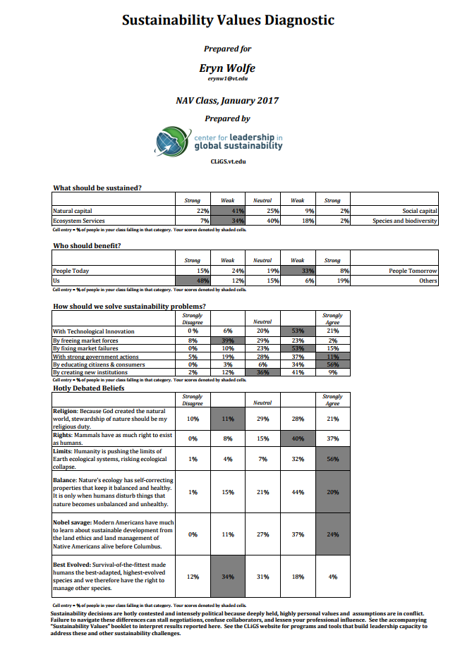





Recap
~10 minutes
Results
(~2-3 weeks)
Dr. Hull
Dr. Hull’s Wife, Mrs. Allen
Sustainability Professional or Student in Blacksburg or NOVA Area
Notes:
Sunny
Here’s a quick recap of what our project is about:
Our group is developing a website to streamline a survey for Dr. Hull, who uses it for his classes and workshops
Currently
Students take the survey
Dr. hull manually downloads the responses and sends the CSV files to his wife
His wife uses Excel and calculates survey data and sends the results back to Dr. Hull
The whole process takes 2-3 weeks for students to get their results
We are trying to streamline that process so students get their results instantly

Slide 4
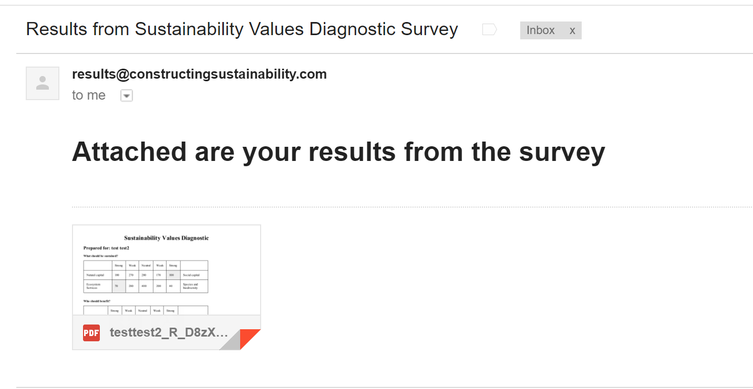
Current Status
Creating a script that emails survey takers
Notes:
Harsh
-During the last presentation, we showed you a simple script that parsed the CSV for a specific survey taker when we hard coded in a user. This required someone to go into the local directory and manually open the pdf to view it.
-Now when we run the script, it can tell who has taken the survey since the script was last run and it will parse the data for those users and send them an email with a PDF of their results
-This is just an example email from running the script after taking the survey

Slide 5
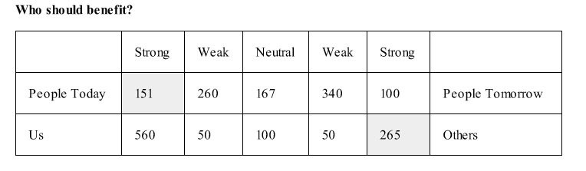
Current Status continued
Notes:
Harsh
-Also, the numbers in the last demo were hard-coded in based off of previous results that our client sent us.
-These numbers now update as more people take the survey, so if someone falls under “strong tendency towards people today benefiting” then only that number updates in the numerator.
-All of these numbers have a denominator, so this number will update for the entire table.

Slide 6
Current Status continued
Using
  WordPress or HTML
  Qualtrics
  Python
  BlueHost Hosting
Notes:
-the smaller details are taken care of, but we’ve run into issues with linking it all together.
-we will get into more details on the next slide
-BUT
-currently, we have the wordpress site up. We have a backup site that’s HTML. (found that WP has a lot of limitations)
-The survey works and gives us the adequate data.
-this survey data is pulled from a script that calls the Qualtrics API - so we know this works
-Python script works -
have tested it extensively (if you filled out our survey, sorry if you’ve received an email)
ALSO, there was a troll who put in professor Balci’s email so you definitely spammed him thanks
-We have everything up on Bluehost, our server, and it runs perfectly when we use ssh,
But there were a few setbacks

Slide 7
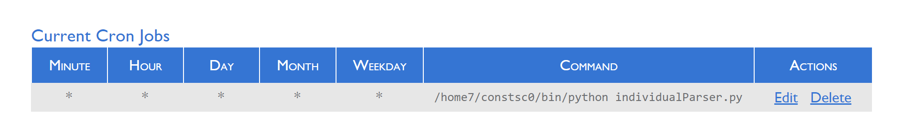
Setbacks
Server Access
Running Python script
  Cron job
WordPress Plugins
  Security issues
Notes:
Caroline
-The Script we made used a lot of imports like for parsing, making PDF’s, and sending emails, so downloading these onto the sever required root access, so this took awhile to get around.
-the root access also was a problem when we wanted to create a cron job that would run the script every minute and see if anyone has taken the survey so it could send them an email of their PDF.
-the packages we had installed for our own use couldn’t be reached by the cron deamon, and we couldn’t change the path or import these packages for the job because the daemon was running on root.
Tried a lot of things to get the job running, from changing paths to even creating a virtual environment and it all came down to the cron job not being able to find executables from imports that it needed
-We then tried to put the parser in an infinite loop and run this in a screen, but this also required root access.
-A lot of the WP plugins didn’t have the functionalities we were looking for (secure login, auth), and those that did cost money, so we ended up changing our idea so that when someone takes the survey, the script will email them their results. (safer than the plugins options)

Slide 8
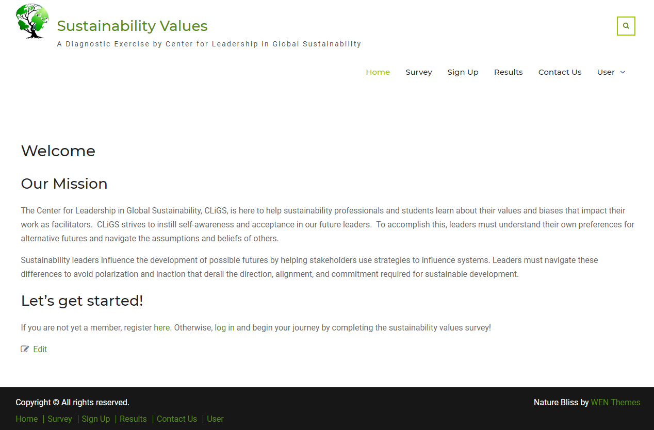
Website
Notes:
Like Caroline mentioned before, WordPress presented a lot of problems.
There are a lot of great plugins for what we wanted to accomplish, but many required costly add-ons for simple things such as secure login features and profiles.
We utilized a database plugin used for polls and volunteer organizations. It is meant as a way to receive information, but does not handle any way to output data.
Since email turned out to be much more secure than any basic login plugin, we found a solution in which a user will receive their results through an email but will still interact with the website

Slide 9
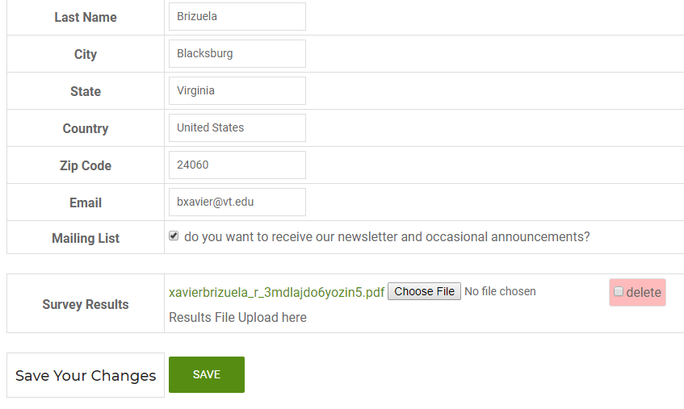
Survey Taker’s View
Notes:
Process:
When a user signs up, a record with a unique ID is created in the database. They will then receive a confirmation email with an encoded URL.
After completing the survey they are able to upload their results by navigating to that URL. (Mention slide)
The administrator’s is very similar to this one with the exception of a few fields regarding the database.

Slide 10
Milestones & Final Touches
February 1 - Requirements due
February 13 - PRESENTATION on requirements
March 12 - Design due
March 15 - PRESENTATION on design
April 3 - Prototyping due
April 5 - PRESENTATION on prototyping
April 23 - Implementation and Testing
April 26 - FINAL PRESENTATION
Before final submission:
Meet with Dr. Hull and discuss best solution
Clean up test survey results
Run tests for bugs
Final Report

Slide 11
Resources & Acknowledgments
Qualtrics logo
http://www.qualtrics.com/
Cron Job Screenshot https://my.bluehost.com
Dr. Bruce Hull
Mrs. Elizabeth Allen

Slide 12
Questions?

