Slide 1

Chapter 5
Business in a Global Environment
(c) Virginia Tech, Department of Management, Pamplin College of Business. CC BY NC SA 4.0.
Available from: http://hdl.handle.net/10919/105157

Slide 2
Objectives
Explain why nations and companies participate in international trade.
Describe the concepts of absolute and comparative advantage.
Explain how trade between nations is measured.
Define importing and exporting.
Explain how companies enter the international market through licensing agreements or franchises.
Describe how companies reduce costs through contract manufacturing and outsourcing.
Explain the purpose of international strategic alliances and joint ventures.
Understand how U.S. companies expand their businesses through foreign direct investments and international subsidiaries.
Appreciate how cultural, economic, legal, and political differences between countries create challenges to successful business dealings.
Describe the ways in which governments and international bodies promote and regulate global trade.
Discuss the various initiatives designed to reduce international trade barriers and promote free trade

Slide 3
Globalization of Business
Notes:
Discuss and Engage various companies, brands and/or organizations that have grown over the past several years through globalization. Use a whiteboard to capture the feedback. Why did they become global?

Slide 4
Globalization- Defined
Globalization Is the spread of products, technology, information, and jobs across national borders and cultures. In economic terms, it describes an interdependence of nations around the globe fostered through free trade

Slide 5
Why Import and Export?
The Globalization of Business -Why do countries trade?
No nation produces all the products & services their citizens want to buy
Exporters –Sell goods & services to other nations.
Importers –Buy goods & services from others.

Slide 6
Why Import and Export?
Absolute Advantage
A nation has an absolute advantage if (1) it’s the only source of a particular product or (2) it can make more of a product using fewer resources than other countries.
Comparative Advantage
Exists when a country can produce a product at a lower opportunity cost compared to another nation.
Opportunity Cost
The products that a country must forego making in order to produce something else. When a country decides to specialize in a particular product, it must sacrifice the production of another product.
Example: Farmer who plants corn vs. wheat

Slide 7
Trade is Critical to Economies
Impact you as a:
Consumer
International student
Future manager dealing with colleagues, suppliers, and customers from abroad

Slide 8
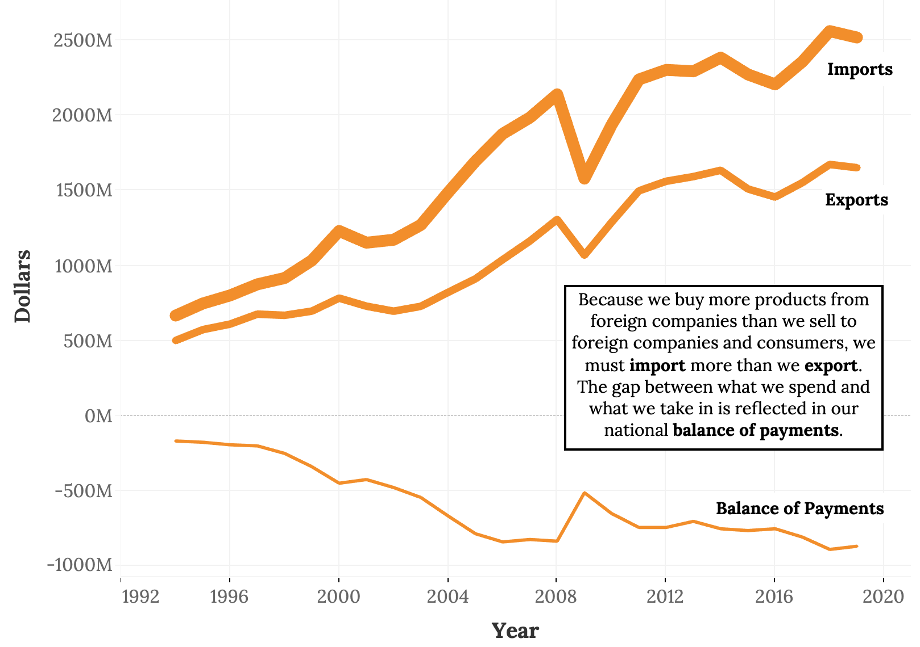
Balance Payments

Slide 9
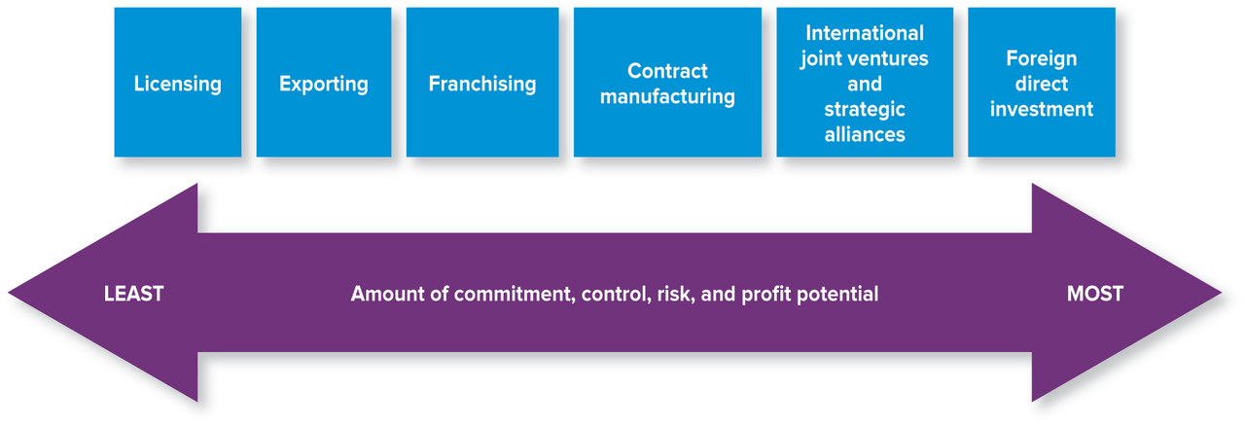
Market Growth- Revenue Expansion
Key strategies for reaching global markets

Slide 10
Opportunities in International Business
Licensing Agreements. An international licensing agreement allows a foreign company (the licensee)to sell the products of a producer (the licensor) or to use its intellectual property (such as patents, trademarks, copyrights) in exchange for what is known as royalty fees.
Franchises. Under an international franchise agreement, a company (the franchiser) grants a foreign company (the franchisee) the right to use its brand name and to sell its products or services. The franchisee is responsible for all operations but agrees to operate according to a business model established by the franchiser. In turn, the franchiser usually provides advertising, training, and new-product

Slide 11
Opportunities in International Business
Licensing
Sign a contract with a company in another country to give them the right to manufacture your product
Typically does not permit use of the brand
Limits sale to a particular geographic region
Licensee pays a royalty to the licensor typically based on a percentage of the revenue earned
Seen as relatively low risk because the licensor’s brand name is not involved

Slide 12
Opportunities in International Business
FRANCHISING
Most often used in restaurants and hotels
Permits the franchisee to use brand name and other aspects of the business model
Allows the franchisor to grow using the franchisee’s capital
Royalties are paid on an ongoing basis
Since the brand name is involved, franchising is a higher risk strategy
Not all franchising is done in a global setting

Slide 13
Opportunities in International Business
PROS AND CONS OF FRANCHISING
Advantages
Expertise, Marketing, and sometimes financial help from the parent
Nationally known name, but you own the outlet and therefore the profits
Franchisor grows using other people’s money
Disadvantages
Big upfront investment in time and money
Share profit through royalties
Mistakes of others may impact whole chain
Selling restrictions (territories), company regulations

Slide 14
Opportunities in International Business
Contract Manufacturing -a form of Outsourcing
Because of high domestic labor costs, many U.S. companies manufacture their products in countries where labor costs are lower.
A U.S. company might contract with a local company in a foreign country to manufacture one of its products. It will, however, retain control of product design and development and put its own label on the finished product

Slide 15
Opportunities in International Business
Joint Venture and Strategic Alliance
Strategic Alliance involves two companies pooling limited resources to work on a given opportunity
Joint Venture goes further, typically resulting in the formation of a new company jointly owned by the companies involved
Risk is higher due to cultural differences and major investments of funds
Return potential comes from realizing synergies –i.e., benefits that occur only by working together

Slide 16
Opportunities in International Business
Foreign direct investment (FDI)
The formal establishment of business operations on foreign soil—the building of factories, sales offices, and distribution networks to serve local markets in a nation other than the company’s home country.
On the other hand, offshoring occurs when the facilities set up in the foreign country replace U.S. manufacturing facilities and are used to produce goods that will be sent back to the United States for sale.

Slide 17
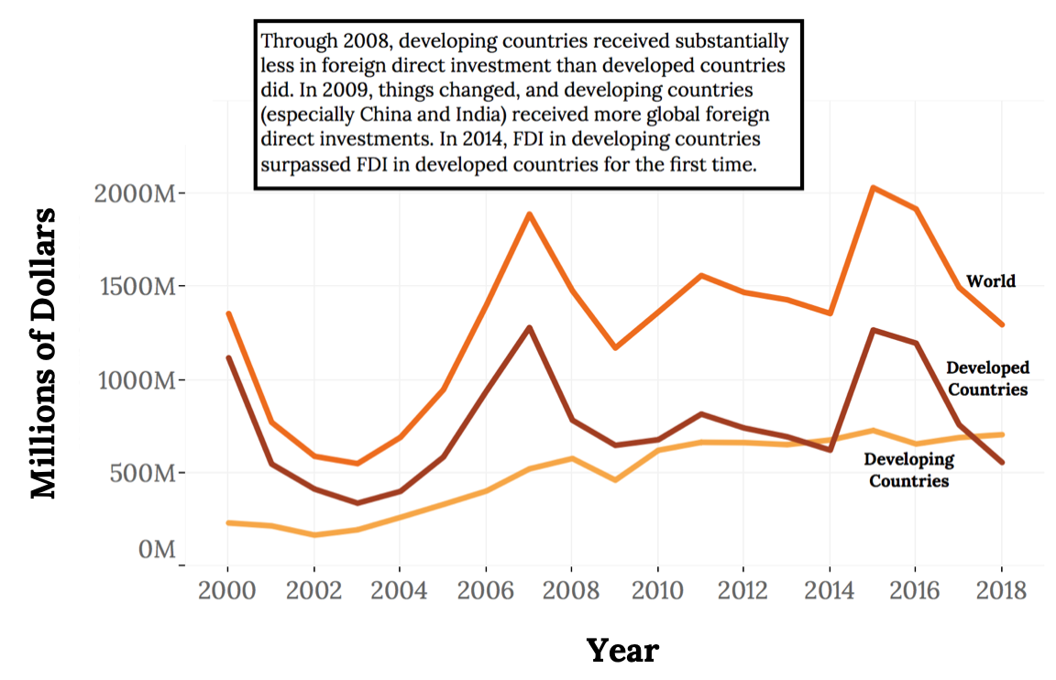
Where does FDI Go?

Slide 18
Global Laws and Ethics
Companies doing international business often face many inconsistent laws and regulations.
American businesspeople must know and follow both U.S. laws and regulations and those of nations in which they operate.
Figure 5.8: Corruption perceptions around the world (2019). A score of 100 is perfect, and anything below 30 means that corruption is considered rampant. Note that since 2015, the United States has dropped 7 points on the CPI scale
Rank | Country | CPI Score
1 | New Zealand | 87
1 | Denmark | 87
3 | Finland | 86
4 | Switzerland | 85
12 | United Kingdom | 77
23 | United States | 69
130 | Mexico | 29
172 | North Korea | 17
173 | Sudan | 16
180 | Somalia | 9

Slide 19
Outsourcing
Defined: Obtaining any product or service from an outside party rather than making the product or performing the service internally.
Note: Not all outsourcing involves foreign companies
All Contract Manufacturing is outsourcing, but not all outsourcing is related to manufacturing
  Technical support (Dell)
  Credit card service (Capital One)

Slide 20
Trade Controls
Subsidies
Tariffs
Quotas
Embargo
Dumping

Slide 21
Trade Controls
Subsidies
Government support that helps a certain group or product more cheaply by giving them financial help to defray their costs.
Subsidies will allow producers to lower the price of their goods to a point below that of imported competitors’ goods. What’s even better is that the lower costs may allow the producers to export their own goods at attractive, competitive prices.
The United States has a long history of subsidizing farmers. Subsidy programs guarantee farmers (including large corporate farms) a certain price for their crops, regardless of the market price

Slide 22
Trade Controls
Quotas
A quota imposes limits on the quantity of a good that can be imported over a period of time. Quotas are used to protect specific industries, usually new industries or those facing strong competitive pressure from foreign firms. U.S. import quotas take two forms.
An extreme form of quota is the embargo, which, for economic or political reasons, bans the import or export of certain goods to or from a specific country.

Slide 23
Reducing Trade Barriers
Trade Agreements and Organizations
General Agreement on Tariffs and Trade (GATT)
World Trade Organization (WTO)
Financial Support for Emerging Economies
The International Monetary Fund (IMF)
The World Bank
Trading Blocs
North American Free Trade Association (NAFTA)
The European Union (EU)

Slide 24
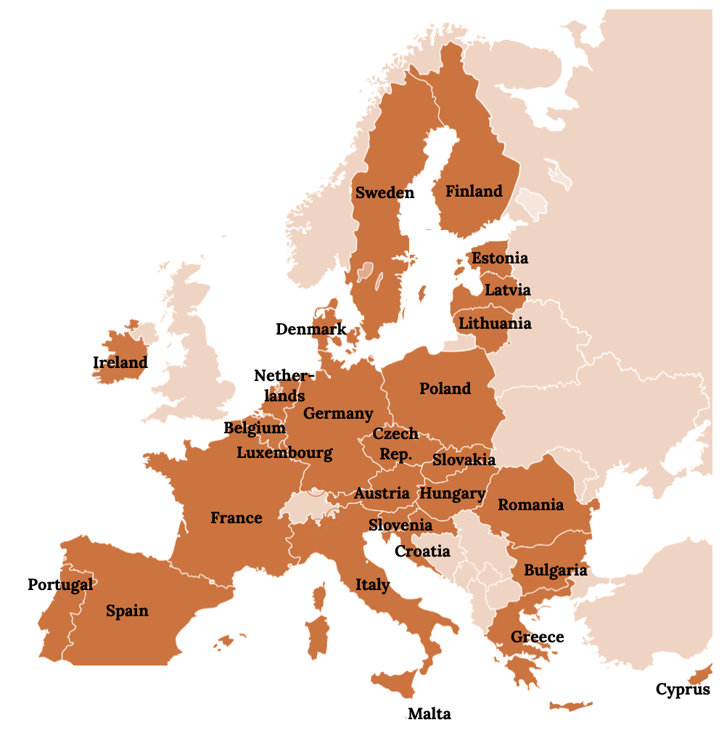
Members of the European Union

Slide 25
Takeaways
Nations trade because they don’t produce all the products that their inhabitants need.
To explain how countries decide what products to import and export, economists use the concepts of absolute and comparative advantage
We determine a country’s balance of trade by subtracting the value of its imports from the value of its exports.
The balance of payments is the difference, over a period of time, between the total flow coming into a country and the total flow going out
A company that operates in many countries is called a multinational corporation (MNC).
Free trade is encouraged by a number of agreements and organizations set up to monitor trade policies.

Slide 26
Chapter 5
Q&A
(c) Virginia Tech, Department of Management, Pamplin College of Business. CC BY NC SA 4.0.
Available from: http://hdl.handle.net/10919/105157

