Slide 1
IDEAL Spreadsheet
Tony Ardura, Austin Burnett, Rex Lacy, Shawn Neumann

Slide 2
Project Description
IDEAL is utilized to provide visualization aids for researchers making use of large web archive files.
This information will be processed through Hadoop with a spreadsheet like interface.
Why would we do things this way?

Slide 3
How Will We Do This?
- Doing a Web Application.
1. RESTful Web Service
2. Front End Interface
3. Integration with Hadoop / Pig / Solr

Slide 4
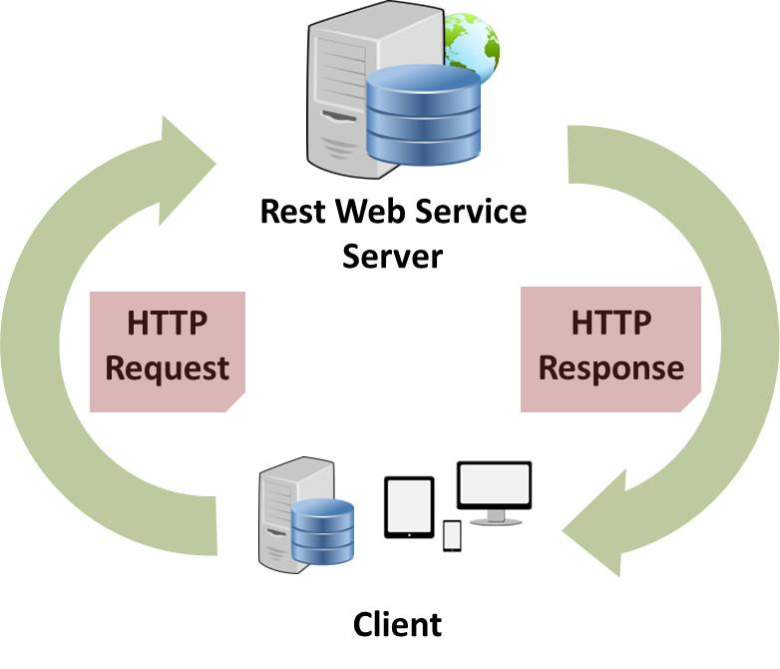
RESTful Web Service
Request Types:
1. GET
2. POST
3. PUT
4. DELETE

Slide 5
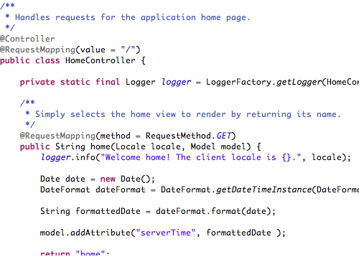

What tools will we use?

Slide 6
Front End Interface
- Using,HTML / CSS, jQuery and javafx
Interface will consist of selectable archives
Filter options to restrict output
Selectable list items take user directly to result

Slide 7
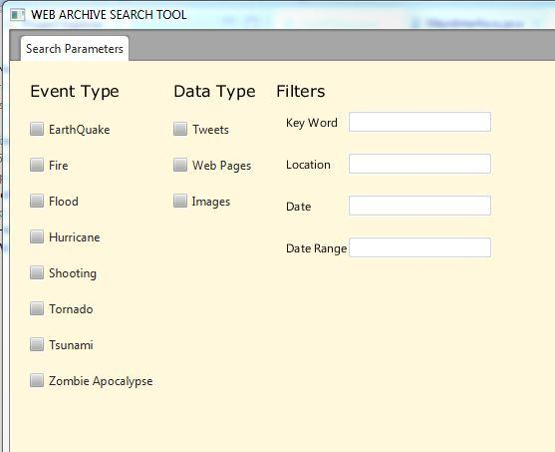
An early idea for a filter tool
Addresses filter needs
But not client specs
Interface design is truly an
Iterative process.

Slide 8
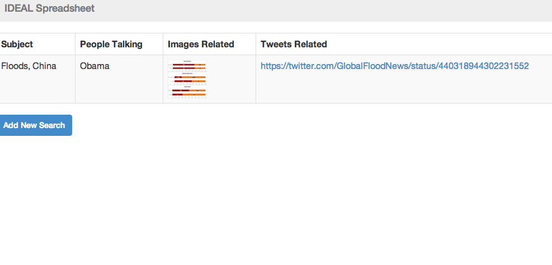
More current version:
Web page of results
Ability to continue search
Ability to further refine

Slide 9



Backend
- WARC files
- Apache Pig
- Concept extraction

Slide 10
Questions?

