Slide 1
Secure Streaming Solution for VT Library
Robert Kania and Luke Gusukuma
CS 4624
5/2/2012
Client: Keith Gilbertson
Notes:
Bobby

Slide 2
Responsibilities
Robert Kania
  HTTP Live Streaming
    Implementation
    Testing
  Instructions for Use
Luke Gusukuma
  Research
  Final Report
  Kaltura
Notes:
Both

Slide 3
Overview
Midterm Review
Work Since
Implementation
Testing
Documentation
Overview of the System
Limitations
How HTTP Live Streaming Works
Ways to Improve
HTTP Live Streaming
Requirements
What We Learned
Notes:
Bobby

Slide 4
Requirements
Notes:
Luke

Slide 5
Requirements
Secure Streaming (Legal Issues)
HTML5
Work on Red Hat Apache Server
Word on iOS Devices (iPad)
Needed Proof of Concept
Notes:
Luke

Slide 6
Midterm Review
Notes:
Bobby

Slide 7
Midterm Review
Project direction changed
Found two possible solutions
Researched secure streaming technologies and HTML5
About to try implementing a solution
Notes:
Bobby

Slide 8
Work Since
Notes:
Luke

Slide 9
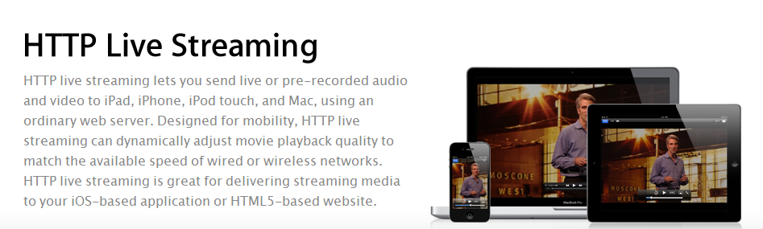
HTTP Live Streaming
Chose HTTP Live Streaming
  Works with iOS devices
  Within legal limits
Notes:
Luke

Slide 10
Implementation
Installed HTTP Live Streaming on Mac
Ran following commands:
  mediafilesegmenter --audio-only –b URL -I –f ./stream FILE_NAME
  Segments the files into .ts or .aac files
  Produces a .plist file
  variantplaylistcreator –o NEW_NAME.m3u8 URL/prog_index.m3u8 ./OLD_NAME.plist
  Creates a final playlist based on varying bitrates in files
  Produces final .m3u8 file
Created HTML file using <video> tags
Uploaded files to web server
Notes:
Bobby

Slide 11
Testing
Safari on Mac
iPod Touch
iPhone
iPad
Windows (All Browsers)
Chrome and Firefox on Mac
Notes:
Bobby

Slide 12
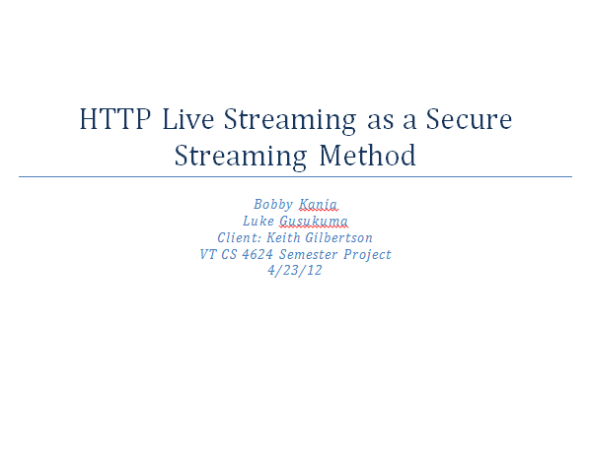
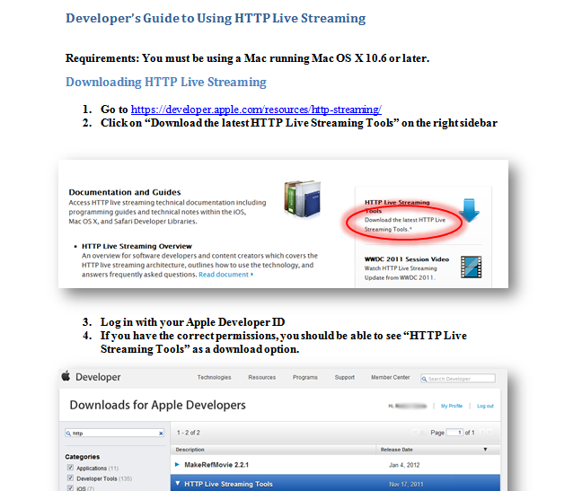
Documentation
Detailed instructions on how to operate HTTP Live Streaming
  Photos
  Step-by-step Instructions
Notes:
Luke

Slide 13
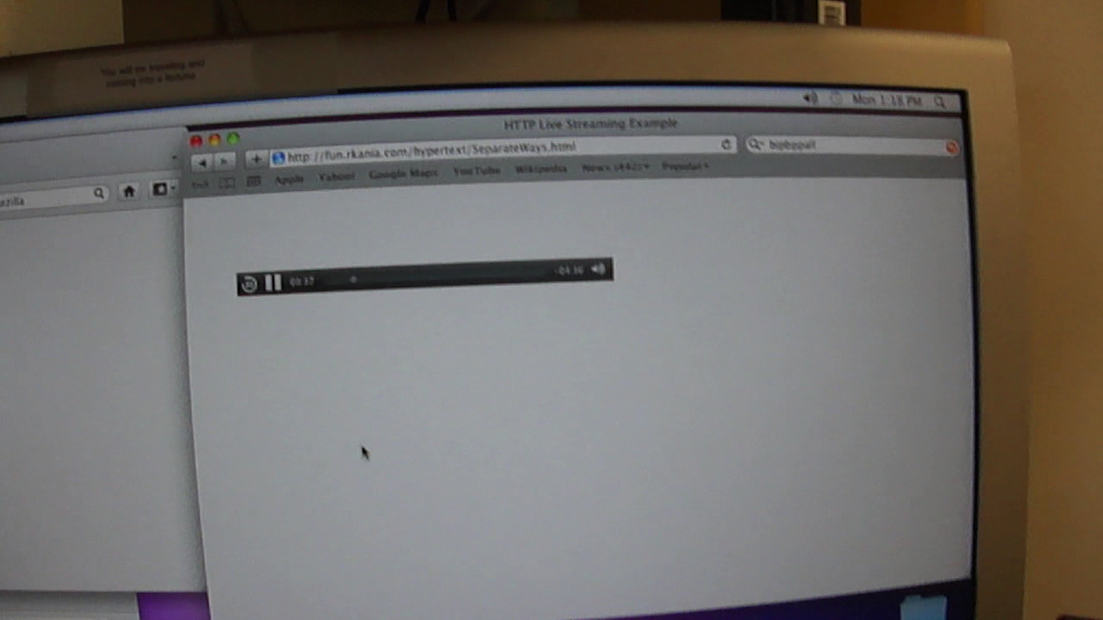
Demo

Slide 14
Overview of the System
Notes:
Luke

Slide 15
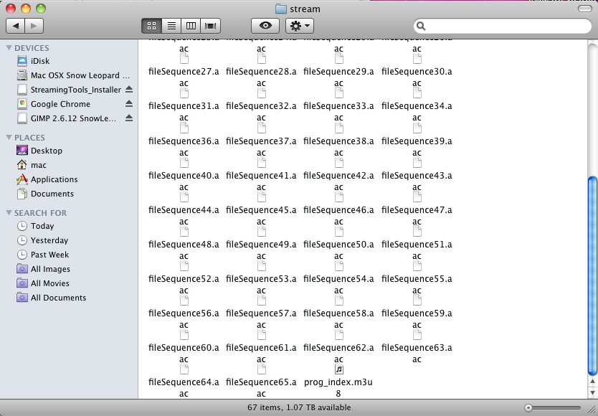
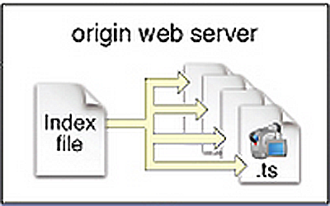
How HTTP Live Streaming Works
Notes:
Luke

Slide 16
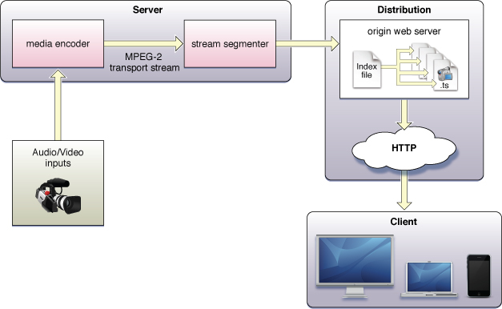
HTTP Live Streaming Cont…
Notes:
Luke

Slide 17
Limitations
Cannot play in Windows or Linux
Requires conversion ahead of time
Requires iPhone Developer’s Account
Doesn’t work in Chrome or Firefox
Notes:
Bobby

Slide 18
Ways to Improve
Fallback for Windows/Flash
Integrate with DSpace
Find way to automatically convert files
Notes:
Bobby

Slide 19
What We Learned
Legal issues with music files
How to use HTTP Live Streaming
HTML5
Notes:
Luke

Slide 20
References
"Deploying Apples HTTP Live Streaming in a GNU Linux Environment." Blog.kyri0s.org. Web. 29 Apr. 2012. <http://blog.kyri0s.org/post/271121944/deploying-apples-http-live-streaming-in-a-gnu-linux>.
"HTTP Live Streaming." HTTP Live Streaming. Apple Developer. Web. 28 Apr. 2012. <https://developer.apple.com/resources/http-streaming/>.
Schulzrinne, Henning. "Real Time Streaming Protocol." Internet Engineering Task Force. Columbia University, 4 May 1998. Web. 28 Apr. 2012. <http://www.ietf.org/rfc/rfc2326.txt>.
Notes:
Bobby

Slide 21
Questions/Comments?

