Slide 1




Slide 2
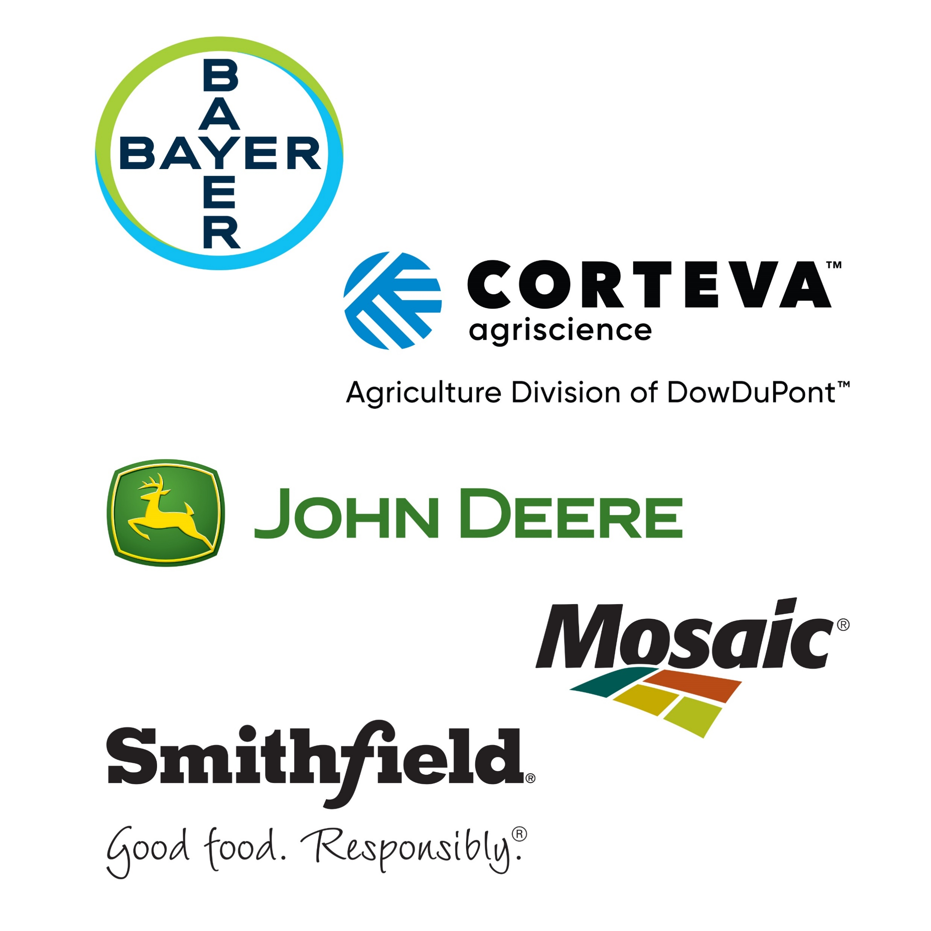
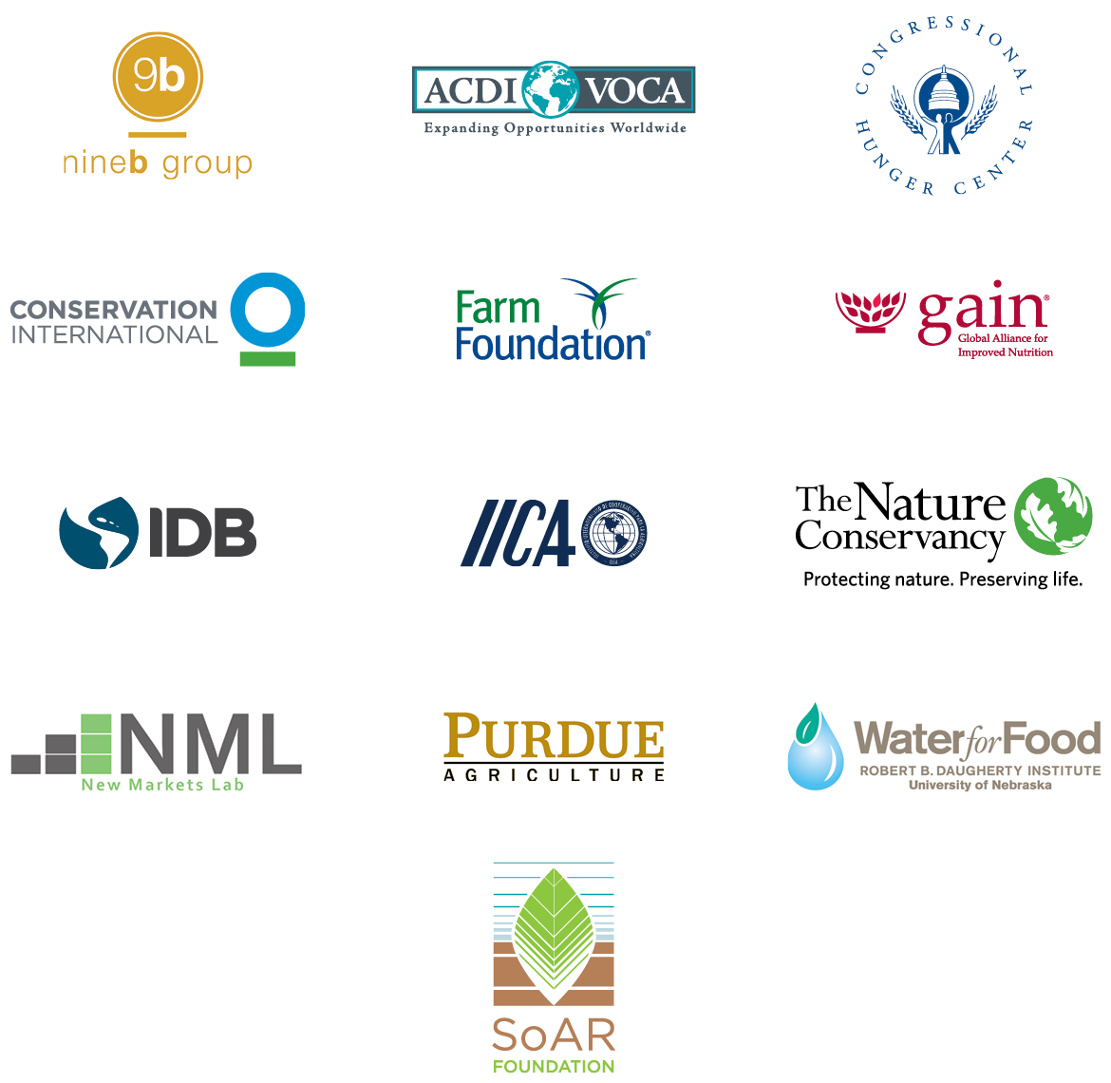
SUPPORTING PARTNERS
CONSULTATIVE PARTNERS

Slide 3










THE GLOBAL AGRICULTURAL
IMPERATIVE FOR A
HEALTHY SUSTAINABLE
WORLD
CONSUMERS
ENVIRONMENT
PRODUCERS
Notes:
The global population is evolving in ways that are driving changes and creating new challenges for our food and agriculture systems.
The world’s population is growing a slower rate, but we will still need to sustainably produce food and agriculture products for almost 10 billion people in 2050.
One in three people in the world do not get enough food or key nutrients or they are overweight or obese. Diet related disease is responsible for 4 million deaths and $2 trillion in economic losses per year.
The number of hungry people in the world has risen to 821 million. Prolonged drought and armed conflict has put 124 million people in need immediate food assistance
At the same time, incomes are the world are rising and consumer taste and preferences are evolving. Women are the primary producers, purchases and preparers of food. Their concerns about the price, nutrition, safety and convenience are driving changes in the food system.
Consumers are shopping for foods in new ways – online food shopping is rapidly rising in the U.S., while supermarket chains are the most rapidly growing retail sector in Africa.
All of these factors and more, have profound consequences for the short and long-term future of agricultural productivity and sustainability.

Slide 4


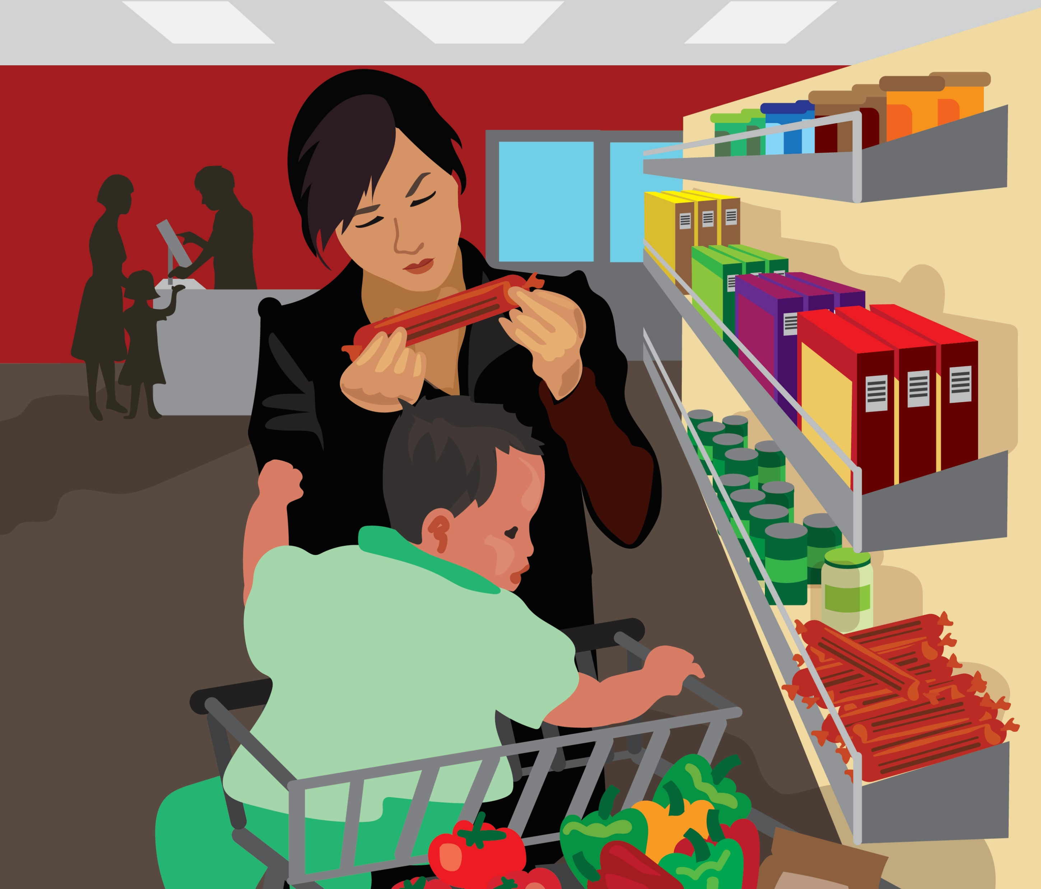
CONSUMER TRENDS AROUND THE WORLD
Notes:
With money to consumers around the world spend, consumers prioritize food diversity, nutrition and safety.
Rising global incomes enable consumer to buy more high value and imported foods.
Supermarkets are popping up in unexpected places.
Demand for premium products – 70 percent of rice consumed in African cities is high-grade premium rice. Opportunity abounds for African farmers to meet this demand.
Chinese consumers have become focused on nutrition. 82 percent of surveyed are willing to pay more for foods they know are higher quality, more nourishing and safe.

Slide 5


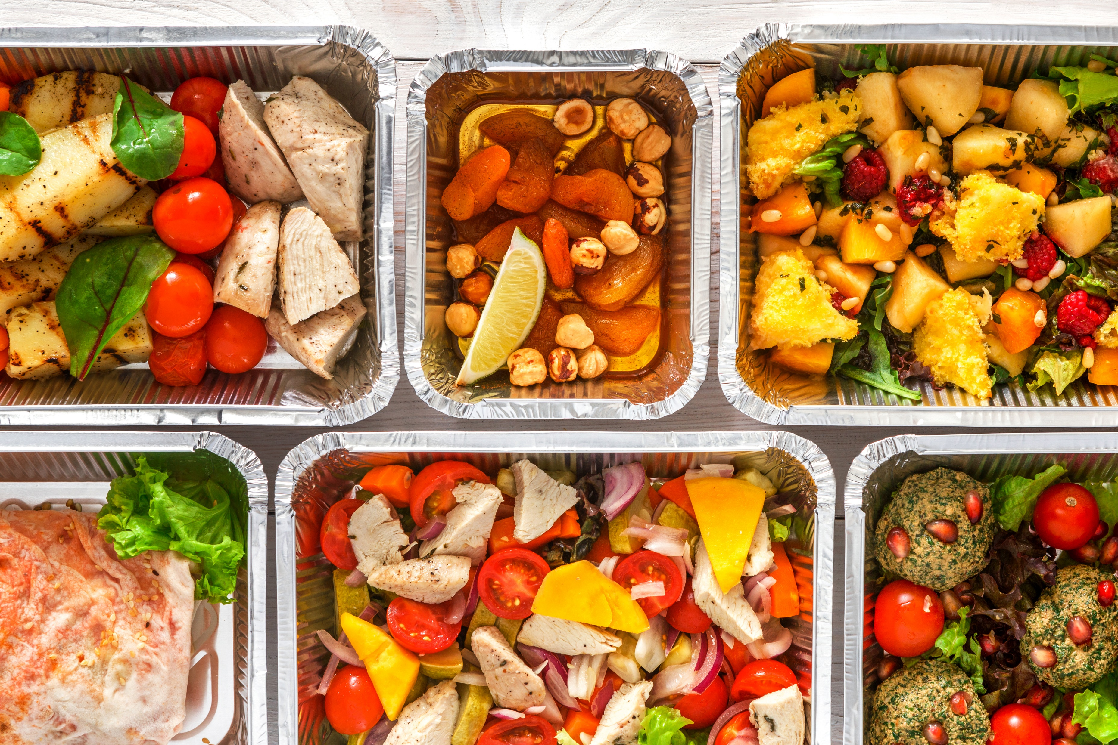
MILLENNIALS AND WOMEN DRIVING CHANGE
Notes:
Driving Millenials and Women
By 2019, the millennial generations age 20-35, will surpass the baby boomers to become the largest US generational group (74 million people).
There numbers and purchasing preferences will fundamentally alter food production and retail in the U.S. and beyond.
Women are a Chief purchasing officers, responsible for 85 percent of all consumer spending in the U.S. and annual purchasing power between 7 trillion to 15 trillion.
Working moms prioritize health, convenience and prices in their food choices. A balancing act.
The need ot manage weight and cardiovascular health is a growing consumer concern.
Sales of fruits and vegetables and fresh meat are increasing.
Millennial consumer are helping scale up sustainability issues in the marketplace
When it comes to purchasing decisions, 62 percent of US millennials indicated they would pay more for food derived from environmentally responsible practices, compaged to 47 percent for Gen X and 30 percent of boomers.
Yet, an upward trend in prices for fresh fruits and vegetables could be preventing low and middle income consumers from purchasing them.

Slide 6




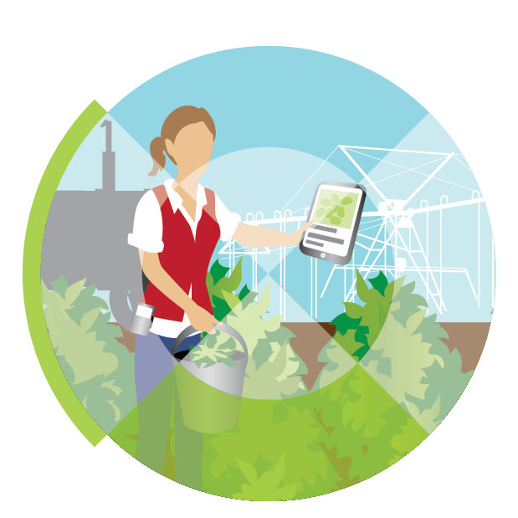


WHAT DOES THIS MEAN FOR OUR FOOD SYSTEM?
FOOD
PROCESSORS
& PACKAGERS
PEOPLE
RETAILERS
AGGREGATORS
& TRADERS
FARMERS
RANCHERS
FORESTERS
FISHERS
AGRICULTURAL
SERVICE
PROVIDERS
FINANCIAL
SERVICES &
RISK
MANAGEMENT

Slide 7

ENABLING POLICY ENVIRONMENT

Slide 8

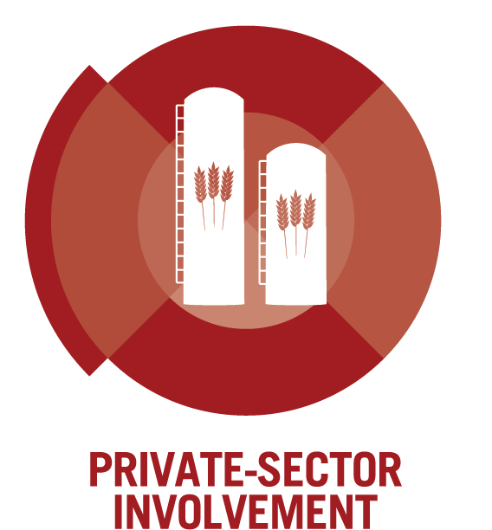
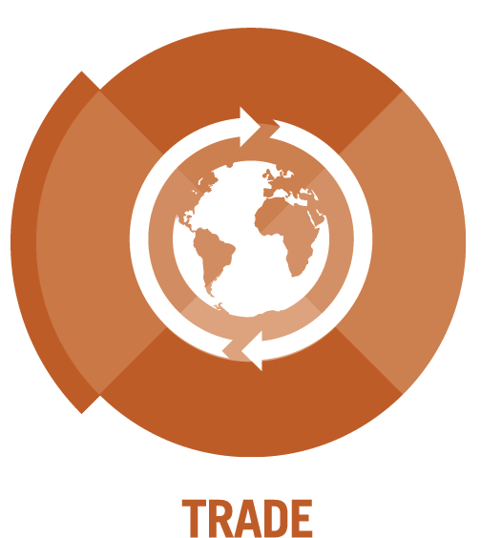


POLICIES FOR PRODUCTIVE SUSTAINABLE AGRICULTURE
Notes:
Finally, the GAP Report lays out a call to a action for effective public policies that improve agriculture.
GHI has identified five strategic policy goals:
Invest in Public Agricultural Research, Development and Extension
Embrace Science-based and Information Technologies
Enhance Private Sector Involvement in Agriculture and Infrastructure Development
Cultivate Partnerships for Sustainable Agriculture and Improved Nutrition and
Foster Capacity for Regional and Global Agricultural Trade
The role of science based and smart regulatory systems will be vital to ensure trust in the products that consumers need. All food systems from farmers through the value chain must have a new focus on growing trust along side these agricultural products
In the online site, you will find sections describing each of these policy areas and how they contribute to a sustainable healthy world. Our panel will also be discussing them today.
[I will ask Ann Steensland to return to the stage to introduce our panel…]

Slide 9




IMPROVES THE LIVES OF PRODUCERS & SOCIETY AS A WHOLE
ENHANCES ENVIRONMENTAL QUALITY
SUSTAINABLE AGRICULTURE…
SUSTAINS THE ECONOMIC VITALITY OF AGRICULTURE
SATISFIES HUMAN NEEDS
Notes:
As our food and agriculture systems evolve to respond to consumer demand, it is important that the changes we are making now are sustainable for the future. We believe sustainable agriculture has four components. It:
Satisfies human needs.
Enhances environmental quality
Sustains the economic vitality of food and agriculture systems
And improves the lives of people in the agricultural value chain and society as a whole
The GAP Report describes the critical role of productivity in sustainable food and agriculture systems, and to understand how, we need to know what productivity is…[click]

Slide 10
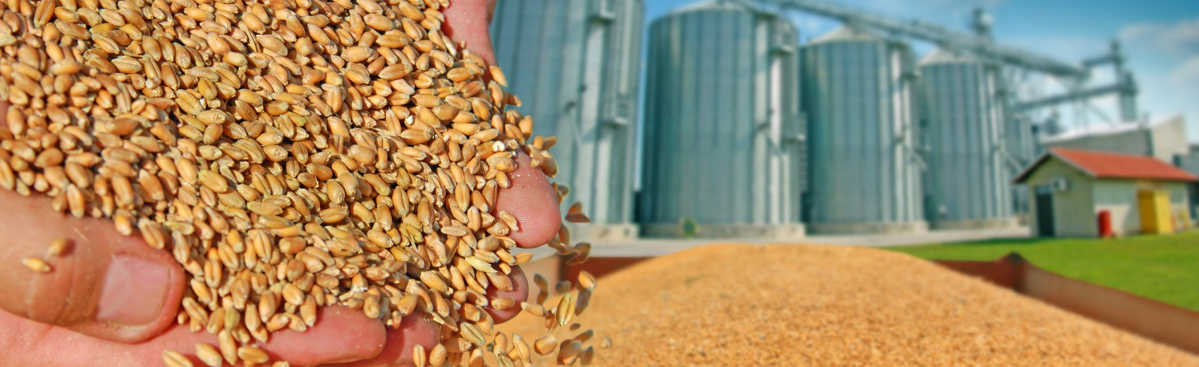
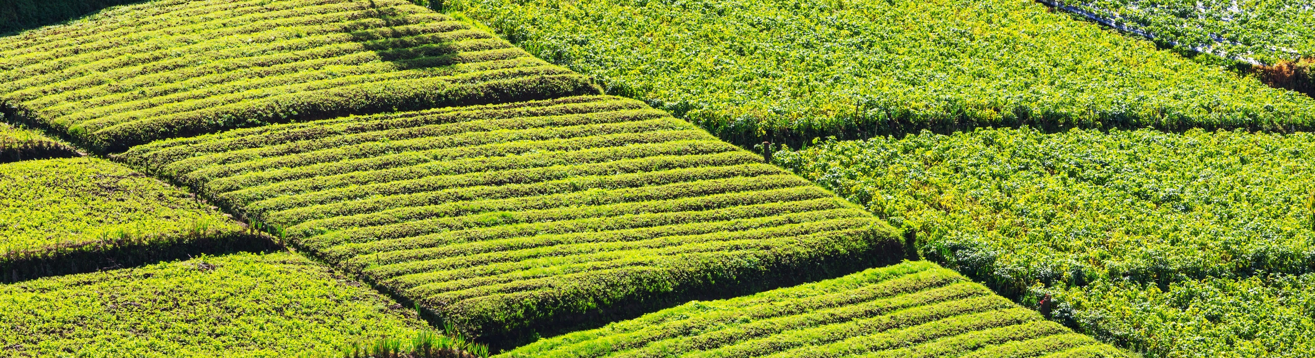
PRODUCTIVITY IS DIFFERENT FROM…
OUTPUT
GROSS AMOUNT OF CROPS
OR LIVESTOCK PRODUCED
YIELD
AMOUT OF OUTPUT
PER UNIT OF PRODUCTION
Notes:
An just as importantly, what it is not.
When we say we want to increase agricultural productivity, we are not talking about just producing more.
Productivity is different from output, which refers to the gross amount of crops or livestock produced.
It is also different that yield, which measures the amount of output per unit of production – usually land.

Slide 11
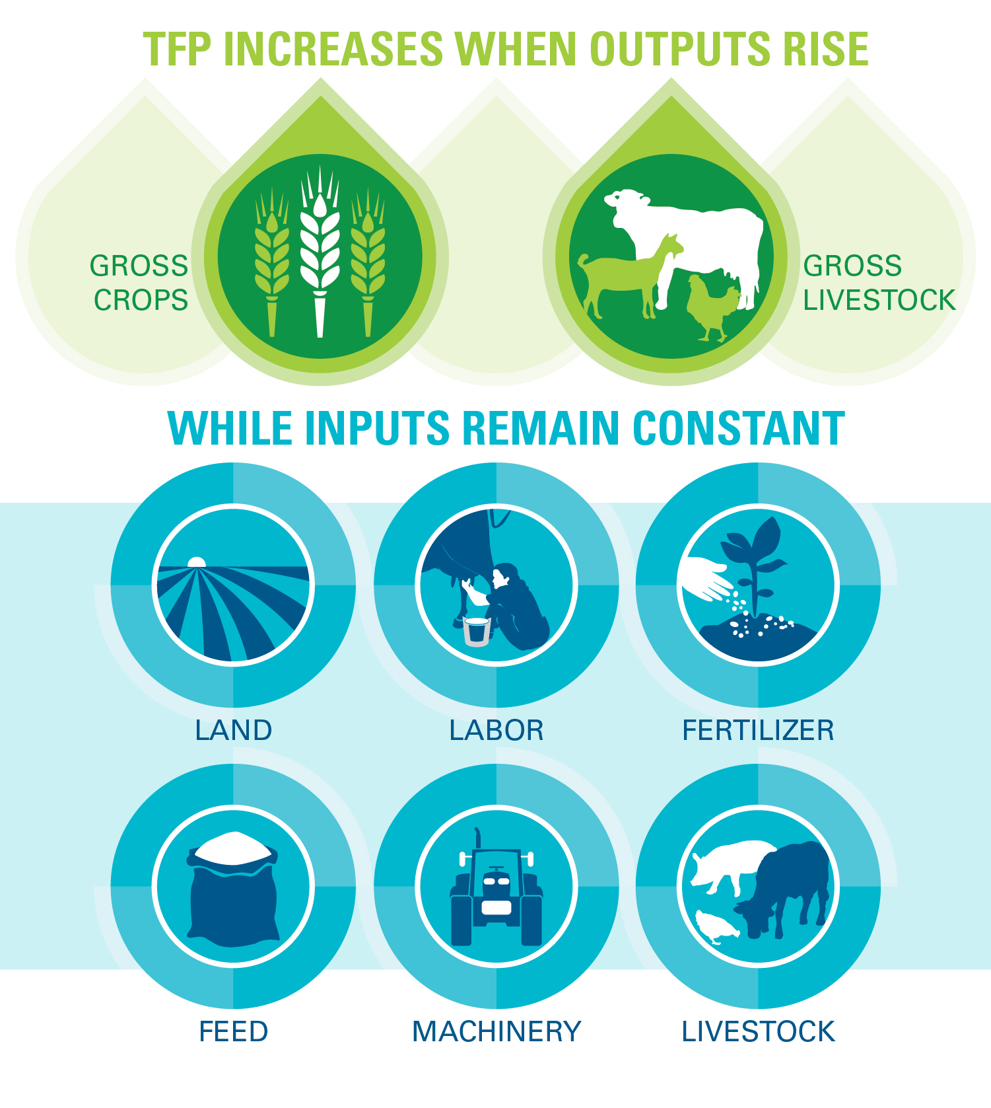
TOTAL FACTOR PRODUCTIVITY
(TFP)
MEASURES CHANGES
IN THE
EFFICIENCY
WITH WHICH
INPUTS
ARE
TRANSFORMED
INTO
OUTPUTS
Notes:
Productivity in agriculture – which we measure as Total Factor Productivity –
Tracks the changes in how efficiently agricultural inputs are transformed into outputs. So TFP increases when more crops are produced, but the amount of land, labor and fertilizer used remains constant.
Since TFP tracks how efficiently we are transforming inputs, like land, into outputs – it can shed light on the sustainability of our food and agriculture systems and help us track the improvements we are making.
This is particularly important as we work towards achieving the Sustainable Development Goals – many of which relate to agriculture.

Slide 12
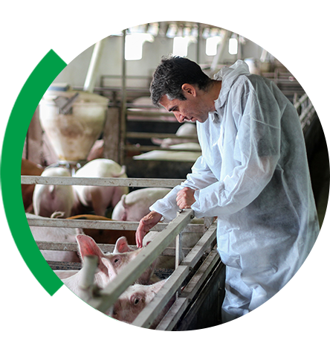
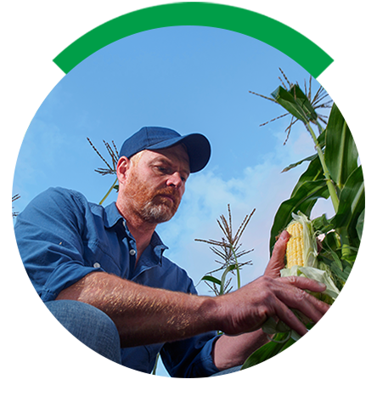

HOW DOES PRODUCTIVITY GROW?
PRODUCTIVITY IS IN THE GENES
PRODUCTIVITY FROM
SEED TO FEED
HEALTHY PRODUCTIVE PIGS
Notes:
Here’s an example of how productivity increases in the pork value chain. It begins in the genes: researchers analyze hundreds of animal traits to breed pigs that are healthier, use less feed and produce more meat.
Seed technologies, good nutrient management practices and precision machinery reduce the amount of land, labor, and other inputs needed to produce crops used for feed.
Nutritious feed and good animal health care practices help pigs develop properly and protect them from disease throughout the life cycle.
Thanks to these innovations throughout the value chain, we can produce more meat with few pigs. That is an increase in productivity.

Slide 13




STRATEGIES FOR MEETING GLOBAL DEMAND
EXTEND
IRRIGATION
TOTAL
FACTOR
PRODUCTIVITY
LAND EXPANSION
LAND
EXPANSION
INPUT INTENSIFICATION
Notes:
As demand for agriculture and food products increases around the world, farmers use a number of strategies to increase their output to meet demand.
They can open new lands for agricultural production, they can extend irrigation into new areas, they can increase the amount of agricultural inputs they apply on existing cultivated land.
[click]
Or they can increase their productivity.

Slide 14

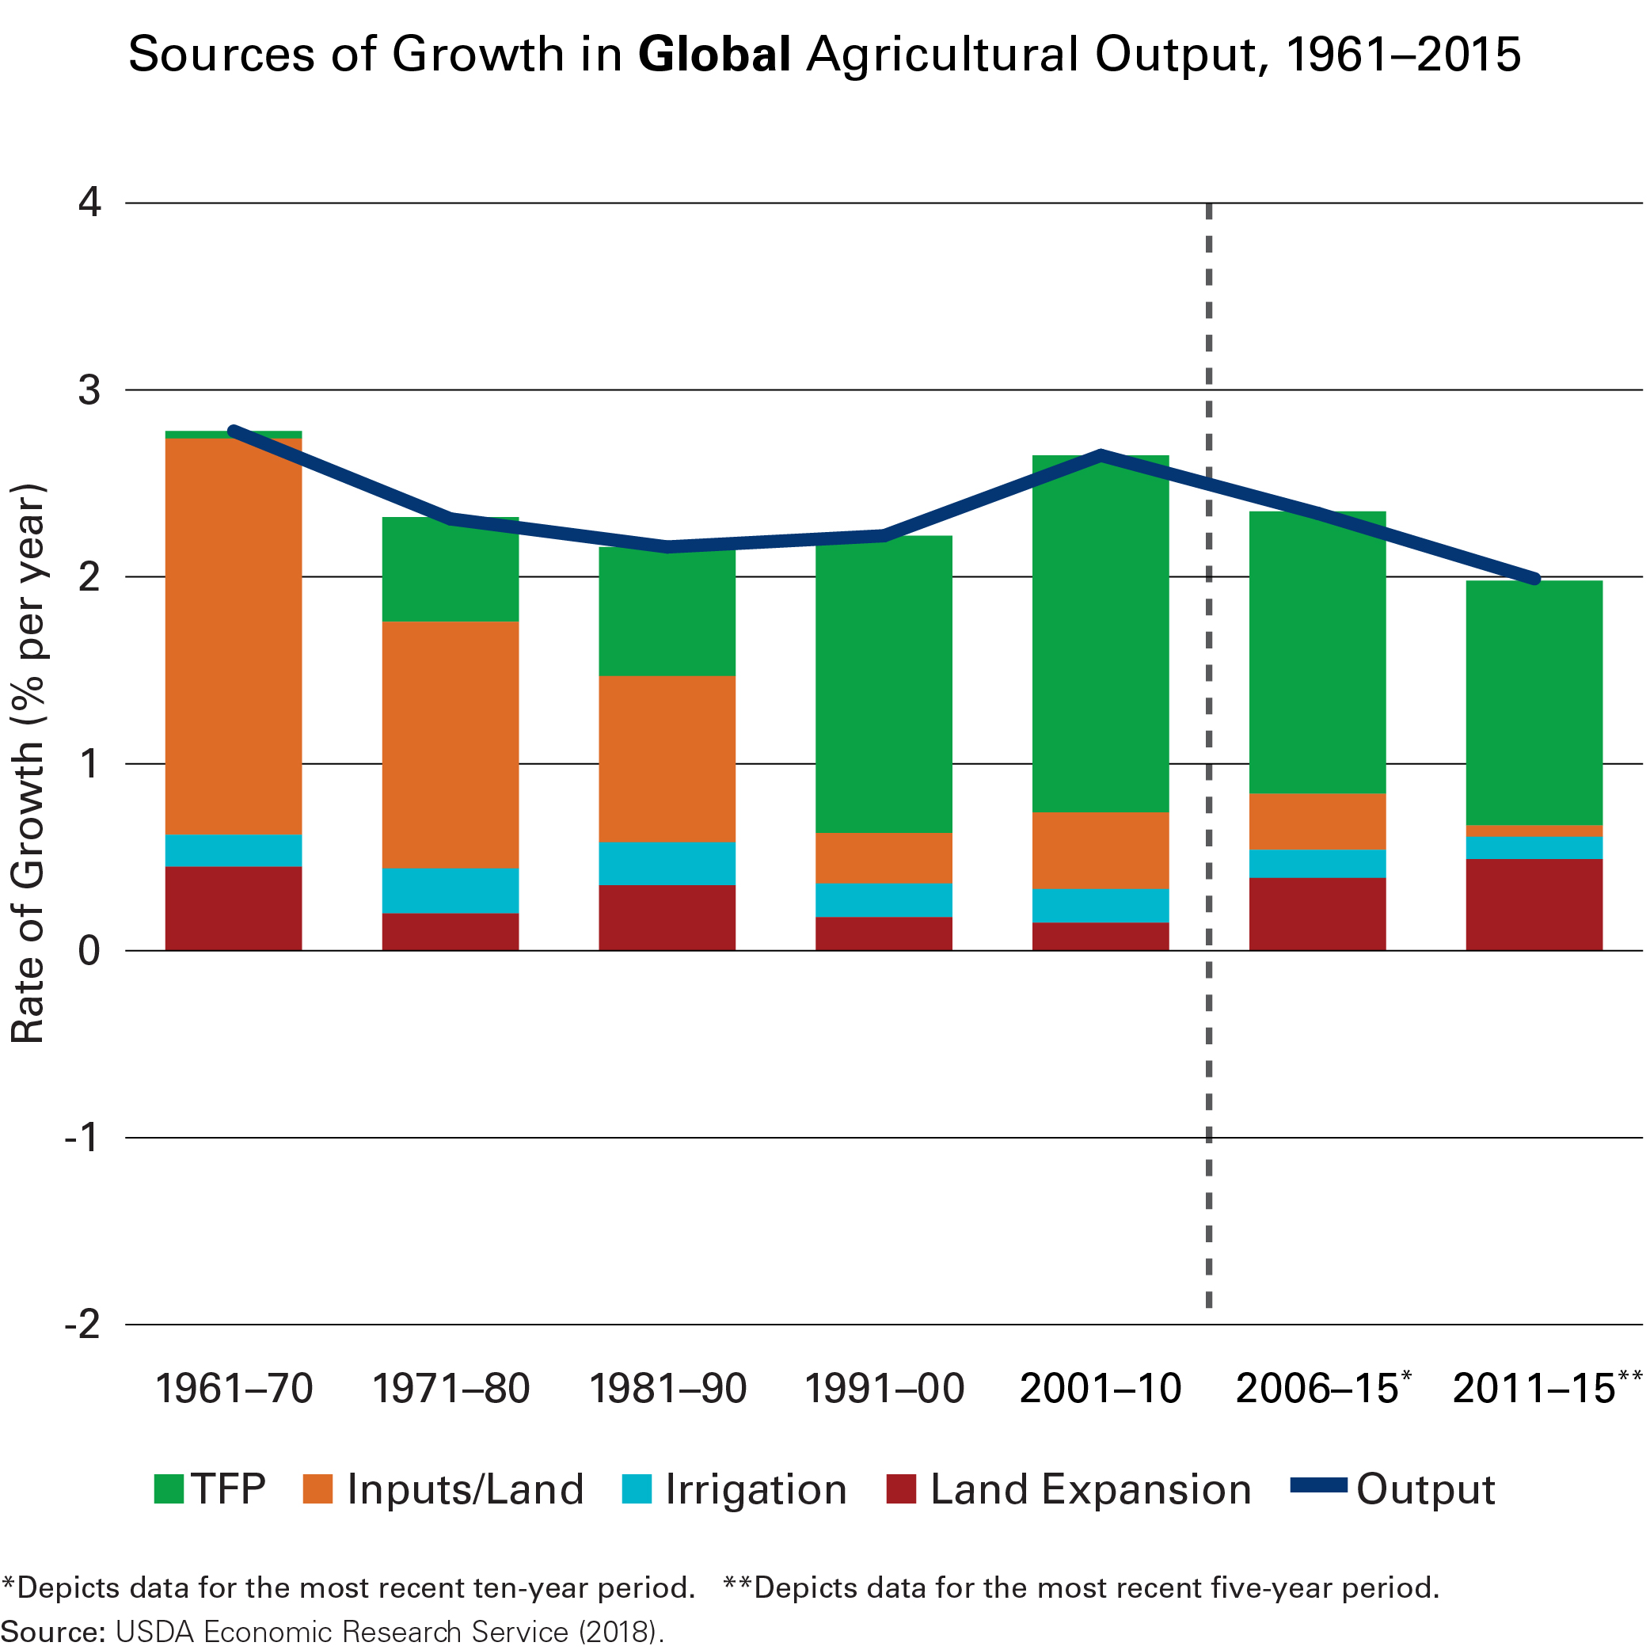
Sources of Growth in Agricultural Output
GLOBAL
Notes:
Here we can see how each of these different strategies have contributed to agricultural output over time.
The Green Revolution in the 1960s brought high-yielding seeds and other inputs to millions of farmers. Indicated by the orange bar. As farmers began using these inputs more efficiently, productivity becomes the driving force of agricultural output- as you can see with the green bar.
You will notice that the most recent data show productivity’s contribution to output is declining, while there has been an increase in land expansion.

Slide 15
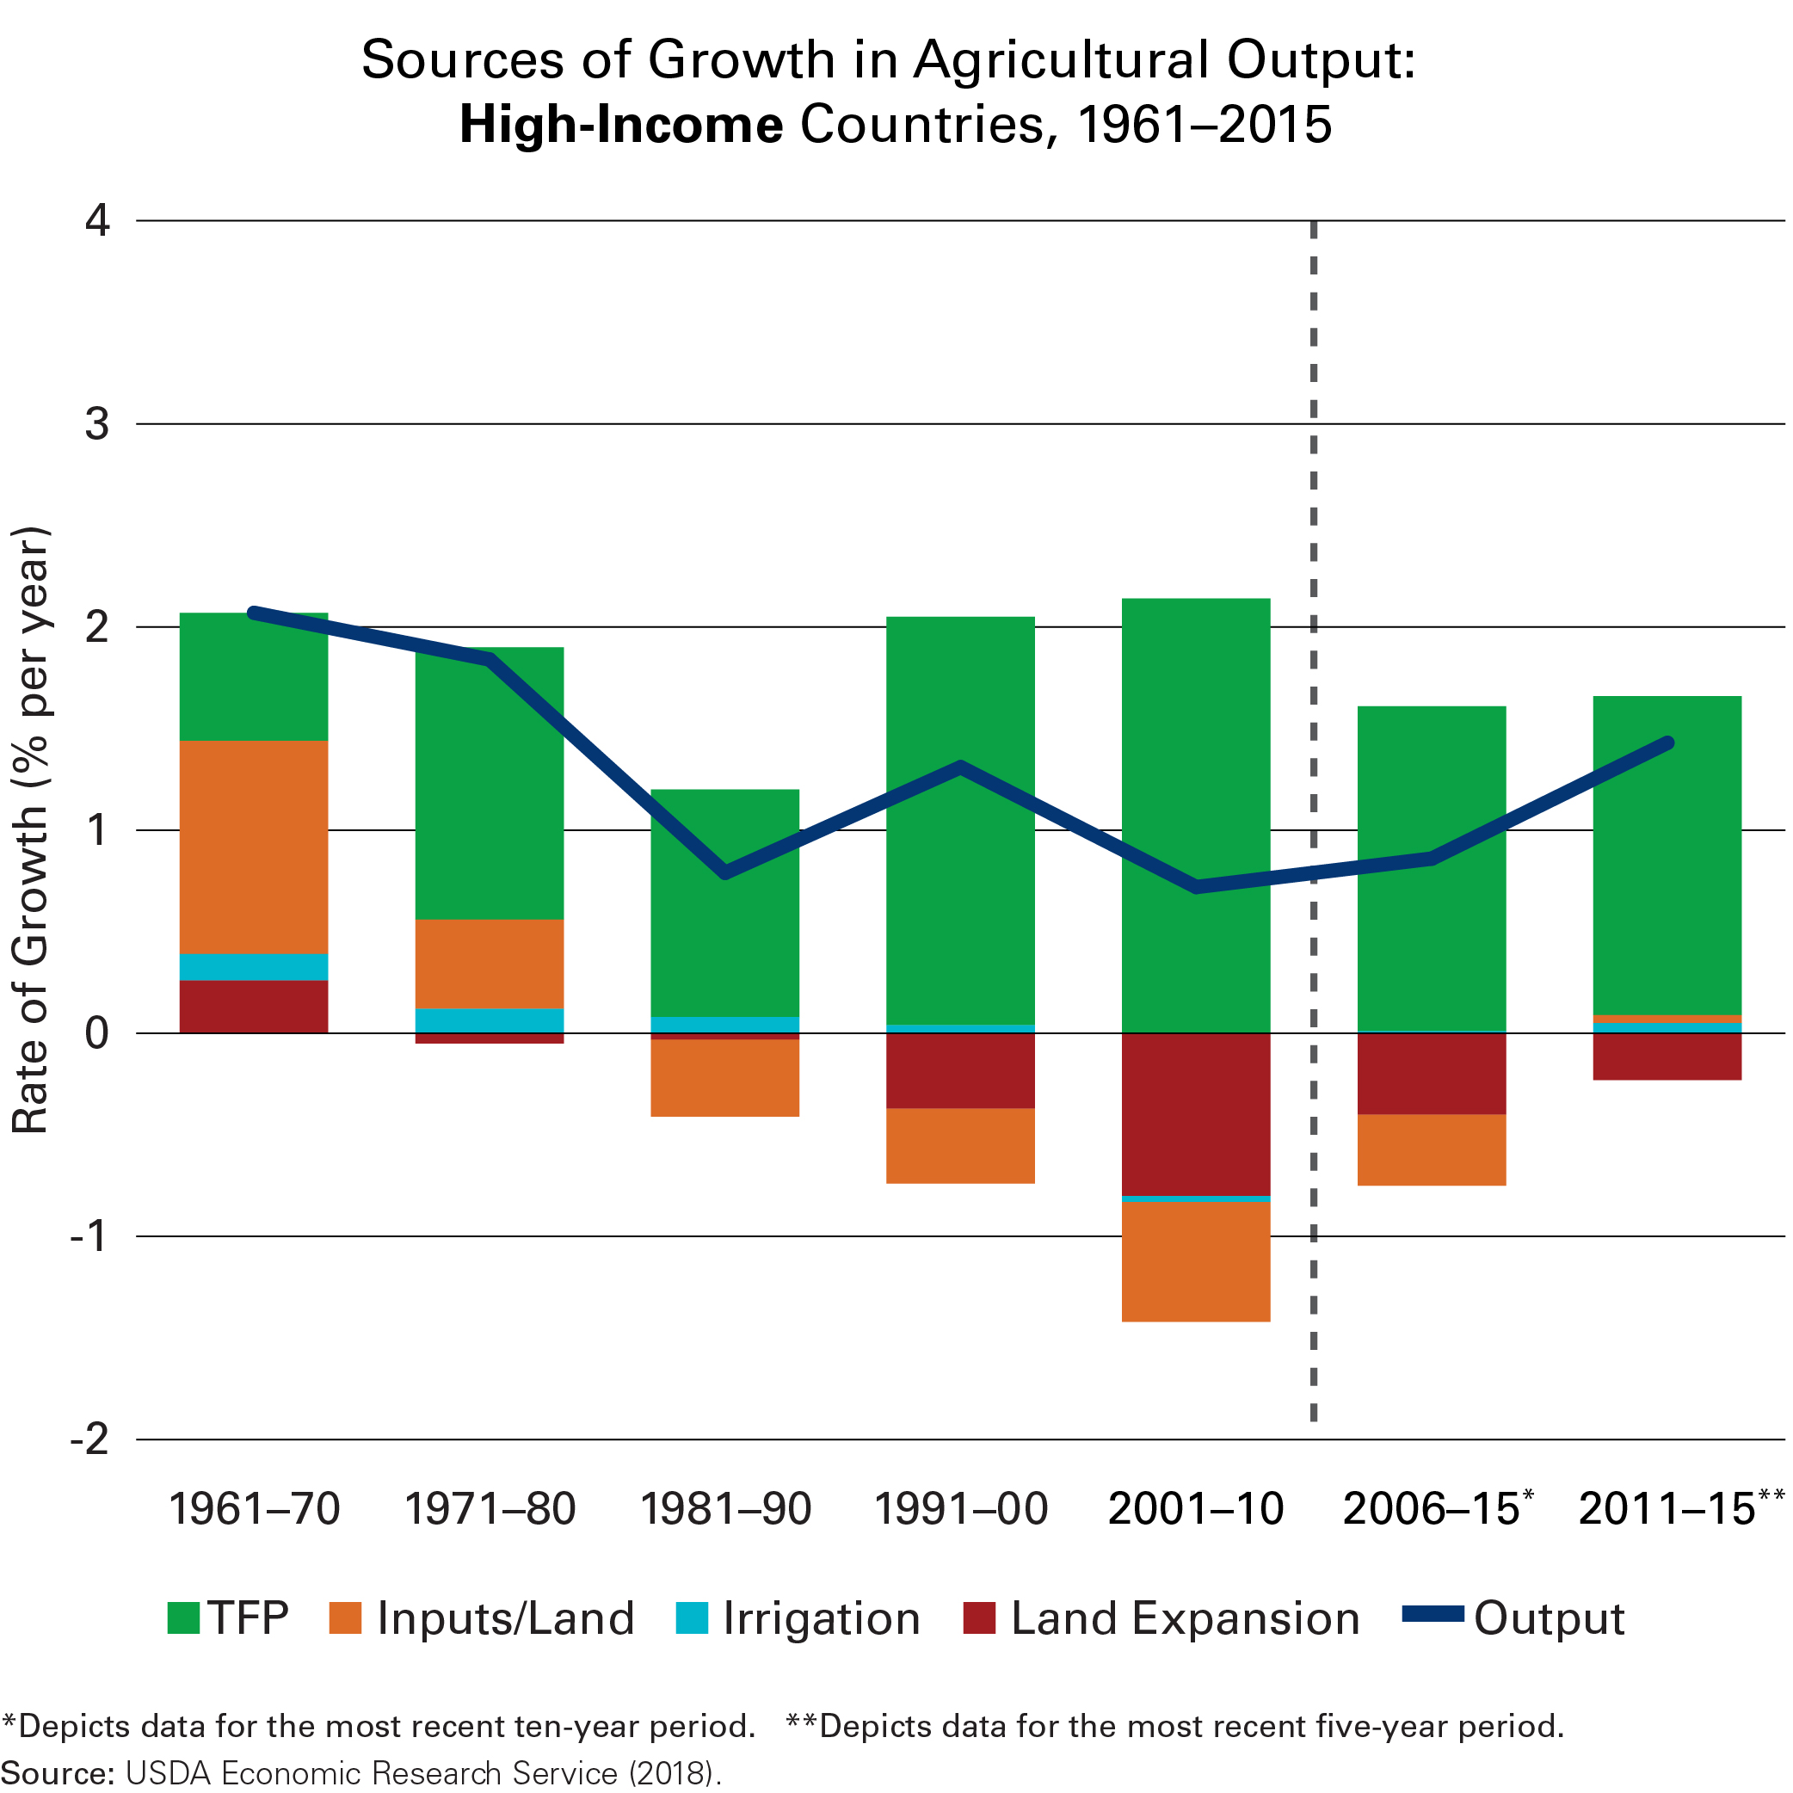
Sources of Growth in Agricultural Output
HIGH-INCOME
Notes:
In high-income countries, all agricultural output can be attributed to increases in productivity.
At the same time, land and labor have been taken out of agricultural production and put into conservation or to other productive uses.

Slide 16
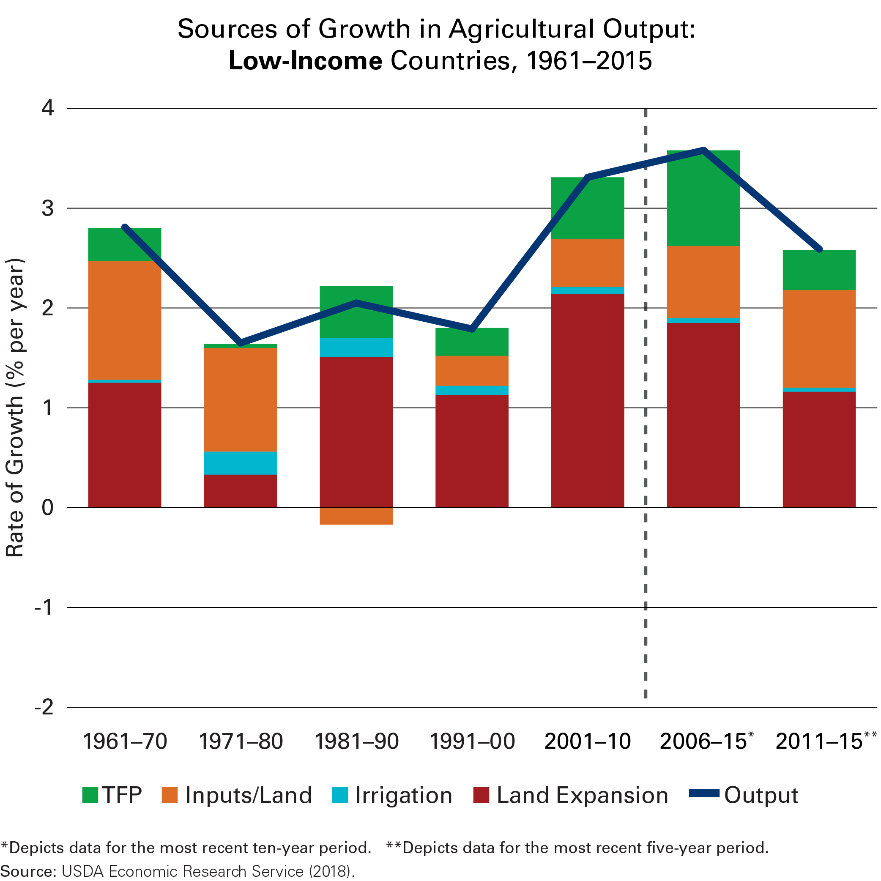
Sources of Growth in Agricultural Output
LOW-INCOME
Notes:
Low income countries have seen strong growth in productivity and agricultural output.
Nevertheless, opening up new land for agricultural production is still the primary source of output in these countries (as you can see from the red bar.)
While some land is suitable for agricultural expansion, greater productivity on existing cultivated land needs to be prioritized if we are improve agricultural sustainability.
You can find out more about the productivity trends in the U.S., China and sub-Saharan Africa on the GAP Report website.

Slide 17
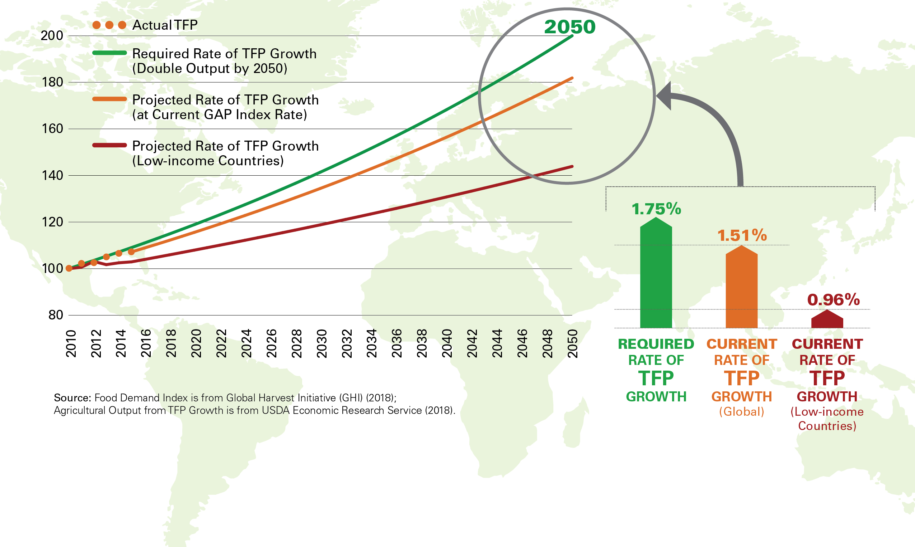
TRACKING PRODUCTIVITY: THE GAP INDEX™
Notes:
GHI has estimated that to sustainably meet the demands of 2050, agricultural productivity must grown by an average annual rate of 1.75 percent.
For the fifth year in a row, we have been below that target. While the difference may seem small, that gap widens over time.
We are particularly concerned about the rate of productivity growth in low income countries.
Over the last four years, the rate of TFP growth in low income countries has declined and unless this trend is reversed, we will struggle to meet the Sustainable Development Goals for food security, nutrition and poverty reduction, among others.

Slide 18
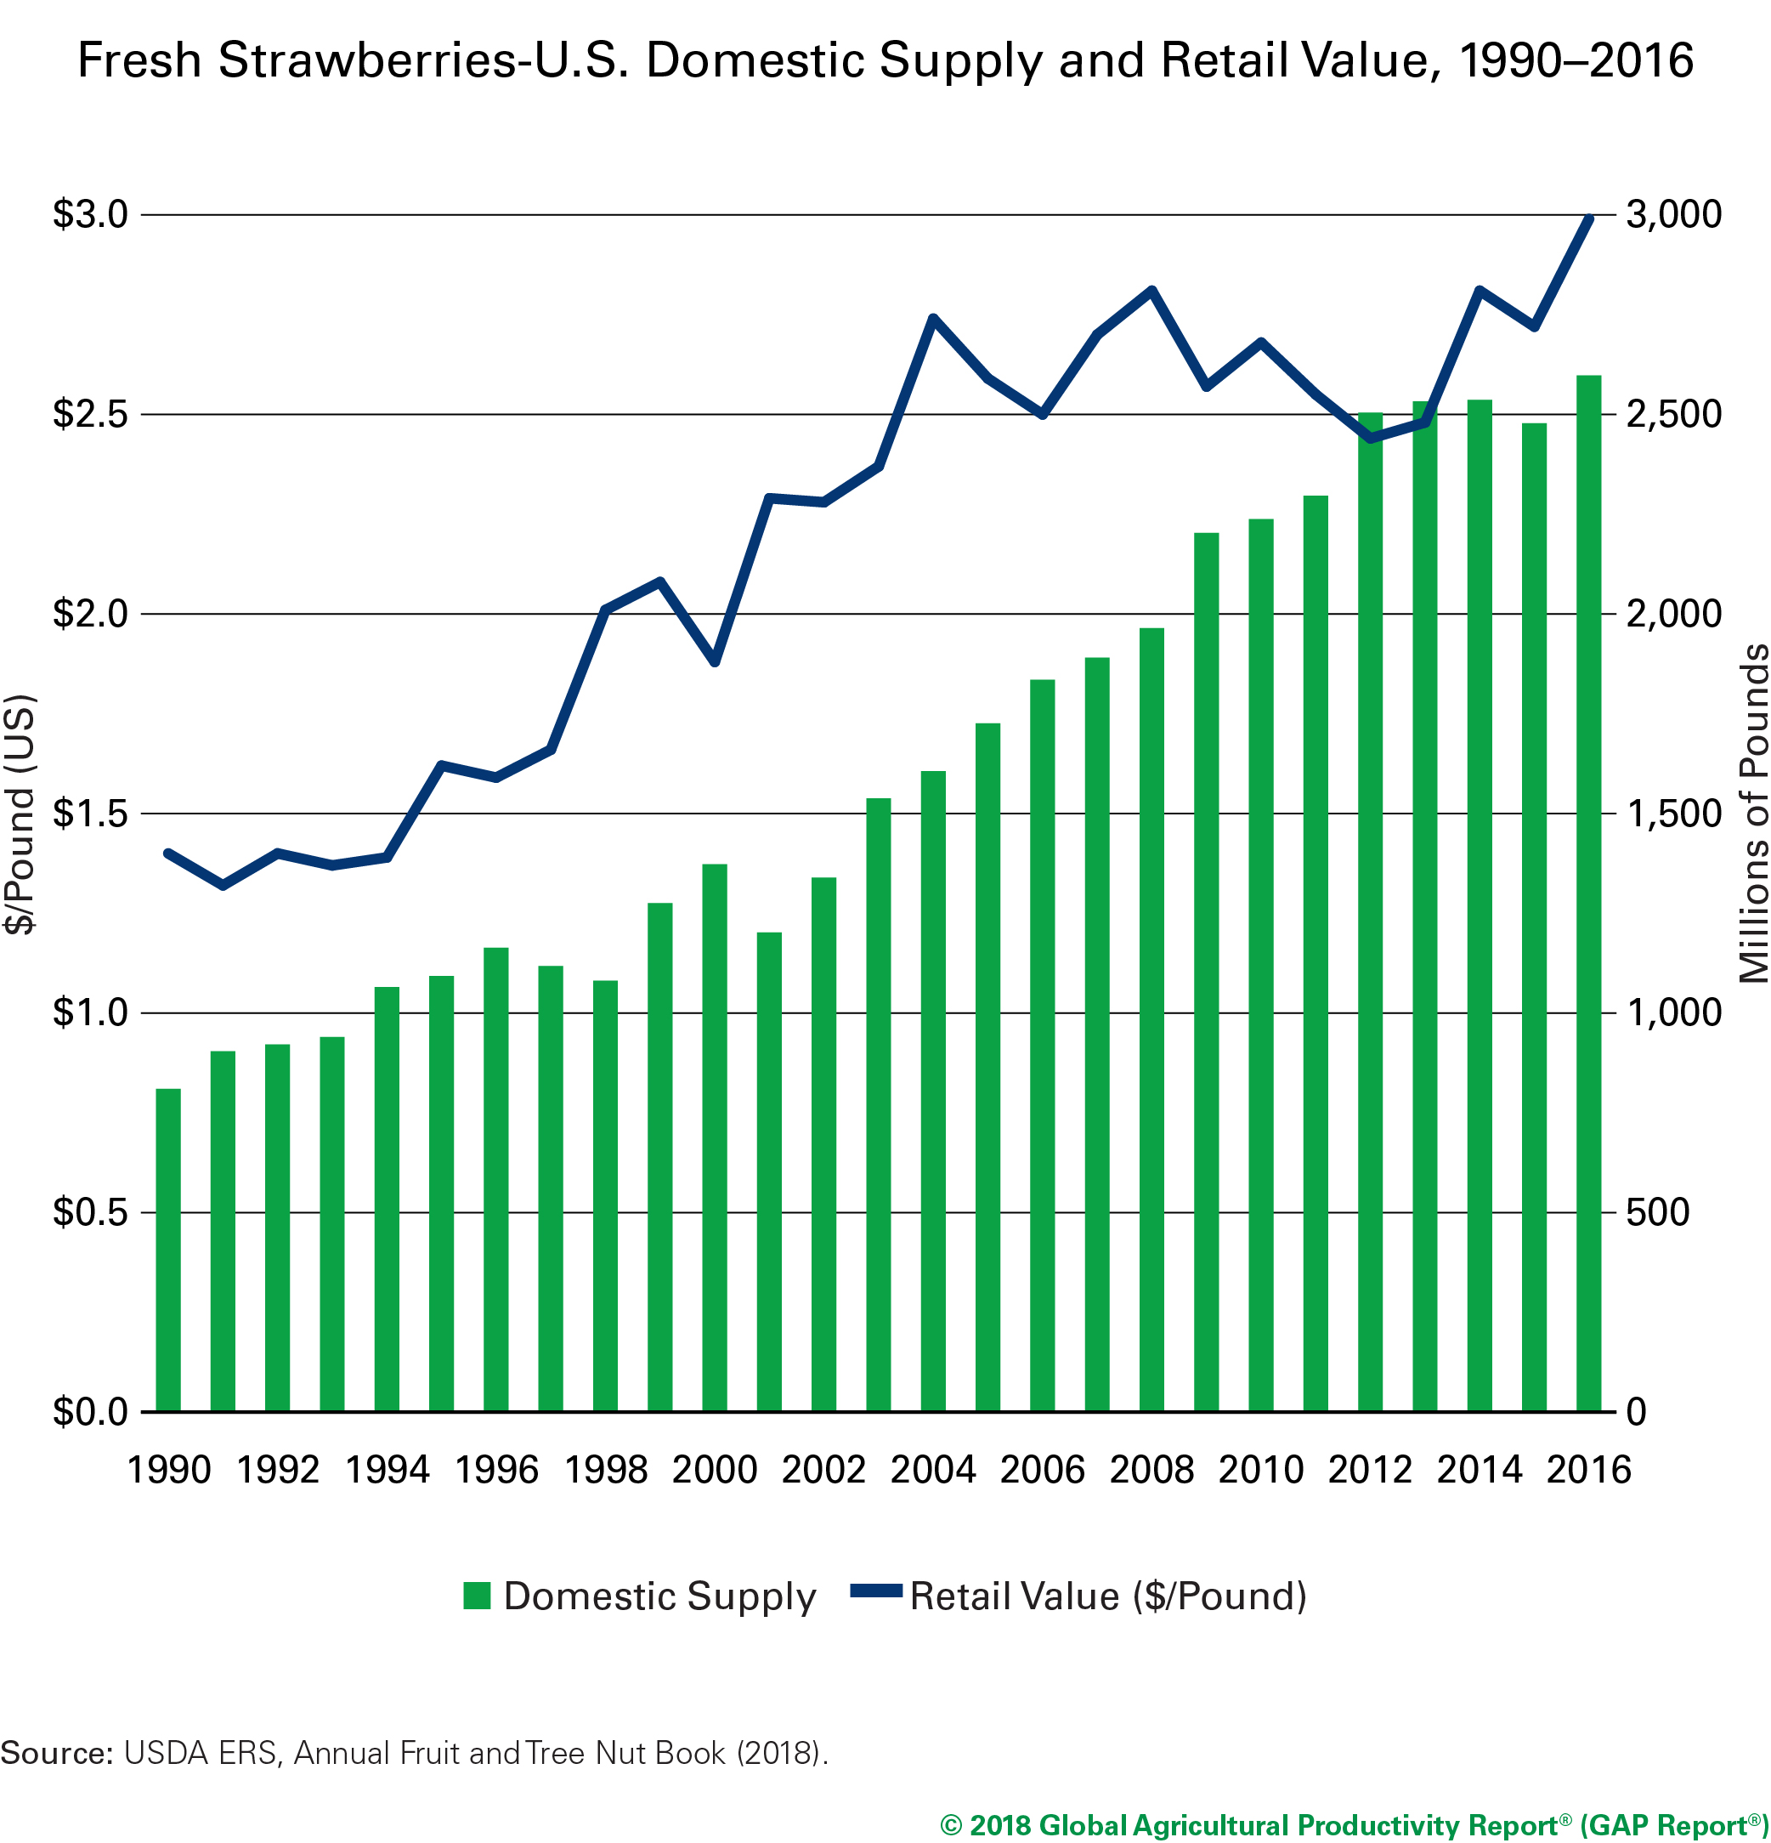

Productivity
for Nutrition
Notes:
Why is productivity important for consumers? One of the ways consumer benefit from productivity growth is through lower food costs.
This is especially important at a time when consumer demand for nutritious foods, such as fruits and vegetables, is rapidly rising. For example, since 1990, the domestic supply of fresh strawberries in the U.S. has tripled. At the same time, the per capital consumption of strawberries has quadrupled. This tremendous increase in consumption has kept prices high, even with the huge boost in supply.
Increasing the productivity of fruit and vegetable production can help bring these prices down, even as demand increases. At the same time, developing fruit and vegetable varieties that have higher nutrient content, better taste and longer shelf will encourage healthier eating.
Today scientists are using a range of traditional and advanced breeding techniques to improve the nutrition of fruits, vegetables and other crops. The recent commercialization of broccoli with high levels of phytonutrients that help reduce the risk of heart disease is an example how agricultural innovation brings direct health benefits to consumers.

Slide 19
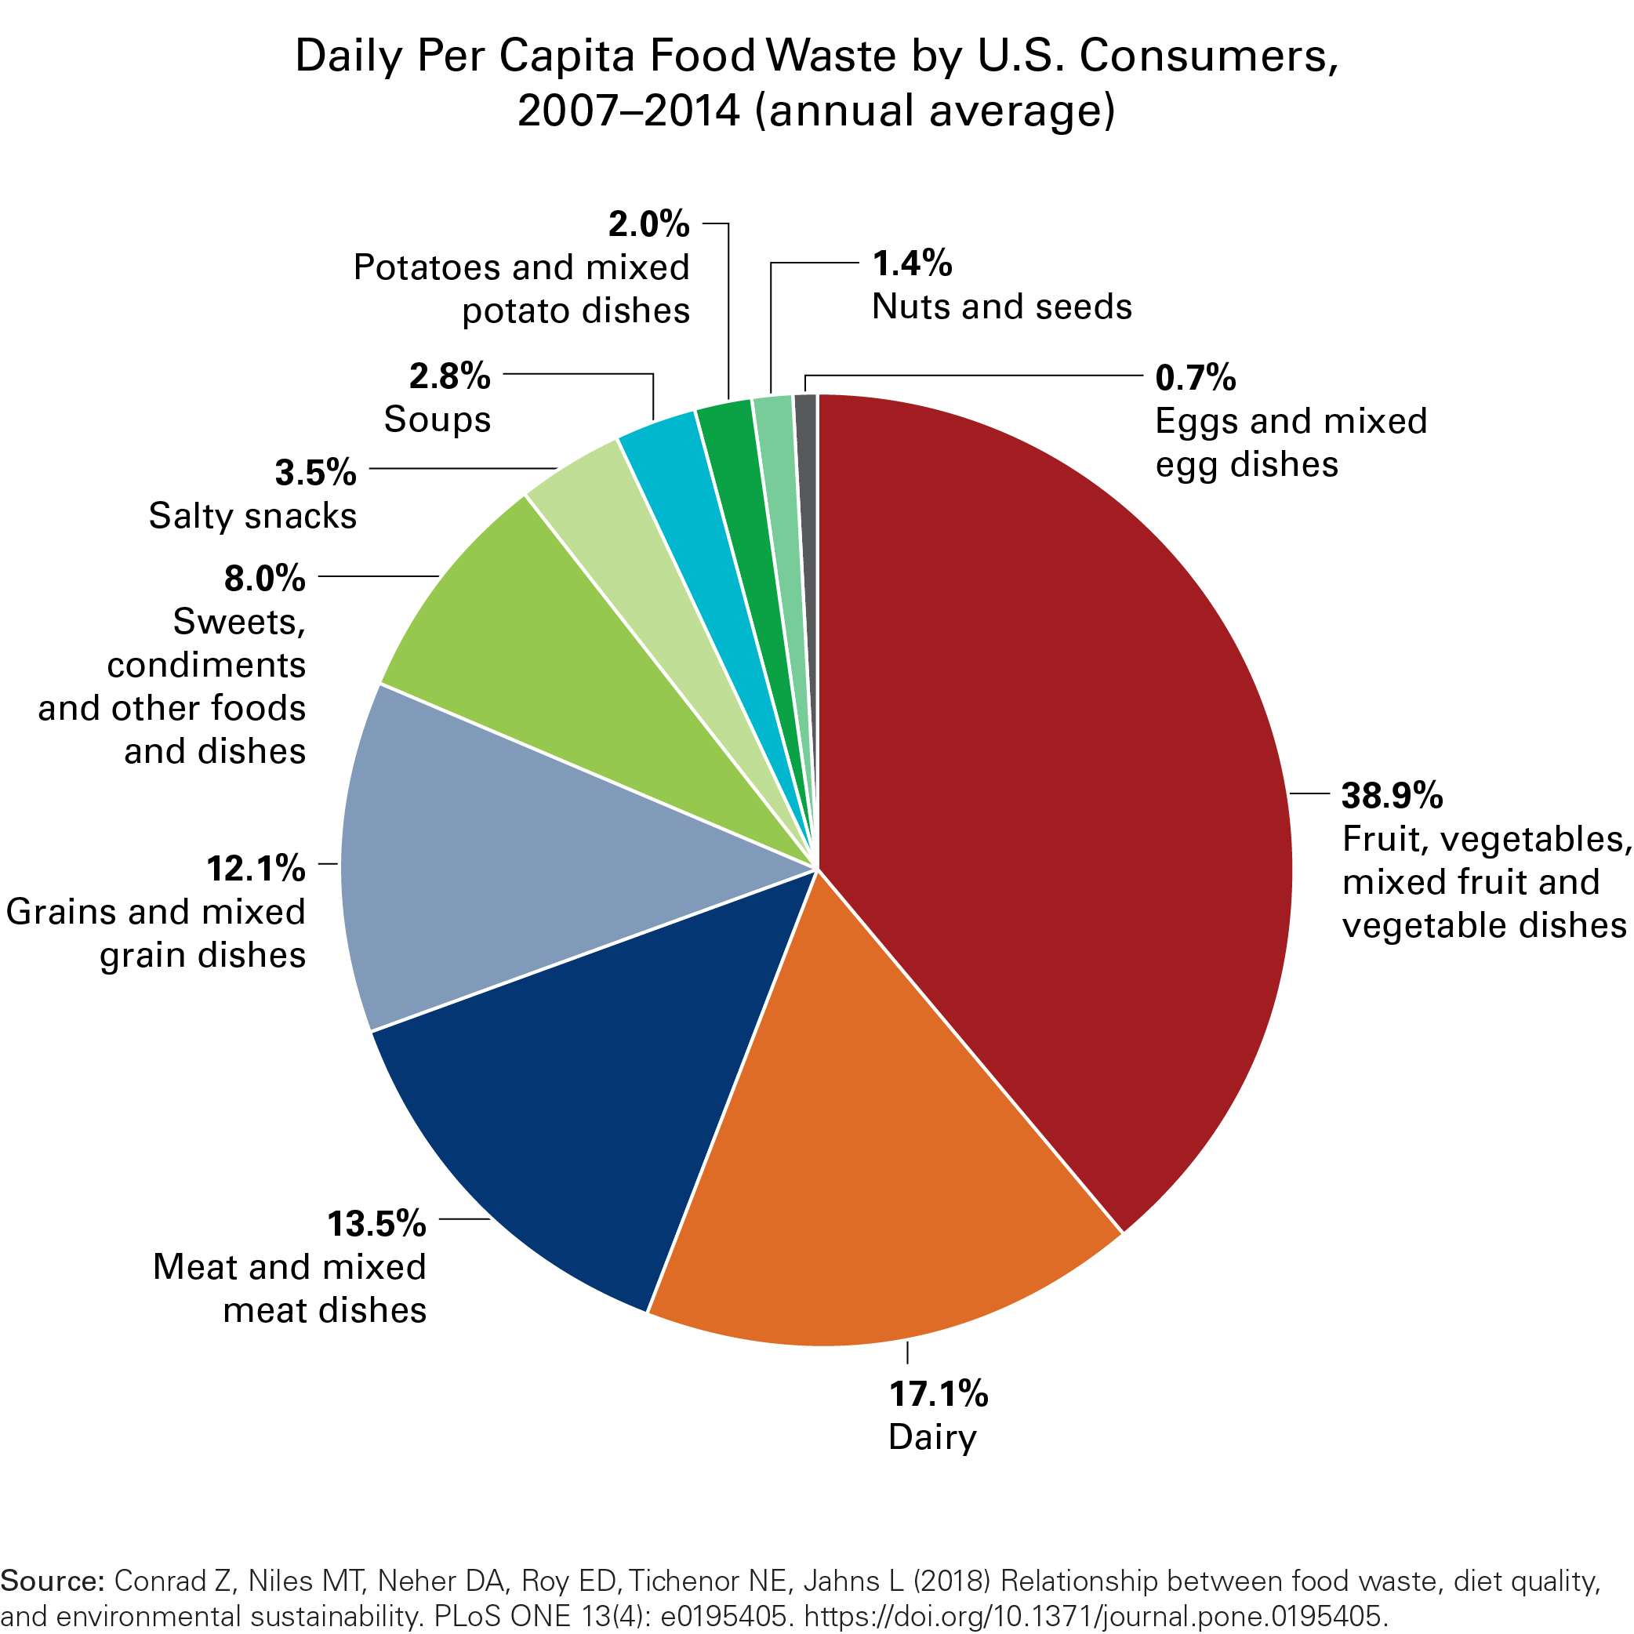
FOOD WASTED = NUTRIENTS
LOST
Notes:
Improving the productivity and lowering the cost of nutritious foods is only part the strategy for achieving healthy sustainable food systems.
Nutrient dense foods are the most like to spoil quickly and end of in the trash can. Fruits and vegetables, dairy products and meat account for 70 percent of the food waste in the U.S. That is a lot of nutrients that are never consumed and end up our landfills.

Slide 20
FOOD WASTED = PRODUCTIVITY LOST
AGRICULTURAL INPUTS AND RESOURCES USED TO PRODUCE WASTED FOOD (U.S.)
Cropland | 30 million acres
Irrigation Water | 4.2 trillion gallons
Pesticide | 780 million pounds
Fertilizer (Nitrogen, Phosphorus, Potash) | 5.6 billion pounds
Notes:
When food is wasted, we also waste the resources that were used to produce it. To produce the food that is wasted in the US in one year, you would need 30 million acres of cropland (10 percent of the cropland in the U.S.) and 4.2 trillion gallons of irrigation water (most of which would be used to produce fruits and vegetables.
Reducing food waste is critical to the sustainability of our food and agriculture systems, as well as to improving diets and health.

Slide 21
TRANSFORMING FOOD AND AGRICULTURE
CONSUMERS
ENVIRONMENT
PRODUCERS
Notes:
The GAP Report contains some great examples of how consumers, producers, researchers, NGOs, and the public and private sectors are working together to make our food and agriculture systems healthy and sustainable.
To share some of these stories with you, I invite Natali Archibee of the Mosaic Company to come to the stage.
[Natali]
One of the strengths of the GAP Report is its use of case studies to personalize the importance of agricultural productivity and sustainability.
There are nearly 20 stories in the online GAP Report showcasing global efforts to make our food and agriculture systems healthier, more productive and sustainable.
I am pleased to be sharing a few of those stories with you today.

Slide 22

HARVESTING ZINC FOR HEALTHY
SOILS, CROPS & PEOPLE
Addressing zinc deficiency, a form of “hidden hunger”
Promoting agronomic biofortification & soil fertilization of staple grains
Doubled zinc levels in harvested grain
The Mosaic Company
HarvestPlus
Notes:
Zinc deficiency is a devastating form of malnutrition, or hidden hunger. Globally, half of the children under the age of 5 do not get enough zinc in their diets. This can cause cognitive and physical underdevelopment and suppress the immune system.
Zinc deficiency rates are highest in rural areas of developing countries. Here, small-scale farmers grow and consume cereal grains, such as maize, wheat or rice, that have very low levels of zinc.
The Mosaic Company is one of the private-sector, foundation and university supporters of the HarvestZinc, a project by HarvestPlus, that has identified a method for fortifying cereal crops through zinc fertilization.
The project conducted field trials over nine years in 12 countries. They found that spraying a fertilizer containing zinc on plants toward the end of the growing processes doubled the zinc concentration in the harvested grain. Adding a fertilizer containing zinc to the soils can improve the plant’s ability to retain zinc, as well as improve crop yields.
Zinc fertilization is a rapid, effective solution to reducing zinc deficiency, especially for small-scale farmers who grow their own food. Combing this technique with biofortified seed technologies could amplify the benefits of both approaches.

Slide 23
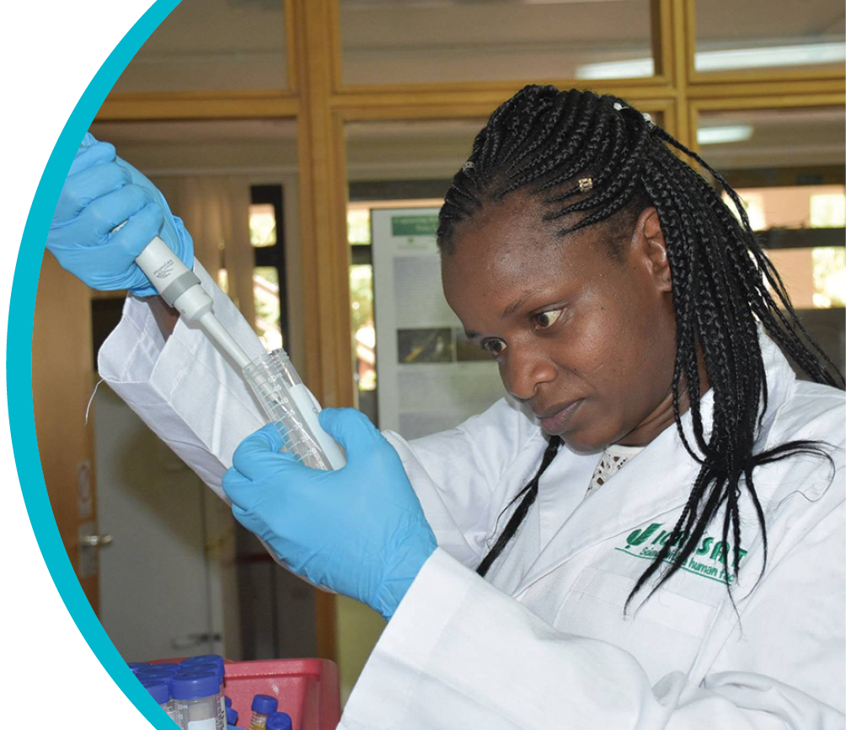
A NEED FOR SEEDS AND
SEED SYSTEMS
Improving micronutrient content of sorghum and millet
Strengthening research capacity through partnership
Tailoring seed systems for small producers
Corteva Agriscience™
ICRISAT
Notes:
For one billion people, sorghum and millets are culturally accepted staple foods. These crops are well-suited to the drylands of India and Africa, giving small-scale farmers three or four growing season a year.
While these crops are important sources of food, particularly for poor farmers, they do not provide enough micronutrients, such as iron, zinc and vitamin A.
A multi-year partnership between the International Crops Research Institute for the Semi-Arid Tropics, or ICRISAT, and Corteva Agriscience, the agriculture division of DowDuport, will invest in improving the productivity and nutritional content of these crops.
Corteva is providing advanced plant breeding tools like CRISPR-Cas, as well as its intellectual property and scientific infrastructure. ICRISAT will work the national agricultural research institutions in Africa and India to identify sorghum and millet varieties that can be customized for local farmers.
Developing a seed production and distribution system for these new varieties will make sure these seeds get to the farmers who need them.
We will hear more about this partnership during our panel discussion today.

Slide 24

MECHANIZATION IS A PATH
TO PRODUCTIVITY
Expanding affordable mechanization services for small producers in Nigeria
Creating access to commercial markets
100,000 farmers will benefit
John Deere
Tata Group
Alluvial
Notes:
Nigeria is the largest rice producer in Africa, but the domestic demand for rice is so high, that the country must import millions of tons of rice each year.
One of the reasons for this gap between domestic production and consumption is that most of Nigeria’s farmers are operating at very small scales and they don’t have access to technologies that could help them produce more on their small parcels of land, for example, mechanization.
Alluvial, a Nigerian company that works with small-scale farmers, and John Deere through its distributor Tata Group, formed a partnership to lease up to 300 tractors that will be used by 100,000 small-scale farmers in the Niger Delta region.
Through this partnership, Alluvial’s farmers will be able to rent a tractor to plow, harrow and harvest their crops for about $100 for the season.
We will learn more about how mechanization and precision technologies are transforming agriculture in our discussion today.

Slide 25

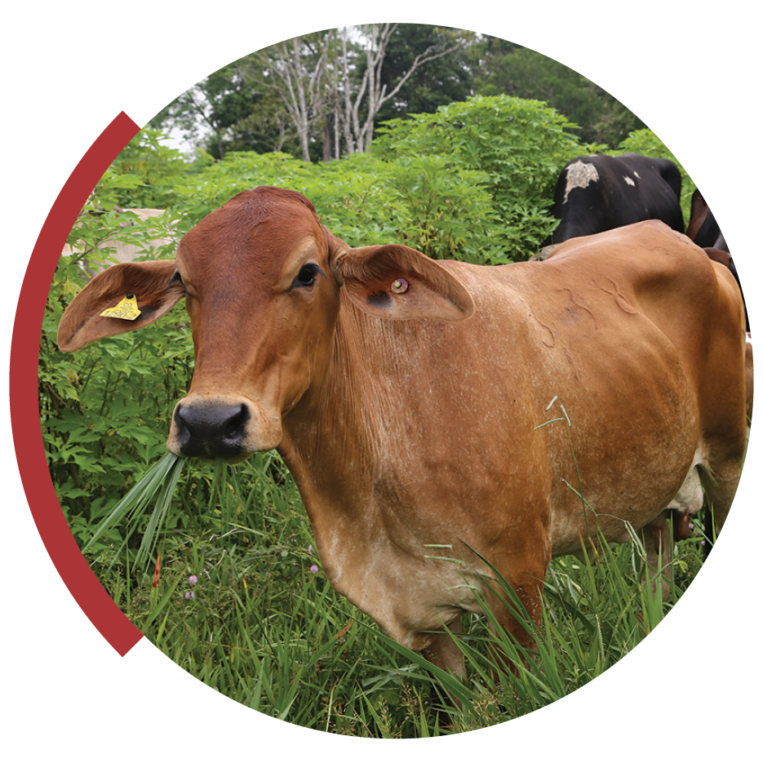
MOOVE OVER COWS;
GOATS GOT MY DAIRY!
A MODEL FOR HEALTHY AG SYSTEMS
IICA
THE NATURE CONSERVANCY
Notes:
The online GAP Report contains great stories from many of our consultative partners. These organizations work with farmers and consumers around the world to transform our agriculture and food systems. I will mention a few before we turn to our panel discussion.
The Trinidad and Tobago Goat and Sheep Society has developed a goat-milk product value chain for small-scale farmers with technical assistance from the International Institute for Cooperation on Agriculture (IICA).
The Nature Conservancy and its partners are helping Latin American farmers of all scales adopt practices that repair the land and sequester carbon, while increasing their productivity and profitability.

Slide 26
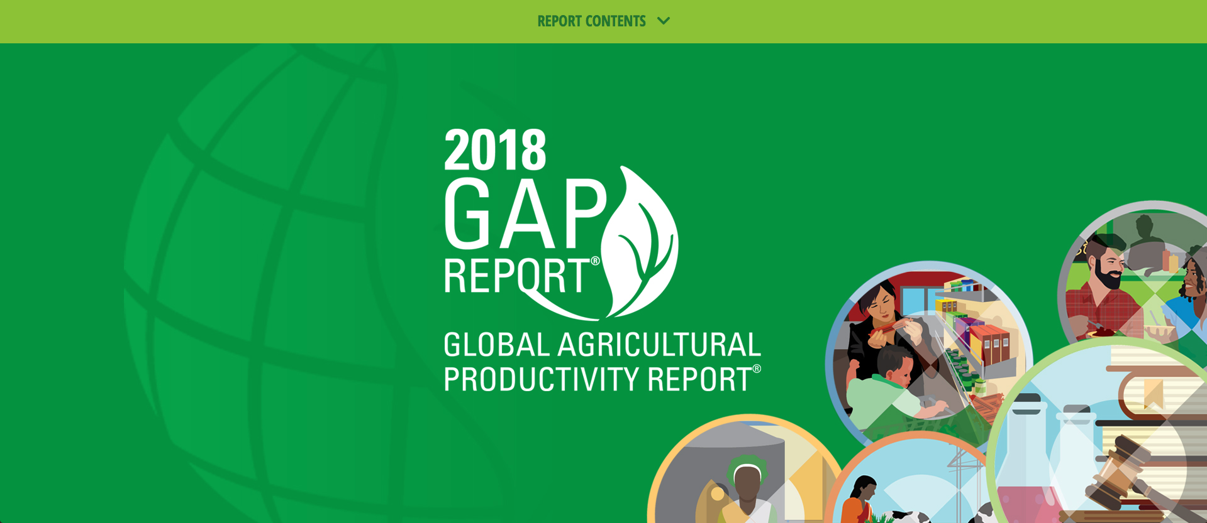
GAP REPORT® GOES DIGITAL!
www.GlobalAgriculturalProductivity.org
Notes:
[invite Ann to the stage]

