Slide 1
CS 6604 Middle Term Report
Computational Linguistics PJ
-Explore Correlation between
Newswires and Twitter
Client:Mohamed Magdy Farag
by Tianyu Geng, Wei Huang, Ji Wang, and Xuan Zhang
March, 6th, 2014
Blacksburg, VA

Slide 2
Table of Contents
Introduction
Solution
Progress

Slide 3
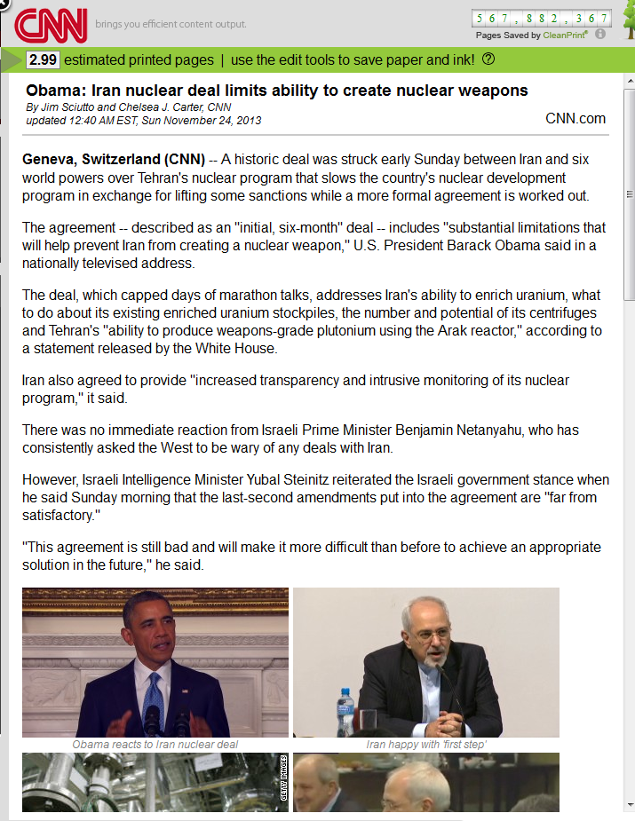
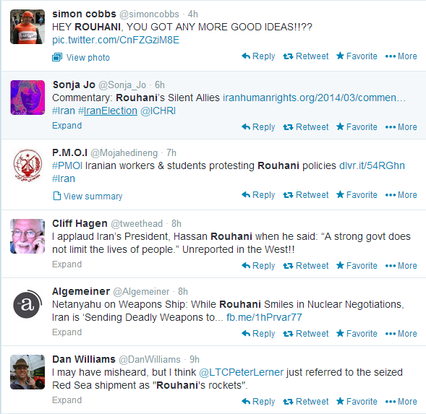
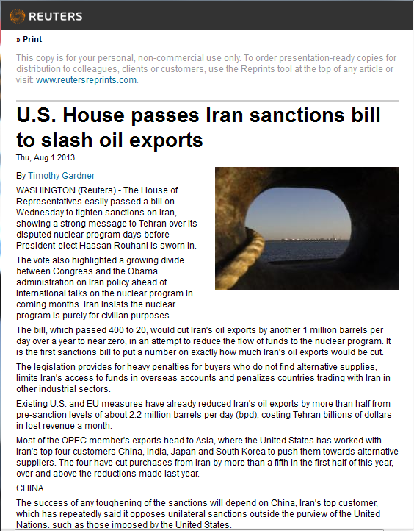

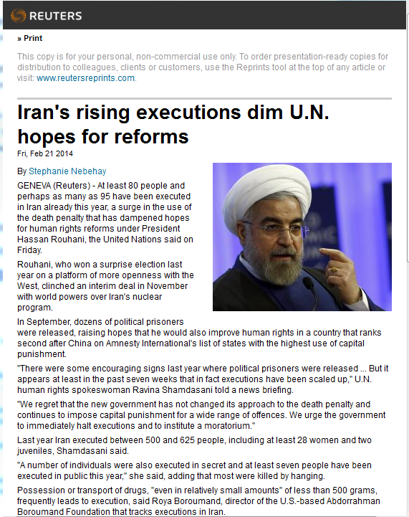
Problem to Solve
Motivation: Much news, much tweets, little connection…
Key points in news?
Relation between news & tweets?
Major attitudes of audience?
Mainstream News
Tweets
1. Summarize info in news and tweets
2. Explore correlation between news & tweets
3. Mine opinions in tweets
Objects:

Slide 4
Solution Overview
Fetch text from news & tweets respectively
Preprocess texts: stemming, stop-word…
Extract events from news
Event: [Topic, Named entities(who, what, where, when)]
Map tweets to events (correlation model)
Mine major opinions around events

Slide 5






Solution: Link Tweets to Events
Event 1
Topic
Who
What
When
Where
Pre-processor
Pre-processor
LDA
NER
Event 2
NER
Correlation analyzer
Topic
Who
What
When
Where

Slide 6
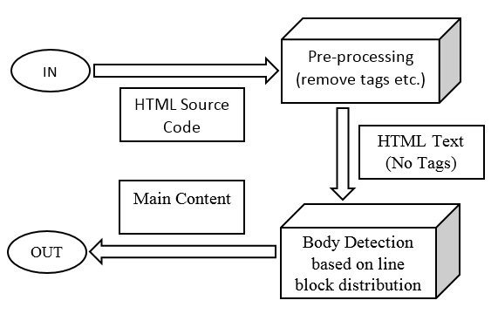
Progress: Text Extraction
Notes:
[ Automatic Text Extraction ]
Fast - Linear time complexity
General - No customized rules
Effective - Over 90% accuracy rate
Simple and Intuitive !
[ Premise behind the Algorithm ]
Webpage's body is text-dominated that contains relatively fewer tags
The body-related source codes are physical neighboring

Slide 7
Progress: Tweets Analysis
We ran LDA on a sample of the #Iran collection from IDEAL
50,000 tweets
Feb 13, 2013 23:58:30 ~ Feb 15, 2013 00:00:03
4 topics
Topic 0
P Keyword
0.028 nuclear
0.018 weapons
0.015 iranian
0.011 stop
0.010 menlu
0.008 iran
0.008 executions
Topic 1
P Keyword
0.027 iran
0.019 time
0.015 now
0.013 opposition
0.012 u
0.012 feb
0.011 seeking
Topic 2
P Keyword
0.018 iran
0.017 via
0.012 2help
0.011 killed
0.010 sanctions
0.009 syria
0.009 guards
Topic 3
P Keyword
0.054 camp
0.053 liberty
0.020 never
0.015 martin
0.014 kobler
0.013 mr
0.012 adequate

Slide 8




Progress: News Analysis
Tools: GibbsLDA, Stanford NLP
Dataset:
1) 2762 news about “Iran Election”.
--Only news titles used for topic modeling
2) News articles from CTRnet PJ
Event 1
Iran
Who: Obama
Sanction
What: N/A
Obama
When: N/A
News Articles
warn
Where: Iran
Event 2
UN
Who: UN
Pre-processor
urge
What: N/A
LDA
human
When: N/A
HTML Parser
right
Where: Iran
Text Extractor
NER
Iran

Slide 9
Future Work: Opinion Mining
Event 1
Event 1
Who
Opinion 1
Topics
Opinion 2
What
When
…
Where
Opinion N
Opinion Mining
Event 2
Event 2
Who
Opinion 1
Topics
Opinion 2
What
When
…
Where
Opinion M

Slide 10
Appendix

Slide 11
Literature Review
Analysis between Tweets and News Articles
Fact: News providers report events earlier, but Twitter contains more details
Algorithm: LDA, cosine similarity, sentiment analysis
Summary based on Templates
Systems: SUMMARIST, Artequakt, etc.
Topic signature is used for selecting summarizing sentences
Using Apple Pie Parser, GATE and WordNet for knowledge extraction

Slide 12
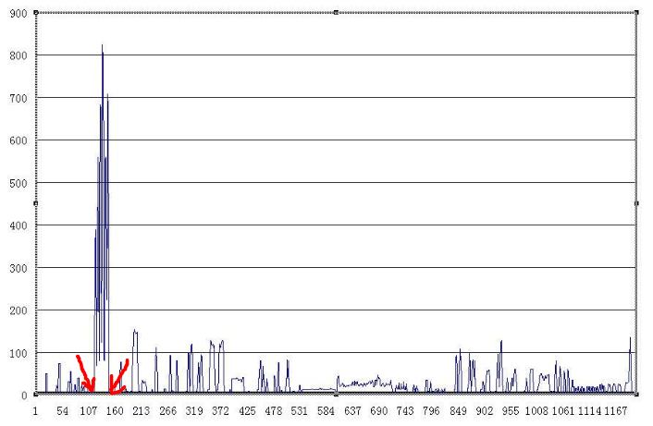
The Characteristics of HTML

Slide 13
Reference
[1] Petrovic S, Osborne M, McCreadie R, et al. Can twitter replace newswire for breaking news[C]//Seventh International AAAI Conference on Weblogs and Social Media. 2013.
[2] Balahur A, Tanev H. Detecting Event-Related Links and Sentiments from Social Media Texts[J]. ACL 2013, 2013: 25.
[3] Lobzhanidze A, Zeng W, Gentry P, et al. Mainstream media vs. social media for trending topic prediction-an experimental study[C]//Consumer Communications and Networking Conference (CCNC), 2013 IEEE. IEEE, 2013: 729-732.
[4] Introne J E, Drescher M. Analyzing the flow of knowledge in computer mediated teams[C]//Proceedings of the 2013 conference on Computer supported cooperative work. ACM, 2013: 341-356.
[5] Hovy E, Lin C Y. Automated text summarization and the SUMMARIST system[C]//Proceedings of a workshop on held at Baltimore, Maryland: October 13-15, 1998. Association for Computational Linguistics, 1998: 197-214.

Slide 14
Reference
[6] Lin C Y, Hovy E. The automated acquisition of topic signatures for text summarization[C]//Proceedings of the 18th conference on Computational linguistics-Volume 1. Association for Computational Linguistics, 2000: 495-501.
[7] Luhn H P. The automatic creation of literature abstracts[J]. IBM Journal of research and development, 1958, 2(2): 159-165.
[8] Alani H, Kim S, Millard D E, et al. Automatic ontology-based knowledge extraction from web documents[J]. Intelligent Systems, IEEE, 2003, 18(1): 14-21.
[9] El Hamali S, Nouali O, Nouali-Taboudjemat N. Knowledge extraction by Internet monitoring to enhance crisis management[R]. CERIST, 2011.

