Slide 1
CS4624S13P-Environment/VWRRC
Ben Katz (bakatz@vt.edu)
Eric hotinger (erichot@vt.edu)
Blacksburg, VIRGINIA. CLASS: CS 4624 @ VIRGINIA TECH, CLIENT: VWRRC, DATE CREATED: 5/1/2013.

Slide 2
Summary of Work
Document Extraction
Document Parsing
Website Parsing
VTechWorks Configuration
VTechWorks Upload
VWRRC Website Advice

Slide 3
Document Extraction
Extracted 394 documents from the Virginia Water Resources Center (VWRRC) using DownThemAll
  Conference Proceedings, Bulletins, Special / Educational Reports, and Newsletters dating back to the 1970’s

Slide 4
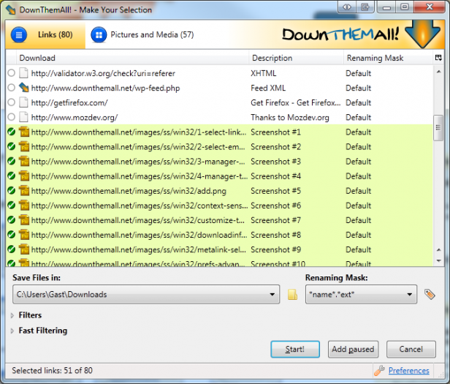
Document Extraction (cont.)

Slide 5

Document Parsing
Parsed each PDF document for tags
  Apache PDFBox for PDF -> Text conversion
  OpenCloud for generation of tags

Slide 6
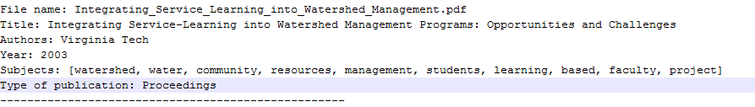
Document Parsing: Output

Slide 7
Website Parsing
Parsed website to obtain metadata about each publication
  Used JSoup along with regular expressions (Pattern class in Java) to alleviate the pain of parsing HTML
Involved splitting a list of authors like “Bob and Jane” by the regexp “and” to obtain an author list with “Bob” as the first element and “Jane” as the second element.
  Simple example, but involved more complicated regexps because of non-uniform data

Slide 8
VTechWorks Configuration
Programatically generated xml configuration documents for each publication, in preparation for upload to VTechWorks
  Involved cleaning of titles and citations to fit VTechWorks quality assurance requirements

Slide 9

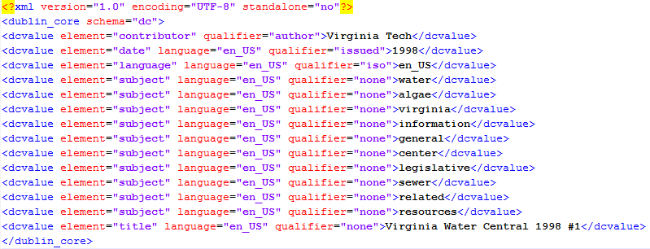
VTechWorks Configuration (cont.)

Slide 10
VTechWorks Upload Preparation
Sent upload package (.zip) to library staffer, who verified our upload and sent to VTechWorks for processing/QA
Some bugfixing involved: had to add contents file which contains a list of all pdfs to be uploaded in a particular set
Rename directories to integers to make exports work from VTechWorks

Slide 11
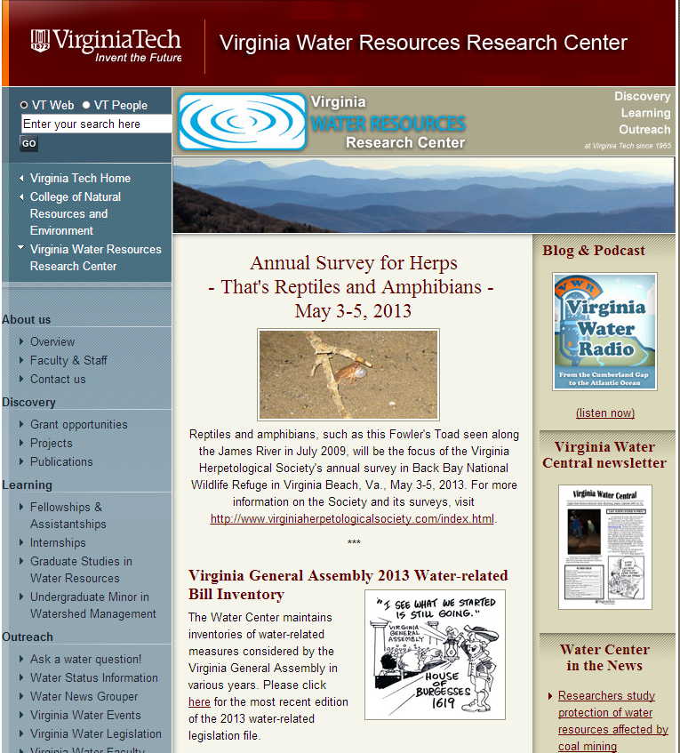
Website Improvements: The Old

Slide 12
Website Improvements: The New

Slide 13
Lessons Learned
Dirty data is difficult to manage
Communication is important
Stick to your timeline
Water links

Slide 14
Questions?

