Slide 1
Sustainability Values Diagnostic
Leah Triplett, Will Miksovic, Andy Paulonis,
Mary Haninger, Kaleb Jubar
CS 4624 Multimedia, Hypertext, and Information Access Dr. Fox
Virginia Tech, Blacksburg VA 24061
5/2/19

Slide 2

Outline
Project Recap
Recent Progress
Implementation
Demo
User Testing Results
Additional User Testing
Final Stretch
Lessons Learned
Acknowledgements
Notes:
Outline, with a list of key headings of the sections of the presentation that follow.

Slide 3
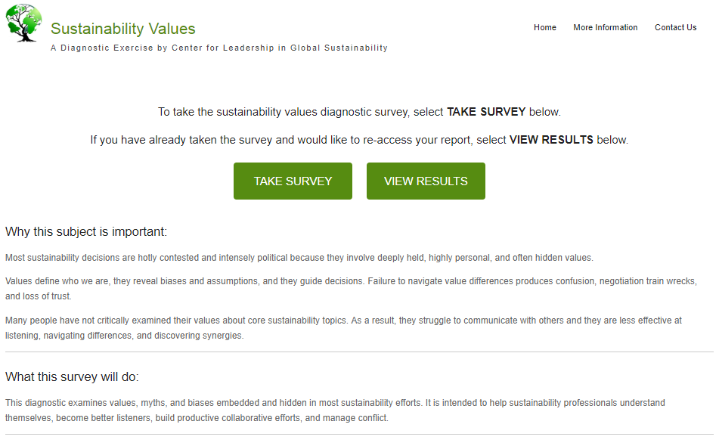
Project Recap
Website to host a survey created by Dr. Hull
Generate a report that defines the user’s sustainability values
Allow users to download/re-access results and administrator to download all data
Notes:
Collect answers to questions from an established values diagnostic survey
Users complete survey based on their views and values of sustainability Conduct a simple analysis of those inputs and generate a report for the user showing results and allowing the user to compare his/her results to others
Generate results for the user and how they compare to others that have taken the survey
Compile those answers in a database that can be exported as Excel spreadsheet for subsequent analysis

Slide 4
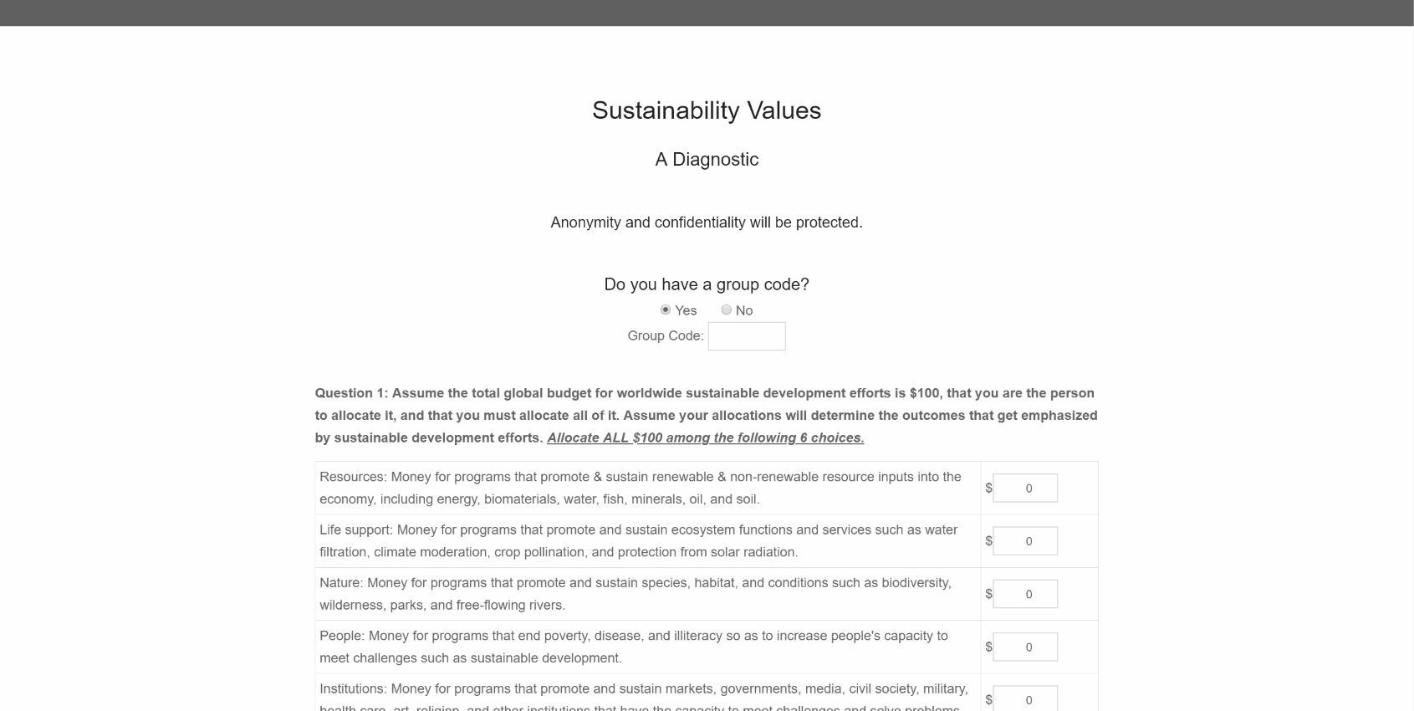
Recent Progress
User testing
With client, Dr. Hull
With undergraduate students in Dr. Hull’s class
Updates/Changes
Group Functionality
VTURCS
Notes:
In addition to our previous work completed- setting up the site, redesigning and condensing information, we have completed the following tasks...

Slide 5
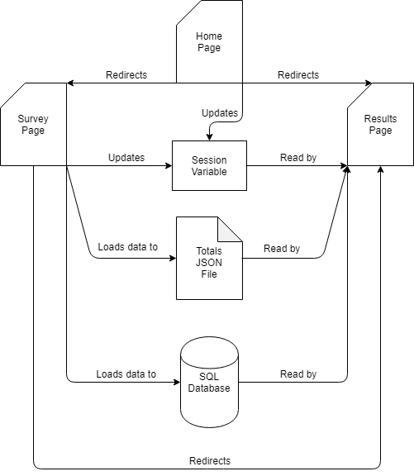
Implementation
PythonAnywhere
Flask
SQLAlchemy
MySQL database

Slide 6
Demo
Functionality
Survey
Individual
Group
Instant report
Download/print results
Re-access results
Administrator portal
Data download
https://www.sustainabilityvalues.com/
Notes:
Collect answers to questions from an established values diagnostic survey
Users complete survey based on their views and values of sustainability Conduct a simple analysis of those inputs and generate a report for the user showing results and allowing the user to compare his/her results to others
Generate results for the user and how they compare to others that have taken the survey
Compile those answers in a database that can be exported as Excel spreadsheet for subsequent analysis

Slide 7
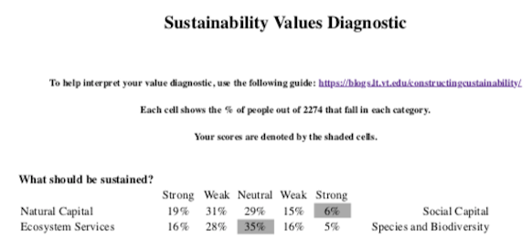
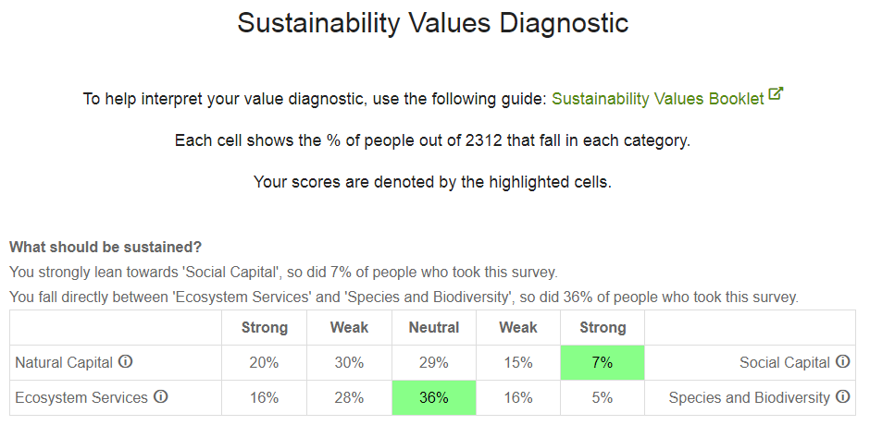
User Testing Results
Before:
Bug in back-end calculations
Result representation was unclear
Added clarification sentences
Terms required more explanation
Added hover explanations
Small aesthetic changes
Changed text size
Added color
After:
Notes:
We will have them click through the site following defined tasks, describe their progress out loud, and answer predetermined questions. Here is the form we will be filling out during the user tests.

Slide 8
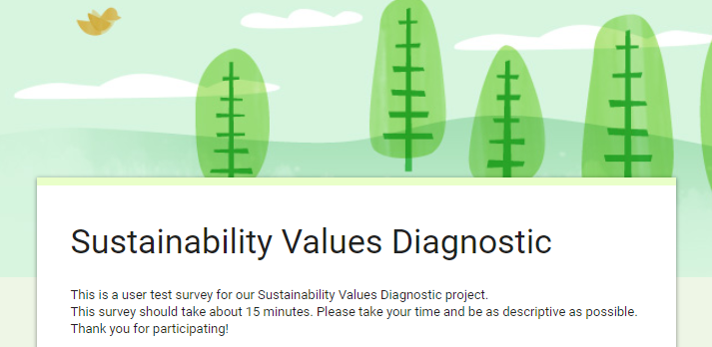
Additional User Testing
For our final user testing we have released a survey
Our survey consists of tasks and subsequent questions for the user
This will be more efficient and will allow us to reach a wider audience
https://forms.gle/iz8kZWfp2aF1Bow19
Notes:
Since we have already performed more in depth user testing and were able to identify and address some of the more important issues we decided to do the rest of our user testing through a survey.

Slide 9
Final Stretch
Sprint 1
Setup
Initial Design
Upload
Sprint 2
Implement Database
Modify HTML
Setup In-House Survey
Sprint 3 (Spring Break)
Load Existing Data
Integration of Front-End and Back-End
Sprint 4
Report Page
Survey Result Analysis
Admin Access
Sprint 5
User Testing
Re-accessible User Results Functionality
Sprint 6
Update
Group Functionality
Visualization
Sprint 7
Finalize
Document
Review with Client
Notes:
Finished sprints 1-6. We found a few small bugs when conducting our user tests. Both of which were errors in our back-end calculations. We decided our stretch goal for additional
Future work: Finalize our site, wrap up our documentation, and have a final review with our client Dr. Hull

Slide 10
Lessons Learned
Don’t trust people to be honest signing up for extra credit user testing
Have user testing earlier on to find bugs quicker
Assess difficulty and feasibility of stretch goals early on
However, our stretch goals could be used for future projects
Additional visualizations
Edit functionality
Easier credential change

Slide 11
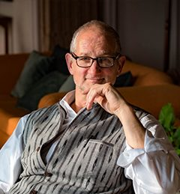
Acknowledgements
Client
Dr. Bruce Hull, Dept. of Forest Resources and Environmental Conservation
Last year’s Sustainability Values team effort
The Center for Leadership in Global Sustainability
http://cligs.vt.edu/
Notes:
Acknowledgements (covering the client, any grants or sponsor details), References (books, papers, URLs with associated title/author/year information, other resources)
The Center for Leadership in Global Sustainability, whose mission is to educate, inspire, and empower professionals to create a better future for people and our planet.

Slide 12
Questions?
Comments or Suggestions?

