Slide 1
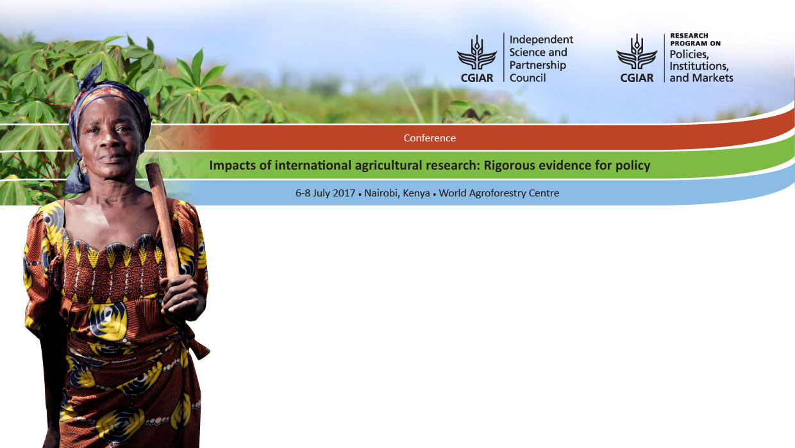
Large-scale adoption and productivity impacts of improved lentil varieties in Bangladesh
Jeffrey Alwang (Virginia Tech), Yigezu A. Yigezu & Aden Aw-Hassan (ICARDA), M. Wakilur Rahman & Md. Bazlur Rahman Mollah (BAU)

Slide 2
Objectives
Present a big-picture perspective on ICARDA’s role in improvement of lentils in Bangladesh
Document the spread of improved lentil varieties in main lentil-growing areas of Bangladesh
  Farmer-reported (from household survey)
  Expert panel (using techniques developed and refined in DIIVA studies)
  DNA-testing of seed samples collected from household
Understand factors affecting adoption
  Does variety-identification strategy affect results?
Discuss impacts of diffusion (Note: study looked at farm-level productivity effects, household-level effects on income, nutrition & dietary diversity, regional-level effects on output)

Slide 3
Background
Bangladesh is characterized by a very high rate (26%) of child malnutrition where 41.3% of children are underweight (UNICEF, 2009 and IFPRI Hunger Index, 2012)
Lentil is most widely consumed pulse in Bangladesh
  It is often referred to as a poor man’s meat as it is an important source of lean protein
  Lentils are also good sources of potassium, calcium, zinc, niacin, vitamin K, folate and iron
  Eating plenty of nutrient-dense foods like lentils can lessen the risk of many serious medical problems

Slide 4
Lentils in Bangladesh
Need to fit into rice-dominated system (in late 1970s and early 1980s, irrigation area expanded and rice moved into areas previously planted to lentils)
In early 1980s, disease susceptibility of lentil landraces was a major factor constraining productivity; researchers noted a lack of genetic variability in traits of importance in local germplasm
  Yield losses from Stemphylium blight (Stemphylium botryosum) > 80%, collar rot (Sclerotium rolfsii) 30-40 %, and rust (Uromyces fabae) 30-40 %. Blight and rust were the most prevalent problems
  Intensive research on pulse production launched at BARI in 1979 in collaboration with ICARDA
In early 1980s, BARI introduced improved varieties with disease resistance from India, but these could not fit into the short-season cropping systems
Suitability in relay system in transplanted rice and in mixed planting system is important

Slide 5
Lentils in Bangladesh
Grown after rainy season on conserved soil moisture; winter season is very short (100-110 days) and mild
  Note: In South Asia region, approximately 11.5 million hectares of land are left fallow after rice
Many competing dry winter crops are found, especially in areas with irrigation; lentil production has been pushed to marginal and sub-marginal lands
Use of lentils as a relay crop is increasing, and several improved varieties have been selected based on their performance under relay conditions (relay cropping has extended lentil production to medium lowlands where lentil cropping after transplanted rice was nearly impossible)
Much of lentil production is mixed/intercropped with other winter crops (wheat, mustard, barley and sugarcane)
Area under lentil crop has been increasing since 2008 (73,000) -> 145,000 hectares(2015)
Notes:
Depending on prior crop, lentils are sown from late-October to mid-December
Some estimates say that total lentil crop in 2015-16 covers almost 250,000 hectares

Slide 6
Major lentil-growing areas

Slide 7
ICARDA’s role in Bangladesh lentils
Cooperation between ICARDA and PRC for lentil improvement began in late 1970s
  In response to yield and disease crisis in Bangladesh lentil production
  Due to limited success with direct introduction, the breeding strategy was revised to include hybridization. ICARDA took main role in mid-1980s in making crosses using improved landraces
  During 1980s, ICARDA changed its breeding program to account for increased national capability; decentralization involved ICARDA developing segregated populations using parents from national programs and incorporating blight and rust resistance; nurseries consisting of genetically fixed materials and segregating populations were shipped to Bangladesh where selections were made under local conditions
  More than 2000 germplasm accessions and breeding lines have been supplied to BARI
Major improvements:
  BARI-3 and BARI-4 varieties were introduced in 1996—resistance to rust and blight and suitability in cropping system were main criteria used during breeding
  BARI-5 & 6 introduced in 2006, with a focus on cooking qualities and nutrient content
Notes:
ICARDA has global mandate for lentil improvement

Slide 8
Lentil variety releases, PRC, Bangladesh
Variety | Release Year | Germplasm (Originating organization) | Characteristics | Maturity | Yield (t/ha)
BARI-1 | 1991 | Local selection (BARI/ICARDA) |  | 105-110 | 1.7-1.8
BARI-2 | 1993 | ICARDA (BARI/ICARDA) | High yield and rust resistance | 105-110 | 1.5-1.7
BARI-3 | 1996 | Local cross (BARI/ICARDA) | High yield and rust resistance; thin seed coat | 100-105 | 1.5-1.7
BARI-4 | 1996 | ICARDA (BARI/ICARDA) | SB and rust resistance; high in iron | 110-115 | 1.6-1.7
BARI-5 | 2006 | ICARDA (BARI/ICARDA) | Resistant to SB and rust, tolerant to foot rot | 110-115 | 1.4-1.6
BARI-6 | 2006 | ICARDA (BARI/ICARDA) | Tolerant to SB and rust; high in iron | 105-110 | 2.2-2.3
BARI-7 | 2011 | ICARDA (BARI/ICARDA) | Tolerant to SB and rust; micronutrient-dense variety | 110-115 | 1.8-2.3
BINA-4 | 2009 | ICARDA (BINA/ICARDA) | Moderately resistant to rust, foot and root rot; good cooking quality | 96-102 | 1.8
BINA-5 | 2011 | BINA | Tolerant to blight and rust, red color, good cooking quality; crude protein (29-30%) | 99-104 | 2.1
BINA-6 | 2011 | BINA | Tolerant to blight and rust, red color, good cooking quality, crude protein (30-31%) | 105-110 | 1.9
BINA-7 | 2013 | BINA (BINA/ICARDA) | Tolerant to blight and rust, red color, good cooking quality, high in crude protein | 100-112 | 2.2-2.4
Notes:
PRC is pulse research center, part of BARI, BINA is the Bangladesh institute of nuclear agriculture
Uthfala is early maturing, small seeding, selected from a landrace, Pabna, and is less susceptible to rust and Stemphylium blight than local cultivars.
Bari-2 is high yielding and resistant to rust. It was developed through a cross of India and Mexican varieties made at ICARDA. Main contribution is rust resistance.
Bari-3 is rust-resistant and developed through a cross between an Indian variety and Pabna local (landrace) at PRC. Good dehulling and cooking properties.
Bari-4 is resistant to rust and Stemphylium blight. Was developed by crosses at ICARDA specifically for conditions in Bangladesh. Wide area of suitability in Bangladesh.
Five major improved varieties cover 75% of lentil area
Local varieties mature in about 108 days with yields (no disease) of .88 t/ha

Slide 9
Estimates of diffusion of lentil MVs
Alternative sources of information
  Farmer-reported (from household survey)
  Expert panel (using techniques developed and refined in DIIVA studies)
  DNA-testing of seed samples collected from household

Slide 10
Brief information on sample
Representative of 10 Districts in Western Bangladesh where lentil production is most common (10 Districts account for about 75% of total lentil area)
Multi-stage sampling with weighting based on estimates of area under lentils: 10 Districts, 20 Upazillas, 52 Villages
  At village level, complete listing of lentil-growing households was conducted; 10 households selected at random
Power analysis based on ability to identify adoption of improved varieties (95% confidence and a minimum of 3% precision)—864 household surveys needed; 1000 households surveyed
Survey included farm-household information, field-level information (on as many as 3 lentil fields) and village survey
  DNA samples of lentils from all lentil fields (from seeds post-harvest)
  Substantial follow-up on village survey through regular contact with local extension

Slide 11
What about the spread of improved varieties in Western Bangladesh? (BAU/ICARDA survey, 2015)
Depends on definition of “improved variety”
  Including 1996 releases-> Almost 100% of farmers grow improved variety; 99.4% of lentil area is covered by improved lentils
  When 2006 is used as cutoff, slightly above 45% of farmers grow improved variety
  Local varieties are practically non-existent
  ICARDA-related varieties represent 96% of total farmer adoption
Only five improved varieties (BARI3, BARI4, BARI5, BARI6, BARI7) were claimed to be used by farmers (all ICARDA-related)
  BARI6, BARI3 & BARI4 cover 31.2% 29.9% and 22.4% of the lentil area
  Latest varieties (BARI7) cover only 3.7% of area

Slide 12
Diffusion of improved varieties: Does method of estimation matter?
Panels of experts over-estimated area covered by more than 23 percentage points
Method | Area Weighted Adoption
HH Survey | 49.0%
Expert | 69.1%
DNA | 45.4%

Slide 13
Expert panel estimates diverge from other methods

Slide 14
Farmer knowledge of variety grown was good
Category | Number of samples | Percent
Total matched samples | 1511 | 89.20%
Total mismatched samples | 168 | 9.92%
Total Unmatched | 15 | 0.89%
NA (DNA samples went bad and hence varieties were not identified) | 3 | 0.18%
Ungrouped (DNA of these samples did not match the DNA of all the samples obtained from BARI and BINA) | 12^ | 0.71%
Total sample | 1694 | 100.00%
^Note = all 12 of these varieties were identified by farmers as local varieties and the research team is convinced that they indeed are.
Notes:
For the 12 samples which were “Ungrouped” during DNA fingerprinting showed that all of them were identified by farmers as “local varieties”. Even though no samples for local varieties were obtained from any source to be used as benchmarks, it is more likely that these samples are indeed local varieties.

Slide 15
Does farmer mis-identification matter?
Estimated models of adoption (probit) and area planted (double-hurdle) to examine whether inferences vary by method of identification
  Improved variety=post-2006 release (insufficient observations when 1996 is used)
  Standard sets of variables: Farmer characteristics, farm and field characteristics, community (including key prices) and area fixed effects
  Do wealth (from asset index) and landholdings affect adoption and area planted to improved varieties?
    Adoption outcome: Farmer-identified MV-> fifth (upper) wealth quintile 14 percentage points more likely than lowest to adopt; more owned land associated with lower likelihood of adoption. Neither of these is significant when using DNA-verified dependent variable.
    Area planted outcome: Farmer-identified MV-> fifth quintile has 37 percent more land planted to MVs compared to lower quintile. Wealth variable is not significant when using DNA-verified dependent variable.
    Area planted: Differences in other marginal effects when using farmer-identified compared to DNA-verified outcomes are not significant
Despite relatively high degree of correspondence, an important inference is changed (wealth matters), but most parameters and significance are not affected
  Probit results show more sensitivity to classification
Notes:
Model fit is not geat (R2 of about .06) and investigation using discriminate analysis led to nothing.
Wealth “almost” significant in DNA version of double-hurdle model (30% more land for highest quintile at means)

Slide 16
Technology impacts
Alternative counterfactual scenarios exist
  Without research leading to 2006 releases?
    No significant yield difference between post- and pre-2006 releases (t-test p=.80)
    Cost of production is nearly identical
    Still examining other differences
  Without research leading to 1996 releases?
    Likely would have led to elimination of short-season lentil growing due to declining yields and disease susceptibility
    Post-1996 releases have clear yield advantage (but sample size in household survey is small)
      Roughly 45% yield gain for improved varieties, holding inputs (labor, land, fertilizer, mechanical) constant
      Households planting pre-1996 varieties differ from norm
Little evidence of yield impact in post-2006 releases compared to prior releases
  1996 releases solved rust and blight problems; later releases focused on consumption traits
But production landscape would be quite different without 1996- and onward releases

Slide 17

Thank You!

Slide 18
Annex XI: Analysis of Seed Homogeneity using DNA Fingerprinting of 4 grains from each of a Sub-sample of 100 seed samples
Are all four seed samples the same as that identified by initial DNA fingerprinting work? |  | Yes | No | Total
All four seed samples are the same as that identified by initial DNA fingerprinting work |  | 89 | 11 | 100
% of each case |  | 89% | 11% | 100%
All or some of the new seed samples that are found to be different from those identified by initial DNA fingerprinting are the same as the variety identified by the farmer |  | 4 (36%) | 7(64%) | 11
The heterogeneous sample has 25% mix of the variety identified by the farmer |  | 3 | 1 | 4
The heterogeneous sample has50% mix of the variety identified by the farmer |  | 0 | 4 | 4
The heterogeneous sample has75% mix of the variety identified by the farmer |  | 1 | 3 | 4
Number of seeds out of 4 which are different from that identified by the initial DNA fingerprinting work = 25% = | 1 | 8 | 3 | 11
Number of seeds out of 4 which are different from that identified by the initial DNA fingerprinting work = 50% = | 2 | 1 | 10 | 11
Number of seeds out of 4 which are different from that identified by the initial DNA fingerprinting work = 75% = | 3 | 2 | 9 | 11
Weighted average number of seeds that are heterogeneous (out of 4 seeds) | 1.45
Weighted average rate of heterogeneity (i.e., number of seeds out of 4 that are different from that identified by the initial DNA finger printing work on all the 1964 sample seeds) | 36%

Slide 19
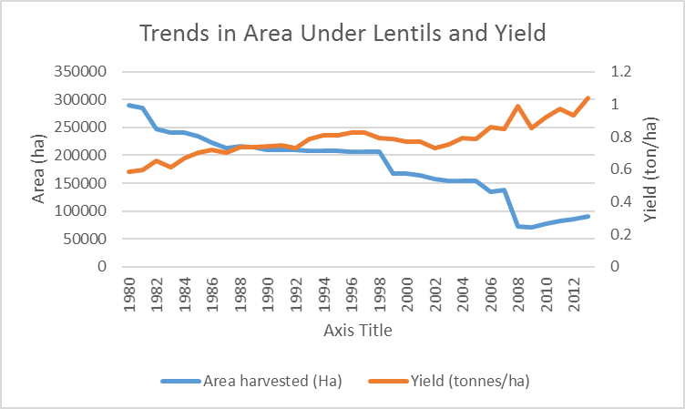
Aggregate lentil production, Bangladesh

