Slide 1

Chapter 7
Entrepreneurship: Starting A Business
(c) Virginia Tech, Department of Management, Pamplin College of Business. CC BY NC SA 4.0.
Available from: http://hdl.handle.net/10919/105157

Slide 2
Objectives
Define entrepreneur and describe the three characteristics of entrepreneurial activity.
Identify five potential advantages to starting your own business
Define a small business and explain the importance of small businesses to the U.S. economy.
Explain why small businesses tend to foster innovation more effectively than large ones.
Describe the goods-producing and service-producing sectors of an economy.
Explain what it takes to start a business and evaluate the advantages and disadvantages starting a business from scratch, buying an existing business, or obtaining a franchise.
Explain why some businesses fail.
Identify sources of small business assistance from the Small Business Administration

Slide 3
Entrepreneur
One who starts a business
Usually they start a small business

Slide 4
Entrepreneurship
Three characteristics of entrepreneurial activity
1) Innovation. Entrepreneurship generally means offering a new product, applying a new technique or technology, opening a new market, or developing a new form of organization for the purpose of producing or enhancing a product.
2) Running a business. Entrepreneurship means setting up a business to make a profit.
3) Risk taking. The term risk means that the outcome of the entrepreneurial venture can’t be known

Slide 5
Should You Make The Leap
The most common reasons for starting a business are the following:
To be your own boss
To accommodate a desired lifestyle
To achieve financial independence
To enjoy creative freedom
To use your skills and knowledge

Slide 6
Entrepreneurship
Thinking about becoming an Entrepreneur? Reflection on the following will help
How do I come up with a business idea?
Should I build a business from scratch, buy an existing business, or invest in a franchise?
What steps are involved in developing a business plan?
Where could I find help in getting my business started?
How can I increase the likelihood that I’ll succeed?

Slide 7
Finding Sources
Before you make the leap and commitment, there has to be some thoughts into funding of the idea –short term and long term. Short term –own money, family loans, etc. …
Crowd Funding A more common as a means of raising capital. An entrepreneur may utilize a crowdfunding platform like Kickstarter to attract investors. The entrepreneur might offer tokens of appreciation in exchange for funds, or perhaps might offer an ownership stake for a substantial enough investment.
Angel Investors Affluent investors who provide capital to start-ups in exchange for an ownership position in the company. Many angels are successful entrepreneurs themselves and invest not only to make money, but also to help other aspiring business owners to succeed.
Venture Capital Like angels, venture firms also take an ownership position in the company. They tend to have a higher expectation of making a return on their money than do angel investors. Usually are brought in later in the funds search

Slide 8
Entrepreneurs and Small Business
Most Entrepreneurial ventures begin as small businesses; however, not all small business
Entrepreneurs are:
Innovators who start companies to create new or improved products
Strive to meet a need that’s not being met
Goal is to grow the business
Eventually expand into other markets
People either start or buy small businesses for the sole purpose of providing an income for themselves and their families. They do not intend to be particularly innovative, nor do they plan to expand significantly. This desire to operate is what’s sometimes called a “lifestyle business.”
The neighborhood pizza parlor or beauty shop, the self-employed consultant who works out of the home, and even a local printing company—many of these are typically lifestyle businesses

Slide 9
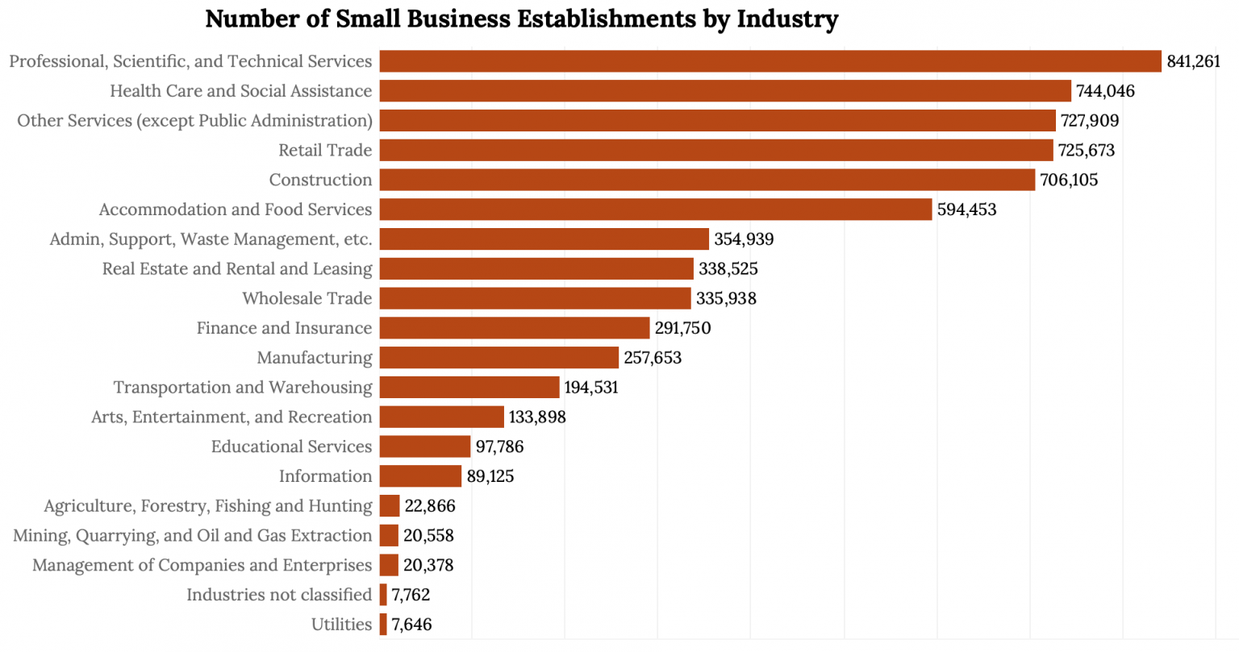
Small Business – By Industry
Goods-producing sector
includes all businesses that produce tangible goods. Examples: Manufacturing, construction, and agriculture. Service-producing sector
includes all businesses that provide services but don’t make tangible goods. Examples: Retail and wholesale trade, transportation, finance, entertainment, recreation, accommodations, food service, and any number of other ventures.
About 20% of small businesses in the United States are concentrated in the goods-producing sector.
The remaining 80% are in the service

Slide 10
Advantages – Small Business Ownership
Independence.As a business owner, you’re your own boss. You can’t get fired. More importantly, you have the freedom to make the decisions that are crucial to your own business success.
Lifestyle.Owning a small business gives you certain lifestyle advantages. Because you’re in charge, you decide when and where you want to work.
Financial rewards. In spite of high financial risk, running your own business gives you a chance to make more money than if you were employed by someone else. You benefit from your own hard work.
Learning opportunities. As a business owner, you’ll be involved in all aspects of your business. This situation creates numerous opportunities to gain a thorough understanding of the various business functions.
Creative freedom and personal satisfaction.As a business owner, you’ll be able to work in a field that you really enjoy. You’ll be able to put your skills and knowledge to use, and you’ll gain personal satisfaction from implementing your ideas, working directly with customers, and watching your business succeed

Slide 11
Disadvantages – Small Business Ownership
Financial risk. The financial resources needed to start and grow a business can be extensive. You may need to commit most of your savings or even go into debt to get started. If things don’t go well, you may face substantial financial loss. In addition, there’s no guaranteed income. There might be times, especially in the first few years, when the business isn’t generating enough cash for you to live on.
Stress. As a business owner, you are the business. There’s a bewildering array of things to worry about—competition, employees, bills, equipment breakdowns, etc.. As the owner, you’re also responsible for the well-being of your employees.
Time commitment. People often start businesses so that they’ll have more time to spend with their families. Unfortunately, running a business is extremely time-consuming. In theory, you have the freedom to take time off, but in reality, you may not be able to get away.
Undesirable duties. When you start up, you’ll undoubtedly be responsible for either doing or overseeing just about everything that needs to be done. You can get bogged down in detail work that you don’t enjoy. As a business owner, you’ll probably have to perform some unpleasant tasks, like firing people

Slide 12
Next steps – Focus on What
Want to start a business, here are the basic questions you’ll need to address:
What, exactly, is my business idea? Is it feasible?
What industry do I want to enter?
What will be my competitive advantage?
Do I want to start a new business, buy an existing one, or buy a franchise?
What form of business organization do I want?
Gaps, Trends and problems

Slide 13
Small Business Can Be Strenuous
SBA studies have found that about 50% of new businesses fail within 5 years. Why?
A lack of formal planning
Insufficient market analysis
Undercapitalization
Insufficient organization structure
Lack of formal policies and procedures

Slide 14
Entrepreneurship Outlets
Home-based business
Internet business
Small, one-person business (ex. service)
Small, traditional business (ex. retail)
Small, untraditional business (ex.______?)
Large businesses started as small businesses

Slide 15
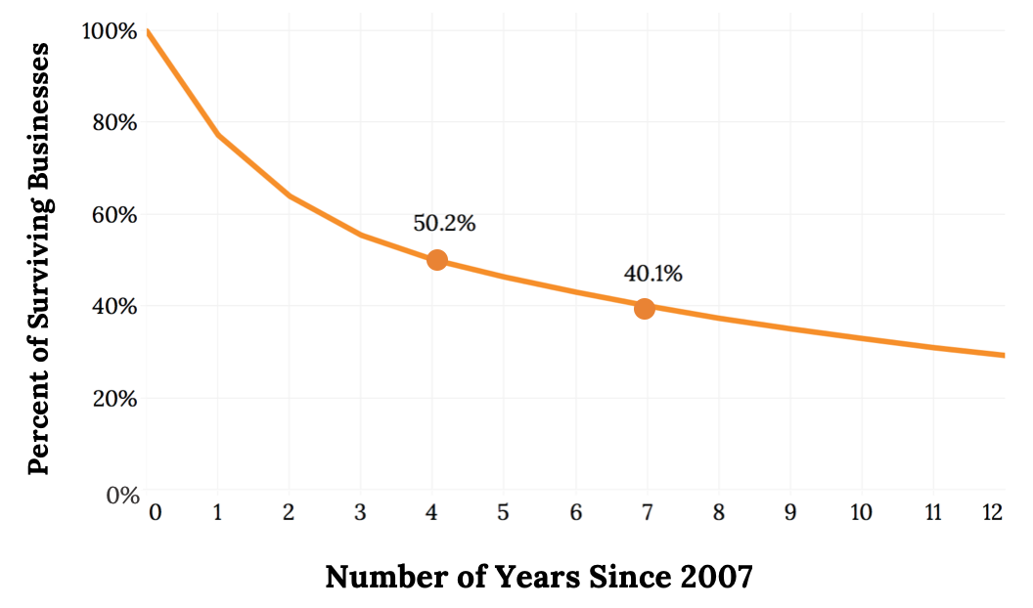
Long Term Survival Rate of U.S Businesses

Slide 16
The Business Plan
What?
Business start-up on paper
Why?
Makes you do your homework
To decide if venture is wise
Improve chances of success
Required for outside fund

Slide 17
Business Plan Structure
Introduction
Marketing Plana.
Market Analysis.
Marketing Strategies
Management Plan
Ownership
Operations Plan
4. Financial Plana
a.Start up costs, sources of funding
b.Financial sustainability: financial project

Slide 18
Introduction
Vision
What business
Start-up versus Buy
Mission
Product
Service

Slide 19
Market Analysis
To answer: will people buy what I have for sale
Industry Analysis
Market Definition
Customer Segmentation/Profile
Target Market
Competitor

Slide 20
Marketing Strategies
Product
Price
Promotion
Place/ location
People
Referral Strategies
Relationship Marketing

Slide 21
Management Plan
Ownership
Legal structure
Management Structure
Organizational Chart
Exit plan

Slide 22
Operational Plan
Staffing plan
Job description
Pay rates
Positions
Work schedule
Hours of operation
Accounting/payroll
Insurance
Vendors/suppliers
Daily routine

Slide 23
Financial Plan
Start-Up Costs
Sources and Uses of Funds
Loan Term or Investment expectations
Financial Sustainability
Cash Flow Projections
Income Statement Pro-Forma
Balance Sheet Proforma
Break Even Analysis
Return on Investment

Slide 24
Financing The Business
Debt Versus Equity
Investors: Angels, Venture Capital, Crowdfunding
Loans:
Six C’s of Credit
Capital, Coverage, Capacity, Conditions, Collateral, Character
SBA-Small Business Administration
Family & Friends
Micro Loan Programs
Minority Programs

Slide 25
Don’t Go At It Alone
Term of Consultants
Small Business Development Center
Lawyer
Accounting
Banker
Small Business Administrations (SBA)
Insuring Agent
Real Estate Agent
Mentor

Slide 26
Registering The Business
State Corporation Commission
IRS- From Employer Identification Number (EIN)
Virginia Department of Taxation
Virginia Employment Commission
Possibly other state Agencies
Local Business License– if required

Slide 27
Opening The Business
Opening bank account(s)
Obtaining utilities
Preparing the location
Buying equipment and furniture
Hiring Staff
Supplies and Inventory
Training staff

Slide 28
Takeaways
The three characteristics of entrepreneurial activity are innovating, running a business, and risk taking
An entrepreneur is someone who identifies a business opportunity and assumes the risk of creating and running a business to take advantage of it.
An industry is a group of companies that compete with one another to sell similar products. There are two broad types of industries, or sectors: the goods-producing sector and the service-producing sector.
Once you decide to start a business, you’ll need to create a business plan—a document that identifies the goals of your proposed business and explains how it will achieve them.
The Small Business Administration (SBA) is a government agency that provides many kinds of support for small businesses, including information and funding assistance.

Slide 29
Chapter 7
Q&A
(c) Virginia Tech, Department of Management, Pamplin College of Business. CC BY NC SA 4.0.
Available from: http://hdl.handle.net/10919/105157

