Slide 1
NRV Tweets
Final Presentation
VT CS4624, Blacksburg, VA
Sponsors: Mohamed Magdy,
Dr. Andrea Kavanaugh, Ji Wang
Ben Roble, Justin Cheng,
Marwan Sbitani
5/06/14

Slide 2
NRVTweets
Actually Tweets and RSS News stories
Take 360,000 Tweets and 15,000 RSS News stories from Virtual Town Square DB
Use Natural Language Processing to associate tweets and news stories with topics
Upload all data into Solr to make it searchable
Notes:
Marwan

Slide 3
Selecting a Tool/API
Dozens available
Commercial licenses
Free usage limits
Notes:
Marwan

Slide 4
Free Tools/API’s considered
word2vec - inaccurate
Weka - data import issues
Stanford Topical Modeling Toolbox - only .csv files
LingPipe - unclear
Gensim - good
PDLA C++ - lack of documentation
MALLET - good
Mahout - needs HADOOP environment
Notes:
Marwan

Slide 5
MALLET -
Machine Learning for Language Toolkit
java source - http://mallet.cs.umass.edu/
document classification
  Naive Bayes, Maximum Entropy, Decision Trees
topical modeling
  LDA, Pachinko Allocation, Hierarchical LDA
Notes:
Marwan

Slide 6
Parsing the data
Modify into JSON
Large file size
Stripping stop words/symbols
Preparing for MALLET
Train data in MALLET
Infer topics from data
Export back to JSON
Notes:
Ben

Slide 7
Topic Modeling
Topics created from groups of tokens (words), each weighted differently
NLP standard is 20 top tokens, but Tweets are on average 15 words [1]
Needed to be specific
The three most heavily weighted tokens from the most relevant topic was returned
[1] http://blog.oup.com/2009/06/oxford-twitter/
Notes:
Ben

Slide 8
Uploading to Solr
Add schema.xml with our json fields
Upload to Solr
Now searchable by topics
Notes:
Justin

Slide 9
Results
All tweets and RSS stories associated with topics
  virginia tech hokies
  county board supervisors
  police crash vehicle
  veterans war military
  food pantry program
  rotary club blacksburg
Tweets associated with hashtags
Notes:
Marwan

Slide 10
<topic titles="big ten, marshall wood fractures foot reducing, smokey classic, big ten challenge, basketball freshman marshall wood turning heads preseason practices, georgia, join, conference, " totalTokens="13853" alpha="0.2" id="6">
<word count="2239" weight="0.1616256406554537">big</word>
<word count="857" weight="0.06186385620443225">georgia</word>
<word count="785" weight="0.05666642604490002">ten</word>
<word count="652" weight="0.04706561755576409">join</word>
<word count="383" weight="0.02764744098751173">conference</word>
<phrase count="98" weight="0.08376068376068375">big ten</phrase>
<phrase count="42" weight="0.035897435897435895">marshall wood fractures foot reducing</phrase>
<phrase count="35" weight="0.029914529914529916">smokey classic</phrase>
<phrase count="31" weight="0.026495726495726495">big ten challenge</phrase>
<phrase count="27" weight="0.023076923076923078">basketball freshman marshall wood turning heads preseason practices</phrase>
</topic>
Notes:
Ben

Slide 11
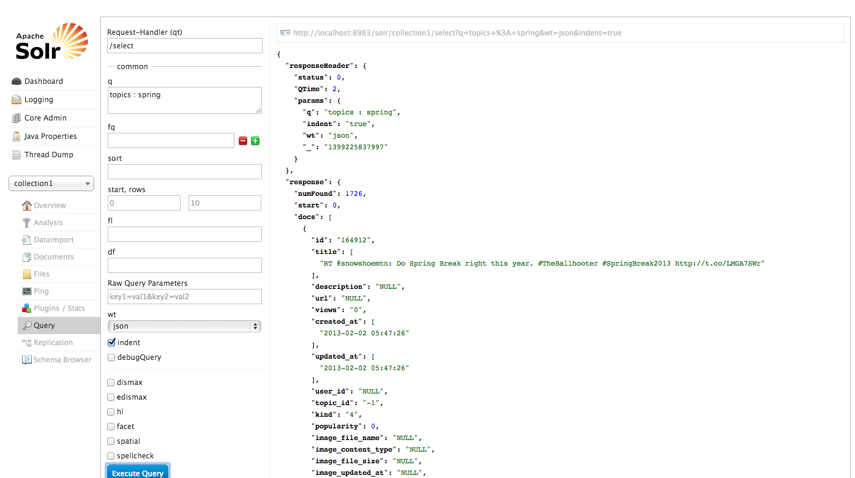
Notes:
Justin

Slide 12
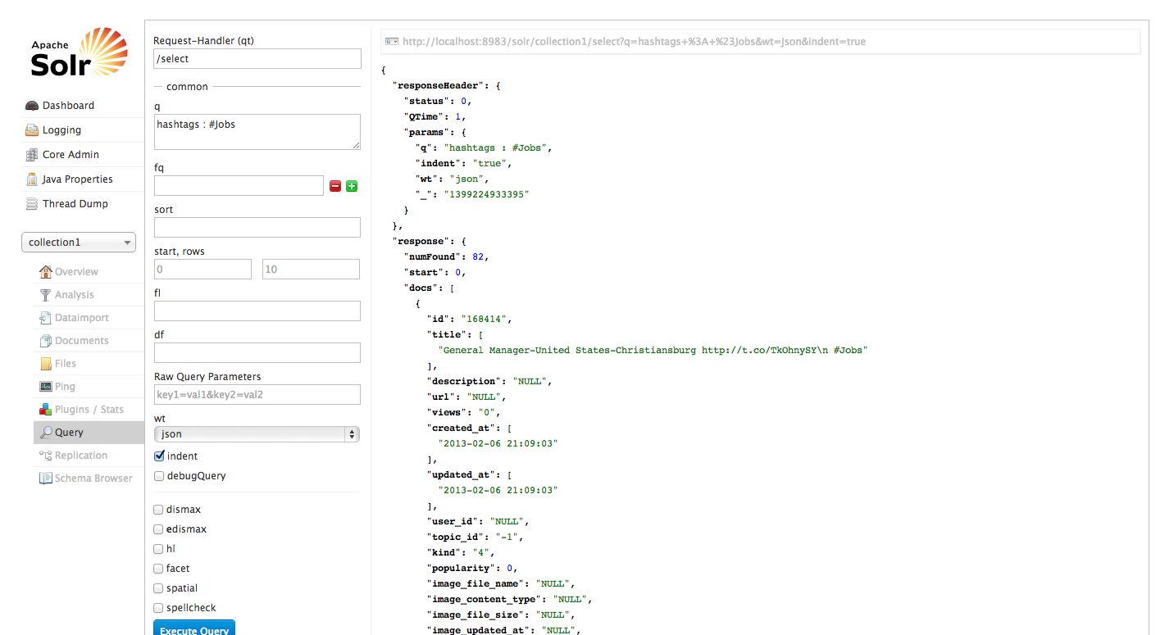
Notes:
Justin

Slide 13
Future work
Modify NLP tool parameters
  Enhance topic association
Use different NLP tool/algorithm
Notes:
Justin

