Slide 1

PARTNERSHIP WITH CULTURAL AND COMMUNITY CENTERS
De-Centering Whiteness in Archives
Midwest Archives Conference, Chicago, Illinois
ANTHONY WRIGHT DE HERNANDEZ
MARCH 24, 2018 · #MAC2018 · #s503 · @RoganWright
Notes:
Good morning.
My talk today will be about work I’ve don’t partnering with Virginia Tech’s Cultural and Community Centers. I’ll share some examples of the exhibits and events I’ve done to support different traditionally marginalized communities and to strengthen the archives’ relationship with them. For my portion, I’m working with a definition of Whiteness that encompasses all traditionally privileged groups: White, Male, Cisgender, Heterosexual, Christian, and Temporarily-Abled.

Slide 2
About me
Anthony Wright de Hernandez
MLIS, University of Washington
BA in Community Studies, UMass Boston
Community Collections Archivist
Improve relationships with traditionally marginalized communities
Increase representation of those communities in the archival record
Identify ways the archives can support these communities
ANTHONY WRIGHT DE HERNANDEZ · @RoganWright · #MAC2018 · #s503
Notes:
First, a little about me and my role at Tech
In addition to my MLIS, I have a Bachelor’s in Community Studies from UMass Boston which gives me a little insight into how to work with and support communities.
At Tech, I’m the Community Collections Archivist. Generally, my job requires the ability to not be a jerk. Part of my job is to improve relationships with traditionally marginalized groups. The ultimate intention of improving those relationships is to increase representation of these groups in our Special Collections which are heavily white, male, heterosexual, cisgender, and Christian.
There is so much complexity involved in working with the variety of groups at Virginia Tech and in the New River Valley of Virginia that I have to approach it fresh every time and just be respectful - or at least endeavor to not be a jerk - by listening to the community’s needs and putting those before the desires of our institutional archives.

Slide 3
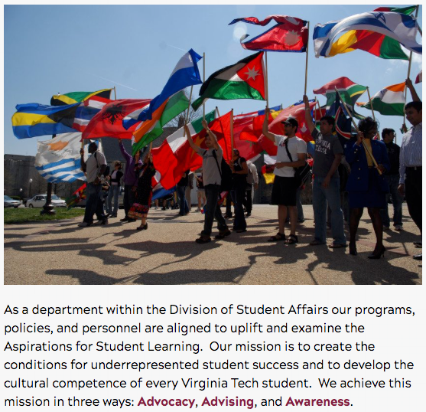
About the Cultural and Community Centers
Part of the Division of Student Affairs
Includes:
American Indian & Indigenous Community Center
Asian Cultural Engagement Center
Black Cultural Center
El Centro
Intercultural Engagement Center
LGBTQ+ Resource Center
ANTHONY WRIGHT DE HERNANDEZ · @RoganWright · #MAC2018 · #s503
Notes:
In approaching this work, there was a natural partner on our campus: the Community and Cultural Centers in the Division of Student Affairs.
Starting our outreach with these centers is like wading into the kiddie pool. It’s a first step toward eventually being able to dive into the deep end by engaging with the broader community beyond the University.
The centers provide places for community engagement and support for the Indigenous, Asian, Black, Latinx, and LGBTQ+ communities. They also partner regularly with the Women’s Center, the Hillel Center, the Muslim Student Union and other on-campus and off-campus groups that exist to support these communities.
Working with the centers has allowed me to begin navigating some of the historic tensions between the University Libraries - Special Collections specifically - and these communities.

Slide 4
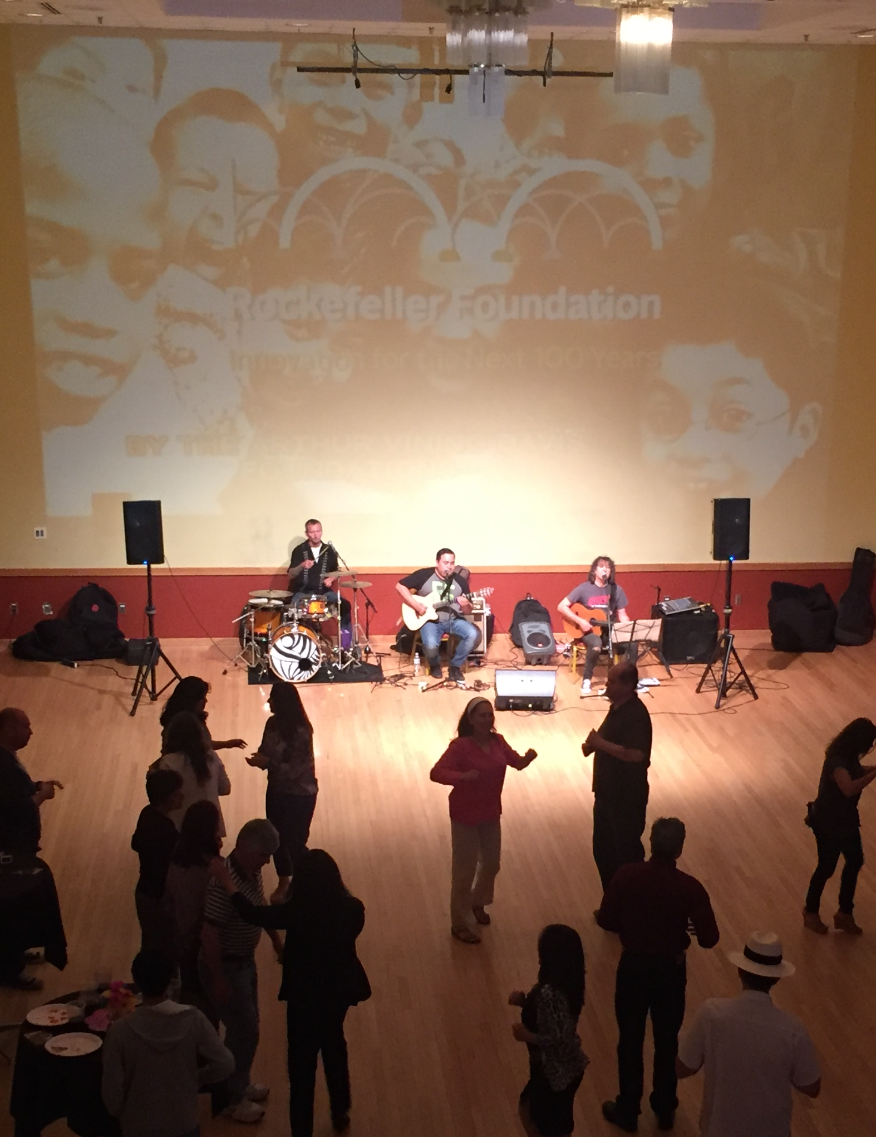
Latino Americans Grant
ALA Public Programs Office Grant
Partnered with Intercultural Engagement Center
Hosted fiesta at end of grant to engage community
Hired local musicians
Catered by local businesses
Invited local Latinx dance groups
ANTHONY WRIGHT DE HERNANDEZ · @RoganWright · #MAC2018 · #s503
Notes:
My first foray into building relationships with these communities was something I inherited. I took over the Latino Americans: 500 Years of History ALA Public Programs Office grant when the grant director left.
This wasn’t an archival project but it was focused on a PBS documentary that incorporated archival holdings to tell the story of Latino Americans in America. Most of the events related to the grant were extremely academic and already planned. The final event was meant to incorporate the community and the Students of Hip-Hop Legacy group on campus. That event fell through and I had to come up with something fast.
I reached out to the Latinx Advocate in the Intercultural Engagement Center (the precursor to the Community and Cultural Centers) and invited her to be part of planning our new final event.
As a final cap to the series of lectures and documentary viewings we had already done, I wanted to invite the community in for something fun. We decided to hold a fiesta. We showed the documentary on the wall, hired local musicians, brought in food from a local business, and invited a local Latinx dance troupe.
Overall, we had about 75 attendees with minimal promotion. The partnership with the Intercultural Engagement Center was invaluable. Their support connected us to the community and gave the event legitimacy so that community members actually showed up.

Slide 5
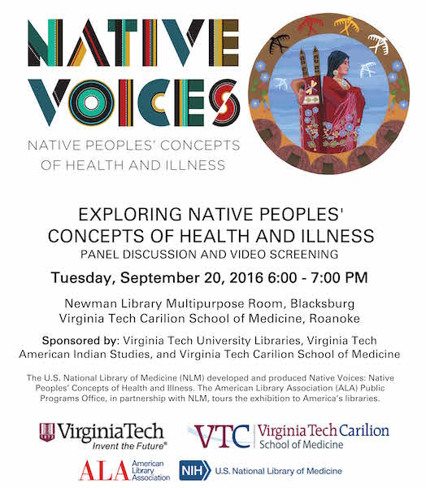
Native Voices
ALA Public Programs Office Touring Exhibit
Partnered with Intercultural Engagement Center, American Indian Studies Program, and the Carilion School of Medicine among others
Worked with the Intercultural Engagement Center from the beginning to plan events useful to the community
ANTHONY WRIGHT DE HERNANDEZ · @RoganWright · #MAC2018 · #s503
Notes:
I followed up the Latino Americans grant with another from the ALA Public Programs office. This was a touring exhibit highlighting an oral history project by the National Library of Medicine.
I brought in the American Indian and Indigenous Advocate from the beginning – when we were working on the grant proposal. He was helpful in identifying key stakeholders in the area.
We held multiple events including Indigenous faculty and community members discussing health topics from an Indigenous perspective. Working on this project helped to strengthen not only Special Collections ties with the community but those of the university itself – helping to set the stage for the creation of an annual Pow-Wow and a summit to discuss the needs of the various tribal nations in Virginia and how the university can serve those needs.

Slide 6
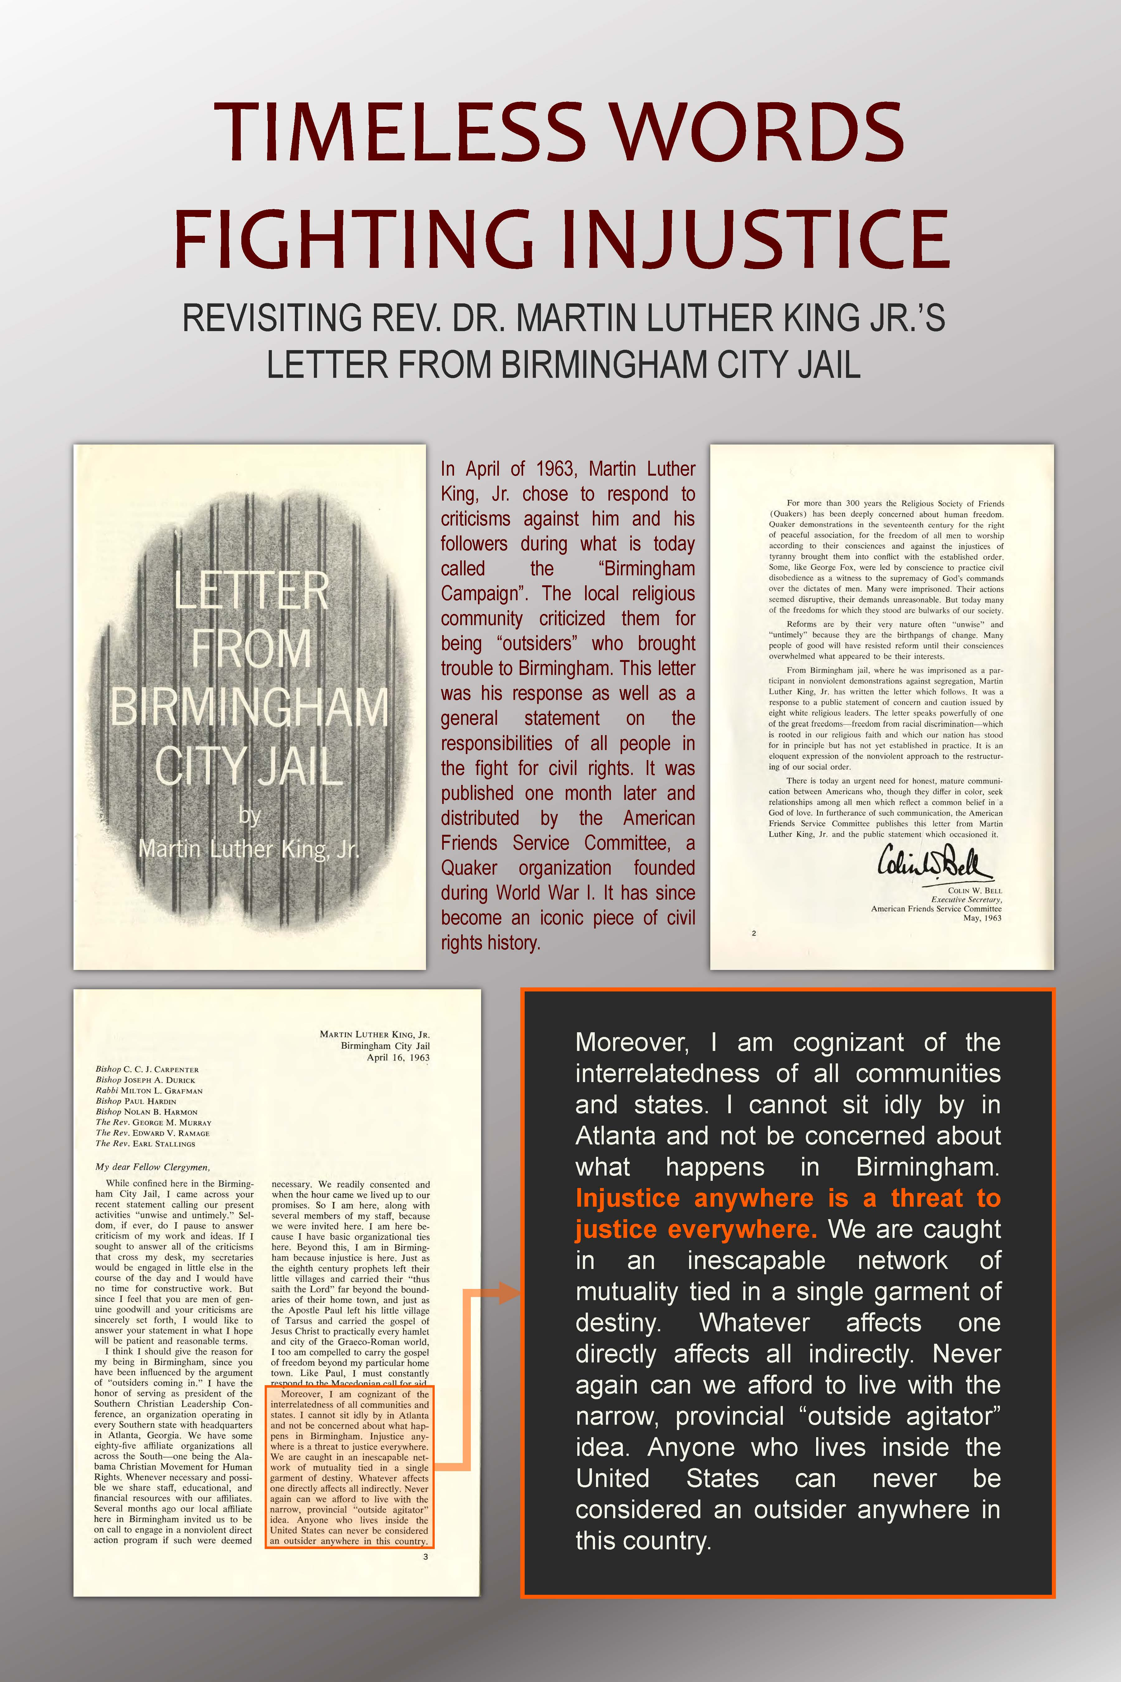
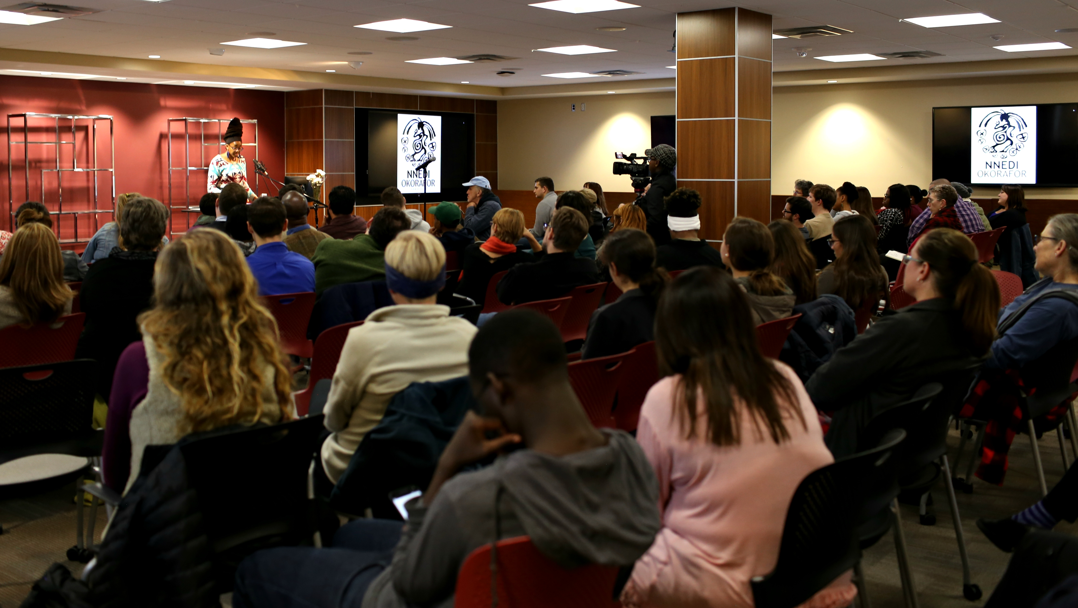
Black Cultural Center
Martin Luther King, Jr. Day Exhibit
Selected a document to highlight
Helped design and print posters
Invited Author: Nnedi Okorafor
Worked with numerous departments to bring author
Project headed by Special Collections faculty even though not directly related to our holdings
ANTHONY WRIGHT DE HERNANDEZ · @RoganWright · #MAC2018 · #s503
Notes:
Since then, I’ve worked on multiple projects with the Black Cultural Center and the LGBTQ+ Resource Center.
I was approached by the Black Cultural Center for help finding a Martin Luther King, Jr. document in our collections that they could highlight for Martin Luther King, Jr. day and Black History Month. I worked with their student employee to select a document. She then chose passages to highlight and provided commentary on them. I then helped design some posters with high-resolution images of the documents and got them printed for the center.
Following that, I helped put together an author visit for the Black community on campus. It was only peripherally related to our collections - tying in with our Speculative Fiction collection which is not one of our current collecting focuses. I did it mostly as an effort to strengthen our relationship with the community. I headed the project and gathered support from various departments to bring author Nnedi Okorafor to campus. It was a big success, with over 100 attendees and a lot of support from the community.
Following these events, I did get some material donations to our archives from the Black Organizations Council - an umbrella organization for the Black student groups on campus.

Slide 7
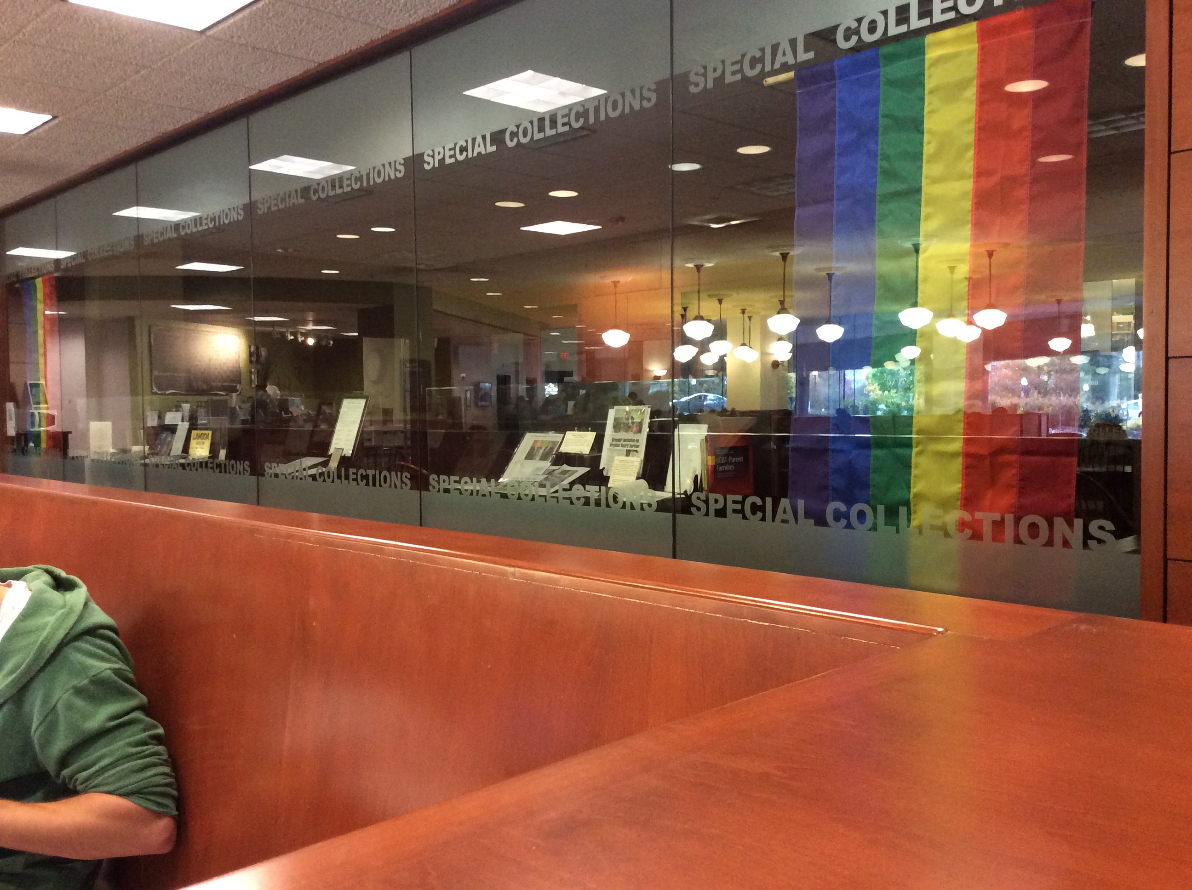
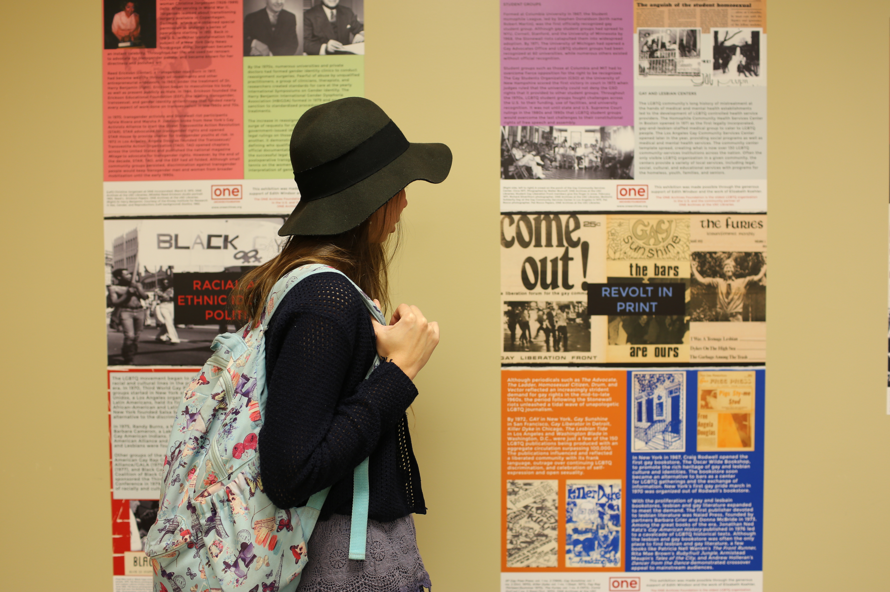
LGBTQ+ Resource Center
LGBTQ+ history exhibits
Sharing Our Voices - oral history project exhibit
LGBTQ+ History at Virginia Tech
LGBTQ+ Student Groups at Virginia Tech
Bringing in outside content
ONE Archives Foundation exhibit
Taking advantage of Library changes
ANTHONY WRIGHT DE HERNANDEZ · @RoganWright · #MAC2018 · #s503
Notes:
For the LGBTQ+ Resource Center, I’ve done a few things. The center, and the HokiePRIDE student group, have requested a few one-shot exhibits and I’ve happily put them together. I also became an instructor for SafeZone sessions on campus which brought me into the planning meetings for things like Pride Week and LGBTQ+ History Month.
Our archives worked with the History department on an oral history project focused on LGBTQ+ history at Virginia Tech and in Southwest Virginia. We invited the community to our launch of a related online timeline and had extensive exhibits of the limited material we did have.
Working with the center, I arranged to display one of the ONE Archives Foundation’s “Traveling Exhibits” about the History of the LGBTQ Civil Rights Movement - since our own holdings are limited and focused on Virginia Tech. The center helped with some funding but the bulk of the costs were paid by Special Collections.
I was able to take advantage of some trends in the library: vinyl stickers for wall displays, a desire to use more library wall space, and an effort to do better marketing for events and exhibits.
We printed the exhibit on removable vinyl and put the posters on display for 9 weeks. It was one of the most visited exhibits we’ve done with over 6,000 students exposed to it. We received tons of great feedback and will likely try to bring in another exhibit from ONE Archives in the future.
Following the exhibit, we let the Center retain the posters so that they can reuse them whenever they want to put up the exhibit in the future.
My support for this community has led to HokiePRIDE donating their records to the University Archives.
Overall, I’ve had success in engaging these communities by focusing on community support rather than focusing on the community’s records and materials. For the communities where the relationships are becoming stronger, I’m beginning to receive donated records. For other communities, there is more work to be done before I expect to see material donations.

Slide 8
Thank you
Anthony Wright de Hernandez, MLIS
Community Collections Archivist
Virginia Tech
antwri@vt.edu
@RoganWright
MARCH 24, 2018 · #MAC2018 · #s503 · @RoganWright
Notes:
Questions?

