Slide 1
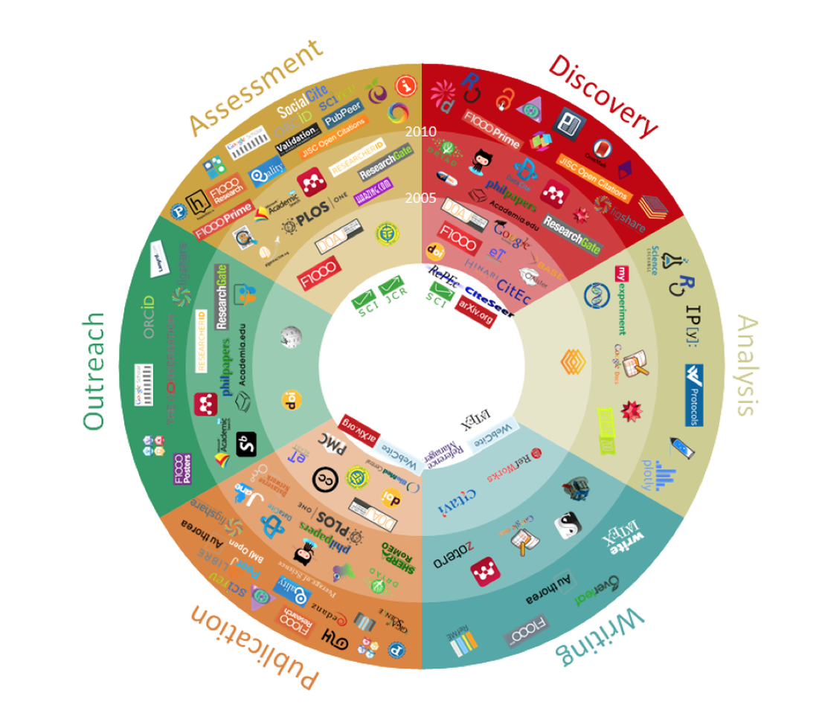
101 Innovations in Scholarly Communication
http://innoscholcomm.silk.co/
Notes:
Life cycle of information
101 Innovations in Scholarly Communication
Part of a “Poster presented at Force 2015 https://www.force11.org/meetings/force2015 In the fast developing world of scholarly communication it is good to take a step back and look at the patterns and processes of innovation in this field. To this end, we have selected 101 innovations (in the form of tools & sites) and graphically displayed them by year and also according to 6 phases of the research workflow…” logos in each, representing digital tools and products
Explanatory article: https://www.insidehighered.com/views/2015/01/28/report-101-innovations-scholarly-communication

Slide 2

The State of Scholarly Publishing
Gail McMillan
Professor, Virginia Tech Libraries
Director, Scholarly Communication
University of Richmond, Feb. 6, 2015
Notes:
Thank you for coming, taking the time from your busy day. I hope you’re here to share your thoughts on scholarly communicationor scholarly publishing—I tend touse both interchangebly
Scholarly Communication is a dynamic topic and these are dynamic times: we’re living and learning as we do it. I have the perspective of 25 years of (online) scholarly communication experience. Are you in the New World or is it still Business as Usual for you?
About me and what I’ve been doing for 25 years: Scholarly Communication. [http://scholar.lib.vt.edu]
Who is in the audience? Please introduce yourselves. What particular aspect of SC are you interested in?
Why do we publish?
Get tenure/promoted
Share knowledge/information
It’s in our job description.
University mission/values
Other reasons?

Slide 3

Virginia Tech’s Mission Statement
Virginia Polytechnic Institute and State University is a public land-grant university serving the Commonwealth of Virginia, the nation, and the world community. The discovery and dissemination of new knowledge are central to its mission. Through its focus on teaching and learning, research and discovery, and outreach and engagement, the university creates, conveys, and applies knowledge to expand personal growth and opportunity, advance social and community development, foster economic competitiveness, and improve the quality of life.
http://www.president.vt.edu/mission_vision/mission.html
Notes:
Sometimes the mission of the university is very explicit, like Virginia Tech’s. An important fact of scholarly research is that the work is not complete until the results have been fully communicated and openly available for others to build upon. (Heather Joseph re Berlin Open Access Convergence, C&RL News, Feb. 2012, . 84)

Slide 4

University of Virginia Statement of Purpose
The central purpose of the University of Virginia is to enrich the mind by stimulating and sustaining a spirit of free inquiry directed to understanding the nature of the universe and the role of mankind in it. Activities designed to quicken, discipline, and enlarge the intellectual and creative capacities, as well as the aesthetic and ethical awareness, of the members of the University and to record, preserve, and disseminate the results of intellectual discovery and creative endeavor serve this purpose. In fulfilling it, the University places the highest priority on achieving eminence as a center of higher learning.
http://www.virginia.edu/statementofpurpose/purpose.html

Slide 5

University of Richmond
The mission of the University of Richmond is to sustain a collaborative learning and research community that supports the personal development of its members and the creation of new knowledge. A Richmond education prepares students to live lives of purpose, thoughtful inquiry, and responsible leadership in a global and pluralistic society.
http://president.richmond.edu/university/
Notes:
Richmond’s mission isn’t so explicit, but I would argue that you’re not charged with creating new knowledge just to sit on it, and that your collaborations extend beyond your campus colleagues.
But who owns the copyright to this new knowledge that we write about in our articles and books?

Slide 6
UR Intellectual Property Policy http://grants.richmond.edu/policies/intellectual-property.html
Copyright: Chapter 2, II. B.
UR “…recognizes the longstanding academic tradition of allowing faculty members the right to own their copyrightable works.”
“…faculty shall be deemed to automatically grant to the University a non-exclusive, royalty-free perpetual license to materials that are developed for University courses or curriculum for all traditional, customary or reasonable academic uses of the material…”
Notes:
[The Congress shall have power] "To promote the progress of science and useful arts, by securing for limited times to authors and inventors the exclusive right to their respective writings and discoveries.” - U.S. Constitution, Article I Section 8 Clause 8
U.S. Code, Title 17.
Copyright holders retain the right to
1. Reproduction 2. Modification 3. Distribution 4. Public performance 5. Public display
Life of the author plus 70 year
URichmond Exceptions: computer programs, databases, “works supported by extraordinary allowances, grants or subventions..”

Slide 7
VT Intellectual Property Policy http://www.policies.vt.edu/13000.pdf
Traditional results of academic scholarship
Contributes to the “university's benefit by its creation and by continued use by the university in teaching, further development, and enhancement of the university's academic stature”
Presumption of ownership is to the author
unless there is explicit evidence that the work was specifically commissioned by the university
University’s rights are limited to free (no cost) use in teaching, research, extension, etc. in perpetuity.
Notes:
For purposes of this policy creations are divided into two groups:
The traditional results of academic scholarship, i.e. journal articles, conference proceedings, textbooks, literary works, artistic creations and artifacts.
and the novel results of research which can be commercialized such as products, processes, machines, software, biological technology, etc.
Our universities concur that we have the Rights of Copyright Holders
Reproduction
Modification
Distribution
Public performance
Public display
Which allows us to give it all away and create this vicious cycle:

Slide 8
Current Publishing Cycle
Academic faculty research, write, review, edit; give it all away
Commercial publishers charge readers for
Free content; authors relinquished copyright
Free peer review
Free editorial services
Libraries/readers buy back content
Many potential readers excluded
Lost control over our own work
Subscriptions far outpace inflation
New models: Open Access
Notes:
Vicious cycle of scholarly communication. We give away our copyright and lose control of our work, inc. ability to use in teaching
Elsevier 2013 profit was larger than Apple’s; up 6% from 2012 http://poeticeconomics.blogspot.com/2014/03/elsevier-stm-publishing-profits-rise-to.html
“EBSCO’s MasterFILE Premier and Academic Search Premier show similar results “http://lj.libraryjournal.com/2013/04/publishing/the-winds-of-change-periodicals-price-survey-2013/ Library Journal: The Winds of Change | Periodicals Price Survey 2013 By Stephen Bosch & Kittie Henderson
What are the costs? Monopoly market; Prices rise faster than CPI; Large publishers are among the most profitable businesses in the world; Journals take up more of library budgets, less money for monograph purchases
Who are we excluding? Colleagues Scholars in the developing world Independent researchers Virginia taxpayers Students who graduate
How can we change this costly publishing cycle? An example: Harvard and at least another 100 institutions have OA mandates w/options to opt out
~20,000 articles, 4 million downloads
http://dash.harvard.edu/bitstream/handle/1/4322574/suber_harvard.html?sequence=1
But first we have to stop giving our copyrights away.

Slide 9

Creative Commons
International not-for-profit organization
Improve clarity about what people can do with copyrighted content
Legal/social framework in the form of licenses
https://www.youtube.com/watch?v=io3BrAQl3so 6 minute video
Notes:
How many of you are familiar with Creative Commons?

Slide 10
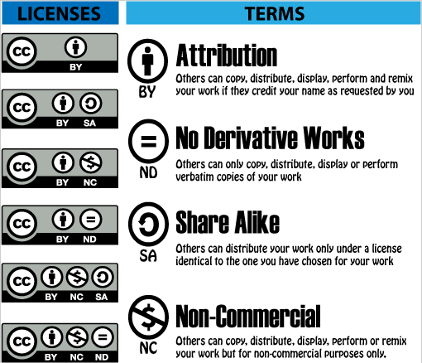
State of the Commons
Notes:
Image source: http://education-copyright.org/creative-commons/
6 license options
“The licence is expressed in three forms:
the legal code (the licence itself);
human-readable deed summarising the principal terms and conditions of the licence,
machine-readable form that computers can parse to identify the key licence features.” http://oapen-uk.jiscebooks.org/ccguide/
Who’s using these licenses? State of the Commons link https://stateof.creativecommons.org/

Slide 11
Balanced Approach to Copyright
Authors: retain some rights
Deposit in your institutional repository
Use and develop your work without restrictions
Increase access for education/research
Receive proper attribution when your work is used
Publishers: receive non-exclusive rights
Publish/distribute and receive financial return
Receive proper attribution/citation
Migrate works to future formats; include in collections
Notes:
Balance means a model like this where publishing and copyright = scholarly communication in the 21st Century
Sometimes necessary to negotiate with the publisher. But try; I’ve always been successful.
Help is available from SPARC (the Scholarly Publishing and Academic Resources Coalition) http://www.sparc.arl.org/resources/authors/addendum
When you retain copyright, then you have options.

Slide 12

Open Access Scholarly Communication
Open-access (OA) literature is digital, online, free of charge, and free of most copyright and licensing restrictions. What makes it possible is the internet and the consent of the author or copyright-holder. Peter Suber
3 minute video
http://vimeo.com/6973160
Green: self-archiving in digital repositories
Gold: publishing on OA journals
Gratis: cost-free access
Libre: free of (permission) barriers
Notes:
Peter Suber is as a leading voice in the open access movement for over a decade. He is a philosopher specializing in the philosophy of law. He is and director of the Harvard Office for Scholarly Communication and fellow at the Berkman Center for Internet & Society
“..OA offers a potential unprecedented public good, building on the capacity of the Internet for free sharing with everyone and the scholarly tradition of giving away academic articles and peer review services (BOAI). Also as described in BOAI, there are two basic approaches to open access, via archiving and publishing. There are compelling arguments for pursuing both approaches at the same time (Guédon, 2008).” oa-apcs-artcile-2014-october-171.pdf
Open access article processing charges: DOAJ survey May 2014 Authors: Heather Morrison, Jihane Salhab, Alexis Calvé-Genest & Tony Horava http://sustainingknowledgecommons.org/?attachment_id=257
“The only aim of scholarly communication should be the widest possible distribution of knowledge and scholarly results. In order for this to be possible, published research ... should be open access. ...“gratis” open access (free to access) isn’t enough; only “libre” open access, which removes permission barriers, allows the widest distribution of knowledge.” [from Graf, K, Thatcher, S. (2012). Point & Counterpoint: Is CC BY the Best Open Access License?. Journal of Librarianship and Scholarly Communication 1(1):eP1043. http://dx.doi.org/10.7710/2162-3309.1043
http://legacy.earlham.edu/~peters/fos/brief.htm, A Very Brief Introduction to Open Access by Peter Suber

Slide 13
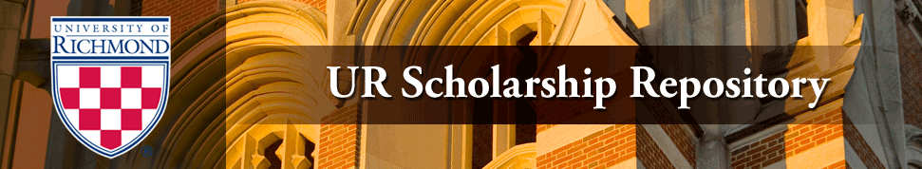
Two Roads to Open Access
OA Repositories
Subject specialties
Publisher policies: Sherpa/RoMEO
OA Journals
Sources, DOAJ, Ulrichs, etc.
New business models
Notes:
When you retain the copyright, you can make your works OPENLY ACCESSIBLE. This will
Maximise the uptake, usage, applications and impact of the research output of your university
Measuree and rewarded for the uptake, usage, applications and impact of the research output of your university (research metrics)
There are new ways to collect, manage and showcase a permanent record of the research output and impact of your university
There are 2 roads to Open Access…
SHERPA (Securing a Hybrid Environment for Research Preservation and Access)
staff team based at the University of Nottingham, 33 research institutions and organisations comprise the SHERPA Partnership.^{[1]}
Harnad: only 15% of faculty self-archive
Sources of OA Journals: www.doaj.org , http://www.ulrichsweb.com/ulrichsweb/

Slide 14
Searchable database of publishers’ copyright and self-archiving policies
Find out if a publishers’ copyright policies allow institutional repository deposit
Searchable by: publisher name, journal title, ISSN
http://www.sherpa.ac.uk/romeo/
Notes:
Some of you are probably think: I don’t remember what the contracts I signed said.
You can go to Sherpa/RoMEO and find out about their policies

Slide 15
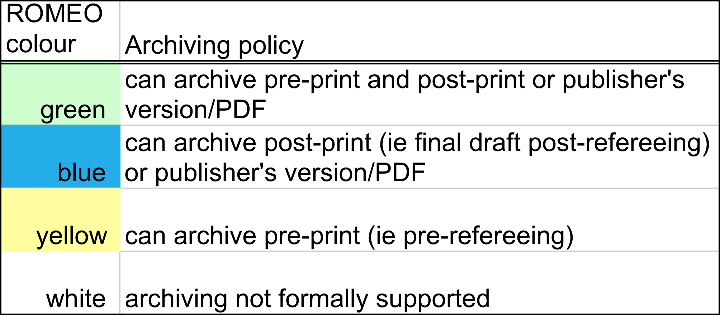
Notes:
A GREEN repository is a GOLD OA publisher/journal
Do some samples searches: logo is hot linked to Sherpa/Romeo URL
philosophy
business

Slide 16


Finding OA Journal Publishers
Directory of Open Access Journals
>10,000 OA, peer-reviewed journals
2,450: So Sci, Lang/Lit, Ed
33,057 peer reviewed, online
874 OA Arts/Lit, Ed, Ethnic/gender studies
OA, online, academic/scholarly, peer reviewed
Notes:
According to Steven Harnad About 25,000 peer-reviewed journals are published worldwide, in all disciplines and all languages=2.5 mil articles/annually
Ulrichsweb http://www.ulrichsweb.com/

Slide 17

Where not to publish
OASPA: Open Access Scholarly Publishers Association
http://oaspa.org/
COPE: Committee on Publication Ethics
http://publicationethics.org/
Beall’s List: Potential, possible, or probable predatory scholarly open-access publishers
http://scholarlyoa.com/publishers/
http://scholarlyoa.com/individual-journals/
Notes:
Avoiding predatory publishers:
Assess website, articles, editorial board
Red flags: multiple journals launched at once, irregular publishing, lack of focus, few articles published, high fees
Criteria for Determining Predatory Open-Access Publishers For more information on predatory publishers, including lists of publishers and standalone journals that meet these criteria, please visit http://scholarlyoa.com
By Jeffrey Beall
3rd edition / January 1, 2015
The criteria below are intended to provide a framework for analyzing scholarly open-access publishers and journals. The criteria recognize two documents published by the Committee on Publication Ethics (COPE):
Code of Conduct for Journal Publishers
Principles of Transparency and Best Practice in Scholarly Publishing

Slide 18
ETDs and Future Scholars 2011-2012 Publishers’ Surveys
Which of the following statements best reflects the editorial policy or practice governing your enterprise?
Manuscripts that are revisions derived from openly accessible electronic theses and dissertations (ETDs) are…
Always welcome for submission. Considered on a case-by-case basis. Considered ONLY IF the contents and conclusions in the manuscript are substantially different from the ETD. Considered ONLY IF the ETD has access limited to the campus or institution where it was completed. Not considered under any circumstances. Other (please elaborate)
Notes:
2011 Social Sciences and Humanities journal editors and press directors
2012 Science journal editors
The Primary Research Question

Slide 19
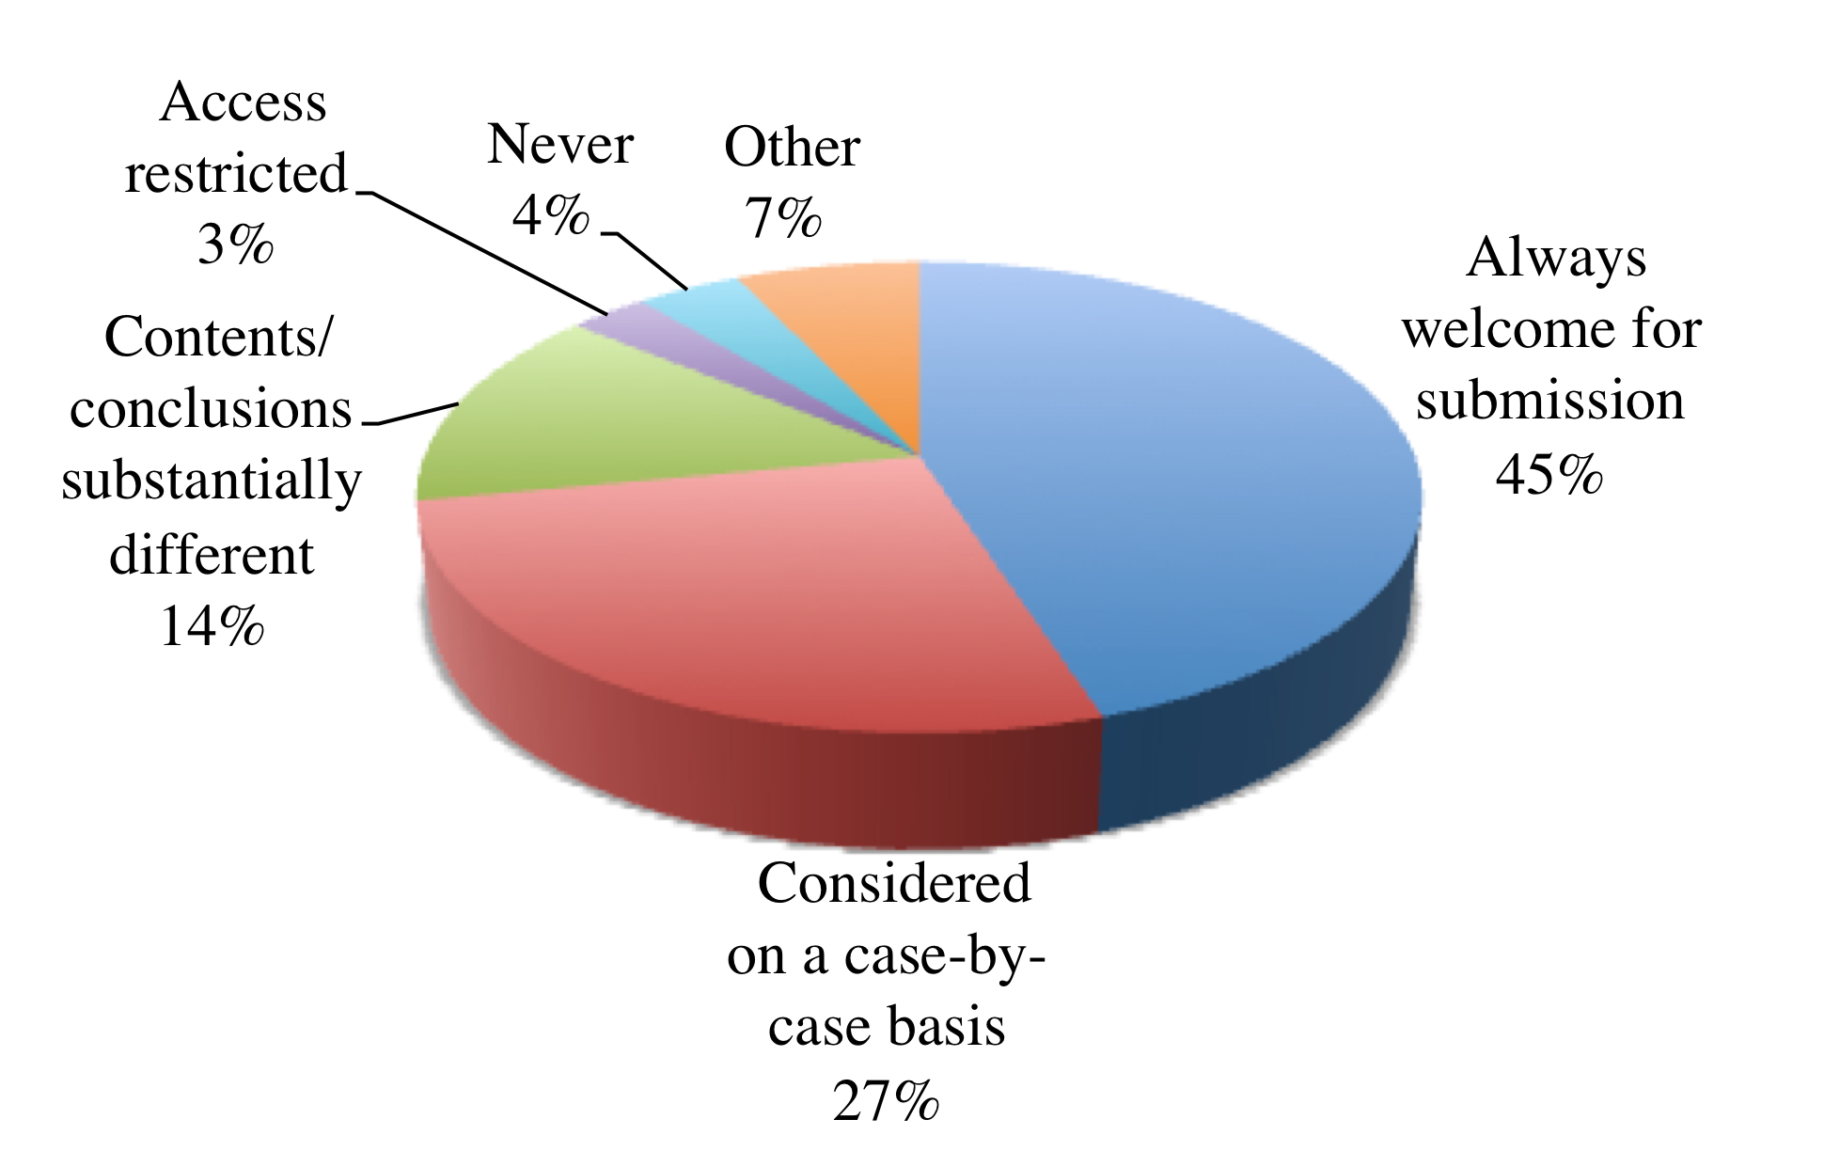
Hum/SoSci publishers’ responses: Manuscripts that are revisions derived from openly accessible ETDs are
75 (12% of 615) social sciences and arts and humanities journal editors
53 (40% of 131) AAUP press directors
17% response rate (128/764)
Notes:
This is the results of the combined journal editors’ and university press directors’ responses.
89% want to consider Mss. based on OA ETDs.
Only 4% said don’t bother sending us your Mss. based on OA ETDs.
Earlier (2000-2003) publications about publishers attitudes towards ETDs: http://scholar.lib.vt.edu/copyright/cprtetd.html
This study specifically investigated university press director’s and journal editors in the social sciences, arts, and humanities to learn about their attitudes toward publicly accessible, online theses and dissertations.
We conducted our study from May 17 - June 16, 2011, and was distributed to 615 journal editors and 131 university press directors via Survey Monkey.
80% of our respondents were Journal Editors and Editors-in-Chief.
88% were Directors and Associate Directors of university presses.

Slide 20
sible ETDs are…
Hum/SoSci journal and press responses: Manuscripts that are revisions derived from openly accessible ETDs are
Notes:
Here is a look at journal editors’ and press directors’ responses in 2011. Journal editors are more enthusiastic about receiving submissions based on ETDs. 66% said they always welcome Mss. derived from ETDs, but only a few press directors agreed.
This is not to say the university presses discourage submissions based on ETDs. More than half welcome or consider ETD-based Mss. submissions on a case-by-case basis.
Only university press directors find access restrictions necessary, which is interesting to me because it is in response to journal editors that we made limiting access to ETDs at VT an option.
But over 80% of the journal editors and the press directors will consider Mss. based on OA ETDs.
The subject areas of the majority of press directors who responded that they would never consider ETD-based manuscripts were: romance literature, applied and social psychology, and mathematical methods in the social sciences.

Slide 21
Comments: Humanities/Social Sciences Survey
“Prior availability through an IR is not usually the deciding factor. We are more interested in the quality of the work, how well it fits with our list, and whether it deserves wider dissemination and promotion.”
“We do not consider the dissertation to be the equivalent of a book. It is student work; a book is professional work.”
“Dissertations have never counted as publications… A pdf of an unpublished work is still an unpublished work.”
“The editorial review and publication process entails substantial refinement and revision of works that originate as part of doctoral work and thus we do not consider raw dissertations as competing with the works eventually published under our imprint.”
“We normally consider theses or dissertations for publication only if the author is willing to revise them for a broader audience; this is our practice regardless of the availability of an ETD.”
Notes:
Nearly half of our survey respondents volunteered comments and they are perhaps as telling as the numbers.
A frequent comment was that a T or D would need to be revised prior to submission to a university press or a journal in order to fit their publications’ guidelines. And, the rhetoric used in a T or D is usually not the appropriate writing style for a journal or the broader readership of a book.
A journal editor commented: “We treat Ts and Ds as unpub’d material… Readers will consider our article to be the version of record, the version they should read and cite, because (a) it will have been vetted by our double-blind peer review process, (b) it will have been professionally edited, and (c) it will be the most up-to-date version of the material.”

Slide 22
Science journal editors’ responses: Manuscripts that are revisions derived from openly accessible ETDs are
27.9% response rate
53 original respondents
28 non-respondents
phone interviews
Notes:
T = 293
Conducted Aug. 9 – 28, and Sept. 7-14.
Much better response rate because the NDLTD funded hiring student to call non-respondents

Slide 23
Comments: Science Editors’ Surveys
“A peer-reviewed publication that comes out of a dissertation or thesis should not only be encouraged but is crucially important for the scholar's development and advancement of scientific knowledge.”
“It is our job to archive and publish the best research. Thus we are quite happy to publish material which otherwise would sit languishing on an online archive.”
“While we recognise theses as legitimate and citeable publications, they are considered gray literature because they do not go through blind external peer review and are not published in a recognized peer reviewed outlet. They are not considered prepublication...”
“Work which has not been published in archival peer reviewed journals is considered appropriate for submission, even if it is accessible elsewhere.”

Slide 24
Publishers’ ETD Policies 2011/2012
Notes:
Most survey respondents will consider publications based on openly accessible ETDs.
However, in the particulars, Uni Presses and J eds vary among the options the survey offered.
Among the So Sci/Hum survey respondents, the option to “Considered ONLY IF the ETD has access limited to the campus or institution where it was completed” was never selected by journal editors. About 3% of the university presses directors prefer ETDs to have access restricted to the home institutions and only 2% of the science editors do.

Slide 25
Based on the data from 2011-2012 editors’/publishers’ surveys
Authors should submit works based on ETDs.
Most publishers will consider them.
89% SoSci/Humanities; 80% Sciences
Harvard Press acquisitions editor: “If you can’t find it, you can’t sign it.”
Quality is the publishers’ main concern.
Adapt them for the new readership.
Peer review is radically different.
http://crl.acrl.org/content/74/4/368.abstract?sid=bedcf9ba-1490-4b70-80af-deb7bfb40214
http://crl.acrl.org/content/early/2013/10/29/crl13-524.full.pdf+html
Notes:
there is very little data on the topic of publishers’ attitudes about ETDs. Most of the media coverage of this topic reports perceptions of publishers’ attitudes and anecdotes.
I’m very disappointed in the American History Association and the Association of Writers and Writing Programs because they do not provide any data to substantiate their recommendations. I think it is very harmful for them to make embargo recommendations based only on anecdotes and perceptions of publishing policies. The contemporary data as well as that from a decade ago clearly contradict these perceptions.
It is important that our students are informed about policies and practices at a variety of levels from the institution’s ETDs to the publishers’. Let’s encourage them not to wait until late in the ETD process to select several potential publishers and investigate their copyright and OA policies.
Do you have an option for a manuscript ETD? You can publish your work before you complete your ETD, of course, retaining copyright.

Slide 26
Changing Business Models APCs: Article Processing Charges
DOAJ
26% article processing charges: $964 (avg.)
61% commercial publishers; 11% university presses
OASF
Open Access Subvention Fund
PeerJ
Peer-reviewed journal for the biological, medical and health sciences
Institutional pre-payment account
Notes:
Here are 2 models: A business model that is gaining traction is shifting from demand-side to supply side, from user pays to author or institution pays
“average cost per article for an open access publishing system were $188 as reported by Edgar and Willinsky (2010) in a survey of
over 900 journals using Open Journal Systems,”
“high average OA APC, for example the $5,000 charged by Elsevier’s Cell Press”
“the average APC for hybrid subscription / open access journals of $2,727 reported by Outsell (2013).
Sustaining Knowledge Commons: http://sustainingknowledgecommons.org/?attachment_id=257
OA APCs article 2014 October 17, Heather Morrison [et al.?]
APC can be handled in a variety of ways

Slide 27
Virginia Tech Open Access Subvention Fund
Open to everyone at VT
For peer-reviewed articles accepted by open access or hybrid OA journals
Limited to $1500 per article and $3000 per author per year
Authors have no other funding sources available
Publisher complies with OASPA Code of Conduct
Journals must be registered in an open access directory
Publishers of hybrid OA journals must reduce institutional subscription prices
Funding limited; disbursed in the order in which requests received
Notes:
2 year pilot project: $8,000 from Provost, VP Research, Lib Dean
FY2015 added to annual budget allocation: $20,000 Provost, $30,000 Lib Dean
open access (OA) subvention fund to subsidize article processing fees for scholarly peer-reviewed articles accepted for publication in open access or hybrid OA journals.
A primary goal of the program is to enable authors to engage in new transformational open publishing environments. We hope to raise awareness among Virginia Tech authors of the benefits of open publishing and to encourage new ways of thinking about digital scholarship and information access.
The program aligns with the University Libraries strategic direction to support the research endeavors of our faculty and students, including the process of providing unrestricted access to digital research and scholarship.
OA fees are often reduced through discounts offered by University Libraries' memberships and subscriptions.

Slide 28
VT OASF Community Supported FY15 as of 1/27/15
Notes:
So far this fiscal year, Virginia Tech Libraries have unded 78 individuals (10 funded 2-3 times)
37 non-VT co-authors
No one has reached the funding limit: $3000 for 2 articles.
Smallest request: $148.50
Largest – maximum funded: $1500

Slide 29
VT OASF Community Supported FY15 as of 1/27/15
Notes:
Funded 28 articles, $34,459 (requested $41,186)
About $1230/article
Not funded: 21 articles: $26, 000 (requested $42,000)
Categories # Articles Not Funded
Submitted; not accepted 5 24%
Hybrid; no discount 10 48%
Predatory publisher 2 10%
Duplicate 1 5%
Not OA 1 5%
Other funding 2 10%
21 100%
The College of Business has not applied for funds.
The College of Liberal Arts and Human Sciences these faculty, staff and students are also supported through some other open models:

Slide 30



New Business Models
Notes:
A troubled market (from KU slides http://www.knowledgeunlatched.org/about/how-it-works/)
Sales of academic monographs have declined by 90% over 20 years: no. titles has increased and no. in the print run has decreased
Prices have increased beyond inflation
Publishers are struggling to cover their costs
Libraries struggle to afford books
Academics struggle to get published
Readers have limited access to the books they want
Libraries are paying the costs one way or another. WE want to support sustainable OA momograph/book publishing in the Hum/SoSci also
The Knowledge Unlatched model depends on many libraries from around the world sharing the payment of a single Title Fee to a publisher, in return for a book being made available on a Creative Commons licence via OAPEN and HathiTrust as a fully downloadable PDF.
297 libraries from 24 countries shared the cost of ‘unlatching’ 28 newly published Humanities and Social Sciences research titles, provided by 13 well-known scholarly publishers. After 24 weeks of the Collection being online, the number of downloads was recorded at 12,763 from 138 countries.
If a title costs $10,000 and 250 libraries contribute $40/each.
Many academic Presses (Purdue, Rutgers, Temple, Mich, Duke, Edinburgh, Liverpool, Cambridge
A study was recently done by the OAPEN Foundation, a non-profit dedicated to Open Access publishing of academic books, mainly in the Humanities and Social Sciences.
European publishers from 2010 to 2012. 50 academic books were published Open Access. For comparison, the publishers provided a similar title that was published in the conventional way. The result? “Open Access publishing [had] no negative effect on book sales, and [increased] online usage and discovery considerably.” [http://www.oapen.nl/index.php?option=com_content&view=article&id=58&Itemid=63]
Books with Open Access editions were sold in the same amounts as the conventional books in the control group. [p.5]
There was a clear effect on online usage. Online usage – measured through Book visits and Page views in Google Books – improved for the Open Access books. On average, discovery of Open Access books, measured as Book visits in Google Books, increased by 142%, and online usage, measured as Page views in Google books, increased by 209%. The effect of Open Access on online discovery and usage is also very clear when comparing average sales to average downloads for all Open Access books: 144 copies sold versus 2800 downloads. [p.5]
Open Library of the Humanities: proposed alternative is a system of Library Partnership Subsidy. Libraries support an infrastructure to get economies of scale. [https://www.openlibhums.org/2014/04/07/library-partnership-subsidies-lps/] …”the OLH model of sustainability takes its cue from the previously successful efforts of the PLOS. PLOS is a non-profit organization dedicated to publishing excellent, thoroughly peer reviewed scientific research under Open Access conditions at a financially fair rate.“ “The Open Library of Humanities (OLH) is a gold open access, peer-reviewed, internationallysupported, academic-led, not-for-profit, mega-journal, multi-journal and books platform for the humanities. It is funded by an international library consortium and so has no author-facing charges.”
“funded through cooperation, not through competition” fund an operation publishing 250 articles and 12 books in partnership with reputable presses per year; preliminary discussions to publish a series of open-access books in partnership with Cambridge University Press, Harvard University Press, Open Book Publishers and Oxford University Press.

Slide 31
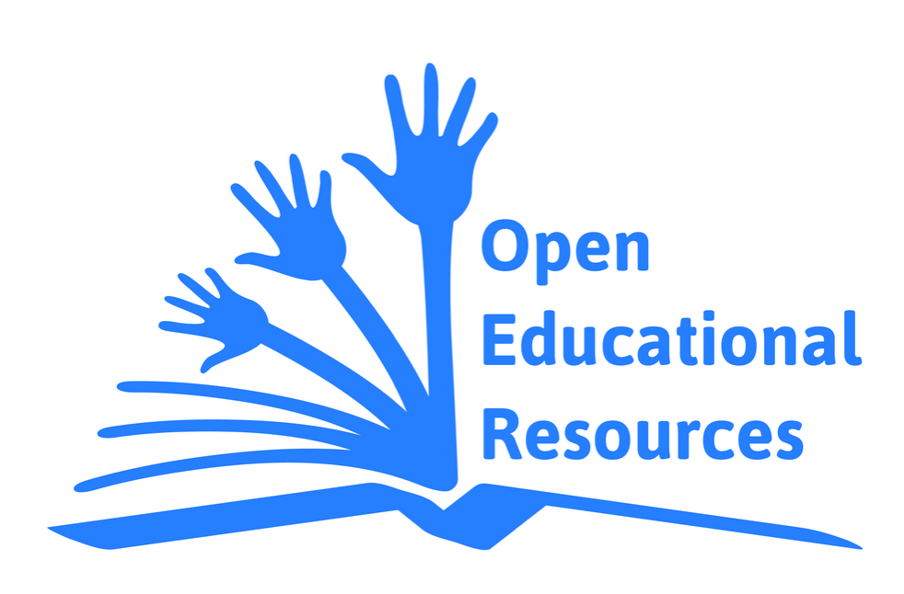
OER: Open Educational Resources
“teaching, learning and research resources that reside in the public domain or have been released under an intellectual property license that permits their free use and repurposing by others. Open educational resources include full courses, course materials, modules, textbooks, streaming videos, tests, software and any other tools, materials or techniques used to support access to knowledge." — The William and Flora Hewlett Foundation
Notes:
http://www.unesco.org/webworld/download/oer/EN/oer_logo_EN_2_CMYK.jpg

Slide 32
OER Advantages
Economic efficiency
Alignment of text content with classroom content
Online accessibility
Presentation of the text
Visually appealing
Organization
Readability
Notes:
First Monday, Volume 18, Number 1 - 7 Jan. 2013 http://firstmonday.org/ojs/index.php/fm/article/view/3972/3383
“The cost and quality of open textbooks: Perceptions of community college faculty and students by TJ Bliss, John Hilton III, David Wiley, and Kim Thanos”
[Rice http://openstaxcollege.org/books]

Slide 33
Measuring Scholarship
Tenure/Promotion
Research performance assessment
Impact factors
Average number of article citations in a journal
https://jcr.incites.thomsonreuters.com/
Article-level metrics
Citation advantage w/OA
80% studies say, “Yes.”
http://sparceurope.org/oaca_table/
Altmetrics: alternative scholarly barometers
Notes:
Publishers (such as PLOS, BioMed Central, and SageOne) are already displaying Article-Level metrics.
Citation advantage: many are Subject specific studies
Metrics of research usage and impact quantify, evaluate, navigate, propagate and reward the fruits of OA self-archiving, motivating Green OA Mandates.
Altmetrics: “socialization” of scholarship, tracking timely usage, mentions, and other signals of general circulation among an engaged, online audience. http://crln.acrl.org/content/75/10/542.full

Slide 34
Altmetrics
Study and use of scholarly impact measures based on activity in web-based environments
Leverages technologies to extend the reach and impact of scholarship
Takes advantage of today’s faster communication
Scholars reach beyond academia (i.e., funded subscribers) to a wider audience.
Notes:
‘Today academic scholarship is shared, discussed, and valued in our networked digital environment (e.g. Cohen 2012). These digital acts of disseminating and sharing scholarly and academic production leave traces of impact, in things like download and view counts, links and mentions in citation management tools, and content sharing across social networks. These traces are being collected, examined, and considered under the umbrella term altmetrics,’
Rodgers, E.P. and S. Barbrow. A look at altmetrics and its growing significance to research libraries. The University of Michigan University Library. 2013. <http://hdl.handle.net/2027.42/99709> p. 3.
ALTMETRICS phrase first coined by Jason Priem in a tweet on Sept. 28, 2010. He is one of a growing number who advocate building a reward system that values and encourages new forms of web-native scholarship.
blog post mentions, Twitter citations, use of an article within citation managers like Mendeley and Zotero, user downloads on data-sharing platforms like figshare
ImpactStory, Altmetrics, PlumAnalytics

Slide 35
Some Sources of Altmetrics
Usage
HTML views, PDF downloads (e.g., journal, PubMed Central, FigShare, Dryad, etc.)
Captures
CiteULike bookmarks, Mendeley readers/groups, Delicio.us
Mentions
Blog posts, news stories, Wikipedia articles, comments, reviews
Social Media
Tweets, Google+, Facebook likes, shares, ratings
Citations
Web of Science, Scopus, CrossRef, PubMed Central, Microsoft Academic Search
Notes:
By looking at some of the computer mediated social networks, we can categorize Altmetrics into these sources [Richard Cave, IT Director at PLOS
figshare is a repository where users can make all of their research outputs available in a citable, shareable and discoverable manner.
figshare allows users to upload any file format to be made visualisable in the browser so that figures, datasets, media, papers, posters, presentations and filesets can be disseminated in a way that the current scholarly publishing model does not allow

Slide 36
Altmetrics can look like this
Cave, Richard. “Overview of the Altmetrics Landscape”
http://www.slideshare.net/rcave/overview-of-the-altmetrics-landscape
11/10/12 1/22/2015
Likes 14 28
Downloads 45 158
Embed Views 240 543
SlideShare views 1,938 8,092
SpringerLink ink.springer.com, for example
http://link.springer.com/article/10.1007/s11098-013-0236-1
http://link.springer.com/article/10.1007%2Fs10902-012-9345-3
Notes:
In conclusion:
Altmetrics and traditional bibliometrics are complementary tools presenting a multidimensional view of multiple research impacts at multiple time scales.
Altmetrics tools:
ImpactStory: https://impactstory.org/about: Impactstory is an open-source, web-based tool that helps scientists explore and share the diverse impacts of all their research products—from traditional ones like journal articles, to emerging products like blog posts, datasets, and software. By helping scientists tell data-driven stories about their impacts, we're helping to build a new scholarly reward system that values and encourages web-native scholarship. We’re funded by the NSF and the Alfred P. Sloan Foundation; IS is a 501(c)(3) nonprofit corp.
Plum Analytics:http://www.plumanalytics.com/: tracks more than 20 different types of artifacts, including journal articles, books, videos, presentations, conference proceedings, datasets, source code, cases, and more. We founded Plum™ Analytics to give researchers and funders a data advantage when it come to conveying a more comprehensive and time impact of their output. We not only measure individual research artifacts, but also amass metrics for labs, departments and other meaningful groups.

Slide 37

What You Can Do Now
Archive your articles, data, presentations, syllabi, reports, white papers in
Read contracts and use addenda to gain self-archiving rights
Consider a departmental, college, or university-wide policy on article archiving
Publish open access journals
Help change promotion and tenure guidelines

Slide 38
The State of Scholarly Publishing
Gail McMillan
Professor, Virginia Tech Libraries
Director, Scholarly Communication
gailmac@vt.edu
Notes:
[Thanks to Anita Walz and Philip Young, my colleagues at Virginia Tech Libraries. Their work in OER/Cc and OA, respectively, helped tremendously to inform me for this presentation. See their presentations in VTechWorks and elsewhere.]

