Slide 1
Planting a Melodious Vegetable Garden
Where the History of Food & Drink Meets a Musical Composition
Kira A. Dietz
Acquisitions and Processing Archivist
(& Unofficial History of Food & Drink Archivist!)
Special Collections, Virginia Tech
MARAC Fall 2013
November 8, 2013

Slide 2
The History of Food & Drink Collection @ Virginia Tech
Established in 1999-2000
Currently contains more than 4,200+ publications
2,800+ of these are housed in Special Collections
50+ manuscript collections
Handwritten receipt (recipe) and home remedy books, household account ledgers, faculty papers, pamphlets, and culinary/cocktail ephemera

Slide 3
Core Collecting Areas
Regional cookbooks & early American imprints
Community cookbooks (Virginia and Appalachia)
Brand-name/advertising pamphlets & publications
Menus, nutrition education, & kitchen planning
Social, domestic, & economic history; changes in food behavior, food processing, & technology
Papers from regional faculty, dieticians, extension/home demonstration agents, chefs
Manuscript receipt/recipe books
Children’s cookbooks and nutrition literature
American cocktail history

Slide 4

The Book
Vegetable Verselets for Humorous Vegetarians by Margaret G. Hays; with illustrations by Grace G. Wiederseim.
Philadelphia; London: J. B. Lippincott, 1911.
(Yes, it out of copyright and available in its entirety online!)

Slide 5
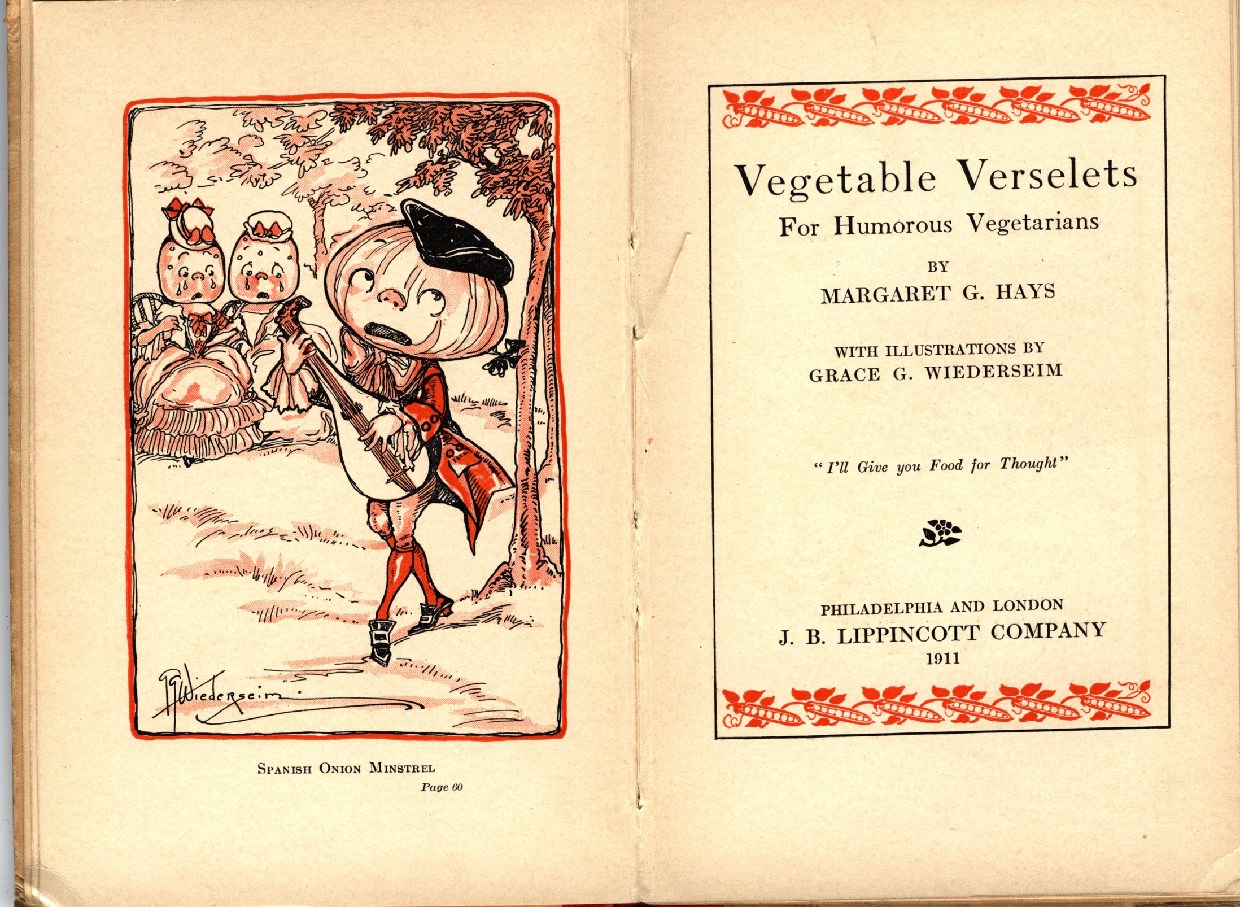

Slide 6
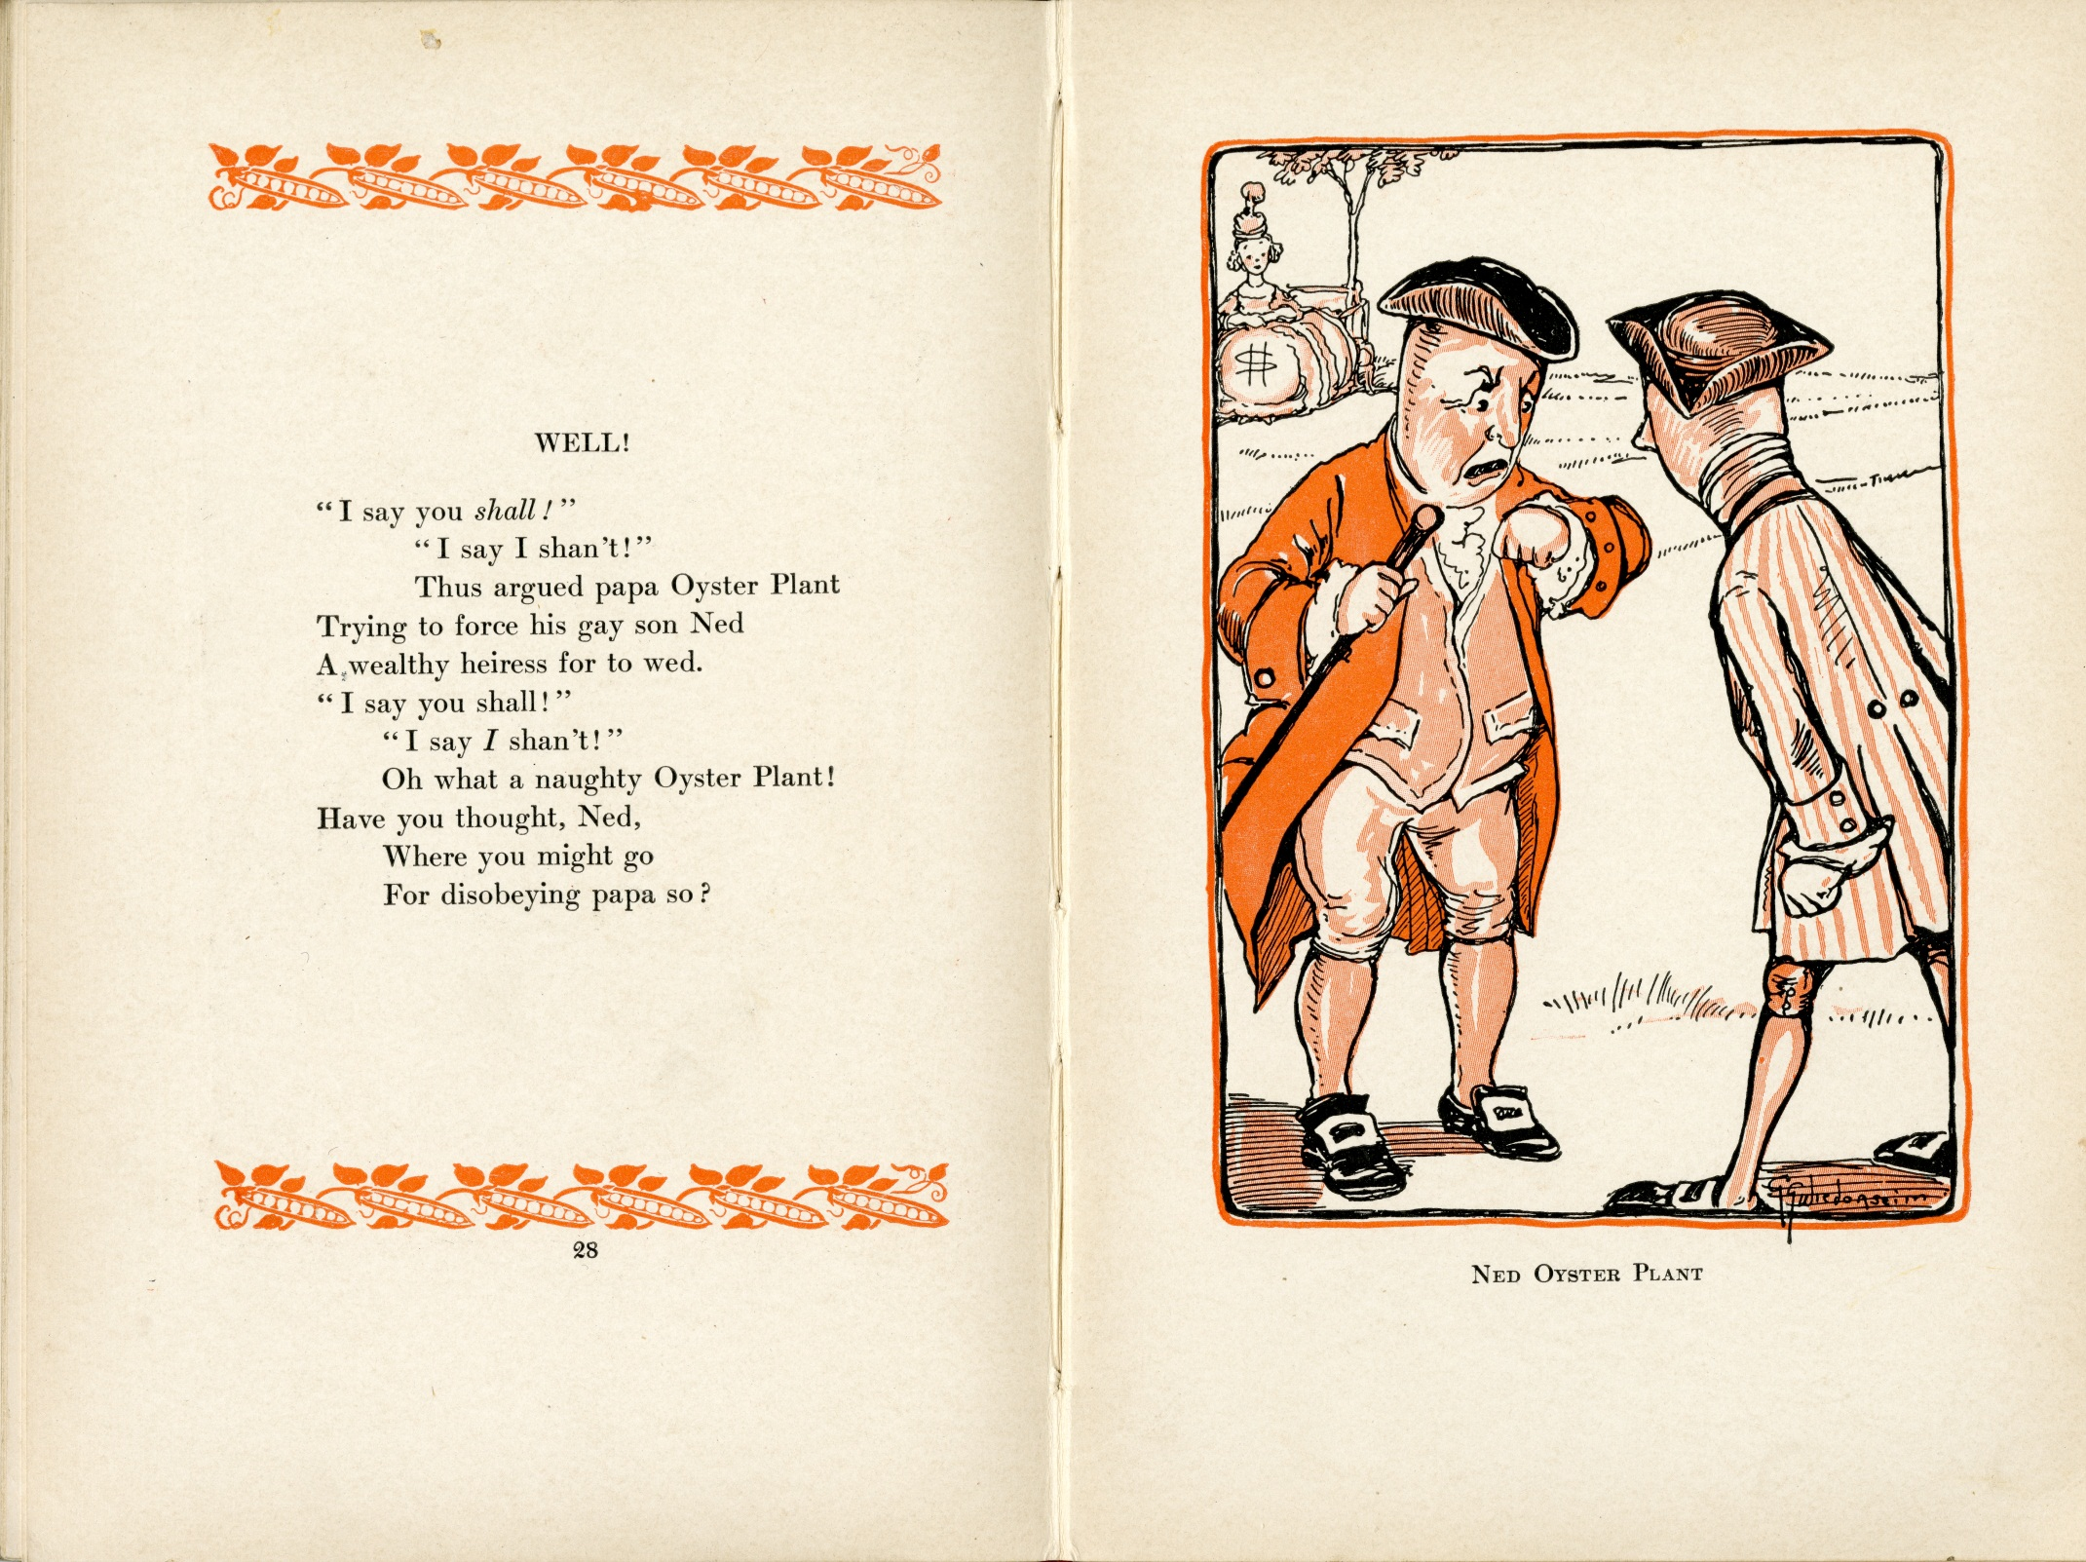

Slide 7
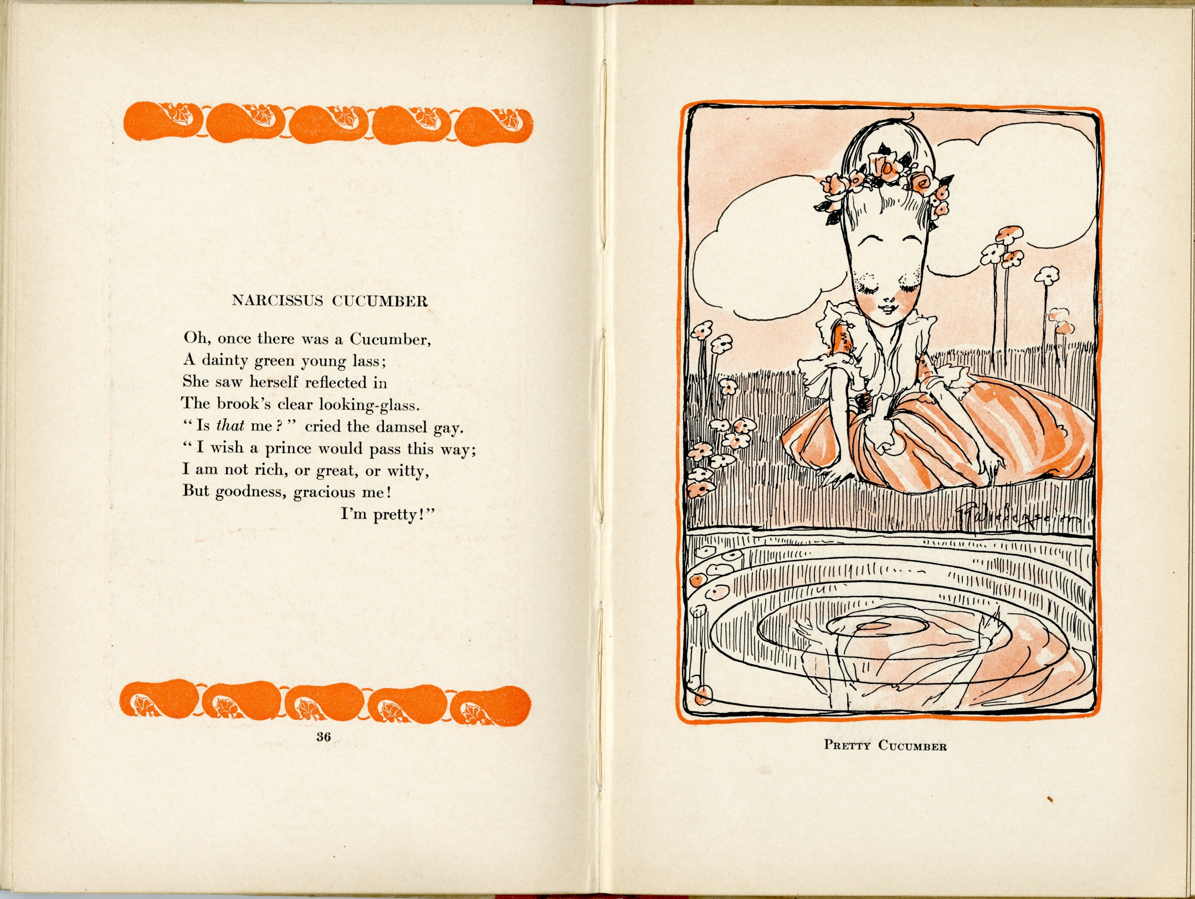

Slide 8
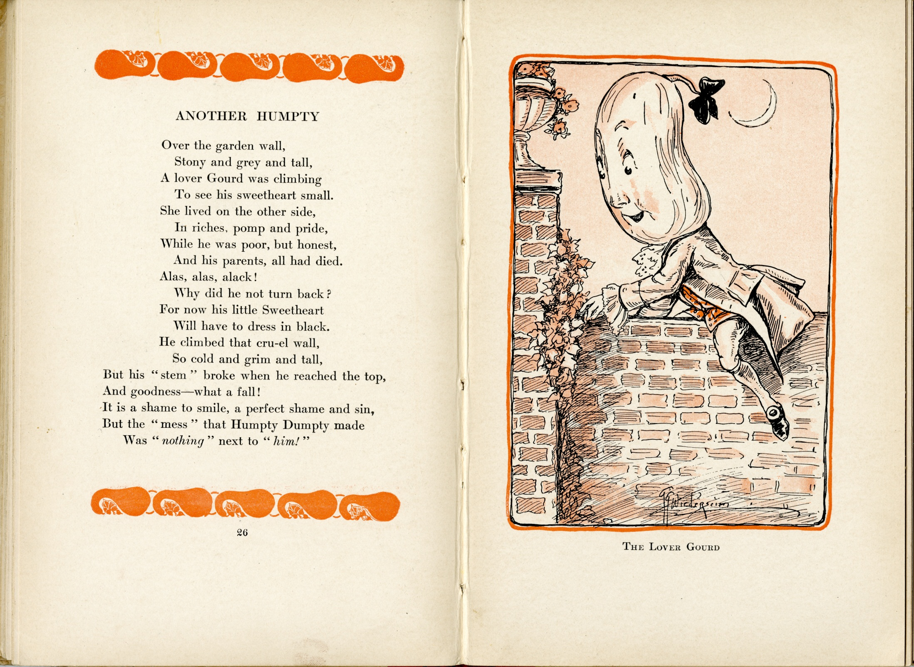

Slide 9
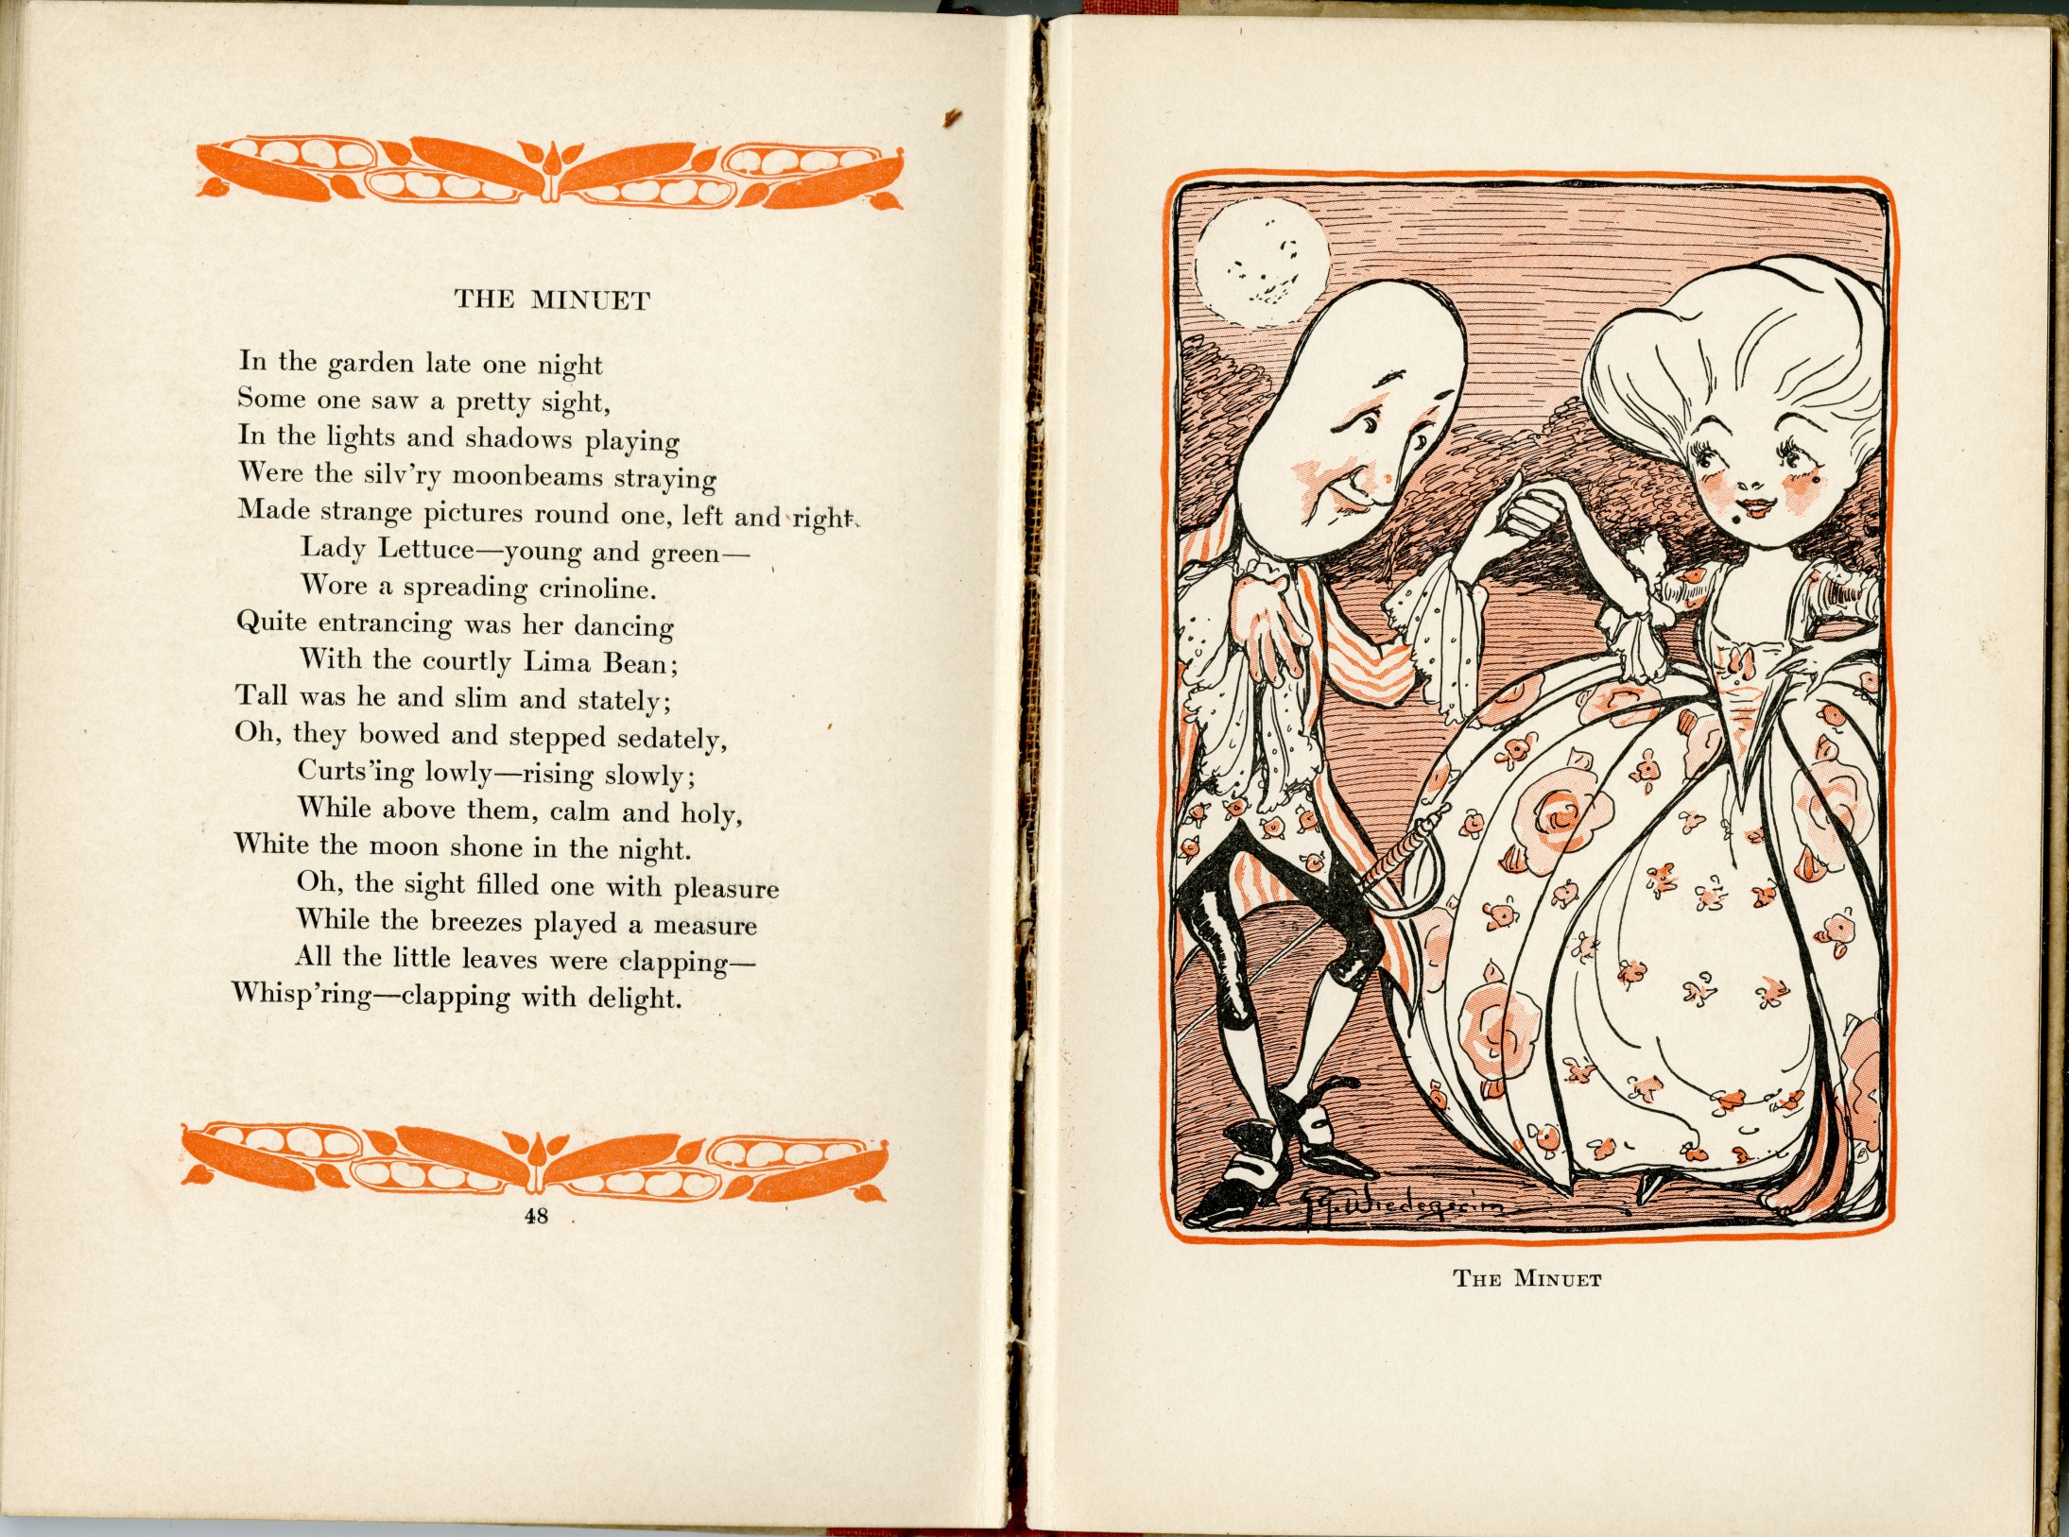

Slide 10
How a Song Cycle is Born
Serendipity
+ An archivist and a pianist
+ A composer and a soprano
+ A bunch of people with a great sense of humor
= “Vegetable Verselets” (A Song Cycle)

Slide 11
The Results
Outreach opportunities for Special Collections, the University Libraries, and the Department of Music
A month long display in our exhibit cases
A lovely afternoon concert with many laughs
A catered reception
An afternoon “hands-on” exhibit
An amazing song cycle

Slide 12
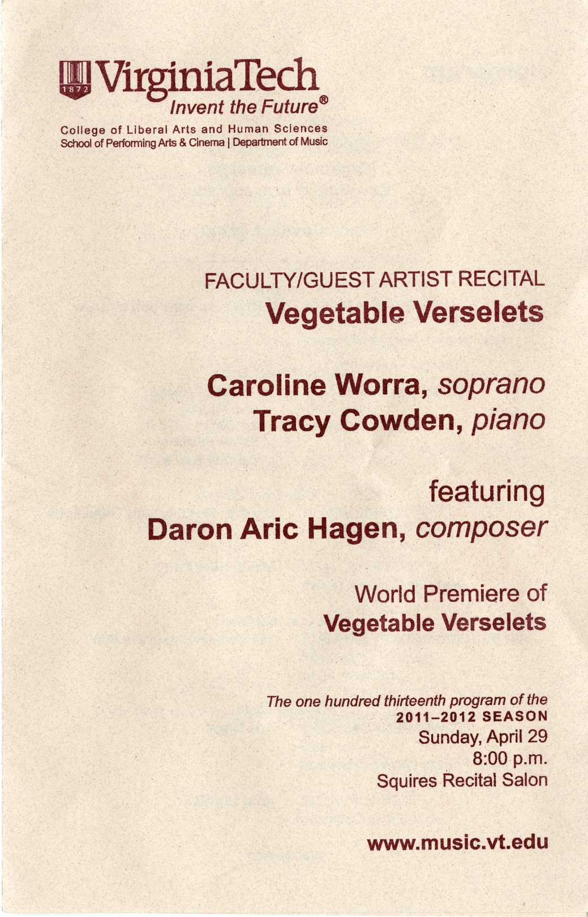

Slide 13
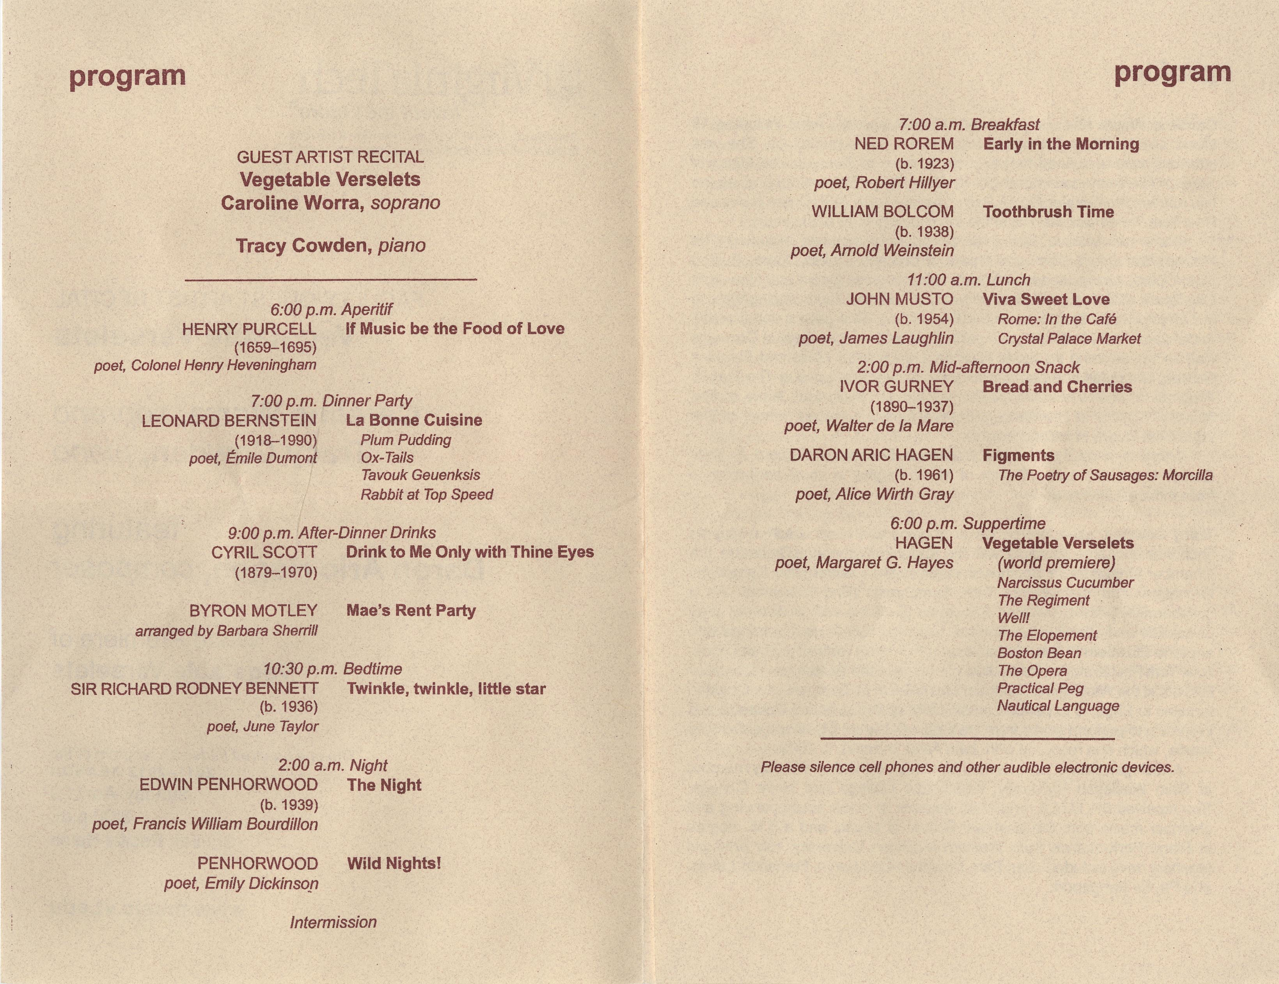

Slide 14
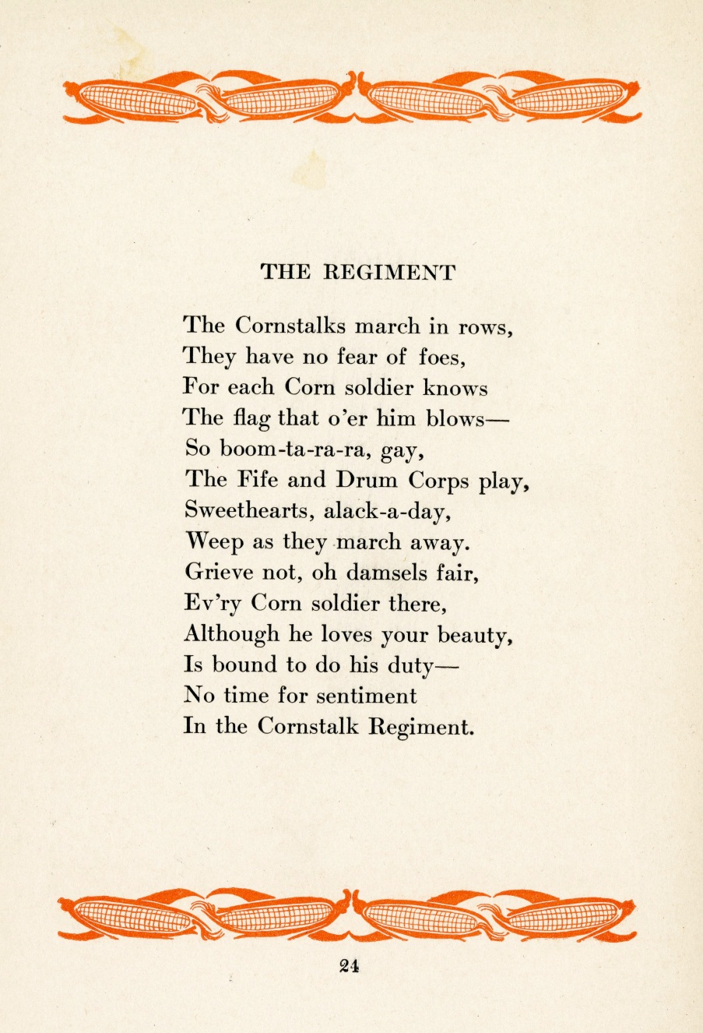

“The Regiment”
Please note: the original version of this presentation included a link to an audio clip from the concert recording. For copyright reasons, it was removed by the presenter.

Slide 15
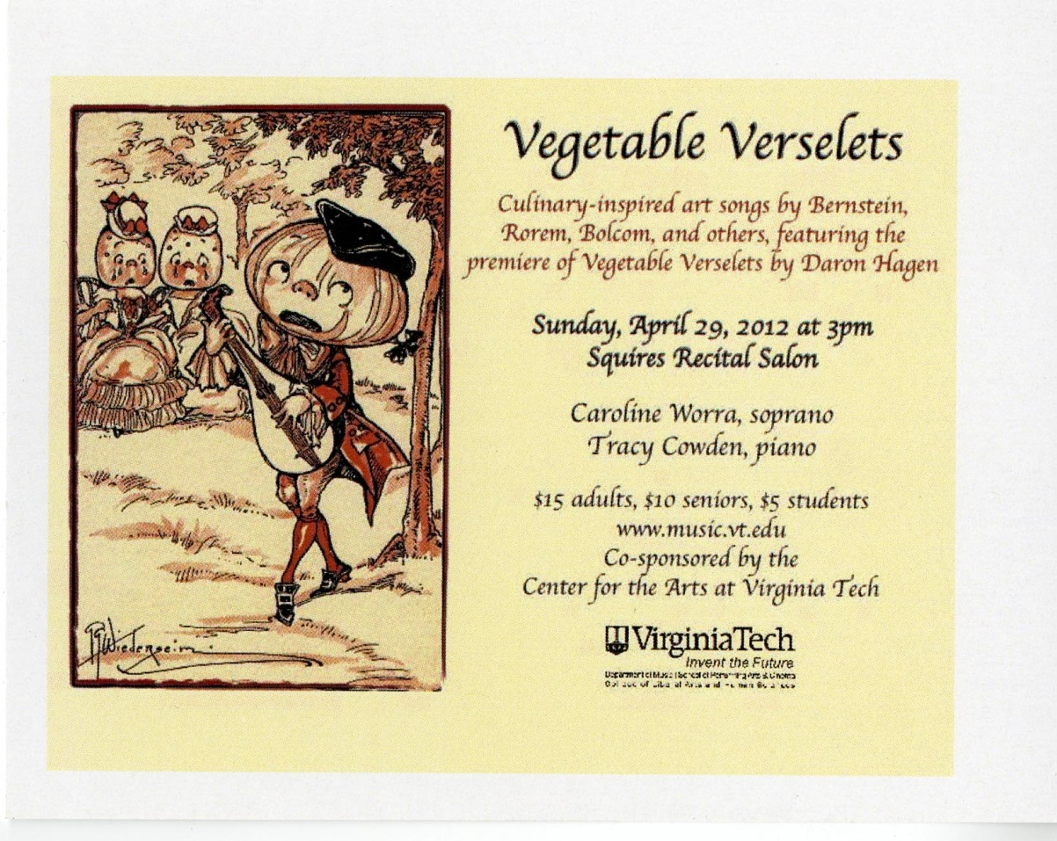

Slide 16
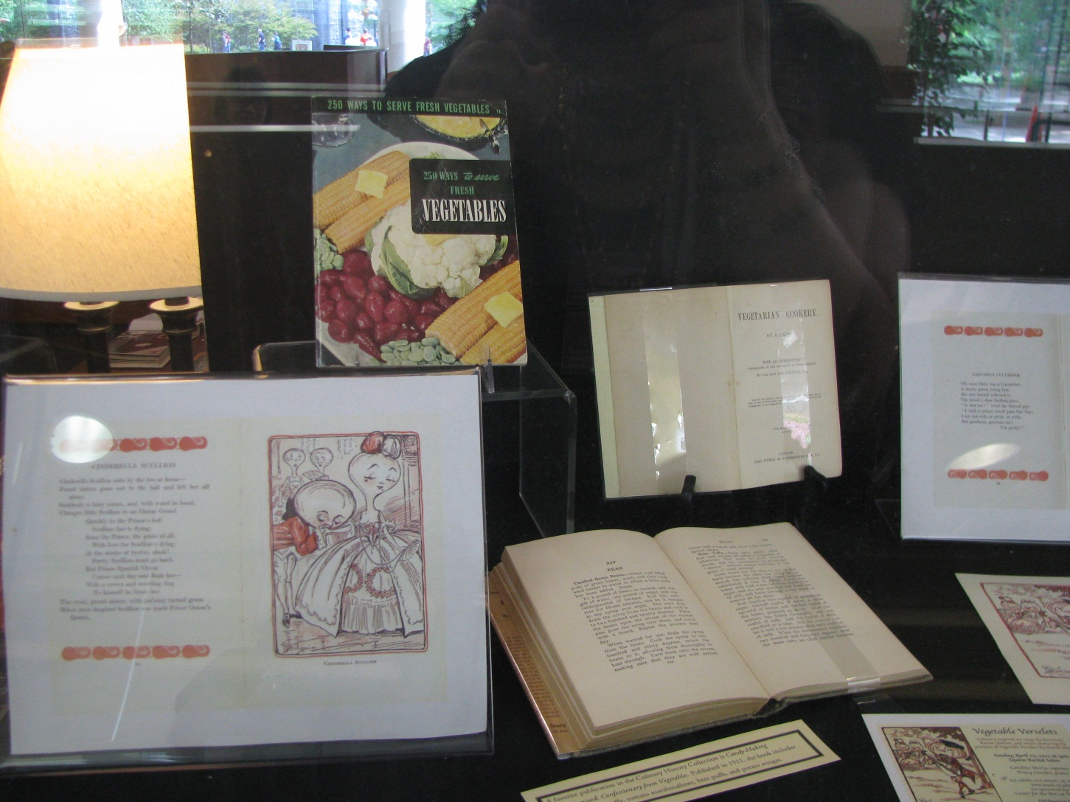
Vegetable Verslets/History of Food & Drink Collection Exhibit

Slide 17
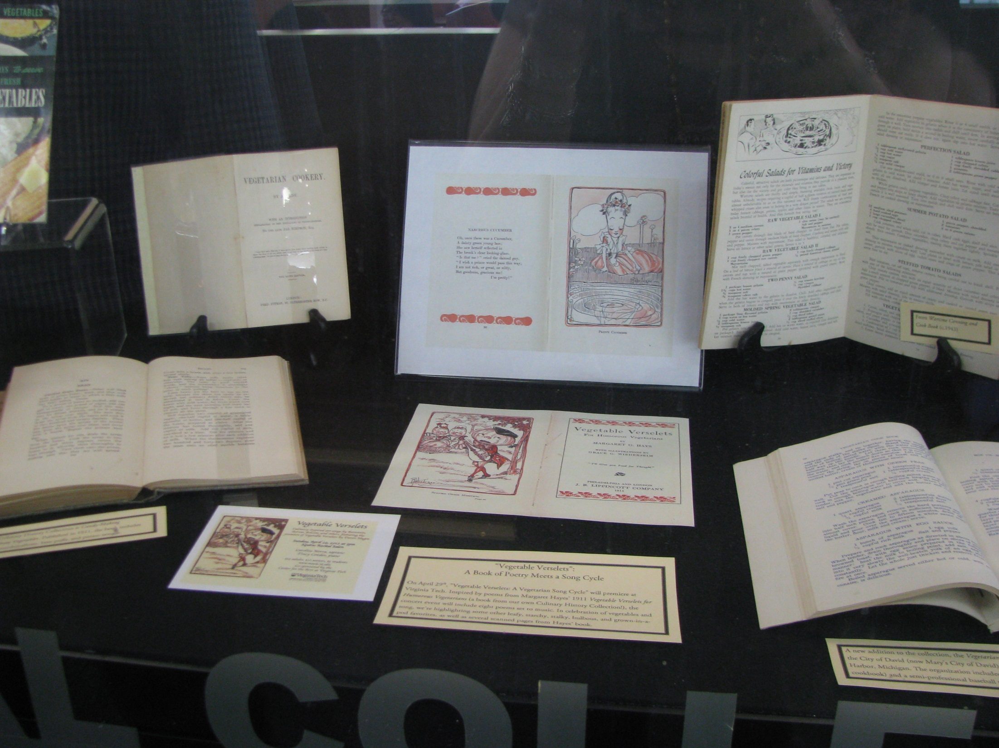

Slide 18
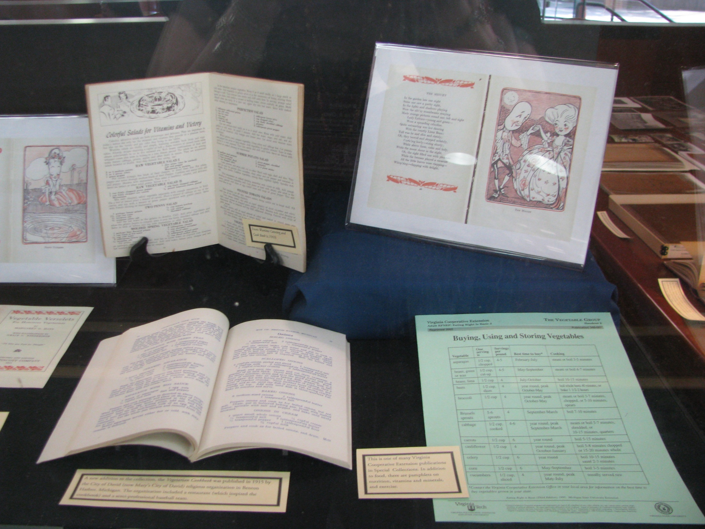

Slide 19
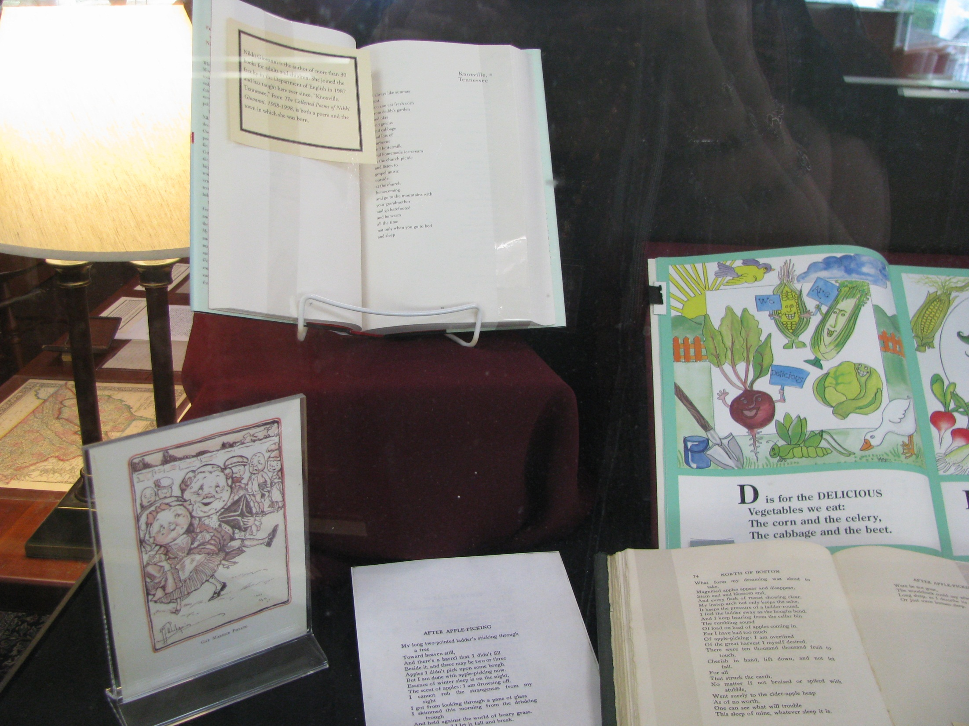

Slide 20
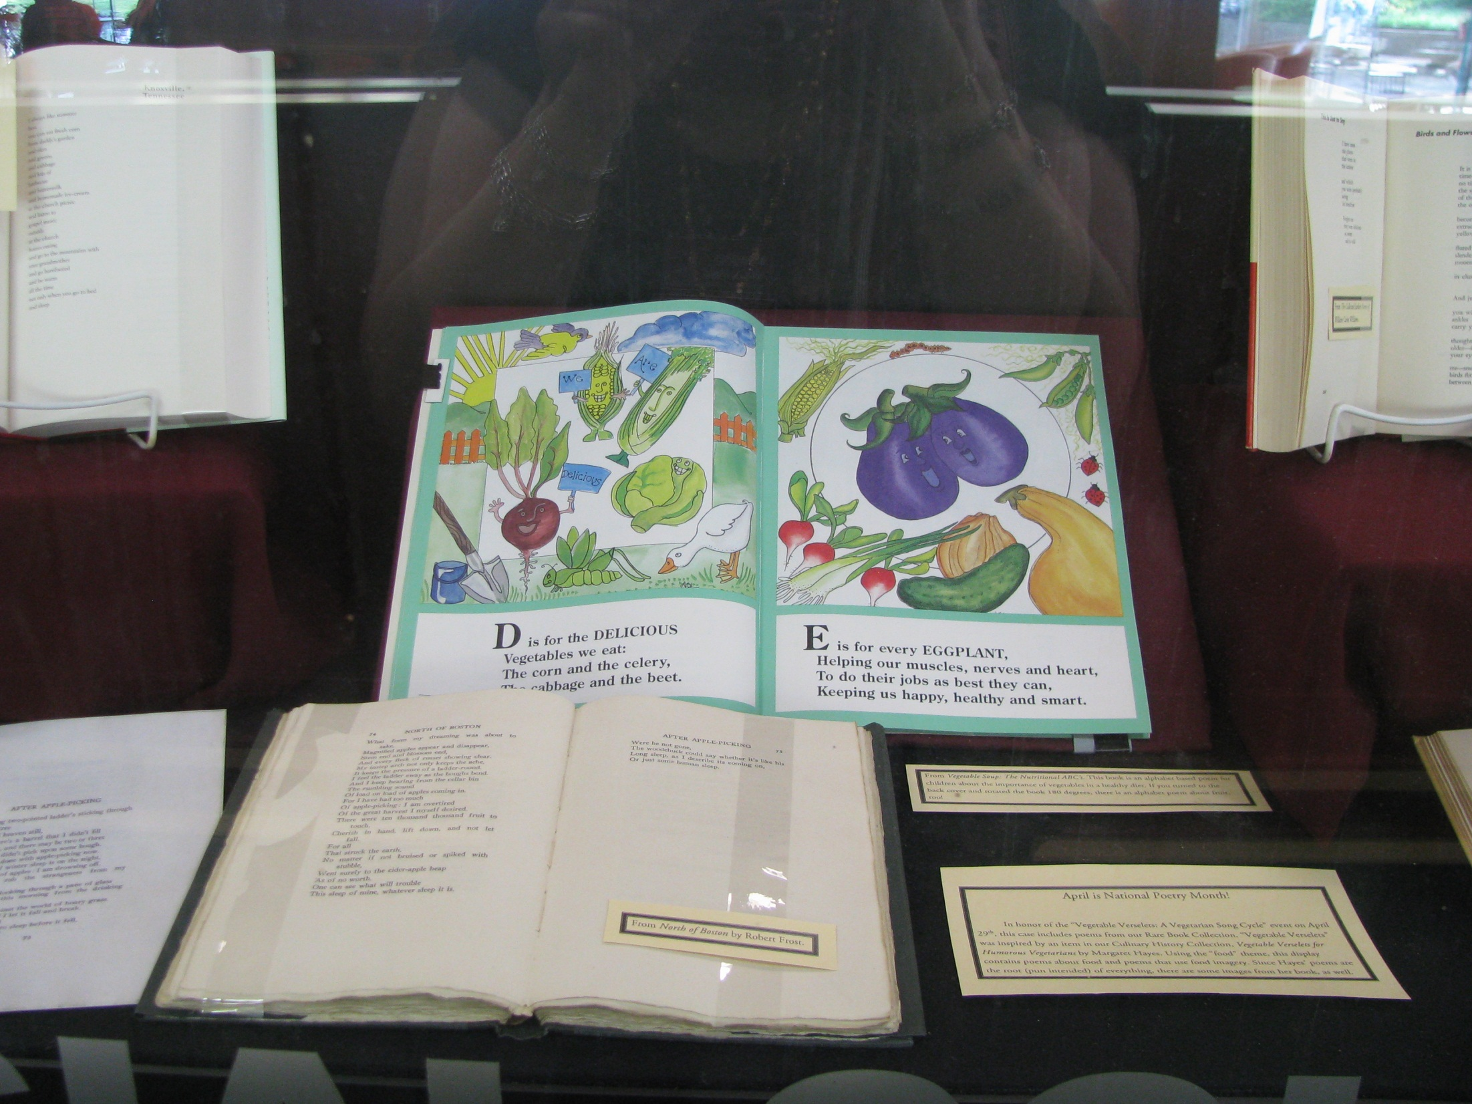

Slide 21
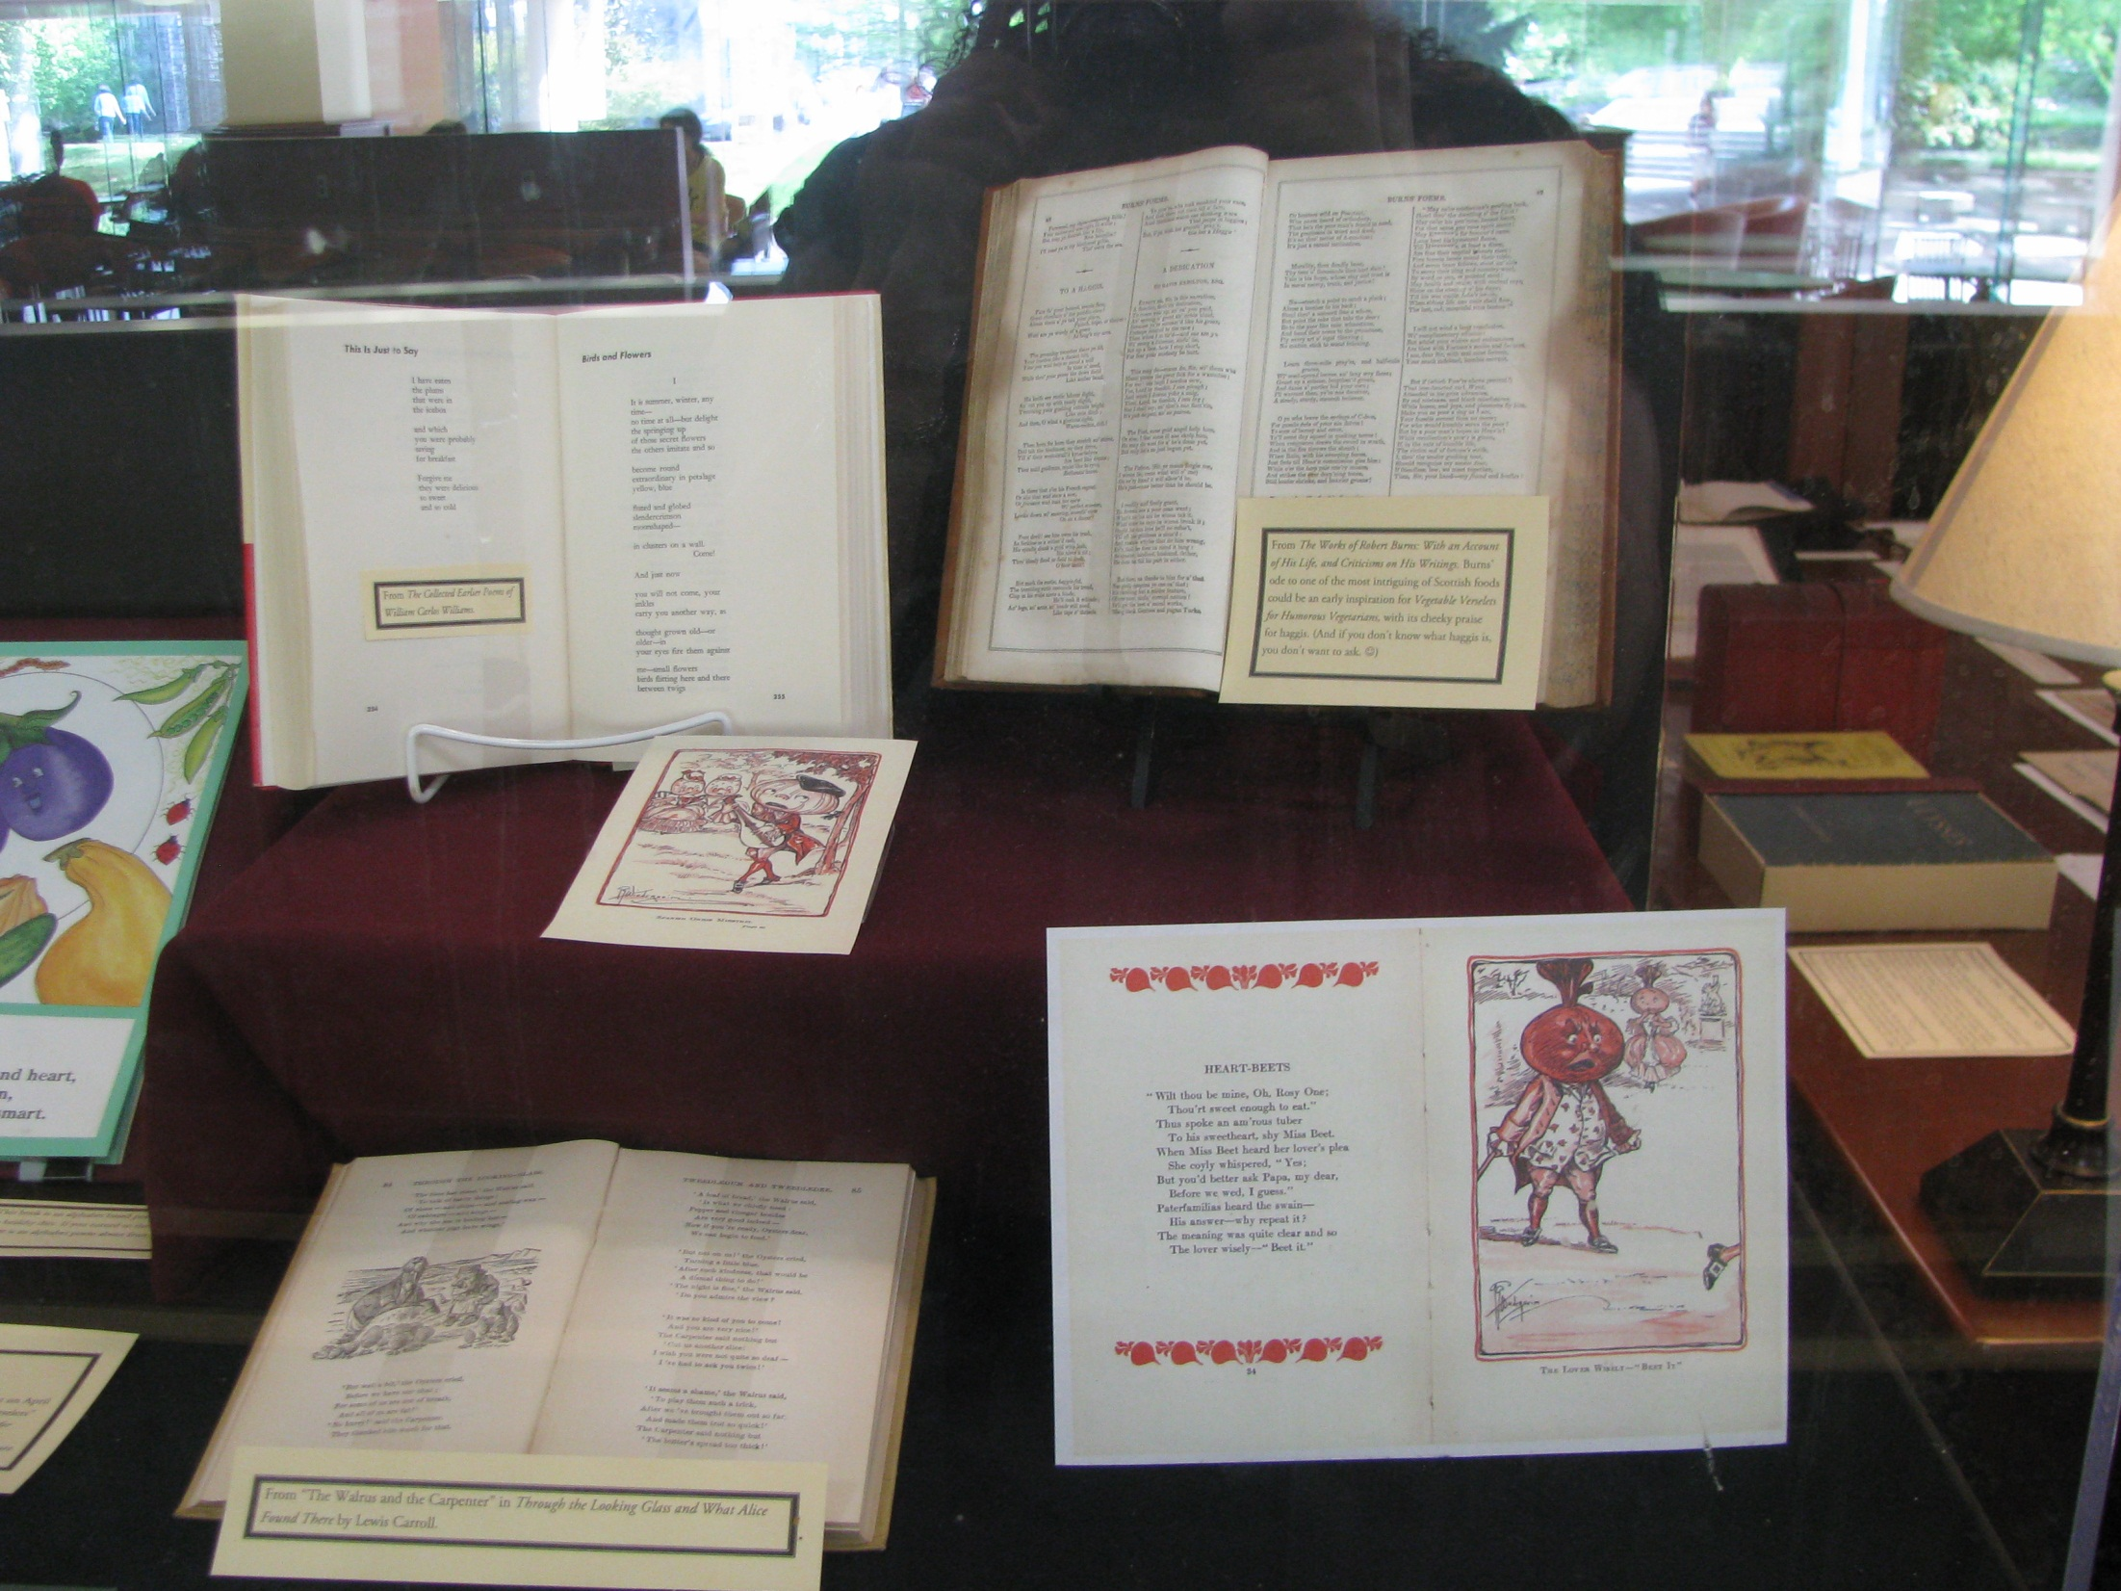

Slide 22
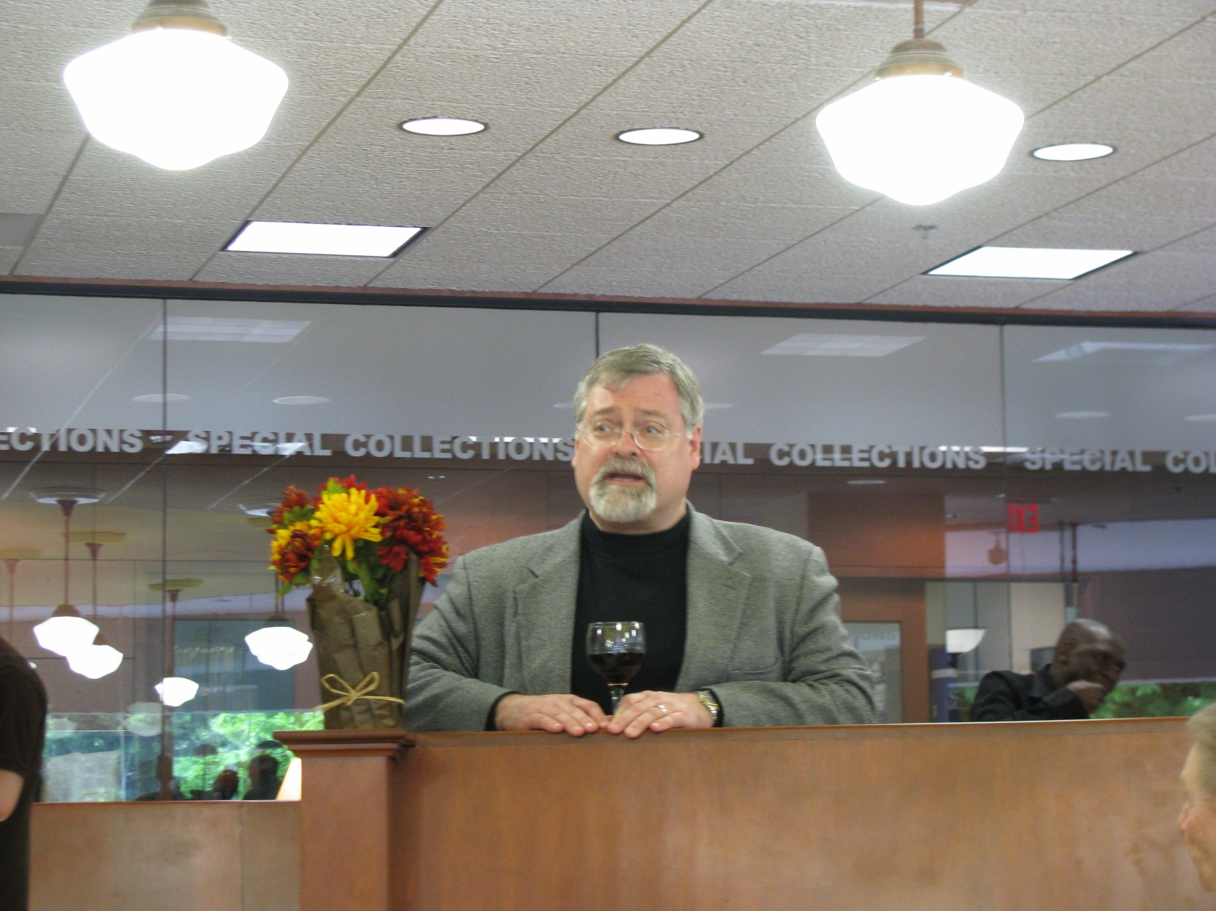
Vegetable Verselets Reception, April 29, 2013

Slide 23
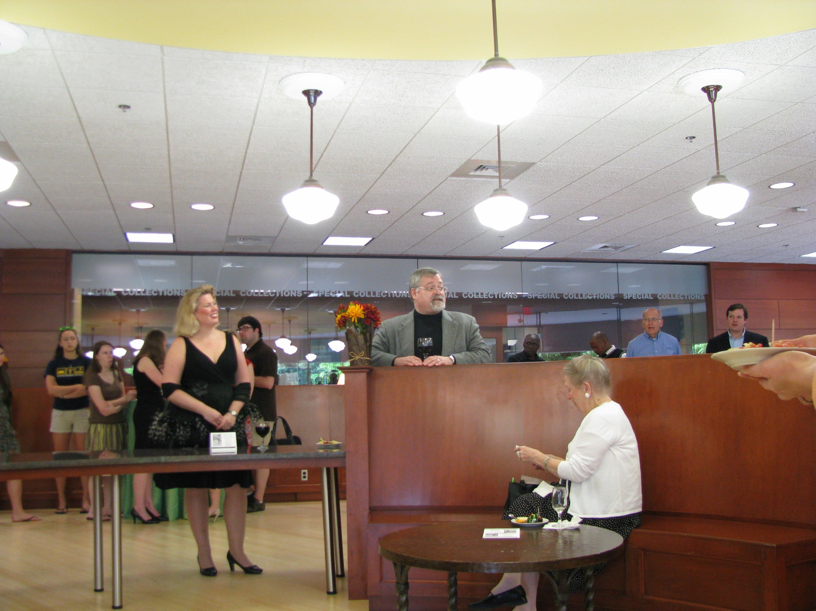

Slide 24
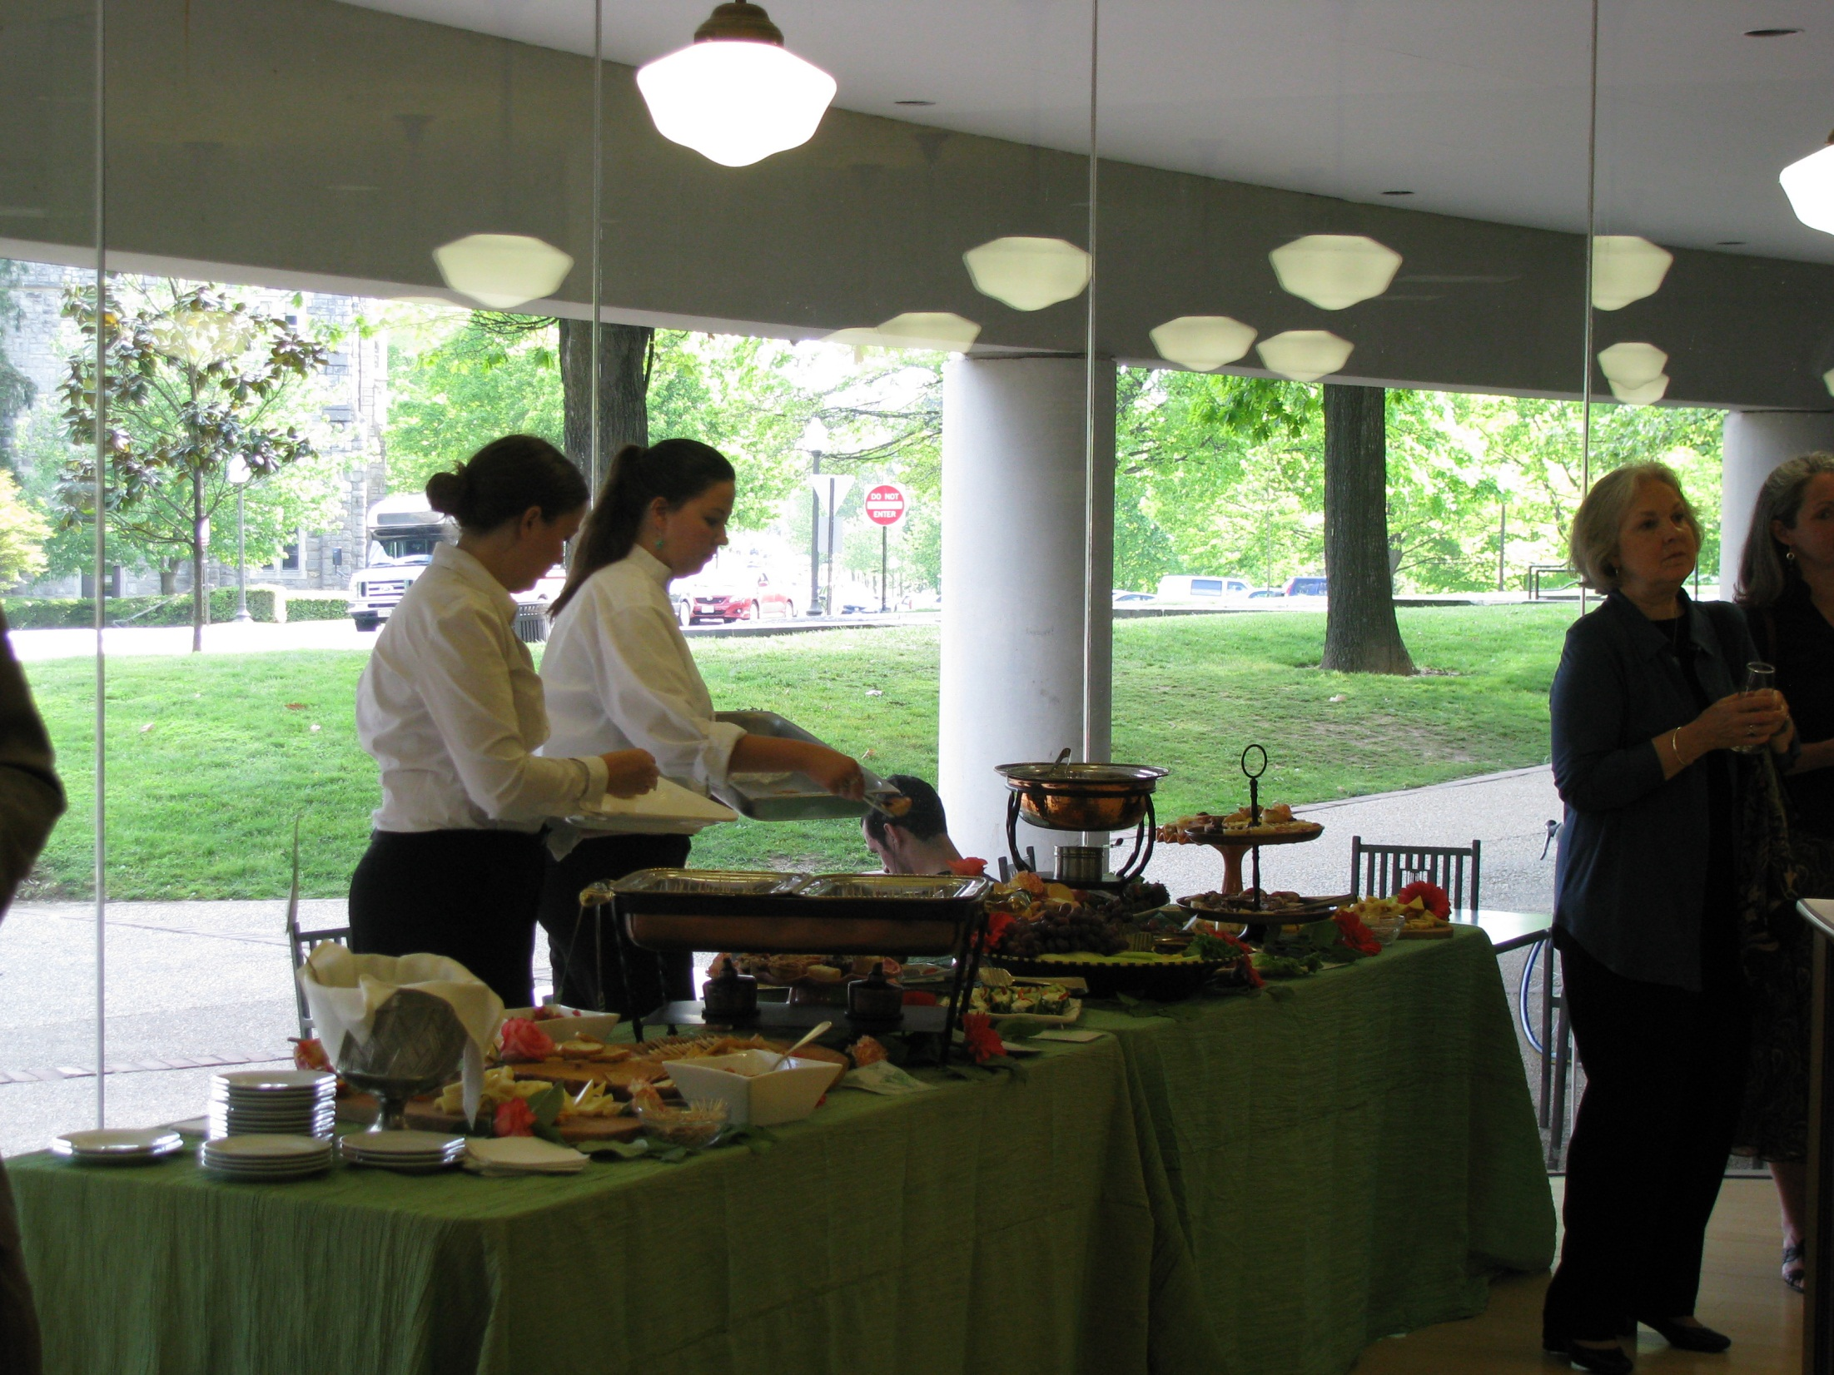

Slide 25
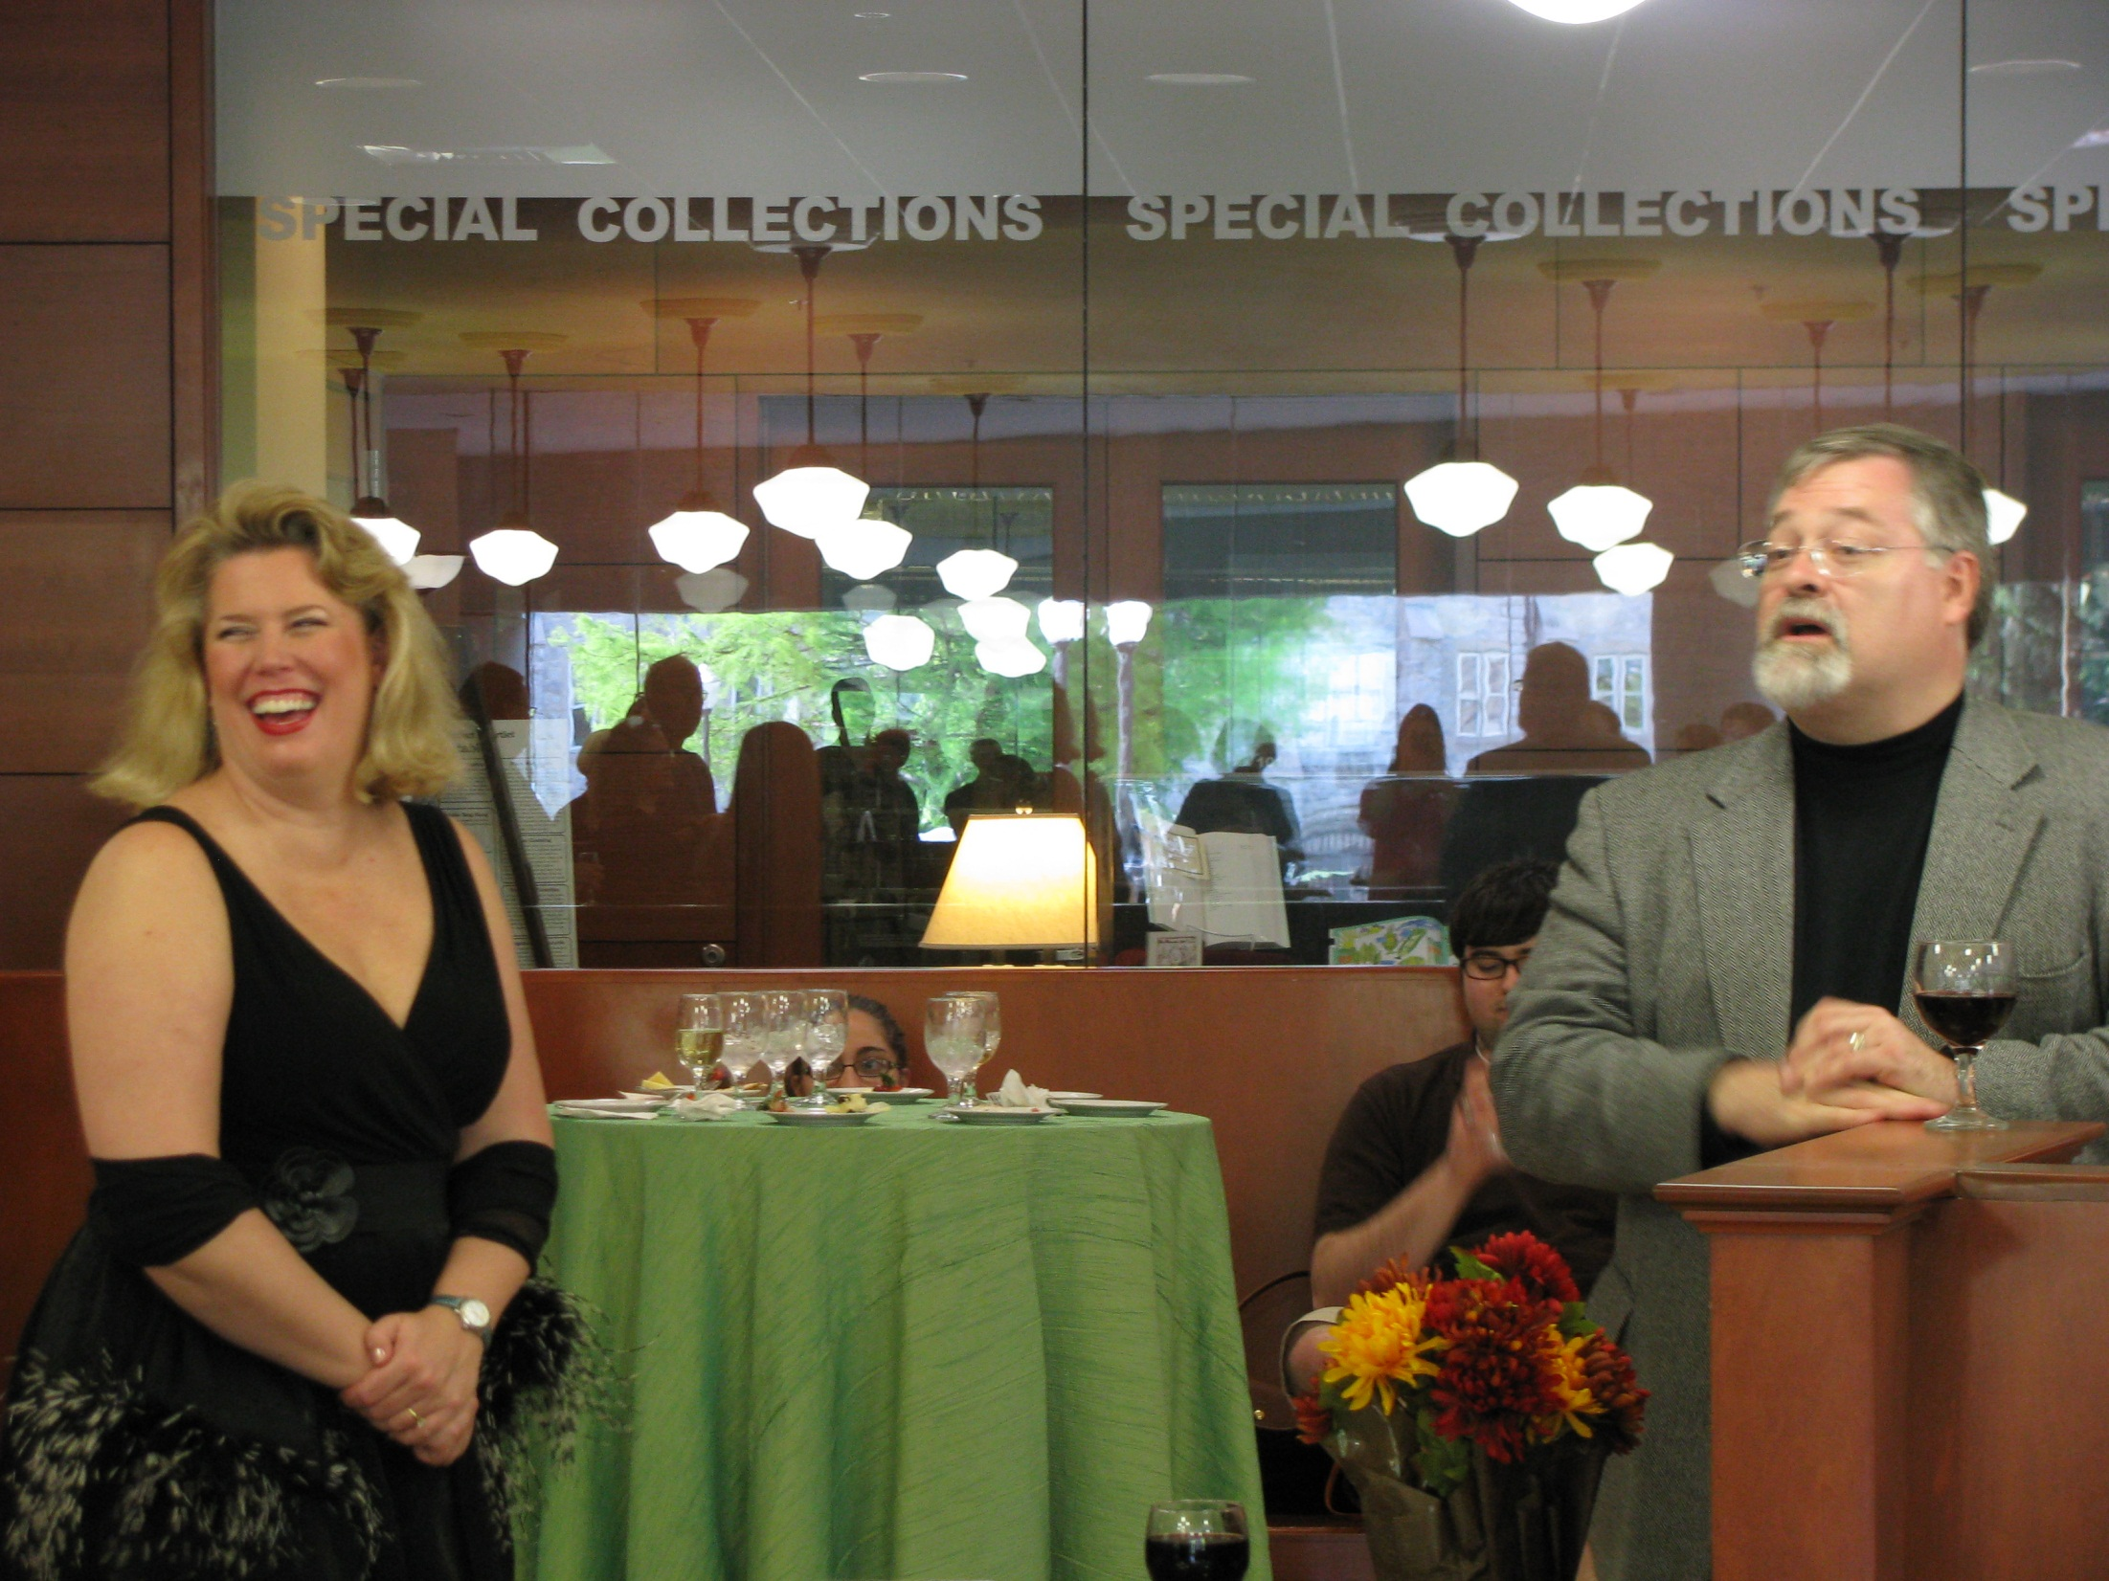

Slide 26
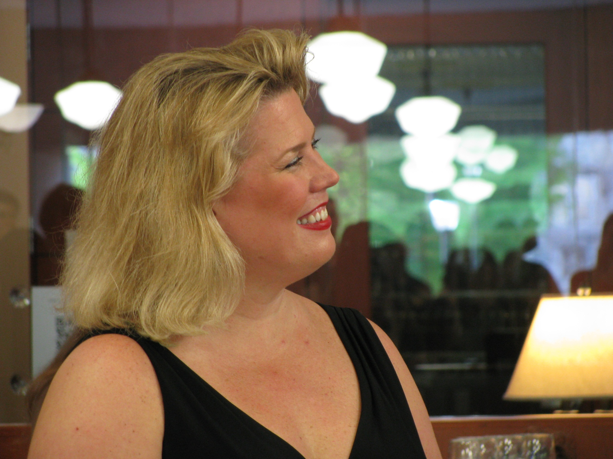

Slide 27
Don’t Forget to Eat Your Veggies (A little advice)
Plan, plan, and plan some more
Be sure to include people from all relevant departments
Communicate often
Take advantage of the unplanned opportunities
Have fun!

Slide 28
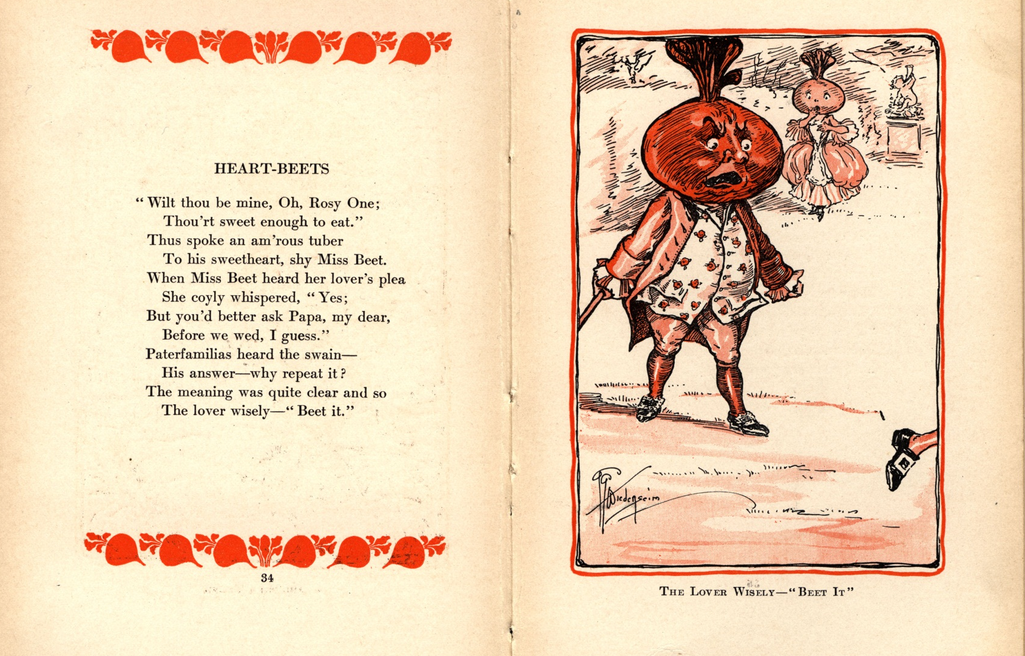
Kira A. Dietz Special Collections, Virginia Tech kadietz@vt.edu http://about.me/kiradietz

