Slide 1
CINET Registry
Mentor
Dr. Keith Bisset (NDSSL, VBI)
Aditya Agashe,
Harshal Ganpatrao Hayatnagarkar and
Sarang Joshi
6 May 2014
Presentation #8
CS 6604 - Digital Libraries
Virginia Tech, Blacksburg, VA, USA

Slide 2
Project Overview
Hypothesis: To model CINET catalog in a Digital Object based repository.
Migration Project: RDBMS Catalog to Digital Object Repository based catalog.

Slide 3
Objectives
Modelling
Migration
CRUD Operations
Faceted Browsing
Services and Visualizations
Workflow
Notes:
This workflow represents steps for migrating from current relational schema to digital object based schema.

Slide 4
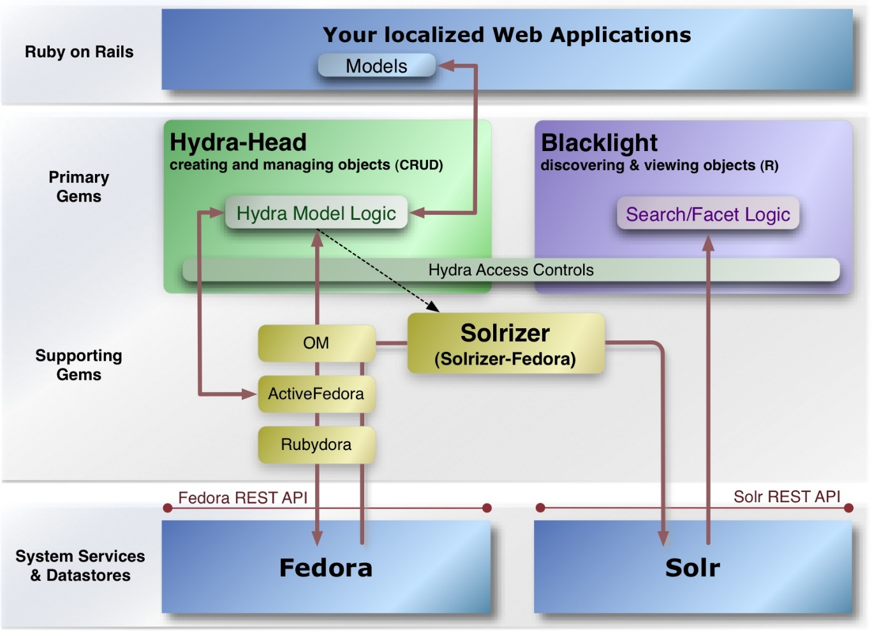
Technology stack

Slide 5
Modelling
Project Hydra transparently interfaces Fedora Commons repository.
Metadata attributes + object relationships
Domain-specific metadata
  Use of taxonomy
  Use of keywords (WIP)

Slide 6
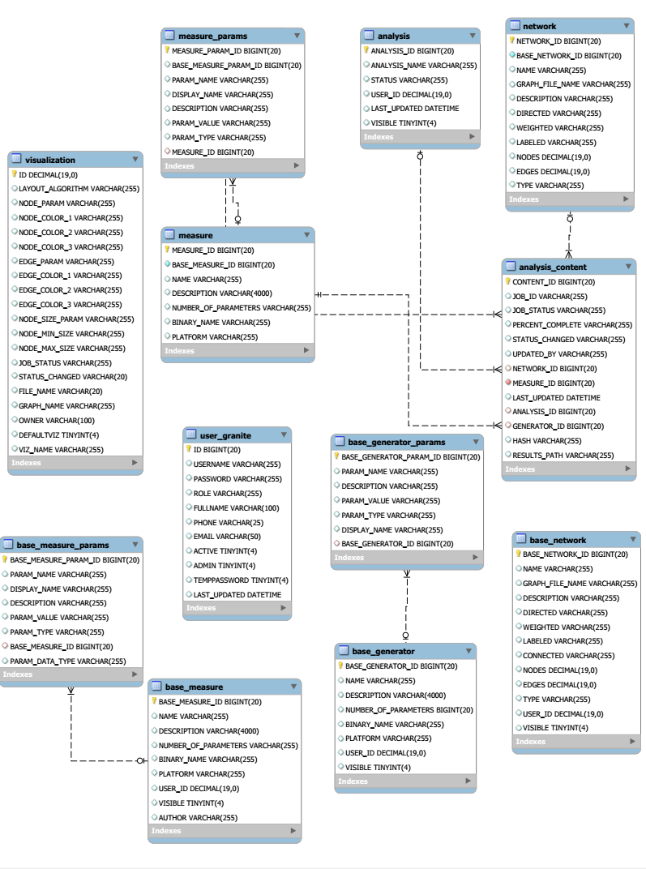

Slide 7
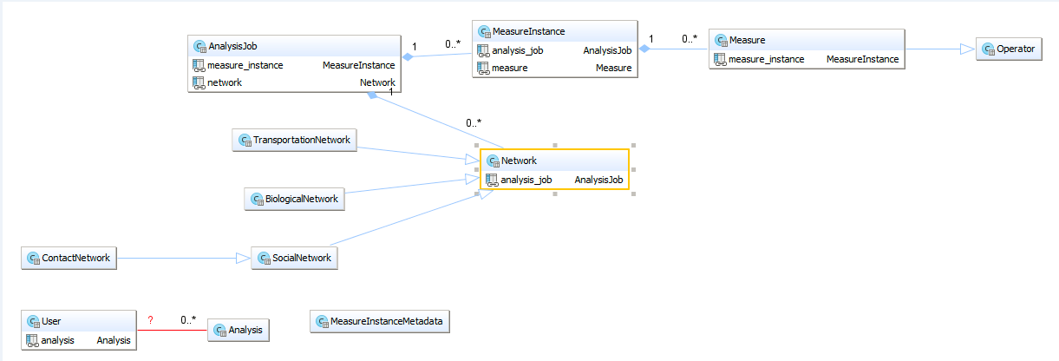
Modelling: Digital Object Schema

Slide 8
Migration
Ingesting data from RDBMS to Fedora Commons repository
Export data from DB
Data ingest is a two-pass process
  Pass 1: Creating digital objects and populating attributes
  Pass 2: Setting relationships between newly created digital objects by maintaining integrity constraints

Slide 9
SCRUD Interfaces
SCRUD: Search, Create, Read, Update and Delete.
Rails Scaffolding: For CRUD operations
  Rails facility for generating RESTful web-services and skeleton HTML UI.
Project Blacklight: For search and browse operations
  Faceted browsing
  Text search
  Based on Solr indexing

Slide 10
Services and Visualization
Incentivization
Networks and algorithms contributed. Analyses performed.
Utilization
Network datasets
Algorithms
Computation resources
Memoization
Uniquely identify an analysis.
Return results of an existing analysis when network, measure and parameters match.
Saves time of execution.
To avoid repetition of analyses
Highlight user contributions
Used coordinated visualization.
Notes:
Whenever analysis is performed on the network and if result is available for this combination, then analysis will not be repeated.

Slide 11
Lessons learned
Modelling
  Domain-specific metadata handling through taxonomy and keywords.
  Constrain handling: ‘has one’ relationship handling through ‘has many’ relationship.
  Transparent handling of Solr indexes.
  Federated queries on Fedora Commons are not flexible through Hydra.
CRUD scaffolds
  Object associations such as composition are not handled out-of-box.
Hierarchical faceted browsing for complex models is not easy.

Slide 12
Future work
Performance improvement for database
Instance-specific metadata
Pluggable metadata
Disseminators for graph format conversion
Authentication and authorization
Integration with CINET

Slide 13
Thank you...

