Slide 1
Crisis Events Digital Library: Frontend
James Hall, Ansh Patel, Ananya Seth
CS4624 - Multimedia, Hypertext, and Information Access
Instructor - Mohamed Farag
Virginia Tech, Blacksburg VA 24061
December 4th, 2024

Slide 2
Outline
Project Overview
Roles
System Architecture
Front-end
Back-end
Database Schema
Demo
Future features
Challenges
Acknowledgements
References

Slide 3
Project Overview
To connect 4 projects into one with a proper functioning front-end
  Text Summarization
  Knowledge Graph Generation
  News Coverage Analysis
  Information Extraction
Main Deliverable
  A fully functioning website that integrates all 4 projects and uses collections to store and display data

Slide 4
Roles
James Hall
  Back-end
  Front-end
Ansh Patel
  Front-end
Ananya Seth
  Front-end

Slide 5
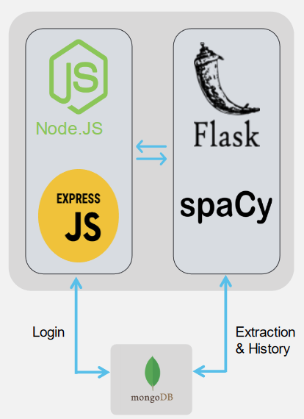
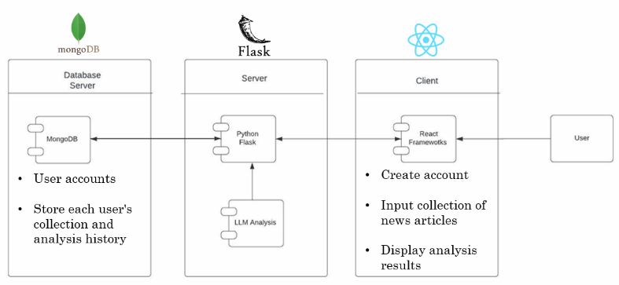
System Architecture (Former pt. 1)
Information Extraction
News Coverage

Slide 6
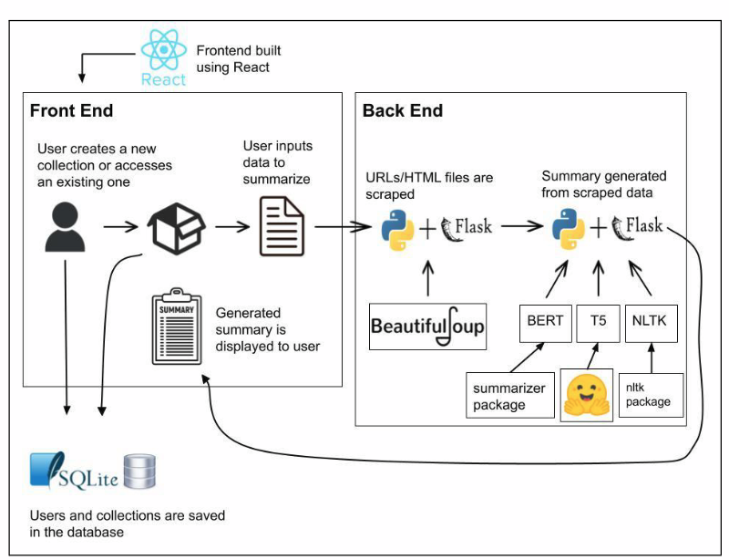
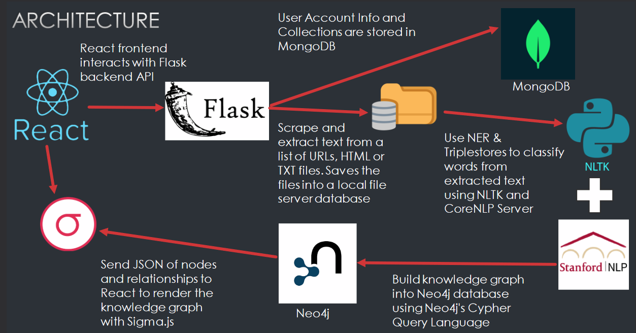
System Architecture (Former pt. 2)
Text Summarization
Graph Generation

Slide 7
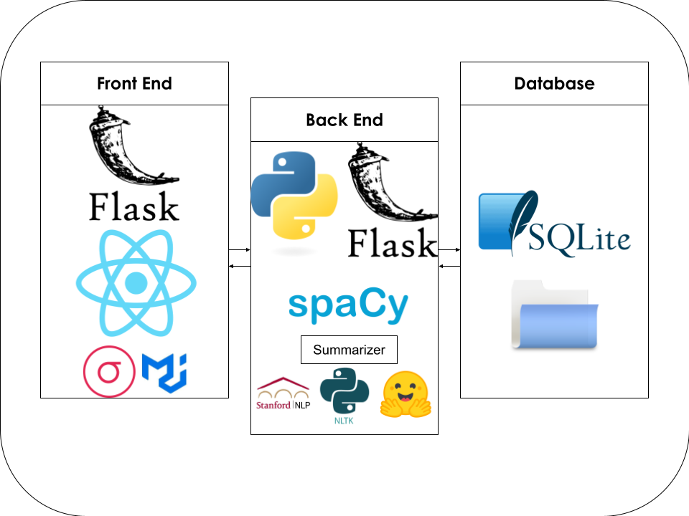
System Architecture (current)

Slide 8





Front-End
Key Features:
  Login/Logout
  Sign Up
  Creating Collections
  Viewing existing collections
  Viewing results from all 4 projects
  About Page

Slide 9






Back-end
Flask server with authentication using flask_jwt_extended (auth tokens)
Imports the directories of the 4 projects processing files
  Run in series when a new collection is created
  Run individually when an update is requested
Connects to an SQLite database and storages files to ./storage/[collection_id]
Summarizer

Slide 10
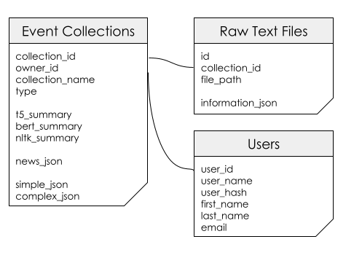
Database Schema

Slide 11
Demo

Slide 12
Future Features
Optimize back-end further
Optimize database
Forgot Password Feature
Admin Account

Slide 13
Challenges
Usability while integrating all 4 projects into a single cohesive interface
Managing and storing data securely
Having users easily interact with data

Slide 14
Acknowledgements
THANK YOU
DR. MOHAMED FARAG, THE PROFESSOR AND CLIENT
Crisis Events Text Summarization
  Francesco Crisafulli
  Aniket Sonnakul
  Tarek Shah
  Farhan Mohammed
  Santiago Guadiamos
Crisis Events Knowledge Graph Generation
  Justin Turkiewicz
  Anthony Tran
  Geethika Abhilash
  Matthew Walters
  James de Chutkowski
Crisis Events News Coverage Analysis
  Hiwot Alemu
  Rayyan Hashmi
  Dylan Harrison
  Eric Wallace
Crisis Events Information Extraction
  Brianna Brown
  Sully Gregory
  Nishesh Saikrishna
  Eitsaam Rabbani
  Will Spies

Slide 15
References
The past 4 projects:
https://vtechworks.lib.vt.edu/items/9b73b21e-29dc-48b5-831f-8541cd222356
https://vtechworks.lib.vt.edu/items/be48d67a-2000-44e9-9848-1f2154f4c6ca
https://vtechworks.lib.vt.edu/items/87b6d517-c44d-42c0-b811-2d94b5a061a0
https://vtechworks.lib.vt.edu/items/60432e79-0da1-42fd-ba83-42e77eb47985

Slide 16
Questions?

