Slide 1
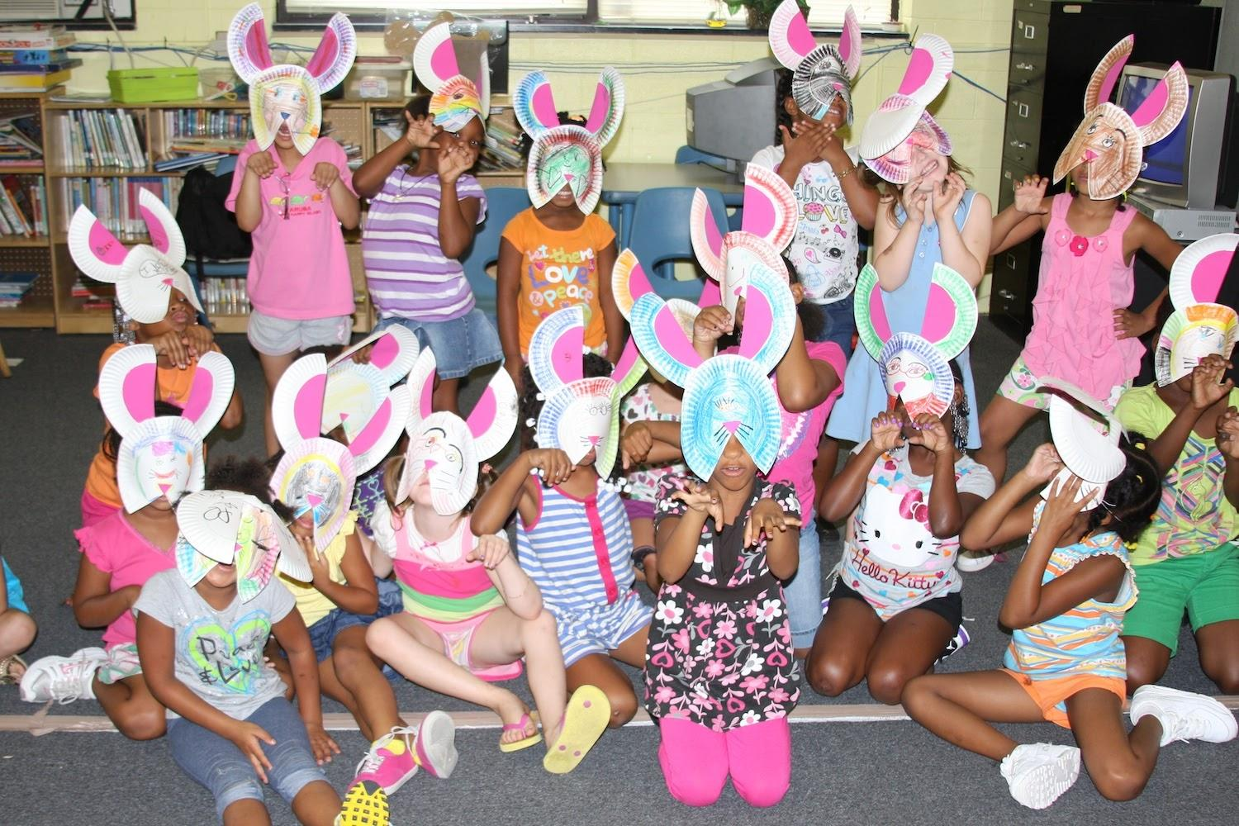
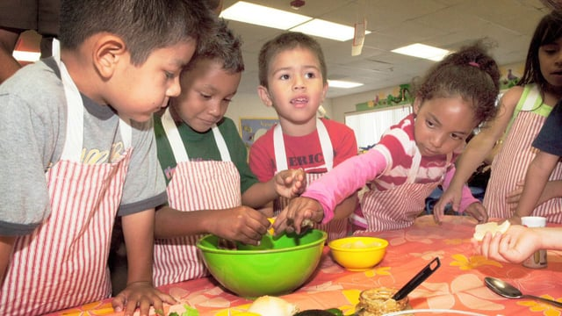
Partnering with Virginia’s
Family Nutrition Program
Hampton Ave
Nov. 15 2017
Kimberly Hoffman
Notes:
A research study conducted in Head Start
preschool classes by Elena Byrne and Susan Nitzke, University
of Wisconsin-Madison (2002), found that the children were
more willing to taste a newly introduced vegetable if they
had heard a story in which the main character had a positive
preference for the food. The study concluded that under
optimal conditions, children’s books could help promote
positive attitudes about vegetables.
Literacy, Eating and Activity for Primary (LEAP)
Youth Health Curriculum Overview
7

Slide 2
Today’s Agenda EXAMPLE
Importance of Nutrition Education for preschool children
LEAP Curriculum Training
Practice leading a lesson
Volunteer Responsibilities
Volunteer Registration
Q/A

Slide 3

Why Nutrition Education
Share in pairs or with whole group
Name 2 healthy habits you see in your students
Name 2 unhealthy habits you see in your students
What are your ideas to impact your students and families for better health?
Notes:
Anchor Activity Suggestions- You can edit your opening activity to fit your group.

Slide 4

LEAP Curriculum
FNP curriculum that targets children
3 to 5 years of age and their families.
Notes:
LEAP is a collection of lessons using storybooks to teach children about staying healthy, being physically active, and eating more fruits and vegetables, low-fat dairy products, and whole grains.
How do you incorporate reading in the daily program at your site?
Children who are read to frequently tend to become superior readers and do better in school. If you set aside a special time each day to read to the group, they will come to expect it and look forward to it.
What are your best practices to help children learn to read?
Show enthusiasm when you read. Change your voice to match the characters in the story.
Ask children questions about the book as you read.
Point out words, letters, numbers, colors, and shapes.
When children are active participants rather than passive listeners. they are more likely to experience improvements in their vocabularies and comprehension abilities.

Slide 5



Literacy
Eating
Activity
Reading to young children is the single most important factor in academic success
What do you do to make reading fun for children?
for Preschool
Notes:
Literacy improves when:
■ We set aside a special time each day
to read to children.
■ We make reading time a fun experience
for the children.
■ We help children learn as you read.
What do you do to make reading fun for children?
Tasting foods in a casual, relaxed atmosphere increases the likelihood that a child will try a new food.
Children are more likely to eat new foods that they have helped choose and prepare
It takes 8-16 tries for children to learn to eat new foods!!
Kids who are physically active, learn best.
Integrate movement with learning
Model healthy habits for healthy kids

Slide 6
Program Goals
Encourage the children to try more and different fruits and vegetables
Encourage the children to get more physical activity every day
Encourage the children to read more
Parents and newsletter

Slide 7

Benefits of the LEAP Curriculum
LEAP Lessons address three topics:
  Literacy
  Activity levels
  Healthy food choices
Easy to Teach Program
  Facilitator Guide
  Age appropriate books
  Reinforcement Activities
  Family Newsletter

Slide 8



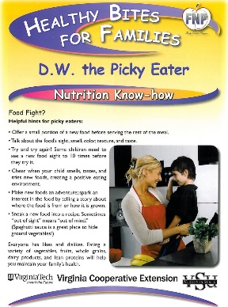
Lessons Include
  The book
  A food experience
  Craft idea (optional)
  Parent Newsletter

Slide 9
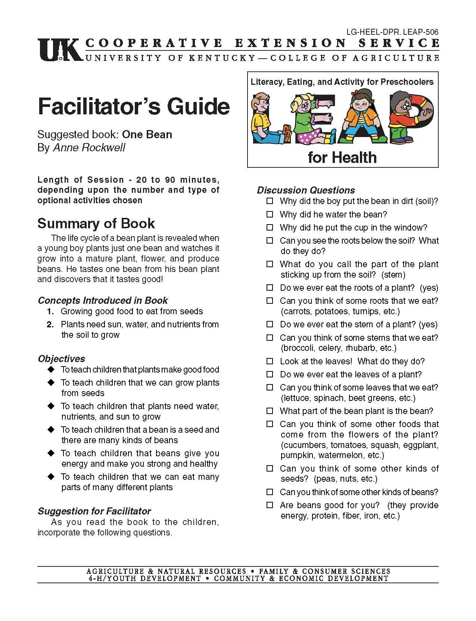
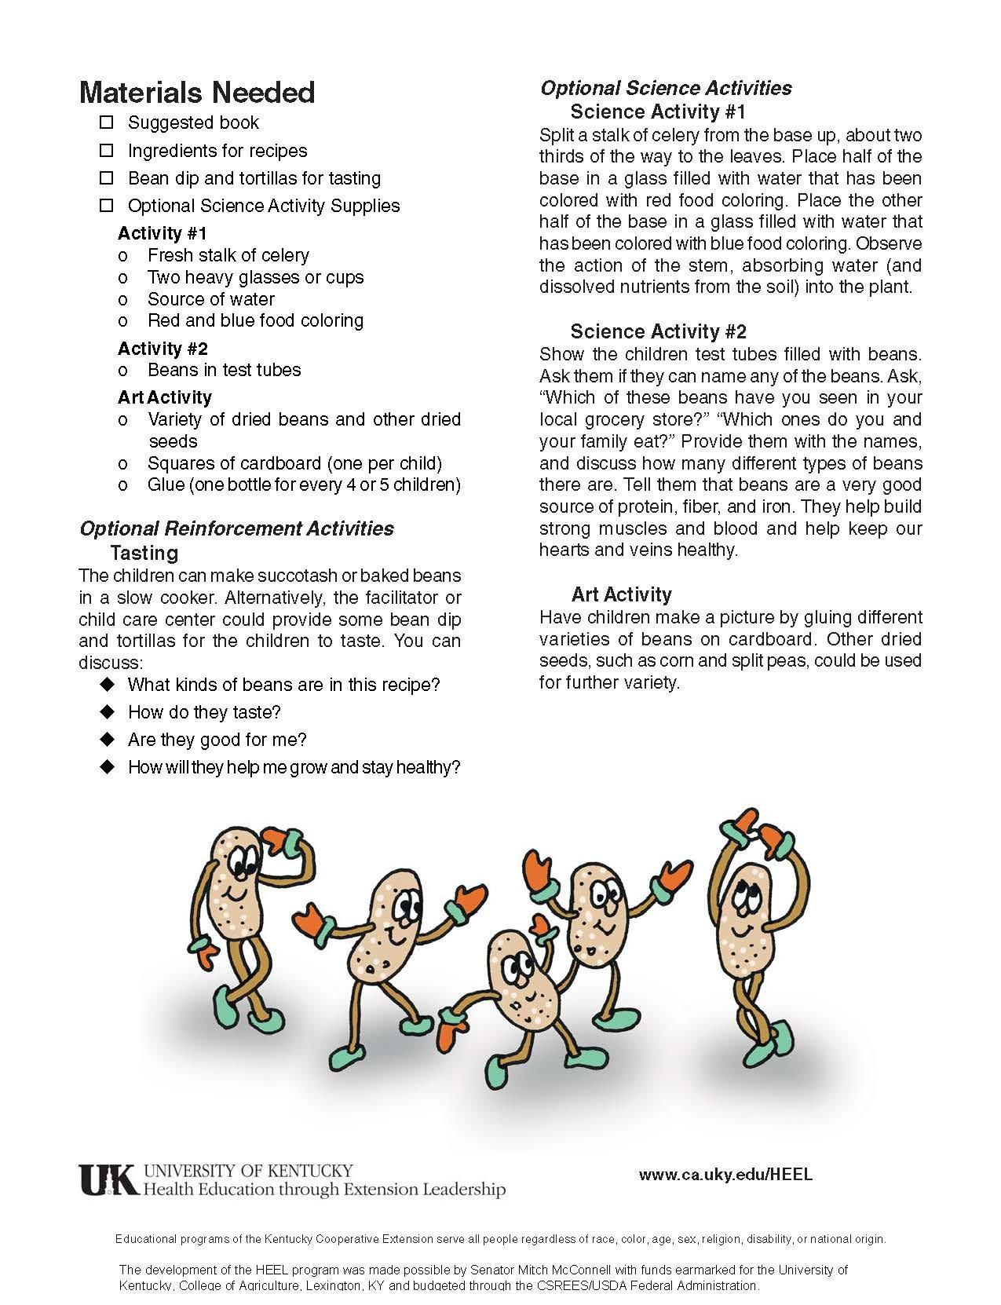
Facilitator’s Guide
Suggested book
Brief Summary
Concepts
Objectives
Suggestions for Facilitator
Discussion Questions
Materials Needed
Reinforcement Activities
Curriculum Matrix

Slide 10

Spriggles: Activity and Exercise by Jeff & Martha Gottlieb
Theme
Activities
Through fun rhymes, the Spriggles animals introduce children to the importance of daily physical activity for good health
Stir the Soup frog hopping

Slide 11

The Very Hungry Caterpillar
By Eric Carle
Theme
Activities
A hungry caterpillar eats his way through a lot of different foods. He goes through cocoon stage to become a butterfly
Make a butterfly craft
Make healthy Fruit Kabobs for growth and development

Slide 12



Eating the Alphabet
By ?
Theme
Activities
Practice reading and identifying new foods. Each letter of the alphabet is represented by a vegetable or fruit
Brown Bag Surprise
  Children reach in and feel what is in the bag and try to guess what is hidden inside
Taste and play with Sweet Potatoes

Slide 13

D.W., The Picky Eater
By Marc Brown
Theme
Activities
Getting children to try new foods can be a challenge. D.W really dislikes spinach and makes an embarrassing fuss when eating out. Later she unknowingly eats spinach at a restaurant with her grandmother and enjoys it!
Make and taste a Spinach Salad

Slide 14
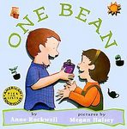
One Bean
By Anne Rockwell
Theme
Activities
Young boy plants just one bean and watches it mature and produce beans. He taste one bean and enjoys it. See the life cycle of plants and learn to eat different parts of the plant.
Play with colored celery stalks and make bean mosaics
Make and eat bean dip

Slide 15

Growing Vegetable Soup
By Louis Ehlert
Theme
Activities
Children learn about growing a garden, the tools needed, and see how seeds become plants.
Make Vegetable Soup
Taste squash and different veggies

Slide 16
The Gigantic Turnip
By Aleski Tolstoy & Niamh Sharkey
Theme
Activities
Children learn about the turnip and how it grows underground. They see the characters in the book make and enjoy turnip soup after their hard work growing and harvesting this vegetable.
See, touch, taste and smell a turnip and other veggies
Carve turnips to make stamp art

Slide 17

Count on Pablo
By Barbara De Rubertis
Theme
Activities
Children see, touch, and smell onions, peppers, and tomatoes. In the book they learn that vegetables that we might not be familiar with can be prepared together to make something we love and is good for us.
Make and taste salsa and vegetables

Slide 18

Spriggles: Health And Nutrition
By Jeff & Martha Gottieb
Theme
Activities
Through fun rhymes, the Spriggles animals introduce children to the importance of selecting foods that provide the proper balance of vitamins and minerals, proper hygiene, and developing healthy habits to last a lifetime.
Make Rabbit Masks
Try carrots and a healthy dip

Slide 19

Those Mean Nasty Dirty Downright Disgusting but ….Invisible germs By ??
Theme
Activities
Children observe that germs are everywhere but we cannot see them
Practice proper hand washing
Sing song to help get hands clean

Slide 20
Eating
Tasting foods in a casual, relaxed atmosphere increases the likelihood that a child will try a new food.
Children are more likely to eat new foods that they have helped choose and prepare
It takes 8-16 tries for children to learn to eat new foods!!
Notes:
We will discuss incorporating food experiences into the LEAP program later in the training.

Slide 21

Food Experience Tips
Work with the food service staff to determine what snacks will be served
Coordinate your lesson to include a snack that is compatible with the nutrition concept
in the book
You need only a taste –
not a whole meal

Slide 22

Tasting etiquette
We want you to taste, but you don’t have to.
Try a small taste. If you don’t like it, you can spit it out in a tissue or the trash can.
If you don’t want to taste, say “No thank you. I’ll try it again another time.”
You have taste buds on your tongue. They change.
You might like that food in a year.
Be friendly. Keep a happy face.
Let other people enjoy the food.

Slide 23
Activity for Preschool
Kids who are physically active, learn best.
Integrate movement with learning
Model healthy habits for healthy kids

Slide 24
LEAP Curriculum Kit for Volunteers
Curriculum Overview
Checklist for Volunteers
Tips for Reading to Young Children
Planning Guide for Teachers (Lesson Log)
Facilitator’s Guides
Evaluation Tools

Slide 25


Checklist for Leaders
Before Each Lesson
  Practice reading the book aloud
  Review the lesson
  Gather materials for reinforcement activity
  Make arrangements with for food preparation
  Purchase demonstration foods
  Select corresponding family newsletter

Slide 26

After each Lesson
Distribute the Family Newsletter
Ideal way for you to initiate the family partnership.
Newsletter can serve as a teaching topic for adult FNP program assistants to provide continuity in the teaching topics
Each school receives 5 sets of newsletters to send home to families.

Slide 27

Lesson Example: Parent Newsletter
Healthy Bits For Families
Backpack Newsletters
*ALWAYS send these home with the children
Notes:
Corresponding number with the Facilitator’s Guide
Theme usually associated with topic covered in the book
Encourages a trip to the local library
Nutritious recipe that children can help prepare
Great way to promote other
activities with this audience
Maximizes the nutrition message so we are speaking with one voice!
Also available in Spanish

Slide 28
Implementation and Reporting
Roles
Forms
Extension Agent Role
Teacher Role
MOA
Volunteer Enrollment
Youth Enrollment Form
LEAP Lesson Log
Evaluation

Slide 29

A few simple steps to begin…
Teachers agree to be “volunteers” to satisfy the federal grant guidelines
Teachers report via email: time preparing and teaching the lessons, food experience, and leading physical activities
FNP will check in about once a month to see how things are going

Slide 30
What is the Extension Agent’s role?
Provide the LEAP newsletters and replace books, if needed
Provide additional resources and support to teachers, if needed
Conduct one observation of each teacher doing a lesson of their choice
Collect demographic and lesson dates from site managers
Report data to the USDA grant to ensure funding for future programming!

Slide 31
What is the teacher’s role?
Report class demographics to site manager BEFORE starting the program
Report the month and date you plan on doing each lesson to site manager BEFORE starting the program
Deliver each of the 10 lessons by reading the book and discussing its health messages
  Use the example activities to provide food experiences, physical activities, and crafts, or create your own activities!
Send each student home with a parent newsletter for 5 of the 10 lessons

Slide 32
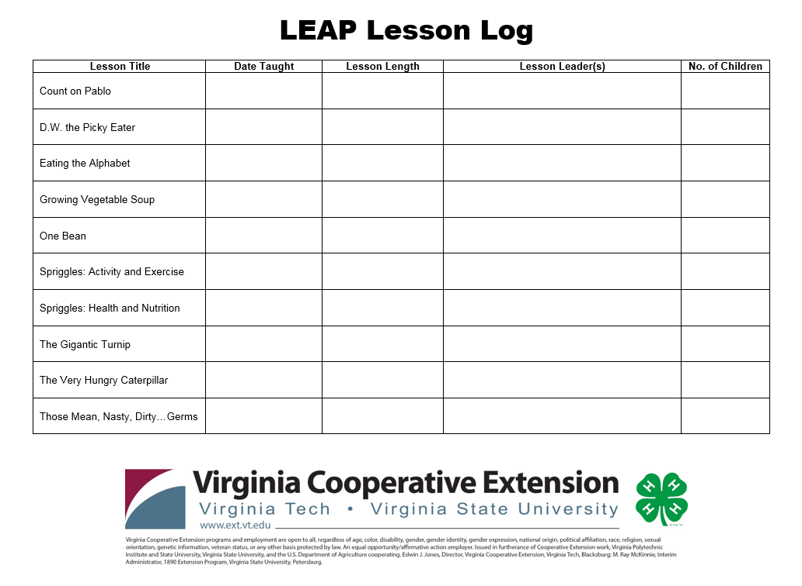
Agent will email once a month for lesson log

Slide 33
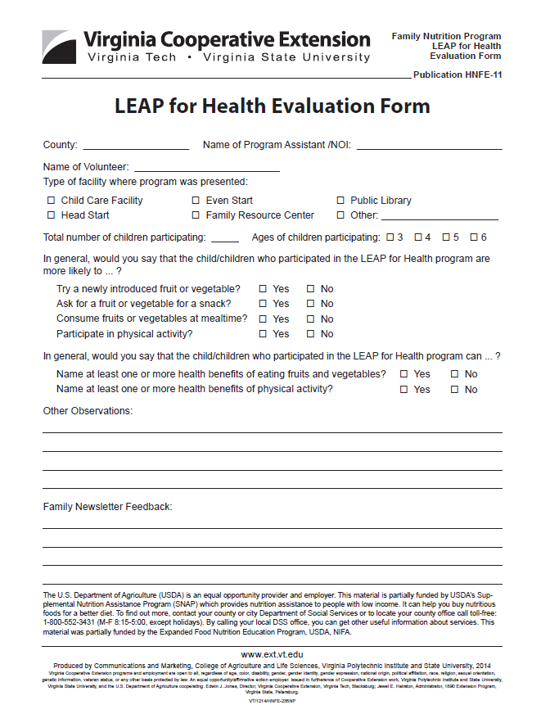

End of Year Evaluation
Agent will send a survey at the end of the year

Slide 34
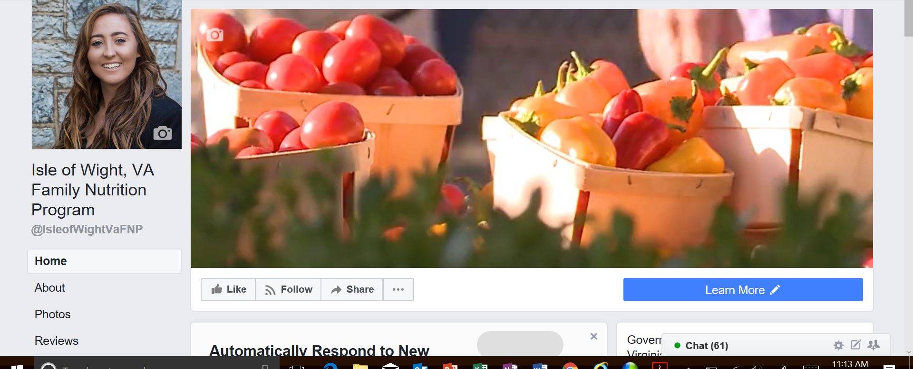
Let’s stay connected!
Facebook
E-Newsletter
‘Like’ me!
Improve your nutrition savvy
  Fun E-newsletter with nutrition and health tips
  Easy on your budget recipe ideas
  Delivered every week.

Slide 35
Wrap Up
Reporting
Paperwork
Agent will e-mail on the 1st and 15th of each month, please respond
  Name of group/grade
  Lesson Taught
  Date Taught
  Duration
Turn in Volunteer Form – Today
Group Log– ASAP
Teacher Observation
  End of Year
Observation
  A time that’s good for you
MLA
  Material Loans Agreement

Slide 36



Questions?
Kimberly
FCS SNAP-Ed Extension Agent
Virginia Cooperative Extension
Isle of Wight Extension Office
17100 Monument Circle
Isle of Wight, VA 23397
Office: 757-357-9610
kimh822@vt.edu

Slide 37


Thank you!
Family Nutrition Program’s ability
to teach our children healthy choices
depends on caring teachers/volunteers like
YOU!

Slide 38


The U.S. Department of Agriculture (USDA) is an equal opportunity provider and employer. This material is funded by USDA’s Supplemental Nutrition Assistance Program – SNAP which provides nutrition assistance to people with low income. It can help you buy nutritious foods for a better diet. To find out more, contact your county or city Department of Social Services or to locate your county office call toll-free: 1-800-552-3431 (M-F 8:15-5:00, except holidays). By calling your local DSS office, you can get other useful information about services.
Virginia Cooperative Extension programs and employment are open to all, regardless of race, color, national origin, sex, religion, age, disability, political beliefs, sexual orientation, genetic information, marital, family, or veteran status, or any other basis protected by law. An equal opportunity/affirmative action employer. Issued in furtherance of Cooperative Extension work, Virginia Polytechnic Institute and State University, Virginia State University, and the U.S. Department of Agriculture cooperating. Edwin J. Jones, Director, Virginia Cooperative Extension, Virginia Tech, Blacksburg; Jewel E. Hairston, Administrator, 1890 Extension Program, Virginia State, Petersburg.

