Slide 1
Traffic Simulation Management System
Nathan Borghese, Sara Grammer, April Monk, Jack Thomas
CS 4624: Multimedia, Hypertext,
and Information Access
Dr. Mohamed Farag, Virginia Tech,
Blacksburg VA, 24061
April 18, 2023
Notes:
Things to show in demo:
- start a run. use QNET. use pre-uploaded executable
- show zip downloading (without executable).
- show an old run. from INET.
this is because INET has more files.
- show off default exe changing page. show the dropdowns and such. probably dont need to actually use it.

Slide 2
Outline
Problem
Solution
Work Accomplished
User Manual
System Design
Implementation Details
Future Work
Lessons Learned
Acknowledgements
References
Notes:
[sara] Problem
[april] Solution
[april] Stuff actually completed
[jack] User manual/screenshots
[sara] Design/architecture
Implementation details
Frontend part (jack)
Backend part (me)
[nathan] Future work
[april] Lessons learned
[sara?] Acknowledgements
[sara?] references

Slide 3
Problem
Current Traffic Simulator
  Can’t rerun a test
  No way to keep track of
    Input files
    Executable
  Lack of metadata storage

Slide 4
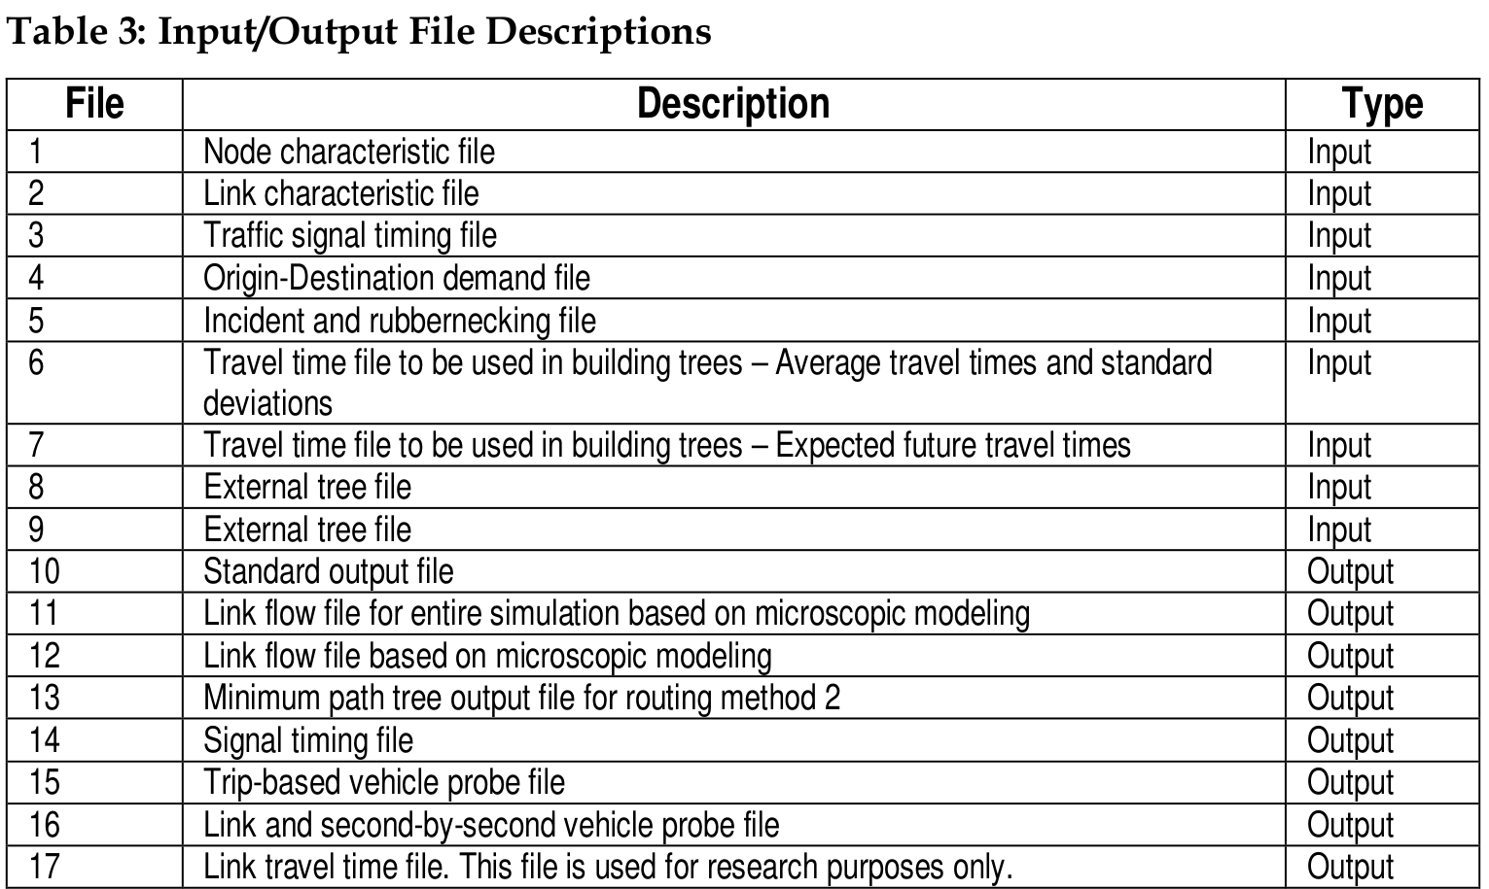
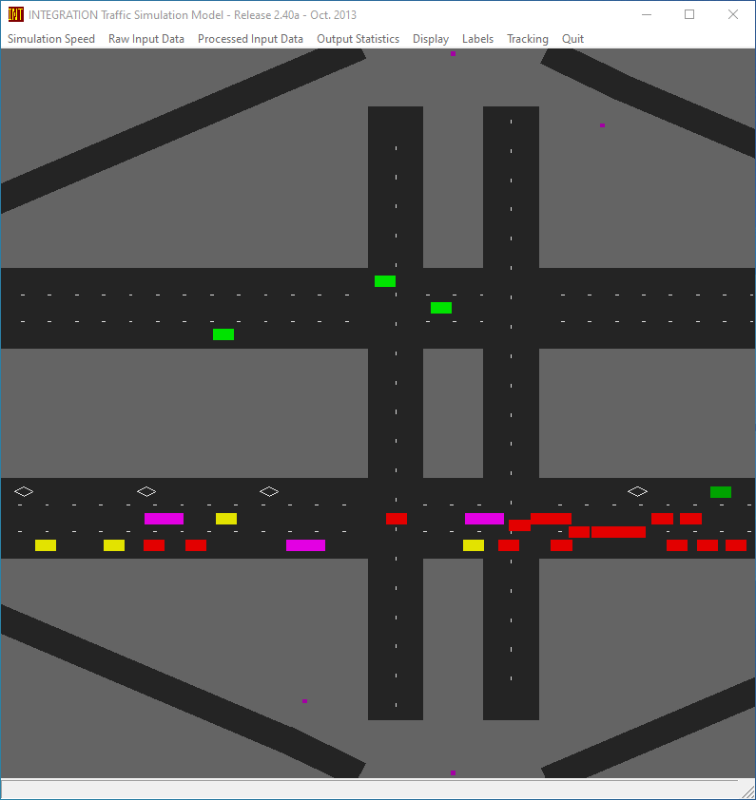
Problem - 3
[2]

Slide 5
Solution
Web App for Running Integration
Requirements:
  Runs Simulations
    Store Metadata
  List Simulations
    Re-run
    Download Files
  Log-In System
    User/Admin Mode

Slide 6
Work Accomplished
Runs Simulations
  One or Batch
  User uploads files
    Input
    Master
    Executable (optional)
  Store and Display Output
  Write and Show Errors

Slide 7
Work Accomplished
Lists Simulations
  Status
  Expands
    Re-run
    More details
    ZIP file
      With/Without Exe
Log-In System
  User
  Admin
    Upload Default Exe

Slide 8
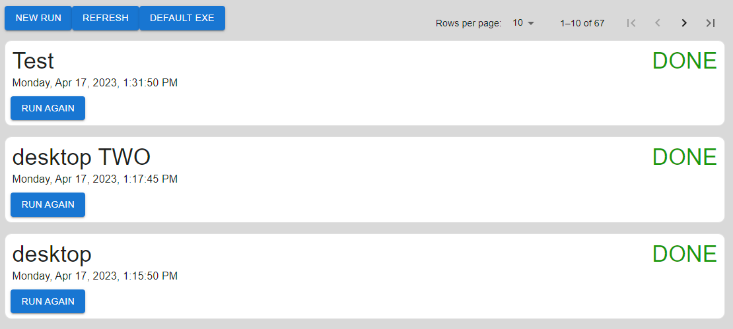
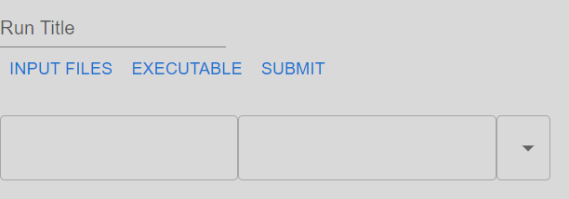
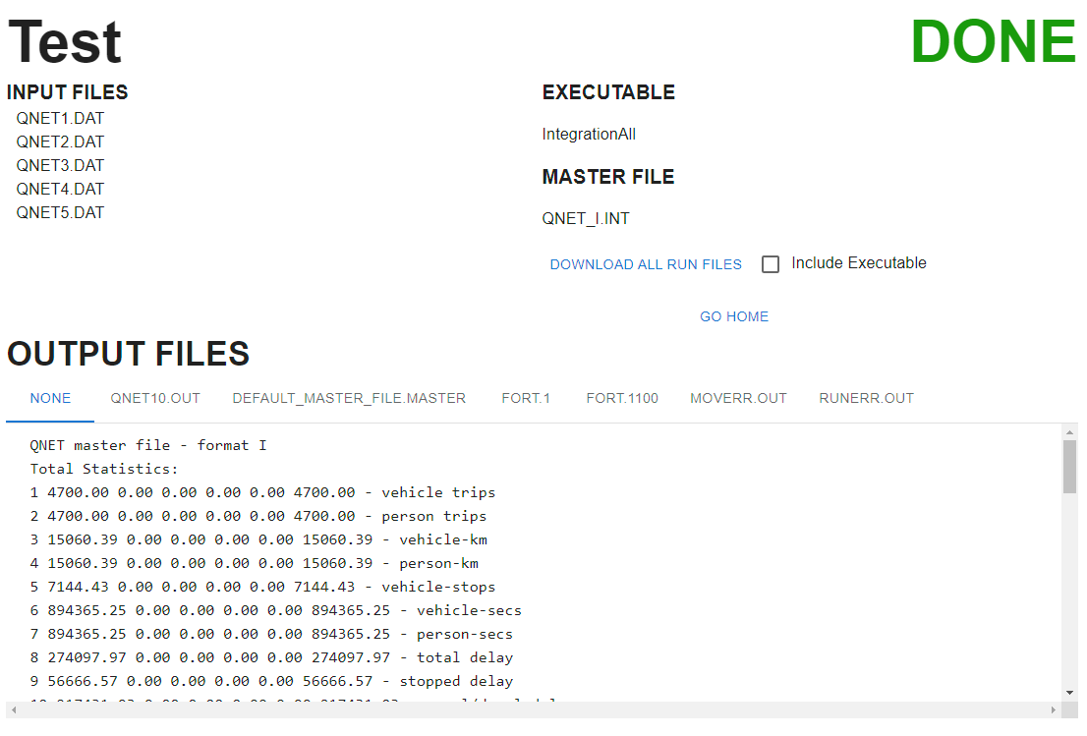
User Manual
Dashboard
  List of runs
New Run
  Name of Run
  Input Files
Run Info
  Run Status, name
  Output files,
  once available
  Download files

Slide 9
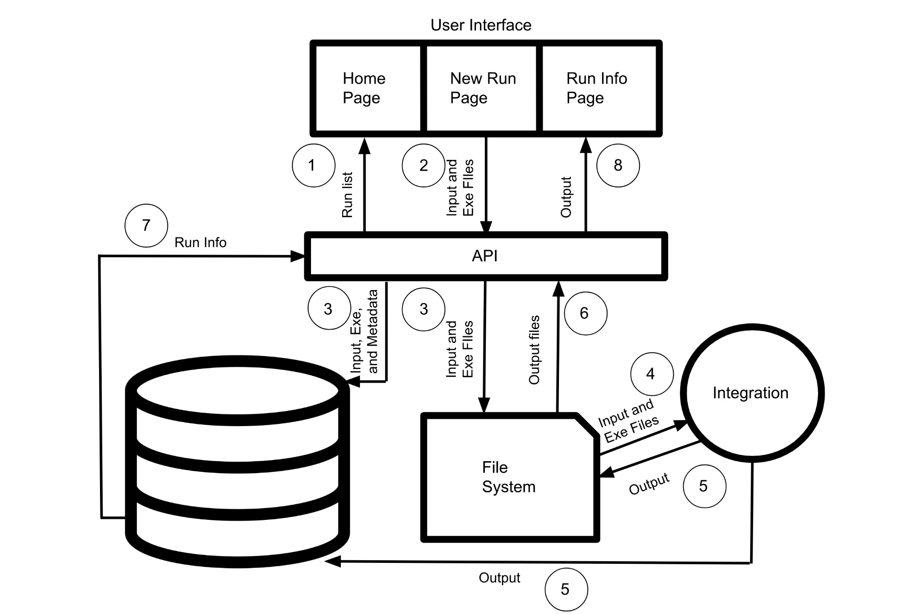
Design - Architecture
Notes:
sara

Slide 10

Frontend Implementation
React
  ‘npx create-react-app’
  JSX
  Stateful Components
MUI

Slide 11
Backend Implementation - Components
MongoDB
Filesystem
Node.js + Express.js

Slide 12

Backend Implementation - API Design (1/2)
Files
/api/
upload_input
Files
Frontend
/api/
upload_executable
Input/EXE ID
/api/
list_executables

Slide 13
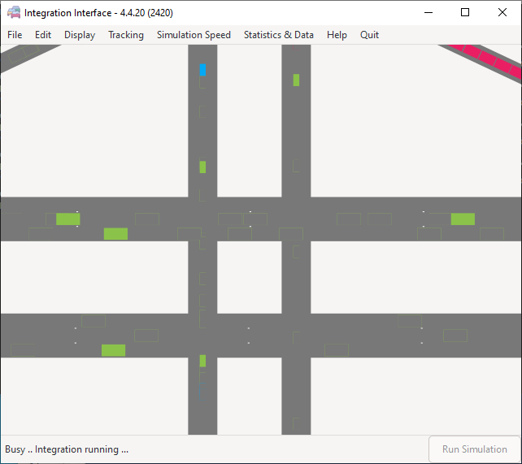
Backend Implementation - API Design (2/2)
Input ID and EXE ID
/api/
doit
Prepare run
Frontend
Run ID
Start Integration

Slide 14
Potential Future Work
Full user accounts
Reuse input files
  Select from list of road networks
  Modify in browser
Unix-like OS support

Slide 15
Lessons Learned
Front-End/
Back-End Concurrency
Testing Regularly as
we Worked
MERN Stack and JavaScript
Git and
Teamwork
Notes:
april

Slide 16
Acknowledgements
Thanks: Dr. Mohamed Farag

Slide 17
References
[1] Rakha, Hesham A. “Software.” INTEGRATION DYNAMIC TRAFFIC ASSIGNMENT AND SIMULATION SOFTWARE, https://sites.google.com/a/vt.edu/hrakha/software?authuser=0#
h.p_PFphBsaJ3l60
[2] Hasham A. Rakha, “INTEGRATION RELEASE 2.40 FOR WINDOWS.” .

