Slide 1

Giles Animal Rescue
Website Redesign Project
Client: Christine Link-Owens
By: Junko Yoshida
Supratim Baruah
Scott Hoang
CS4624 Multimedia/Hypertext/Information Access
Professor E.A. Fox
Virginia Tech, Blacksburg 2015

Slide 2
Introduction
Our client, Christine Link-Owens asked us to upgrade and modify their website at gilesanimalrescue.org running Drupal.
Goals of this project are to make the changes needed by Christine and to help Giles Animal Rescue operate on their own.

Slide 3
Drupal 7
Problems about Drupal
Security problems
How to change themes and interface

Slide 4
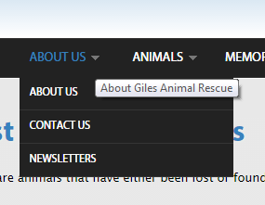
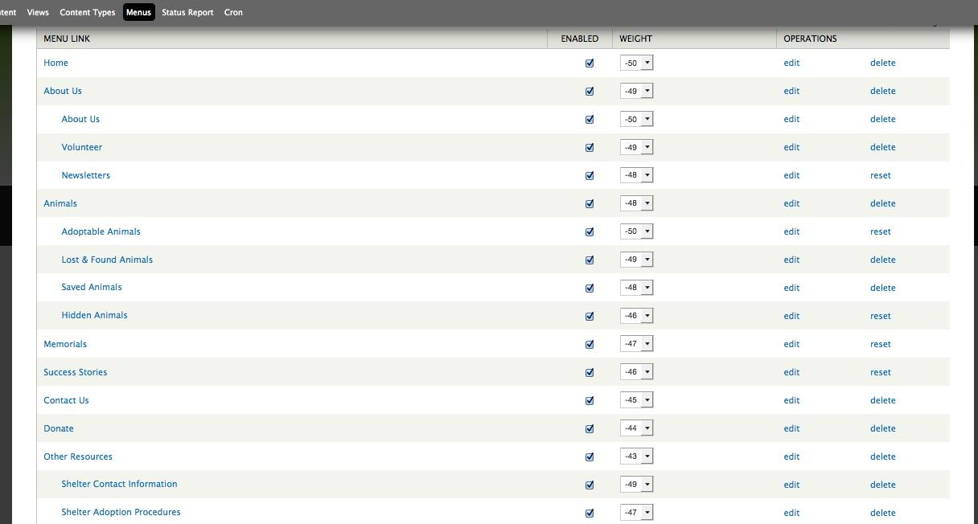
Notes:
Navigational menu change

Slide 5
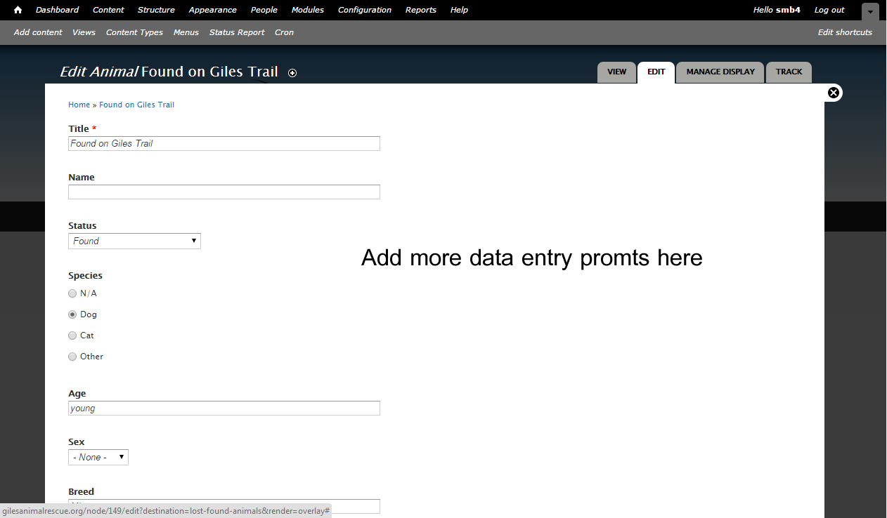
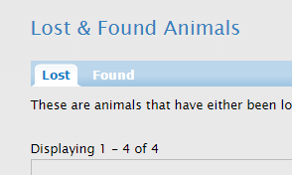
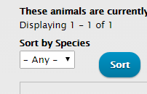
Notes:
Adding data to fields

Slide 6
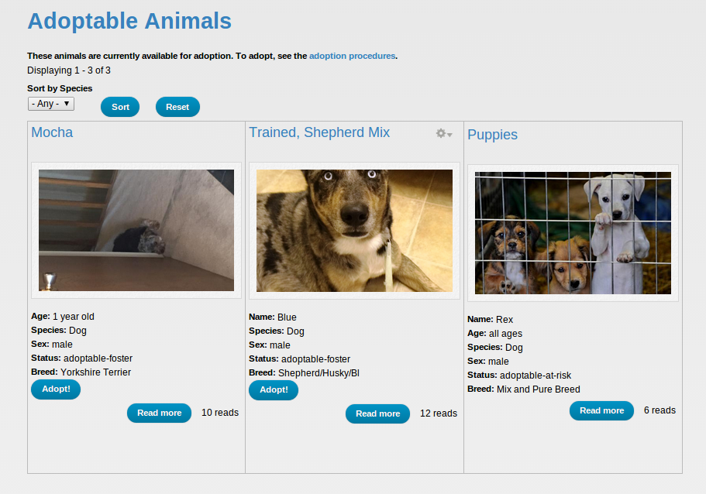
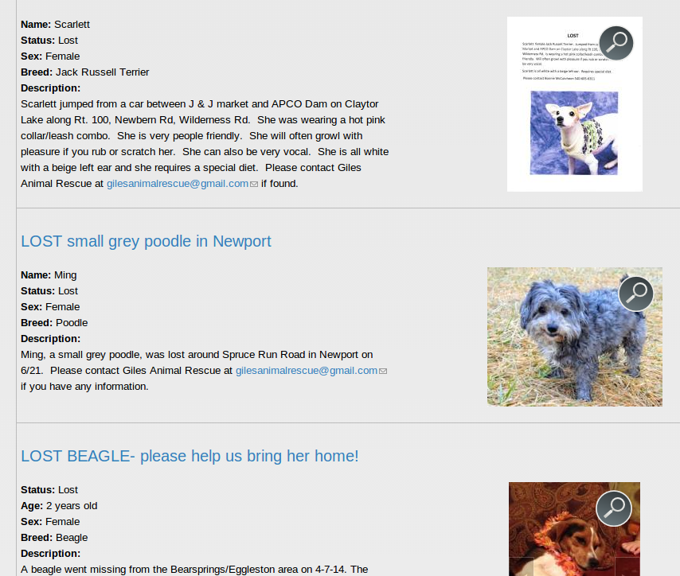
Notes:
Changing Views

Slide 7
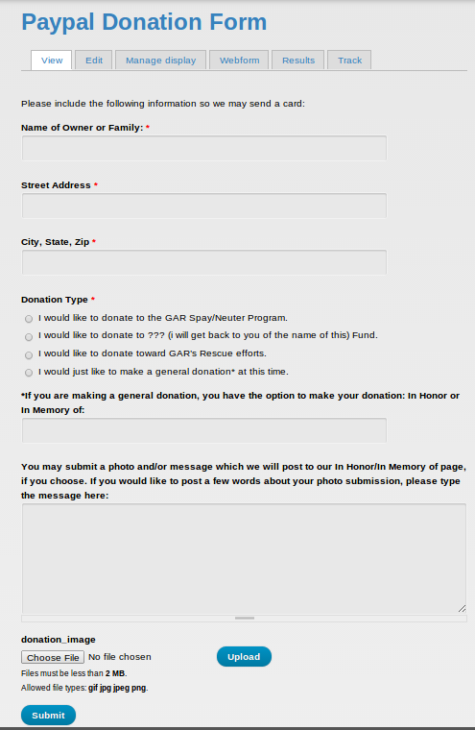
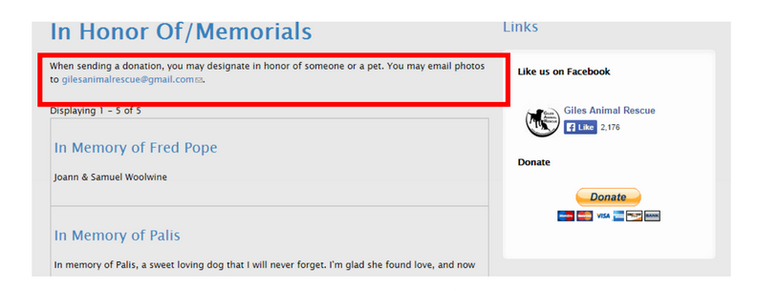
PayPal
Notes:
paypal web form

Slide 8

Paypal Problem
Request from our client
Email to Site Owner
Name
Address
Email
Purpose of Donation
Amount of Donation
Donation Form
Name
Address
Email
Purpose of Donation
Amount of donation
Transaction succeeded
Integration with outside service
Security concerns?
Incompatible version of modules

Slide 9
Paypal Solution
Our solution
Transaction result
Amount of Donation
Donation Form
Name
Address
Email
Purpose of Donation
Redirct
Email to Site Owner
Name
Email
Purpose of Donation

Slide 10
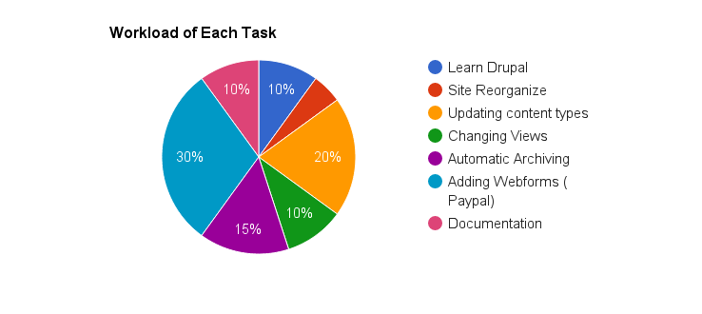
Workload of Each Task

Slide 11
Plan for the rest of the semester
Update site operational manual and development manual
Explain our clients how to use the new features

Slide 12
Acknowledgements
Christine Link-Owens and Giles Animal Rescue at gilesanimalrescue.org
Professor Fox

