Slide 1









Conservation Agriculture for Food Security in Cambodia
Stephane B., Stephane C., L. Hok, P. Kou, M. Reyes
ASABE Annual Meeting, Dallas, Texas
July 30, 2012

Slide 2
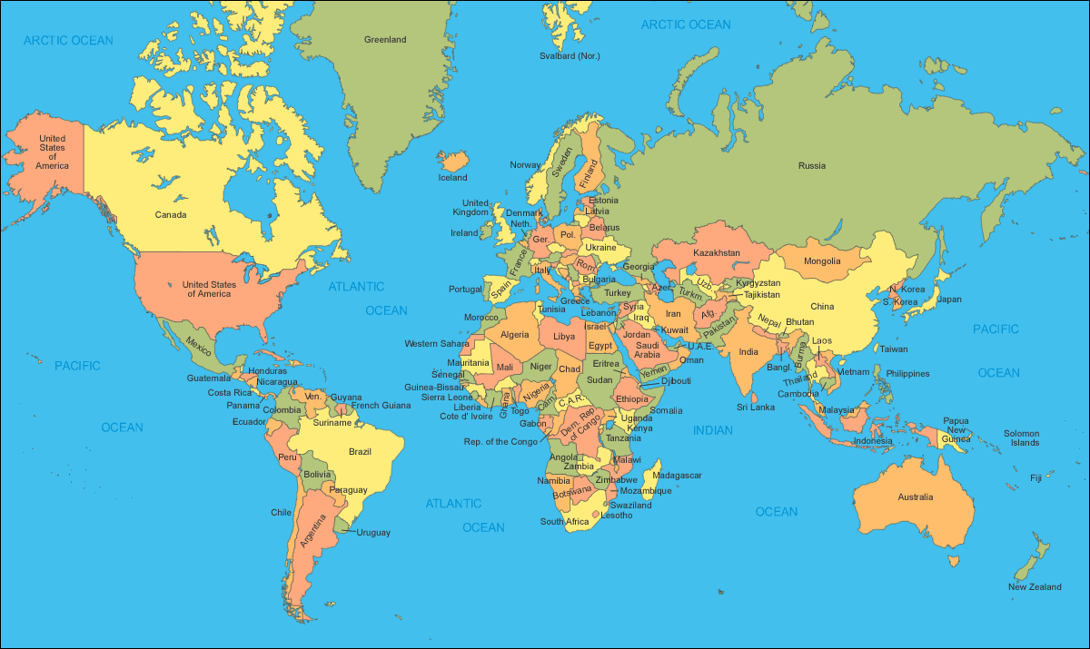
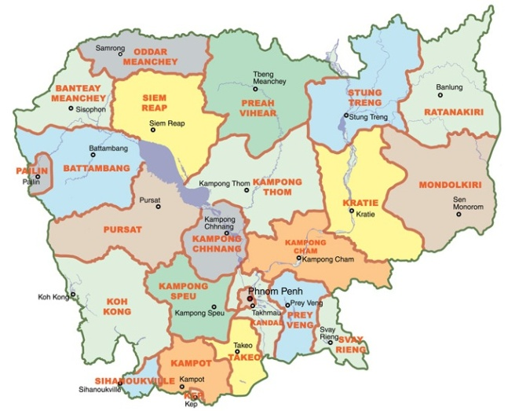

Where is Cambodia located?

Slide 3
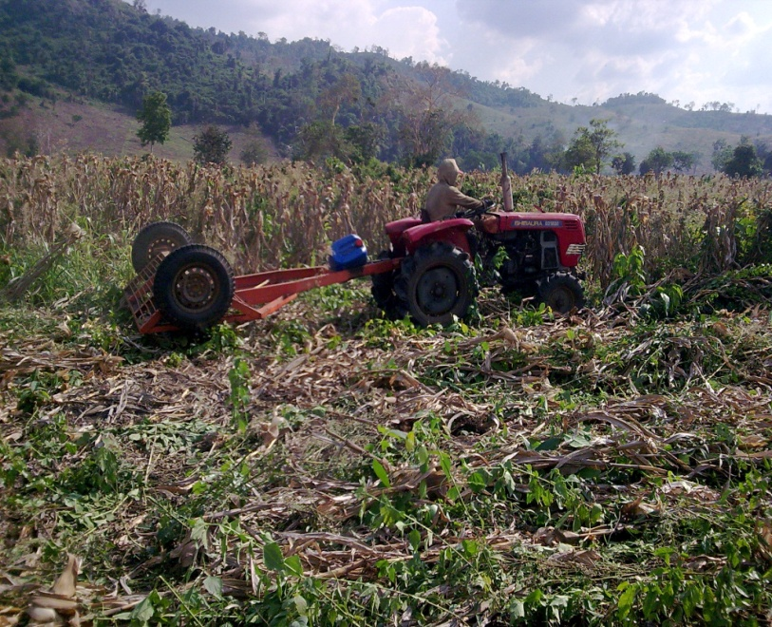
Introduction
In Cambodia, agriculture remains the largest employer, engaging more than 70% of the active population.
Most of population is made of smallholders with less than 2 ha/household and the low productivity of agriculture implies that poverty is widespread in the country.

Slide 4
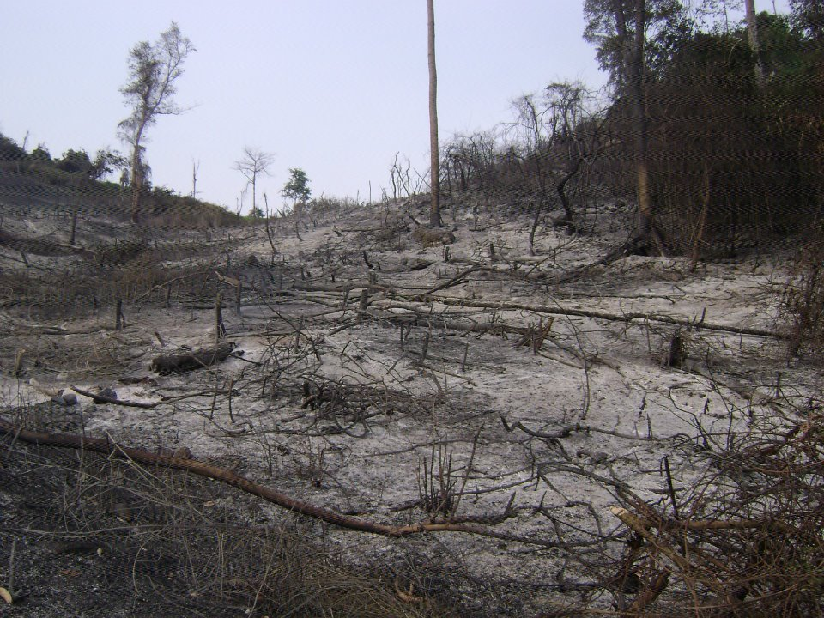
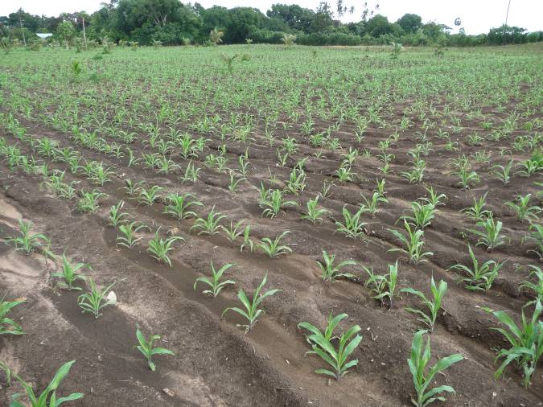
Conventional agricultural practices, mainly disc plowing systems, are commonly applied to annual crop production in Cambodia.
This causes to annual soil degradation in many agricultural land areas countrywide due to highly erodible soils.

Slide 5
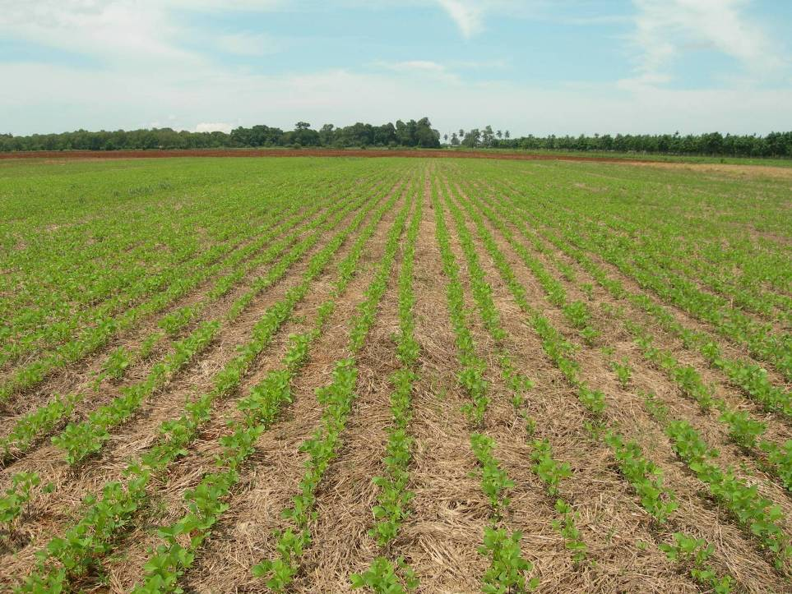
CA can improve the efficiency of input, increase farm income, improve or sustain crop yields, and protect and
Conservation Agriculture in Cambodia
revitalize soil, biodiversity and the natural resource base.

Slide 6
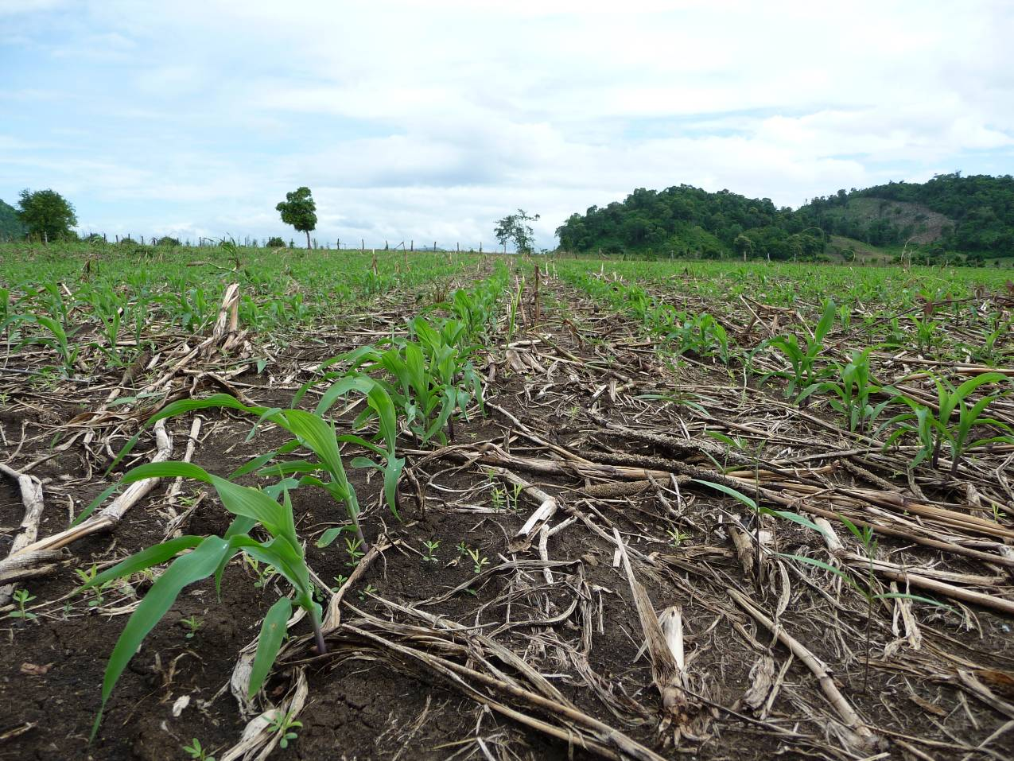
Principles of Conservation Agriculture
McD
Minimal soil disturbance
continuous mulch
Diverse species

Slide 7
Conservation Agriculture (CA) in Cambodia
CA has been transferred from Brazil and promoted by CIRAD, France collaborated with General Directorate of Agriculture, Cambodia in 2004.
Five-year USAID-SANREM-CRSP-funded project (2010-2014) ‘Conservation Agriculture for Food Security in Cambodia and the Philippines’

Slide 8
Objectives
Economics: Identify field-and-farm-level CAPS that will minimize smallholder costs and risks while maximizing benefits and adoption;
Crop Yield: Measure crop yield and biomass from CAPS, and compare them with conventional plow-based systems.

Slide 9
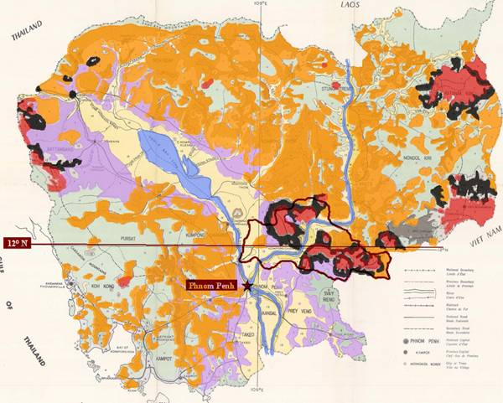
Experimental Site
Rattanak Mondul
Rattanak Mondul District, Battambang Province

Slide 10
Research Methodology
Farmers’ plot
30 Farmers’ plots are used for biophysical research
(15 CAPS & 15 CT).
Experimental Plots
Demo plot
Cropping patterns and tillage system are tested.

Slide 11
Farmers’ Plot
30 Farmers’ plots were used for biophysical research (15 CAPS & 15 CT).
Monocropping of corn and corn/Stylo CAPS cropping are being tested.
Farmers in 3 villages are involved with Farmer Organization development to support farmers involved with CAPS.

Slide 12
Demo Plot
A 2 hectare plot.
Fertilizer application rate 70-30-30
4 treatments are tested:
1. Bi-annual rotation (Maize//Soybean): Bio pump Millet + Stylo/Maize + Stylo + Crotalaria ochroleuca
2nd cropping: Bio pump Millet+Stylo/Soybean + Sorghum + Stylo
2. Maize monocropping: Bio pump Millet + Stylo/ Maize+Stylo + Crotalaria ochroleuca

Slide 13
3. Bi-annual rotation (Maize//Cassava): Bio pump Millet + Stylo/Maize+Stylo + Eleusine coracana + Crotalaria ochroleuca
2nd cropping: Cassava + Stylo
4. Plow based maize

Slide 14
Yield Measurement
4 sampling spots of 50 m² per farm are collected from 15 CAPS and 15 plow-based farmers’ plots.
Corn yield is harvested from 50 m²
Biomass production of main and cover crops are measured.

Slide 15
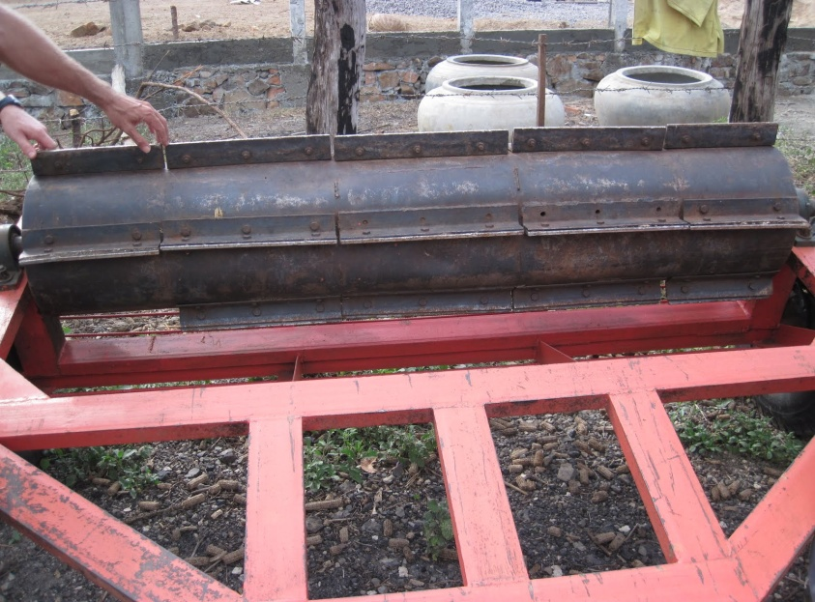
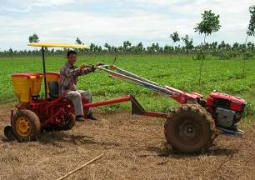
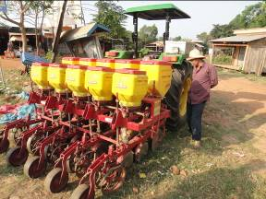
Mechanization
Homemade roller
Two row Planter Fitarelli
No-till Planter Vence Tudo SA-11500

Slide 16
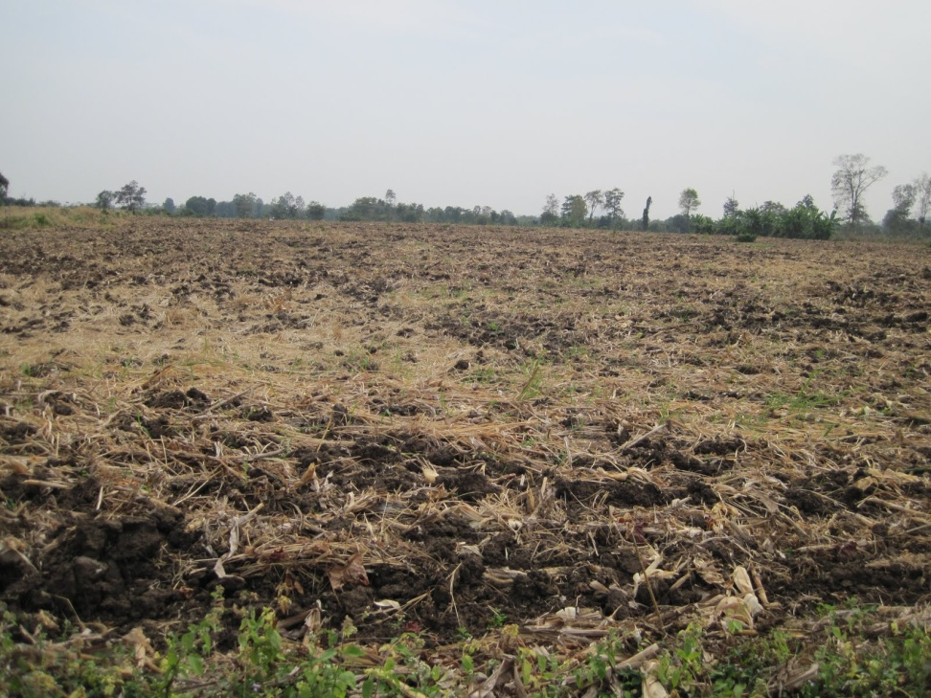
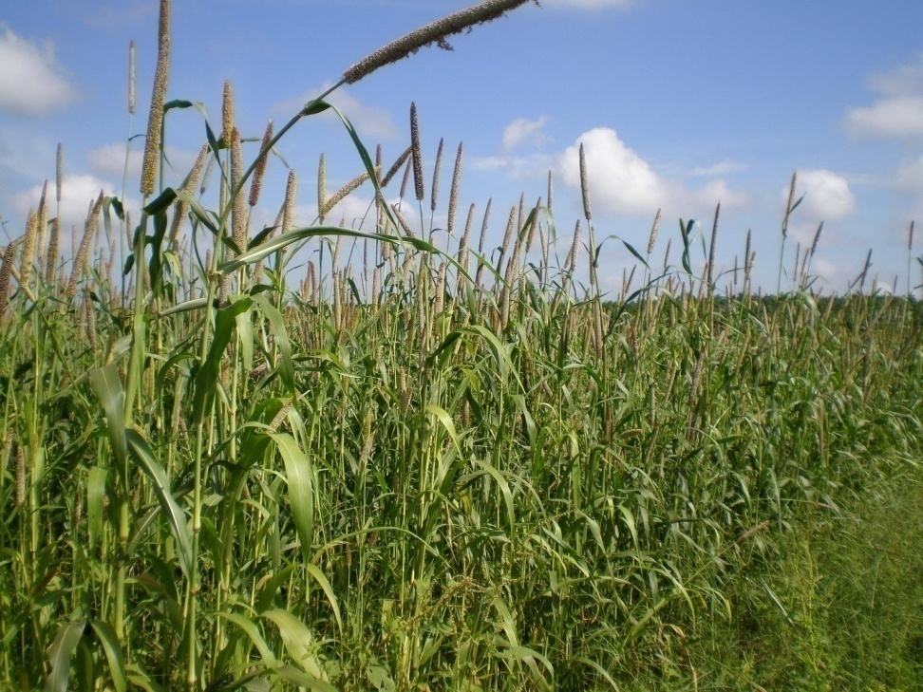
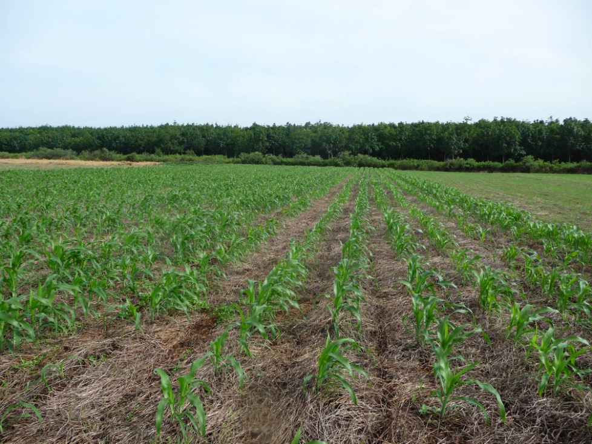
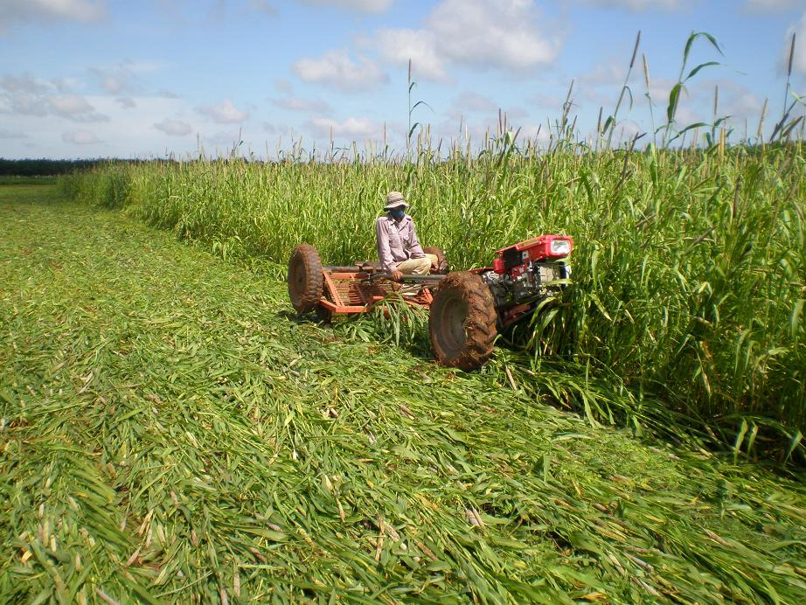

Slide 17
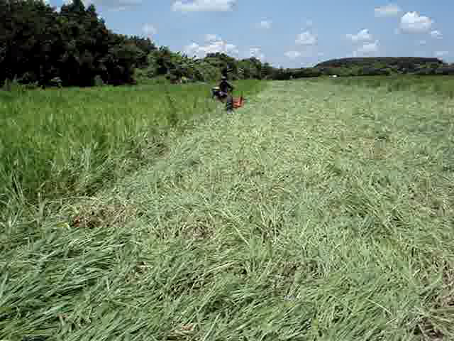

Slide 18
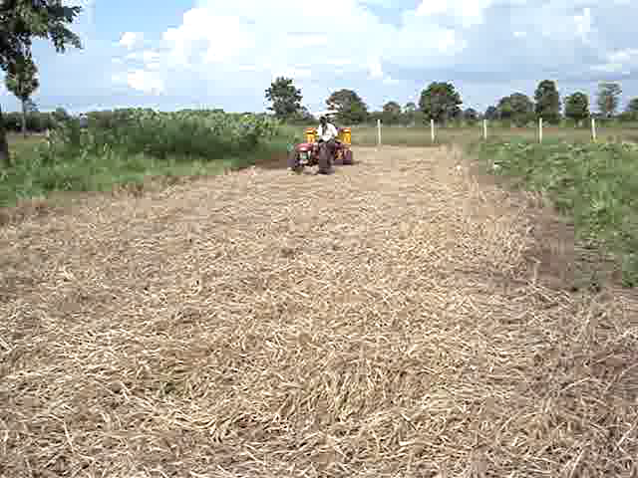

Slide 19
Baseline Results of Farmers’ Plot

Slide 20
Maize Yield in CAPS and Plow-based Systems
Maize yield (t/ha)
Year

Slide 21
Gross Profit Margin (GPM) of CAPS and CT
Maize CAPS
Year 1
Maize CAPS
Year 2
Maize CAPS
Year 3
Maize on Plowing

Slide 22
Sensitivity of GPM (2009-2011) to Maize Price in Plow-based System

Slide 23
Evolution of the CAPS surface within the farmers network

Slide 24
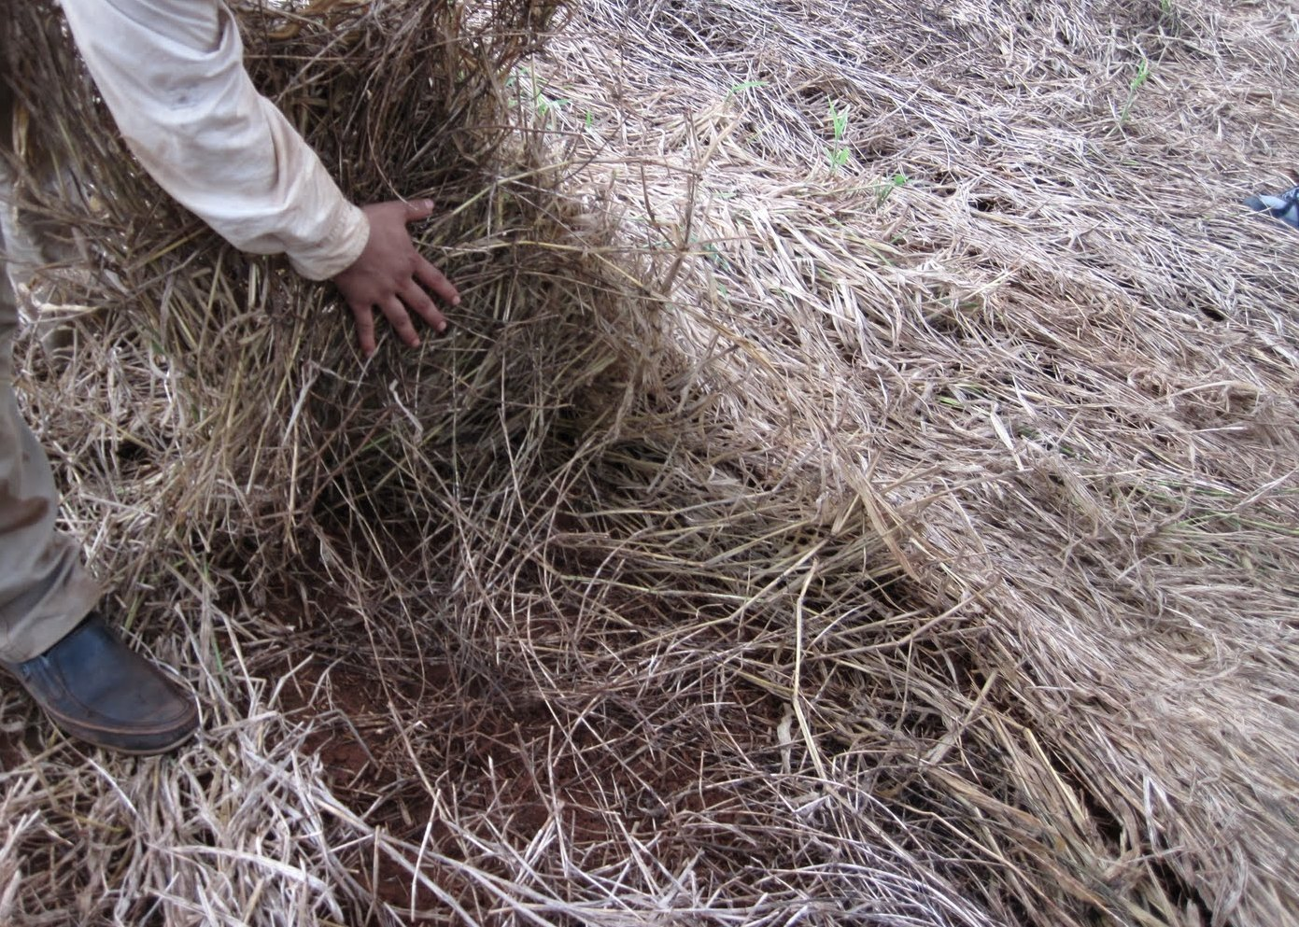
Stylo cover crop in CAPS plot

Slide 25
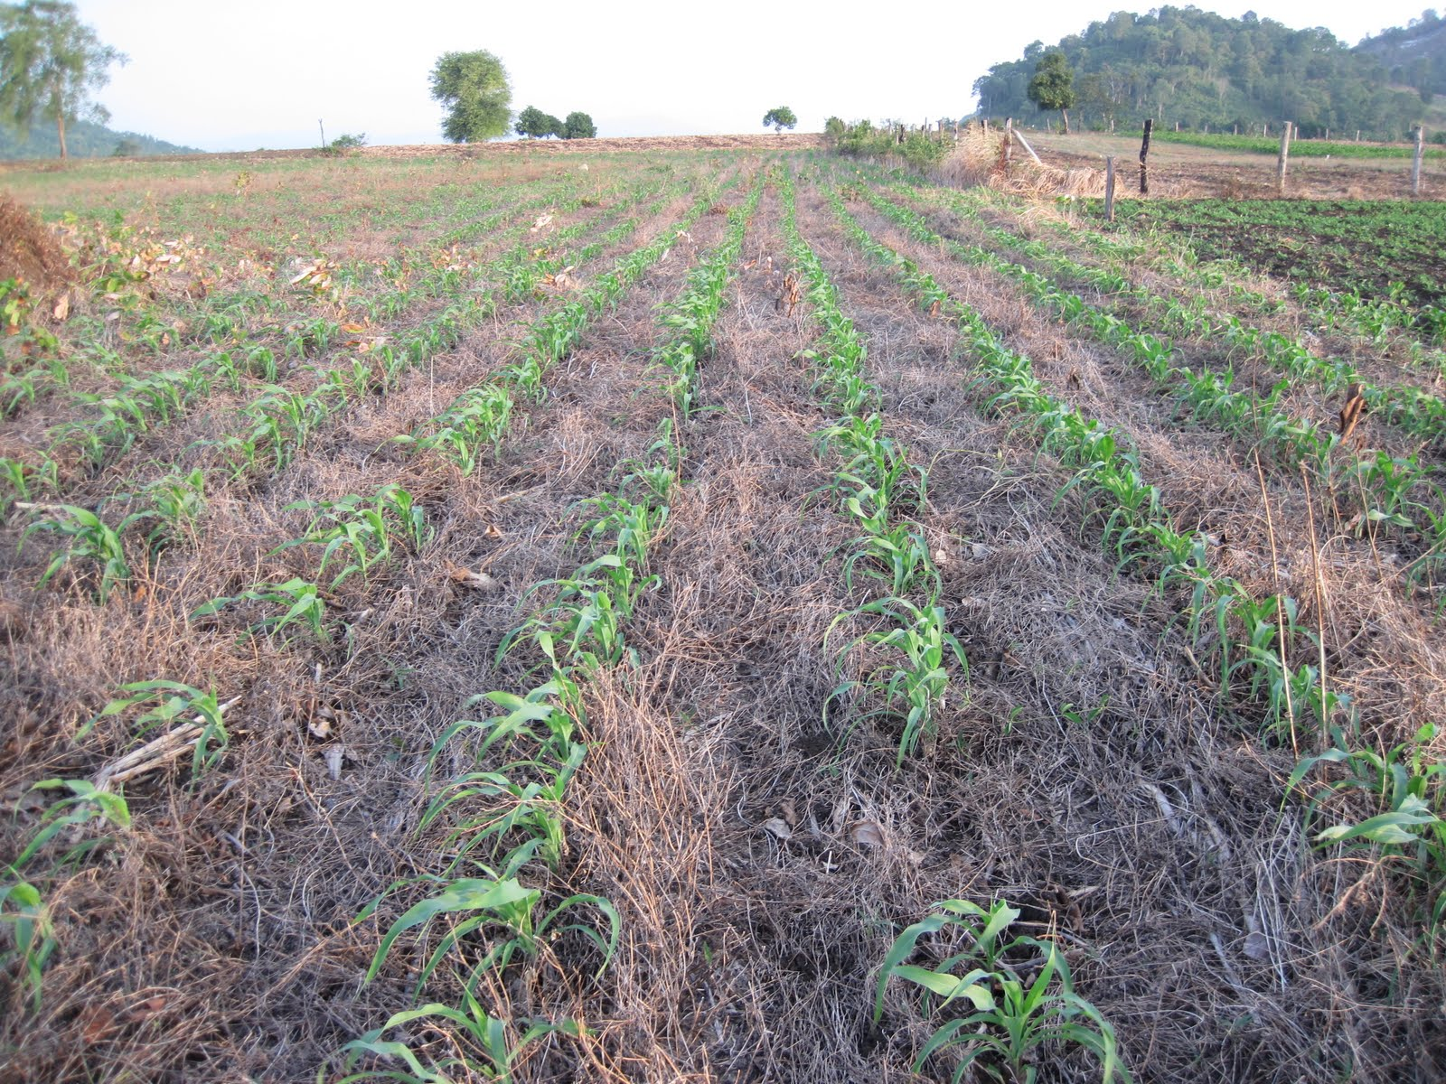
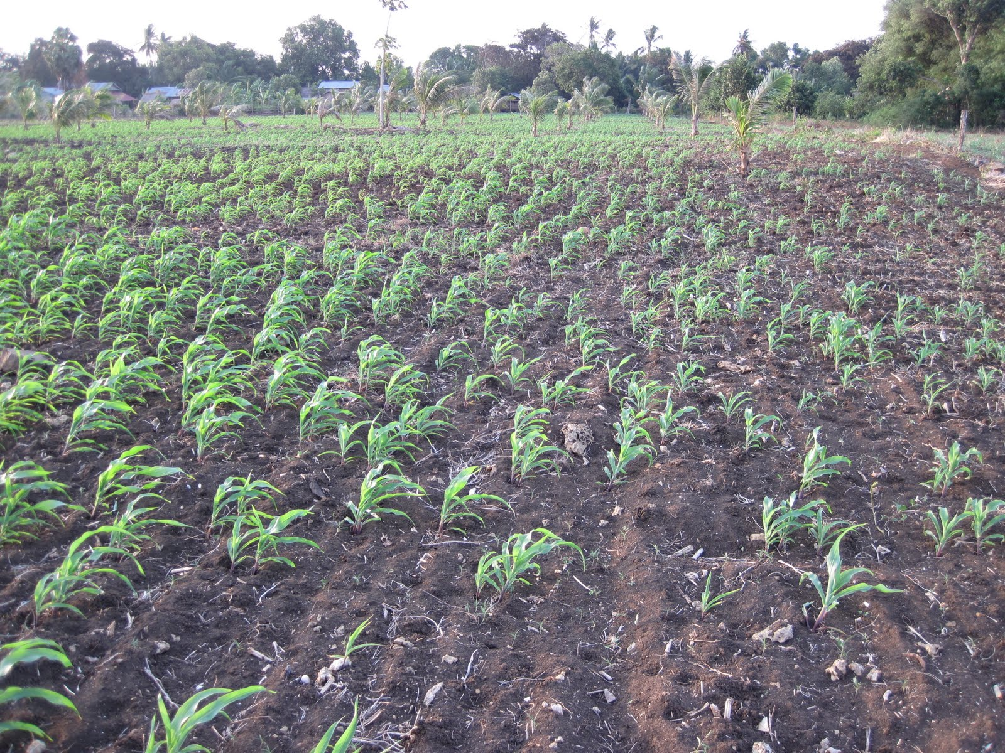
CAPS
CT

Slide 26
Baseline Results of Demo Plot

Slide 27
Maize Yield 2011
Maize Yield (t/ha)
Cropping Systems

Slide 28
Conclusion
Initial results showed that in Cambodia CAPS produced higher maize yield within three years.

Slide 29
GMP of CAPS increases with time and is higher than plow-based system.
As a first concrete success in this domain, two farmers have lately ordered sowing machines and will start to “retail” services to other farmers.

Slide 30
Thank You for Your Attention!!!

