Slide 1
Handout on Creating Bibliography from a Selected Item in Zotero
Titilola Obilade
Instructional Design for Distance Learning
November 19, 2011

Slide 2
Before proceeding on the handout on creating bibliography from a selected article in Zotero:
I would encourage you to go through the asynchronous module on importing from Zotero.

Slide 3
CREATING BIBLIOGRAPHY FROM A SELECTED ITEM IN ZOTERO
First Example
1. Inside Zotero, click on the 2010 4th International Conference on Application of Information article that was saved from the asynchronous module on importing into Zotero
2. Right mouse click if using a PC (A pop up window opens up with about 10 selections)
3. Select Create bibliography from selected item (Another window pops up titled Create Bibliography)
4. Select American Psychological Association 6th Edition because that is the reference style I have chosen. You can choose any of the available styles from Zotero.

Slide 4
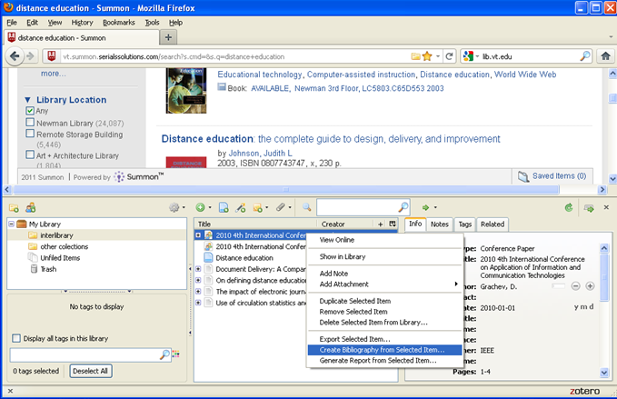
Notes:
This PowerPoint slide is a screen shot of what you should see when you are creating a bibliography for 2010 4th International Conference on Application of Information.
The red arrows highlight the steps you should see; The yellow, Zotero icon, the selected article on 2010 4th International Conference on Application of Information and the highlighted Create Bibliography from Selected Item

Slide 5
Pasting Selected Bibliography on Microsoft Word Document
Select Copy to clip board and click OK (It would be on the electronic clip board of your computer so you would not see it)
Open your Microsoft Word Document
Click Control V to paste the Bibliography of the selected item
Click Command V if you are using a Mac. o paste the exported article
Click Command V if you are using a Mac.

Slide 6
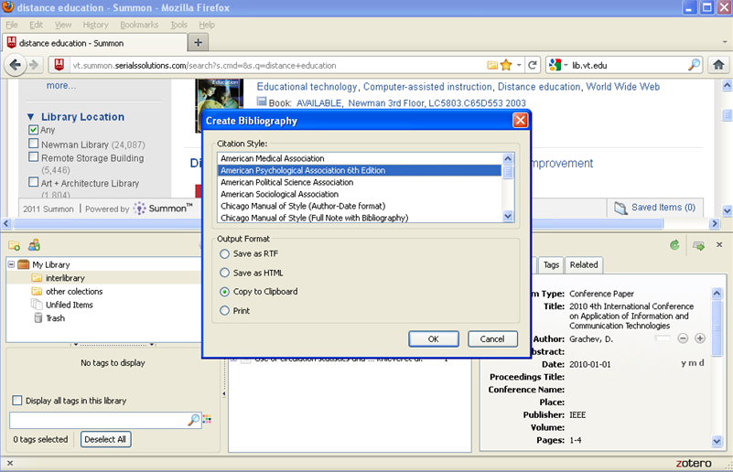
Notes:
This PowerPoint slide is a screen shot of what you should see when you are creating a bibliography for 2010 4th International Conference on Application of Information.
The red arrows highlight the yellow Zotero icon, the Create Bibliography box, the selected citation style-APA and copy to clipboard option.

Slide 7
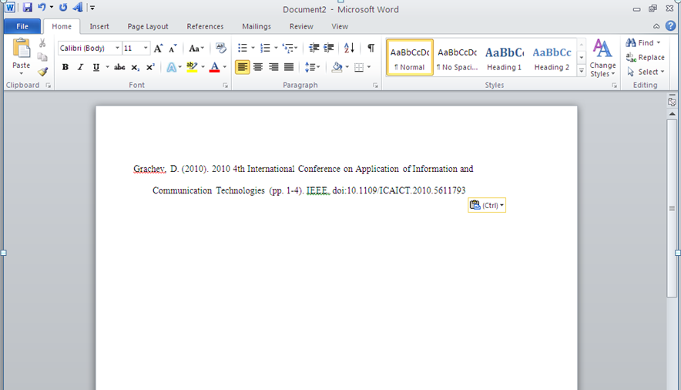
Notes:
The screen shot on this PowerPoint slide shows you what you should see after pasting the selected bibliography for 2010 4th International Conference on Application of Information on your Word Document.

Slide 8
A Second Example
Create a bibliography for the article Old concerns with new distance education research that was imported into Zotero in the asynchronous module on Zotero

Slide 9
CREATING BIBLIOGRAPHY FROM A SELECTED ITEM IN ZOTERO
Second Example
1. Inside Zotero, click on the Old concerns with new distance education research article that was saved from the asynchronous module on importing into Zotero
2. Right mouse click if using a PC (A pop up window opens up with about 10 selections)
3. Select Create bibliography from selected item (Another window pops up titled Create Bibliography)
4. Select American Psychological Association 6th Edition because that is the reference style I have chosen. You can choose any of the available styles from Zotero.

Slide 10
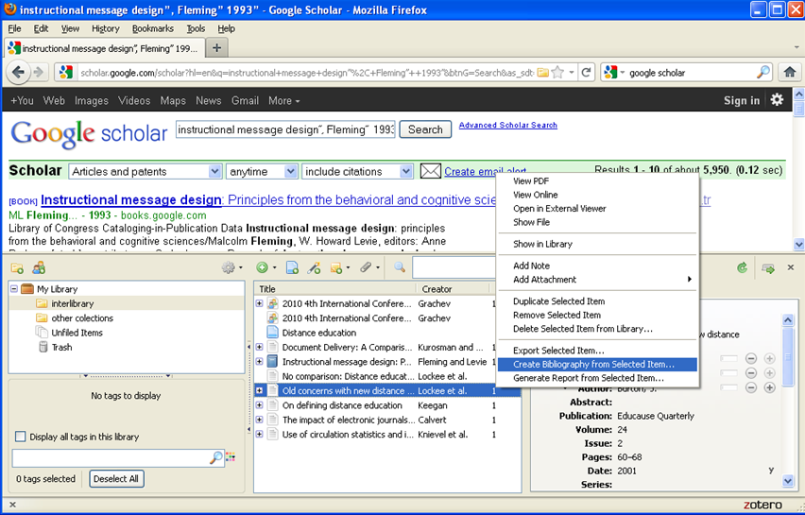
Notes:
The three red arrows point to the yellow Zotero icon, the selected article Old concerns with new distance education research and Create Bibliography from selected item. You should see all the items highlighted by the arrows.

Slide 11
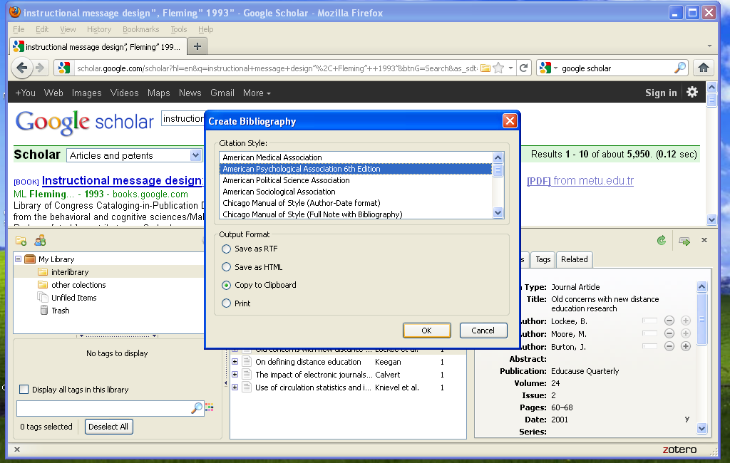
Notes:
The red arrows point to the yellow Zotero icon, the selected APA citation style, copy to clipboard and OK.

Slide 12
Pasting Selected Bibliography on Microsoft Word Document
Select Copy to clip board and click OK (It would be on the electronic clip board of your computer so you would not see it)
Open your Microsoft Word Document
Click Control V to paste the bibliography of the selected item
Click Command V if you are using a Mac. o paste the exported article
Click Command V if you are using a Mac.

Slide 13
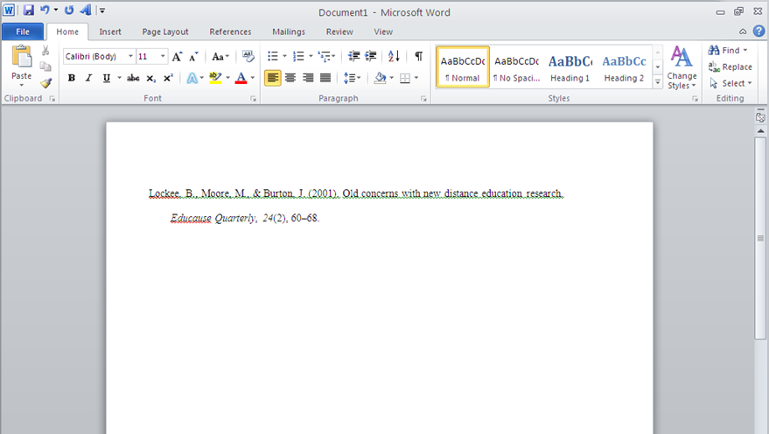
Notes:
The screen shot on this PowerPoint slide shows you what you should see after pasting the selected bibliography for Old concerns with new distant education research on your Word Document.

