Slide 1
Advanced Care Planning for People Living with Dementia
Sarah Stubbs, MD, FAAFP
Geriatrics
Center for Healthy Aging
Virginia Tech Carilion School of Medicine

Slide 2
Disclosure
It is the policy of the AAFP that all individuals in a position to control CME content disclose any relationships with ineligible companies upon nomination/invitation of participation. Disclosure documents are reviewed for potential relevant financial relationships. If relevant financial relationships are identified, mitigation strategies are agreed to prior to confirmation of participation. Only those participants who had no relevant financial relationships or who agreed to an identified mitigation process prior to their participation were involved in this CME activity.
All individuals in a position to control content for this session have indicated they have no relevant financial relationships to disclose.
Notes:
In Lecture Slide for All Faculty

Slide 3
Learning Objectives
Review different types of Advanced Directives and their
appropriate uses
Discuss different types of medical and legal surrogates that
may advocate for incapacitated patients

Slide 4


A few statistics…
Approximately ONE in THREE adults in the US complete any type of advanced directive for end-of-life care
Similar proportions of patients with chronic illnesses (38.2 percent) and healthy adults (32.7 percent) had completed advance directives
Yadav KN, Gabler NB, Cooney E, Kent S, Kim J, Herbst N, Mante A, Halpern SD, Courtright KR. Approximately One In Three US Adults Completes Any Type Of Advance Directive For End-Of-Life Care. Health Aff (Millwood). 2017 Jul 1;36(7):1244-1251. doi: 10.1377/hlthaff.2017.0175. PMID: 28679811.

Slide 5
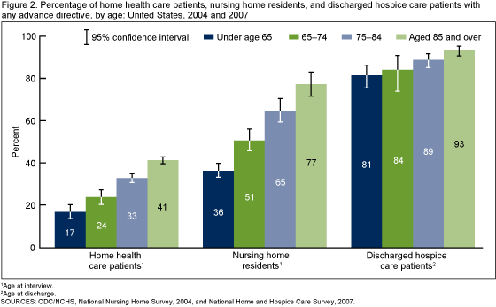
A few statistics…
Percentage of patients with advanced directives
Home health care ~28%
Nursing home residents ~65%
Discharged hospice care patients ~88%
White patients are more likely to have ACP documents than patients of color

Slide 6
What is Advanced Care Planning
Advanced care planning encompasses oral and written communication that delineates a patient’s medical choices across their lifespan
These are legal documents and orders that allow patients to communicate their wishes even if they are incapacitated
Advanced Directive
Living Will
POLST or MOLST
Power of Attorney
DDNR

Slide 7
Why are ACPs important?
Plans for the “what ifs”
Encourages open communication and understanding between patients and families
Observational studies suggest that there are benefits to completing advance directives
  Less likely to die in the hospital
  More likely to receive care that is consistent with their preferences
  More likely to have surrogates who report better communication with physicians near the end of life
  Helps families grieve easier and feel less guilt over decisions
  More likely to receive less costly care in certain regions.
Yadav KN et al. 2017.

Slide 8
Advanced Directives and Living Wills
A legal document that tells healthcare providers how a patient wants to be treated if they cannot make their own decisions about emergency treatment.
Legally recognized but NOT legally binding
  A healthcare provider will strive to abide by decisions, but may be limited by clarity of choice, healthcare policy, accepted medical standards, or conscience
Legal and Financial Planning for People Living With Dementia. National Institute on Aging. 2020 Oct. NIH Publication No. 20-AG-6422. Accessed Feb 2023

Slide 9
Advanced Directives and Living Wills
The patient will fill out the state-specific document and it should be witnessed or notarized depending on requirements of the state
Components of advanced directives
  Preferences for common medical decisions for end-of-life care
  Name and contact information of healthcare proxy, or “agent”
  List of decisions that the agent is or is not designated to make on behalf of the patient
  Some may include medical decisions and directions for agents regarding mental health treatment
  Some may include choices regarding organ donation
National Institute on Aging. 2020

Slide 10
Where to find these documents
Download your state’s form online from one of these national organizations:
  AARP:
    https://www.aarp.org/caregiving/financial-legal/free-printable-advance-directives/
  American Bar Association:
    https://www.americanbar.org/groups/law_aging/resources/health_care_decision_making/Stateforms/
  National Hospice and Palliative Care Organization
    https://www.caringinfo.org/planning/advance-directives/
  Veteran’s Affairs (VA) office
    https://www.va.gov/find-forms/about-form-10-0137/Advance Care Planning: Advance Directives for Health Care. www.nia.nih.gov

Slide 11
When to create or review ACP documents
Ideal time to create ACP documents are when a patient is healthy and able to think about decisions for the future
  Annual physical or Medicare Wellness Exam
A patient should review and potentially redraft
  Change in health status
  At hospital follow up
  Before a planned procedure
    Remember there are no “minor procedures” for older adults…
  Changes in family structure
    Marriage, divorce, death
  Before a move to a new living situation or state
    States may have different requirements!
Planning ahead helps a patient avoid the dreaded “If you are dying…” conversation in the ED!

Slide 12
Standard Will
A standard will (which is different from a “living will”) is a document identifying whom a person has chosen as:
  Executor: the person who will manage the estate.
  Beneficiaries: the people who will receive the assets in the estate.
The executor named in the will has no legal authority while the person is living.
A will only takes effect when a person dies.
A will cannot be used to communicate health care preferences. However, it can offer peace of mind that a person's wishes regarding their finances and property will be fulfilled upon death.
National Institute on Aging. 2020

Slide 13
Durable Power of Attorney
A legal document that names a proxy (aka representative, surrogate, or agent) to make legal decisions for a patient in the event of their incapacity
  The POA will generally stipulate the requirements for deeming a patient incapable of making decisions.
May be may be medical, financial or both
Written by a lawyer
The proxy should be chosen carefully and have ongoing conversations with the patient to fully understand their desires for care
National Institute on Aging. 2020

Slide 14
Durable Power of Attorney
Power of attorney does not give the agent the authority to override the principal's decision-making until the patient no longer has capacity to make the decision(s) themselves.
A Financial Power of Attorney does not convey medical privileges
A General or Non-durable Power of Attorney expires upon incapacity
National Institute on Aging. 2020

Slide 15
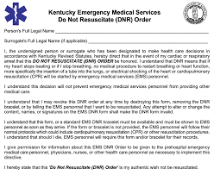
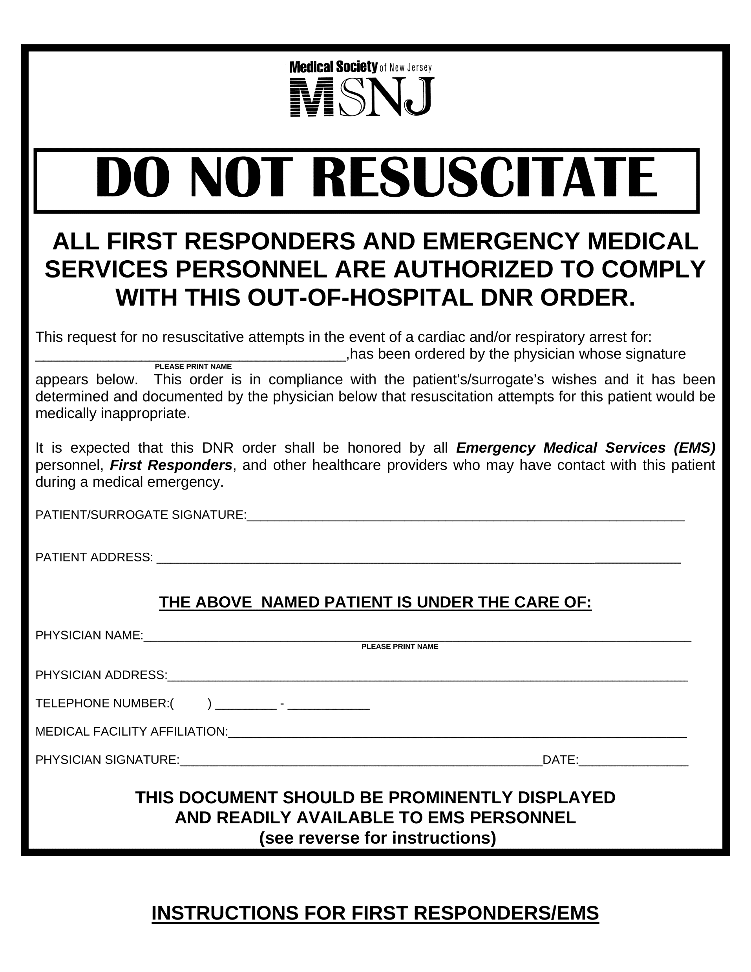
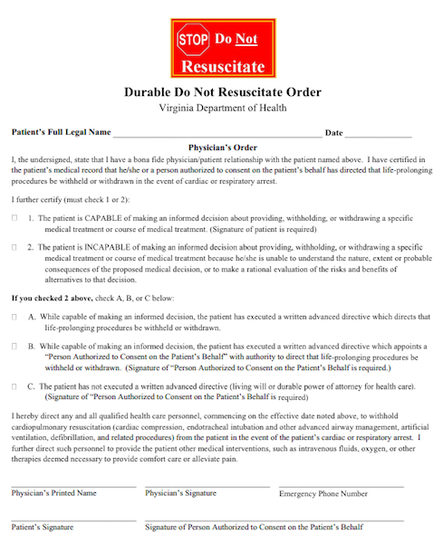
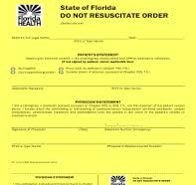
DNR
A medical order indicating that the patient does not want CPR or other life-support measures to be attempted they go into cardiac arrest.
  Indicates if the patient is capable or incapable of making the medical decision
  Signed by patient or by patient’s healthcare proxy
  Transportable between hospital, SNF, and home
Notes:
Check state’s guidelines – there may be some states in which these are NOT transferable between the inpatient and outpatient settings and need to be signed each time

Slide 16
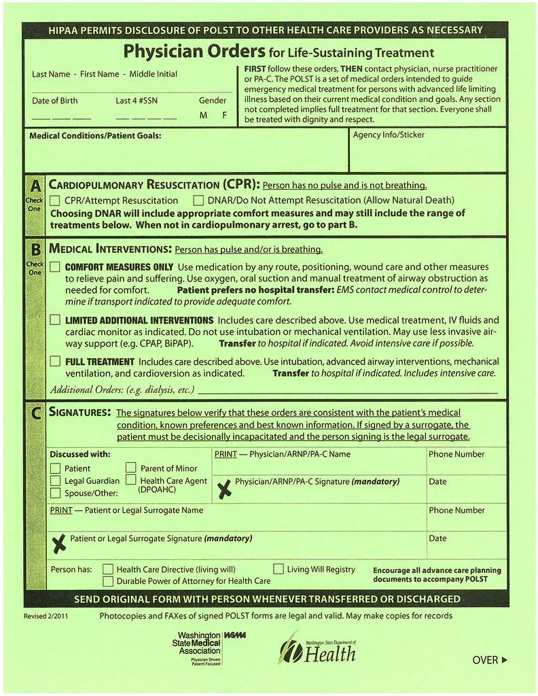
POLST or MOLST
Physician (or Medical) Order for Life-Sustaining Treatment
Gives seriously ill or frail people more specific direction over their health care treatments
Require a more in-depth conversation about a patient’s prognosis and shared decision-making about treatment plans
Notes:
Again, check with your state to see if these are available!

Slide 17
POLST or MOLST
Code Status
  Resuscitate or Do Not Resuscitate?
Medical Interventions
  Comfort focused treatment
  Limited treatment
  Full Treatment
Optional sections (vary by state): antibiotics and artificial nutrition (Feeding Tubes)
  I also write in dialysis options
Must be signed by a physician, NP, or PA as well as patient or representative
DNR Deluxe!
These documents are NO GOOD if they are not in the home!
Put on the back of the main door or on the refrigerator for EMS.

Slide 18
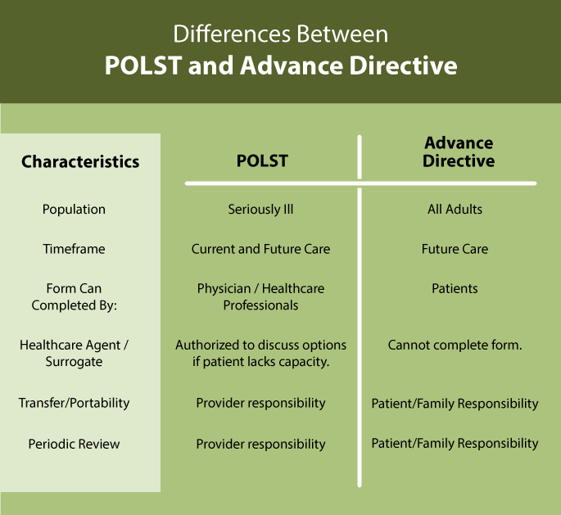
A POLST/MOLST form and DNR are used in conjunction with an advanced directive, but do not replace an advanced directive.
Ideal time for this conversation is post hospitalization and for the solo-senior
Crossroads Hospice and Palliative Care. https://www.crossroadshospice.com

Slide 19
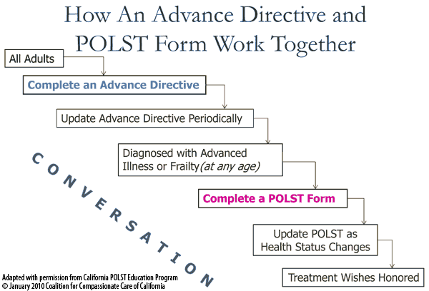

Slide 20
Guardianship or Conservatorship
A guardian or conservator is appointed by a court to make decisions about a person's care and property.
Guardianship is generally considered when a person with dementia is no longer able to provide for his or her own care and either the family is unable to agree upon the type of care needed or there is no family.
This legal process takes time, goes through the court system, and requires a lawyer
May sometimes be completed through Adult Protective Services or a residential facility (long-term care)
Adult Guardianship and Conservatorship. Virginia Poverty Law Center. Valegalaid.org. Accessed Feb 2023
Notes:
Remember: executing advanced directives and POAs early (ie: before incapacity) prevents need to pursue guardianship. This is a last resort!
There are some states in which a patient can authorize a “pre-need guardian” which states a patient can recommend a guardian should one be required by the courts. Check your state guidelines

Slide 21
Guardianship vs Conservatorship
Guardian
  Guardian of the person
  Authorized to make decisions involving the life or person of the ward, including healthcare decisions and place of residence
  Some decisions (like movement of a person to a nursing home or major medical interventions) may require court approval
Conservator
  Guardian of the estate
  Authorized to use the assets of the estate to provide for the care and maintenance of the ward
  Generally granted the authority to make decisions on the ward’s property and estate, but state law may prescribe some limits or require court approval
Adult Guardianship and Conservatorship. Virginia Poverty Law Center. Valegalaid.org. Accessed Feb 2023

Slide 22
Advanced Care Planning
It’s good for the soul
Having this conversation is considered an essential step for achieving a “good death”
  Physical pain and emotional distress are minimized
  Patient’s and family members’ treatment preferences are respected
ACP conversations promote patient autonomy
ACP is linked with reduced use of aggressive, costly and futile treatments at the end of life and greater use of palliative care, practices linked with both superior patient and survivor well-being
Deborah Carr, PhD, Elizabeth A Luth, PhD, Advance Care Planning: Contemporary Issues and Future Directions, Innovation in Aging, Volume 1, Issue 1, 1 March 2017

Slide 23
Advanced Care Planning
It’s good for the family
An estimated 45%–70% of older adults facing end-of-life treatment decisions are incapable of making those decisions themselves
Advance care planning is associated with better outcomes for family members, including reduced decision-making burden, and fewer anxiety and depressive symptoms
Deborah Carr, PhD, Elizabeth A Luth, PhD. 2017

Slide 24
Advanced Care Planning
It’s good for the provider
We can bill for it!!
  99497 for 16-30min (2.25 RVUs, $82.90)
  99498 for each additional 30min increments (2.12 RVUs, $72.50)
  Completion of specific forms, such as, MOLST, DNR, Living Will, or other standard forms is not required to bill for the service.
  Use modifier -33 to avoid co-pay and deductible
There are no limits on the number of times or how often advanced care planning is provided to a beneficiary
  If billed multiple times, Medicare will require documentation of changes in patient’s health status or wishes
Making sense of MACRA: Advanced Care Planning. AAFP Handout. 2018. Accessed March 2023

Slide 25
Case 1: Ms. Smith
Ms. Smith is a 76y/o female with a history of HTN, HLD, intellectual disability, and recurrent UTIs
  Social hx: grew up in rural Southwest Virginia, has always been “a little slow”, didn’t graduate high school, worked in a factory.
  When I met her, she lived with her brother, never married, no children
Poor follow-up with primary care
  She would miss her appointments, but would randomly walk into clinic asking for something for “itching down there”
  I tried calling her brother for more information and to express my concerns about her cognitive status, could never reach him
APS got involved due to concern for self-neglect
  Witnessed poor living situation, controlling brother
  Ms. Smith was removed from the home and placed in ALF after APS witnessed brother threatening her
No Dementia diagnosis, assessment of capacity, or advanced care planning
  Patient lost to follow up, APS was seeking guardianship at last contact
Notes:
I was her PCP for 5 years after I inherited her care from my predecessor who treated her for 40 years.

Slide 26
Case 1: Ms. Smith… 2 years later
Ms. Smith is now a resident of a longterm care facility
  Diagnosis of dementia (stage 6) and “behavioral problems”
  Routinely refuses medications, care, and increasingly food and drink
  Ms. Smith is her own “responsible party”, still DOES NOT have a guardian or advanced care planning. She is a full code.
Her dementia progresses (stage 7) and health declines and facility administration becomes concerned about keeping her safe due to her decline and her behaviors
  Would benefit from hospice services, but cannot consent as deemed to lack capacity to make her own medical decisions
  I contact her previous APS social worker who attempts to reach out to distant family to see if they will assume guardianship
  She has several admissions for AMS, dehydration, worsening behaviors. Still no guardianship after 2-3 months, still full code
Last I heard, she was discharged to a memory care unit, no guardian, no solution to lack of advanced care planning
Points where her healthcare professionals could have intervened:
Her PCP could have assessed for capacity much sooner (known Intellectual Disability)
APS was able to get her away from an abusive/neglectful situation, but was unable to secure guardianship (limited resources, limited time)
She was admitted to a longterm care facility, but no guardian was identified, and no advanced care planning was able to be set up
She had multiple admissions for conditions that were ultimately stemming from her dementia decline
She suffered because she could not consent to her care and others had not been appointed to speak for her
Notes:
I was her PCP for 5 years after I inherited her care from my predecessor who treated her for 40 years.

Slide 27
Case 2: Mrs. Jones
Mrs. Jones is a 67y/o female with a history of diabetes, hypertension, chronic kidney disease, and anxiety
  Social hx: grew up in New York, college educated retired former teacher
  Lives with husband who also has multiple medical issues. Many friends, but no other relatives
  She and her husband have advanced directives, but no other advanced care planning
Her husband’s health declines, he ends up in the hospital on a ventilator. Mrs. Jones is responsible making end-of-life decisions
  She states it was hard on her to have to “pull the plug” on her husband and vows never to have this happen to her
She signs documents for herself appointing a friend as her durable POA as well as a durable DNR

Slide 28
Case 2: Mrs. Jones… 4 years later
Mrs. Jones’ health is failing
  She has multiple admissions for renal failure and one for a minor stroke
  She decides to go on dialysis
She moves to an assisted living facility in Roanoke to be closer to her specialists, and transfers care to a Roanoke PCP due to transportation issues
  Her advanced care documentation in her Problem List on the EMR is removed, but her documents are scanned into the system
Two months later, she ends up in the hospital with acute respiratory distress, and is intubated in the ICU.
  Her documents are finally “found”, and she is extubated and expired
She did everything right! Why did this outcome happen?
She has no close family to advocate for her
Her POA and DNR documents were “buried” in the system
The ALF did not send over her DNR when she was transferred to the hospital (?)

Slide 29
Practice Recommendations
Every adult should have an advanced directive or a living will
Seriously or terminally ill patients should consider a DNR POLST/MOLST form
Patients should establish a durable power of attorney to manage their health and financial decisions in the event they are incapacitated. Failure to appoint a durable power of attorney may result in need for guardianship.
Review these documents often with patients – open conversation makes for better decisions.
Make sure the advanced care planning documentation is in the home as well as accurately documented in the EMR.

Slide 30
© 2023 American Academy of Family Physicians. All rights reserved.
All materials/content herein are protected by copyright and are for the sole, personal use of the user.
No part of the materials/content may be copied, duplicated, distributed or retransmitted
in any form or medium without the prior permission of the applicable copyright owner.

Slide 31


