Slide 1
MOSAIC:
Model of Securing Application Information Confidentiality
Kimberly Zeitz & Chris Frisina
Client: Randy Marchany
Director of the VT IT Security Lab
Prior Research Contact: Noha El Sherbiny
Blacksburg
March 6, 2013
CS6604

Slide 2
Background
Motivation
  Clarify scattered security concepts
  Guide decision making
  Comprehensive tailored security framework
  Breakdown of decisions based on security concern areas
Notes:
Access and communication of information
Mixed classification of data
Mixed classification of users
Circumstantial guidelines

Slide 3
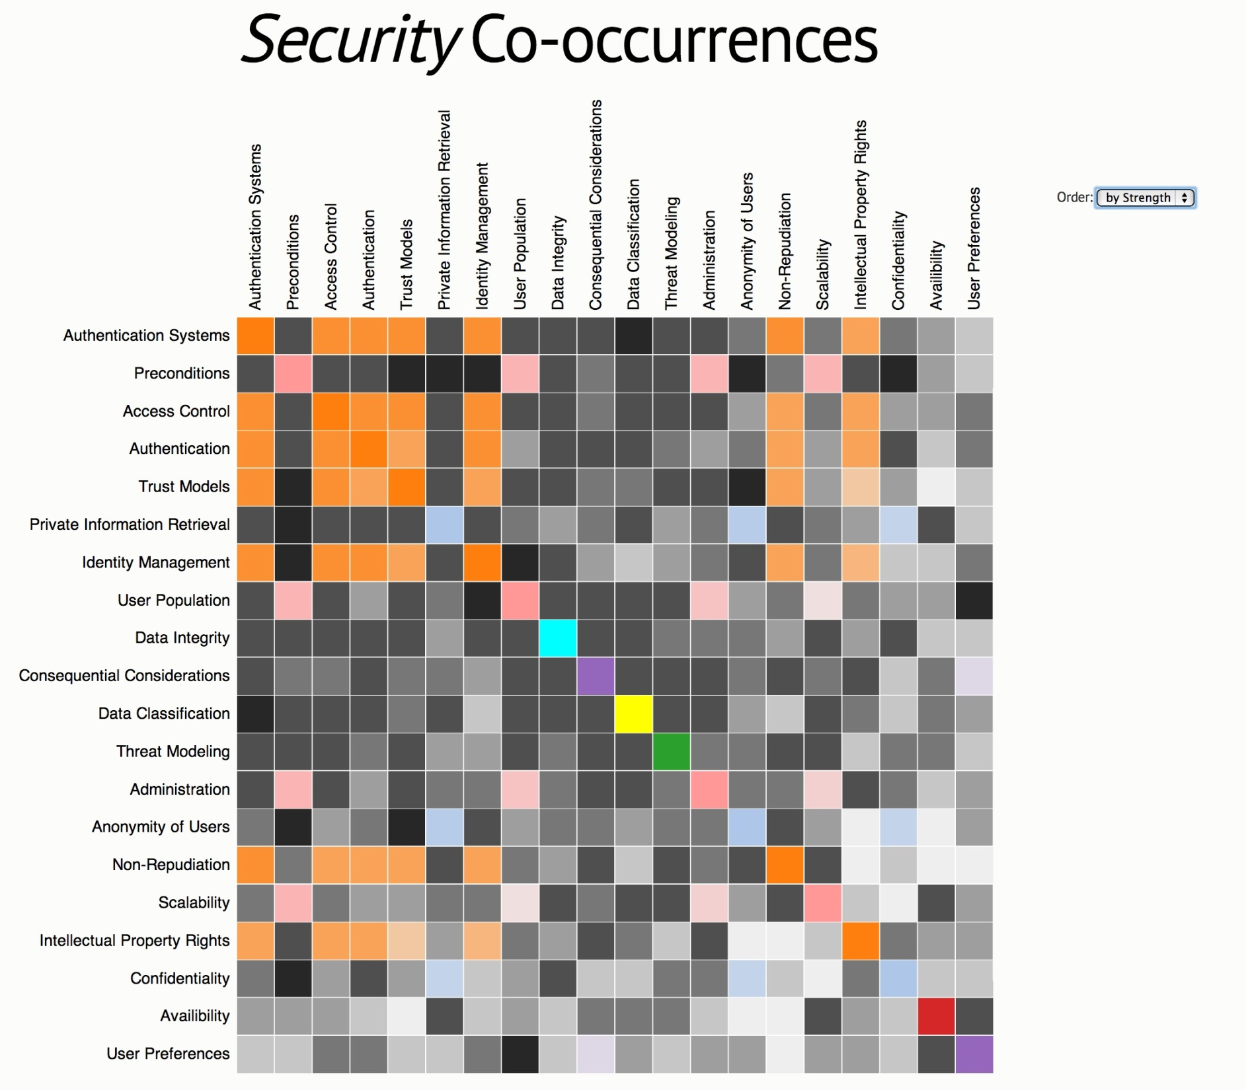








Private Information Retrieval
Access Control
Data Integrity
Threat Modeling
Data Classification
Availability
Preconditions
Post-conditions

Slide 4
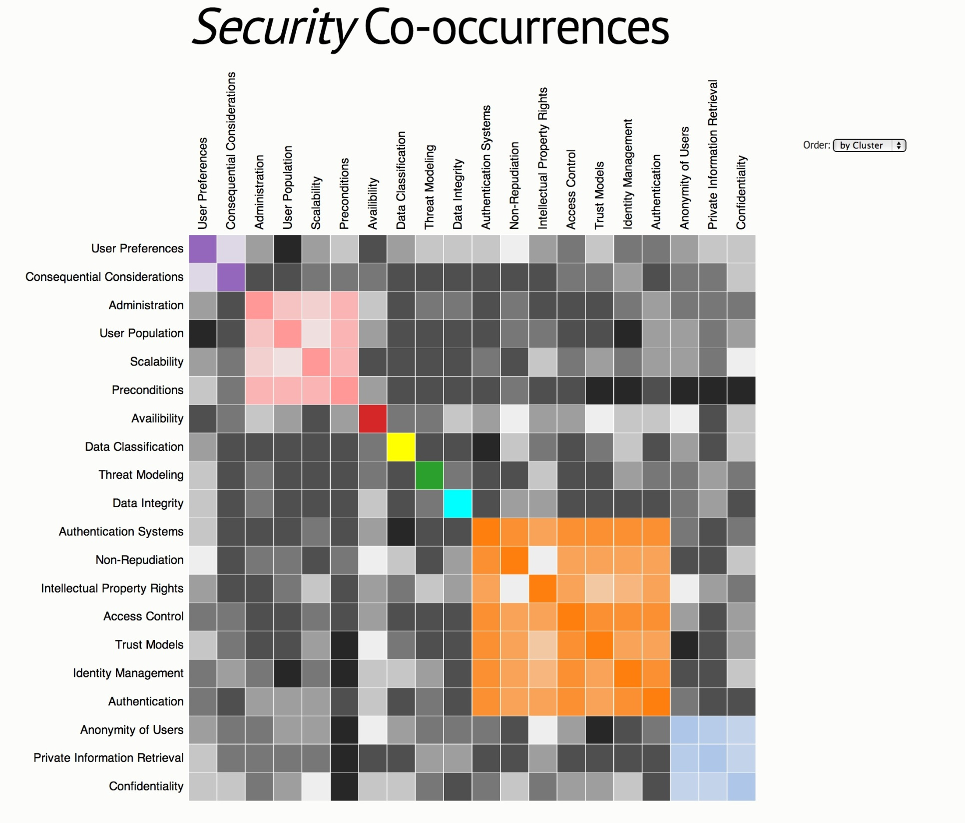
Private Information Retrieval
Access Control
Data Integrity
Threat Modeling
Data Classification
Availability
Preconditions
Post-conditions

Slide 5
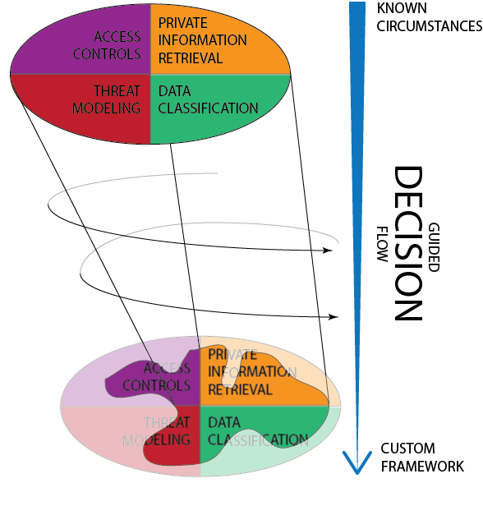
Notes:
Step 1: Know specific circumstances
Step 2: MOSAIC guides decision making
Access Controls
Who can access what?
Private Information Retrieval
Are the users and queries anonymous?
Data Classification
Data confidentiality or integrity?
Threat Modeling
What are the relevant threats and vulnerabilities?

Slide 6
(Content) CBAC
(Role) RBAC
(Task) TBAC
(Team) TMAC
Access Control List
Capability List
Pseudonyms
Database Replication
Secret Handshakes
Onion Routing
Private Information Retrieval
Access Controls
Threat
Modeling
Data
Classification
Biba for Data Integrity
Write-down read up
BLP [Bell-LaPadula] for Confidentiality
Write-up read down
Attacker-centric
System-centric
Asset-centric

Slide 7
Remaining Work
Justification for classification system
Detail current methodologies
  Pros & Cons
  Relevant Situations
Present the decisions and solutions in a usable and concise manner

Slide 8
Questions?

Slide 9
References
Access Controls
[1] N. R. Adam, V. Atluri, E. Bertino, and E. Ferrari, “A content-based authorization model for digital libraries,” IEEE Trans. Knowl. Data Eng., vol. 14, no. 2, pp. 296–315, 2002.
[2] A. Adams and M. A. Sasse, “Users are not the enemy,” Commun. ACM, vol. 42, no. 12, pp. 40–46, Dec. 1999.
[3] R. Butler, C. Kesselman, J. Volmer, S. Tuecke, I. Foster, D. Engert, and V. Welch, “A national-scale authentication infrastructure,” Computer (Long. Beach. Calif)., vol. 33, no. 12, pp. 60–66, 2000.
[4] J.-W. Byun, E. Bertino, and N. Li, “Purpose based access control of complex data for privacy protection,” in Proceedings of the tenth ACM symposium on Access control models and technologies - SACMAT ’05, 2005, p. 102.
[5] M. Ion, G. Russello, and B. Crispo, “Enforcing Multi-user Access Policies to Encrypted Cloud Databases,” in 2011 IEEE International Symposium on Policies for Distributed Systems and Networks, 2011, pp. 175–177.
[6] N. K. Ratha, J. H. Connell, and R. M. Bolle, “Enhancing security and privacy in biometrics-based authentication systems,” IBM Syst. J., vol. 40, no. 3, pp. 614–634, 2001.
[7] K. Ren, W. Lou, K. Kim, and R. Deng, “A Novel Privacy Preserving Authentication and Access Control Scheme for Pervasive Computing Environments,” IEEE Trans. Veh. Technol., vol. 55, no. 4, pp. 1373–1384, Jul. 2006.
[8] R. Sandhu, E. Coynek, H. L. Feinstein, and C. E. Youman, “Role-Based Access Control Models,” IEEE Comput., pp. 38–47, 1996.
Data Classification
[1] A. F. Karr, J. Lee, A. Sanil, J. Hernandez, S. Karimi, and K. Litwin, “Disseminating Information but Protecting Confidentiality,” IEEE Comput., vol. 34, no. 2, pp. 36–37, 2001.
[2] V. Lenders, E. Koukoumidis, P. Zhang, and M. Martonosi, “Location-based trust for mobile user-generated content,” in Proceedings of the 9th workshop on Mobile computing systems and applications - HotMobile ’08, 2008, p. 60.
[3] S. Wiseman, “Control of confidentiality in databases,” Comput. Secur., vol. 9, no. 6, pp. 529–537, Oct. 1990.

Slide 10
References
Private Information Retrieval
[1] D. Asonov, “Private Information Retrieval: An Overview of Current Trends,” 2001.
[2] B. Chor, E. Kushilevitz, O. Goldreich, and M. Sudan, “Private information retrieval,” J. ACM, vol. 45, no. 6, pp. 965–981, Nov. 1998.
[3] C. Devet, I. Goldberg, and N. Heninger, “Optimally Robust Private Information Retrieval,” Secur. Proc. 21st USENIX Conf. Secur. Symp.
[4] P. Mittal, F. Olumofin, C. Troncoso, N. Borisov, and I. Goldberg, “PIR-Tor: Scalable Anonymous Communication Using Private Information Retrieval,” USENIX Secur. Symp., 2011.
[5] M. F. Mokbel, C.-Y. Chow, and W. G. Aref, “The new Casper: query processing for location services without compromising privacy,” VLDB, pp. 763–774, Sep. 2006.
[6] P. Neuhaus, “privacy and confidentiality in digital reference,” Ref. User Serv. Q., vol. 43, no. 1, pp. 26–36, 2003.
[7] B. Sattarzadeh, M. Asadpour, and R. Jalili, “Improved User Identity Confidentiality for UMTS Mobile Networks,” in Fourth European Conference on Universal Multiservice Networks (ECUMN’07), 2007, pp. 401–409.
[8] G. Tsudik and S. Xu, “Privacy Enhancing Technologies,” in Privacy Enhancing Technologies, vol. 4258, G. Danezis and P. Golle, Eds. Berlin, Heidelberg: Springer Berlin Heidelberg, 2006, pp. 295–315.
Threat Modeling
[1] A. Adams and M. A. Sasse, “Users are not the enemy,” Commun. ACM, vol. 42, no. 12, pp. 40–46, Dec. 1999.
[2] S. Saha, D. Bhattacharyya, T. Kim, and S. K. Bandyopadhyay, “Model Based Threat and Vulnerability Analysis of E-Governance Systems,” Int. J. u- e- Serv. Sci. Technol., vol. 3, no. 2, 2010.
[3] S. Subashini and V. Kavitha, “A survey on security issues in service delivery models of cloud computing,” J. Netw. Comput. Appl., vol. 34, no. 1, pp. 1–11, Jan. 2011.

