Slide 1
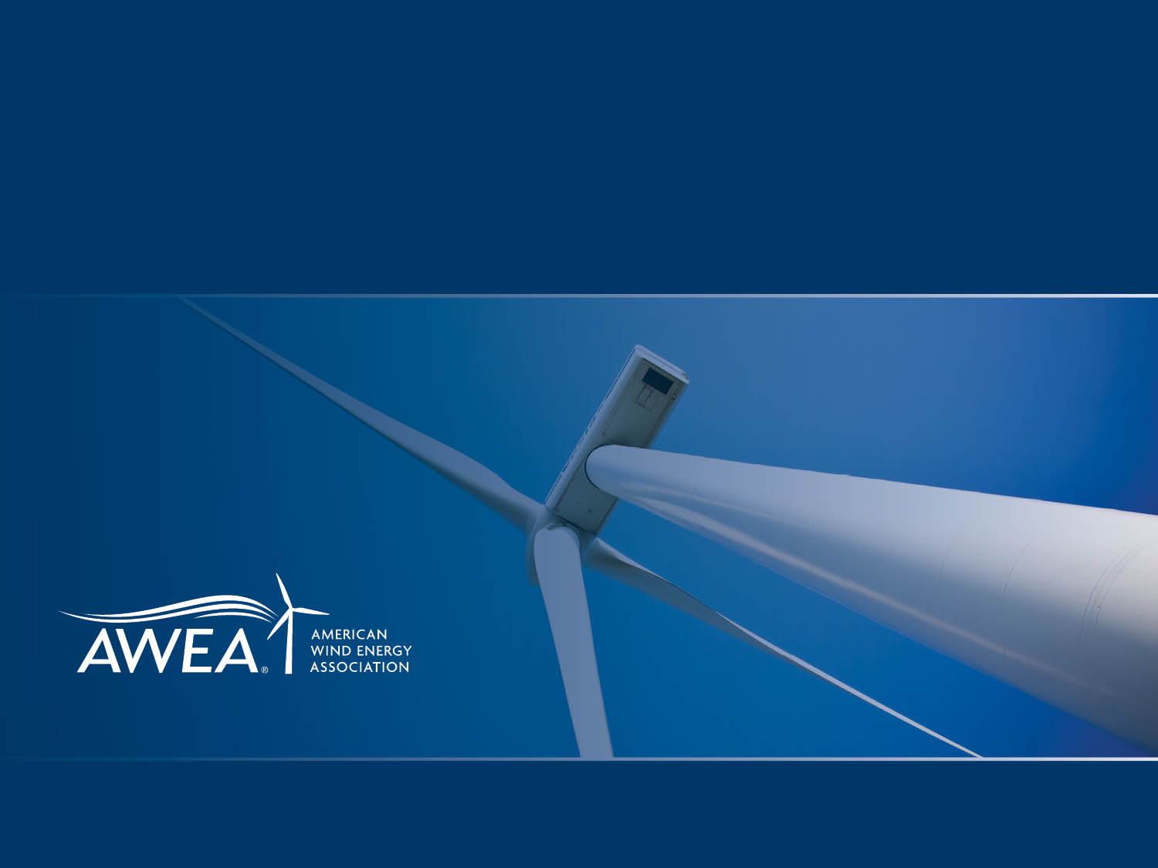
NAWEA 2015 Symposium
Wind Industry Market and Policy Overview
Hannah Hunt, AWEA

Slide 2
Overview of the Wind Energy Industry
U.S. Wind Market Data and Trends
Policy Drivers of Wind

Slide 3
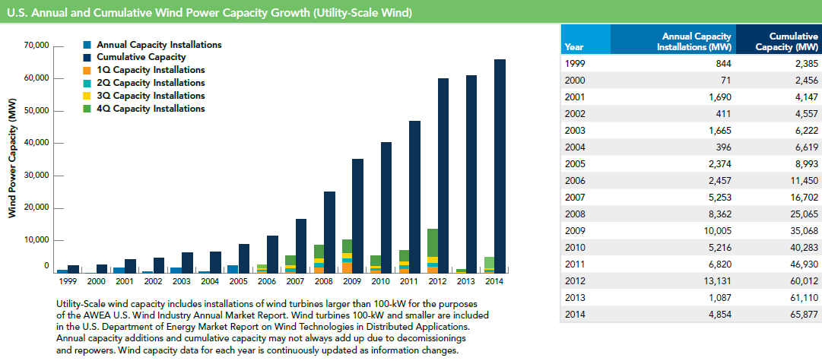
U.S. Annual & Cumulative Wind Power Capacity Growth (Utility-Scale Wind)

Slide 4

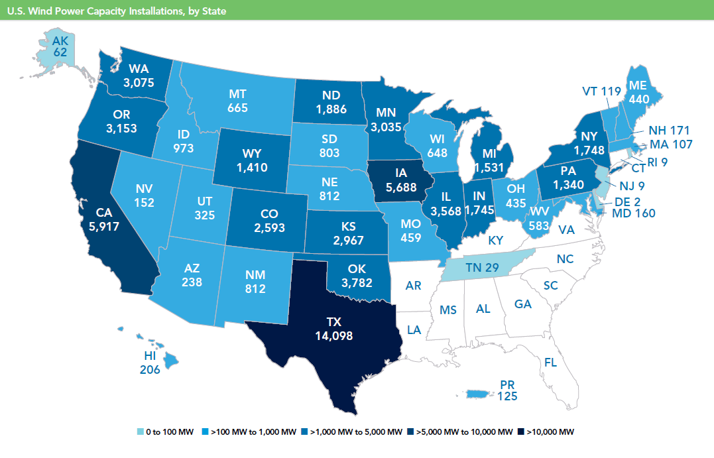
Wind Capacity Installations, by State

Slide 5
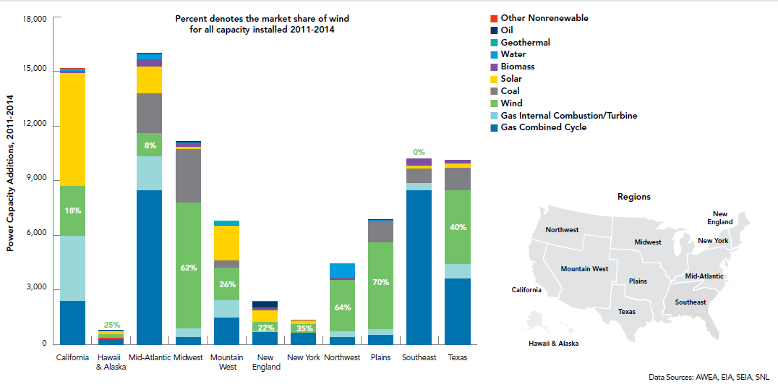
Wind Capacity Installations 2011-2014, by Region
Wind provided 80% of all new capacity installed in IA, MN, ND, and SD.

Slide 6
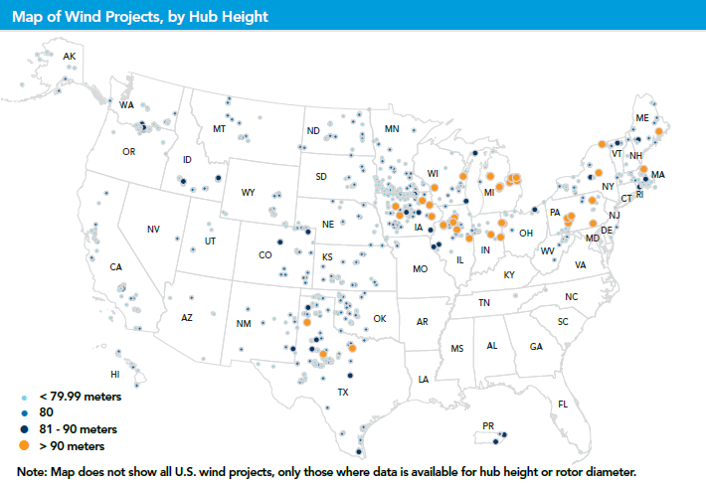
Wind Projects, by Hub Height

Slide 7
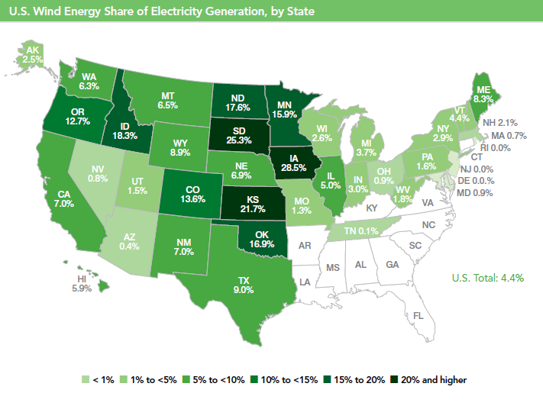
U.S. is Reliably Integrating Large Amounts of Wind

Slide 8
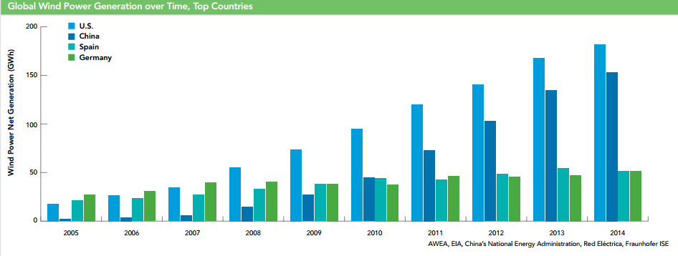
Global Wind Power Generation over Time
U.S. leads the world in wind energy generation, producing over 181 billion kWh of wind energy compared to China’s 153 billion kWh.

Slide 9
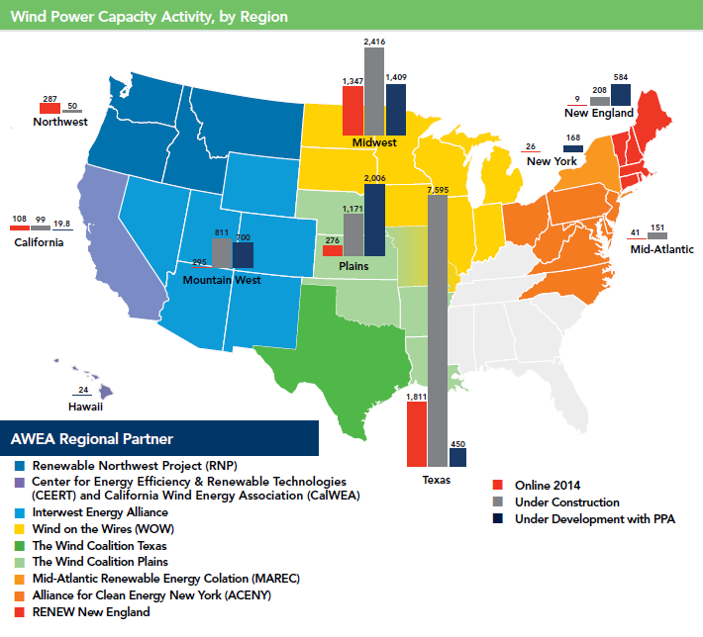
Under Construction Activity

Slide 10
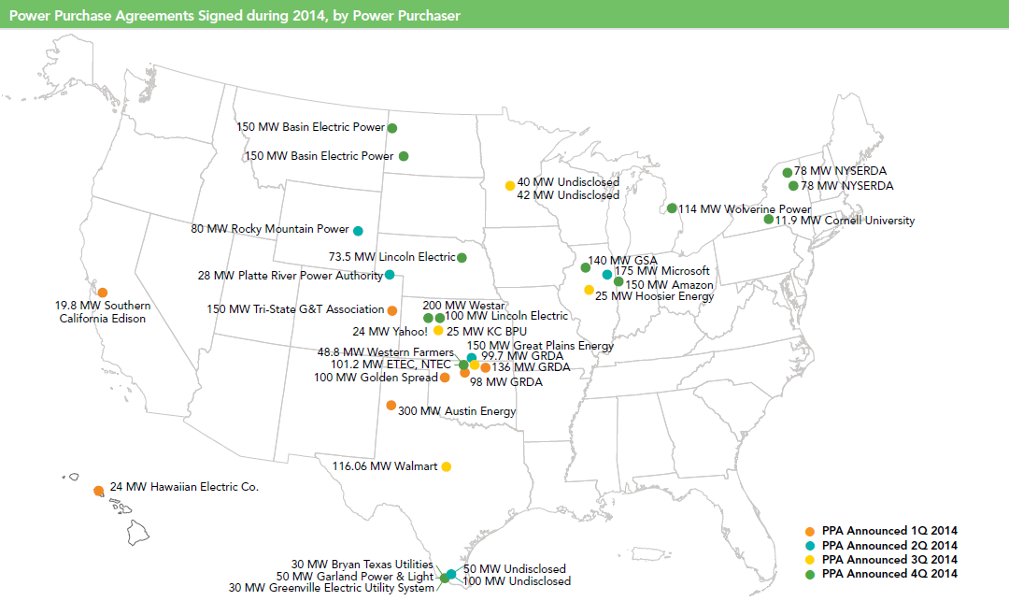
Record number of long-term contracts signed 2013-14

Slide 11
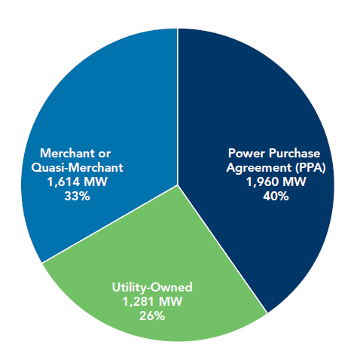
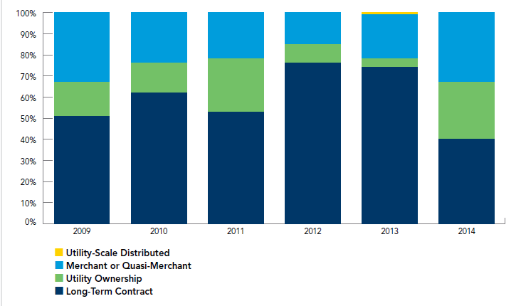
U.S. Wind Power Capacity Offtake
Merchant projects in Texas may include hedge contracts
62% of all wind energy procured through long-term PPAs between IPPs and the power purchaser.

Slide 12
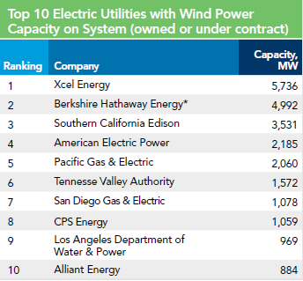
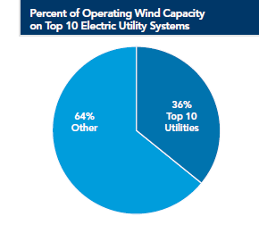
Who’s Purchasing Wind Power?
Top Cooperative Utility: Basin Electric Power Cooperative (716 MW)
Top Public Utility: CPS Energy (1,059 MW)
Cooperative utilities signed 23% of the 3,300 MW of total new PPAs during 2014.

Slide 13
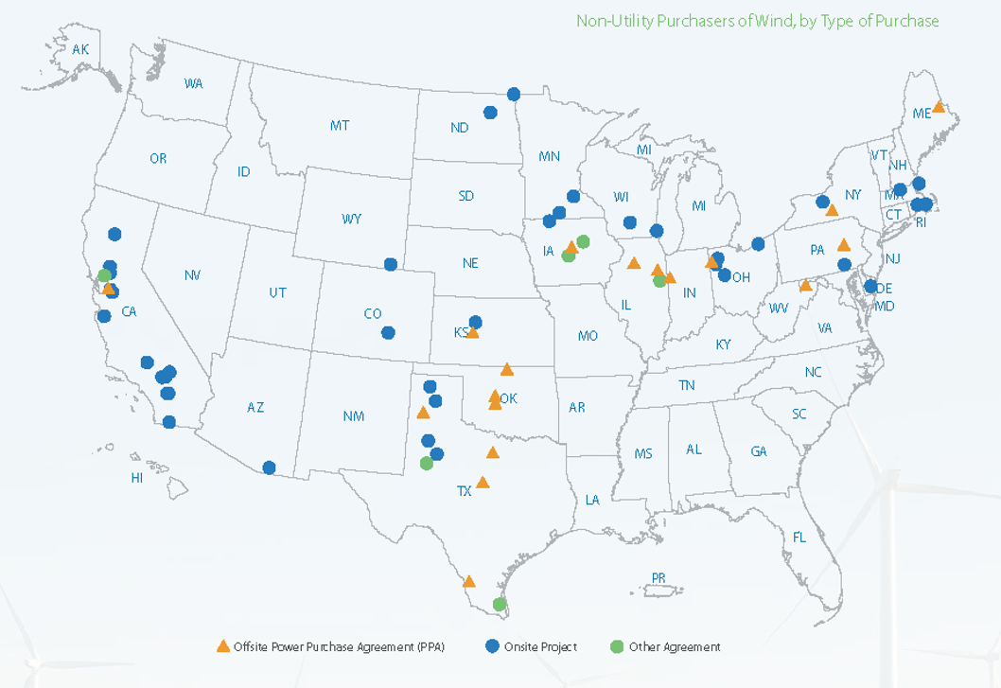
Growth in Non-Utility Purchasers

Slide 14
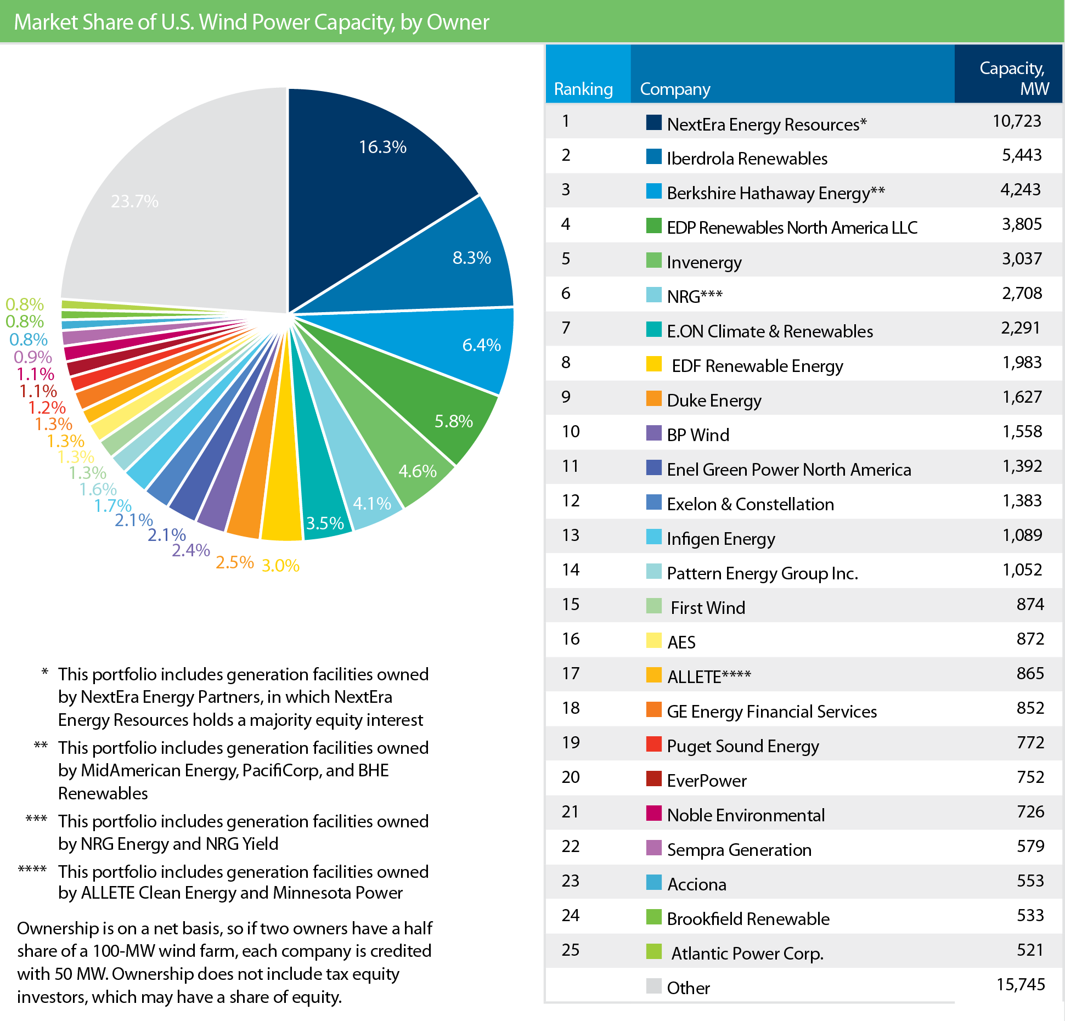
Who Owns the Wind Projects?
Notes:
The market-share rankings for top companies saw some significant changes in 2014 through both new construction and project acquisitions. In 2014, NRG became one of the top 10 owners of U.S. wind capacity when it acquired the wind assets of Edison Mission Energy. NRG also acquired the 947 MW Alta Wind project from Terra-Gen in August 2014.
The biggest upward movers in the Top 25 Ranking of U.S. Wind Capacity Asset Owners include Invenergy, NRG, Enel Green Power North America, Pattern Energy Group Inc., and ALLETE.

Slide 15
Policy Drivers of Wind

Slide 16
Federal Policy: Production Tax Credit (PTC)
PTC expired in law in 1999, 2001, 2003, 2012, 2012, 2013, and 2014.
PTC was set to expire in 2005, 2007, 2008, 2009, but extended prior to expiration.
Two week PTC extension in December 2014 included language to qualify physical construction activity or 5% safe harbor; expired again on December 31, 2014.

Slide 17
Boom and Bust Cycle
-92%
Incremental Capacity Additions (MW)
-76%
-76%
-92%
1999
2000
2001
2002
2003
2004
2005
2006
2007
2008
2009
2010
2011
2012
2013
2014

Slide 18
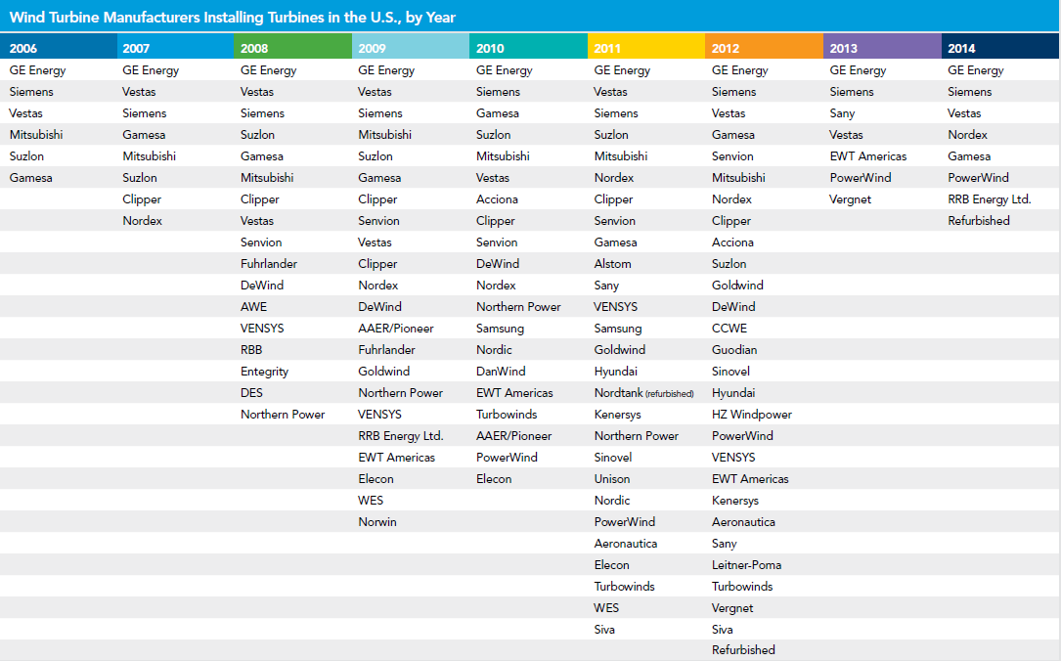
Manufacturers with Turbines Installed in US, by Year

Slide 19
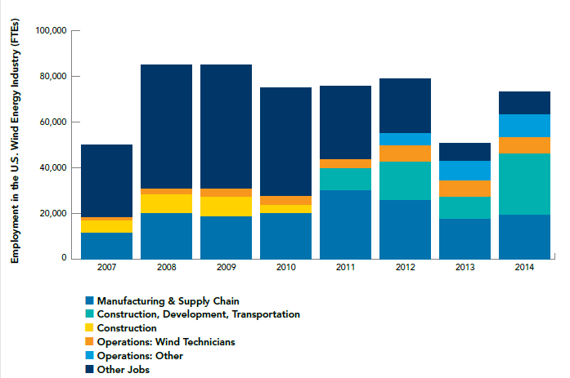
73,000 Jobs Supported by Wind Industry in 2014

Slide 20
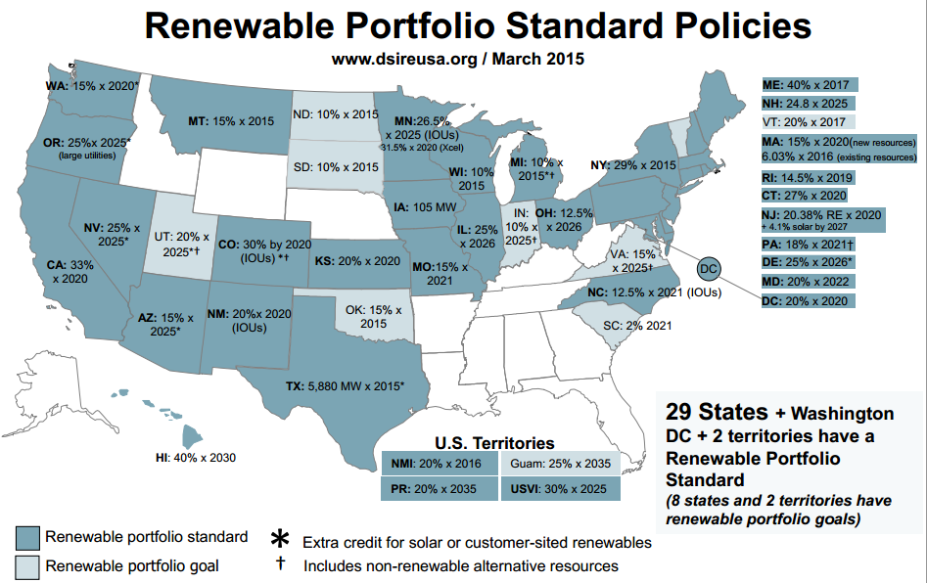

Slide 21
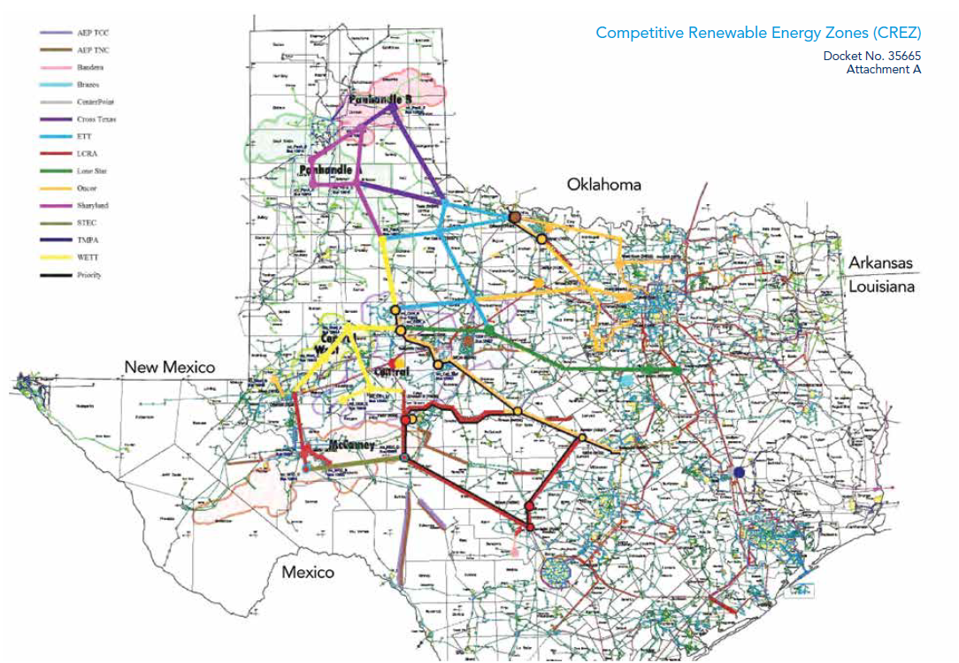
Successful State Policy

Slide 22

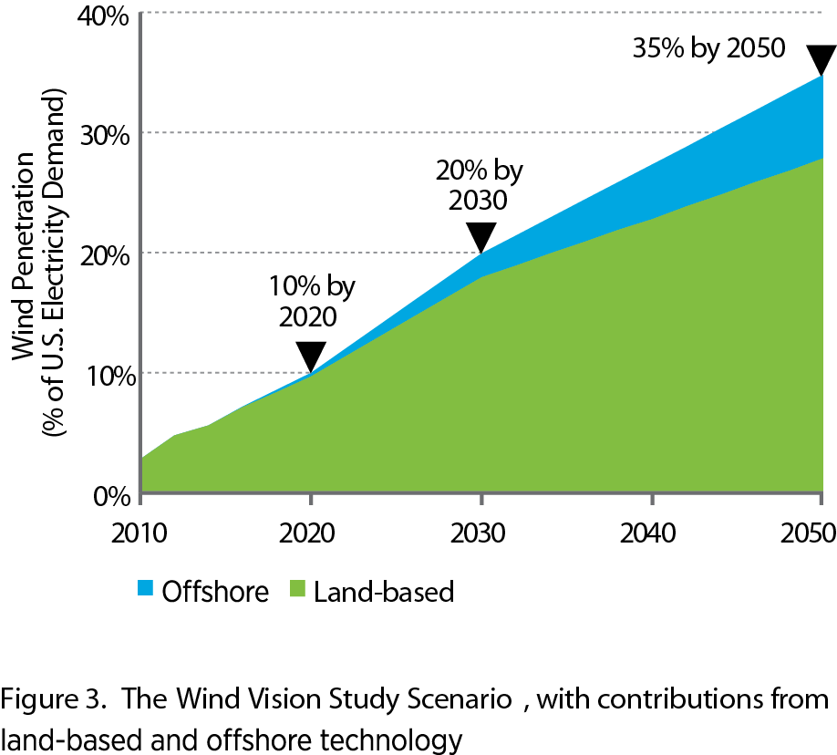
DOE Wind Vision: 20% Wind Energy by 2030

Slide 23
EPA Clean Power Plan
Carbon regulations for both new (under 111(b) of the Clean Air Act) and existing power plants (under 111(d))
30% reduction in power sector CO2 emissions by 2030, below 2030 levels
Final ruling expected at the end of the summer, states will have 13 months to submit final plan but expect extension requests
Assigns each state an emissions rate goal, in pounds of carbon dioxide (CO2) per megawatt hour (MWh), proposed option for mass-based goal
“Building block” options to cut carbon emissions
  Fossil fuel plant efficiencies
  Shifting generation from coal to natural gas
  Renewable energy capacity additions
  Energy Efficiency in buildings and industries
Additionally, states can also join together in multi-state or regional compacts to find the lowest cost options for reducing their carbon emissions.

Slide 24
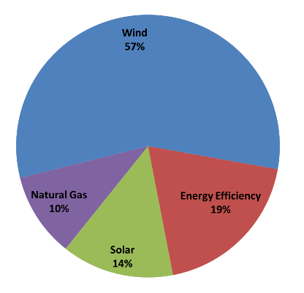
EIA Analysis of CPP Impacts
In Base Policy Scenario, optimal compliance mix results in wind adding adding 317 million megawatt-hours (MWh) by the year 2030 compared to Reference Scenario, more than half of the optimal compliance mix

